Slide 1
CS 5413: High Performance Systems and Networking
Hakim Weatherspoon
Assistant Professor, Dept of Computer Science
CS 5413: High Performance Systems and Networking
August 27, 2014

Slide 2
Goals for Today
Be brief!
Background on Professor
Why take this course?
How does this class operate?
Class details

Slide 3

Who am I?
Prof. Hakim Weatherspoon
  (Hakim means Doctor, wise, or prof. in Arabic)
  Background in Education
    Undergraduate University of Washington
      Played Varsity Football
        Some teammates collectively make $100’s of millions
        I teach!!!
    Graduate University of California, Berkeley
      Some class mates collectively make $100’s of millions
      I teach!!!
  Background in Operating Systems
    Peer-to-Peer Storage
      Antiquity project - Secure wide-area distributed system
      OceanStore project – Store your data for 1000 years
    Network overlays
      Bamboo and Tapestry – Find your data around globe
    Tiny OS
      Early adopter in 1999, but ultimately chose P2P direction

Slide 4











Context
The promise of the Cloud
  A computer utility; a commodity
  Catalyst for technology economy
  Revolutionizing for health care, financial systems,
  scientific research, and society
SEATTLE
Notes:
The cloud completes the commoditization process and makes storage and computation a commodity.

Slide 5
Context
The promise of the Cloud
  ubiquitous, convenient, on-demand network access to a shared pool of configurable computing resources (e.g., networks, servers, storage, applications, and services) that can be rapidly provisioned and released with minimal management effort or service provider interaction.
NIST Cloud Definition
SEATTLE
Notes:
The cloud completes the commoditization process and makes storage and computation a commodity.
Public vs private
IaaS, PaaS, SaaS
On demand (self service), network access, resource pooling, rapid elasticity, measured service

Slide 6
Context
The promise of the Cloud
  ubiquitous, convenient, on-demand network access to a shared pool of configurable computing resources (e.g., networks, servers, storage, applications, and services) that can be rapidly provisioned and released with minimal management effort or service provider interaction.
NIST Cloud Definition
SEATTLE
Notes:
The cloud completes the commoditization process and makes storage and computation a commodity.
Public vs private
IaaS, PaaS, SaaS
On demand (self service), network access, resource pooling, rapid elasticity, measured service

Slide 7
Context
The promise of the Cloud
  ubiquitous, convenient, on-demand network access to a shared pool of configurable computing resources (e.g., networks, servers, storage, applications, and services) that can be rapidly provisioned and released with minimal management effort or service provider interaction.
Requires fundamentals in distributed systems
  Networking
  Computation
  Storage
NIST Cloud Definition
Notes:
The cloud completes the commoditization process and makes storage and computation a commodity.
Public vs private
IaaS, PaaS, SaaS
On demand (self service), network access, resource pooling, rapid elasticity, measured service

Slide 8


High Performance Networks
How to optimize a global network of data centers?

Slide 9
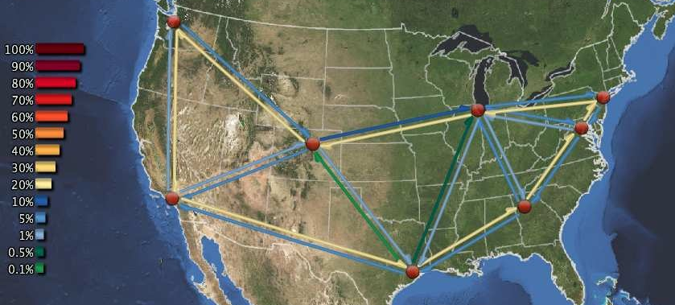
High Performance Networks
How to optimize a global network of data centers?
  E.g. Need to optimize movement of data between DCs
  [NSDI 2013, NSDI 2008, FAST 2009, IMC 2010, DSN 2010]

Slide 10

High Performance Networks
How to optimize a global network of data centers?
  E.g. Investigate novel data center designs
  [ToN 2013 and ANCS 2012; best paper]
Core Switch (CS)
Aggregate
Switch (AS)
…
…
…
ToR
…
…
…
…
…
…

Slide 11
High Performance Storage
Large organizations considering using the cloud
  New York Times
  Netflix
  Nintendo
  Cornell
  Library of Congress
The more data you have, the harder it is to move
  Switching providers entails paying for bandwidth twice
  Inhibits opportunistic migration

Slide 12

High Performance Storage
How hard is it to move a PetaByte?
Titan tech boom, randy katz, 2008

Slide 13
High Performance Storage
All my valuable data/computation is in the cloud
Am I locked in to one provider forever?
  The more data you have, the harder it is to move
RACS: Redundant Array of Cloud Storage
  Collaboration with the Internet Archive and IBM
  [SOCC 2010]; See Also [EuroSys 2007, FAST 2009, FAST 2013]
k=3
n=4
RACS(3,4)
Notes:
RACS: Redundant Array of Cloud Storage
Stripe data over n cloud storage repositories
Any k-subset contains a complete copy of data
Tolerate up to (n-k) failures
Written RACS(k,n)

Slide 14

High Performance Storage
All my valuable data/computation is in the cloud Am I locked in to one provider forever?
  The more data you have, the harder it is to move
RACS: Redundant Array of Cloud Storage
  Collaboration with the Internet Archive and IBM
  See Also [EuroSys 2007, FAST 2009, FAST 2013]
RACS(3,4)
33KB
Object
100 KB
33KB
Object
100 KB
33KB
33KB
k=3
n=4
Relative Storage | n/k
Relative Upload Bandwidth | n/k
Relative Download Bandwidth | 1
RACS(3,4)
Notes:
RACS: Redundant Array of Cloud Storage
Stripe data over n cloud storage repositories
Any k-subset contains a complete copy of data
Tolerate up to (n-k) failures
Written RACS(k,n)

Slide 15
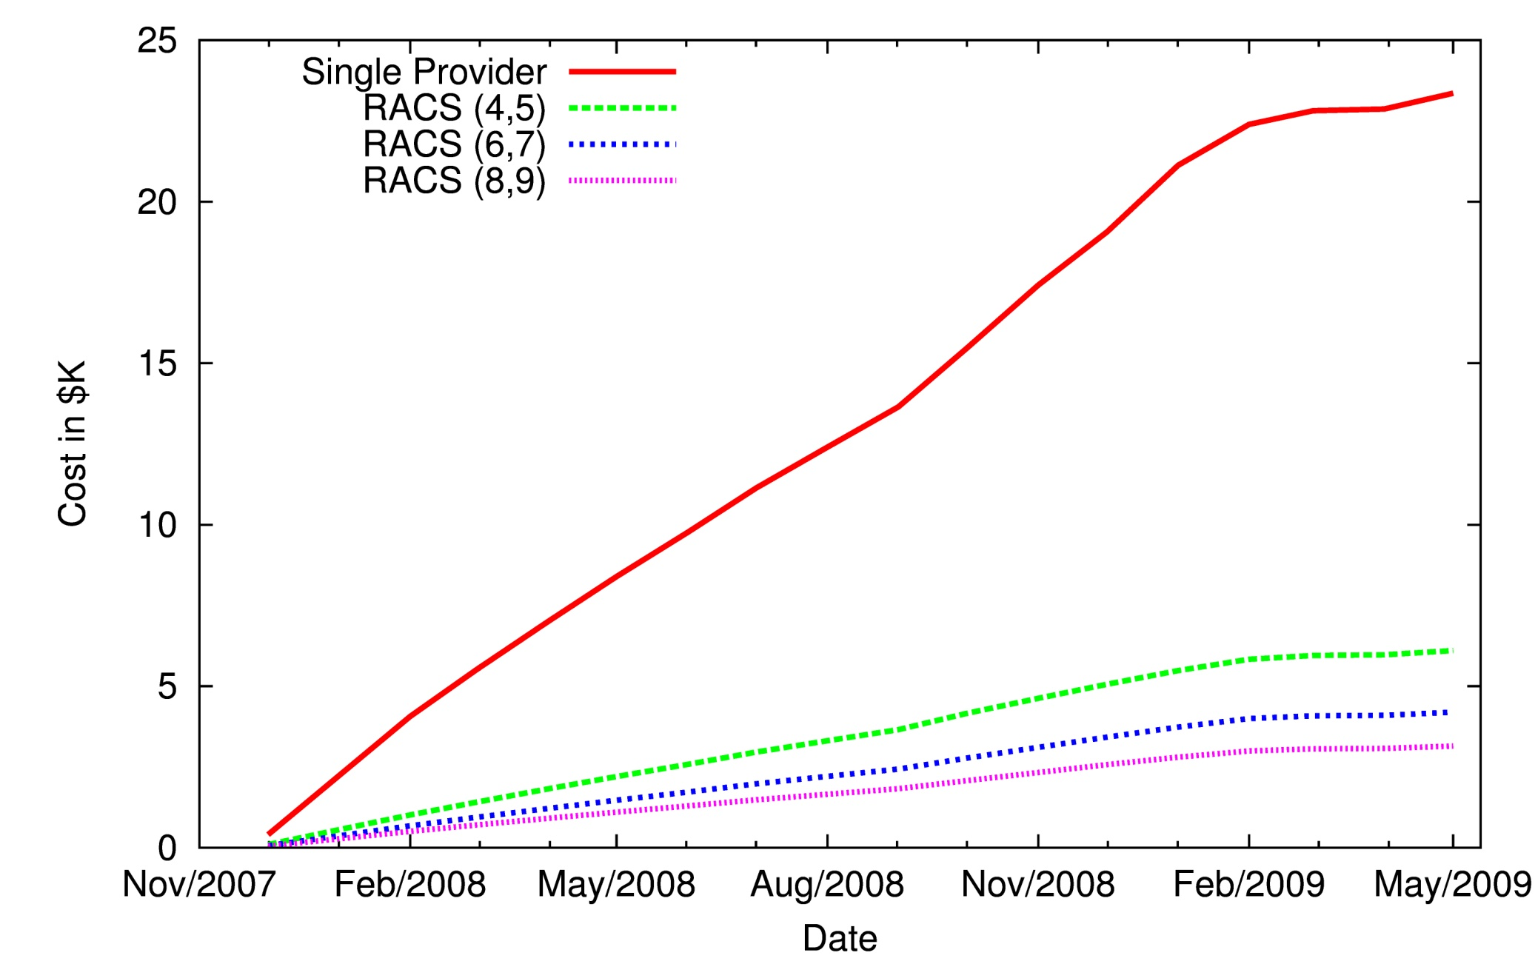
High Performance Storage
Estimated Cost of Switching Cloud Providers
33KB
RACS(3,4)
Object
100 KB
33KB
33KB
Relative Storage | n/k
Relative Upload Bandwidth | n/k
Relative Download Bandwidth | 1
33KB

Slide 16
High Performance Storage
RACS: How do I optimize storage globally
  Collaboration with Internet Archive / IBM
Gecko: How do I optimize storage locally
  Collaboration with Google and Microsoft
33KB
Object
100 KB
RACS(3,4)
33KB
33KB
33KB
Relative Storage | n/k
Relative Upload Bandwidth | n/k
Relative Download Bandwidth | 1
Notes:
RACS and Gecko

Slide 17
High Performance Computation
Can I compute in the cloud if some of my data is in a vault at
home or on another provider
Xen-Blanket and VirtualWire
    Collaboration with IBM
    [HotCloud 2012, EuroSys 2012]
33KB
33KB
33KB
33KB

Slide 18
High Performance Computation
Can create your own
Cloud-within-a-Cloud
Migrate computation among different cloud providers
App
33KB
Guest OS
Xen-Blanket
VMM 1
App
Object
100 KB
Guest OS
33KB
App
Xen-Blanket
Guest OS
VMM 2
Xen-Blanket
33KB
VMM
Xen-Blanket
VMM 3
33KB
Xen-Blanket
VMM 4

Slide 19
High Performance Computation
Can create your own
Cloud-within-a-Cloud
Migrate computation among different cloud providers
Switch
VM
VM
33KB
VM
Xen-Blanket
VM
VMM 1
Object
100 KB
33KB
Xen-Blanket
VMM 2
Xen-Blanket
33KB
VMM
Xen-Blanket
VMM 3
33KB
Xen-Blanket
VMM 4

Slide 20
My Contributions
Cloud Networking
  SoNIC in NSDI 2013
  Wireless DC in ANCS 2012 (best paper) and NetSlice in ANCS 2012
  Bifocals in IMC 2010 and DSN 2010
  Maelstrom in ToN 2011 and NSDI 2008
  Chaired Tudor Marian’s PhD 2010 (now at Google)
Cloud Computation & Vendor Lock-in
  Plug into the Supercloud in IEEE Internet Computing-2013
  Supercloud/Xen-Blanket in EuroSys-2012 and HotCloud-2011
  Overdriver in VEE-2011
  Chaired Dan William’s PhD 2012 (now at IBM)
Cloud Storage
  Gecko in FAST 2013 / HotStorage 2012
  RACS in SOCC-2010
  SMFS in FAST 2009
  Antiquity in EuroSys 2007 / NSDI 2006
  Chaired Lakshmi Ganesh’s PhD 2011 (now at Facebook)

Slide 21
Goals for Today
Be brief!
Background on course and Professor
Why take this course?
How does this class operate?
Class details

Slide 22
Why take this course
Learn about systems abstractions, principles, and artifacts that have lead to the high performance systems and networks we see in the cloud,
Understand attributes of systems research that is likely to have impact,
Become comfortable navigating the statee of the art in systems and networking,
Gain experience in thinking critically and analytically about systems research, and
Acquire the background needed to work on cloud and data center problems currently under study at Cornell and elsewhere.

Slide 23
Who is the course “for”?
MEng students
  Students who have mastered 4410/4411
  PhD students as well
  Serious undergraduates
MEng Project
  Projects in this course can be used to satisfy MEng project requirements

Slide 24
Goals for Today
Be brief!
Background on course and Professor
Why take this course?
How does this class operate?
Class details

Slide 25
How this class operates
Instructor: Hakim Weatherspoon
  hweather@cs.cornell.edu
  Office Location: 427 Gates Hall
TA: Ki Suh Lee and Han Wang
  kslee@cs.cornell.edu and hwang@cs.cornell.edu
Lectures:
  CS 5413: M,W,F: 1:25–2:15 PM, 205 Thurston Hall
  Three slots reserved a week,
  ***but lecture will be twice a week on average***

Slide 26
Course Help
Course staff, office hours, etc:
  http://www.cs.cornell.edu/courses/cs5413/2014fa
MEng projects
  http://www.cs.cornell.edu/courses/cs5413/2014fa/projects.htm

Slide 27
CS 5413: Overview
Prerequisite:
  Mastery of CS 4410 and 4411 material
    Fundamentals of OS design
    How parts of the OS are structured
    What algorithms are commonly used
    What are the mechanisms and policies used
    Programming in C/C++
Class Structure
  Lecture/Readings
  Labs/Homeworks
  Project
  In class Quizzes

Slide 28
CS 5413: Topics
Overview
  Cloud computing, and Internet vs Data Center Networks
High Performance Networking Basics
  Textbook networking vs Data Center Networks
  Network protocol stack: TCP/IP protocol stack
High Performance Data Center Systems & Networks
  Basic Switching Technologies: 50Gb/s routers &NetFPGA
  Data Center Topologies, Software Router Designs,
  Alternative switching technologies, Data Center Transport
  Software defined networking, virtual networks
  Middleboxes, advanced topics
  Data Center traffic and analysis

Slide 29
CS 5413: Paper Readings
Required reading is always one paper and/or book reading
  Book reading provides basic background knowledge
  Papers pulled from, best journals and conferences
    TOCS, SOSP, OSDI, …
Read papers before each class and bring notes
  takes ~2 hrs, write notes and questions
Write a review and turn in at least two hours before beginning of class
  Turn on online via Course Management System (CMS)
  No late reviews will be accepted

Slide 30
CS 5413: Writing Reviews
Each student is required to prepare notes on each paper before class and to bring them to class for use in discussion.
Your notes should list assumptions, innovative contributions and criticisms. Every paper in the reading list has at least one major weakness.
Turn paper reviews in online before class via CMS
  Be succinct—One paragraph per paper
    Short summary of paper (two or three sentences)
    Two to three strengths/contributions
    and at least one weaknesses

Slide 31
CS 5413: Lecture Format
40 minute presentation
All students are required to read ahead of time and participate!
Counts in final grading.

Slide 32
CS 5413: Labs/Homeworks
4 labs/homeworks
  work in groups
  1-3 weeks per lab/homework
  Topics
    Building a network proxy (singled, then multi-threaded)
    Implement an N-port switch
    Implement a softward-defined network (sdn) switch/controller
Facilities
  Using cloud (Amazon EC2/S3 or local Fractus cloud)

Slide 33
CS 5413: Project
One major project per group
  Groups include three people
Group formation – early September
Initial selection of project topic – due mid-September
Survey of area (related works)–due begin of October
Midterm draft paper – due begin of November
Peer reviews—due a week later
Final demo/presentation–due begin of December
Final project report – due a week later

Slide 34
CS 5413: Project Suggestions
One major project per group
  Groups include three people
Group formation – early September
Initial selection of project topic – due mid-September
Survey of area (related works)–due begin of October
Midterm draft paper – due begin of November
Peer reviews—due a week later
Final demo/presentation–due begin of December
Final project report – due a week later

Slide 35
CS 5413: Project Infrastructure
GENI: Global Environment for Networking Innovations
SoNIC: Software Network Interface Cards
NetFPGA
Fractus: our very own (mini) cloud
Amazon’s Cloud Infrastructure EC2/S3
Emulab
PlanetLab
Cornell’s Center for Advanced Computing (CAC)
…

Slide 36
Academic Integrity
Submitted work should be your own
Acceptable collaboration:
  Clarify problem, C syntax doubts, debugging strategy
  You may use any idea from any other person or group in the class or out, provided you clearly state what you have borrowed and from whom.
  If you do not provide a citation (i.e. you turn other people's work in as your own) that is cheating.
Dishonesty has no place in any community
  May NOT be in possession of someone else’s homework/project
  May NOT copy code from another group
  May NOT copy, collaborate or share homework/assignments
  University Academic Integrity rules are the general guidelines
Penalty can be as severe as an ‘F’ in CS 6410
Notes:
To draw a very clear line, you may use any idea from any other person or group in the class or out, provided you clearly state what you have borrowed and from whom. If you do not provide a citation---that is, you turn other people's work in as your own---that is cheating. Anything else is fair game. Of course, we will be grading you on the ideas you have added, but you should always borrow as much as you can as a starting point as there is no point in reinventing the wheel.

Slide 37
Stress, Health and Wellness
Need to pace yourself to manage stress
  Need regular sleep, eating, and exercising
Do not come to class sick (with the flu)!
  Email me ahead of time that you are not feeling well
  People not usually sick more than once in a semester

Slide 38
Before Next time
Read one paper below and write review
  The Cost of a Cloud: Research Problems in Data Center Networks, A. Greenberg, J. Hamilton, D. A. Maltz, P. Patel. ACM SIGCOMM computer communication review, Volume 39, Issue 1 (January 2009), pages 68--73. http://dl.acm.org/citation.cfm?id=1496103 (can only access link within Cornell network). http://131.107.65.14/en-us/um/people/dmaltz/papers/DC-Costs-CCR-editorial.pdf (can access outside Cornell network)
Check website for updated schedule

