Slide 1
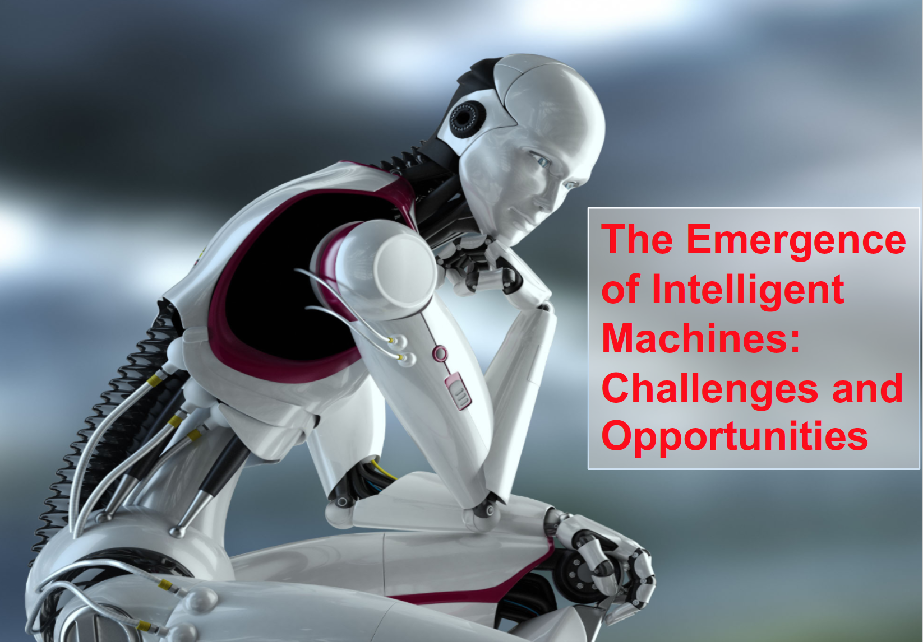
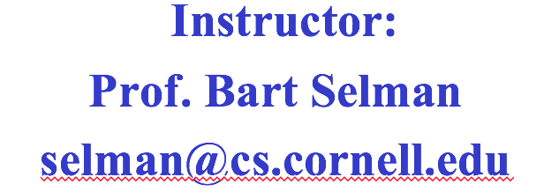

Slide 2
CS 4700/5700: Foundations of Artificial Intelligence
Instructor:
Prof. Selman
selman@cs.cornell.edu
Admin

Slide 3
Course Administration
Hybrid model! Stay safe!
Key announcements via email
Web page shortly
Text book: Russell & Norvig --- Artificial Intelligence: A Modern Approach (AIMA)

Slide 4
Grading
Homework (15%)
Prelim/Midterm (35%)
Final (45%)
Participation (5%)
CS-5700: Additional AI essay, included in Hwk. (5%)
Late policy: 5 one-day extensions to be used (almost) however you want during the term. (Count weekend as 1 day.) Max of 3 days per assignment.
Prelim/exam date & time: See university schedule.
(Google: “exam roster Cornell”
Out mid Sept. or before.)
Prelim/Exam: In person! Only take class if date/time works for you.

Slide 5
Admin details
This is a large course. Sadly, that’s why there is much less flexibility than in a small or mid-size course.
Before signing up, make sure that
--- you can attend the midterm and final.
There is no make-up, except for approved medical reasons.
--- you can attend the final exam (don’t travel home before
the final.)
--- late days on homework are there to give you the needed
flexibility in your schedule. Use them wisely!
If you cannot attend midterm or exam, do not sign up for the
course! (Otherwise need to withdraw later.)
Exams date & time: See University schedule on web. (Google
“Cornell exam calendar”.)

Slide 6
Homework
Homework is important. It is the best way for you to learn the material. You are encouraged to discuss the problems with your classmates, but all work handed in should be original, and written by you in your own words.

Slide 7
Content
This is a general AI course. This is not a machine learning (ML) course.
AI is a much broader field than ML. We only do a fairly brief intro to ML.
If you are looking for ML, take one of our excellent ugrad ML courses!

