Slide 1
CS 4700:
Foundations of Artificial Intelligence
Bart Selman
selman@cs.cornell.edu
Module:
Adversarial Search
R&N: Chapter 5
Part I

Slide 2
Outline
Adversarial Search
Optimal decisions
Minimax
α-β pruning
Case study: Deep Blue
UCT and Go

Slide 3
Adversarial Reasoning: Games
Mathematical Game Theory
Branch of economics that views any multi-agent environment as
a game, provided that the impact of each agent on the others is
“significant”, regardless of whether the agents are cooperative or
competitive.
First step:
  Deterministic
  Turn taking
  2-player
  Zero-sum game of perfect information (fully observable)
  “my win is your loss” and vice versa; utility of final states
  opposite for each player. My +10 is your -10.

Slide 4
Game Playing vs. Search
Multi-agent game vs. single-agent search problem
"Unpredictable" opponent need a strategy: specifies a move
for each possible opponent reply.
E.g with “huge” lookup table.
Time limits → unlikely to find optimal response, must approximate
Rich history of game playing in AI, in particular in the area of chess.
Both Turing and Shannon viewed chess as an important challenge for
machine intelligence because playing chess appears to require some
level of intelligence.

Slide 5
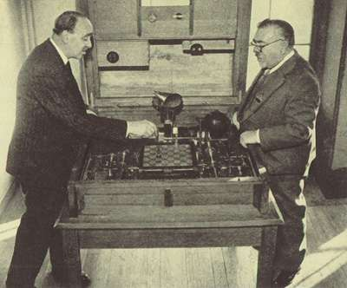
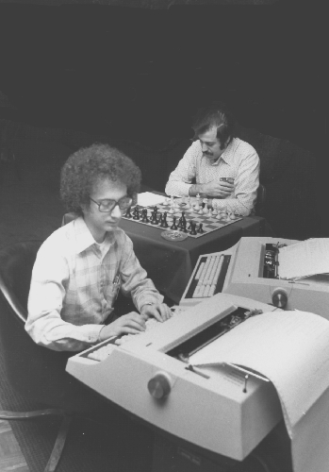
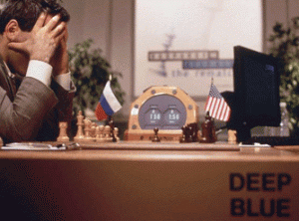
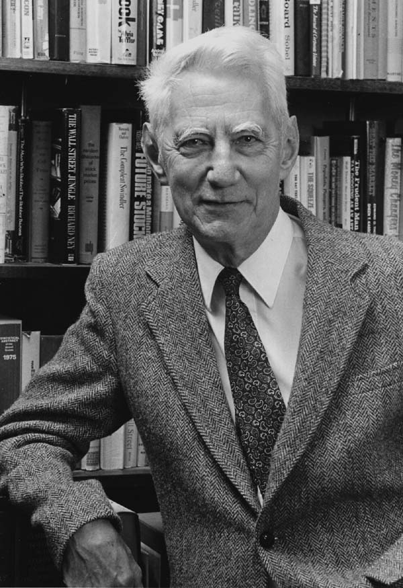
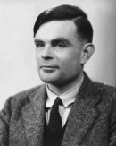
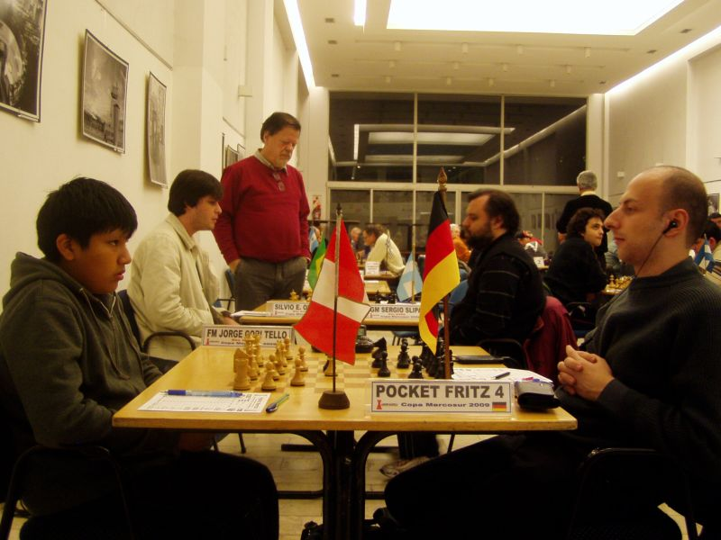
A Brief History of Computer Chess
1997
1912
1970s
1950s
Today

Slide 6
Human-computer hybrid most exciting new level of play. Computers
as smart assistants are becoming accepted.
Area referred to as “Assisted Cognition.”
Another example: mind-reading binoculars for 10 km vision.

Slide 7
Why is Game-Playing a Challenge for AI?
Competent game playing is a mark of some aspects of “intelligence”
  Requires planning, reasoning and learning
Proxy for real-world decision making problems
  Easy to represent states & define rules
  Obtaining good performance is hard
“Adversary” can be nature
PSPACE-complete (or worse)
  Computationally equivalent to hardware debugging, formal verification, logistics planning
  PSPACE believed to be harder than NP.

Slide 8
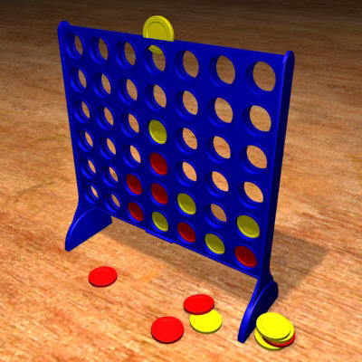
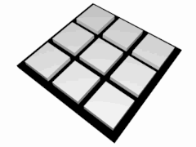
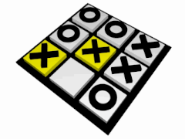
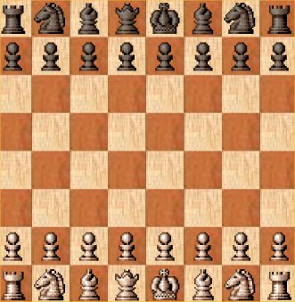
Traditional Board Games
Finite
Two-player
Zero-sum
Deterministic
Perfect Information
Sequential
Notes:
The field of game theory deals with games in a very general sense
In this talk, we will focus on the “classic” board games that fit the above criteria, which already throw up some interesting challenges

Slide 9
Key Idea: Look Ahead
Tic-tac-toe (or Noughts and crosses, Xs and Os)
We start 3 moves per player in:
3x3 Tic-Tac-Toe
optimal play
X’s turn
O’s turn
X
loss
loss

Slide 10
Look-ahead based Tic-Tac-Toe
X’s turn
O’s turn
X
Tie
Tie
Tie
Tie

Slide 11
Look-ahead based Tic-Tac-Toe
X’s turn
O’s turn
Win for O
Win for O
Tie
Tie
Tie
Tie

Slide 12
Look-ahead based Tic-Tac-Toe
X’s turn
O’s turn
Win for O
Win for O
Tie
Tie
Tie
Tie

Slide 13
Look-ahead based Tic-Tac-Toe
X’s turn
Win for O
Tie
Win for O
O’s turn
Win for O
Tie
Tie
Tie
Tie
Win for O

Slide 14
Each board in game tree gets unique
game tree value (utility; -1/0/+1)
under optimal rational play.
(Convince yourself.)
E.g. 0 for top board.
What if our opponent
does not play optimally?
X’s turn
Win for O
Tie
Win for O
Approach: Look first at bottom tree. Label bottom-most boards.
Then label boards one level up, according result of best possible move.
… and so on. Moving up layer by layer.
Termed the Minimax Algorithm
  Implemented as a depth-first search

Slide 15
Aside: Game tree learning
Can (in principle) store all board values in large table. 3^19 = 19,683
for tic-tac-toe.
Can use table to try to train classifier to predict “win”, “loss”, or “draw.”
Issue: For real games, one can only look at tiny, tiny fragment of
table.
Reinforcement learning builds on this idea.
See eg Irvine Machine Learning archive.
archive.ics.uci.edu/ml/datasets/Tic-Tac-Toe+Endgame

Slide 16
Look-ahead based Chess
But there’s a catch…
X’s turn
White’s turn
Black’s turn
O’s turn
X

Slide 17
How big is this tree?
~35 moves per position
~80 levels deep
Approx. 10^120 > Number of atoms in the observable universe (10^80)
We can really only search a tiny, miniscule faction of this tree!
Around 60 x 10^9 nodes for 5 minute move. Approx. 1 / 10^70 fraction.

Slide 18
What’s the work-around?
Don’t search to the very end
  Go down 10-12 levels (still deeper than most humans)
  But now what?
  Compute an estimate of the position’s value
    This heuristic function is typically designed by a domain expert
Consider a game tree
with leaf utilities (final
boards) +1 / 0 / -1 (or +inf / 0 –inf).
What are the utilities of
intermediate boards in the
game tree?
+1 / 0 / -1
(or +inf / 0 / -inf)
The board heuristics is trying to estimate these values from a quick calculation on the board. Eg, considering material won/loss on chess board or regions captures in GO. Heuristic value of e.g. +0.9, suggests true value may be +1.
Notes:
Idea was proposed by Shannon and Turing in the 50s, took till 1997 for hardware to catch up so Kasparov could be beaten
Today – Chess software running on smart phones play at GM level

Slide 19
What is a problem for the board heuristics (or evaluation functions)
at the beginning of the game?
(Consider a heuristics that looks at lost and captured pieces.)
What will the heuristic values be near the top?
Close to 0! Not much has happened yet….
Other issue: children of any node are mostly quite similar.
Gives almost identical heuristic board values. Little or no
information about the right move.
Solution: Look ahead. I.e., build search tree several levels
deep (hopefully 10 or more levels). Boards at bottom of tree more diverse. Use minimax search to determine value of starting board, assuming optimal play for both players.

Slide 20
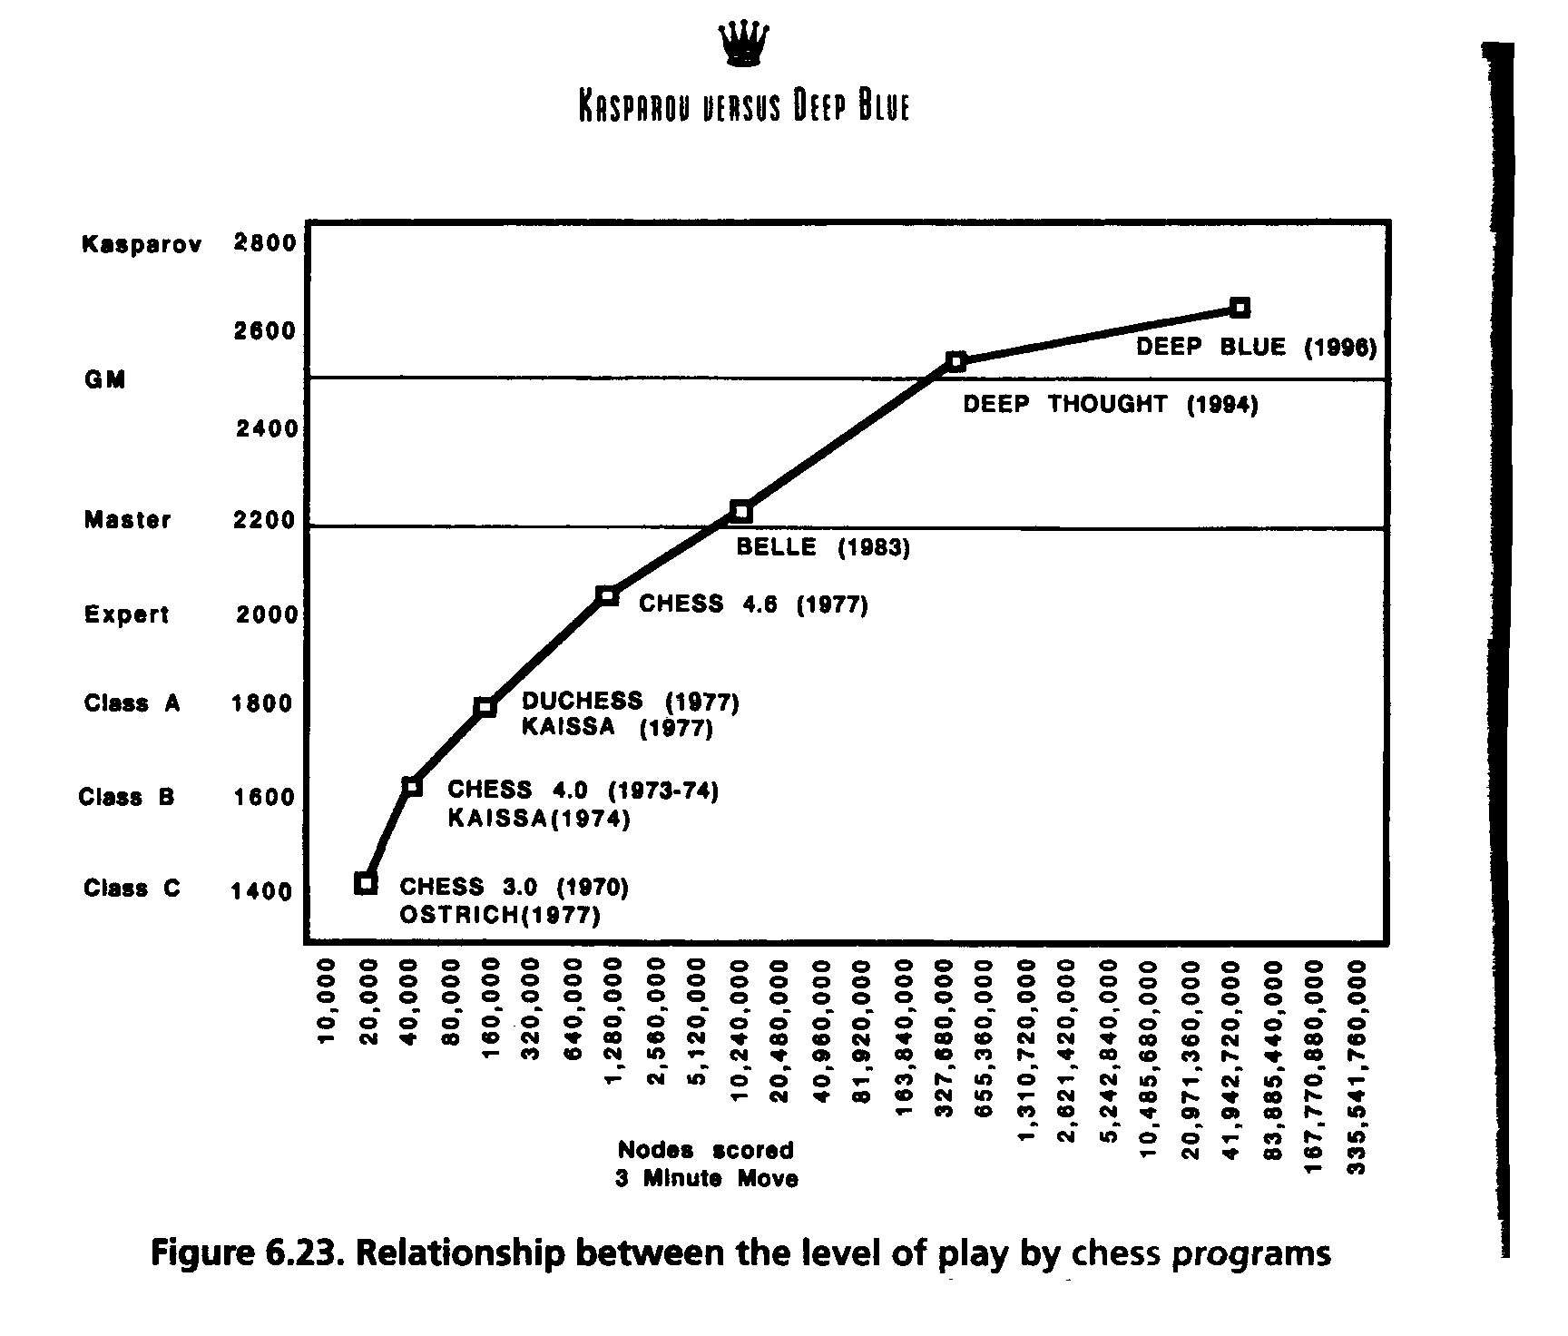
Fun aside:
What is the
formal computational
complexity of chess? Use
Big-O notation.
IBM knew this when they “acquired” the Deep Thought team.
They could predict what it would take to beat Kasparov.

Slide 21
Will deeper search give stronger play?
Always? And why?
Very counterintuitive: there are “artificial games” where searching
deeper leads to worse play! (Nau and Pearl 1980) Not in natural games!
Game tree anomaly.
Heuristic board eval value is sometimes informally
referred to as the “chance of winning” from that position.
That’s a bit odd, because in a deterministic game with
perfect information and optimal play, there is no “chance”
at all! Each board has a fixed utility:
-1, 0, or +1 (a loss, draw, or a win). (result from game theory)
Still, “chance of winning” is an informally useful notion. But, remember, no clear semantics to heuristic values.
What if board eval gives true board utility? How much
search is needed to make a move?
We’ll see that using machine learning and “self play,”
we can get close for backgammon.

Slide 22
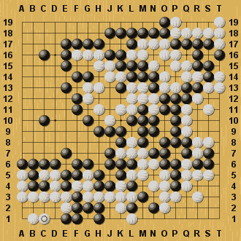
Limitations?
Two important factors for success:
  Deep look ahead
  Good heuristic function
Are there games where this is not feasible?

Slide 23
Limitations?
Two important factors for success:
  Deep look ahead
  Good heuristic function
Are there games where this is not feasible?
Looking 14 levels ahead in Chess ≈ Looking 4 levels ahead in Go

Slide 24
Limitations?
Two important factors for success:
  Deep look ahead
  Good heuristic function
Are there games where this is not feasible?
Looking 14 levels ahead in Chess ≈ Looking 4 levels ahead in Go
Moves have extremely delayed effects

Slide 25
Limitations?
Two important factors for success:
  Deep look ahead
  Good heuristic function
Are there games where this is not feasible?
Looking 14 levels ahead in Chess ≈ Looking 4 levels ahead in Go
Moves have extremely delayed effects
Minimax players for GO were very weak until 2007…but now play at master level

Slide 26
Limitations?
Two important factors for success:
  Deep look ahead
  Good heuristic function
Are there games where this is not feasible?
Looking 14 levels ahead in Chess ≈ Looking 4 levels ahead in Go
Moves have extremely delayed effects
New sampling based search method:
Upper Confidence bounds applied to Trees (UCT)

Slide 27
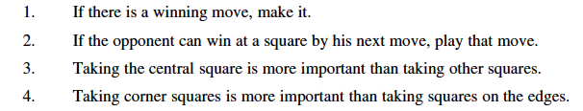
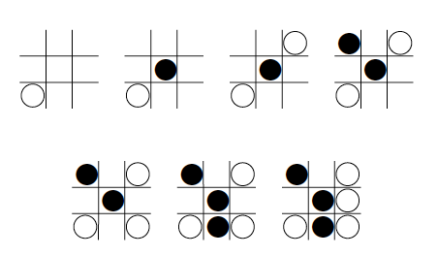
Well… Why not use a strategy / knowledge, as humans do?
Consider for Tic-Tac-Toe:
Rule 2
Rule 4
Sounds reasonable… right?
Oops!!
Consider
Black uses
the strategy…
Rule 3

Slide 28
So, although one can capture strategic knowledge of many games
in high-level rules (at least to some extent), in practice any
interesting game will revolve precisely around the exceptions to
those rules!
Issue has been studied for decades but research keeps coming back to
game tree search (or most recently, game tree sampling).
Currently only one exception: reinforcement learning for backgammon.
(discussed later)
A very strong board evaluation function was learned in self-play.
Represented as a neural net.
Almost no search remained.

Slide 29
Formal definition of a game:
  Initial state
  Successor function: returns list of (move, state) pairs
  Terminal test: determines when game over
    Terminal states: states where game ends
  Utility function (objective function or payoff function): gives numeric value for terminal states
We will consider games with 2 players (Max and Min)
Max moves first.

Slide 30
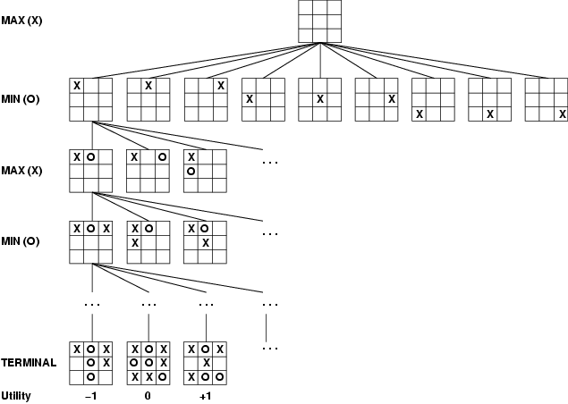
Game Tree Example:
Tic-Tac-Toe
Tree from
Max’s
perspective
Notes:
Crosses and noughts

Slide 31
Minimax Algorithm
Minimax algorithm
  Perfect play for deterministic, 2-player game
  Max tries to maximize its score
  Min tries to minimize Max’s score (Min)
  Goal: Max to move to position with highest minimax value
  → Identify best achievable payoff against best play

Slide 32
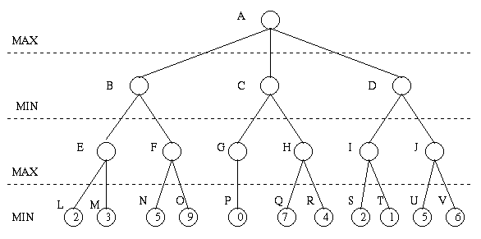
Minimax Algorithm
Payoff for Max

Slide 33
Minimax Algorithm (cont’d)
3
9
0
7
2
6
Payoff for Max

Slide 34
Minimax Algorithm (cont’d)
3
0
2
3
9
0
7
2
6
Payoff for Max

Slide 35
Minimax Algorithm
What if
payoff(Q) = 100
payoff(R) = 200
Do DFS. Real games:
use iterative deepening.
(gives “anytime” approach.)
Starting DFS, left to right,
do we need to know eval(H)?
>= 3
(DFS left to right)
3
<= 0
<= 2
alpha-beta
pruning
3
0
Prune!
2
Prune!
3
9
0
7
2
6
Payoff for Max

Slide 36
Properties of minimax algorithm:
Complete? Yes (if tree is finite)
Optimal? Yes (against an optimal opponent)
Time complexity? O(b^{m})
Space complexity? O(bm) (depth-first exploration, if it generates all successors at once)
For chess, b ≈ 35, m ≈ 80 for "reasonable" games
→ exact solution completely infeasible
m – maximum depth of the tree; b – legal moves

Slide 37
Minimax Algorithm
Limitations
  Generally not feasible to traverse entire tree
  Time limitations
Key Improvements
  Use evaluation function instead of utility (discussed earlier)
    Evaluation function provides estimate of utility at given position
  Alpha/beta pruning
Notes:
Similar to heuristic function

Slide 38
α-β Pruning
Can we improve search by reducing the size of the game tree to be examined?
  → Yes! Using alpha-beta pruning
Principle
  If a move is determined worse than another move already examined, then there is no need for further examination of the node.
Analysis shows that will be able to search almost twice as deep.
Really is what makes game tree search practically feasible.
E.g. Deep Blue 14 plies using alpha-beta pruning.
Otherwise only 7 or 8 (weak chess player). (plie = half move / one player)

Slide 39
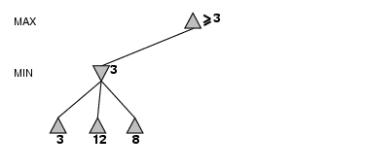
α-β Pruning Example

Slide 40
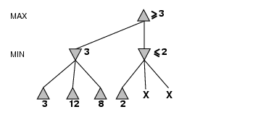

Slide 41
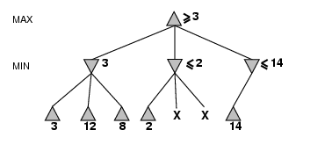

Slide 42
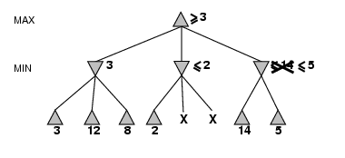

Slide 43
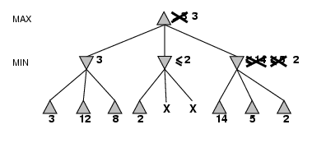
Note: order
children matters!
What gives best pruning?
Visit most promising (from min/max perspective) first.

Slide 44
Alpha-Beta Pruning
Rules:
  α is the best (highest) found so far along the path for Max
  β is the best (lowest) found so far along the path for Min
  Search below a MIN node may be alpha-pruned if the
  its β ≤ α of some MAX ancestor
  Search below a MAX node may be beta-pruned if the its
  α ≥ β of some MIN ancestor.
See also fig. 5.5 R&N.

Slide 45
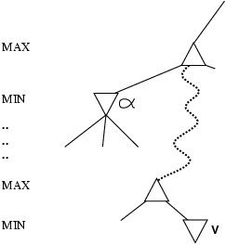
More abstractly
α is the value of the best (i.e., highest-value) choice found so far at any choice point along the path for max
If v is worse than α, max will avoid it
  → prune that branch
Define β similarly for min

Slide 46
Properties of α-β Prune
Pruning does not affect final result
Good move ordering improves effectiveness of pruning b(e.g., chess, try captures first, then threats, froward moves, then backward moves…)
With "perfect ordering," time complexity = O(b^{m/2})
  → doubles depth of search that alpha-beta pruning can explore
Example of the value of reasoning about which
computations are relevant (a form of metareasoning)

Slide 47
A few quick approx. numbers for Chess:
b = 35
200M nodes / second ===> 5 mins = 60 B nodes in search tree
(2 M nodes / sec. software only, fast PC ===> 600 M nodes in tree)
35^7 = 64 B
35^5 = 52 M
So, basic minimax: around 7 plies deep. (5 plies)
With, alpha-beta 35^(14/2) = 64 B. Therefore, 14 plies deep. (10 plies)
  Aside:
  4-ply ≈ human novice
  8-ply / 10-ply ≈ typical PC, human master
  14-ply ≈ Deep Blue, Kasparov (+ depth 25 for “selective extensions”) / 7 moves by each player.

Slide 48
Resource limits
Can’t go to all the way to the “bottom:”
evaluation function
  = estimated desirability of position
cutoff test:
  e.g., depth limit
  (Use Iterative Deepening)
  “Unstable positions:”
  Search deeper.
  Selective extensions.
  E.g. exchange of several
  pieces in a row.
What is the problem with that?
Horizon effect.
  add quiescence search:
  quiescent position: position where next move unlikely to cause large change in players’ positions

Slide 49
Evaluation Function
  Performed at search cutoff point
  Must have same terminal/goal states as utility function
  Tradeoff between accuracy and time → reasonable complexity
  Accurate
    Performance of game-playing system dependent on accuracy/goodness of evaluation
    Evaluation of nonterminal states strongly correlated with actual chances of winning

Slide 50
Evaluation functions
For chess, typically linear weighted sum of features
Eval(s) = w₁ f₁(s) + w₂ f₂(s) + … + w_{n} f_{n}(s)
e.g., w₁ = 1 with
f₁(s) = (number of white pawns) – (number of black pawns), etc.
  Key challenge – find a good evaluation features:
  Not just material! (as used by novice)
  Isolated pawns are bad.
  How well protected is your king?
  How much maneuverability to you have?
  Do you control the center of the board?
  Strategies change as the game proceeds
Features are a form of chess knowledge. Hand-coded in eval function.
Knowledge tightly integrated in search.
Feature weights: can be automatically tuned (“learned”).
Standard issue in machine learning:
Features, generally hand-coded; weights tuned automatically.
How?

Slide 51

When Chance is involved:
Backgammon Board

Slide 52
Expectiminimax
Generalization of minimax for games with chance nodes
Examples: Backgammon, bridge
Calculates expected value where probability is taken
over all possible dice rolls/chance events
- Max and Min nodes determined as before
- Chance nodes evaluated as weighted average

Slide 53
Game Tree for Backgammon
…
…
…
…
…
…
…
…
…
C
…
…
…
…
…
…
…
…
…
Notes:
Have to include chance nodes in addition to MIN and MAX nodes.
Branches leading from chance nodes denote possible dice rolls and each is labeled with the probability that it will occur (36 ways to roll the dice, but only 21 distinct rolls 6-5 is the same as 5-6)
How should we calculate MINIMAX value? Can only calculate the average or expected value taken over all possible dice rolls.
Lots more about this, if interested send me email for references.

Slide 54
Expectiminimax
Expectiminimax(n) =
Utility(n) | for n, a terminal state
 | for n, a Max node
 | for n, a Min node
 | for n, a chance node

Slide 55
Expectiminimax
Small chance at high payoff wins.
But, not necessarily the best thing
to do!
.9 * 2 + .1 * 3 = 2.1
Notes:
Obvious extension to the algorithm, as in minimax, is to cut off the search at some depth, and apply an evaluation function to each leaf.
Unlike minimax, however, it is not enough for the evaluation function to just give higher scores to better positions. The presence of chance nodes means that one has to be more careful...
Evaluation function assigns values of 1, 2, 3, 4 to the leaves: move a-1 is best. Evaluation function that preserves the ordering of the leaves (values of 1, 20, 30, 400) will select a-2. The algorithm behaves completely differently if we make a change in the scale of some evaluation values.
To avoid this behavior, the evaluation function must be a positive linear transformation of the probability of winning from a position.
Another problem with expectiminimax: very expensive!! Where minimax is O(b^{m}), expectiminimax is O(b^{m} n^{m}) where n is the number of distinct rolls.

Slide 56
Summary
--- game tree search
--- minimax
--- optimality under rational play
--- alpha-beta pruning
--- board evaluation function (utility) / weighted sum of features and tuning
--- expectiminimax

