Slide 1
CS 4700:
Foundations of Artificial Intelligence
Bart Selman
selman@cs.cornell.edu
Local Search
Readings R&N: Chapter 4:1 and 6:4

Slide 2
So far:
methods that systematically explore the search space, possibly
using principled pruning (e.g., A*)
Current best such algorithm can handle search spaces of up to 10¹⁰⁰
states / around 500 binary variables (“ballpark” number only!)
What if we have much larger search spaces?
Search spaces for some real-world problems may be much larger
e.g. 10^{30,000} states as in certain reasoning and planning tasks.
A completely different kind of method is called for --- non-systematic:
Local search
(sometimes called: Iterative Improvement Methods)

Slide 3
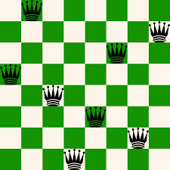
Intro example: N-queens
Problem: Place N queens on an NxN chess board so that no queen attacks another.
Example solution for N = 8.
How hard is it to find
such solutions? What if N gets larger?
Can be formulated as a search problem.
Start with empty board. [Ops? How many?]
Operators: place queen on location (i,j). [N^2. Goal?]
Goal state: N queens on board. No-one attacks another.
N=8, branching 64. Solution at what depth?
N. Search: (N^2)^N Informed search? Ideas for a heuristic?
Issues: (1) We don’t know much about
the goal state. That’s what we are looking for!
(2) Also, we don’t care about path to solution!
N-Queens demo!
What algorithm would you write to solve this?

Slide 4
Local Search: General Principle
Key idea (surprisingly simple):
1) Select (random) initial state (initial guess at solution)
e.g. guess random placement of N queens
2) Make local modification to improve current state
e.g. move queen under attack to “less attacked” square
3) Repeat Step 2 until goal state found (or out of time)
cycle can be done billions of times
Unsolvable if
out of time?
Not necessarily!
Method is incomplete.
Requirements:
  generate an initial
  (often random; probably-not-optimal or even valid) guess
  evaluate quality of guess
  move to other state (well-defined neighborhood function)
. . . and do these operations quickly
. . . and don't save paths followed

Slide 5
Local Search
Hill-climbing search or greedy local search
Simulated annealing
Local beam search
Genetic algorithms (related: genetic programming)
Tabu search (not covered)

Slide 6
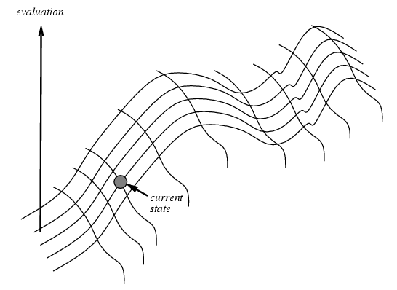
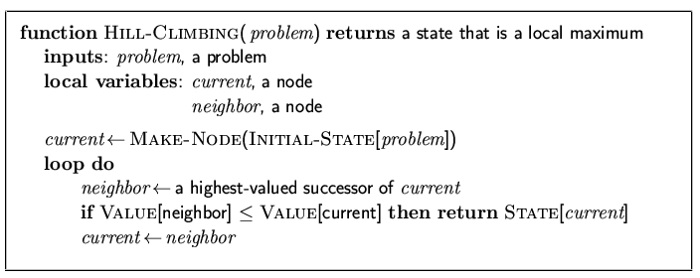
Hill-climbing search
“Like climbing Everest in thick fog with amnesia”
Keep trying to move to a better “neighbor”,
using some quantity to optimize.
Note: (1) “successor” normally called neighbor.
(2) minimization, isomorphic.
(3) stops when no improvement but often better to just
“keep going”, especially if improvement = 0

Slide 7
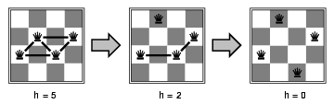
4-Queens
States: 4 queens in 4 columns (256 states)
Neighborhood Operators: move queen in column
Evaluation / Optimization function: h(n) = number of attacks / “conflicts”
Goal test: no attacks, i.e., h(G) = 0
Initial state (guess).
Local search: Because we only consider local changes to the state
at each step. We generally make sure that series of local changes
can reach all possible states.

Slide 8
8-Queens
1
2
2
0
3
2
3
2
2
2
2
2
3
2
Representation: 8 integer variables giving positions of 8 queens in columns
(e.g. <2, 5, 7, 4, 3, 8, 6, 1>)
Section 6.4 R&N (“hill-climbing with min-conflict heuristics”)
Pick initial complete assignment (at random)
Repeat
  Pick a conflicted variable var (at random)
  Set the new value of var to minimize the number of conflicts
  If the new assignment is not conflicting then return it
(Min-conflicts heuristics)
Inspired GSAT and Walksat

Slide 9
Remarks
Local search with min-conflict heuristic works extremely well for
N-queen problems. Can do millions and up in seconds. Similarly,
for many other problems (planning, scheduling, circuit layout etc.)
Why?
Commonly given: Solns. are densely distributed in the O(n^{n})
space; on average a solution is a few steps away from a randomly picked
assignment. But, solutions still exponentially rare!
In fact, density of solutions not very relevant. Even problems with a single solution can be “easy” for local search!
It all depends on the structure of the search space and the guidance
for the local moves provided by the optimization criterion.
For N-queens, consider h(n) = k, if k queens are attacked.
Does this still give a valid solution? Does it work as well?
What happens if h(n) = 0 if no queen under attack; h(n) = 1 otherwise?
Does this still give a valid solution? Does it work as well?
“Blind” search! No gradient in optimization criterion!

Slide 10
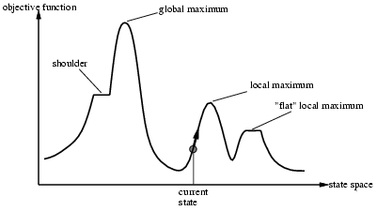
Issues for hill-climbing search
Problem: depending on initial state, can get stuck in local optimum (here maximum)
How to overcome
local optima and plateaus ?
→ Random-restart hill climbing
But, 1D figure is deceptive. True local optima are surprisingly rare in
high-dimensional spaces! There often is an escape to a better state.

Slide 11
Potential Issues with Hill Climbing / Greedy Local Search
Local Optima: No neighbor is better, but not at global optimum.
  May have to move away from goal to find (best) solution.
  But again, true local optima are rare in many high-dimensional spaces.
Plateaus: All neighbors look the same.
  8-puzzle: perhaps no action will change # of tiles out of place.
  Soln. just keep moving around! (will often find some improving
  move eventually)
Ridges: sequence of local maxima
May not know global optimum: Am I done?

Slide 12
Improvements to Greedy /
Hill-climbing Search
Issue:
  How to move more quickly to successively better plateaus?
  Avoid “getting stuck” / local maxima?
Idea: Introduce “noise:”
downhill (uphill) moves to escape from
plateaus or local maxima (mimima)
E.g., make a move that increases the number of attacking pairs.
Noise strategies:
  1. Simulated Annealing
    Kirkpatrick et al. 1982; Metropolis et al. 1953
  2. Mixed Random Walk (Satisfiability)
    Selman, Kautz, and Cohen 1993

Slide 13
Simulated Annealing
Idea:
Use conventional hill-climbing style techniques, but
occasionally take a step in a direction other than that in which there is improvement (downhill moves; away from solution).
As time passes, the probability that a down-hill step is taken is
gradually reduced and the size of any down-hill step taken is
decreased.
Notes:
Purpose of SA is to avoid local maxima. (Most frequently encountered difficulty with hill climbing.) Idea... [allows downhill steps occasionally].
The undirected steps won't in general reduce the ability of the procedure to find a global maximum (although they might increase the running time). But they may dislodge the problem solver from a foothill, i.e., a local maximum.
Q: Why large steps at first?
A: To avoid local maxima that extend over a wide area of the search space. Like doing a lot of exploring of the whole search space early. Subsequent undirected steps are smaller because we expect to only have to avoid more restricted local maxima.
Name came from an analogy with metal-casting.

Slide 14
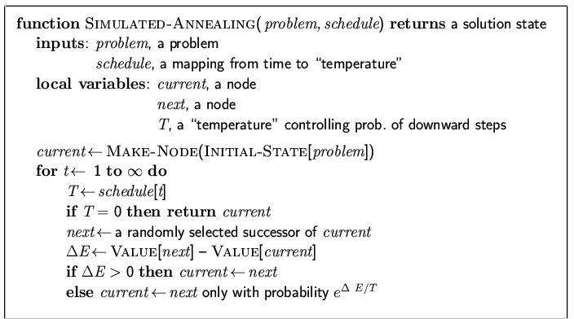
Simulated annealing search
(one of the most widely used optimization methods)
What’s the probability when: T → inf?
What’s the probability when: T → 0?
What’s the probability when: Δ=0? (sideways / plateau move)
What’s the probability when: Δ→-∞?
Idea: escape local maxima by allowing some "bad" moves but
gradually decrease frequency of such moves.
their frequency
Similar to hill climbing,
but a random move instead
of best move
case of improvement, make the move
Otherwise, choose the move with probability
that decreases exponentially with the “badness” of the move.

Slide 15
Notes
Noise model based on statistical mechanics
  . . . introduced as analogue to physical process of growing crystals
Convergence:
  1. With exponential schedule, will provably converge to global optimum
One can prove: If T decreases slowly enough, then simulated annealing search will find a global optimum with probability approaching 1
  2. Few more precise convergence rate.
  (Recent work on rapidly mixing Markov chains.
  Surprisingly deep foundations.)
Key aspect: downwards / sideways moves
  Expensive, but (if have enough time) can be best
Hundreds of papers / year; original paper one of most cited papers in CS!
  Many applications: VLSI layout, factory scheduling, protein folding. . .

Slide 16
Simulated Annealing (SA) --- Foundations
Superficially: SA is local search with some noise added. Noise starts high and is slowly decreased.
True story is much more principled:
SA is a general sampling strategy to sample from a combinatorial space according to a well-defined probability distribution.
Sampling strategy models the way physical systems, such as gases, sample from their statistical equilibrium distributions. Order 10^23 particles. Studied in the field of statistical physics.
We will sketch the core idea.

Slide 17
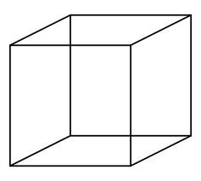
Example: 3D Hypercube space
110
111
States Value f(s)
s1 000 2
s2 001 4.25
s3 010 4
s4 011 3
s5 100 2.5
s6 101 4.5
s7 110 3
s8 111 3.5
100
101
010
011
000
001
N dimensional “hypercube” space. N =3. 2^3 = 8 states total.
Goal: Optimize f(s), the value function. Maximum value 4.5 in s6.
Use local search: Each state / node has N = 3 neighbors (out of 2^N total).

Slide 18
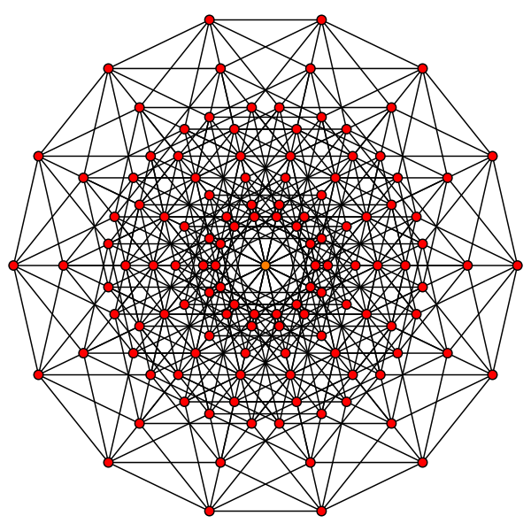
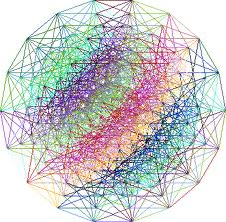
Of course, real interest in large N…
Spaces with 2^N states and each state with N neighbors.
7D hypercube; 128 states.
Every node, connected to 7 others.
Max distance between two nodes: 7.
9D hypercube; 512 states.
Practical reasoning problem: N = 1,000,000. 2^N = 10^300,000

Slide 19
SA node sampling strategy
Consider the following “random walker” in hypercube space:
1) Start at a random node S (the “current node”).
(How do we generate such a node?)
2) Select, at random, one of the N neighbors of S, call it S’
If (f(S’) – f(S)) > 0, move to S’, i.e. set S := S’
(i.e., jump to node with better value)
else with probability e^(f(S’)-f(S))/T move to S’, i.e., set S := S’
4) Go back to 2)
Note: Walker keeps going and going. Does not get stuck in any one node.

Slide 20
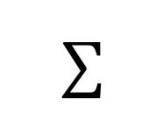
Central Claim --- Equilibrium Distribution:
After “a while,” we will find the walker in state S with probability
Prob(S) = e^(f(S)/T) / Z
where Z is a normalization constant (function of T) to make sure the probabilities over all states add up to 1.
Z is called the “partition function” and is given by
Z = e^(f(x))/T
where the sum is over all 2^N states x. So, an exponential sum!
Very hard to compute but we generally don’t have to!

Slide 21
For our example space
Prob(s) = e^(f(s))/T / Z
States Value f(s)
s1 000 2
s2 001 4.25
s3 010 4
s4 011 3
s5 100 2.5
s6 101 4.5
s7 110 3
s8 111 3.5
T=0.5 Prob(s)
55 0.003
4915 0.27
2981 0.17
403 0.02
148 0.008
8103 0.45
403 0.02
1097 0.06
sum Z = 18,105
T=1.0 Prob(s)
7.4 0.02
70.1 0.23
54.6 0.18
20.1 0.07
12.2 0.04
90.0 0.29
20.1 0.07
33.1 0.11
sum Z = 307.9
T=0.25 Prob(s)
2981 0.000
24,154,952 0.24
8,886,111 0.09
162,755 0.001
22,026 0.008
65,659,969 0.65
162,755 0.001
1,202,604 0.06
sum Z = 100,254,153
So, at T = 1.0, walker will spend roughly 29% of its time in the best state.
T = 0.5, roughly 45% of its time in the best state.
T = 0.25, roughly 65% of its time in the best state.
And, remaining time mostly in s2 (2nd best)!

Slide 22
So, when T gets lowered, the probability distribution starts to
“concentrate” on the maximum (and close to maximum) value states.
The lower T, the stronger the effect!
What about T high? What is Z and Prob(S)?
At low T, we can just output the current state. It will quite likely be a
maximum value (or close to it) state. In practice: Keep track of best
state seen during the SA search.
SA is an example of so-called Markov Chain Monte Carlo
or MCMC sampling.
It’s very general technique to sample from complex probability
distributions by making local moves only. For optimization, we chose
a clever probability distribution that concentrates on the optimum
states for low T. (Kirkpatrick et al. 1984)
2^N and 1/(2^N)
because e^0 =1 in each row

Slide 23
Some final notes on SA:
“Claim Equilibrium Distribution” needs proof. Not too difficult but takes a bit of background about Markov Chains. It’s beautiful and useful theory.
How long should we run at each T? Technically, till the process reaches the stationary distribution. Here’s the catch: may take exponential time in the worst case. ☹
How quickly should we “cool down”? Various schedules in literature.
To get (near-)optimum, you generally can run much shorter than needed for full stationary distribution.
Keep track of best solution seen so far.
A few formal convergence rate results exists, including some polytime results (“rapidly mixing Markov chains”).
Many variations on basic SA exist, useful for different applications.

Slide 24
Local beam search
Start with k randomly generated states
Keep track of k states rather than just one
At each iteration, all the successors of all k states are generated
If any one is a goal state, stop; else select the k best successors from the complete list and repeat.
Equivalent to k random-restart hill-climbing?
No: Different since information is shared between k search points:
  Some search points may contribute none to best successors: one search point may contribute all k successors “Come over here, the grass is greener” (R&N)

Slide 25
Genetic Algorithms

Slide 26
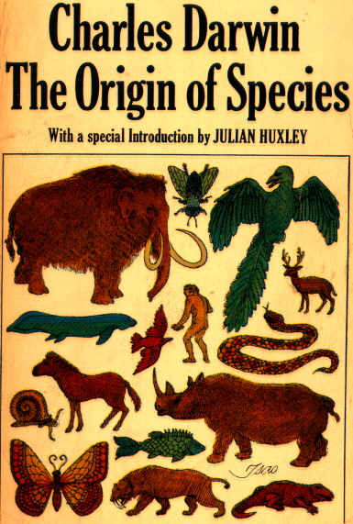
Genetic Algorithms
Another class of iterative improvement algorithms
  A genetic algorithm maintains a population of candidate solutions for the problem at hand, and makes it evolve by iteratively applying a set of stochastic operators
Inspired by the biological evolution process
Uses concepts of “Natural Selection” and “Genetic Inheritance” (Darwin 1859)
Originally developed by John Holland (1975)

Slide 27
High-level Algorithm
Randomly generate an initial population
Evaluate the fitness of members of population
Select parents based on fitness, and “reproduce” to get the next generation (using “crossover” and mutations)
Replace the old generation with the new generation
Repeat step 2 though 4 till iteration N
Notes:
T is predefined by the user.

Slide 28
Stochastic Operators
Cross-over
  decomposes two distinct solutions and then
  randomly mixes their parts to form novel solutions
Mutation
  randomly perturbs a candidate solution

Slide 29
A successor state is generated by combining two parent states
Start with k randomly generated states (population)
A state is represented as a string over a finite alphabet
(often a string of 0s and 1s)
Evaluation function (fitness function). Higher values for better states.
Produce the next generation of states by selection, crossover, and mutation

Slide 30
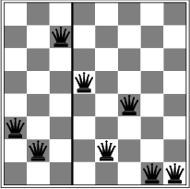
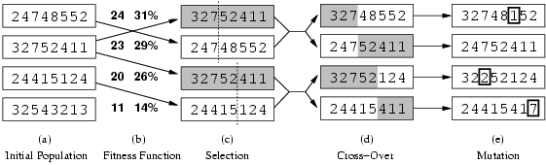
Genetic algorithms
Operate on state representation.
production of next generation
random mutation
Fitness function: number of non-attacking pairs of queens (min = 0, max = 8 × 7/2 = 28
→ the higher the better)
24/(24+23+20+11) = 31%
23/(24+23+20+11) = 29% etc
crossover point randomly generated
probability of a given pair selection
proportional to the fitness (b)

Slide 31
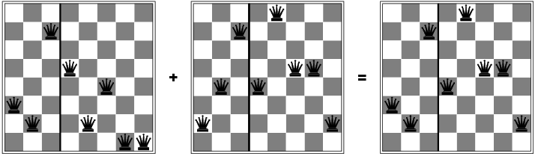
Genetic algorithms

Slide 32
Lots of variants of genetic algorithms with different selection, crossover, and mutation rules.
GAs have a wide application in optimization – e.g., circuit layout and job shop scheduling
Much wirk remains to be done to formally understand GAs and to identify the conditions under which they perform well.

Slide 33
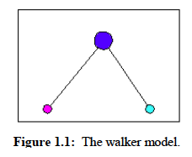
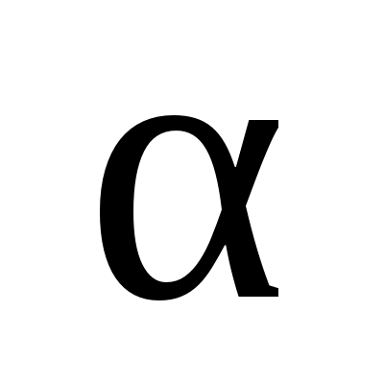
Demo of Genetic Programming (GP):
The Evolutionary Walker
Stick figure ---
Three nodes:
1 body
2 feet
Basic physics
model:
gravity
momentum etc.
Discrete time
Goal:
Make it
run as fast as
possible!
Evolve population
of control
programs.
Actions to control:
1) angle
2) push off ground for each foot.
Input for control program (from physics module):
Position and velocity for the three nodes.

Slide 34
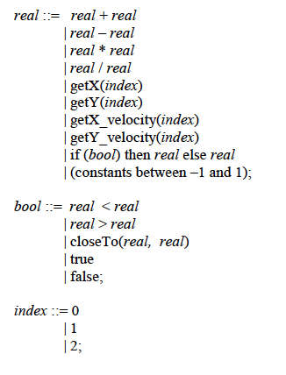
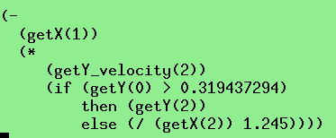
Control language:
Example:
Basically, computes a real number
to set angle (or push strength) for
next time step.
Body and foot will each evolve their
own control program.

Slide 35
Population of control programs is maintained and evolved.
Fitness determined by measuring how far the walker gets in T time
units (T fixed).
Evolution through parent selection based on fitness.
Followed by
crossover (swap parts of control programs, i.e., arithmetic expression
trees) and
mutations (randomly generate new parts of control program).

Slide 36
Can this work? How well?
Would it be hard to program directly? Think about it…
Demo

Slide 37
Leaner.txt --- most basic walker
(/(-(/(R -1.8554944551635097)(U(N 0)))(+(-(R 0.26696974973371823)(Y(N 1)))(-(-(X(N 0))(V(N 0)))(U(N 0)))))(-(*(R 0.6906081172421406)(Y(N 0)))(-(V(N 1))(V(N 0)))))
(I(<(-(*(R -0.4749818581316987)(Y(N 1)))(-(V(N 2))(-(V(N 1))(V(N 1)))))(/(+(Y(N 1))(R 1.8836665782029058))(X(N 1))))(+(+(*(Y(N 2))(+(R 0.26073435346772067)(+(X(N 1))(X(N 1)))))(+(X(N 1))(+(-(Y(N 2))(I(B false)(Y(N 1))(Y(N 2))))(V(N 1)))))(/(V(N 1))(X(N 1))))(-(I(<(U(N 1))(I(B false)(I(B true)(X(N 1))(X(N 0)))(U(N 1))))(+(+(I(B false)(X(N 1))(Y(N 1)))(I(B false)(Y(N 0))(*(U(N 1))(U(N 2)))))(X(N 1)))(X(N 1)))(R 0.5940420353545179)))
(+(I(>(R 0.5794443410907397)(X(N 2)))(+(Y(N 0))(I(=(X(N 1))(R 0.8970017727908304))(I(>(X(N 2))(U(N 2)))(+(R -1.7936388433304842)(X(N 2)))(R -1.5628590286537545))(+(R -0.8070029381426358)(Y(N 0)))))(Y(N 2)))(-(-(I(B false)(X(N 2))(-(Y(N 2))(I(B true)(V(N 1))(Y(N 2)))))(I(=(X(N 2))(V(N 2)))(Y(N 2))(U(N 2))))(I(<(-(X(N 2))(X(N 2)))(+(R 0.9121162135497185)(R -1.2851304610388143)))(X(N 2))(*(R 0.2968842304359933)(Y(N 2))))))
====================
Pop size: 50
Max gen: 100
Mutate prob: 0.0
Cross prob: 0.0

Slide 38
Sprinter7661.txt --- one of the fastest walkers
(-(-(-(U(N 0))(+(Y(N 0))(/(+(+(R 0.7499415628721899)(+(Y(N 0))(Y(N 0))))(X(N 0)))(*(R 0.20363512445479204)(-(U(N 2))(X(N 0)))))))(-(-(Y(N 0))(X(N 0)))(I(<(/(+(X(N 0))(Y(N 0)))(+(U(N 0))(Y(N 0))))(X(N 0)))(X(N 0))(Y(N 0)))))(-(-(U(N 0))(X(N 0)))(*(-(-(Y(N 0))(R 0.90287443905547))(Y(N 0)))(I(B false)(R 1.6373642908344364)(*(V(N 0))(-(Y(N 0))(X(N 1))))))))
(+(I(=(X(N 0))(X(N 0)))(I(B true)(/(I(<(/(+(V(N 0))(X(N 1)))(Y(N 1)))(-(-(-(X(N 1))(Y(N 1)))(Y(N 0)))(+(V(N 1))(I(B true)(I(B false)(V(N 1))(Y(N 1)))(Y(N 1))))))(X(N 0))(X(N 1)))(Y(N 1)))(R 1.7322667925012376))(X(N 1)))(+(I(=(X(N 0))(X(N 0)))(I(B true)(I(=(X(N 0))(X(N 0)))(I(B true)(/(I(<(/(+(V(N 0))(X(N 1)))(Y(N 1)))(-(-(-(X(N 1))(Y(N 1)))(Y(N 0)))(+(V(N 1))(I(B true)(I(B false)(V(N 1))(Y(N 1)))(Y(N 1))))))(+(X(N 0))(V(N 1)))(X(N 1)))(Y(N 1)))(R 1.7322667925012376))(X(N 1)))(R 1.7322667925012376))(X(N 1)))(-(+(Y(N 1))(-(I(>(X(N 2))(I(=(X(N 2))(X(N 1)))(X(N 1))(+(/(V(N 1))(X(N 1)))(*(Y(N 1))(R -0.2527339900147063)))))(*(*(I(>(U(N 1))(I(B false)(V(N 1))(X(N 1))))(V(N 1))(*(R 0.5789447390820031)(V(N 1))))(Y(N 1)))(Y(N 1)))(U(N 2)))(I(B true)(X(N 1))(R -1.3674019962815391))))(I(B true)(X(N 1))(R -1.3674019962815391)))))
(I(<(-(R 1.0834795574638003)(/(V(N 2))(X(N 2))))(I(<(-(/(+(*(+(-(Y(N 0))(I(B false)(X(N 2))(Y(N 1))))(I(B true)(*(/(X(N 0))(I(B true)(Y(N 1))(-(Y(N 2))(R -0.7459046887493868))))(X(N 0)))(I(=(R 0.06513609737108705)(/(U(N 2))(Y(N 0))))(I(B false)(R 0.586892403392552)(+(R -0.9444619621722184)(R -0.3539879557813772)))(Y(N 0)))))(X(N 1)))(X(N 1)))(U(N 2)))(/(V(N 2))(X(N 0))))(X(N 2)))(*(+(-(Y(N 0))(I(B false)(X(N 2))(Y(N 1))))(I(B true)(*(/(X(N 0))(I(B true)(Y(N 1))(-(Y(N 2))(R -0.7459046887493868))))(X(N 0)))(X(N 2))))(X(N 2)))(I(=(R 0.06513609737108705)(I(<(-(R 1.0834795574638003)(/(V(N 2))(X(N 2))))(I(<(-(/(+(*(+(-(Y(N 0))(I(B false)(X(N 2))(Y(N 1))))(I(B true)(*(/(X(N 0))(I(B true)(Y(N 1))(-(Y(N 2))(R -0.7459046887493868))))(X(N 0)))(I(=(R 0.06513609737108705)(/(U(N 2))(Y(N 0))))(I(B false)(R 0.586892403392552)(+(R -0.9444619621722184)(R -0.3539879557813772)))(Y(N 0)))))(X(N 1)))(X(N 1)))(U(N 2)))(/(V(N 2))(X(N 0))))(X(N 2)))(*(+(-(Y(N 0))(I(B false)(X(N 2))(Y(N 1))))(I(B true)(*(/(X(N 0))(I(B true)(Y(N 1))(-(Y(N 2))(R -0.7459046887493868))))(X(N 0)))(X(N 2))))(X(N 2)))(I(=(R 0.06513609737108705)(/(U(N 2))(Y(N 0))))(I(B false)(I(<(-(/(+(*(+(-(Y(N 0))(I(B false)(X(N 2))(Y(N 1))))(I(B true)(*(/(X(N 0))(I(B true)(Y(N 1))(-(Y(N 2))(R -0.7459046887493868))))(X(N 0)))(I(=(R 0.06513609737108705)(/(U(N 2))(Y(N 0))))(I(B false)(R 0.586892403392552)(+(R -0.9444619621722184)(R -0.3539879557813772)))(Y(N 0)))))(X(N 1)))(X(N 1)))(U(N 2)))(/(V(N 2))(X(N 0))))(X(N 2)))(*(+(-(Y(N 0))(I(B false)(X(N 2))(Y(N 1))))(I(B true)(*(/(X(N 0))(I(B true)(Y(N 1))(-(Y(N 2))(R -0.7459046887493868))))(X(N 0)))(X(N 2))))(X(N 2)))(I(=(R 0.06513609737108705)(/(U(N 2))(Y(N 0))))(I(B false)(*(I(=(Y(N 1))(V(N 2)))(*(R -1.785981479518025)(-(Y(N 2))(/(-(/(Y(N 1))(V(N 2)))(-(V(N 2))(X(N 2))))(Y(N 2)))))(/(-(-(R 0.6169974948994237)(X(N 2)))(X(N 2)))(I(B false)(Y(N 2))(V(N 2)))))(-(X(N 2))(I(=(Y(N 2))(-(Y(N 2))(U(N 2))))(X(N 2))(Y(N 2)))))(I(=(R

Slide 39
0.06513609737108705)(/(U(N 2))(Y(N 0))))(I(B false)(*(I(=(Y(N 1))(V(N 2)))(*(R -1.785981479518025)(-(Y(N 2))(/(-(/(Y(N 1))(V(N 2)))(-(V(N 2))(X(N 2))))(Y(N 2)))))(/(-(-(R 0.6169974948994237)(X(N 2)))(X(N 2)))(I(B false)(Y(N 2))(V(N 2)))))(-(X(N 2))(I(=(Y(N 2))(-(Y(N 2))(U(N 2))))(X(N 2))(Y(N 2)))))(X(N 2)))(V(N 2))))(X(N 0))))(I(=(R 0.06513609737108705)(/(U(N 2))(Y(N 0))))(I(B false)(*(I(=(Y(N 1))(V(N 2)))(*(R -1.785981479518025)(-(Y(N 2))(/(-(/(Y(N 1))(V(N 2)))(-(V(N 2))(X(N 2))))(Y(N 2)))))(/(-(-(R 0.6169974948994237)(X(N 2)))(X(N 2)))(I(B false)(Y(N 2))(V(N 2)))))(-(X(N 2))(I(=(Y(N 2))(-(Y(N 2))(U(N 2))))(X(N 2))(Y(N 2)))))(X(N 2)))(V(N 2))))(X(N 0)))))(*(+(-(Y(N 0))(I(B false)(X(N 2))(Y(N 1))))(I(B true)(*(/(X(N 0))(I(B true)(Y(N 1))(-(Y(N 2))(R -0.7459046887493868))))(X(N 0)))(I(=(R 0.06513609737108705)(/(U(N 2))(Y(N 0))))(I(B false)(R 0.586892403392552)(+(R -0.9444619621722184)(R -0.3539879557813772)))(Y(N 0)))))(I(<(-(R 1.0834795574638003)(/(V(N 2))(X(N 2))))(I(<(-(/(+(*(+(-(Y(N 0))(I(B false)(X(N 2))(Y(N 1))))(I(B true)(*(/(X(N 0))(I(B true)(Y(N 1))(-(Y(N 2))(R -0.7459046887493868))))(X(N 0)))(I(=(R 0.06513609737108705)(/(U(N 2))(Y(N 0))))(I(B false)(R 0.586892403392552)(+(R -0.9444619621722184)(R -0.3539879557813772)))(Y(N 0)))))(X(N 1)))(X(N 1)))(U(N 2)))(/(V(N 2))(X(N 0))))(X(N 2)))(*(+(-(Y(N 0))(I(B false)(X(N 2))(Y(N 1))))(I(B true)(*(/(X(N 0))(I(B true)(Y(N 1))(-(Y(N 2))(R -0.7459046887493868))))(X(N 0)))(I(=(R 0.06513609737108705)(/(U(N 2))(Y(N 0))))(I(B false)(R 0.586892403392552)(+(R -0.9444619621722184)(R -0.3539879557813772)))(Y(N 0)))))(X(N 2)))(I(=(R 0.06513609737108705)(/(U(N 2))(Y(N 0))))(I(B false)(*(I(=(Y(N 1))(V(N 2)))(*(R -1.785981479518025)(-(Y(N 2))(/(-(/(Y(N 1))(V(N 2)))(-(V(N 2))(X(N 2))))(Y(N 2)))))(/(-(-(R 0.6169974948994237)(X(N 2)))(X(N 2)))(I(B false)(Y(N 2))(V(N 2)))))(-(X(N 2))(I(=(Y(N 2))(-(Y(N 2))(U(N 2))))(X(N 2))(Y(N 2)))))(I(=(R 0.06513609737108705)(/(U(N 2))(Y(N 0))))(I(B false)(*(I(=(Y(N 1))(V(N 2)))(*(R -1.785981479518025)(-(Y(N 2))(/(-(/(Y(N 1))(V(N 2)))(-(V(N 2))(X(N 2))))(Y(N 2)))))(/(-(-(R 0.6169974948994237)(X(N 2)))(X(N 2)))(I(B false)(Y(N 2))(V(N 2)))))(-(X(N 2))(I(=(Y(N 2))(-(Y(N 2))(U(N 2))))(X(N 2))(Y(N 2)))))(X(N 2)))(V(N 2))))(X(N 0)))))(*(+(-(Y(N 0))(I(B false)(X(N 2))(Y(N 1))))(I(B true)(*(/(X(N 0))(I(B true)(Y(N 1))(-(Y(N 2))(R -0.7459046887493868))))(X(N 0)))(I(=(R 0.06513609737108705)(/(U(N 2))(Y(N 0))))(I(B false)(R 0.586892403392552)(+(R -0.9444619621722184)(R -0.3539879557813772)))(Y(N 0)))))(X(N 1)))(I(=(R 0.06513609737108705)(/(U(N 2))(Y(N 0))))(I(B false)(*(I(=(Y(N 1))(V(N 2)))(*(R -1.785981479518025)(-(Y(N 2))(/(-(/(Y(N 1))(V(N 2)))(-(V(N 2))(X(N 2))))(Y(N 2)))))(/(-(-(R 0.6169974948994237)(X(N 2)))(X(N 2)))(I(B false)(Y(N 2))(V(N 2)))))(-(X(N 2))(I(=(Y(N 2))(-(Y(N 2))(U(N 2))))(X(N 2))(Y(N 2)))))(X(N 2)))(X(N 2)))))(I(=(R 0.06513609737108705)(/(U(N 2))(*(+(-(Y(N 0))(I(B false)(X(N 2))(Y(N 1))))(I(B true)(*(/(X(N 0))(I(B true)(Y(N 1))(-(Y(N 2))(R -0.7459046887493868))))(X(N 0)))(I(=(R 0.06513609737108705)(/(U(N 2))(Y(N 0))))(I(B false)(R 0.586892403392552)(+(R -0.9444619621722184)(R -0.3539879557813772)))(Y(N 0)))))(X(N 1)))))(I(B false)(X(N 1))(X(N 2)))(X(N 2)))))(I(B false)(I(<(-(/(+(*(+(-(Y(N 0))(I(B false)(X(N 2))(Y(N 1))))(I(B true)(*(/(X(N 0))(I(B true)(Y(N 1))(-(Y(N 2))(R -0.7459046887493868))))(X(N 0)))(I(=(R 0.06513609737108705)(/(U(N 2))(Y(N 0))))(I(B false)(R 0.586892403392552)(+(R -0.9444619621722184)(R -0.3539879557813772)))(Y(N 0)))))(X(N 1)))(X(N 1)))(U(N 2)))(/(V(N 2))(X(N 0))))(X(N 2)))(*(+(-(Y(N 0))(I(B false)(X(N 2))(Y(N 1))))(I(B

Slide 40
true)(*(/(X(N 0))(I(B true)(Y(N 1))(-(Y(N 2))(R -0.7459046887493868))))(X(N 0)))(X(N 2))))(X(N 2)))(I(=(R 0.06513609737108705)(/(U(N 2))(Y(N 0))))(I(B false)(*(I(=(Y(N 1))(V(N 2)))(*(R -1.785981479518025)(-(Y(N 2))(/(-(/(Y(N 1))(V(N 2)))(-(V(N 2))(X(N 2))))(Y(N 2)))))(/(-(-(R 0.6169974948994237)(X(N 2)))(X(N 2)))(I(B false)(Y(N 2))(V(N 2)))))(-(X(N 2))(I(=(Y(N 2))(-(Y(N 2))(U(N 2))))(X(N 2))(Y(N 2)))))(I(=(R 0.06513609737108705)(/(U(N 2))(Y(N 0))))(I(B false)(*(I(=(Y(N 1))(V(N 2)))(*(R -1.785981479518025)(-(Y(N 2))(/(-(/(Y(N 1))(V(N 2)))(-(V(N 2))(X(N 2))))(Y(N 2)))))(/(-(-(R 0.6169974948994237)(X(N 2)))(X(N 2)))(I(B false)(Y(N 2))(V(N 2)))))(-(X(N 2))(I(=(Y(N 2))(-(Y(N 2))(U(N 2))))(X(N 2))(Y(N 2)))))(X(N 2)))(V(N 2))))(X(N 0))))(I(=(R 0.06513609737108705)(/(U(N 2))(Y(N 0))))(I(B false)(*(I(=(Y(N 1))(V(N 2)))(*(R -1.785981479518025)(-(Y(N 2))(/(-(/(Y(N 1))(V(N 2)))(-(V(N 2))(X(N 2))))(Y(N 2)))))(/(-(-(R 0.6169974948994237)(X(N 2)))(X(N 2)))(I(B false)(Y(N 2))(V(N 2)))))(-(X(N 2))(I(=(Y(N 2))(-(Y(N 2))(U(N 2))))(X(N 2))(Y(N 2)))))(X(N 2)))(V(N 2))))(X(N 0)))))(*(+(-(Y(N 0))(I(B false)(X(N 2))(Y(N 1))))(I(B true)(*(/(X(N 0))(I(B true)(Y(N 1))(-(Y(N 2))(R -0.7459046887493868))))(X(N 0)))(I(=(R 0.06513609737108705)(/(U(N 2))(Y(N 0))))(I(B false)(R 0.586892403392552)(+(R -0.9444619621722184)(R -0.3539879557813772)))(Y(N 0)))))(I(<(-(R 1.0834795574638003)(/(V(N 2))(X(N 2))))(I(<(-(/(+(*(+(-(Y(N 0))(I(B false)(X(N 2))(Y(N 1))))(I(B true)(*(/(X(N 0))(I(B true)(Y(N 1))(-(Y(N 2))(R -0.7459046887493868))))(X(N 0)))(I(=(R 0.06513609737108705)(/(U(N 2))(Y(N 0))))(I(B false)(R 0.586892403392552)(+(R -0.9444619621722184)(R -0.3539879557813772)))(Y(N 0)))))(X(N 1)))(X(N 1)))(U(N 2)))(/(V(N 2))(X(N 0))))(X(N 2)))(*(+(-(Y(N 0))(I(B false)(X(N 2))(Y(N 1))))(I(B true)(*(/(X(N 0))(I(B true)(Y(N 1))(-(Y(N 2))(R -0.7459046887493868))))(X(N 0)))(I(=(R 0.06513609737108705)(/(U(N 2))(Y(N 0))))(I(B false)(R 0.586892403392552)(+(R -0.9444619621722184)(R -0.3539879557813772)))(Y(N 0)))))(X(N 2)))(I(=(R 0.06513609737108705)(/(U(N 2))(Y(N 0))))(I(B false)(*(I(=(Y(N 1))(V(N 2)))(*(R -1.785981479518025)(-(Y(N 2))(/(-(/(Y(N 1))(V(N 2)))(-(V(N 2))(X(N 2))))(Y(N 2)))))(/(-(-(R 0.6169974948994237)(X(N 2)))(X(N 2)))(I(B false)(Y(N 2))(V(N 2)))))(-(X(N 2))(I(=(Y(N 2))(-(Y(N 2))(U(N 2))))(X(N 2))(Y(N 2)))))(I(=(R 0.06513609737108705)(/(U(N 2))(Y(N 0))))(I(B false)(*(I(=(Y(N 1))(V(N 2)))(*(R -1.785981479518025)(-(Y(N 2))(/(-(/(Y(N 1))(V(N 2)))(-(V(N 2))(X(N 2))))(Y(N 2)))))(/(-(-(R 0.6169974948994237)(X(N 2)))(X(N 2)))(I(B false)(Y(N 2))(V(N 2)))))(-(X(N 2))(I(=(Y(N 2))(-(Y(N 2))(U(N 2))))(X(N 2))(Y(N 2)))))(X(N 2)))(V(N 2))))(X(N 0)))))(*(+(-(Y(N 0))(I(B false)(X(N 2))(Y(N 1))))(I(B true)(*(/(X(N 0))(I(B true)(Y(N 1))(-(Y(N 2))(R -0.7459046887493868))))(X(N 0)))(I(=(R 0.06513609737108705)(/(U(N 2))(Y(N 0))))(I(B false)(R 0.586892403392552)(+(R -0.9444619621722184)(R -0.3539879557813772)))(Y(N 0)))))(X(N 1)))(I(=(R 0.06513609737108705)(/(U(N 2))(Y(N 0))))(I(B false)(*(X(N 2))(-(X(N 2))(I(=(Y(N 2))(-(Y(N 2))(U(N 2))))(X(N 2))(Y(N 2)))))(X(N 2)))(X(N 2)))))(I(=(Y(N 0))(/(U(N 2))(*(+(-(Y(N 0))(I(B false)(X(N 2))(Y(N 1))))(I(B true)(*(/(X(N 0))(I(B true)(Y(N 1))(-(Y(N 2))(R -0.7459046887493868))))(X(N 0)))(I(=(R 0.06513609737108705)(/(U(N 2))(Y(N 0))))(I(B false)(R 0.586892403392552)(+(R -0.9444619621722184)(R -0.3539879557813772)))(Y(N 0)))))(X(N 1)))))(I(B false)(X(N 1))(X(N 2)))(I(B true)(-(X(N 2))(+(I(<(U(N 2))(-(X(N 2))(Y(N 2))))(-(I(=(Y(N 2))(/(Y(N 2))(-(I(B false)(X(N 2))(Y(N 2)))(R -0.2816474909118467))))(X(N 2))(X(N 0)))(+(V(N 2))(-(U(N 1))(Y(N

Slide 41
2)))))(+(Y(N 2))(R -1.6972810613722311)))(-(Y(N 2))(+(X(N 2))(-(U(N 0))(-(Y(N 2))(U(N 2))))))))(I(=(/(Y(N 2))(/(Y(N 1))(+(I(B false)(X(N 2))(X(N 2)))(+(Y(N 2))(I(>(V(N 2))(-(Y(N 0))(X(N 2))))(R 1.442859722538481)(X(N 1)))))))(-(R -0.8609985653714518)(Y(N 1))))(V(N 2))(+(*(V(N 2))(Y(N 2)))(X(N 0)))))))
====================
Pop size: 100
Max gen: 50000
Mutate prob: 0.9
Cross prob: 0.9

Slide 42
Summary
Local search algorithms
  Hill-climbing search
  Local beam search
  Simulated annealing search
  Genetic algorithms (Genetic algorithms)
  Tabu search (not covered)

Slide 43
1) Surprisingly efficient search technique
2) Often the only feasible approach
3) Wide range of applications
4) Formal properties / guarantees still difficult to obtain
5) Intuitive explanation:
  Search spaces are too large for systematic search anyway. . .
6) Area will most likely continue to thrive

