Slide 1
CS 4700:
Foundations of Artificial Intelligence
Bart Selman
selman@cs.cornell.edu
Module:
Adversarial Search
R&N: Chapter 5
Part II

Slide 2
Outline
Game Playing
Optimal decisions
Minimax
α-β pruning
Case study: Deep Blue
UCT and Go

Slide 3
Case Study: IBM’s Deep Blue

Slide 4
Combinatorics of Chess
Opening book
Endgame
  database of all 5 piece endgames exists; database of all 6 piece games being built
Middle game
  Positions evaluated (estimation)
    1 move by each player = 1,000
    2 moves by each player = 1,000,000
    3 moves by each player = 1,000,000,000

Slide 5
Positions with Smart Pruning
Search Depth (ply) Positions
2 60
4 2,000
6 60,000
8 2,000,000
10 (<1 second DB) 60,000,000
12 2,000,000,000
14 (5 minutes DB) 60,000,000,000
16 2,000,000,000,000
How many lines of play does a grand master consider?
Around 5 to 7 ☺

Slide 6
Formal Complexity of Chess
How hard is chess?
  Obvious problem: standard complexity theory tells us nothing about finite games!
  Generalized chess to NxN board: optimal play is EXPTIME-complete
  Still, I would not rule out a medium-size (few hundred to a few thousand nodes) neural net playing almost perfect chess within one or two decades.

Slide 7
Game Tree Search
(discussed before)
How to search a game tree was independently invented by
Shannon (1950) and Turing (1951).
Technique called: MiniMax search.
Evaluation function combines material & position.
  Pruning "bad" nodes: doesn't work in practice
  Extend "unstable" nodes (e.g. after captures): works well in
  practice.

Slide 8
A Note on Minimax
Minimax “obviously” correct -- but
  Nau (1982) discovered pathological game trees
Games where
  evaluation function grows more accurate as it nears the leaves
  but performance is worse the deeper you search!

Slide 9
Clustering
Monte Carlo simulations showed clustering is important
  if winning or loosing terminal leaves tend to be clustered, pathologies do not occur
  in chess: a position is “strong” or “weak”, rarely completely ambiguous!
But still no completely satisfactory theoretical understanding of why minimax is good!

Slide 10
History of Search Innovations
Shannon, Turing Minimax search 1950
Kotok/McCarthy Alpha-beta pruning 1966
MacHack Transposition tables 1967
Chess 3.0+ Iterative-deepening 1975
Belle Special hardware 1978
Cray Blitz Parallel search 1983
Hitech Parallel evaluation 1985
Deep Blue ALL OF THE ABOVE 1997

Slide 11
Evaluation Functions
Primary way knowledge of chess is encoded
  material
  position
    doubled pawns
    how constrained position is
Must execute quickly - constant time
  parallel evaluation: allows more complex functions
    tactics: patterns to recognitize weak positions
    arbitrarily complicated domain knowledge

Slide 12
Learning better evaluation functions
  Deep Blue learns by tuning weights in its board evaluation function
        f(p) = w₁f₁(p) + w₂f₂(p) + ... + w_{n}f_{n}(p)
  Tune weights to find best least-squares fit with respect to moves actually chosen by grandmasters in 1000+ games. Weights tweaked multiple digits of precision.
  The key difference between 1996 and 1997 match!
  Note that Kasparov also trained on
  “computer chess” play. But, he did not have access to DB.

Slide 13
Transposition Tables
Introduced by Greenblat's Mac Hack (1966)
Basic idea: caching
  once a board is evaluated, save in a hash table, avoid re-evaluating.
  called “transposition” tables, because different orderings (transpositions) of the same set of moves can lead to the same board.

Slide 14
Transposition Tables as Learning
Is a form of root learning (memorization).
  positions generalize sequences of moves
  learning on-the-fly
Deep Blue --- huge transposition tables (100,000,000+), must be carefully managed.

Slide 15
Time vs Space
Iterative Deepening
  a good idea in chess, as well as almost everywhere else!
  Chess 4.x, first to play at Master's level
  trades a little time for a huge reduction in space
    lets you do breadth-first search with (more space efficient) depth-first search
  anytime: good for response-time critical applications

Slide 16
Special-Purpose and Parallel Hardware
Belle (Thompson 1978)
Cray Blitz (1993)
Hitech (1985)
Deep Blue (1987-1996)
  Parallel evaluation: allows more complicated evaluation functions
  Hardest part: coordinating parallel search
  Interesting factoid: Deep Blue never quite played the same game, because of “noise” in its hardware!

Slide 17
Deep Blue
Hardware
  32 general processors
  220 VSLI chess chips
Overall: 200,000,000 positions per second
  5 minutes = depth 14
Selective extensions - search deeper at unstable positions
  down to depth 25 !
  Aside:
  4-ply ≈ human novice
  8-ply to 10-ply ≈ typical PC, human master
  14-ply ≈ Deep Blue, Kasparov (+ depth 25 for “selective extensions”)

Slide 18
Evolution of Deep Blue
From 1987 to 1996
  faster chess processors
  port to IBM base machine from Sun
    Deep Blue’s non-Chess hardware is actually quite slow, in integer performance!
  bigger opening and endgame books
  1996 differed little from 1997 - fixed bugs and tuned evaluation function!
    After its loss in 1996, people underestimated its strength!

Slide 19
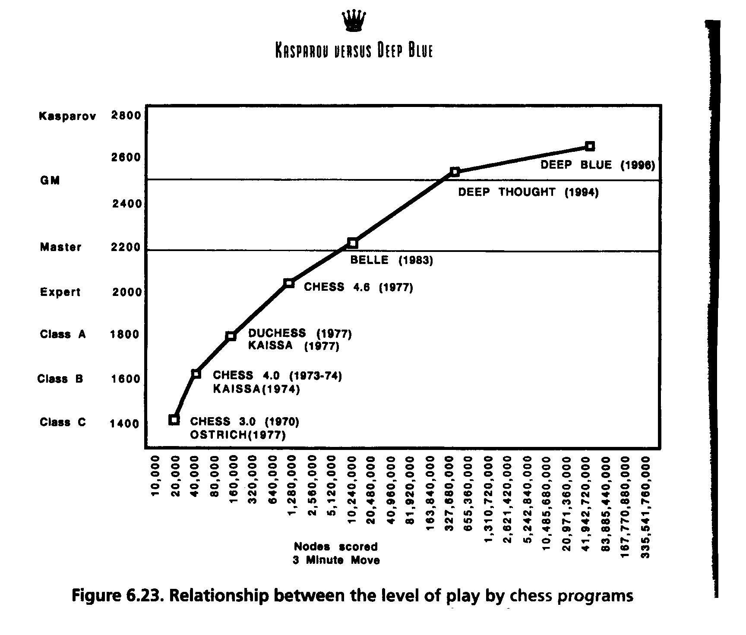

Slide 20
Tactics into Strategy
As Deep Blue goes deeper and deeper into a position, it displays elements of strategic understanding. Somewhere out there mere tactics translate into strategy. This is the closet thing I've ever seen to computer intelligence. It's a very weird form of intelligence, but you can feel it. It feels like thinking.
  Frederick Friedel (grandmaster), Newsday, May 9, 1997
This is an example of how massive computation ---
with clever search and evaluation function tuning ---
lead to a qualitative leap in performance (closer to human).
We see other recent examples with massive amounts of
data and clever machine learning techniques. E.g. machine
translation and speech/face recognition.

Slide 21
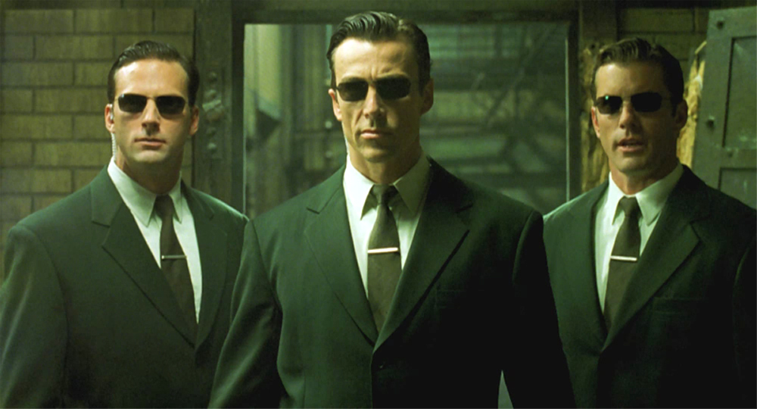
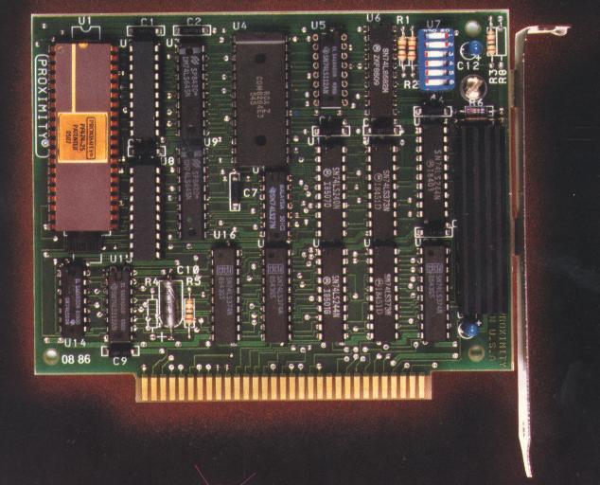
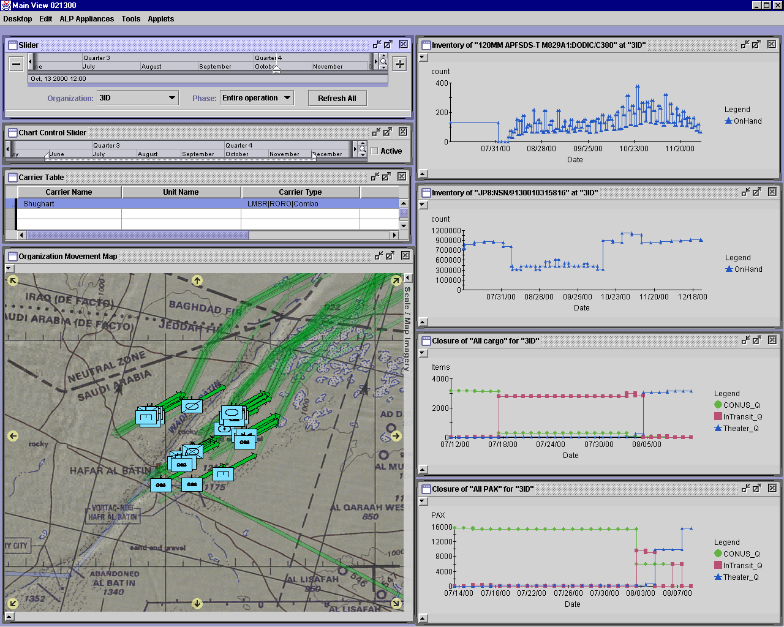
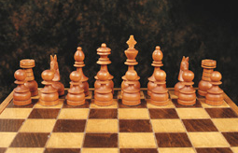
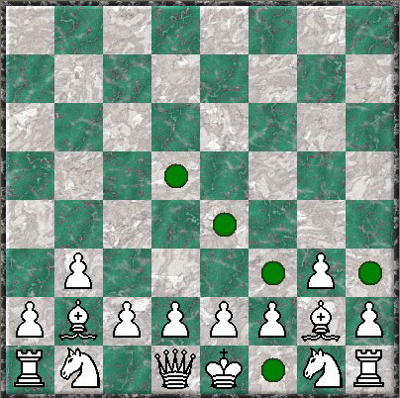


Automated reasoning --- the path
1M
5M
Multi-agent systems
combining:
reasoning,
uncertainty &
learning
10^{301,020}
Complexity
0.5M
1M
VLSI
Verification
10^{150,500}
Case complexity
Exponential
100K
450K
Military Logistics
10⁶⁰²⁰
20K
100K
Chess (20 steps deep) & Kriegspiel (!)
No. of atoms
On earth
10³⁰¹⁰
10⁴⁷
10K
50K
Deep space mission control
Seconds until heat death of sun
10³⁰
100
200
Car repair diagnosis
Protein folding
Calculation (petaflop-year)
100
10K
20K
100K
1M
Variables
$25M Darpa research program --- 2004-2009
Rules (Constraints)

Slide 22
Kriegspiel
Pieces hidden
from opponent
Interesting combination of
reasoning, game tree
search, and uncertainty.
Another chess variant:
Multiplayer
asynchronous chess.

Slide 23
The Danger of Introspection
When people express the opinion that human grandmasters do not examine 200,000,000 move sequences per second, I ask them, ``How do you know?'' The answer is usually that human grandmasters are not aware of searching this number of positions, or are aware of searching many fewer. But almost everything that goes on in our minds we are unaware of.
  Drew McDermott
In fact, recent neuroscience evidence shows that
true expert performance (mind and sports) gets “compiled”
to the sub-conscience level of our brain, and becomes
therefore inaccessible to reflection. (Requires approx.
10K hours of practice for world-level performance.)

Slide 24
State-of-the-art of other games

Slide 25

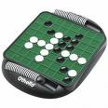
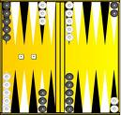
Deterministic games in practice
Checkers: Chinook ended 40-year-reign of human world champion
Marion Tinsley in 1994. Used a pre-computed endgame database
defining perfect play for all positions involving 8 or fewer pieces on
the board, a total of 444 billion positions.
2007: proved to be a draw! Schaeffer et al. solved checkers for
“White Doctor” opening (draw) (about 50 other openings).
Othello: human champions refuse to compete against computers, who are too strong.
Backgammon: TD-Gammon is competitive with World Champion (ranked
among the top 3 players in the world). Tesauro's approach (1992) used
learning to come up with a good evaluation function. Exciting application
of reinforcement learning.

Slide 26
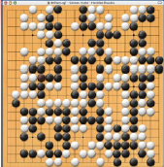

Playing GO
Go: human champions refuse to compete against computers, considered too weak. In GO, b > 300, so most programs use pattern knowledge bases to suggest plausible moves (R&N, 2nd edition).
Not true!
Computer Beats Pro at U.S. Go Congress
http://www.usgo.org/index.php?%23_id=4602
On August 7, 2008, the computer program MoGo running on 25 nodes (800 cores) beat professional Go player Myungwan Kim (8p) in a handicap game on the 19x19 board. The handicap given to the computer was nine stones.
MoGo uses Monte Carlo based methods combined with, upper confidence bounds applied to trees (UCT).

Slide 27
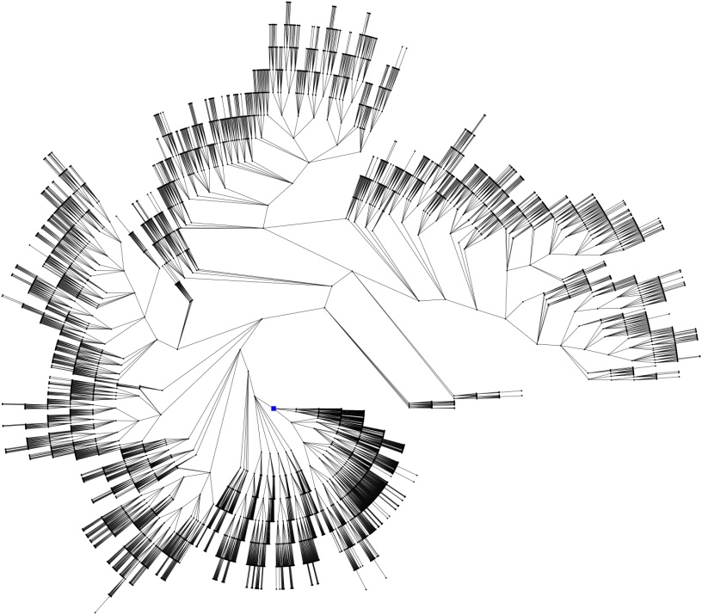
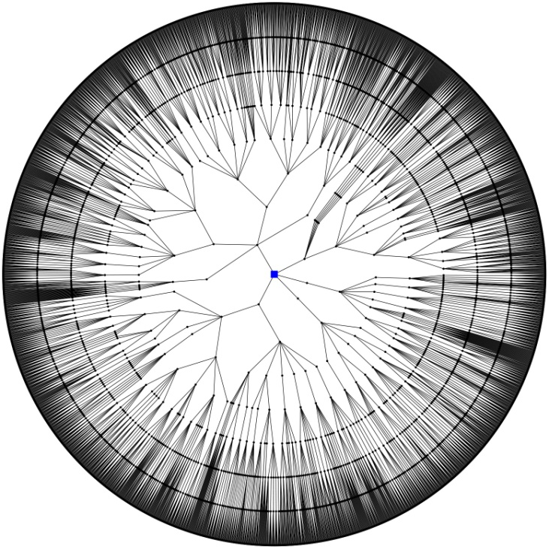
Two Search Philosophies
UCT Tree
Minimax Tree
Asymmetric tree
Complete tree up to some depth bound

Slide 28
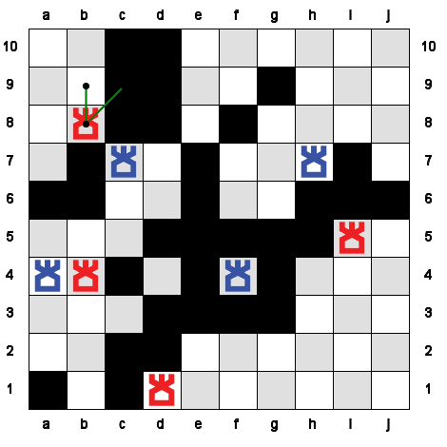
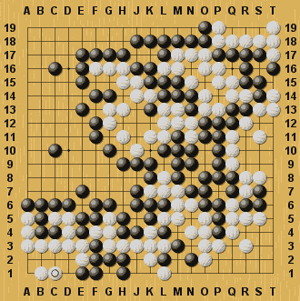
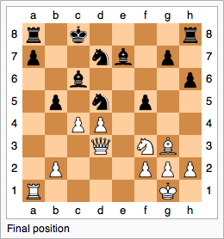
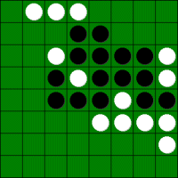
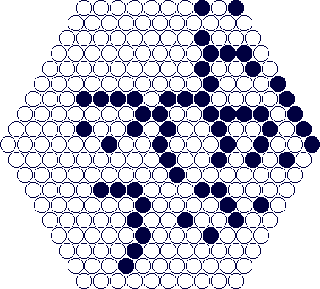
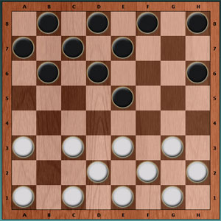
Two Search Philosophies
UCT
Minimax

Slide 29
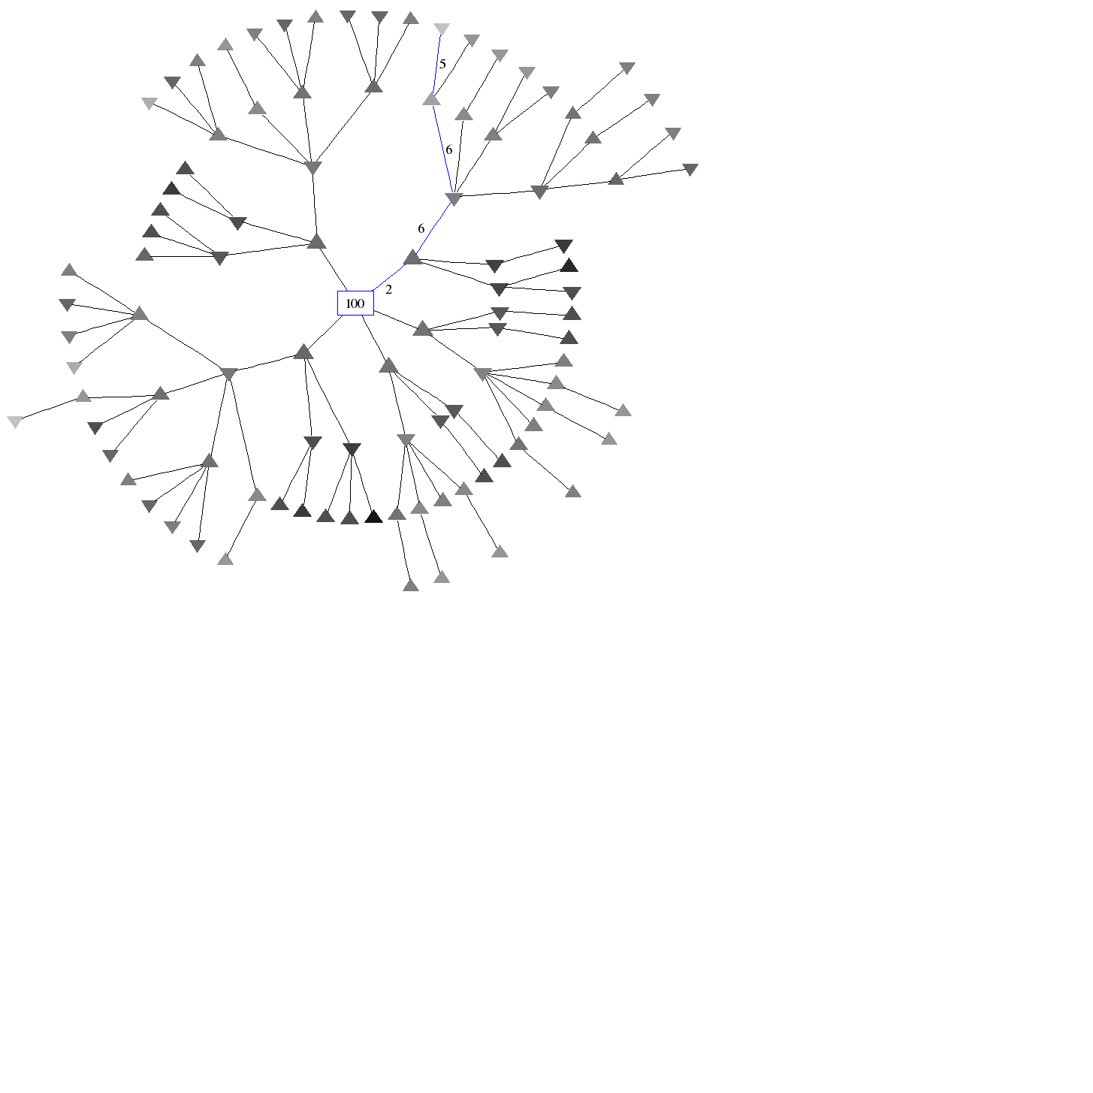
UCT in action

Slide 30
Why does UCT work in some domains but not others?

Slide 31
How is Chess different? Or, why just sampling of the game tree does not work?
Winning is defined by a small portion of the state
Winning is defined by a global function of the state

Slide 32
Trap States
Level-3 trap state
Level-k search trap: position from where opponent can force a win in k steps (with optimal play)

Slide 33
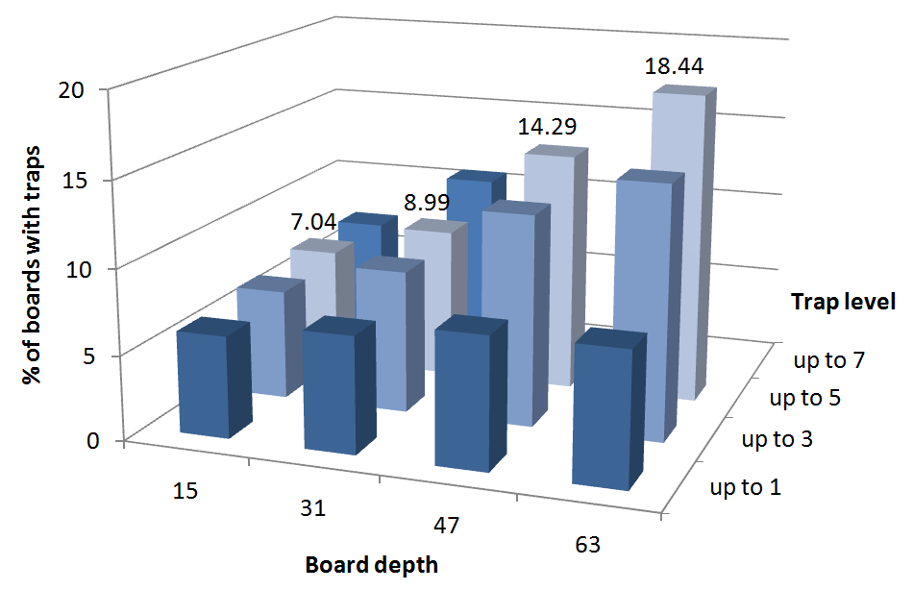
Shallow Trap States in Chess: even in top-level games, “traps everywhere”

Slide 34
How is Chess different?
Shallow trap states are sprinkled throughout the search space
Trap states only appear in the endgame
Sampling may
miss these!!

Slide 35
Summary
Game systems rely heavily on
  Search techniques
  Heuristic functions
  Bounding and pruning techniques
  Knowledge database on game
For AI, the abstract nature of games makes them an
appealing subject for study:
state of the game is easy to represent;
agents are usually restricted to a small number of
actions whose outcomes are defined by precise rules

Slide 36
Game playing was one of the first tasks undertaken in AI as soon as computers became programmable (e.g., Turing, Shannon, and Wiener tackled chess).
Game playing research has spawned a number of interesting research ideas on search, data structures, databases, heuristics, evaluations functions and other areas of computer science.
Notes:
Game playing was one of the first tasks undertaken in AI as soon as computers became programmable (e.g., Turing, Shannon, Wiener tackled chess).

