Slide 1
CS 4700:
Foundations of Artificial Intelligence
Bart Selman
selman@cs.cornell.edu
Module:
Constraint Satisfaction
Chapter 6, R&N
(Completes part II – Problem Solving)

Slide 2
Outline
Constraint Satisfaction Problems (CSP)
Backtracking search for CSPs

Slide 3
Key issue: So far, we have treated nodes in
search trees as “black boxes,” only looked
inside to check whether the node is a goal state.
In CSPs, we want to “look inside the nodes”
and exploit problem structure during the
search. Sometimes, reasoning or inference
(“propagation techniques”) will
led us find solutions without any search!

Slide 4
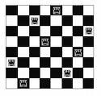
Motivational Example:
8-Queens
Usual goal:
place 8 non-attacking
queens.
Already shown effectiveness of local search.

Slide 5
Generic (DFS/BFS) search
Is this how you would
program this problem?
Node is a (partial) state of the board
Action: “place a queen on board”
Goal test: are there 8 non-attacking queens?
How many placements of 8 queens will be considered?
The DFS/BFS tree will enumerate up to
64⁸ combinations (assume limit depth to 8).
64^8 = 2^48 = 2.8 x 10^14
Note redundancy: Q1 in (1,3), Q2 in (2,7) …
vs. Q1 in (2,7), Q2 in (1,3) …

Slide 6
Alternative: Use “factored representation.”
Factoring refers to “splitting things into smaller parts.”
State has internal structure.
1) Here, a set of 8 variables.
x_1, x_2, … x_8.
2) Each with domain {1,…8}, the
possible variable values.
3) A set of constraints:
e.g. no two vars can be assigned
the same value. (Why?)
Each variable gives the position
of a queen in a row.
Number of board states to explore:
“only” 8⁸ = 16.7 x 10^6 combinations.
Set of vars, set of possible values for each vars
& set of constraints defines a CSP.

Slide 7
Set of vars, set of possible values for each vars & set of constraints defines a CSP.
A solution to the CSP is an assignment of values to the variables so that all constraints are satisfied (no “violated constraints.”)
A CSP is inconsistent if no such solution exists.
Eg try to place 9 non-attacking queens on an 8x8 board.
Hmm. Can a search program figure out that you can’t place 101 queens on 100x100 board?
Not so easy! Most search approaches can’t. Need much more clever reasoning, instead of just search. (Need to use Pigeon Hole principle.)
Aside: Factored representation does not even allow one to ask
the question. Knowledge is build in.)
Alternative question: With N queens is there a solution with queen
in bottom right hand corner on a N x N board?

Slide 8
How do we search for a solution?
Start with empty variable assignment (no vars assigned). Then, build up partial assignments until all vars assigned.
Action: “assign a variable a value.”
Goal test: “all vars assigned and no constraint violation.”
What is the search space? (n vars, each with d possible values)
Top level branching: n . d
Next branching: (n-1) . d
Next branching: (n-2) . d
…
Bottom level: d
(one var remains to be set)
So, tree with n! d^n leaves.
Hmm. But “only” n^d distinct value assignments! Different var ordering can lead to the same assignment! Wasteful…
Just “fix” a variable ordering:
Backtrack search.
Check only n^d full var-value assignments.

Slide 9
Backtrack search
Aside: “legal” and “feasible”
Already assumes a bit of “reasoning.” (Next.)
There are many improvements on intuitive idea…
Intuitive:
Fix some ordering on the variables. Eg x1, x2, x3 …
Fix some ordering on possible values. Eg 1, 2, 3, …
Assign first variable, first (legal) value.
Assign next variable, its first (legal) value.
Etc.
Until no remaining (feasible) value exist for variable x_i,
backtrack to previous var setting of x_(i-1), try next possible
setting. If none exists, move back another level. Etc.
Visually, very intuitive on the N-Queens board (“the obvious strategy”).
See figure 6.5 book. Recursive implementation. Practice: Iterative with stack.

Slide 10
Reasoning, inference or “propagation.”
Message:
CSP propagation techniques can dramatically reduce search.
Sometimes to no search at all! Eg. Sudoku puzzles.
After placing the first queen, what would you do for the 2nd?

Slide 11
General Search vs.
Constraint satisfaction problems (CSPs)
Standard search problem:
  state is a "black box“ – can be accessed only in limited way:
  successor function; heuristic function; and goal test.
What is needed for CSP:
Not just a successor function and goal test. Also a means of
propagating the constraints (e.g. imposed by one queen on
the others and an early failure test).
Explicit representation of constraints and constraint manipulation algorithms
Constraint Satisfaction Problems (CSP)

Slide 12
Constraint satisfaction problems (CSPs)
  States and goal test have a standard representation.
  state is defined by variables X_{i} with values from domain D_{i}
  goal test is a set of constraints specifying allowable
  combinations of values for subsets of variables
Interesting tradeoff:
Example of a (restricted) formal representation language.
Allows useful general-purpose algorithms more powerful than standard search
algorithms that have to resort to problem specific heuristics
to enable solution of large problems.

Slide 13
Constraint Satisfaction Problem
Set of variables {X1, X2, …, Xn}
Each variable Xi has a domain Di of possible values
Usually Di is discrete and finite
Set of constraints {C1, C2, …, Cp}
Each constraint Ck involves a subset of variables and specifies the allowable combinations of values of these variables
Goal:
Assign a value to every variable such that all constraints are satisfied

Slide 14
Motivational Example:
8-Queens
l + k = 10
l – k = 1
l – k =0
How do we represent 8-Queens
as a CSP:
Variables?
Constraints?
Note: More than one option.
…
l – k= -5
l = 3
l = 2
l = 1
k = 1
k = 3
k = 2
…

Slide 15
Example: 8-Queens Problem
Xi – column for queen in row i
8 variables Xi, i = 1 to 8 (one per row)
Domain for each variable {1,2,…,8}
Constraints are of the form:
  Xi ≠ Xj when j≠i (i.e. no two in the same column)
  No queens in same diagonal:
    1) X_{i} – X_{j} ≠ i – j
    2) X_{i} – X_{j} ≠ j – i
    (check that this works!)
Alternative?
Boolean vars

Slide 16
Boolean Encoding
64 variables Xij, i = 1 to 8, j = 1 to 8
Domain for each variable {0,1} (or {False, True})
Constraints are of the form:
Row and columns
  If (Xij = 1) then (Xik = 0) for all k = 1 to 8, k≠j (logical constraint)
  Xij = 1 ➔ Xkj = 0 for all k = 1 to 8, k≠i
Diagonals
  Xij = 1 ➔ Xi+l,j+l = 0 l = 1 to 7, i+l ≤8; j+l≤8 (right and up)
  Xij = 1 ➔ Xi-l,j+l = 0 l = 1 to 7, i-l ≥1; j+l≤8 (right and down)
  Xij = 1 ➔ Xi-l,j-l = 0 l = 1 to 7, i-l ≥1; j-l≥1 (left and down)
  Xij = 1 ➔ Xi+l,j-l = 0 l = 1 to 7, i+l ≤8; j-l≥1 (left and up)
X_{ij} = 1 iff “there is a queen on location (i,j).”
What’s missing?
Need N (= 8) queens on board!
3 options:
1) Maximize sum X_ij (optimization formulation)
2) Sum X_ij = N (CSP; bit cumbersome in Boolean logic)
3) For each row i: (X_i1 OR X_i2 OR X_i3 … X_iN)

Slide 17
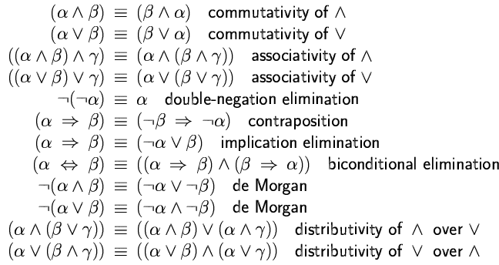
Logical equivalence
Two sentences p an q are logically equivalent (≡ or ⇔) iff p ↔ q is a tautology
(and therefore p and q have the same truth value for all truth assignments)
→
→
→
↔
→
→

Slide 18
Propositional Satisfiability problem
Satifiability (SAT): Given a formula in propositional calculus, is there a model
(i.e., a satisfying interpretation, an assignment to its variables) making it true?
We consider clausal form, e.g.:
( a ∨ ¬b ∨ ¬ c ) AND ( b ∨ ¬ c) AND ( a ∨ c)
possible assignments
SAT: prototypical hard combinatorial search and reasoning problem. Problem is NP-Complete. (Cook 1971)
Surprising “power” of SAT for encoding computational problems.

Slide 19

Significant progress in
Satisfiability Methods
Software and hardware verification – complete methods are critical - e.g. for verifying the correctness of chip design, using SAT encodings
Many Applications:
Hardware and
Software Verification
Planning,
Protocol Design,
Scheduling, Materials Discovery etc.
Going from 50 variable, 200 constraints
to 1,000,000 variables and 5,000,000 constraints
in the last 10 years
Current methods can verify automatically the correctness of large portions of a chip

Slide 20
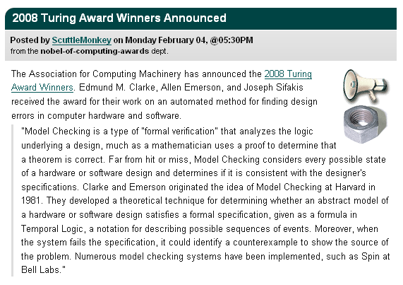
Turing Award: Model Checking
Source: Slashdot

Slide 21
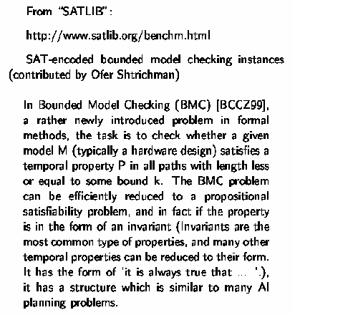
A “real world” example

Slide 22
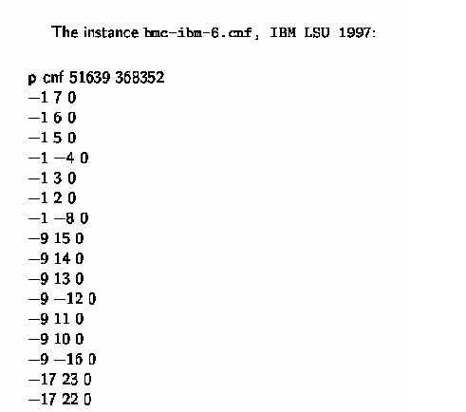
Bounded Model Checking instance:
i.e. ((not x₁) or x₇)
and ((not x₁) or x₆)
and … etc.

Slide 23
Dimacs Format for CNF
File format
The benchmark file format will be in a simplified version of the DIMACS format: c
c start with comments
c
c
p cnf 5 3
1 -5 4 0
-1 5 3 4 0
-3 -4 0
The file can start with comments, that is lines begining with the character c.
Right after the comments, there is the line p cnf nbvar nbclauses indicating that the instance is in CNF format; nbvar is the exact number of variables appearing in the file; nbclauses is the exact number of clauses contained in the file.
Then the clauses follow. Each clause is a sequence of distinct non-null numbers between -nbvar and nbvar ending with 0 on the same line; it cannot contain the opposite literals i and -i simultaneously. Positive numbers denote the corresponding variables. Negative numbers denote the negations of the corresponding variables.

Slide 24
Example of Sat Solver
SAT Solver : Lingeling
http://fmv.jku.at/lingeling/
Nqueen4-v1.cnf
Nquuens4-v2.cnf

Slide 25
p cnf 16 84
1 2 3 4 0
-1 -2 0
-1 -3 0
-1 -4 0
-2 -3 0
-2 -4 0
-3 -4 0
5 6 7 8 0
-5 -6 0
-5 -7 0
-5 -8 0
-6 -7 0
-6 -8 0
-7 -8 0
9 10 11 12 0
-9 -10 0
-9 -11 0
-9 -12 0
-10 -11 0
-10 -12 0
-11 -12 0
13 14 15 16 0
-13 -14 0
-13 -15 0
-13 -16 0
-14 -15 0
-14 -16 0
-15 -16 0
1 5 9 13 0
-1 -5 0
-1 -9 0
-1 -13 0
-5 -9 0
-5 -13 0
-9 -13 0
2 6 10 14 0
-2 -6 0
-2 -10 0
-2 -14 0
-6 -10 0
-6 -14 0
-10 -14 0
3 7 11 15 0
-3 -7 0
-3 -11 0
-3 -15 0
-7 -11 0
-7 -15 0
-11 -15 0
4 8 12 16 0
-4 -8 0
-4 -12 0
-4 -16 0
-8 -12 0
-8 -16 0
-12 -16 0
-1 -6 0
-1 -11 0
-1 -16 0
-6 -11 0
-6 -16 0
-11 -16 0
-2 -7 0
-2 -12 0
-7 -12 0
-3 -8 0
-5 -10 0
-5 -15 0
-10 -15 0
-9 -14 0
-4 -7 0
-4 -10 0
-4 -13 0
-7 -10 0
-7 -13 0
-10 -13 0
-3 -6 0
-3 -9 0
-6 -9 0
-2 -5 0
-8 -11 0
-8 -14 0
-11 -14 0
-12 -15 0
2 3 4
6 7 8
10 11 12
13 14 15 16

Slide 26
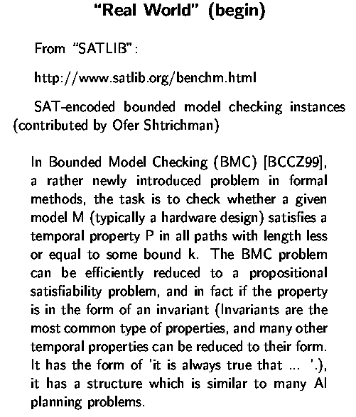
How Large are the Problems?
A bounded model checking problem:
Source: IBM

Slide 27
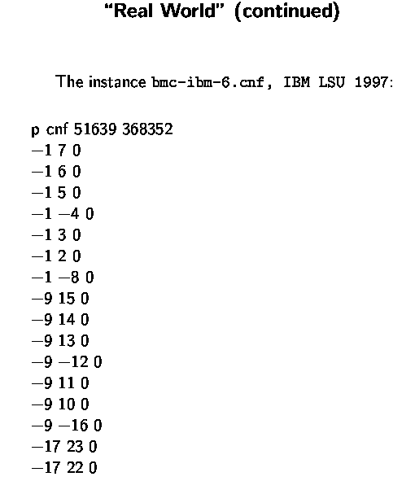
SAT Encoding
(automatically generated from problem specification)
i.e., ((not x₁) or x₇)
((not x₁) or x₆)
etc.
x₁, x₂, x₃, etc. are our Boolean variables
(to be set to True or False)
Should x₁ be set to False??

Slide 28
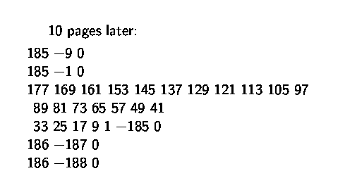
10 Pages Later:
…
i.e., (x₁₇₇ or x₁₆₉ or x₁₆₁ or x₁₅₃ …
x₃₃ or x₂₅ or x₁₇ or x₉ or x₁ or (not x₁₈₅))
clauses / constraints are getting more interesting…
Note x₁ …

Slide 29
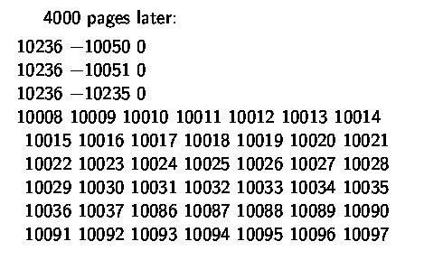
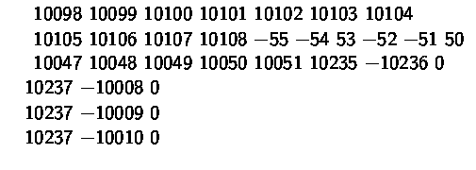
4,000 Pages Later:
…

Slide 30
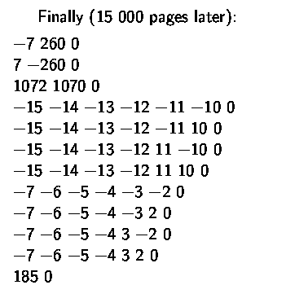

Finally, 15,000 Pages Later:
Search space of truth assignments:
Current SAT solvers solve this instance in
under 10 seconds!

Slide 31
Example of a Boolean Satisfiability (SAT) encoding.
Very “simple” but effective representation.
Example of a logical knowledge representation language.
For propositional logic, see R&N 7.4.1 & 7.4.2.

Slide 32
Which encoding is better?Allows for faster solutions?
One would think, fewer variables is better…
Search spaces:
8⁸ = 1.6 x 10⁶ vs 2⁶⁴ = 1.8 x 10¹⁹
However, in practice SAT encodings can be surprisingly
effective, even with millions of Boolean variables. Often,
few true local minima in search space.
Demo of backtrack search and local search on Boolean
encoding of N-queens.

Slide 33
N-Queens
The standard N by N Queen's problem asks how to place N queens on an ordinary chess board so that they don’t attack each other
7
6
5
4
3
2
1
0
 | 0 | 1 | 2 | 3 | 4 | 5 | 6 | 7
N=8
Is this problem
NP-Complete?

Slide 34
N-Queens
N=8 (another solution)
7
6
5
4
3
2
1
0
 | 0 | 1 | 2 | 3 | 4 | 5 | 6 | 7

Slide 35
Linear congruence equations
N = 6 α;
N = 6 α + 1;
N = 6 α ± 2; (not N=4;)
N = 6 α + 3; (not N=9;)
N = 6 α - 2; (inc. N=4)
N = 12 α - 3; (inc. N=9)

Slide 36
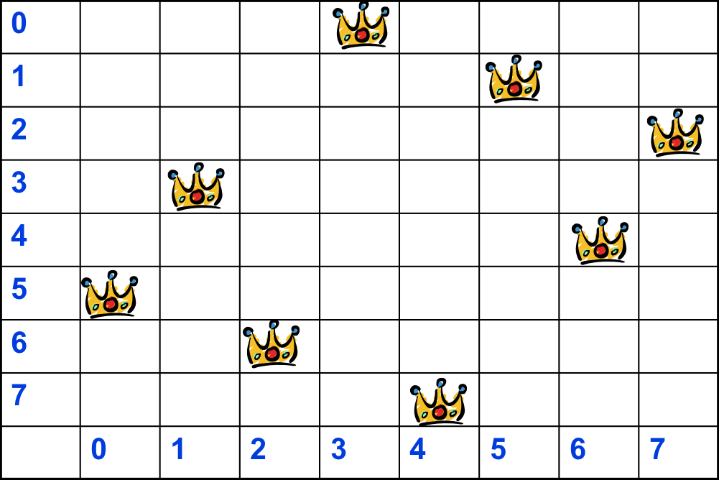
N-Queens
N=8
N = 6α ±2, α=1
S(8) = {3}.
For all c ∈ S(8), the linear congruence equations
Let’s consider c=3.
6 x + y ≡ 3 (mod 8),
where x = 0, 1, 2, 3.
x = 0 y=3; x=1 y = 5; x=2 y= 7;x=3 y = 1;
6 x + y ≡ 6 (mod 8),
where x = 4,5,6,7,8
X=4, y = 6; x=5 y = 0; x=6 y = 2; x=7 y=4;

Slide 37
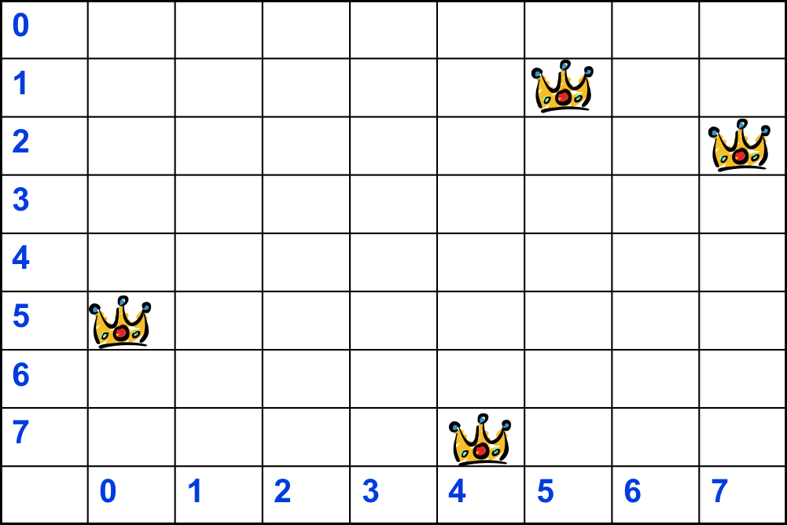
Partially Filled Nqueens
So the N-queens problem is easy when we start with an empty board.
What about if we pre-assign some quuens and ask for a completion?
Open question
Conjecture: completing a partially filled N-queens board is NP-complete.

Slide 38
Example: Crypt-arithmetic Puzzle
S E N D
+ MOR E
----------
MONEY
Variables: S, E, N, D, M, O, R, Y
Domains:
[0..9] for S, M, E, N, D, O, R, Y
Search space: 1,814,400
Aside: could have [1..9] for S and M
Soln.:9567
1085
====
10652

Slide 39
Constraints
Option 1:
C1a) 1000 S + 100 E + 10 N + D +
1000 M + 100 O + 10 R + E
= 10000 M + 1000 O + 100 N + 10 E + Y
SEND
+MORE
----------
MONEY
Or use 5 equality constraints, using auxiliary “carry” variables C1, …, C4 Є [0…9]
Option 2: C1b)
D + E = 10 C1 + Y
C1 + N + R = 10 C2 + E
C2 + E + O = 10 C3 + N
C3 + S + M = 10 C4 + O
C4 = M
Which constraint set better
for solving? C1a or C1b? Why?
C1b, more “factored”. Smaller
pieces. Gives more propagation!
Need two more sets of constraints:
C2) S =/= 0, M =/= 0
C3) S =/= M, S =/= O, … E =/= Y (28 not equal constraints)
Note: need to assert everything!
Alt. “All_diff(S,M,O,...Y)” for C3.

Slide 40

Some Reflection:
Reasoning/Inference vs. Search
How do human solve this?
What is the first step?
M = 1, because M =/= 0 and …
the carry over of the addition of two
digits (plus previous carry) is at most 1.
Actually, a somewhat subtle
piece of mathematical background
knowledge.
Also, what made us focus on M?
Experience / intuition …

Slide 41
M = 1, because M =/= 0 and …
the carry over of the addition of two
digits (plus previous carry) is at most 1.
2) O = 0. Because M=1 and we have to have a carry to the next column. S + 1 + C3 is either 10 or 11. So, O equals 0 or 1.
1 is taken. So, O = 0.
3) S = 9. There cannot be a carry to the 4th column (if there were, N would also have to be 0 or 1. Already taken.). So, S = 9.
A collection of “small pieces” of local reasoning,
using basic constraints from the rules of arithmetic.
A logic (SAT) based encoding will likely “get these steps.”

Slide 42
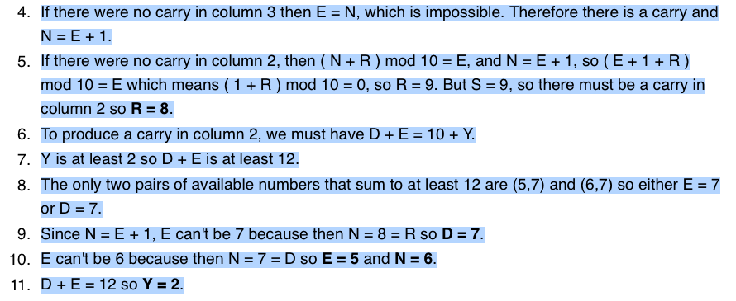
And further it goes…
Largely, a clever chain of reasoning / inference /
propagation steps (no search) except for…
exploring 2 remaining options (i.e., search) to
find complete solution.

Slide 43
Human problem solving nicely captures key idea behind how to solve
CSPs: replace as much of search by propagation (inference/reasoning).
One difficulty: Humans often use subtle background knowledge.
Can search be completely avoided?
A.: Most likely NO. General cryptarithmetic is NP-complete
(Eppstein 1987)

Slide 44

Example: Map-Coloring
Variables WA, NT, Q, NSW, V, SA, T
Domains D_{i} = {red,green,blue}
Constraints: adjacent regions must have different colors
e.g., WA ≠ NT, or (WA,NT) in {(red,green),(red,blue),(green,red), (green,blue),(blue,red),(blue,green)}

Slide 45
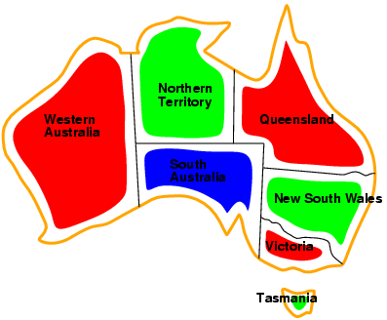
Example: Map-Coloring
Solutions are complete and consistent assignments, e.g., WA = red, NT = green,
Q = red,NSW = green,V = red,SA = blue,T = green
(Aside: Four colors suffice. (Appel and Haken 1977)

Slide 46
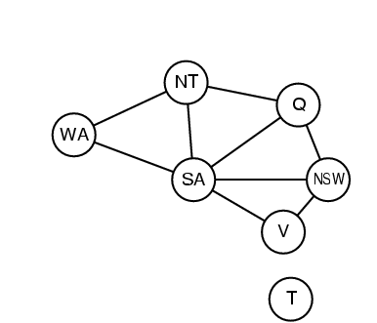
Constraint graph:
Graph Coloring
Binary CSP: each constraint relates two variables
Constraint graph: nodes are variables, arcs are constraints
Two variables are adjacent or neighbors if they
are connected by an edge or an arc

Slide 47
Application of Graph Coloring
Lots of applications involving scheduling and assignments.
Scheduling of final exams – nodes represent finals, edges between finals
denote that both finals have common students (and therefore they have to
have different colors, or different periods).
Time Period → courses
1
1
7
7
I (red) → 1,6
II (blue)→2
III (green)→3,5
IV (black)→
2
2
6
3
6
3
5
4
5
4
Graph of finals for 7 courses

Slide 48
Varieties of CSPs
Discrete variables
  finite domains:
    n variables, domain size d → O(d^{n}) complete assignments
  infinite domains:
    integers, strings, etc.
    e.g., job scheduling, variables are start/end days for each job
    need a constraint language, e.g., StartJob₁ + 5 ≤ StartJob₃
Continuous variables
  e.g., start/end times for Hubble Space Telescope observations
  linear constraints solvable in polynomial time by linear
  programming
our focus
      (includes Boolean satisfiability 1st problem to be shown NP-complete.)

Slide 49
Varieties of constraints
Unary constraints involve a single variable,
  e.g., SA ≠ green
Binary constraints involve pairs of variables,
  e.g., SA ≠ WA
Higher-order constraints involve 3 or more variables,
  e.g., cryptarithmetic column constraints

Slide 50
CSP as a Search Problem
Initial state: empty assignment
Successor function: a value is assigned to any unassigned variable, which does not conflict with the currently assigned variables
Goal test: the assignment is complete
Path cost: irrelevant

Slide 51
Remark
Finite CSP include 3SAT as a special case (under logical reasoning).
3SAT is known to be NP-complete.
So, in the worst-case, we cannot expect to solve a finite CSP in less than exponential time.

Slide 52
Solving CSP by search : Backtrack Search
BFS vs. DFS
  BFS → not a good idea.
    A tree with n!d^{n} leaves : (nd)*((n-1)d)*((n-2)d)*…*(1d) = n!d^{n}
    Reduction by commutativity of CSP
      A solution is not in the permutations but in combinations.
      A tree with d^{n} leaves
  DFS
    Used popularly
      Every solution must be a complete assignment and therefore appears at depth n if there are n variables
      The search tree extends only to depth n.
    A variant of DFS: Backtrack search
      Chooses values for one variable at a time
      Backtracks when failed even before reaching a leaf.
    Better than BFS due to backtracking but still need more
    “cleverness” (reasoning/propagation).

Slide 53
Backtrack search
Variable assignments are commutative}, i.e.,
[WA = red then NT = green] same as [ NT = green then WA = red ]
Only need to consider assignments to a single variable at each node
  → b = d and there are d^{n} leaves
Depth-first search for CSPs with single-variable assignments is called
backtrack search
Backtracking search is the basic uninformed algorithm for CSPs
Can solve n-queens for n ≈ 30

Slide 54
→ Backtrack Search
empty assignment
1st variable
2nd variable
3rd variable
Assignment = {}

Slide 55
→ Backtrack Search
empty assignment
1st variable
2nd variable
3rd variable
Assignment = {(var1=v11)}

Slide 56
→ Backtrack Search
empty assignment
1st variable
2nd variable
3rd variable
Assignment = {(var1=v11),(var2=v21)}

Slide 57
→ Backtrack Search
empty assignment
1st variable
2nd variable
3rd variable
Assignment = {(var1=v11),(var2=v21),(var3=v31)}

Slide 58
→ Backtrack Search
empty assignment
1st variable
2nd variable
3rd variable
Assignment = {(var1=v11),(var2=v21),(var3=v32)}

Slide 59
→ Backtrack Search
empty assignment
1st variable
2nd variable
3rd variable
Assignment = {(var1=v11),(var2=v22)}

Slide 60
→ Backtrack Search
empty assignment
1st variable
2nd variable
3rd variable
Assignment = {(var1=v11),(var2=v22),(var3=v31)}

Slide 61
Solving CSP by search : Backtrack Search
function BACKTRACKING-SEARCH (csp) returns a solution, or failure
return RECURSIVE-BACKTRACKING({}, csp)
function RECURSIVE-BACKTRACKING(assignment, csp) returns a solution, or failure
if assignment is complete then return assignment
var ← SELECT-UNASSIGNED-VARIABLE(VARIABLES[csp], assignment, csp)
for each value in ORDER-DOMAIN-VALUES(var, assignment, csp) do
if value is consistent with assignment according to CONSTRAINTS[csp] then
add {var=value} to assignment
result ← RECURSIVE-BACKTRACKING(assignment, csp)
if result != failure then return result
remove {var = value} from assignment
return failure
☜ BACKTRACKING OCCURS HERE!!

Slide 62
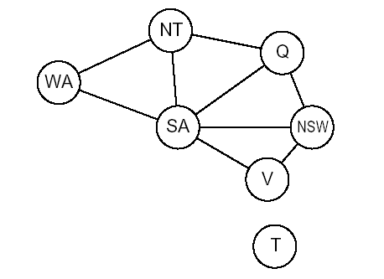
Improving Backtracking Efficiency
Variable & value ordering to increase the likelihood to success
Which variable should be assigned next?
  Minimum Remaining Values heuristic
In what order should its values be tried?
  Least Constraining Values heuristic
Can we detect inevitable failure early?
  Forward checking
  Constraint propagation (Arc Consistency)
When a path fails, can the search avoid repeating this failure?
  Backjumping
Can we take advantage of problem structure?
  Tree-structured CSP
Early failure-detection to decrease the likelihood to fail
Restructuring to reduce the problem’s complexity
General purpose techniques

Slide 63
Improving backtracking efficiency
function BACKTRACKING-SEARCH (csp) returns a solution, or failure
return RECURSIVE-BACKTRACKING({}, csp)
function RECURSIVE-BACKTRACKING(assignment, csp) returns a solution, or failure
if assignment is complete then return assignment
var ← SELECT-UNASSIGNED-VARIABLE(VARIABLES[csp], assignment, csp)
for each value in ORDER-DOMAIN-VALUES(var, assignment, csp) do
if value is consistent with assignment according to CONSTRAINTS[csp] then
add {var=value} to assignment
result ← RECURSIVE-BACKTRACKING(assignment, csp)
if result != failure then return result
remove {var = value} from assignment
return failure

Slide 64

Choice of Variable
#1: Minimum Remaining Values (aka Most-constrained-variable heuristic):
Select a variable with the fewest remaining values

Slide 65

Choice of Variable, cont.
Tie-breaker among most constrained variables
#2 Most constraining variable:
  choose the variable with the most constraints on remaining variables

Slide 66
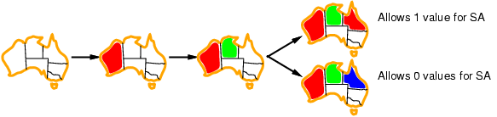
Choice of Value:
Least constraining value
#3 Given a variable, choose the least constraining value:
  the one that rules out the fewest values in the remaining variables

Slide 67
Constraint Propagation
The process of determining how the possible values of one variable affect the possible values of other variables

Slide 68
Forward Checking
After a variable X is assigned a value v, look at each unassigned variable Y that is connected to X by a constraint and deletes from Y’s domain any value that is inconsistent with v
Terminate branch when any variable has no legal values & backtrack.

Slide 69
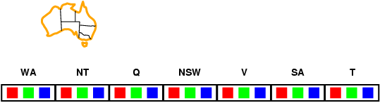
Forward checking

Slide 70
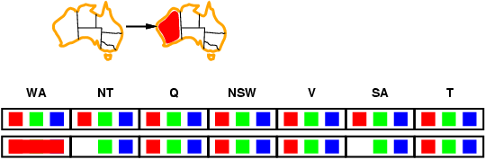

Slide 71
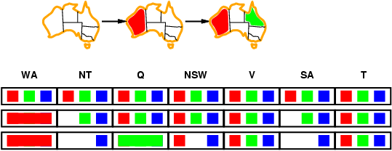

Slide 72
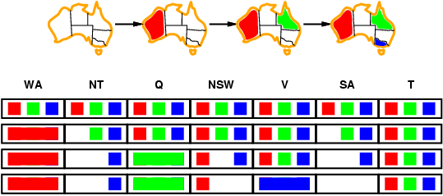

Slide 73

Constraint propagation
NT
Q
WA
SA
NSW
V
Forward checking propagates information from assigned to unassigned variables, but doesn't provide early detection for all failures:
What’s the problem here?
WA
NT
Q
SA
NSW
V
T
≠
NT and SA cannot both be blue!
Use: constraint propagation repeatedly to enforce constraints locally.

Slide 74
Definition (Arc consistency)
A constraint C_xy is said to be arc consistent w.r.t. x iff
for each value v of x there is an allowed value of y.
Similarly, we define that C_xy is arc consistent w.r.t. y.
A binary CSP is arc consistent iff every constraint C_xy is arc
consistent wrt x as well as wrt y.

Slide 75
When a CSP is not arc consistent, we can make it arc
consistent.
This is also called “enforcing arc consistency”.

Slide 76
Example
Let domains be
D_x = {1, 2, 3}, D_y = {3, 4, 5, 6}
One constraint
C_xy = {(1,3), (1,5), (3,3), (3,6)} [“allowed value pairs”]
C_xy is not arc consistent w.r.t. x, neither w.r.t. y. Why?
To enforce arc consistency, we filter the domains, removing inconsistent values.
D’_x = {1, 3}, D’_y={3, 5, 6}

Slide 77
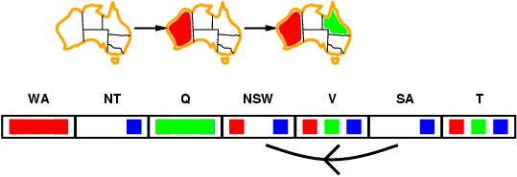
Arc consistency
Simplest form of propagation makes each arc consistent.
I.e., X →Y is consistent iff
for every value x of X there is some allowed y
NT
Q
WA
SA
NSW
V

Slide 78
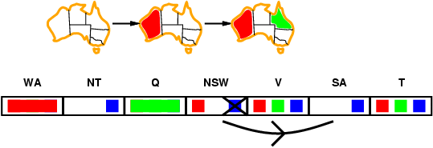
NT
Q
WA
SA
NSW
V

Slide 79
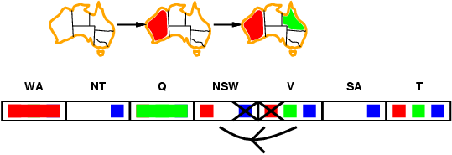
NT
Q
WA
SA
NSW
V

Slide 80
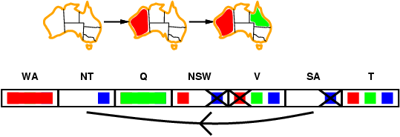
If X loses a value, neighbors of X need to be rechecked.
Arc consistency detects failure earlier than forward checking.
Can be run as a preprocessor or after each assignment.
(takes polytime each time)
NT
Q
WA
SA
NSW
V
Empty domain detected! Backtrack early.

Slide 81
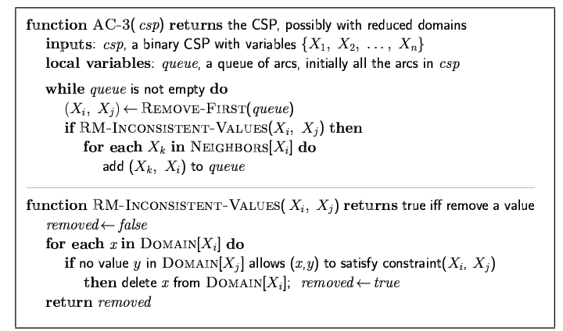
Arc consistency algorithm AC-3
If Xi’s domain
is filtered all the constraints
associated with it and
other variables are added to the queue
Binary
constraint
Xi, Xj
n²= number of constraints (edges; n is the # of variables)
d = number of values per variable
Time complexity:
REMOVE-ARC-INCONSISTENCY takes O(d²) time
Each variable is inserted in Queue up to d times, since at most d values can be deleted
→AC3 takes O(n²d³) time to run

Slide 82
Beyond Arc Consistency
{1, 2}
{1, 2}
X ≠ Y
X
Y
Is this network arc consistent?
What is the solution?
X ≠ Z
Y ≠ Z
Clearly arc consistency is not enough to guarantee global consistency.
There are other forms of consistency, such as k-consistency.
But when k = n (num vars), we are looking at the original problem!
Z
{1, 2}

Slide 83
k - Consistency
{1, 2}
{1, 2}
X ≠ Y
X
Y
A graph is K-consistent iff the following is true:
Choose values of any K-1 variables that satisfy all the constraints among these variables and choose any K th variable. Then, there exists a value for this K th variable that satisfies all the constraints among these K variables.
A graph is strongly K-consistent if it is J-consistsent for all J<=K.
X ≠ Z
Y ≠ Z
Z
{1, 2}
What type of consistency would we need here to solve any constraint problem without search?
K = N

Slide 84
Consistency
Node consistency = strong 1- consistency
Arc consistency = strong 2- consistency
(note: arc-consistency is usually
assumed to include node-consistency as well).
See R&N sect. 6.2.3 for “path-consistency” = 3-consistency for binary CSPs.
Algorithms exist for making a constraint graph strongly K-consistent for K>2
but in practice they are rarely used because of efficiency issues.
Other consistency notions involve “global constraints,” spanning many
variables. E.g. AllDiff constraint can handle Pigeon Hole principle.

Slide 85
Summary: Solving a CSP
Search:
  can find solutions, but may examine many non-solutions along the way
Constraint Propagation:
  can rule out non-solutions, but but may not lead
  to full solution.
Interweave constraint propagation and search
  Perform constraint propagation at each search step.
  Goal: Find the right balance between search (backtracking) and propagation (reasoning).
Surprising efficiency (last 10 yrs):
100K + up to one million variable CSP problems
are now solvable!
See also local search. R&N 6.4

