Slide 1
Robust fitting

Slide 2
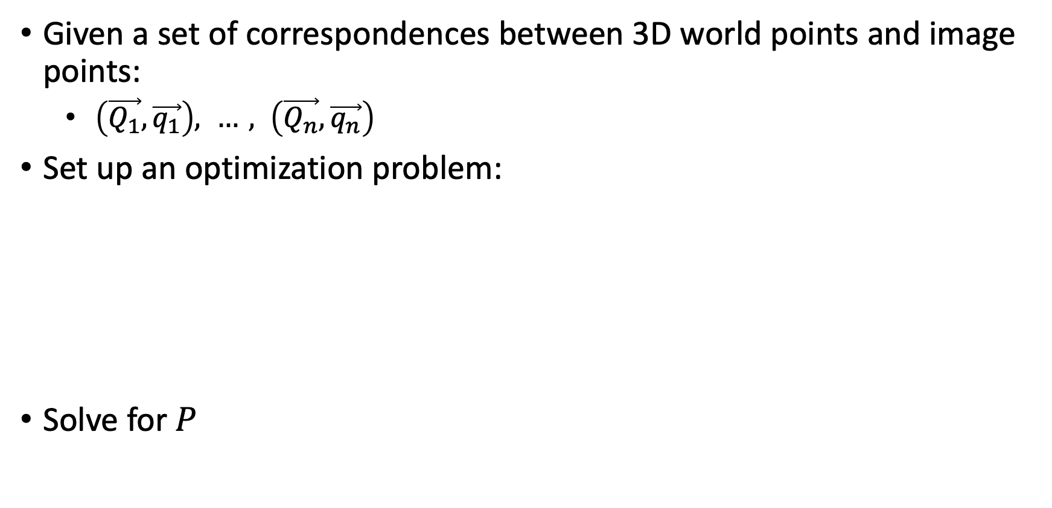
Camera calibration
Given a set of correspondences between 3D world points and image points:
  $\left(\vec{Q_{1}}, \vec{q_{1}}\right), …, \left(\vec{Q_{n}},\vec{q_{n}}\right)$
Set up an optimization problem:
Solve for $P$

Slide 3
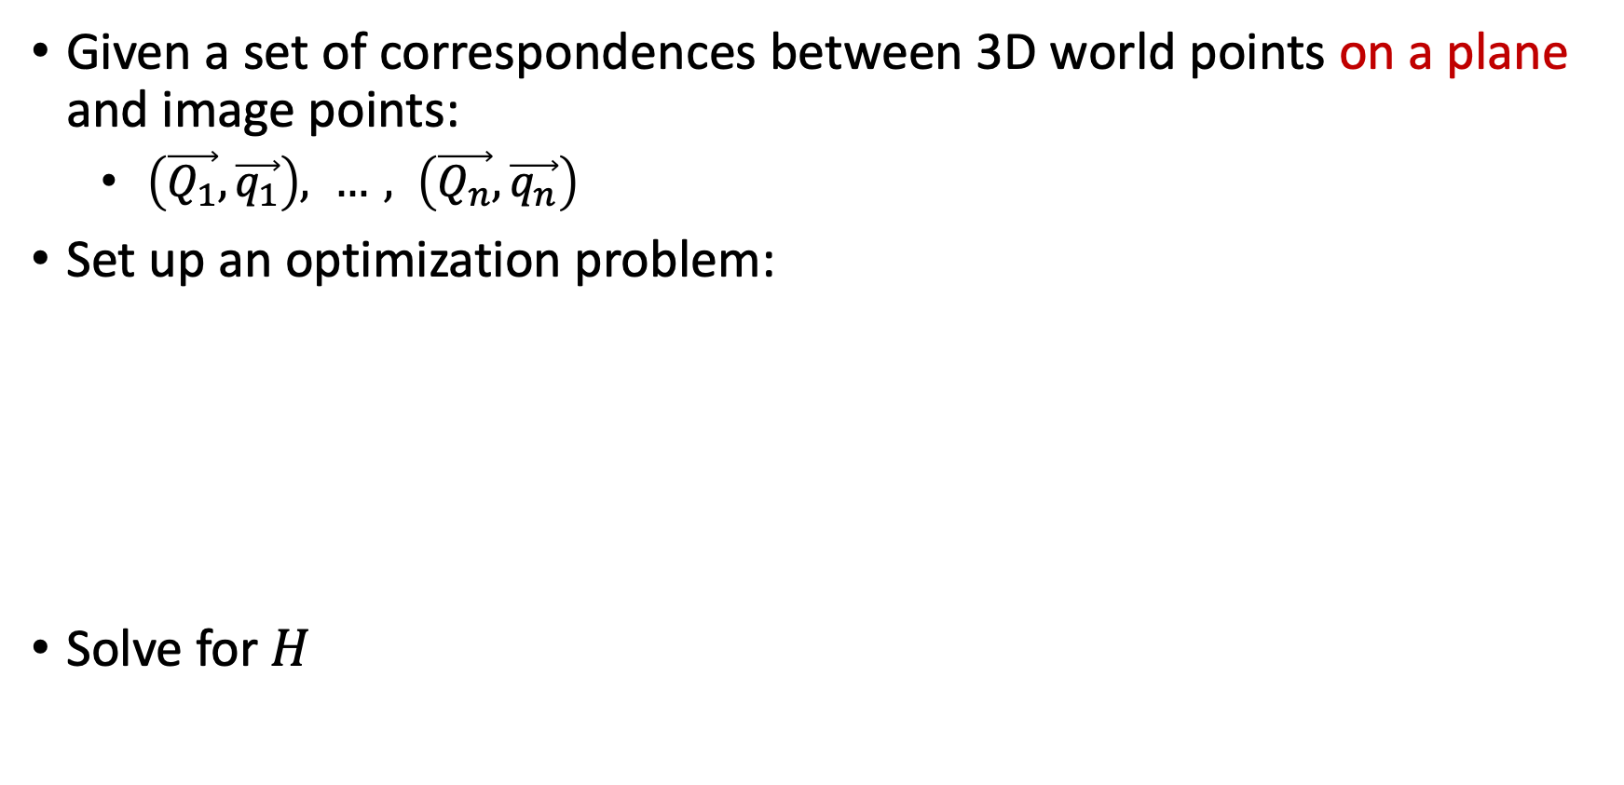
Homography estimation
Given a set of correspondences between 3D world points on a plane and image points:
  $\left(\vec{Q_{1}}, \vec{q_{1}}\right), …, \left(\vec{Q_{n}},\vec{q_{n}}\right)$
Set up an optimization problem:
Solve for $H$

Slide 4
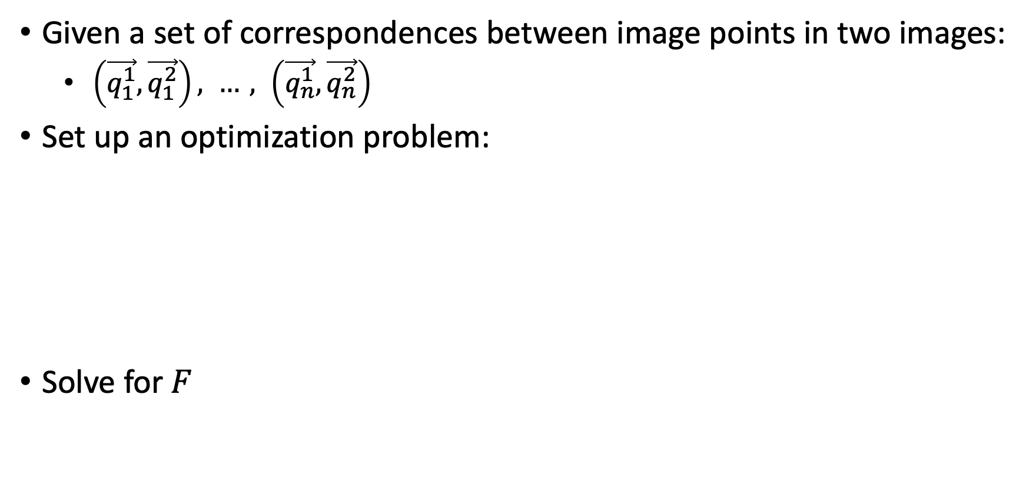
Fundamental matrix/ essential matrix estimation
Given a set of correspondences between image points in two images:
  $\left(\vec{q_{1}^{1}}, \vec{q_{1}^{2}}\right), …, \left(\vec{q_{n}^{1}},\vec{q_{n}^{2}}\right)$
Set up an optimization problem:
Solve for $F$

Slide 5
What happens when correspondences are wrong?
Not just noisy
  Noise (e.g., ~1 pixel) can be handled because we are solving a minimization problem, rather than exactly satisfy equations
Wrong correspondences can be way off.

Slide 6
Impact of incorrect correspondences
Correct:
Incorrect:

Slide 7

Outliers
outliers
inliers

Slide 8
Fitting in general
Fitting: find the parameters of a model that best fit the data
Other examples:
  least squares linear regression

Slide 9
Least squares: linear regression
(y_{i}, x_{i})
y = mx + b

Slide 10
Linear regression
residual error

Slide 11
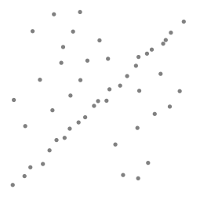
Robustness
Outliers!
Problem: Fit a line to these datapoints
Least squares fit

Slide 12
How do we find the best line in the presence of outliers?
Unlike least-squares, no simple closed-form solution
Hypothesize-and-test
  Try out many lines, keep the best one
  Which lines?
  How to measure which is best?

Slide 13
Choosing lines to hypothesize
Randomly choose lines?
  Not optimal: highly unlikely to run into correct line by chance
Idea: randomly sample data points from the dataset and fit line to them
How many data points should we sample?
  Any point we pick might be an outlier ☹
  Want to maximize the chance that all sampled points are inliers → get the true line
  Idea: sample the minimum number of points necessary to get a line

Slide 14
Choosing lines to hypothesize

Slide 15
Choosing lines to hypothesize

Slide 16
Choosing lines to hypothesize

Slide 17
Choosing lines to hypothesize

Slide 18
Measuring goodness of a line
Given a hypothesized line
Count the number of points that “agree” with the line
  “Agree” = within a small distance of the line
  I.e., the inliers to that line
For all possible lines, select the one with the largest number of inliers

Slide 19
Counting inliers

Slide 20
Counting inliers
Inliers: 3

Slide 21
Counting inliers
Inliers: 20

Slide 22
RANSAC (Random Sample Consensus)
Line fitting example
Algorithm:
Sample (randomly) the number of points required to fit the model (#=2)
Solve for model parameters using samples
Score by the fraction of inliers within a preset threshold of the model
Repeat 1-3 until the best model is found with high confidence
Illustration by Savarese
Notes:
Let me give you an intuition of what is going on. Suppose we have the standard line fitting problem in presence of outliers.
We can formulate this problem as follows: want to find the best partition of points in inlier set and outlier set such that…
The objective consists of adjusting the parameters of a model function so as to best fit a data set.
"best" is defined by a function f that needs to be minimized.
Such that the best parameter of fitting the line give rise to a residual error lower that delta
as when the sum, S, of squared residuals

Slide 23
RANSAC
Line fitting example
Algorithm:
Sample (randomly) the number of points required to fit the model (#=2)
Solve for model parameters using samples
Score by the fraction of inliers within a preset threshold of the model
Repeat 1-3 until the best model is found with high confidence
Notes:
Let me give you an intuition of what is going on. Suppose we have the standard line fitting problem in presence of outliers.
We can formulate this problem as follows: want to find the best partition of points in inlier set and outlier set such that…
The objective consists of adjusting the parameters of a model function so as to best fit a data set.
"best" is defined by a function f that needs to be minimized.
Such that the best parameter of fitting the line give rise to a residual error lower that delta
as when the sum, S, of squared residuals

Slide 24
RANSAC
Line fitting example
Algorithm:
Sample (randomly) the number of points required to fit the model (#=2)
Solve for model parameters using samples
Score by the fraction of inliers within a preset threshold of the model
Repeat 1-3 until the best model is found with high confidence
Notes:
Let me give you an intuition of what is going on. Suppose we have the standard line fitting problem in presence of outliers.
We can formulate this problem as follows: want to find the best partition of points in inlier set and outlier set such that…
The objective consists of adjusting the parameters of a model function so as to best fit a data set.
"best" is defined by a function f that needs to be minimized.
Such that the best parameter of fitting the line give rise to a residual error lower that delta
as when the sum, S, of squared residuals

Slide 25
RANSAC
Algorithm:
Sample (randomly) the number of points required to fit the model (#=2)
Solve for model parameters using samples
Score by the fraction of inliers within a preset threshold of the model
Repeat 1-3 until the best model is found with high confidence
Notes:
Let me give you an intuition of what is going on. Suppose we have the standard line fitting problem in presence of outliers.
We can formulate this problem as follows: want to find the best partition of points in inlier set and outlier set such that…
The objective consists of adjusting the parameters of a model function so as to best fit a data set.
"best" is defined by a function f that needs to be minimized.
Such that the best parameter of fitting the line give rise to a residual error lower that delta
as when the sum, S, of squared residuals

Slide 26
RANSAC
Idea:
  All the inliers will agree with each other on the translation vector; the (hopefully small) number of outliers will (hopefully) disagree with each other
    RANSAC only has guarantees if there are < 50% outliers
  “All good marriages are alike; every bad marriage is bad in its own way.”
  – Tolstoy via Alyosha Efros

Slide 27

Translations

Slide 28
RAndom SAmple Consensus
Select one match at random, count inliers

Slide 29
RAndom SAmple Consensus
Select another match at random, count inliers

Slide 30
RAndom SAmple Consensus
Output the translation with the highest number of inliers

Slide 31
Final step: least squares fit
Find average translation vector over all inliers

Slide 32
RANSAC - hyperparameters
Inlier threshold related to the amount of noise we expect in inliers
  Often model noise as Gaussian with some standard deviation (e.g., 3 pixels)
Number of rounds related to the percentage of outliers we expect, and the probability of success we’d like to guarantee
  Suppose there are 20% outliers, and we want to find the correct answer with 99% probability
  How many rounds do we need?

Slide 33
How many rounds?
If we have to choose k samples each time
  with an inlier ratio p
  and we want the right answer with probability P
 | proportion of inliers p
k | 95% | 90% | 80% | 75% | 70% | 60% | 50%
2 | 2 | 3 | 5 | 6 | 7 | 11 | 17
3 | 3 | 4 | 7 | 9 | 11 | 19 | 35
4 | 3 | 5 | 9 | 13 | 17 | 34 | 72
5 | 4 | 6 | 12 | 17 | 26 | 57 | 146
6 | 4 | 7 | 16 | 24 | 37 | 97 | 293
7 | 4 | 8 | 20 | 33 | 54 | 163 | 588
8 | 5 | 9 | 26 | 44 | 78 | 272 | 1177
P = 0.99
Source: M. Pollefeys

Slide 34
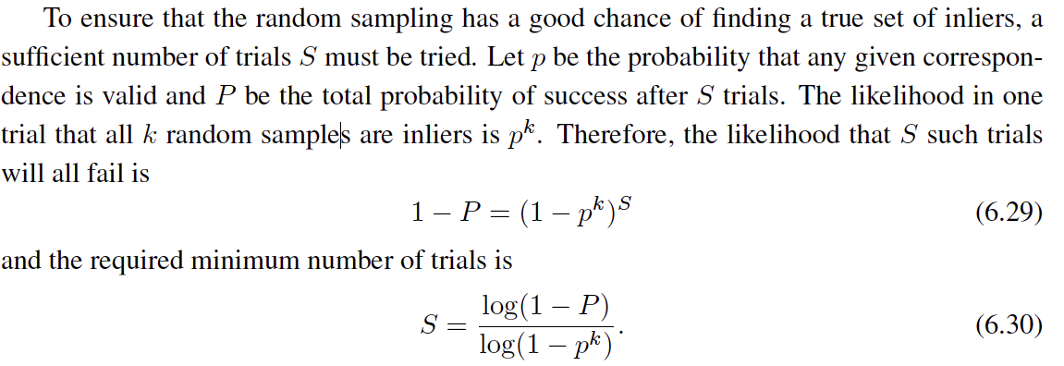
 | proportion of inliers p
k | 95% | 90% | 80% | 75% | 70% | 60% | 50%
2 | 2 | 3 | 5 | 6 | 7 | 11 | 17
3 | 3 | 4 | 7 | 9 | 11 | 19 | 35
4 | 3 | 5 | 9 | 13 | 17 | 34 | 72
5 | 4 | 6 | 12 | 17 | 26 | 57 | 146
6 | 4 | 7 | 16 | 24 | 37 | 97 | 293
7 | 4 | 8 | 20 | 33 | 54 | 163 | 588
8 | 5 | 9 | 26 | 44 | 78 | 272 | 1177
P = 0.99
Notes:
(1-(1-e)^s)^N = 1-p
(1-e)^s = all fail = 1-P

Slide 35
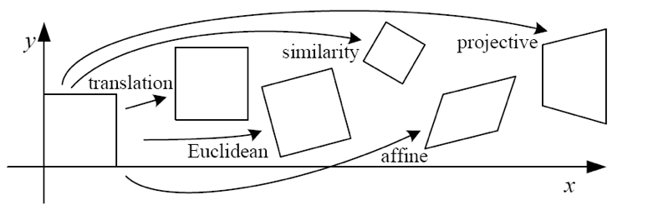
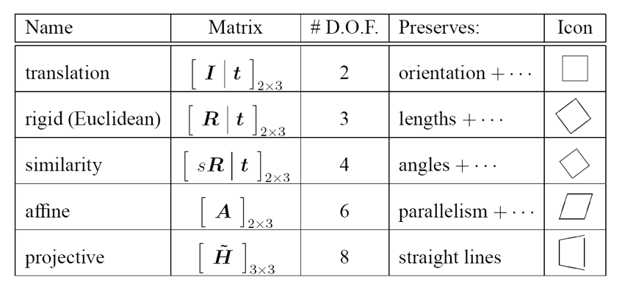
How big is k?
For alignment, depends on the motion model
  Here, each sample is a correspondence (pair of matching points)

Slide 36
RANSAC pros and cons
Pros
  Simple and general
  Applicable to many different problems
  Often works well in practice
Cons
  Parameters to tune
  Sometimes too many iterations are required
  Can fail for extremely low inlier ratios

Slide 37
RANSAC
An example of a “voting”-based fitting scheme
Each hypothesis gets voted on by each data point, best hypothesis wins
There are many other types of voting schemes
  E.g., Hough transforms…

Slide 38
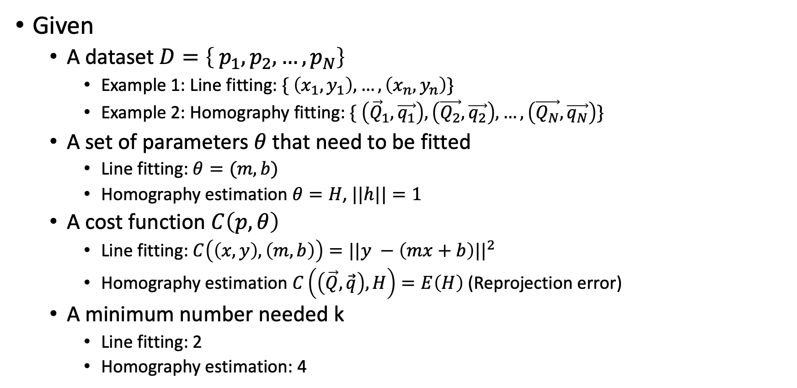
RANSAC - Setup
Given
  A dataset $D=\left\{ p_{1},p_{2}, …,p_{N}\right\}$
    Example 1: Line fitting: $\{ \left(x_{1},y_{1}\right), …, \left(x_{n}, y_{n}\right)\}$
    Example 2: Homography fitting: $\{ \left({\vec{Q}}_{1}, \vec{q_{1}}\right), \left(\vec{Q_{2}}, \vec{q_{2}}\right), …, \left(\vec{Q_{N}}, \vec{q_{N}}\right)\}$
  A set of parameters $θ$ that need to be fitted
    Line fitting: $θ=(m, b)$
    Homography estimation $θ=H$, $||h||=1$
  A cost function $C\left(p, θ\right)$
    Line fitting: $C\left(\left(x,y\right), \left(m,b\right)\right)=||y −\left(mx+b\right)||^{2}$
    Homography estimation $C\left(\left(\vec{Q},\vec{q}\right), H\right)=E\left(H\right)$ (Reprojection error)
  A minimum number needed k
    Line fitting: 2
    Homography estimation: 4

Slide 39

RANSAC - Setup
Given
  A dataset $D=\left\{ p_{1},p_{2}, …,p_{N}\right\}$
  A set of parameters $θ$ that need to be fitted
  A cost function $C\left(p, θ\right)$
  k
  $θ^{∗}=\min_{θ} \sum_{i}{C(p_{i}, θ)}$?
  Problem: outliers

Slide 40
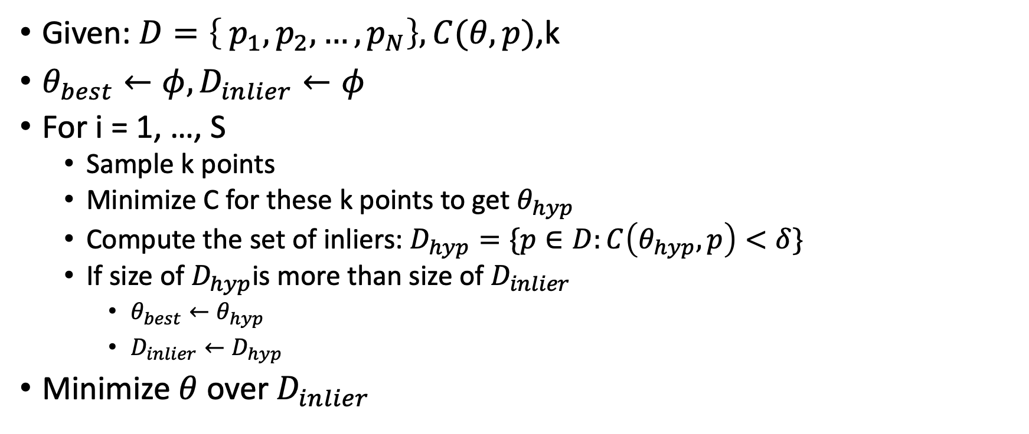
RANSAC - Algorithm
Given: $D=\left\{ p_{1},p_{2}, …,p_{N}\right\}, C(θ,p)$,k
$θ_{best}←φ, D_{inlier}←φ$
For i = 1, …, S
  Sample k points
  Minimize C for these k points to get $θ_{hyp}$
  Compute the set of inliers: $D_{hyp}=\{p∈D:C\left(θ_{hyp}, p\right)<δ\}$
  If size of $D_{hyp}$is more than size of $D_{inlier}$
    $θ_{best}←θ_{hyp}$
    $D_{inlier}←D_{hyp}$
Minimize $θ$ over $D_{inlier}$

Slide 41

RANSAC: how many iterations do we need?
p = inlier fraction
k = minimum number of data points
S = iter
$P=(1 −{\left(1−p^{k}\right)}^{S})$

