Slide 1
Computer Vision and Society

Slide 2
As a member of the public
Lots of news about computer vision
Most coverage by journalists not necessarily well-versed
Things to watch out for:
Claims of doing the impossible (“enhance!”)
Articles based on single papers
Unfounded comparisons to the human brain

Slide 3
The ethics of computer vision
Does the application align with your values?
Does the task specification / evaluation metric reflect the things you care about?
For recognition:
Does the collected training / test set match your true distribution?
Are the algorithm’s errors biased?
Are you being honest in public descriptions of your results?
Is the accuracy/correctness sufficient for public release?

Slide 4
An example
Task: Given image of workplace predict occupation

Slide 5
An example
Model A | Gender A | Gender B
Occupation A | 70% | 70%
Occupation B | 70% | 70%
Data | Gender A | Gender B
Occupation A | 25% | 75%
Occupation B | 75% | 25%
Model B | Gender A | Gender B
Occupation A | 0% | 100%
Occupation B | 100% | 0%

Slide 6
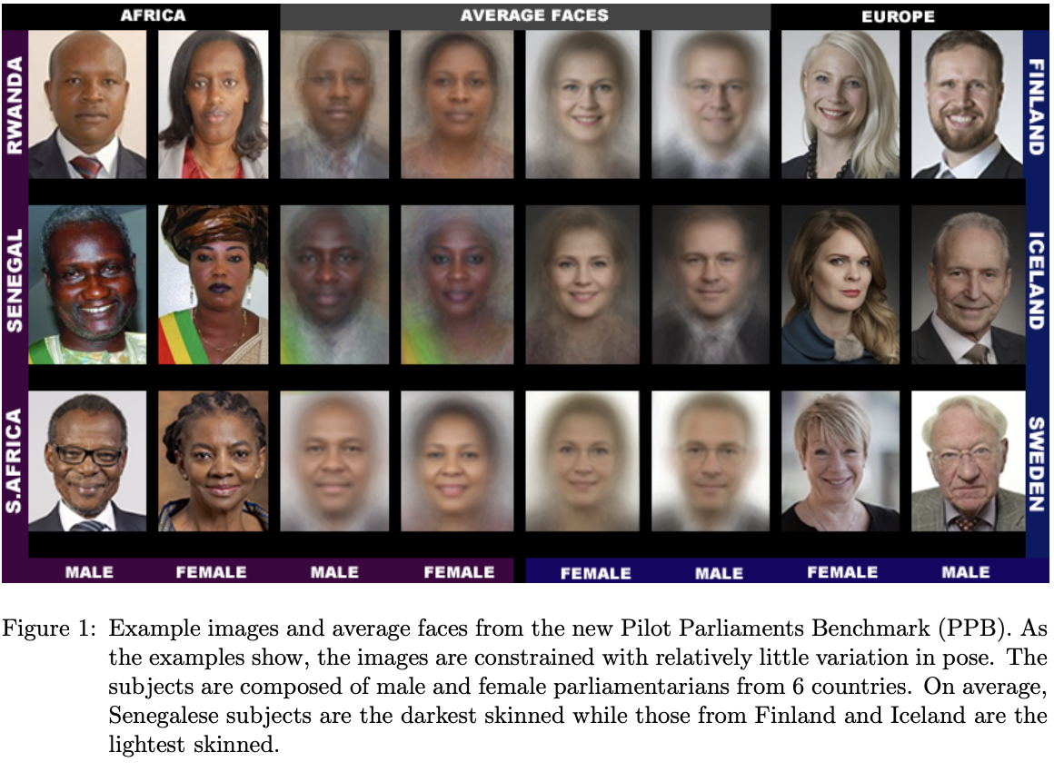
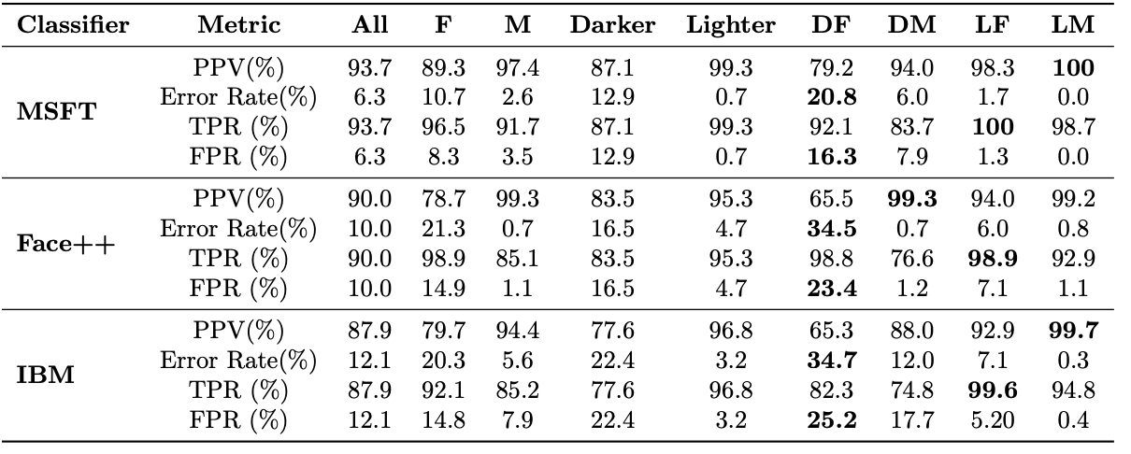
Case study: face recognition
Buolamwini, Joy, and Timnit Gebru. "Gender shades: Intersectional accuracy disparities in commercial gender classification." Conference on fairness, accountability and transparency. 2018.

Slide 7
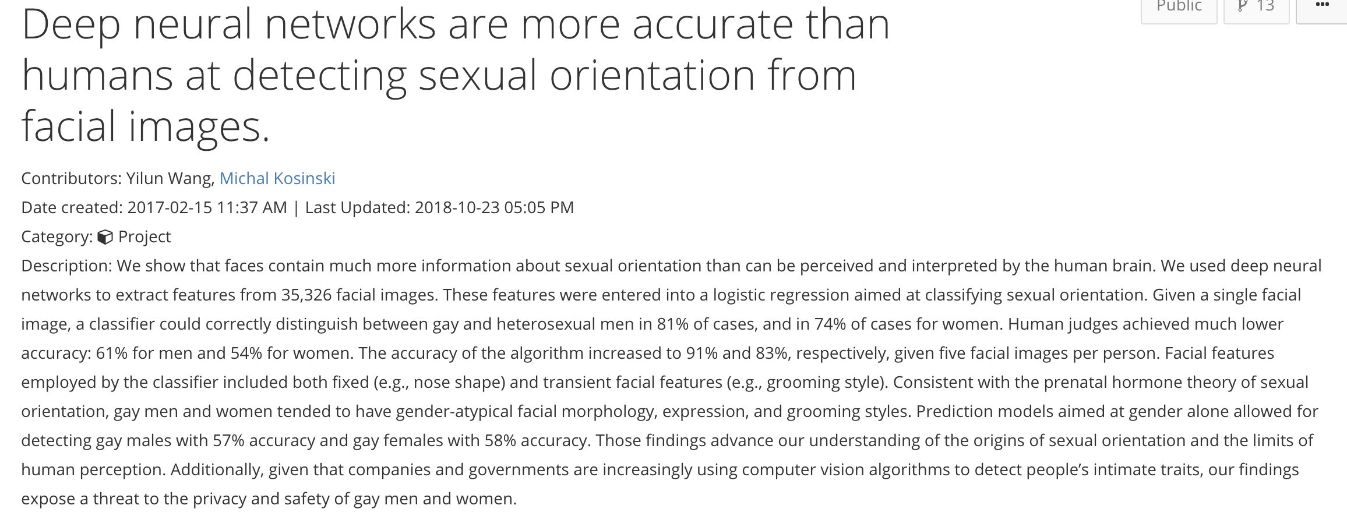
Case study

Slide 8
Case study
We show that faces contain much more information about sexual orientation than can be perceived and interpreted by the human brain. … Given a single facial image, a classifier could correctly distinguish between gay and heterosexual men in 81% of cases, and in 74% of cases for women. … Consistent with the prenatal hormone theory of sexual orientation, gay men and women tended to have gender-atypical facial morphology, expression, and grooming styles … our findings expose a threat to the privacy and safety of gay men and women.

Slide 9
Some questions
Does the application align with your values?
Does the task specification / evaluation metric reflect the things you care about?
For recognition:
Does the collected training / test set match your true distribution?
Are the algorithm’s errors biased?
Are you being honest in public descriptions of your results?
Is the accuracy/correctness sufficient for public release?

Slide 10
Some answers
Training and testing set?
35,326 images from public profiles on a US dating website
”average” images of straight/gay people:
Question:
Are differences caused by actual differences in faces
Or how people choose to present themselves in dating websites?
https://medium.com/@blaisea/do-algorithms-reveal-sexual-orientation-or-just-expose-our-stereotypes-d998fafdf477

Slide 11
Some answers
Men on average taller than women
Straight men take selfies from slightly below, straight women from slightly above
Profiles in dating websites reflect cultural norms
Straight women more likely to wear eyeshadow/make-up
Straight men more likely to keep facial hair
Physiology of sexual orientation more nuanced
Hard to say what exactly neural network was detecting
Goal: raise privacy concerns. Side-effects?
Reinforces potentially harmful stereotypes
Provides ostensibly “objective” criteria for discrimination

