Slide 1
Visualizing convolutional networks

Slide 2
Receptive field
Which input pixels does a particular unit in a feature map depends on
convolve with 3 x 3 filter

Slide 3
Receptive field
convolve with 3 x 3 filter
convolve with 3 x 3 filter
5x5 receptive field
3x3 receptive field

Slide 4
Receptive field
convolve with 3 x 3 filter, subsample

Slide 5
Receptive field
convolve with 3 x 3 filter, subsample by factor 2
convolve with 3 x 3 filter
7x7 receptive field: union of 9 3x3 fields with stride of 2
3x3 receptive field

Slide 6
Visualizing convolutional networks
Take images for which a given unit in a feature map scores high
Identify the receptive field for each.
Rich feature hierarchies for accurate object detection and semantic segmentation. R. Girshick, J. Donahue, T. Darrell, J. Malik. In CVPR, 2014.

Slide 7
Visualizing convolutional networks II
Block regions of the image and classify
Visualizing and Understanding Convolutional Networks. M. Zeiler and R. Fergus. In ECCV 2014.

Slide 8
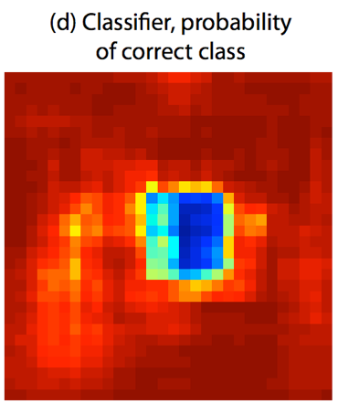
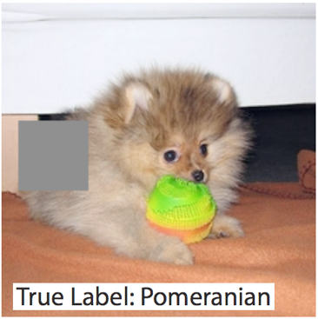
Visualizing convolutional networks II
Image pixels important for classification = pixels when blocked cause misclassification
Visualizing and Understanding Convolutional Networks. M. Zeiler and R. Fergus. In ECCV 2014.

Slide 9
Semantic Segmentation

Slide 10
The Task
person
grass
trees
motorbike
road

Slide 11
Evaluation metric
Pixel classification!
Accuracy?
Heavily unbalanced
Common classes are over-emphasized
Intersection over Union
Average across classes and images
Per-class accuracy
Compute accuracy for every class and then average

Slide 12
Things vs Stuff
THINGS
Person, cat, horse, etc
Constrained shape
Individual instances with separate identity
May need to look at objects
STUFF
Road, grass, sky etc
Amorphous, no shape
No notion of instances
Can be done at pixel level
“texture”

Slide 13
Challenges in data collection
Precise localization is hard to annotate
Annotating every pixel leads to heavy tails
Common solution: annotate few classes (often things), mark rest as “Other”
Common datasets: PASCAL VOC 2012 (~1500 images, 20 categories), COCO (~100k images, 20 categories)

Slide 14
Pre-convnet semantic segmentation
Things
Do object detection, then segment out detected objects
Stuff
”Texture classification”
Compute histograms of filter responses
Classify local image patches

Slide 15
Semantic segmentation using convolutional networks
w
3
h

Slide 16
Semantic segmentation using convolutional networks
c
w/4
h/4

Slide 17
Semantic segmentation using convolutional networks
c
w/4
h/4

Slide 18
Semantic segmentation using convolutional networks
c
w/4
Can be considered as a feature vector for a pixel
h/4

Slide 19
Semantic segmentation using convolutional networks
c
#classes
Convolve with #classes 1x1 filters
w/4
h/4

Slide 20
Semantic segmentation using convolutional networks
Pass image through convolution and subsampling layers
Final convolution with #classes outputs
Get scores for subsampled image
Upsample back to original size

Slide 21
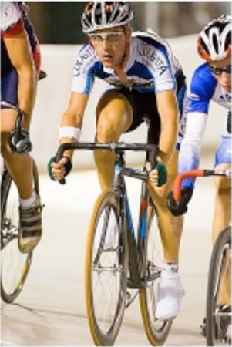
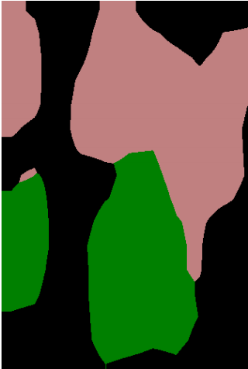
Semantic segmentation using convolutional networks
person
bicycle

Slide 22
The resolution issue
Problem: Need fine details!
Shallower network / earlier layers?
Deeper networks work better: more abstract concepts
Shallower network => Not very semantic!
Remove subsampling?
Subsampling allows later layers to capture larger and larger patterns
Without subsampling => Looks at only a small window!

Slide 23
Solution 1: Image pyramids
Higher resolution Less context
Small networks that maintain resolution
Learning Hierarchical Features for Scene Labeling. Clement Farabet, Camille Couprie, Laurent Najman, Yann LeCun. In TPAMI, 2013.

Slide 24
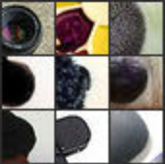
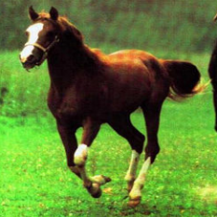
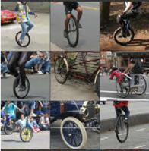
Solution 2: Skip connections
Problem: early layers not semantic
Horse
Visualizations from : M. Zeiler and R. Fergus. Visualizing and Understanding Convolutional Networks. In ECCV 2014.
Notes:
If you look at what one of these higher layers is detecting, here I am showing the input image patches that are highly scored by one of the units. This particular layer really likes bicycle wheels, so if this unit fires, you know that there is a bicycle wheel in the image. Unfortunately, you don’t know where the bicycle wheel is, because this unit doesn’t care where the bicycle wheel appears, or at what orientation or what scale.

Slide 25
Solution 2: Skip connections
upsample
Compute class scores at multiple layers, then upsample and add

Slide 26
Solution 2: Skip connections
Red arrows indicate backpropagation

Slide 27
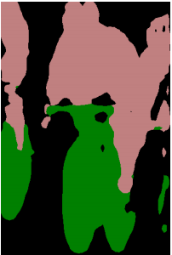
Skip connections
without skip
with skip
Fully convolutional networks for semantic segmentation. Evan Shelhamer, Jon Long, Trevor Darrell. In CVPR 2015

Slide 28
Solution 3: Dilation
Need subsampling to allow convolutional layers to capture large regions with small filters
Can we do this without subsampling?

Slide 29
Solution 3: Dilation
Need subsampling to allow convolutional layers to capture large regions with small filters
Can we do this without subsampling?

Slide 30
Solution 3: Dilation
Need subsampling to allow convolutional layers to capture large regions with small filters
Can we do this without subsampling?

Slide 31
Solution 3: Dilation
Instead of subsampling by factor of 2: dilate by factor of 2
Dilation can be seen as:
Using a much larger filter, but with most entries set to 0
Taking a small filter and “exploding”/ “dilating” it
Not panacea: without subsampling, feature maps are much larger: memory issues

Slide 32
Putting it all together
Best Non-CNN approach: ~46.4%
Semantic Image Segmentation with Deep Convolutional Nets and Fully Connected CRFs. Liang-Chieh Chen, George Papandreou, Iasonas Kokkinos, Kevin Murphy, Alan Yuille. In ICLR, 2015.

