Slide 1
Recognition

Slide 2
Image classification
Given an image, produce a label
Label can be:
  0/1 or yes/no: Binary classification
  one-of-k: Multiclass classification
  0/1 for each of k concepts: Multilabel classification

Slide 3
Image classification - Binary classification
Is this a dog? Yes

Slide 4
Image classification - Multiclass classification
Which of these is it: dog, cat or zebra?
Dog

Slide 5
Image classification - Multilabel classification
Is this a dog? Yes
Is this furry? Yes
Is this sitting down? Yes

Slide 6
A history of classification : MNIST
2D
10 classes
6000 examples per class
1990’s

Slide 7
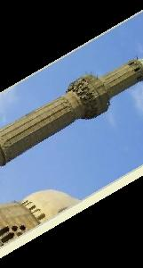
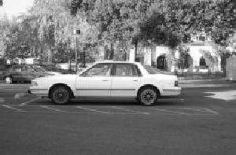
A history of classification : Caltech 101
101 classes
10 classes
30 examples per class
Strong category-specific biases
Clean images
MNIST
1990’s
2004

Slide 8
A history of classification: PASCAL VOC
20 classes
~500 examples per class
Clutter, occlusion, natural scenes
MNIST
Caltech 101
1990’s
2004
2007-2012

Slide 9
A history of classification: ImageNet
1000 classes
~1000 examples per class
Mix of cluttered and clean images
MNIST
Caltech 101
PASCAL VOC
1990’s
2004
2007-2013
2013-2017

Slide 10
Why is recognition hard?
Pose variation

Slide 11
Why is recognition hard?
Lighting variation

Slide 12
Why is recognition hard?
Scale variation

Slide 13
Why is recognition hard?
Clutter and occlusion

Slide 14
Why is recognition hard?
Intrinsic intra-class variation

Slide 15
Why is recognition hard?
Inter-class similarity

Slide 16
The language of recognition
Boundaries of classes are often fuzzy
“A dog is an animal with four legs, a tail and a snout”
Really?

Slide 17
The language of recognition
“… Practically anything can happen in an image and furthermore practically everything did” - Marr
Much better to talk in terms of probabilities
Joint distribution of images and labels : P(x,y)
Conditional distribution of labels given image : P(y|x)

Slide 18
Learning
We are interested in the conditional distribution
Key idea: teach computer visual concepts by providing examples
Training Set

Slide 19
Example
Binary classifier “Dog” or ”not Dog”
Labels: {0, 1}
Training set
{(
, 1),
(
, 1),
, 0) , … }
(

Slide 20
Choosing a model class
Will try and find P(y = 1 | x)
P(y=0 | x) = 1 - P(y=1 | x)
Need to find
But: enormous number of possible mappings

Slide 21
Choosing a model class
Assume h is a linear classifier in feature space
Feature space?
Linear classifier?

Slide 22
Feature space: representing images as vectors
Represent an image as a vector in
Simple way: step 1: convert image to gray-scale and resize to fixed size

Slide 23

Feature space: representing images as vectors
Step 2: Flatten 2D array into 1D vector

Slide 24
Feature space: representing images as vectors
Can represent this as a function that takes an image and converts into a vector
(
) =

Slide 25
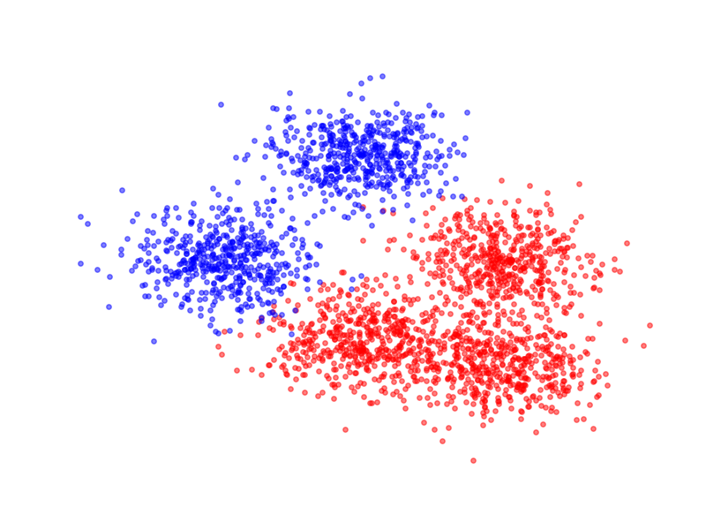
Linear classifiers
Given an image, can use $φ$ to get a vector and plot it as a point in high dimensional space

Slide 26
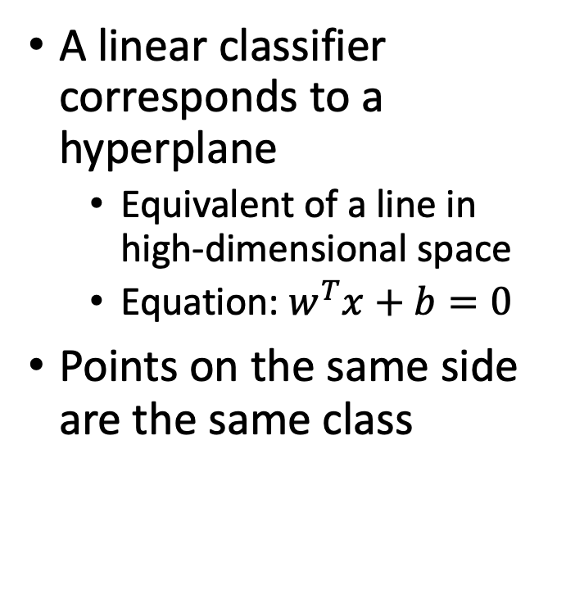
Linear classifiers
A linear classifier corresponds to a hyperplane
  Equivalent of a line in high-dimensional space
  Equation: $w^{T}x+b=0$
Points on the same side are the same class

Slide 27
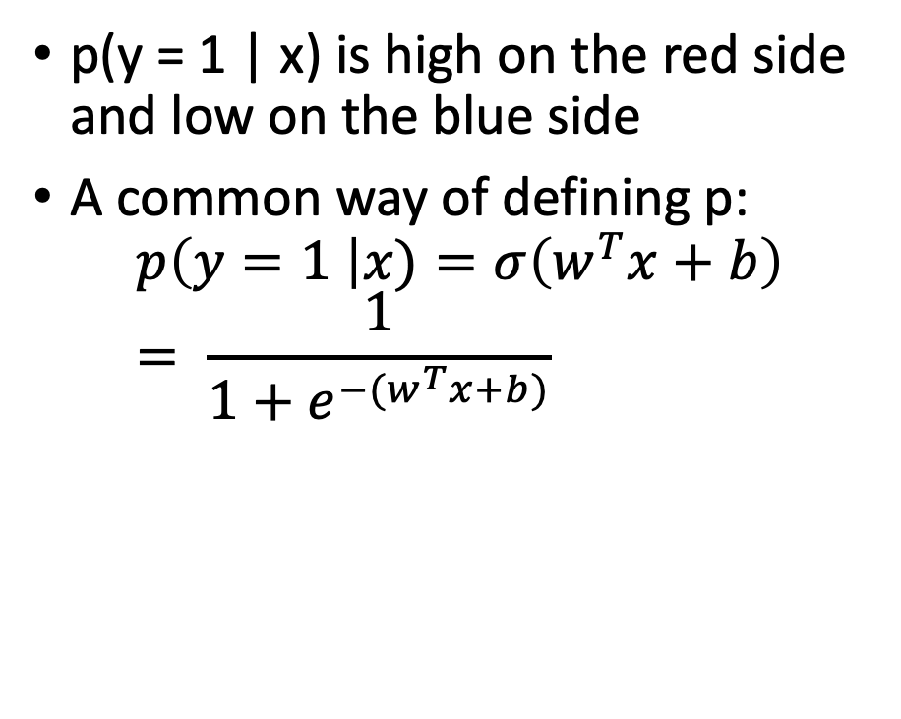
Linear classifiers
p(y = 1 | x) is high on the red side and low on the blue side
A common way of defining p:
$$p\left(y=1 \right|x)=σ\left(w^{T}x+b\right) \\ = \frac{1}{1+e^{−(w^{T}x+b)}}$$
sigmoid function

Slide 28


Linear classifiers in feature space
$$σ(s)$$
$$s$$

Slide 29
Linear classifiers in feature space
Family of functions depending on w and b
Each function is called a hypothesis
Family is called a hypothesis class
Hypotheses indexed by w and b
Need to find the best hypothesis = need to find best w and b
w and b are called parameters

Slide 30
Training: Choosing the best hypothesis
Use training set to find best-fitting hypothesis
$$S=\{\left(x_{i},y_{i}\right):i=1, …, n\}$$
Question: how do we define fit?

Slide 31
Training: Choosing the best hypothesis
Use training set to find best-fitting hypothesis
Question: how do we define fit?
Given (x,y), and candidate hypothesis $h(⋅;w,b)$
  $h(x;w,b)$ is estimated probability label is 1
  Idea: compute estimated probability for true label y
  Want this probability to be high
  Likelihood

Slide 32
An alternate expression for the hypothesis

Slide 33
An alternate expression for the hypothesis

Slide 34
Training: Choosing the best hypothesis
Likelihood of a single data point
Fit = total likelihood of entire training dataset

Slide 35
Training: Choosing the best hypothesis
Use log likelihood
Pick the hypothesis that maximizes log likelihood
  Each hypothesis corresponds to a setting of w and b
  Maximization problem

Slide 36
Training: Choosing the best hypothesis
Maximizing log likelihood = Minimizing average negative log likelihood

Slide 37
Training: Choosing the best hypothesis
Negative log likelihood is a loss function
Training = minimizing average loss on a training set

Slide 38
General recipe
Fix hypothesis class
Define loss function
Minimize average loss on the training set
Why should this work?
How do we do the minimization in practice

Slide 39
Training = Optimization
Need to minimize an objective
More generally, objective takes the form

Slide 40
Training = optimization
How do we minimize this?
Start from an initial estimate
Iteratively reduce F. How?

Slide 41
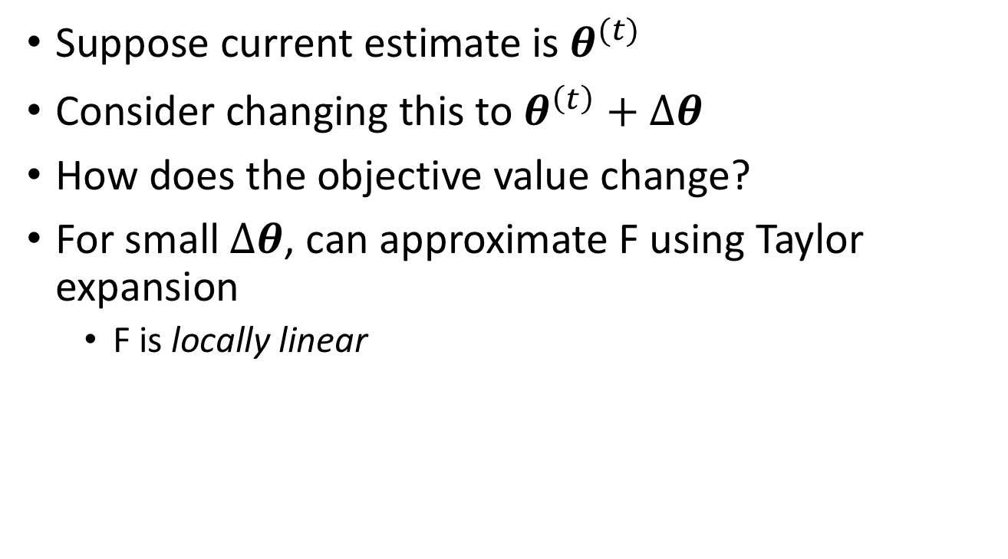
Optimization and function gradients
Suppose current estimate is $θ^{(t)}$
Consider changing this to $θ^{\left(t\right)}+Δθ$
How does the objective value change?
For small $Δθ$, can approximate F using Taylor expansion
  F is locally linear

Slide 42
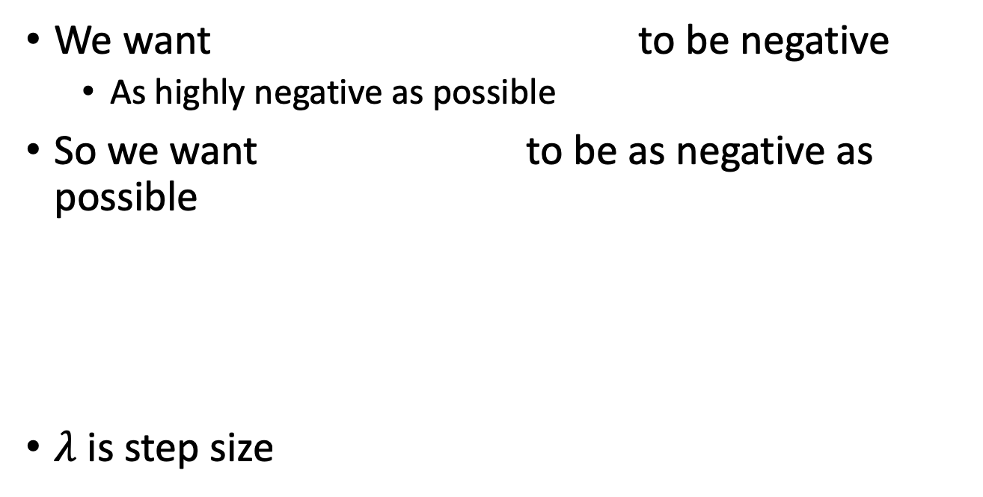
Optimization and function gradients
We want to be negative
  As highly negative as possible
So we want to be as negative as possible
$λ$ is step size

Slide 43
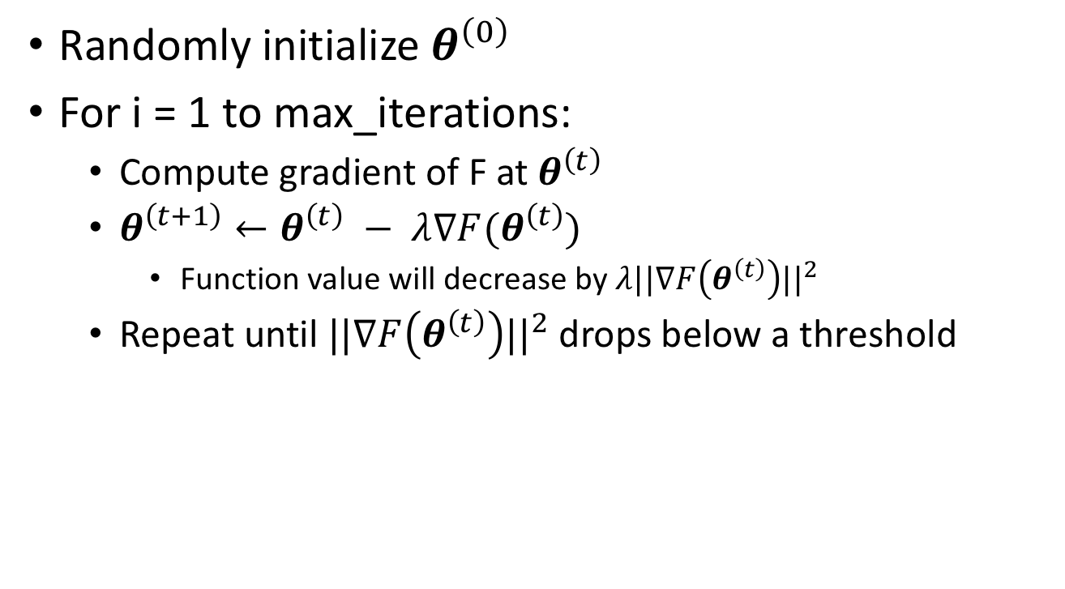
Optimization using gradient descent
Randomly initialize $θ^{\left(0\right)}$
For i = 1 to max_iterations:
  Compute gradient of F at $θ^{\left(t\right)}$
  $θ^{\left(t+1\right)}←θ^{\left(t\right)} − λ∇F(θ^{\left(t\right)})$
    Function value will decrease by $λ||∇F\left(θ^{\left(t\right)}\right)||^{2}$
  Repeat until $||∇F\left(θ^{\left(t\right)}\right)||^{2}$ drops below a threshold

Slide 44
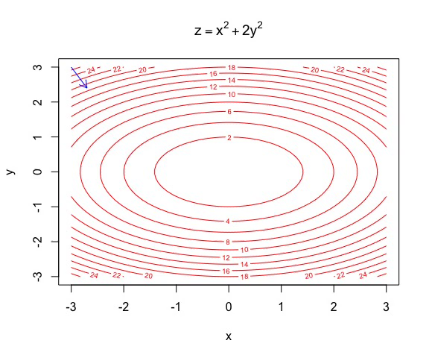
Gradient descent
https://yihui.name/animation/example/grad-desc/

Slide 45
Gradient descent - convergence
Every step leads to a reduction in the function value
If function is bounded below, we will eventually stop
But will we stop at the right “global minimum”?
  Not necessarily: local optimum!
Local min
Global min

Slide 46
Gradient descent in machine learning
Computing the gradient requires a loop over all training examples
Very expensive for large datasets

Slide 47
Stochastic gradient descent
Gradient is average of per-example gradient
Can get an estimate of the average by using a small random sample (called a “minibatch”)
Take step along estimated gradient
Stochastic gradient descent!

Slide 48
General recipe
Logistic Regression!
Fix hypothesis class
Define loss function
Minimize average loss on the training set using SGD

Slide 49
General recipe
Fix hypothesis class
Define loss function
Minimize average loss on the training set using SGD
Why should this work?

Slide 50
Why should this work?
Let us look at the objective more carefully
We are minimizing average loss on the training set
Is this what we actually care about?

Slide 51
Risk
Given:
  Distribution over (x,y) pairs
  A hypothesis from hypothesis class H
  Loss function L
We are interested in Expected Risk (think of this as “Error”):
Given training set S, and a particular hypothesis h, Empirical Risk (Training error):

Slide 52
Risk
Left: true quantity of interest, right: estimate
How good is this estimate?
If h is randomly chosen, actually a pretty good estimate!
  In statistics-speak, it is an unbiased estimator : correct in expectation

Slide 53
Risk
Empirical risk unbiased estimate of expected risk
Want to minimize expected risk
Idea: Minimize empirical risk instead
This is the Empirical Risk Minimization Principle

Slide 54
Overfitting
For randomly chosen h, empirical risk (training error) good estimate of expected risk
But we are choosing h by minimizing training error
Empirical risk of chosen hypothesis no longer unbiased estimate:
  We chose hypothesis based on S
  Might have chosen h for which S is a special case
Overfitting:
  Minimize training error, but generalization error increases

Slide 55
Overfitting = fitting the noise
Minimizer of empirical risk
Minimizer of expected risk
True distribution
Sampled training set

Slide 56
Generalization
Training error
Generalization error

Slide 57
Controlling generalization error
Variance of empirical risk inversely proportional to size of S (central limit theorem)
  Choose very large S!
Larger the hypothesis class H, Higher the chance of hitting bad hypotheses with low training error and high generalization error
  Choose small H!
For many models, can bound generalization error using some property of parameters
  “Regularization”

Slide 58
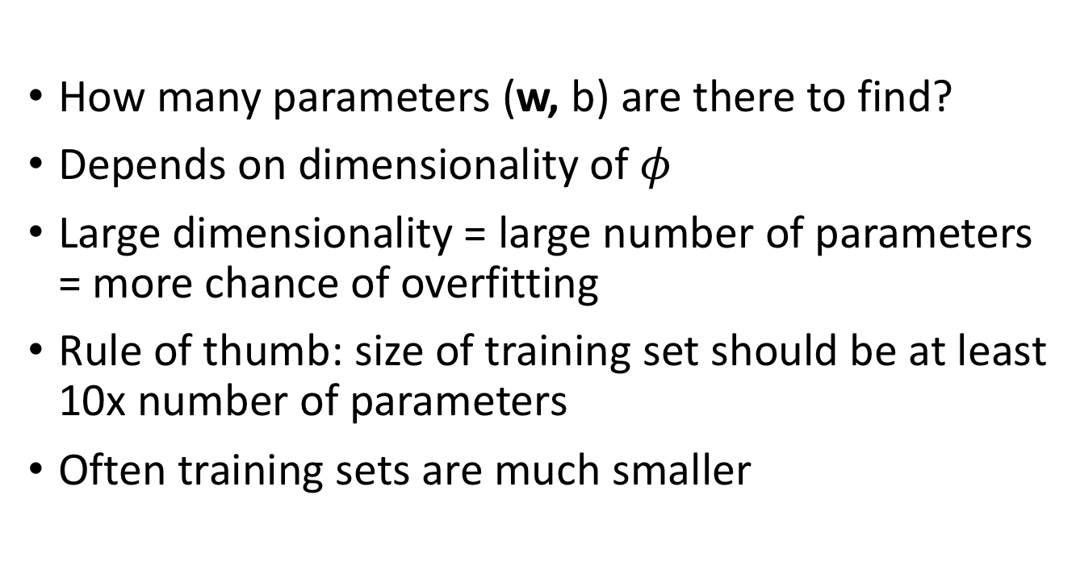
Controlling the size of the hypothesis class
How many parameters (w, b) are there to find?
Depends on dimensionality of $φ$
Large dimensionality = large number of parameters = more chance of overfitting
Rule of thumb: size of training set should be at least 10x number of parameters
Often training sets are much smaller

Slide 59
Regularization
Old objective
New objective
Why does this help?

Slide 60
Regularization
Ensures classifier does not weigh any one feature too highly
Makes sure classifier scores vary slowly when image changes

Slide 61
Controlling generalization error
How do we know we are overfitting?
  Use a held-out “validation set”
  To be an unbiased sample, must be completely unseen
Choose hypothesis class, regularization etc that lowers validation error
Note: to get final estimate of expected risk, need another held-out set: the “test set”

Slide 62
Putting it all together
Want model with least expected risk = expected loss
But expected risk hard to evaluate
Empirical Risk Minimization: minimize empirical risk in training set
Might end up picking special case: overfitting
Avoid overfitting by:
  Constructing large training sets
  Reducing size of model class
  Regularization

Slide 63
Putting it all together
Collect training set and validation set
Pick hypothesis class
Pick loss function
Minimize empirical risk (+ regularization)
Measure performance on held-out validation set
Profit!

Slide 64
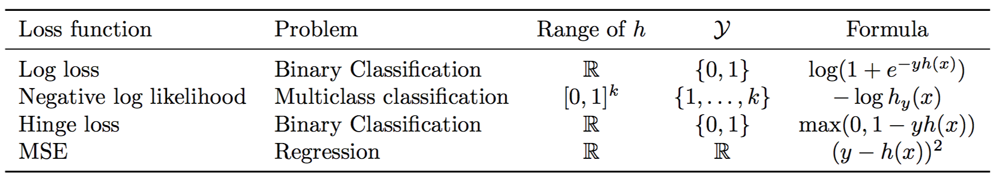
Loss functions and hypothesis classes

Slide 65

Back to images
What should $φ$ be?
Simplest solution: string 2D image intensity values into vector

