Slide 1
Grouping

Slide 2
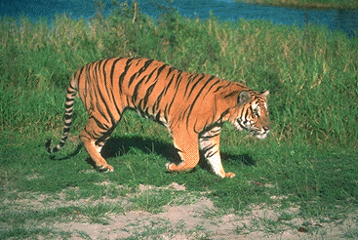
Regions Boundaries

Slide 3
Grouping by clustering
G
R
B

Slide 4
Grouping by clustering
Idea: embed pixels into high-dimensional space (e.g. 3-dimensions)
Each pixel is a point
Group together points

Slide 5
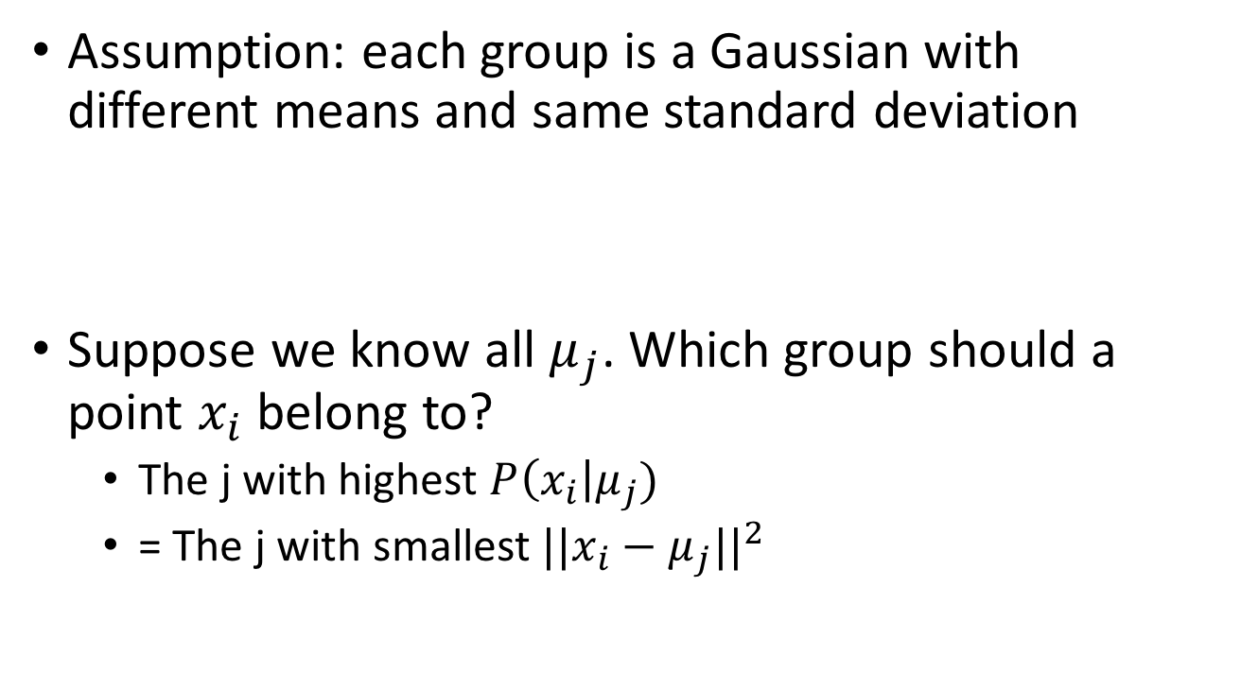
K-means
Assumption: each group is a Gaussian with different means and same standard deviation
Suppose we know all $μ_{j}$. Which group should a point $x_{i}$ belong to?
  The j with highest $P\left(x_{i}\right|μ_{j})$
  = The j with smallest $||x_{i}−μ_{j}||^{2}$

Slide 6
K-means
Assumption: each group = a Gaussian with different means and same standard deviation
If means are known, then trivial assignment to groups. How?
Assign data point to nearest mean!

Slide 7
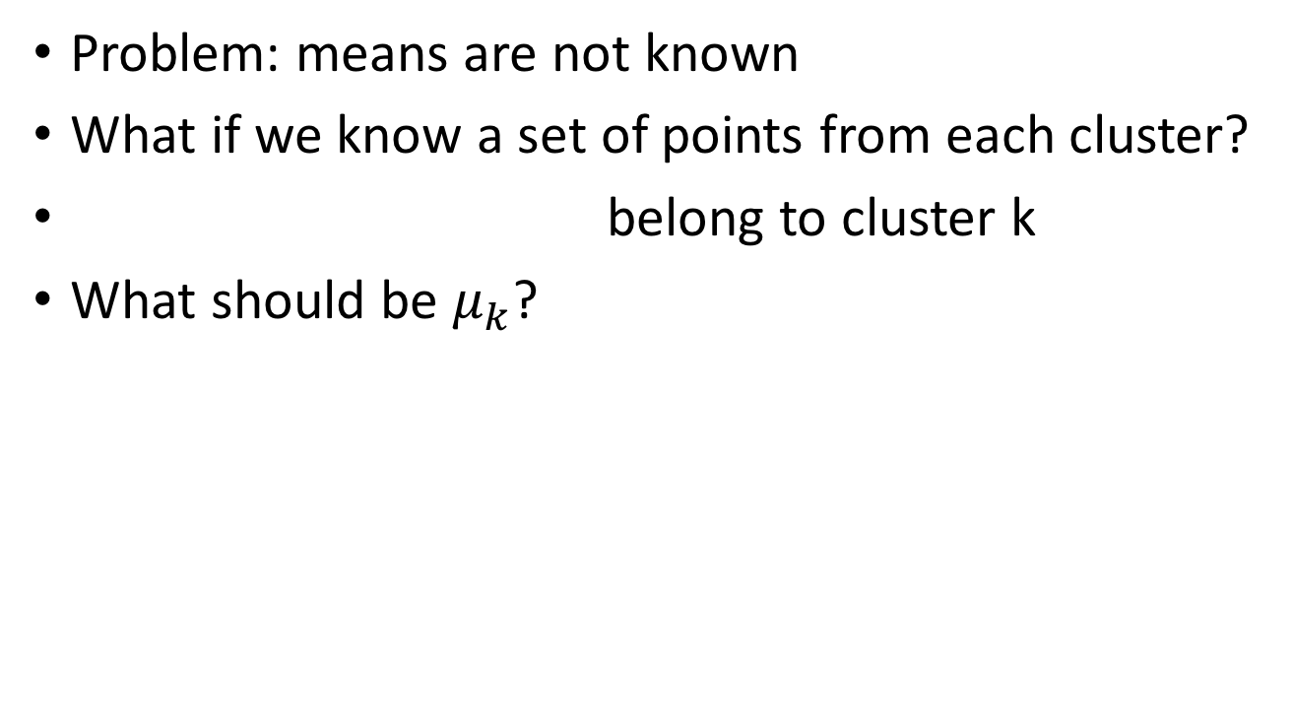
K-means
Problem: means are not known
What if we know a set of points from each cluster?
belong to cluster k
What should be $μ_{k}$?

Slide 8
K-means
Problem: means are not known
If assignment of points to clusters is known, then finding means is easy
How? Compute the mean of every cluster!

Slide 9
K-means
Given means, can assign points to clusters
Given assignments, can compute means
Idea: iterate!

Slide 10
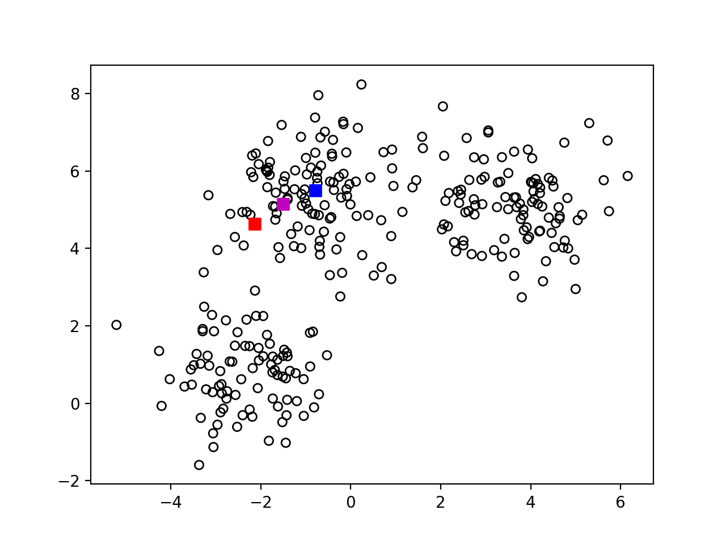
K-means
Step-1 : randomly pick k centers

Slide 11
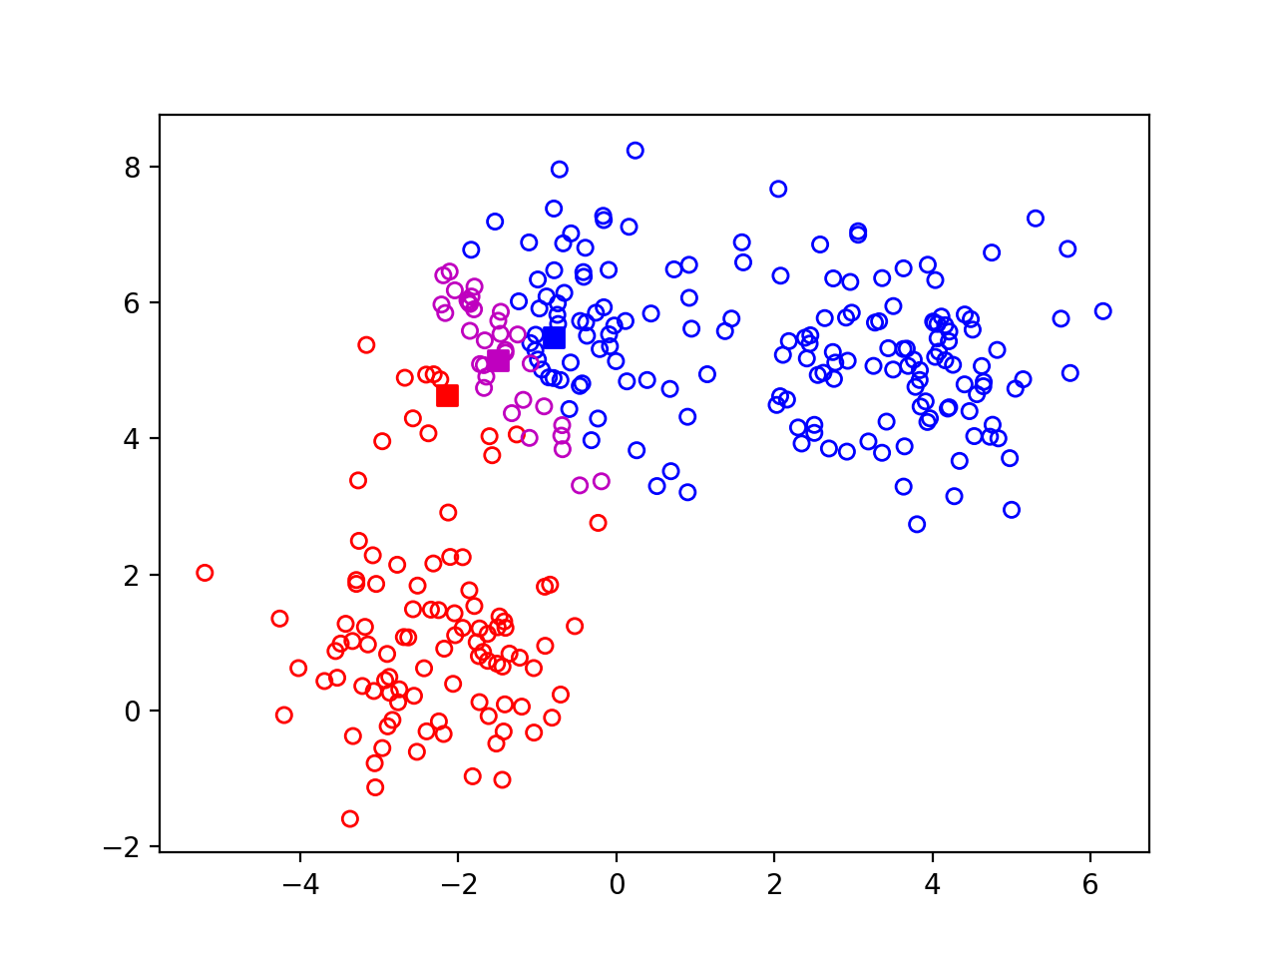
K-means
Step 2: Assign each point to nearest center

Slide 12

K-means
Step 3: re-estimate centers

Slide 13

K-means
Step 4: Repeat

Slide 14
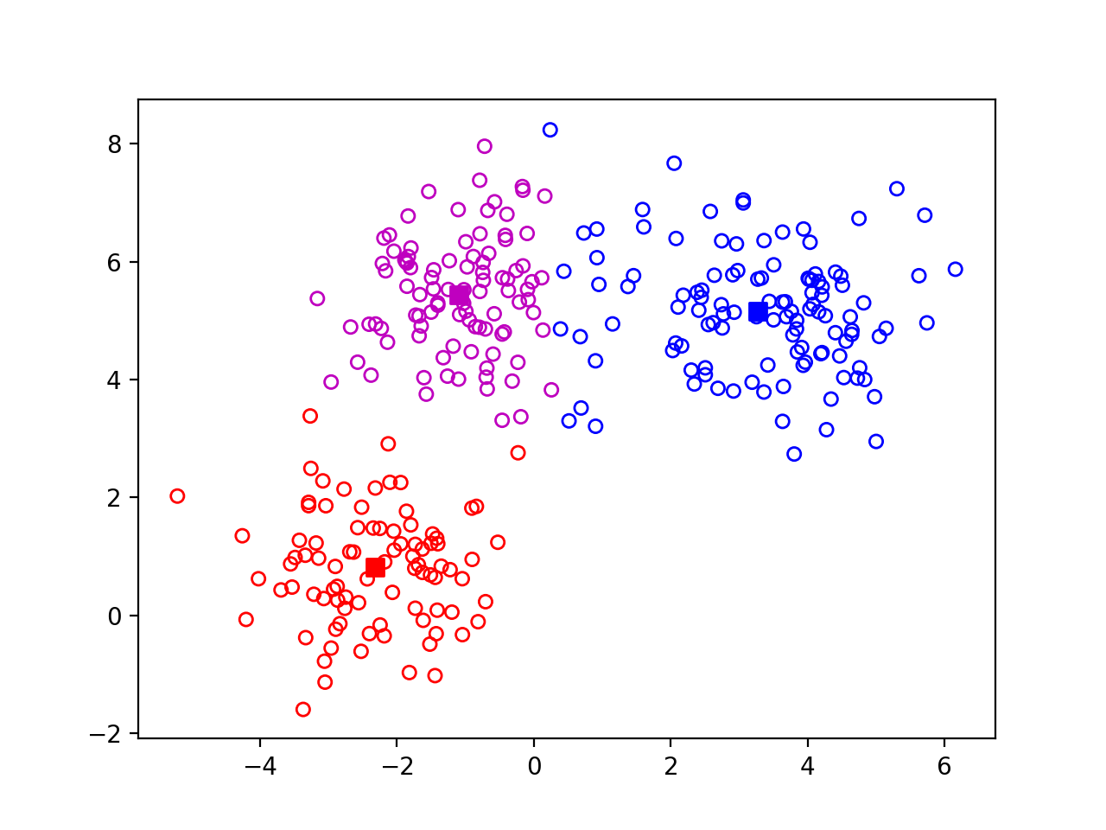
K-means
Step 4: Repeat

Slide 15
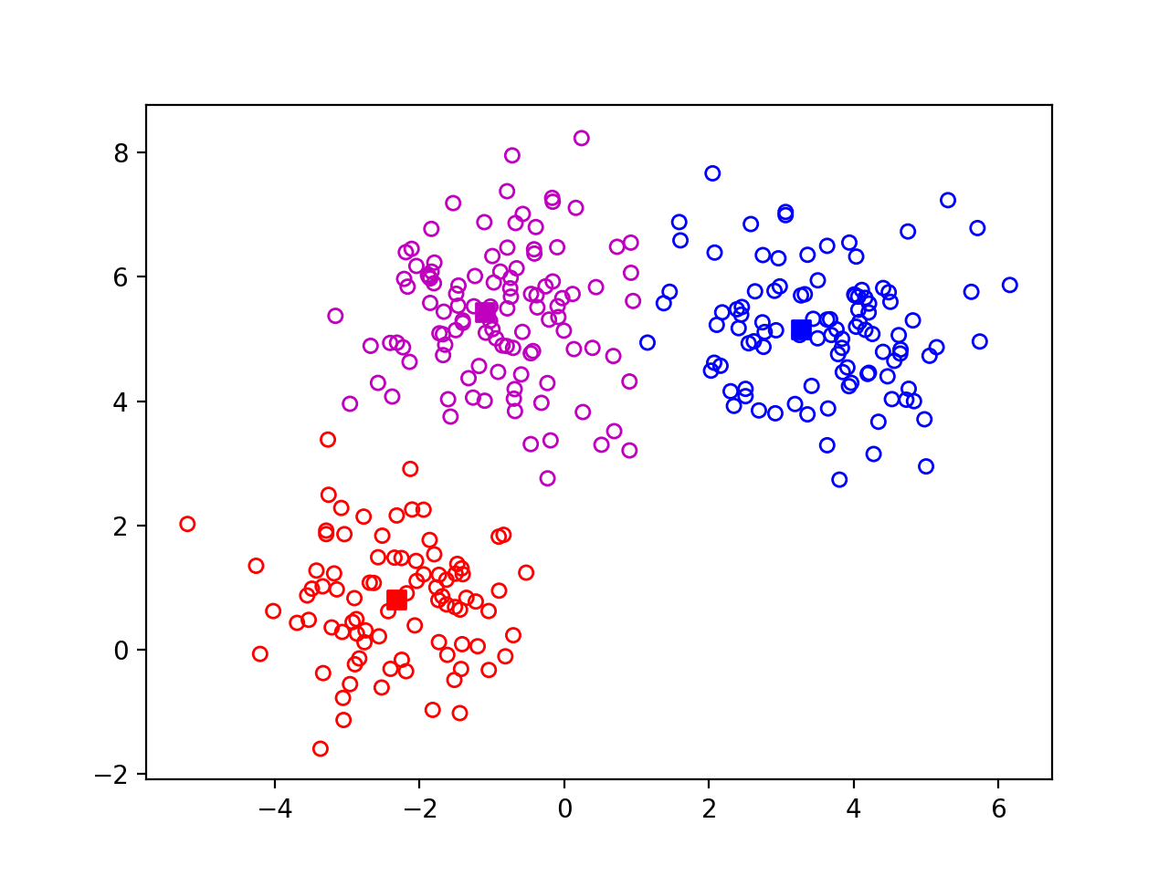
K-means
Step 4: Repeat

Slide 16
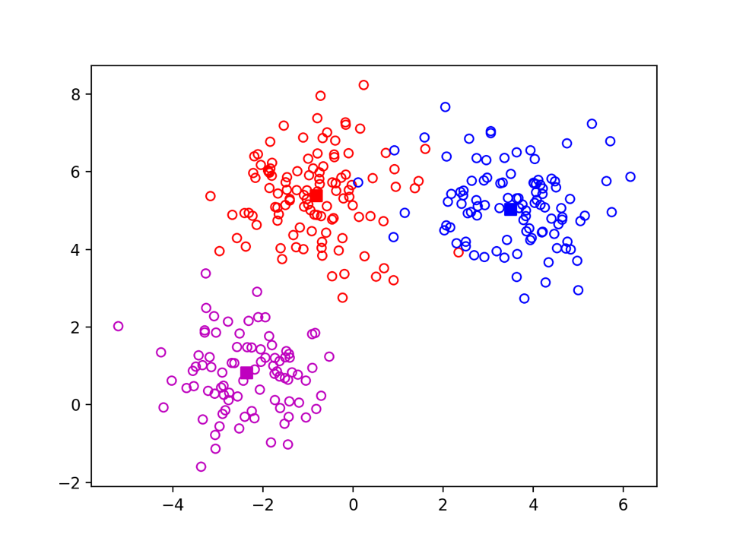

K-means
Ground-truth vs k-means
Ground truth
K-means 100 iterations

Slide 17
K-means - another example

Slide 18
K-means
Input: set of data points, k
Randomly pick k points as means
For i in [0, maxiters]:
  Assign each point to nearest center
  Re-estimate each center as mean of points assigned to it

Slide 19
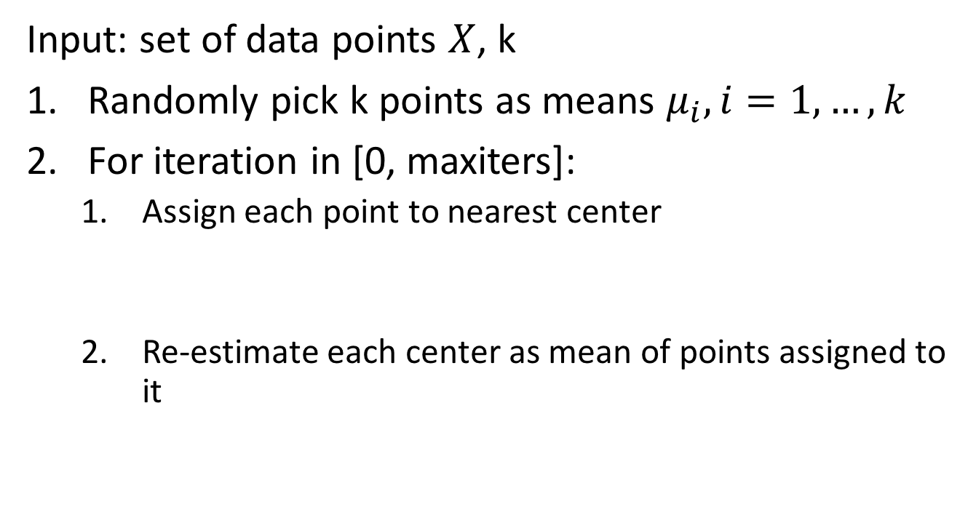
K-means - the math
Input: set of data points $X$, k
Randomly pick k points as means $μ_{i}, i=1,…, k$
For iteration in [0, maxiters]:
  Assign each point to nearest center
  Re-estimate each center as mean of points assigned to it

Slide 20
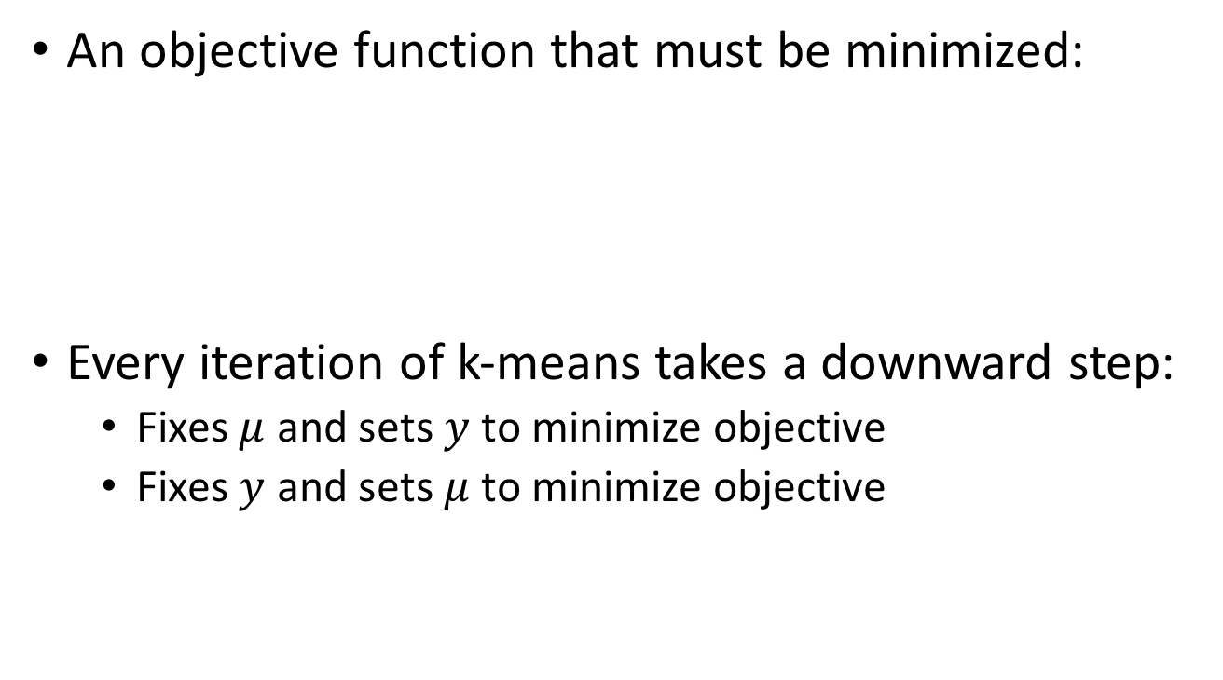
K-means - the math
An objective function that must be minimized:
Every iteration of k-means takes a downward step:
  Fixes $μ$ and sets $y$ to minimize objective
  Fixes $y$ and sets $μ$ to minimize objective

Slide 21
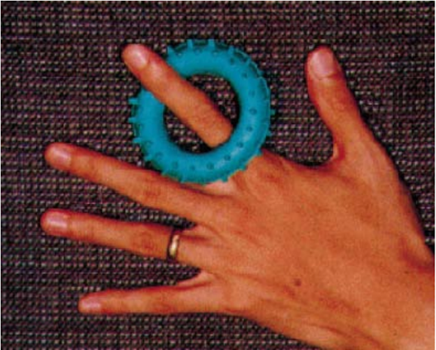
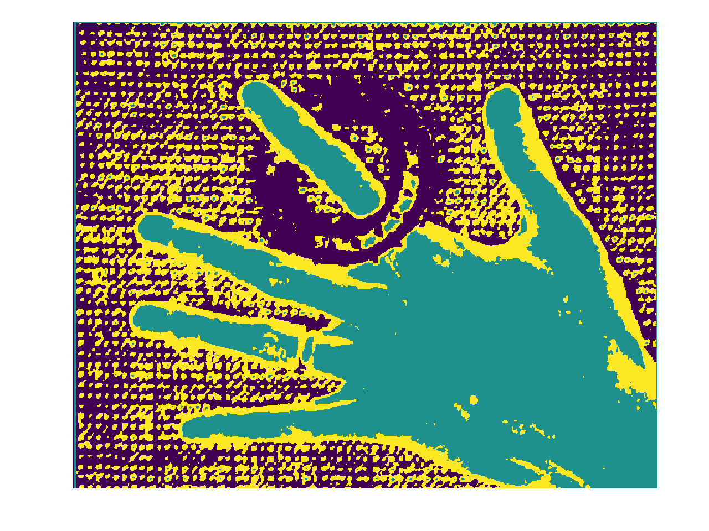


K-means on image pixels
Iteration 1
Iteration 5
Final: Iteration 17

Slide 22
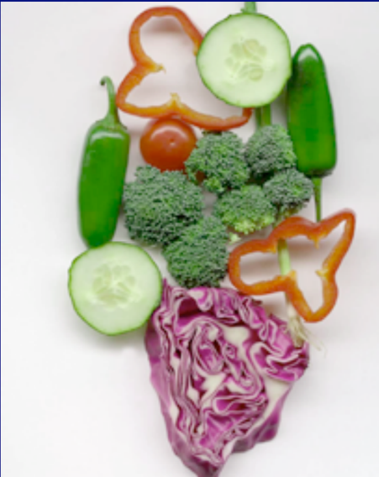
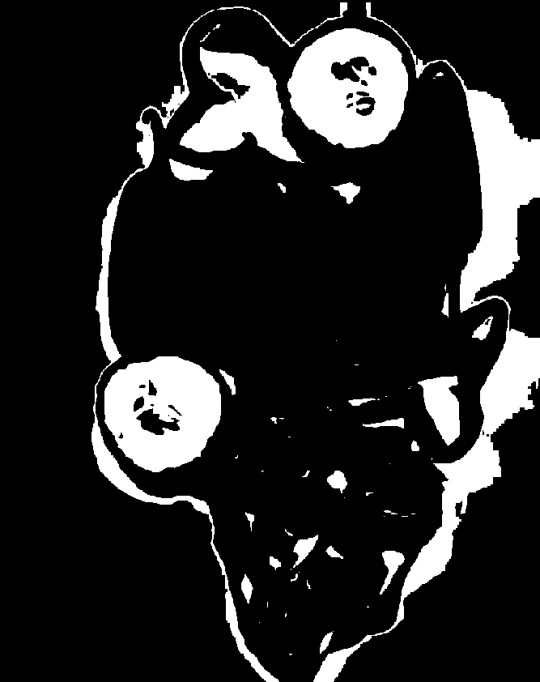
K-means on image pixels
Picture courtesy David Forsyth
One of the clusters from k-means

Slide 23

K-means on image pixels
What is wrong?
Pixel position
  Nearby pixels are likely to belong to the same object
  Far-away pixels are likely to belong to different objects
How do we incorporate pixel position?
  Instead of representing each pixel as (r,g,b)
  Represent each pixel as (r,g,b,x,y)

Slide 24

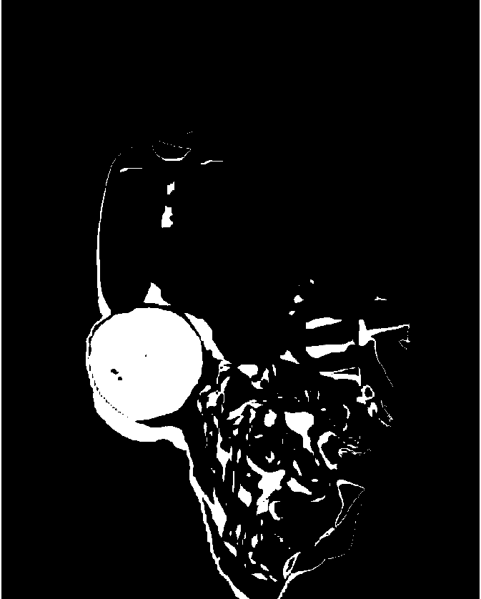
K-means on image pixels+position

Slide 25
The issues with k-means
Captures pixel similarity but
  Doesn’t capture continuity of contours
  Captures near/far relationships only weakly
  Can merge far away objects together
Requires knowledge of k!
Can it deal with texture?

Slide 26
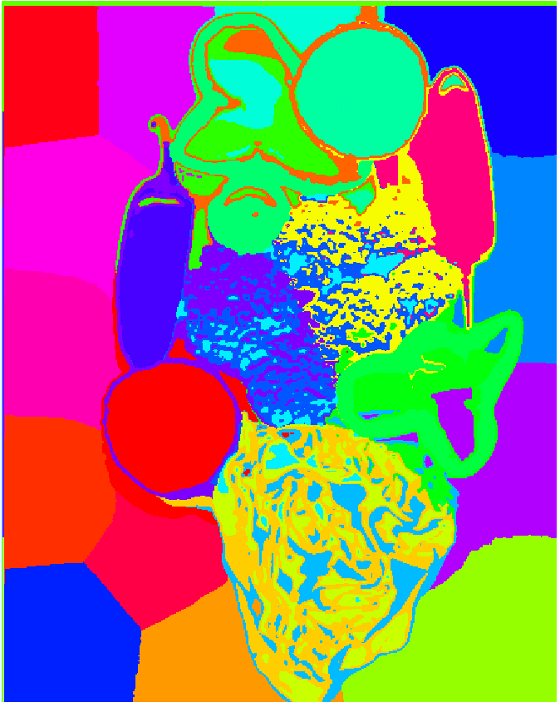
Oversegmentation and superpixels
We don’t know k. What is a safe choice?
Idea: Use large k
  Can potentially break big objects, but will hopefully not merge unrelated objects
  Later processing can decide which groups to merge
  Called superpixels

