Slide 1
Fourier transforms

Slide 2
Gaussian filter
21x21, $σ$=0.5
21x21, $σ$=1
21x21, $σ$=3

Slide 3
“Blurriness” / “Smoothness”
Gaussian filters with increasing sigma make image “blurrier”
Input
$$σ=1$$
$$σ=3$$
$$σ=5$$

Slide 4
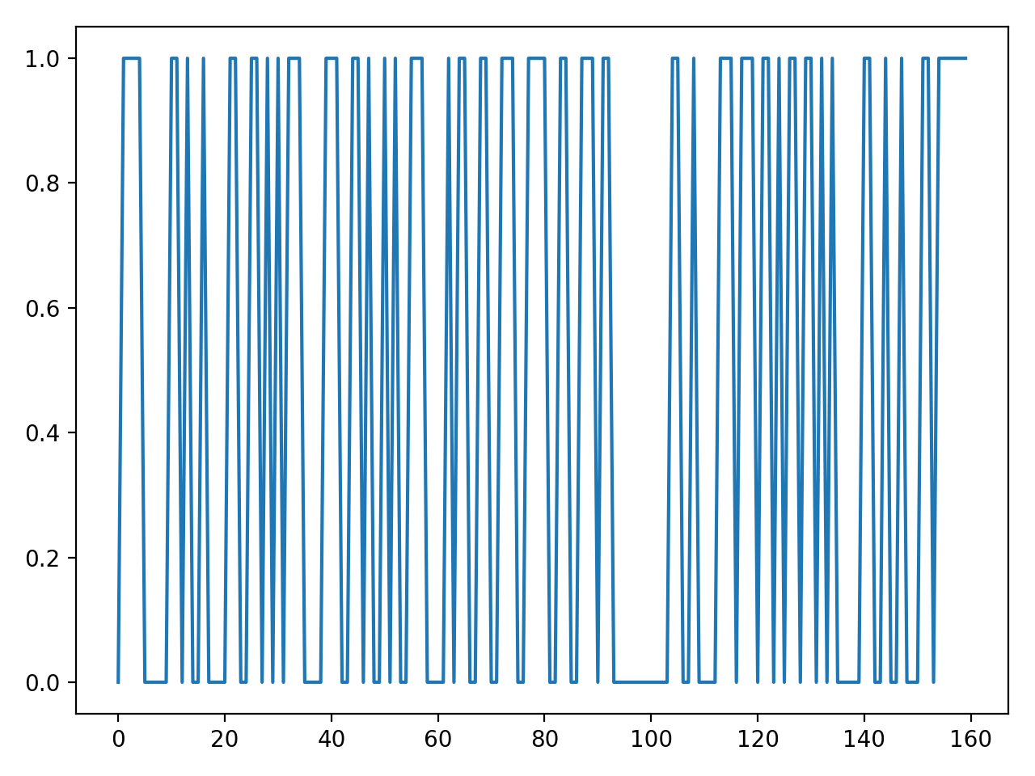
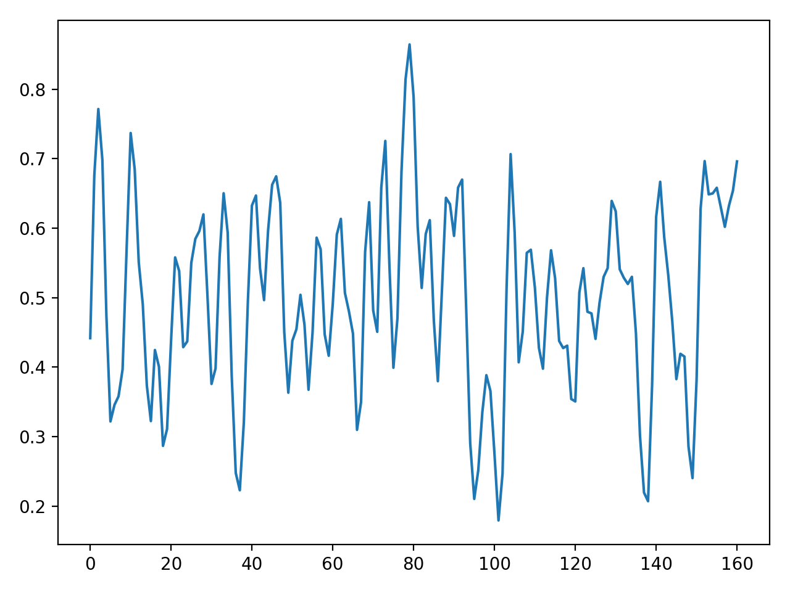
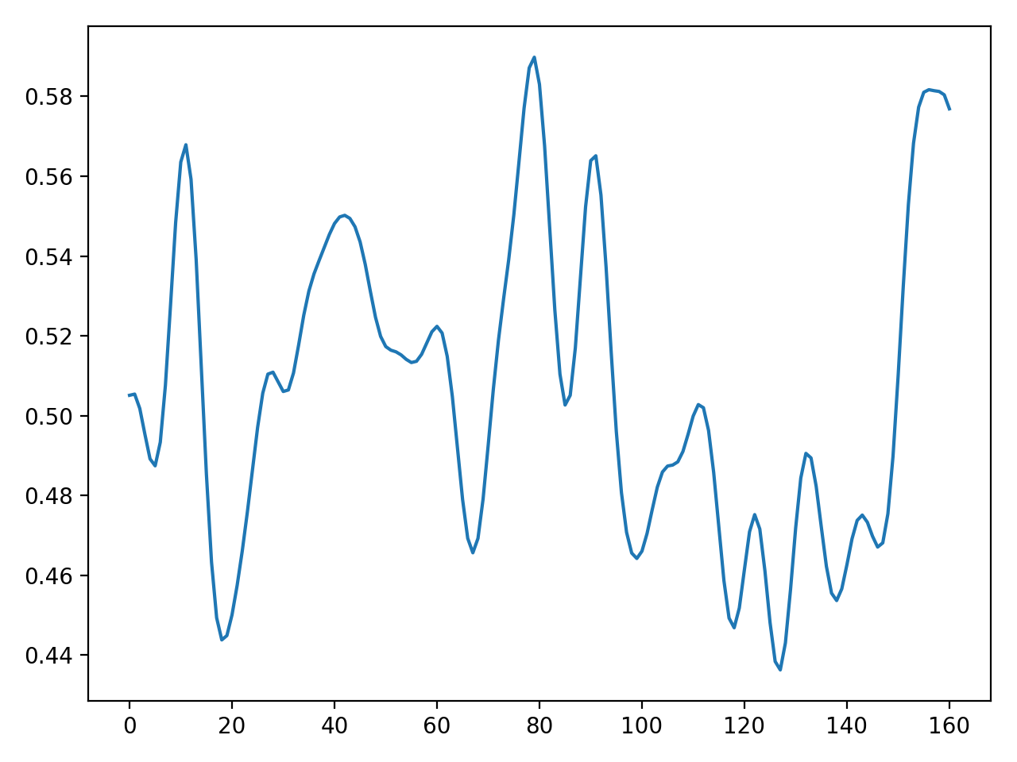
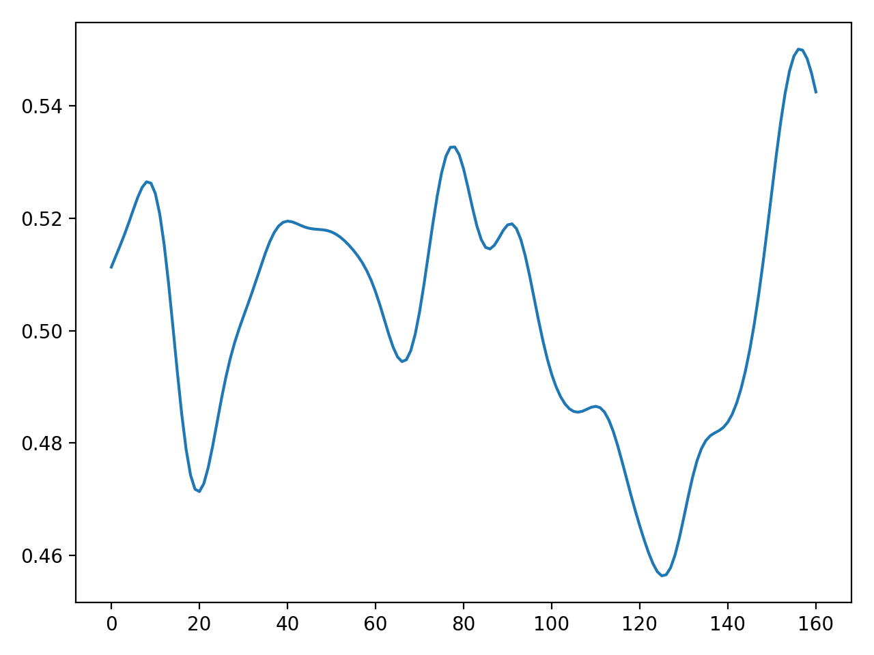
Blurriness/smoothness
In blurrier images, intensity changes more slowly with position
An important concept in image processing: frequency
Input
$$σ=1$$
$$σ=3$$
$$σ=5$$

Slide 5
Frequency and the Fourier transform

Slide 6
Images as vector space
Images of given size are a vector space
Usual definitions of addition and scalar multiplication
If $I_{1}$ and $I_{2}$ are images, so is ${αI}_{1}+βI_{2}$
The dimensionality of the vector space of $m × n$images is $mn$
This vector space has a basis: images $B_{i}$ such that for any image $I$:
$I=α_{1}B_{1}+α_{2}B_{2}+…+α_{mn}B_{mn}$

Slide 7
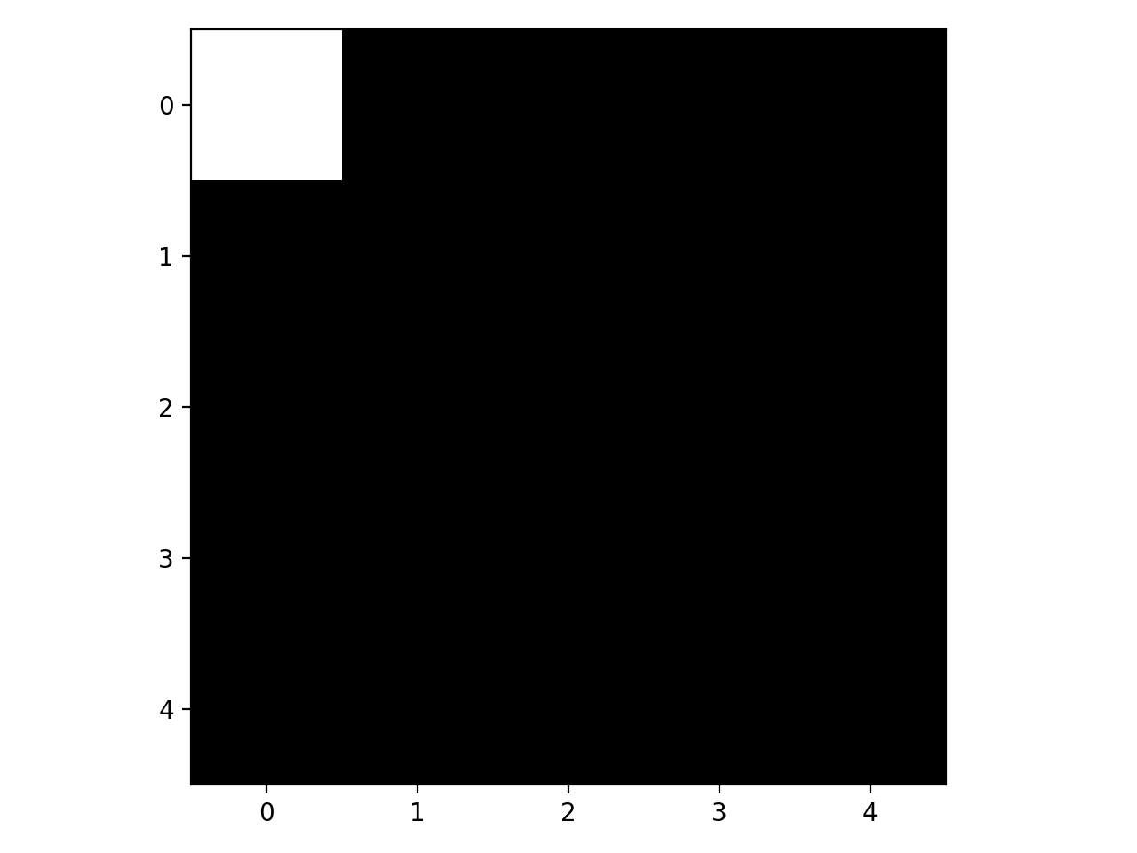
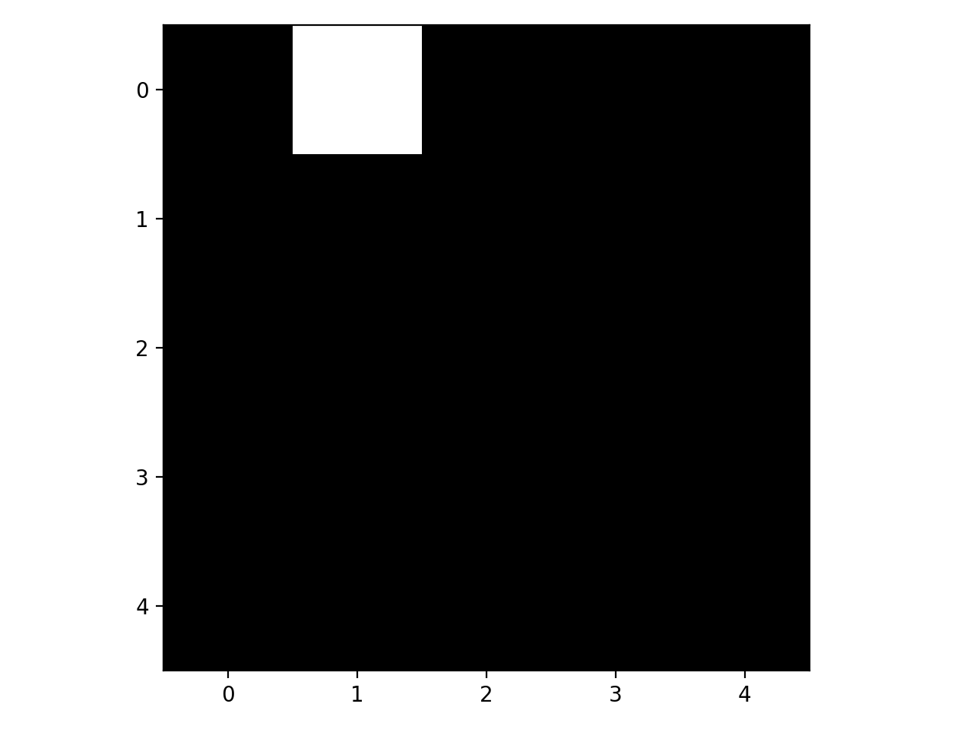
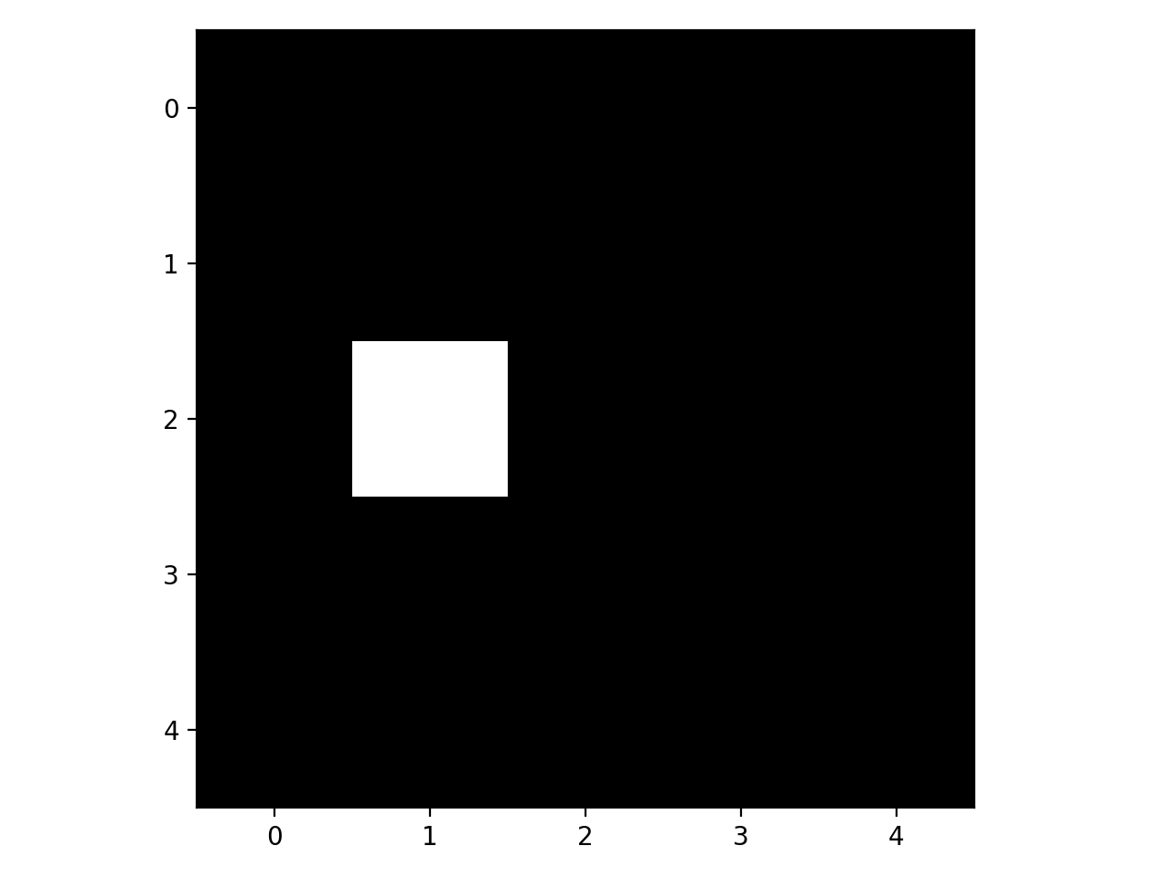
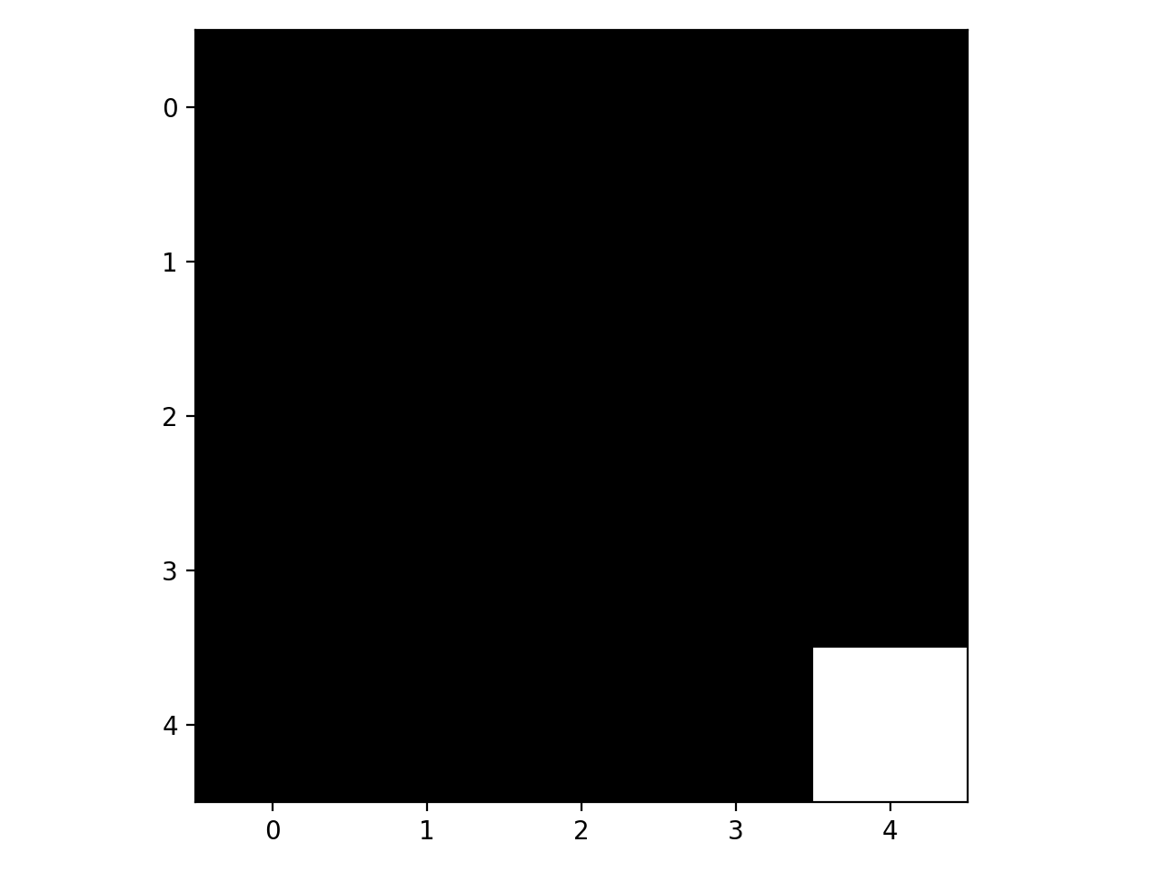
Basis for images
Canonical basis:
Each canonical basis vector is an image with single pixel as 1
$f=\sum_{x,y}{f\left(x,y\right)B_{x,y}}$
Basis vectors for 5 x 5 images:
$$B_{0,0}$$
$$B_{0,1}$$
$$B_{2,1}$$
$$B_{4,4}$$
…
…

Slide 8
Basis for images
Images (2D arrays of real numbers) satisfy definition of vector space.
Canonical basis:
Each canonical basis vector is an image with single pixel as 1
Alternate basis based on frequency: Fourier basis

Slide 9
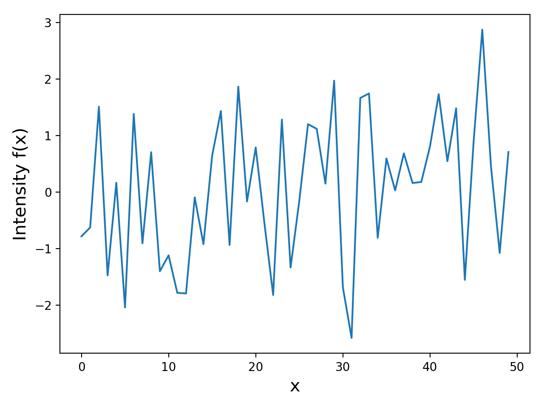
Fourier basis for $1 × N$ images
Consider images that are a single row of pixels
Random image below:

Slide 10
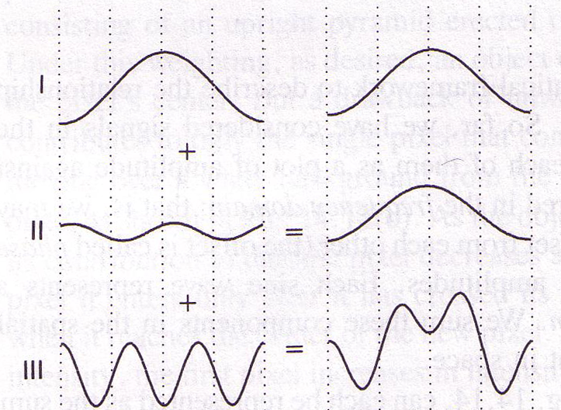
Key idea of Fourier basis
Every such image (doesn’t matter what it is) is a linear combination of sine/cosine waves

Slide 11
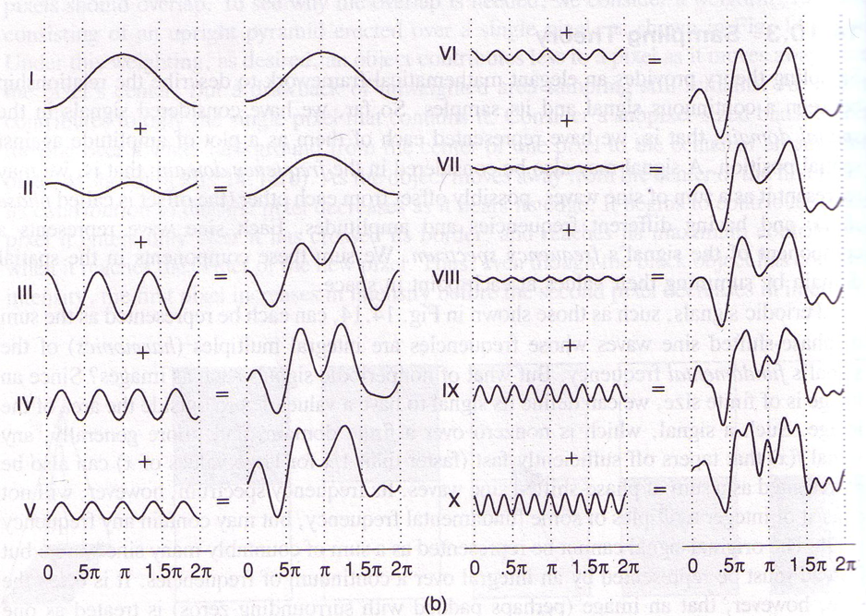
Key idea of Fourier basis
Every such image (doesn’t matter what it is) is a linear combination of sine/cosine waves

Slide 12
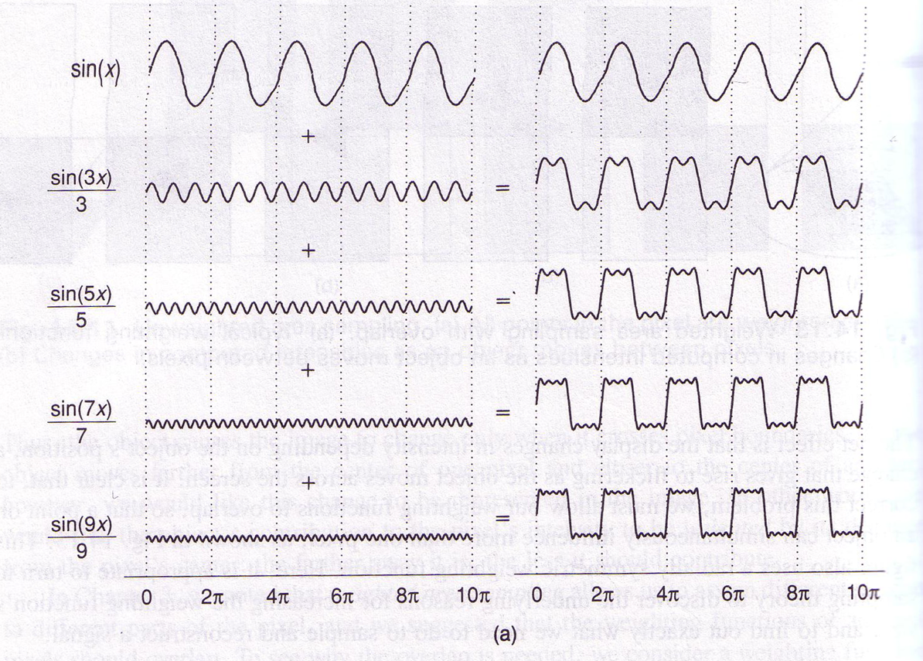
A box-like example

Slide 13
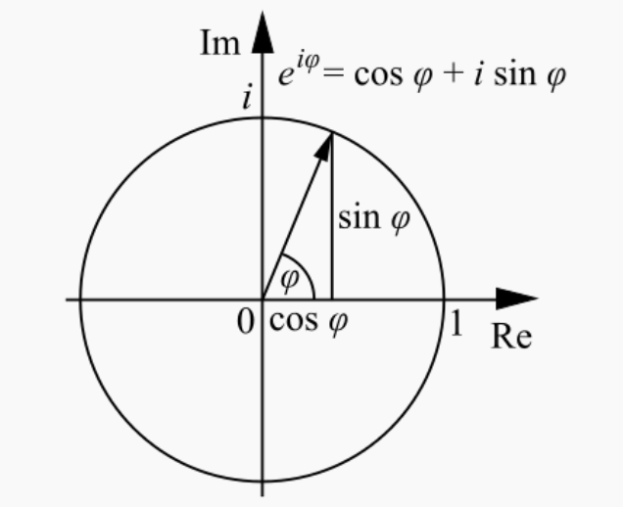
Fourier basis for $1 × N$images
Not exactly sines and cosines, but complex variants
Euler’s formula:
$e^{iφ}=\cos{φ}+i\sin{φ}$
k-th basis vector $B_{k}$ is a $1 × N$image
$B_{k}\left(x\right)=e^{\frac{i2πkx}{N}}=\cos{\frac{2πkx}{N}}+i\sin{\frac{2πkx}{N}}$

Slide 14
Understanding the k-th basis
$B_{k}\left(x\right)=e^{\frac{i2πkx}{N}}=\cos{\frac{2πkx}{N}}+i\sin{\frac{2πkx}{N}}$
Real part: $\cos{\frac{2πkx}{N}}$
Periodic in x. Period?
$B_{k}\left(\frac{N}{k}\right)=e^{\frac{i2πk}{N} \frac{N}{k}}=e^{i2π}=1=e^{i0}=B_{k}(0)$
$B_{k}$ repeats every N/k pixels

Slide 15
Understanding the Fourier basis
Real
Imaginary
$$B_{1}$$
$$B_{5}$$
Increasing frequency
$$B_{10}$$

Slide 16
Understanding the Fourier basis
Different basis elements have different frequencies
Any image combines these with different coefficients
$I_{1}=0.5 B_{1}+0.8 B_{5}$
$I_{2}=0.5 B_{1}+0.8 B_{5}+0.5 B_{10}$
$I_{2}$ is said to have more high-frequency components

Slide 17
Fourier transform
Consider any 1D signal x with N entries
It can be expressed as a combination of Fourier basis elements:
$x=a_{0}\left(x\right)B_{0}+a_{1}\left(x\right)B_{1}+ …+a_{N−1}\left(x\right)B_{N−1}$
x can be represented using N Fourier coefficients:
X = [$a_{0}\left(x\right), a_{1}\left(x\right), …, a_{N−1}(x)]$
Fourier transform of x is X
Inverse Fourier transform of X is x

Slide 18
Fourier transform
Problem: basis is complex, but signal is real?
Combine a pair of conjugate basis elements
$B_{N−k}\left(n\right)=e^{\frac{2πi\left(N−k\right)n}{N}}= e^{2πin −\frac{2πikn}{N}}= e^{−\frac{2πikn}{N}}=B_{−k}\left(n\right)$
Consider $B_{−N/2}$to $B_{N/2}$ as basis elements
Real signals will have same coefficients for $B_{k}$ and $B_{−k}$

Slide 19
Fourier transform
What is $B_{0}?$
$B_{0}= e^{2πi0n/N}=1$
Coefficient at 0 acts as a “constant bias”
All other basis elements average out to 0
So average must come from 0 coefficient
“DC component”

