Slide 1
Lecture 2: Image filtering

Slide 2
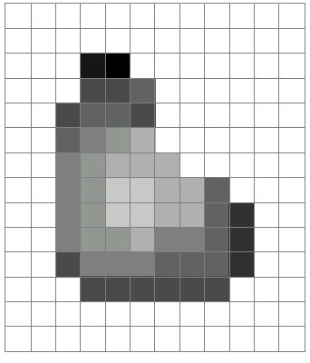
What is an image?
A grid (matrix) of intensity values
(common to use one byte per value: 0 = black, 255 = white)
255 | 255 | 255 | 255 | 255 | 255 | 255 | 255 | 255 | 255 | 255 | 255
255 | 255 | 255 | 255 | 255 | 255 | 255 | 255 | 255 | 255 | 255 | 255
255 | 255 | 255 | 20 | 0 | 255 | 255 | 255 | 255 | 255 | 255 | 255
255 | 255 | 255 | 75 | 75 | 75 | 255 | 255 | 255 | 255 | 255 | 255
255 | 255 | 75 | 95 | 95 | 75 | 255 | 255 | 255 | 255 | 255 | 255
255 | 255 | 96 | 127 | 145 | 175 | 255 | 255 | 255 | 255 | 255 | 255
255 | 255 | 127 | 145 | 175 | 175 | 175 | 255 | 255 | 255 | 255 | 255
255 | 255 | 127 | 145 | 200 | 200 | 175 | 175 | 95 | 255 | 255 | 255
255 | 255 | 127 | 145 | 200 | 200 | 175 | 175 | 95 | 47 | 255 | 255
255 | 255 | 127 | 145 | 145 | 175 | 127 | 127 | 95 | 47 | 255 | 255
255 | 255 | 74 | 127 | 127 | 127 | 95 | 95 | 95 | 47 | 255 | 255
255 | 255 | 255 | 74 | 74 | 74 | 74 | 74 | 74 | 255 | 255 | 255
255 | 255 | 255 | 255 | 255 | 255 | 255 | 255 | 255 | 255 | 255 | 255
255 | 255 | 255 | 255 | 255 | 255 | 255 | 255 | 255 | 255 | 255 | 255
=

Slide 3
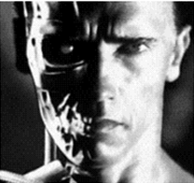
Images as functions
An image contains discrete numbers of pixels
Pixel value
  grayscale/intensity
    [0,255] or [0,1] or any real
  Color
    RGB [R, G, B]
    Lab [L, a, b]: Lightness, a and b are color-opponent dimensions
    HSV [H, S, V]: Hue, saturation, value

Slide 4
Images as functions
Can think of image as a function, f, from R² to R or R^{M}:
  Grayscale: f (x,y) gives intensity at position (x,y)
    f: [a,b] x [c,d] ➔R
  Color: f (x,y) = [r(x,y), g(x,y), b(x,y)]

Slide 5
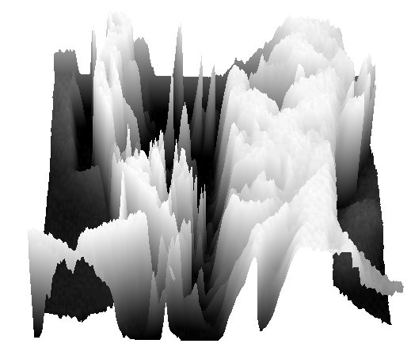
What is an image?
  A digital image is a discrete (sampled, quantized) version of this function
f (x, y)
x
y

Slide 6
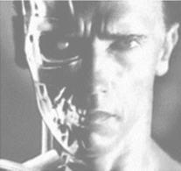
Image transformations
Appearance transformations
Geometric
transformations
  g (x,y) = f (x,y) + 20
  g (x,y) = f (-x,y)

Slide 7
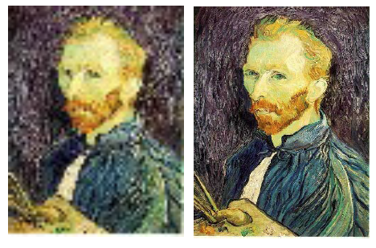
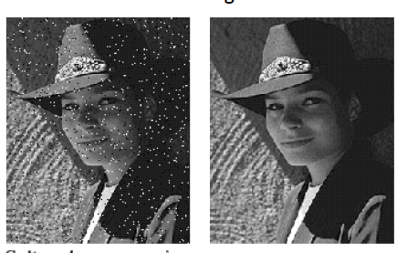
Example applications
Super-resolution: Increase image size
Noise reduction: Remove noise

Slide 8
Image denoising

Slide 9
Why would images have noise?
Sensor noise
  Sensors count photons: noise in count
Dead pixels
Old photographs
…

Slide 10

What is an image?
A grid (matrix) of intensity values: 1 color or 3 colors
(common to use one byte per value: 0 = black, 255 = white)
255 | 255 | 255 | 255 | 255 | 255 | 255 | 255 | 255 | 255 | 255 | 255
255 | 255 | 255 | 255 | 255 | 255 | 255 | 255 | 255 | 255 | 255 | 255
255 | 255 | 255 | 20 | 0 | 255 | 255 | 255 | 255 | 255 | 255 | 255
255 | 255 | 255 | 75 | 75 | 75 | 255 | 255 | 255 | 255 | 255 | 255
255 | 255 | 75 | 95 | 95 | 75 | 255 | 255 | 255 | 255 | 255 | 255
255 | 255 | 96 | 127 | 145 | 175 | 255 | 255 | 255 | 255 | 255 | 255
255 | 255 | 127 | 145 | 175 | 175 | 175 | 255 | 255 | 255 | 255 | 255
255 | 255 | 127 | 145 | 200 | 200 | 175 | 175 | 95 | 255 | 255 | 255
255 | 255 | 127 | 145 | 200 | 200 | 175 | 175 | 95 | 47 | 255 | 255
255 | 255 | 127 | 145 | 145 | 175 | 127 | 127 | 95 | 47 | 255 | 255
255 | 255 | 74 | 127 | 127 | 127 | 95 | 95 | 95 | 47 | 255 | 255
255 | 255 | 255 | 74 | 74 | 74 | 74 | 74 | 74 | 255 | 255 | 255
255 | 255 | 255 | 255 | 255 | 255 | 255 | 255 | 255 | 255 | 255 | 255
255 | 255 | 255 | 255 | 255 | 255 | 255 | 255 | 255 | 255 | 255 | 255
=

Slide 11
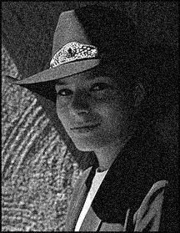
An assumption about noise
Let us assume noise at a pixel is
  independent of other pixels
  distributed according to a Gaussian distribution
    i.e., low noise values are more likely than high noise values
    “grainy images”

Slide 12
Noise reduction
Nearby pixels are likely to belong to same object
  thus likely to have similar color
Replace each pixel by average of neighbors

Slide 13
Mean filtering
0 | 0 | 0 | 0 | 0 | 0 | 0 | 0 | 0 | 0
0 | 0 | 0 | 10 | 10 | 10 | 0 | 0 | 0 | 0
0 | 0 | 10 | 20 | 20 | 20 | 10 | 40 | 0 | 0
0 | 10 | 20 | 30 | 0 | 20 | 10 | 0 | 0 | 0
0 | 10 | 0 | 30 | 40 | 30 | 20 | 10 | 0 | 0
0 | 10 | 20 | 30 | 40 | 30 | 20 | 10 | 0 | 0
0 | 10 | 20 | 10 | 40 | 30 | 20 | 10 | 0 | 0
0 | 10 | 20 | 30 | 30 | 20 | 10 | 0 | 0 | 0
0 | 0 | 10 | 20 | 20 | 0 | 10 | 0 | 20 | 0
0 | 0 | 0 | 10 | 10 | 10 | 0 | 0 | 0 | 0
(0 + 0 + 0 + 10 + 40 + 0 + 10 + 0 + 0)/9 = 6.66

Slide 14
Mean filtering
0 | 0 | 0 | 0 | 0 | 0 | 0 | 0 | 0 | 0
0 | 0 | 0 | 10 | 10 | 10 | 0 | 0 | 0 | 0
0 | 0 | 10 | 20 | 20 | 20 | 10 | 40 | 0 | 0
0 | 10 | 20 | 30 | 0 | 20 | 10 | 0 | 0 | 0
0 | 10 | 0 | 30 | 40 | 30 | 20 | 10 | 0 | 0
0 | 10 | 20 | 30 | 40 | 30 | 20 | 10 | 0 | 0
0 | 10 | 20 | 10 | 40 | 30 | 20 | 10 | 0 | 0
0 | 10 | 20 | 30 | 30 | 20 | 10 | 0 | 0 | 0
0 | 0 | 10 | 20 | 20 | 0 | 10 | 0 | 20 | 0
0 | 0 | 0 | 10 | 10 | 10 | 0 | 0 | 0 | 0
(0 + 0 + 0 + 0 + 0 + 10 + 0 + 0 + 0 + 0 + 20 + 10 + 40 + 0 + 0 + 20 + 10 + 0 + 0 + 0 + 30 + 20 + 10 + 0 + 0)/25 = 6.8

Slide 15
Mean filtering
0 | 0 | 0 | 0 | 0 | 0 | 0 | 0 | 0 | 0
0 | 0 | 0 | 10 | 10 | 10 | 0 | 0 | 0 | 0
0 | 0 | 10 | 20 | 20 | 20 | 10 | 40 | 0 | 0
0 | 10 | 20 | 30 | 0 | 20 | 10 | 0 | 0 | 0
0 | 10 | 0 | 30 | 40 | 30 | 20 | 10 | 0 | 0
0 | 10 | 20 | 30 | 40 | 30 | 20 | 10 | 0 | 0
0 | 10 | 20 | 10 | 40 | 30 | 20 | 10 | 0 | 0
0 | 10 | 20 | 30 | 30 | 20 | 10 | 0 | 0 | 0
0 | 0 | 10 | 20 | 20 | 0 | 10 | 0 | 20 | 0
0 | 0 | 0 | 10 | 10 | 10 | 0 | 0 | 0 | 0
0 | 0 | 0 | 0 | 0 | 0 | 0 | 0 | 0 | 0
0 | 1 | 0 | 0 | 0 | 0 | 0 | 0 | 0 | 0
0 | 0 | 0 | 0 | 0 | 0 | 0 | 0 | 0 | 0
0 | 0 | 0 | 0 | 0 | 0 | 0 | 0 | 0 | 0
0 | 0 | 0 | 0 | 0 | 0 | 0 | 0 | 0 | 0
0 | 0 | 0 | 0 | 0 | 0 | 0 | 0 | 0 | 0
0 | 0 | 0 | 0 | 0 | 0 | 0 | 0 | 0 | 0
0 | 0 | 0 | 0 | 0 | 0 | 0 | 0 | 0 | 0
0 | 0 | 0 | 0 | 0 | 0 | 0 | 0 | 0 | 0
0 | 0 | 0 | 0 | 0 | 0 | 0 | 0 | 0 | 0
(0 + 0 + 0 + 0 + 0 + 0 + 0 + 0 + 10)/9 = 1.11

Slide 16
Mean filtering
0 | 0 | 0 | 0 | 0 | 0 | 0 | 0 | 0 | 0
0 | 0 | 0 | 10 | 10 | 10 | 0 | 0 | 0 | 0
0 | 0 | 10 | 20 | 20 | 20 | 10 | 40 | 0 | 0
0 | 10 | 20 | 30 | 0 | 20 | 10 | 0 | 0 | 0
0 | 10 | 0 | 30 | 40 | 30 | 20 | 10 | 0 | 0
0 | 10 | 20 | 30 | 40 | 30 | 20 | 10 | 0 | 0
0 | 10 | 20 | 10 | 40 | 30 | 20 | 10 | 0 | 0
0 | 10 | 20 | 30 | 30 | 20 | 10 | 0 | 0 | 0
0 | 0 | 10 | 20 | 20 | 0 | 10 | 0 | 20 | 0
0 | 0 | 0 | 10 | 10 | 10 | 0 | 0 | 0 | 0
0 | 0 | 0 | 0 | 0 | 0 | 0 | 0 | 0 | 0
0 | 1 | 4 | 0 | 0 | 0 | 0 | 0 | 0 | 0
0 | 0 | 0 | 0 | 0 | 0 | 0 | 0 | 0 | 0
0 | 0 | 0 | 0 | 0 | 0 | 0 | 0 | 0 | 0
0 | 0 | 0 | 0 | 0 | 0 | 0 | 0 | 0 | 0
0 | 0 | 0 | 0 | 0 | 0 | 0 | 0 | 0 | 0
0 | 0 | 0 | 0 | 0 | 0 | 0 | 0 | 0 | 0
0 | 0 | 0 | 0 | 0 | 0 | 0 | 0 | 0 | 0
0 | 0 | 0 | 0 | 0 | 0 | 0 | 0 | 0 | 0
0 | 0 | 0 | 0 | 0 | 0 | 0 | 0 | 0 | 0
(0 + 0 + 0 + 0 + 0 + 10 + 0 + 10 + 20)/9 = 4.44

Slide 17
Mean filtering
0 | 0 | 0 | 0 | 0 | 0 | 0 | 0 | 0 | 0
0 | 0 | 0 | 10 | 10 | 10 | 0 | 0 | 0 | 0
0 | 0 | 10 | 20 | 20 | 20 | 10 | 40 | 0 | 0
0 | 10 | 20 | 30 | 0 | 20 | 10 | 0 | 0 | 0
0 | 10 | 0 | 30 | 40 | 30 | 20 | 10 | 0 | 0
0 | 10 | 20 | 30 | 40 | 30 | 20 | 10 | 0 | 0
0 | 10 | 20 | 10 | 40 | 30 | 20 | 10 | 0 | 0
0 | 10 | 20 | 30 | 30 | 20 | 10 | 0 | 0 | 0
0 | 0 | 10 | 20 | 20 | 0 | 10 | 0 | 20 | 0
0 | 0 | 0 | 10 | 10 | 10 | 0 | 0 | 0 | 0
0 | 0 | 0 | 0 | 0 | 0 | 0 | 0 | 0 | 0
0 | 1 | 4 | 8 | 0 | 0 | 0 | 0 | 0 | 0
0 | 0 | 0 | 0 | 0 | 0 | 0 | 0 | 0 | 0
0 | 0 | 0 | 0 | 0 | 0 | 0 | 0 | 0 | 0
0 | 0 | 0 | 0 | 0 | 0 | 0 | 0 | 0 | 0
0 | 0 | 0 | 0 | 0 | 0 | 0 | 0 | 0 | 0
0 | 0 | 0 | 0 | 0 | 0 | 0 | 0 | 0 | 0
0 | 0 | 0 | 0 | 0 | 0 | 0 | 0 | 0 | 0
0 | 0 | 0 | 0 | 0 | 0 | 0 | 0 | 0 | 0
0 | 0 | 0 | 0 | 0 | 0 | 0 | 0 | 0 | 0
(0 + 0 + 0 + 0 + 10 + 10 + 10 + 20 + 20)/9 = 7.77

Slide 18
Mean filtering
0 | 0 | 0 | 0 | 0 | 0 | 0 | 0 | 0 | 0
0 | 0 | 0 | 10 | 10 | 10 | 0 | 0 | 0 | 0
0 | 0 | 10 | 20 | 20 | 20 | 10 | 40 | 0 | 0
0 | 10 | 20 | 30 | 0 | 20 | 10 | 0 | 0 | 0
0 | 10 | 0 | 30 | 40 | 30 | 20 | 10 | 0 | 0
0 | 10 | 20 | 30 | 40 | 30 | 20 | 10 | 0 | 0
0 | 10 | 20 | 10 | 40 | 30 | 20 | 10 | 0 | 0
0 | 10 | 20 | 30 | 30 | 20 | 10 | 0 | 0 | 0
0 | 0 | 10 | 20 | 20 | 0 | 10 | 0 | 20 | 0
0 | 0 | 0 | 10 | 10 | 10 | 0 | 0 | 0 | 0
0 | 0 | 0 | 0 | 0 | 0 | 0 | 0 | 0 | 0
0 | 1 | 4 | 8 | 10 | 8 | 9 | 6 | 4 | 0
0 | 4 | 11 | 13 | 16 | 11 | 12 | 7 | 4 | 0
0 | 6 | 14 | 19 | 23 | 19 | 18 | 10 | 6 | 0
0 | 8 | 18 | 23 | 28 | 23 | 17 | 8 | 2 | 0
0 | 8 | 16 | 26 | 31 | 30 | 20 | 10 | 3 | 0
0 | 10 | 18 | 27 | 29 | 27 | 17 | 8 | 2 | 0
0 | 8 | 14 | 22 | 22 | 20 | 11 | 8 | 3 | 0
0 | 4 | 11 | 17 | 17 | 12 | 6 | 4 | 2 | 0
0 | 0 | 0 | 0 | 0 | 0 | 0 | 0 | 0 | 0

Slide 19
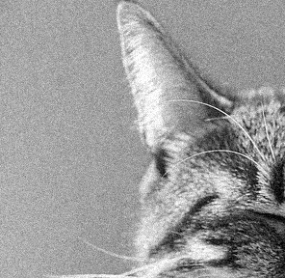
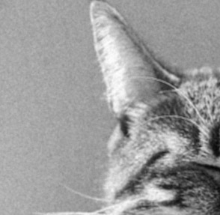
Noise reduction using mean filtering

Slide 20
Mean filtering
Replace pixel by mean of neighborhood
10
5
3
4
5
1
4.1
1
1
7
Local image data
f
Modified image data
S[f]

Slide 21
A more general version
10
5
3
4
5
1
7
1
1
7
Local image data
Kernel / filter

Slide 22
A more general version
0 | 10 | 5 | 7 | 0
5 | 11 | 6 | 8 | 3
9 | 22 | 4 | 5 | 1
2 | 9 | 14 | 6 | 7
3 | 10 | 15 | 12 | 9
 |  | 7
Local image data
Kernel size = 2k+1

Slide 23
A more general version
w(i,j) = 1/(2k+1)² for mean filter
If w(i,j) >=0 and sum to 1, weighted mean
But w(i,j) can be arbitrary real numbers!
This operation is called cross-correlation

Slide 24
Boundary conditions
Clearly valid
90 | 0 | 0 | 0 | 0 | 0 | 0 | 0 | 0 | 0
0 | 0 | 0 | 10 | 10 | 10 | 0 | 0 | 0 | 0
0 | 0 | 10 | 20 | 20 | 20 | 10 | 40 | 0 | 0
0 | 10 | 20 | 30 | 0 | 20 | 10 | 0 | 0 | 0
0 | 10 | 0 | 30 | 40 | 30 | 20 | 10 | 0 | 0
0 | 10 | 20 | 30 | 40 | 30 | 20 | 10 | 0 | 0
0 | 10 | 20 | 10 | 40 | 30 | 20 | 10 | 0 | 0
0 | 10 | 20 | 30 | 30 | 20 | 10 | 0 | 0 | 0
0 | 0 | 10 | 20 | 20 | 0 | 10 | 0 | 20 | 0
0 | 0 | 0 | 10 | 10 | 10 | 0 | 0 | 0 | 0

Slide 25
Boundary conditions
Can do if we assume empty space is 0
90 | 0 | 0 | 0 | 0 | 0 | 0 | 0 | 0 | 0
0 | 0 | 0 | 10 | 10 | 10 | 0 | 0 | 0 | 0
0 | 0 | 10 | 20 | 20 | 20 | 10 | 40 | 0 | 0
0 | 10 | 20 | 30 | 0 | 20 | 10 | 0 | 0 | 0
0 | 10 | 0 | 30 | 40 | 30 | 20 | 10 | 0 | 0
0 | 10 | 20 | 30 | 40 | 30 | 20 | 10 | 0 | 0
0 | 10 | 20 | 10 | 40 | 30 | 20 | 10 | 0 | 0
0 | 10 | 20 | 30 | 30 | 20 | 10 | 0 | 0 | 0
0 | 0 | 10 | 20 | 20 | 0 | 10 | 0 | 20 | 0
0 | 0 | 0 | 10 | 10 | 10 | 0 | 0 | 0 | 0

Slide 26
Boundary conditions
Can still potentially compute
90 | 0 | 0 | 0 | 0 | 0 | 0 | 0 | 0 | 0
0 | 0 | 0 | 10 | 10 | 10 | 0 | 0 | 0 | 0
0 | 0 | 10 | 20 | 20 | 20 | 10 | 40 | 0 | 0
0 | 10 | 20 | 30 | 0 | 20 | 10 | 0 | 0 | 0
0 | 10 | 0 | 30 | 40 | 30 | 20 | 10 | 0 | 0
0 | 10 | 20 | 30 | 40 | 30 | 20 | 10 | 0 | 0
0 | 10 | 20 | 10 | 40 | 30 | 20 | 10 | 0 | 0
0 | 10 | 20 | 30 | 30 | 20 | 10 | 0 | 0 | 0
0 | 0 | 10 | 20 | 20 | 0 | 10 | 0 | 20 | 0
0 | 0 | 0 | 10 | 10 | 10 | 0 | 0 | 0 | 0

Slide 27
Boundary conditions
Output will be 0 so no point computing
90 | 0 | 0 | 0 | 0 | 0 | 0 | 0 | 0 | 0
0 | 0 | 0 | 10 | 10 | 10 | 0 | 0 | 0 | 0
0 | 0 | 10 | 20 | 20 | 20 | 10 | 40 | 0 | 0
0 | 10 | 20 | 30 | 0 | 20 | 10 | 0 | 0 | 0
0 | 10 | 0 | 30 | 40 | 30 | 20 | 10 | 0 | 0
0 | 10 | 20 | 30 | 40 | 30 | 20 | 10 | 0 | 0
0 | 10 | 20 | 10 | 40 | 30 | 20 | 10 | 0 | 0
0 | 10 | 20 | 30 | 30 | 20 | 10 | 0 | 0 | 0
0 | 0 | 10 | 20 | 20 | 0 | 10 | 0 | 20 | 0
0 | 0 | 0 | 10 | 10 | 10 | 0 | 0 | 0 | 0

Slide 28
Boundary conditions
90 | 0 | 0 | 0 | 0 | 0 | 0 | 0 | 0 | 0
0 | 0 | 0 | 10 | 10 | 10 | 0 | 0 | 0 | 0
0 | 0 | 10 | 20 | 20 | 20 | 10 | 40 | 0 | 0
0 | 10 | 20 | 30 | 0 | 20 | 10 | 0 | 0 | 0
0 | 10 | 0 | 30 | 40 | 30 | 20 | 10 | 0 | 0
0 | 10 | 20 | 30 | 40 | 30 | 20 | 10 | 0 | 0
0 | 10 | 20 | 10 | 40 | 30 | 20 | 10 | 0 | 0
0 | 10 | 20 | 30 | 30 | 20 | 10 | 0 | 0 | 0
0 | 0 | 10 | 20 | 20 | 0 | 10 | 0 | 20 | 0
0 | 0 | 0 | 10 | 10 | 10 | 0 | 0 | 0 | 0

Slide 29
Boundary conditions
Setup
  m x m image
  k x k kernel
Output size?

Slide 30
Boundary conditions in practice
“Full”: compute if any part of kernel intersects with image
  Assumes image is padded with 0’s
  Output size = m+k-1
  Technically cross-correlation and convolution means this
  0 padding can cause artifacts
“Same convolution”: compute if center of kernel is in image
  Assumes image is padded with 0’s
  output size = m
  Common in practice
“Valid convolution”: compute only if all of kernel is in image
  no padding
  output size = m-k+1
  No artifacts

Slide 31
Properties: Linearity

Slide 32
Properties: Linearity

Slide 33
Properties: Linearity

Slide 34
Properties: Linearity

Slide 35
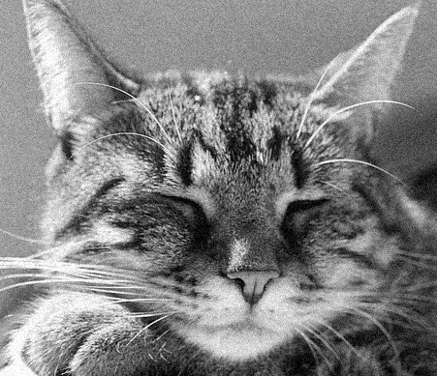
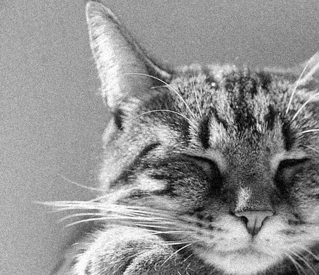
Properties: Shift equivariance
f
f’

Slide 36
Shift equivariance

Slide 37
Shift equivariance
Shift, then filter = filter, then shift
Output of filtering does not depend on where the pixel is
f
f’

Slide 38
Convolution and cross-correlation
Cross correlation
Convolution

Slide 39
Cross-correlation
1 | 2 | 3
4 | 5 | 6
7 | 8 | 9
1 | 2 | 3
4 | 5 | 6
7 | 8 | 9
w
f
1*1 + 2*2 + 3*3 + 4*4 + 5*5 + 6*6 + 7*7 + 8*8 + 9*9

Slide 40
Convolution
1 | 2 | 3
4 | 5 | 6
7 | 8 | 9
1 | 2 | 3
4 | 5 | 6
7 | 8 | 9
w
f
1*9 + 2*8 + 3*7 + 4*6 + 5*5 + 6*4 + 7*3 + 8*2 + 9*1

Slide 41

Convolution
Adapted from F. Durand

Slide 42
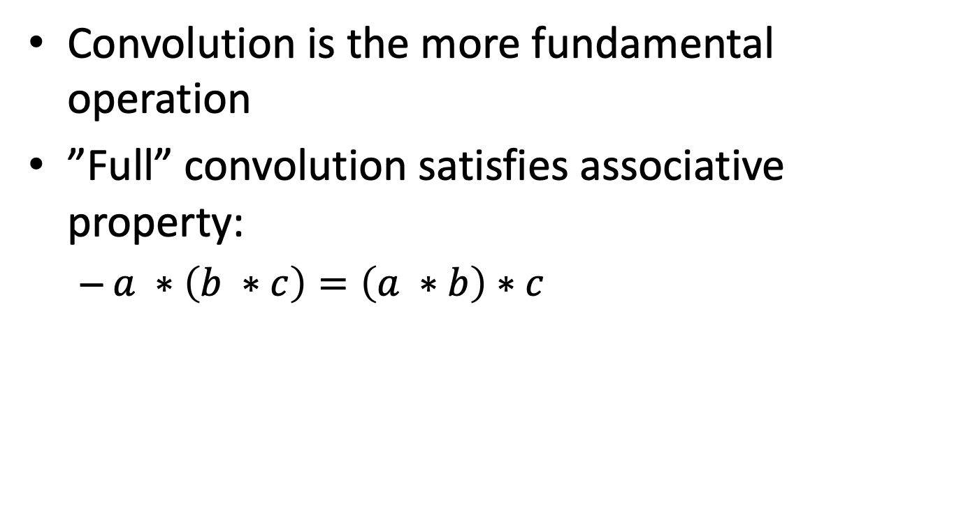
Convolution
Convolution is the more fundamental operation
”Full” convolution satisfies associative property:
  $a ∗\left(b ∗c\right)=\left(a ∗b\right)∗c$

Slide 43

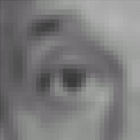

Filters: examples
*
1
1
1
=
1
1
1
1
1
1
Kernel (k)
Original (f)
Blur (with a mean filter) (g)
Source: D. Lowe

Slide 44
Filters: examples
*
0
0
0
=
0
1
0
0
0
0
Kernel (k)
Original (f)
Identical image (g)
Source: D. Lowe

Slide 45
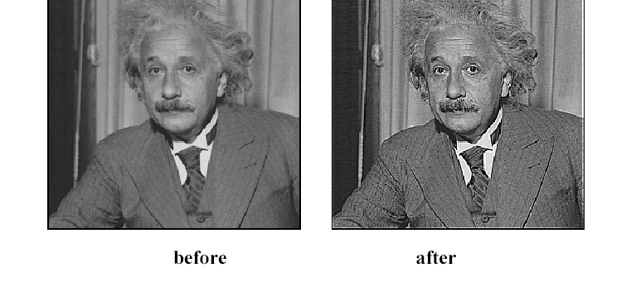
Sharpening
Source: D. Lowe

Slide 46
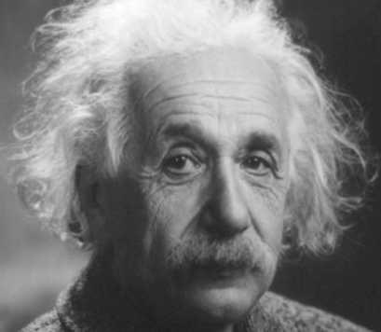
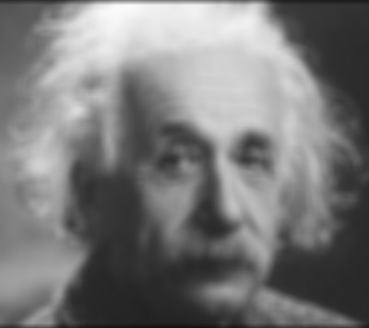
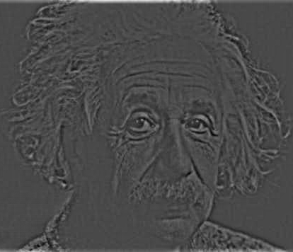
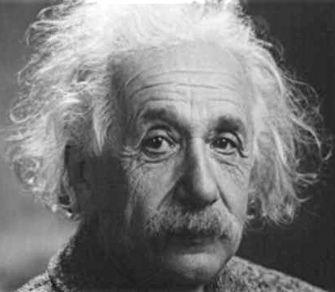
Sharpening
What does blurring take away?
–
=
Let’s add it back:
+ α
=
original
detail

Slide 47
Sharpening

Slide 48
Sharpening
What does blurring take away?
–
=
Let’s add it back:
+ α
=
original
detail

Slide 49
Sharpening
0
0
0
1
1
1
0
1
0
1
1
1
0
0
0
1
1
1

Slide 50




Sharpening filter
*
0
0
0
-
1
1
1
=
0
2
0
1
1
1
0
0
0
1
1
1
Sharpening filter (accentuates edges)
Original
Source: D. Lowe

Slide 51
Another example
-1 | -1 | -1 | -1 | -1 | -1 | -1 | -1 | -1 | -1 | -1
1 | -1 | -1 | -1 | -1 | -1 | -1 | -1 | -1 | -1 | -1
1 | 1 | -1 | -1 | -1 | -1 | -1 | -1 | -1 | -1 | -1
1 | 1 | 1 | -1 | -1 | -1 | -1 | -1 | -1 | -1 | -1
1 | 1 | 1 | 1 | -1 | -1 | -1 | -1 | -1 | -1 | -1
1 | 1 | 1 | 1 | 1 | -1 | -1 | -1 | -1 | -1 | -1
1 | 1 | 1 | 1 | 1 | 1 | -1 | -1 | -1 | -1 | -1
1 | 1 | 1 | 1 | 1 | 1 | 1 | -1 | -1 | -1 | -1
1 | 1 | 1 | 1 | 1 | 1 | 1 | 1 | -1 | -1 | -1
1 | 1 | 1 | 1 | 1 | 1 | 1 | 1 | 1 | -1 | -1
1 | 1 | 1 | 1 | 1 | 1 | 1 | 1 | 1 | 1 | -1

Slide 52
Another example

Slide 53
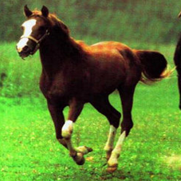
Convolution is everywhere
Horse

Slide 54


Why is convolution important?
Shift equivariance is a crucial property

Slide 55
Why is convolution important?
We like linearity
  Linear functions behave predictably when input changes
  Lots of theory just easier with linear functions
All linear shift-equivariant systems can be expressed as a convolution

Slide 56
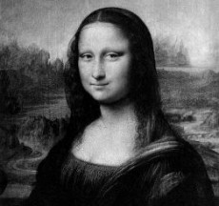
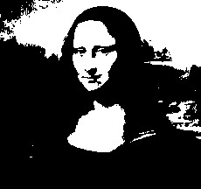

Non-linear filters: Thresholding

Slide 57
Non-linear filters: Rectification
g(m,n) = max(f(m,n), 0)
Crucial component of modern convolutional networks

Slide 58
Non-linear filters
Sometimes mean filtering does not work

Slide 59
Non-linear filters
Sometimes mean filtering does not work

Slide 60
Non-linear filters
Mean is sensitive to outliers
Median filter: Replace pixel by median of neighbors

Slide 61
Non-linear filters

Slide 62
Takeaway
Two general recipes:
  convolution
  cross-correlation
Properties
  Shift-equivariant: a sensible thing to require
  Linearity: convenient
Can be used for smoothing, sharpening
Also main component of CNNs

Slide 63
Next up
Back to linear filters
Signal processing view of filtering
Filtering for detecting edges etc

Slide 64
Images as functions
An image contains discrete numbers of pixels
Pixel value
  grayscale/intensity
    [0,255]
  Color
    RGB [R, G, B], where [0,255] per channel

Slide 65
Images as functions
Can think of image as a function, f, from R² to R or R^{M}:
  Grayscale: f (x,y) gives intensity at position (x,y)
    f: [a,b] x [c,d] ➔[0,255]
  Color: f (x,y) = [r(x,y), g(x,y), b(x,y)]
Most adjacent pixels are correlated => function is continuous

Slide 66
What is an image?
  A digital image is a discrete (sampled, quantized) version of this function
f (x, y)
x
y

