Slide 1
Semantic Segmentation

Slide 2
The Task
person
grass
trees
motorbike
road

Slide 3
Evaluation metric
Pixel classification!
Accuracy?
Heavily unbalanced
Common classes are over-emphasized
Intersection over Union
Average across classes and images
Per-class accuracy
Compute accuracy for every class and then average

Slide 4
Things vs Stuff
THINGS
Person, cat, horse, etc
Constrained shape
Individual instances with separate identity
May need to look at objects
STUFF
Road, grass, sky etc
Amorphous, no shape
No notion of instances
Can be done at pixel level
“texture”

Slide 5
Challenges in data collection
Precise localization is hard to annotate
Annotating every pixel leads to heavy tails
Common solution: annotate few classes (often things), mark rest as “Other”
Common datasets: PASCAL VOC 2012 (~1500 images, 20 categories), COCO (~100k images, 20 categories)

Slide 6
Pre-convnet semantic segmentation
Things
Do object detection, then segment out detected objects
Stuff
”Texture classification”
Compute histograms of filter responses
Classify local image patches

Slide 7
Semantic segmentation using convolutional networks
w
3
h

Slide 8
Semantic segmentation using convolutional networks
c
w/4
h/4

Slide 9
Semantic segmentation using convolutional networks
c
w/4
h/4

Slide 10
Semantic segmentation using convolutional networks
c
w/4
Can be considered as a feature vector for a pixel
h/4

Slide 11
Semantic segmentation using convolutional networks
c
#classes
Convolve with #classes 1x1 filters
w/4
h/4

Slide 12
Semantic segmentation using convolutional networks
Pass image through convolution and subsampling layers
Final convolution with #classes outputs
Get scores for subsampled image
Upsample back to original size

Slide 13
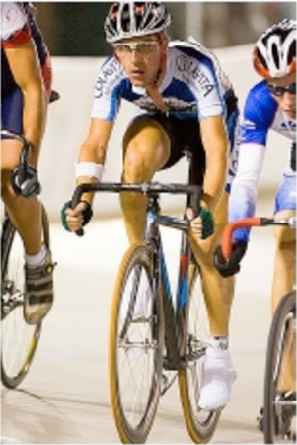
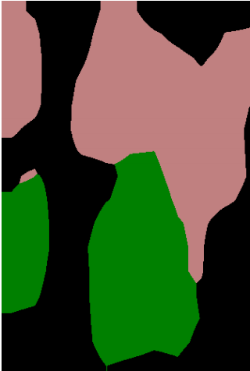
Semantic segmentation using convolutional networks
person
bicycle

Slide 14
The resolution issue
Problem: Need fine details!
Shallower network / earlier layers?
Deeper networks work better: more abstract concepts
Shallower network => Not very semantic!
Remove subsampling?
Subsampling allows later layers to capture larger and larger patterns
Without subsampling => Looks at only a small window!

Slide 15
Solution 1: Image pyramids
Higher resolution Less context
Small networks that maintain resolution
Learning Hierarchical Features for Scene Labeling. Clement Farabet, Camille Couprie, Laurent Najman, Yann LeCun. In TPAMI, 2013.

Slide 16
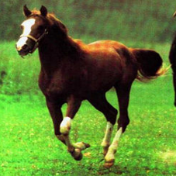
Solution 2: Skip connections
upsample
Compute class scores at multiple layers, then upsample and add

Slide 17
Solution 2: Skip connections
Red arrows indicate backpropagation

Slide 18
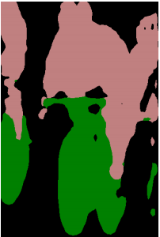
Skip connections
without skip
with skip
Fully convolutional networks for semantic segmentation. Evan Shelhamer, Jon Long, Trevor Darrell. In CVPR 2015

Slide 19
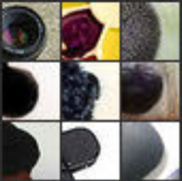
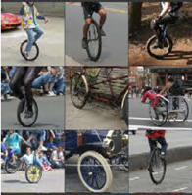
Skip connections
Problem: early layers not semantic
Horse
Visualizations from : M. Zeiler and R. Fergus. Visualizing and Understanding Convolutional Networks. In ECCV 2014.
Notes:
If you look at what one of these higher layers is detecting, here I am showing the input image patches that are highly scored by one of the units. This particular layer really likes bicycle wheels, so if this unit fires, you know that there is a bicycle wheel in the image. Unfortunately, you don’t know where the bicycle wheel is, because this unit doesn’t care where the bicycle wheel appears, or at what orientation or what scale.

Slide 20
Solution 3: Dilation
Need subsampling to allow convolutional layers to capture large regions with small filters
Can we do this without subsampling?

Slide 21
Solution 3: Dilation
Need subsampling to allow convolutional layers to capture large regions with small filters
Can we do this without subsampling?

Slide 22
Solution 3: Dilation
Need subsampling to allow convolutional layers to capture large regions with small filters
Can we do this without subsampling?

Slide 23
Solution 3: Dilation
Instead of subsampling by factor of 2: dilate by factor of 2
Dilation can be seen as:
Using a much larger filter, but with most entries set to 0
Taking a small filter and “exploding”/ “dilating” it
Not panacea: without subsampling, feature maps are much larger: memory issues

Slide 24
Putting it all together
Best Non-CNN approach: ~46.4%
Semantic Image Segmentation with Deep Convolutional Nets and Fully Connected CRFs. Liang-Chieh Chen, George Papandreou, Iasonas Kokkinos, Kevin Murphy, Alan Yuille. In ICLR, 2015.

