Slide 1
Image recognition

Slide 2
General recipe
Logistic Regression!
Fix hypothesis class
Define loss function
Minimize average loss on the training set using SGD

Slide 3
Optimization using SGD
Need to minimize average training loss
Initialize parameters
Repeat
  Sample minibatch of k training examples
  Compute average gradient of loss on minibatch
  Take step along negative ofaverage gradient

Slide 4
Overfitting = fitting the noise
Minimizer of empirical risk
Minimizer of expected risk
True distribution
Sampled training set

Slide 5
Generalization
Training error
Generalization error

Slide 6
Controlling generalization error
Variance of empirical risk inversely proportional to size of S (central limit theorem)
  Choose very large S!
Larger the hypothesis class H, Higher the chance of hitting bad hypotheses with low training error and high generalization error
  Choose small H!
For many models, can bound generalization error using some property of parameters
  “Regularization”

Slide 7
Back to images

Slide 8
Linear classifiers on pixels are bad
Solution 1: Better feature vectors
Solution 2: Non-linear classifiers

Slide 9
Better feature vectors
These must have different feature vectors: discriminability
These must have similar feature vectors: invariance

Slide 10
SIFT
Match pattern of edges
  Edge orientation – clue to shape
Be resilient to small deformations
  Deformations might move pixels around, but slightly
  Deformations might change edge orientations, but slightly
Not resilient to large deformations: important for recognition
Other feature representations exist

Slide 11
Linear classifiers on pixels are bad
Solution 1: Better feature vectors
Solution 2: Non-linear classifiers

Slide 12
Non-linear classifiers
Suppose we have a feature vector for every image

Slide 13
Non-linear classifiers
Suppose we have a feature vector for every image
  Linear classifier

Slide 14
Non-linear classifiers
Suppose we have a feature vector for every image
  Linear classifier
  Nearest neighbor: assign each point the label of the nearest neighbor

Slide 15
Non-linear classifiers
Suppose we have a feature vector for every image
  Linear classifier
  Nearest neighbor: assign each point the label of the nearest neighbor
  Decision tree: series of if-then-else statements on different features

Slide 16
Non-linear classifiers
Suppose we have a feature vector for every image
  Linear classifier
  Nearest neighbor: assign each point the label of the nearest neighbor
  Decision tree: series of if-then-else statements on different features
  Neural networks

Slide 17
Non-linear classifiers
Suppose we have a feature vector for every image
  Linear classifier
  Nearest neighbor: assign each point the label of the nearest neighbor
  Decision tree: series of if-then-else statements on different features
  Neural networks / multi-layer perceptrons

Slide 18
Multilayer perceptrons
Key idea: build complex functions by composing simple functions
Caveat: simple functions must include non-linearities
W(U(Vx)) = (WUV)x
Let us start with only two ingredients:
  Linear: y = Wx + b
  Rectified linear unit (ReLU, also called half-wave rectification): y = max(x,0)

Slide 19
The linear function
y = Wx + b
Parameters: W,b
Input: x (column vector, or 1 data point per column)
Output: y (column vector or 1 data point per column)
Hyperparameters:
  Input dimension = # of rows in x
  Output dimension = # of rows in y
  W : outdim x indim
  b : outdim x 1

Slide 20
The linear function
y = Wx + b
Every row of y corresponds to a hyperplane in x space
=
d_{in}
d_{out}
The case when d_{in} = 2. A single row in y plotted for every possible value of x

Slide 21
Multilayer perceptrons
Key idea: build complex functions by composing simple functions
x
f(x) = Wx
g(x) = max(x,0)
f(x) = Wx
g(x) = max(x,0)
f(x) = Wx
y
z
1 row of z plotted for every value of x
1 row of y plotted for every value of x

Slide 22
Multilayer perceptron on images
An example network for cat vs dog
Linear + ReLU
Linear + ReLU
Linear + sigmoid
Reshape
256
65K
p(dog | image)
256
32
1024

Slide 23
The linear function
y = Wx + b
How many parameters does a linear function have?
=
d_{in}
d_{out}
The case when d_{in} = 2. A single row in y plotted for every possible value of x

Slide 24
The linear function for images
W
1024
65K
65K

Slide 25
Reducing parameter count
A single “pixel” in the output is a weighted combination of all input pixels
W

Slide 26
Reducing parameter count
A single “pixel” in the output is a weighted combination of all input pixels

Slide 27
Idea 1: local connectivity
Instead of inputs and outputs being general vectors suppose we keep both as 2D arrays.
Reasonable assumption: output pixels only produced by nearby input pixels

Slide 28
Idea 2: Translation invariance
Output pixels weighted combination of nearby pixels
Weights should not depend on the location of the neighborhood

Slide 29
Linear function + translation invariance = convolution
Local connectivity determines kernel size
5.4 | 0.1 | 3.6
1.8 | 2.3 | 4.5
1.1 | 3.4 | 7.2

Slide 30
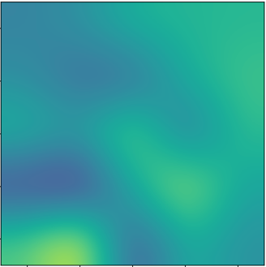
Linear function + translation invariance = convolution
Local connectivity determines kernel size
Running a filter on a single image gives a single feature map
Feature map
5.4 | 0.1 | 3.6
1.8 | 2.3 | 4.5
1.1 | 3.4 | 7.2

Slide 31
Convolution with multiple filters
Running multiple filters gives multiple feature maps
Each feature map is a channel of the output
Feature map
5.4 | 0.1 | 3.6
1.8 | 2.3 | 4.5
1.1 | 3.4 | 7.2

Slide 32
Convolution over multiple channels
If the input also has multiple channels, each filter also has multiple channels, and output of a filter = sum of responses across channels
*
+
*
*
=
+
*

Slide 33
Convolution as a primitive
To get c’ output channels out of c input channels, we need c’ filters of c channels each
c
c
c’
c’
Convolution
h
h
w
w

Slide 34
Kernel sizes and padding
As with standard convolution, we can have ”valid”, “same” or “full” convolution (typically valid or same)
k
k

Slide 35
Kernel sizes and padding
Valid convolution decreases size by (k-1)/2 on each side
Pad by (k-1)/2!
k
Valid convolution
k
(k-1)/2

Slide 36
The convolution unit
Each convolutional unit takes a collection of feature maps as input, and produces a collection of feature maps as output
Parameters: Filters (+bias)
If c_{in} input feature maps and c_{out} output feature maps
  Each filter is k x k x c_{in}
  There are c_{out} such filters
Other hyperparameters: padding

Slide 37
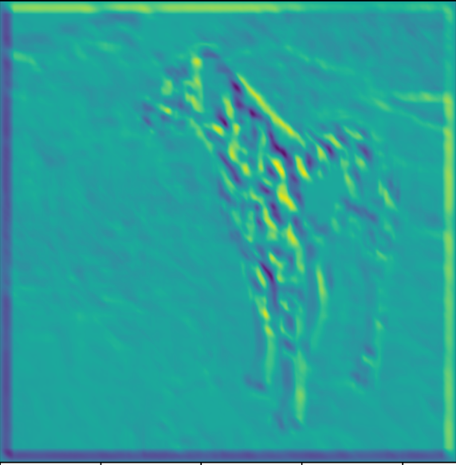
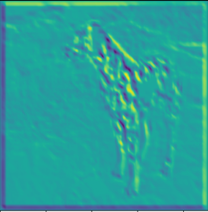
Invariance to distortions: Subsampling
Convolution by itself doesn’t grant invariance
But by subsampling, large distortions become smaller, so more invariance

Slide 38
Convolution-subsampling-convolution
Interleaving convolutions and subsamplings causes later convolutions to capture a larger fraction of the image with the same kernel size
Set of image pixels that an intermediate output pixel depends on = receptive field
Convolutions after subsamplings increase the receptive feild

Slide 39
Convolution subsampling convolution
Convolution in earlier steps detects more local patterns less resilient to distortion
Convolution in later steps detects more global patterns more resilient to distortion
Subsampling allows capture of larger, more invariant patterns

Slide 40
Strided convolution
Convolution with stride s = standard convolution + subsampling by picking 1 value every s values
Example: convolution with stride 2 = standard convolution + subsampling by a factor of 2

Slide 41
Invariance to distortions: Average Pooling
4 | 7 | 6 | 9 | 3 | 11
8 | 3 | 21 | 4 | 0 | 0
1 | 2 | 1 | 3 | 5 | 6
7 | 9 | 4 | 3 | 1 | 8
5 | 2 | 1 | 5 | 5 | 0
0 | 1 | 6 | 4 | 5 | 6
…
5.5 | 10 | 3.5
4.75 | 2.75 | 5
2 | 4 | 4

Slide 42
Global average pooling
4 | 7 | 6 | 9 | 3 | 11
8 | 3 | 21 | 4 | 0 | 0
1 | 2 | 1 | 3 | 5 | 6
7 | 9 | 4 | 3 | 1 | 8
5 | 2 | 1 | 5 | 5 | 0
0 | 1 | 6 | 4 | 5 | 6
…
5.5
1 x 1 x c
=c dimensional vector
w x h x c

Slide 43
The pooling unit
Each pooling unit takes a collection of feature maps as input and produces a collection of feature maps as output
Output feature maps are usually smaller in height / width
Parameters: None

Slide 44
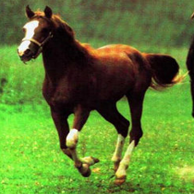
Convolutional networks
Global average pooling
Horse

Slide 45
Convolutional networks
conv
subsample
conv
subsample
linear
filters
filters
weights

Slide 46
Empirical Risk Minimization
Convolutional network
Gradient descent update

Slide 47
Computing the gradient of the loss

Slide 48
Convolutional networks
conv
subsample
conv
subsample
linear
filters
filters
weights

Slide 49
The gradient of convnets
z₁
z₂
z₃
z₄
z₅ = z
f₁
f₂
f₃
f₄
f₅
x
w₁
w₂
w₃
w₄
w₅

Slide 50
The gradient of convnets
z₁
z₂
z₃
z₄
z₅ = z
f₁
f₂
f₃
f₄
f₅
x
w₁
w₂
w₃
w₄
w₅

Slide 51
The gradient of convnets
z₁
z₂
z₃
z₄
z₅ = z
f₁
f₂
f₃
f₄
f₅
x
w₁
w₂
w₃
w₄
w₅

Slide 52
The gradient of convnets
z₁
z₂
z₃
z₄
z₅ = z
f₁
f₂
f₃
f₄
f₅
x
w₁
w₂
w₃
w₄
w₅

Slide 53
The gradient of convnets
z₁
z₂
z₃
z₄
z₅ = z
f₁
f₂
f₃
f₄
f₅
x
w₁
w₂
w₃
w₄
w₅

Slide 54
The gradient of convnets
z₁
z₂
z₃
z₄
z₅ = z
f₁
f₂
f₃
f₄
f₅
x
w₁
w₂
w₃
w₄
w₅

Slide 55
The gradient of convnets
z₁
z₂
z₃
z₄
z₅ = z
f₁
f₂
f₃
f₄
f₅
x
w₁
w₂
w₃
w₄
w₅

Slide 56
The gradient of convnets
z₁
z₂
z₃
z₄
z₅ = z
f₁
f₂
f₃
f₄
f₅
x
w₁
w₂
w₃
w₄
w₅

Slide 57
The gradient of convnets
z₁
z₂
z₃
z₄
z₅ = z
f₁
f₂
f₃
f₄
f₅
x
w₁
w₂
w₃
w₄
w₅

Slide 58
The gradient of convnets
z₁
z₂
z₃
z₄
z₅ = z
f₁
f₂
f₃
f₄
f₅
x
w₁
w₂
w₃
w₄
w₅

Slide 59
The gradient of convnets
z₁
z₂
z₃
z₄
z₅ = z
f₁
f₂
f₃
f₄
f₅
x
w₁
w₂
w₃
w₄
w₅

Slide 60
The gradient of convnets
z₁
z₂
z₃
z₄
z₅ = z
f₁
f₂
f₃
f₄
f₅
x
w₁
w₂
w₃
w₄
w₅

Slide 61
The gradient of convnets
z₁
z₂
z₃
z₄
z₅ = z
f₁
f₂
f₃
f₄
f₅
x
w₁
w₂
w₃
w₄
w₅

Slide 62
The gradient of convnets
z₁
z₂
z₃
z₄
z₅ = z
f₁
f₂
f₃
f₄
f₅
x
w₁
w₂
w₃
w₄
w₅
Recurrence going backward!!

Slide 63
The gradient of convnets
z₁
z₂
z₃
z₄
z₅ = z
f₁
f₂
f₃
f₄
f₅
x
w₁
w₂
w₃
w₄
w₅
Backpropagation

Slide 64
Backpropagation for a sequence of functions
Previous term
Function derivative

Slide 65
Backpropagation for a sequence of functions
Assume we can compute partial derivatives of each function
Use g(z_{i}) to store gradient of z w.r.t z_{i}, g(w_{i}) for w_{i}
Calculate g_{i} by iterating backwards
Use gi to compute gradient of parameters

Slide 66
Backpropagation for a sequence of functions
Each “function” has a “forward” and “backward” module
Forward module for f_{i}
  takes z_{i-1} and weight w_{i} as input
  produces z_{i} as output
Backward module for f_{i}
  takes g(z_{i} ) as input
  produces g(z_{i-1} ) and g(w_{i}) as output

Slide 67
Backpropagation for a sequence of functions
z_{i-1}
f_{i}
z_{i}
w_{i}

Slide 68
Backpropagation for a sequence of functions
g(z_{i-1})
f_{i}
g(z_{i})
g(w_{i})

Slide 69
Chain rule for vectors
Jacobian

Slide 70
Loss as a function
label
conv
subsample
conv
subsample
linear
loss
filters
filters
weights

Slide 71
Neural network frameworks
Caffe

Slide 72
Beyond sequences: computation graphs
Arbitrary graphs of functions
No distinction between intermediate outputs and parameters
g
k
u
x
f
l
z
y
h
w

Slide 73
Computation graph - Functions
Each node implements two functions
  A “forward”
    Computes output given input
  A “backward”
    Computes derivative of z w.r.t input, given derivative of z w.r.t output

Slide 74
Computation graphs
a
f_{i}
b
d
c

Slide 75
Computation graphs
f_{i}

Slide 76
Computation graphs
a
f_{i}
b
d
c

Slide 77
Computation graphs
f_{i}

Slide 78


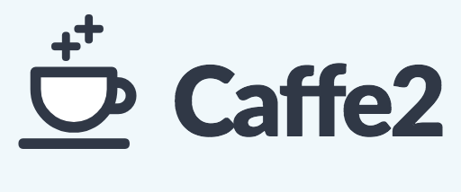

Neural network frameworks

