Slide 1
Grouping

Slide 2
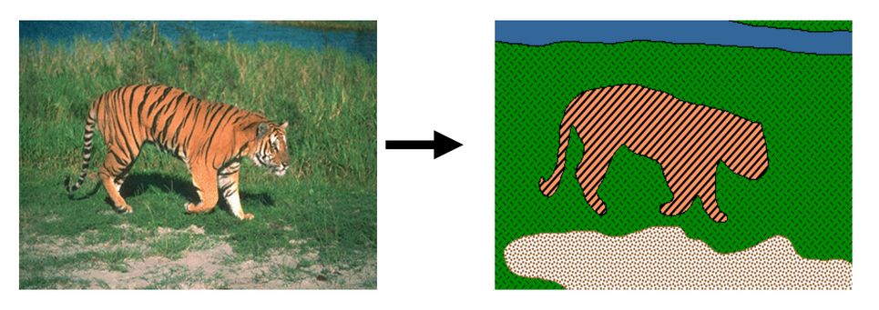
Grouping
Grouping pixels into objects (“perceptual organization”)

Slide 3
Why grouping?
Pixels property of sensor, not world
Reasoning at object level (might) make things easy:
  objects at consistent depth
  objects can be recognized
  objects move as one
"I stand at the window and see a house, trees, sky. Theoretically I might say there were 327 brightnesses and nuances of colour. Do I have "327"? No. I have sky, house, and trees."
Max Wertheimer

Slide 4
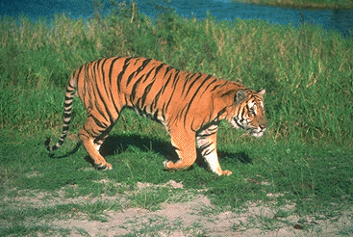
Regions Boundaries

Slide 5
Why edges?
Resilience to lighting and color
  useful for recognition, matching patches across images

Slide 6
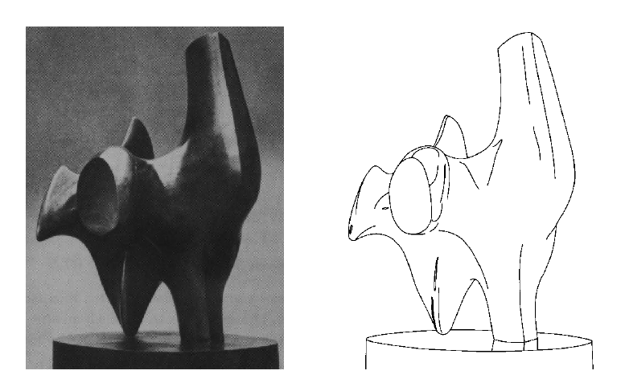
Why edges?
Humans are sensitive to edges
Convert a 2D image into a set of curves
  Extracts salient features of the scene, more compact
TexPoint fonts used in EMF.
Read the TexPoint manual before you delete this box.: AAA

Slide 7
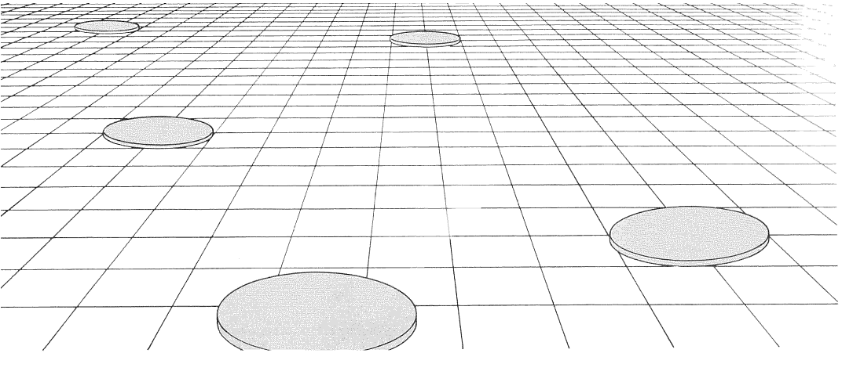
Why edges?
Cue to shape and geometry
  useful for recognition, understanding 3D structure
Credit: Jitendra Malik
Credit: Attneave

Slide 8
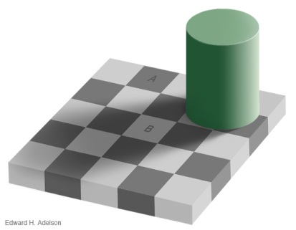
Edges
Edges are curves in the image, across which the brightness changes “a lot”
Corners/Junctions
Notes:
Reflctance edges
Shadow edges
Depth edges
Normal edges

Slide 9
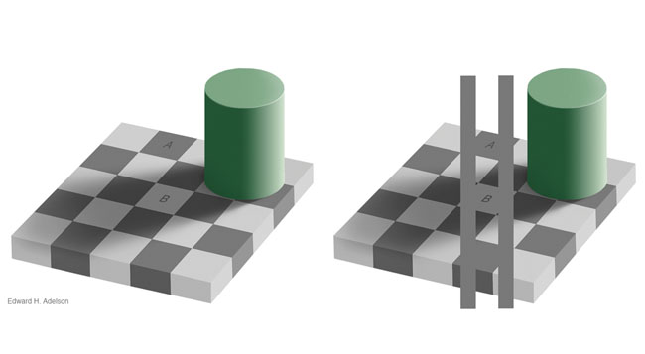
Aside

Slide 10

Closeup of edges
Source: D. Hoiem

Slide 11

Closeup of edges
Source: D. Hoiem

Slide 12

Closeup of edges
Source: D. Hoiem

Slide 13

Characterizing edges
An edge is a place of rapid change in the image intensity function
intensity function
(along horizontal scanline)
image
first derivative
edges correspond to
extrema of derivative
Source: L. Lazebnik

Slide 14
Derivatives and convolution
Differentiation is linear
Differentiation is shift-invariant
  Derivative of shifted signal is shifted derivative
Hence, differentiation can be represented as convolution!

Slide 15
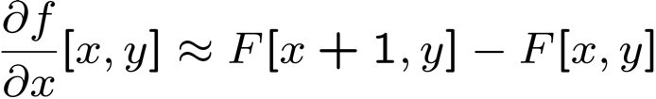




Image derivatives
How can we differentiate a discrete image F[x,y]?
  Option 1: reconstruct a continuous image, f, then compute the derivative
  Option 2: take discrete derivative (finite difference)
How would you implement this as a linear filter?
1 | -1
 | -1
 | 1
:
:
Source: S. Seitz
Notes:
give definition of partial derivative: lim h->0 [f(x+h,y) – f(x,y)]/h

Slide 16





Image gradient
The gradient of an image:
The gradient points in the direction of most rapid increase in intensity
The edge strength is given by the gradient magnitude:
The gradient direction is given by:
  how does this relate to the direction of the edge?
Source: Steve Seitz
Notes:
give definition of partial derivative: lim h->0 [f(x+h,y) – f(x,y)]/h
Gradient direction perpendicular to edge direction

Slide 17
Image gradient
Gradient magnitude
Gradient in x
Gradient in y
Source: L. Lazebnik
Notes:
Top right: gradient magnitude
x, y

Slide 18





Effects of noise
Noisy input image
Where is the edge?
Source: S. Seitz
Notes:
How to fix?

Slide 19
Effects of noise
Noise is high frequency
Differentiation accentuates noise

Slide 20
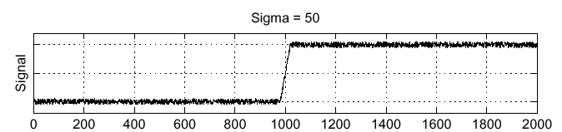
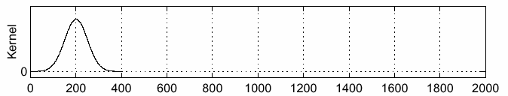
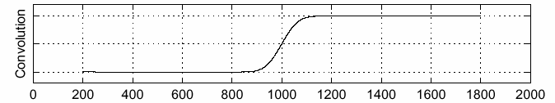
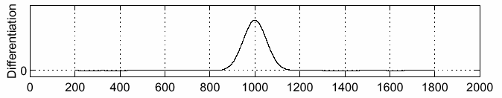
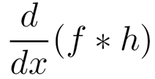
Solution: smooth first
f
h
f * h
To find edges, look for peaks in
Source: S. Seitz

Slide 21
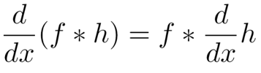
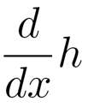
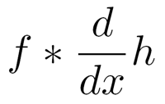

Associative property of convolution
Differentiation is a convolution
Convolution is associative:
This saves us one operation:
f
Source: S. Seitz

Slide 22




2D edge detection filters
derivative of Gaussian (x)
Gaussian
Notes:
How many 2nd derivative filters are there? There are four 2nd partial derivative filters.
In practice, it’s handy to define a single 2nd derivative filter—the Laplacian

Slide 23


Derivative of Gaussian filter
x-direction
y-direction

Slide 24
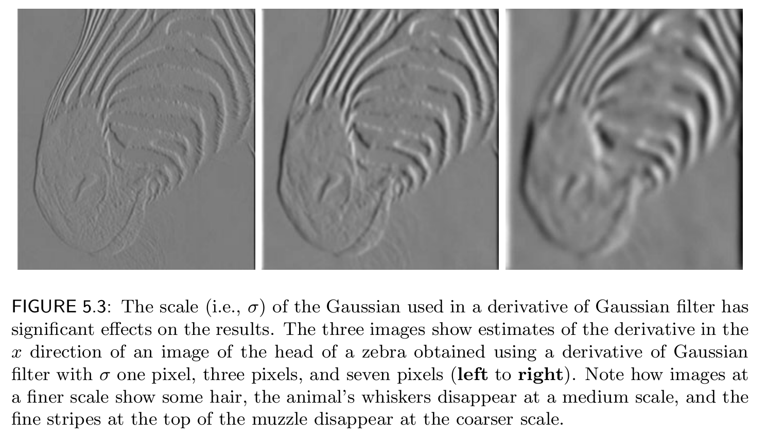

Slide 25
Derivative of Gaussian filter
x-direction
y-direction

Slide 26
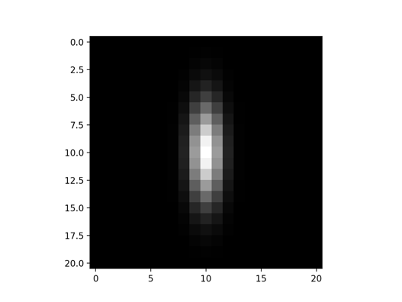
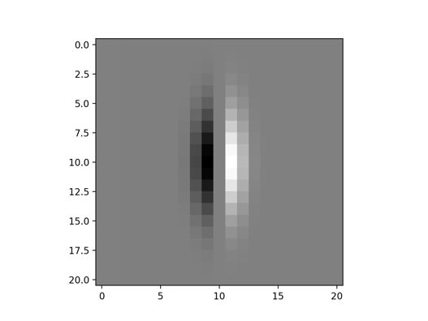
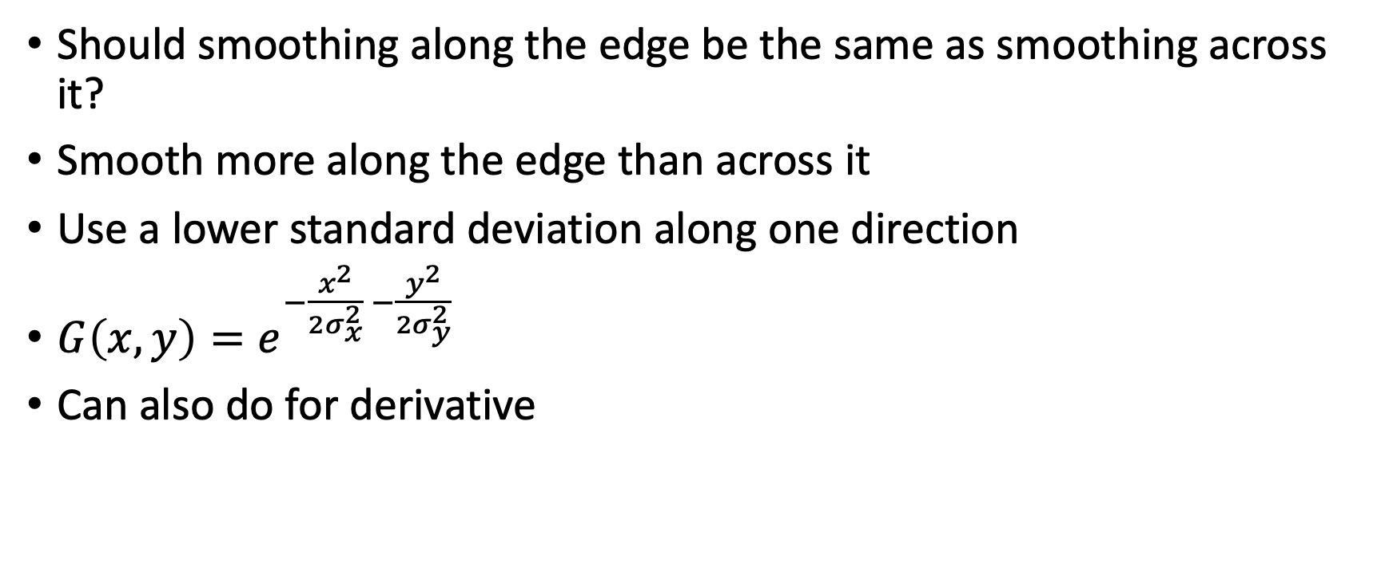
Anisotropic Gaussian
Should smoothing along the edge be the same as smoothing across it?
Smooth more along the edge than across it
Use a lower standard deviation along one direction
$G\left(x,y\right)=e^{−\frac{x^{2}}{{2σ}_{x}^{2}} −\frac{y^{2}}{{2σ}_{y}^{2}}}$
Can also do for derivative

Slide 27

Oriented Gaussian Derivatives
Instead of just derivative along x and y, can also rotate filter to get derivatives along different directions

Slide 28
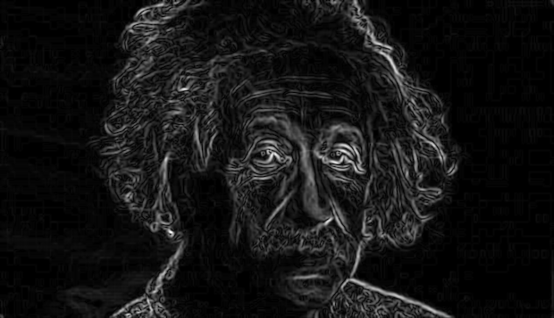
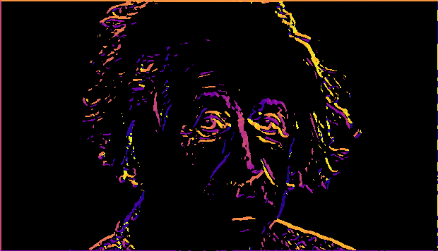
Gradient magnitude and orientation
Orientation is undefined at pixels with 0 gradient
Magnitude
Orientation
theta = numpy.arctan2(gy, gx)

Slide 29


Non-maximum suppression for each orientation
At q, we have a maximum if the value is larger than those at both p and at r. Interpolate to get these values.
Source: D. Forsyth

Slide 30
Before Non-max Suppression

Slide 31
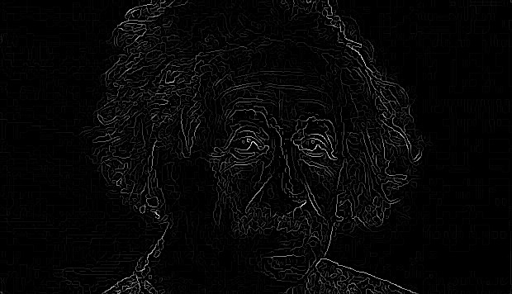
After Non-max Suppression

Slide 32
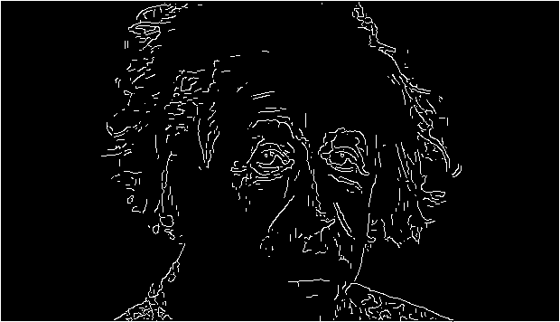
Hysteresis thresholding
Threshold at low/high levels to get weak/strong edge pixels
Do connected components, starting from strong edge pixels

Slide 33
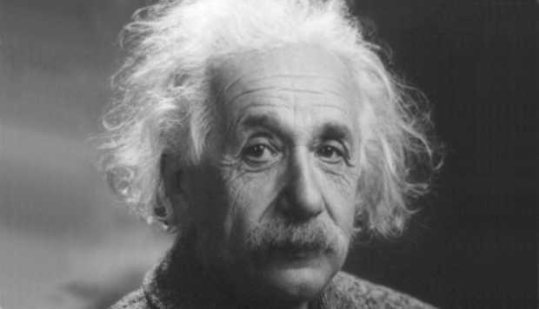
Final Canny Edges

Slide 34
Canny edge detector
Filter image with x, y derivatives of Gaussian
Find magnitude and orientation of gradient
Non-maximum suppression:
  Thin multi-pixel wide “ridges” down to single pixel width
Thresholding and linking (hysteresis):
  Define two thresholds: low and high
  Use the high threshold to start edge curves and the low threshold to continue them
Source: D. Lowe, L. Fei-Fei

