Slide 2
Detour: Time complexity of convolution
Image is w x h
Filter is k x k
Every entry takes O(k²) operations
Number of output entries:
  (w+k-1)(h+k-1) for full
  wh for same
Total time complexity:
  O(whk²)

Slide 3
Optimization: separable filters
basic alg. is O(r²): large filters get expensive fast!
definition: w(x,y) is separable if it can be written as:
Write u as a k x 1 filter, and v as a 1 x k filter
Claim:

Slide 4
Separable filters
u₁
u₂
u₃
*
v₁ | v₂ | v₃
u₁
u₂
u₃
u₃
u₂
u₁
u₁v₁

Slide 5
Separable filters
u₁
u₂
u₃
*
v₁ | v₂ | v₃
u₁
u₂
u₃
u₃
u₂
u₁
u₁v₁ | u₁v₂

Slide 6
Separable filters
u₁
u₂
u₃
*
v₁ | v₂ | v₃
u₁
u₂
u₃
u₃
u₂
u₁
u₁v₁ | u₁v₂ | u₁v₃

Slide 7
Separable filters
u₁
u₂
u₃
*
v₁ | v₂ | v₃
u₁
u₂
u₃
u₃
u₂
u₁
u₁v₁ | u₁v₂ | u₁v₃
u₂v₁

Slide 8
Separable filters
u₁
u₂
u₃
*
v₁ | v₂ | v₃
u₁
u₂
u₃
u₃
u₂
u₁
u₁v₁ | u₁v₂ | u₁v₃
u₂v₁ | u₂v₂

Slide 9
Separable filters
u₁
u₂
u₃
*
v₁ | v₂ | v₃
u₁
u₂
u₃
u₃
u₂
u₁
u₁v₁ | u₁v₂ | u₁v₃
u₂v₁ | u₂v₂ | u₂v₃

Slide 10
Separable filters
u₁
u₂
u₃
*
v₁ | v₂ | v₃
u₁
u₂
u₃
u₃
u₂
u₁
u₁v₁ | u₁v₂ | u₁v₃
u₂v₁ | u₂v₂ | u₂v₃
u₃v₁

Slide 11
Separable filters
u₁
u₂
u₃
*
v₁ | v₂ | v₃
u₁
u₂
u₃
u₃
u₂
u₁
u₁v₁ | u₁v₂ | u₁v₃
u₂v₁ | u₂v₂ | u₂v₃
u₃v₁ | u₃v₂

Slide 12
Separable filters
u₁
u₂
u₃
*
v₁ | v₂ | v₃
w
u₁
u₂
u₃
u₃
u₂
u₁
u₁v₁ | u₁v₂ | u₁v₃
u₂v₁ | u₂v₂ | u₂v₃
u₃v₁ | u₃v₂ | u₃v₃

Slide 13
Separable filters
Time complexity of original : O(whk²)
Time complexity of separable version : O(whk)

Slide 14
Image resizing

Slide 15
Why do we need to talk about resizing?
Need to zoom in to a region to get more details
Can we get more details?
Louis Daguerre, 1838

Slide 16
Why do we need to talk about resizing?
Far away objects appear small, nearby objects appear larger
Need to recognize objects at multiple scales
Resizing images to same size helps recognition

Slide 17
Why is resizing hard?
E.g, consider reducing size by a factor of 2
Simple solution: subsampling
Example: subsampling by a factor of 2

Slide 18
Why is resizing hard?
Dropping pixels causes problems

Slide 20
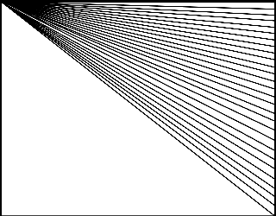

Slide 21
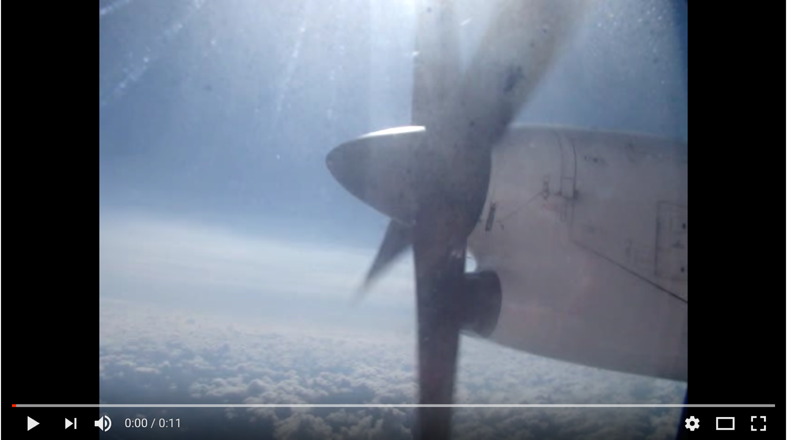
Aliasing in time

Slide 22
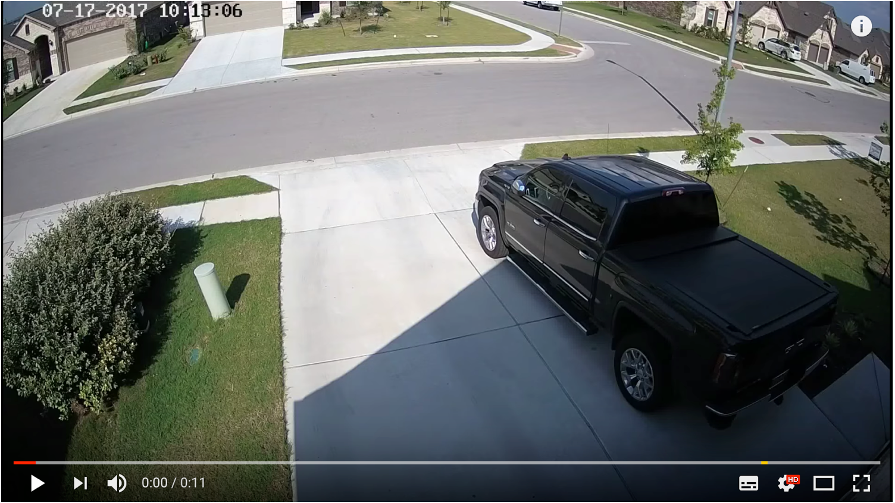
Aliasing in time

Slide 23
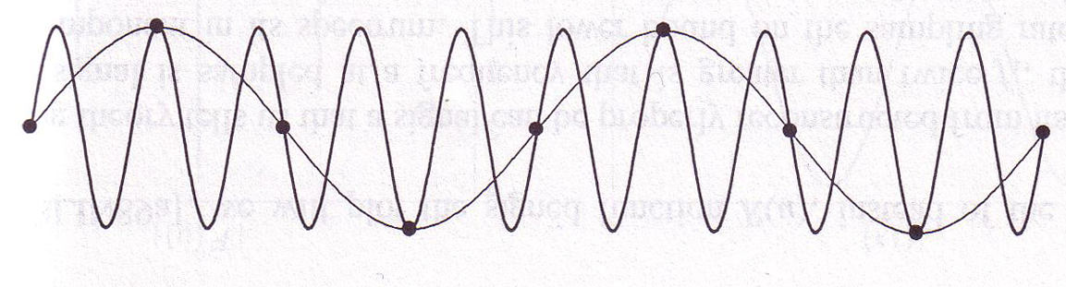
Why does aliasing happen?
We ”miss” things between samples
High frequency signals might appear as low frequency signals
Called “aliasing”
© Kavita Bala, Computer Science, Cornell University

Slide 24
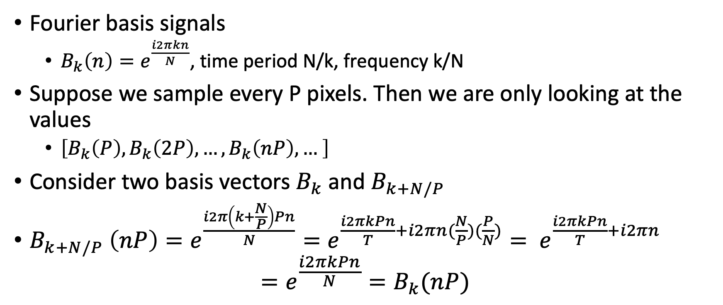
Let’s look at it mathematically
Fourier basis signals
  $B_{k}\left(n\right)=e^{\frac{i2πkn}{N}}$, time period N/k, frequency k/N
Suppose we sample every P pixels. Then we are only looking at the values
  $\left[B_{k}\left(P\right), B_{k}\left(2P\right), …, B_{k}\left(nP\right), … \right]$
Consider two basis vectors $B_{k}$ and $B_{k+N/P}$
$B_{k+N/P} \left(nP\right)=e^{\frac{i2π\left(k+\frac{N}{P}\right)Pn}{N}}=e^{\frac{i2πkPn}{T}+i2πn(\frac{N}{P})(\frac{P}{N})}= e^{\frac{i2πkPn}{T}+i2πn}$
$=e^{\frac{i2πkPn}{N}}=B_{k}(nP)$

Slide 25
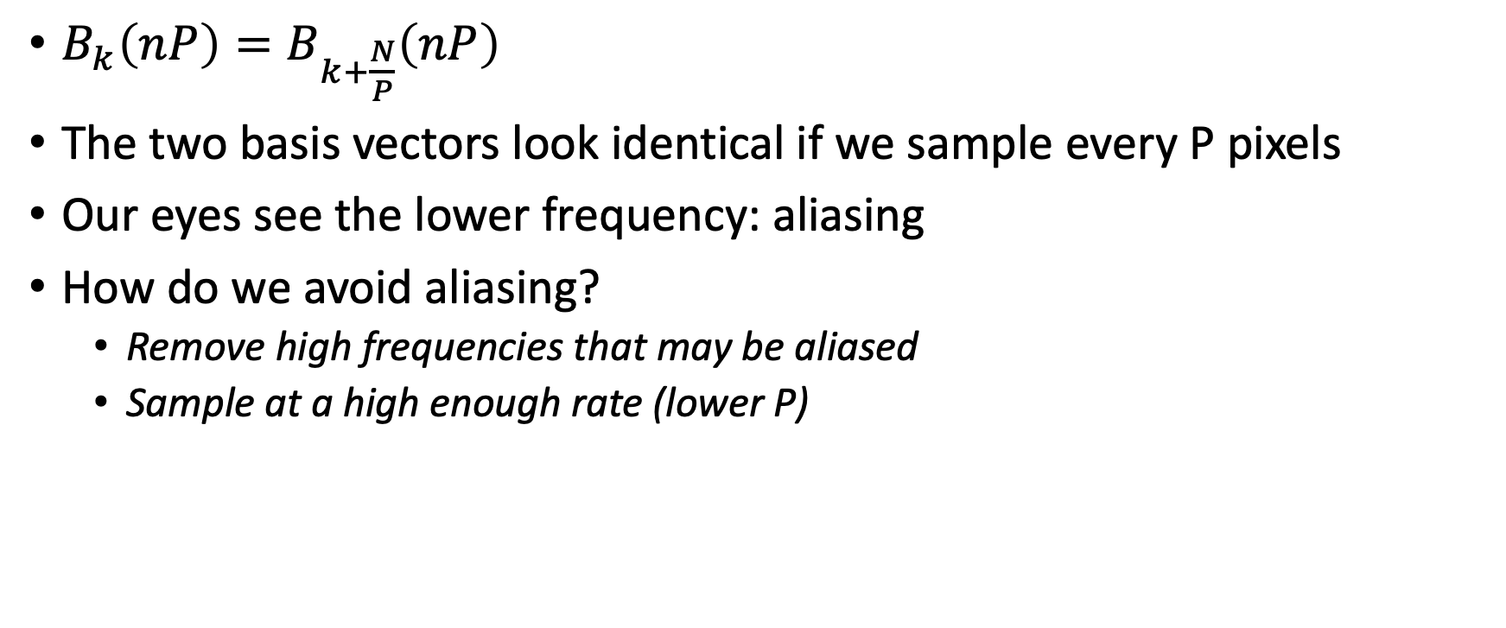
Let’s look at it mathematically
$B_{k}\left(nP\right)=B_{k+\frac{N}{P}}\left(nP\right)$
The two basis vectors look identical if we sample every P pixels
Our eyes see the lower frequency: aliasing
How do we avoid aliasing?
  Remove high frequencies that may be aliased
  Sample at a high enough rate (lower P)

Slide 26

Avoiding aliasing
Suppose image has limited high frequency components
Fourier transform of x is X
Suppose X is non-zero only for $−k_{max}$ to $k_{max}$
-N/2
-k_{max}
0
k_{max}
N/2

Slide 27

Avoiding aliasing
When sampling once every P pixels, $−k_{max}$ is indistinguishable from $−k_{max}+N/P$
If image has both coefficients, they will get mixed
So we want that $k_{max}<−k_{max}+\frac{N}{P}⇒ 2k_{max}<\frac{N}{P}$
-N/2
-k_{max}
0
k_{max}
N/2
-k_{max}+N/P

Slide 28
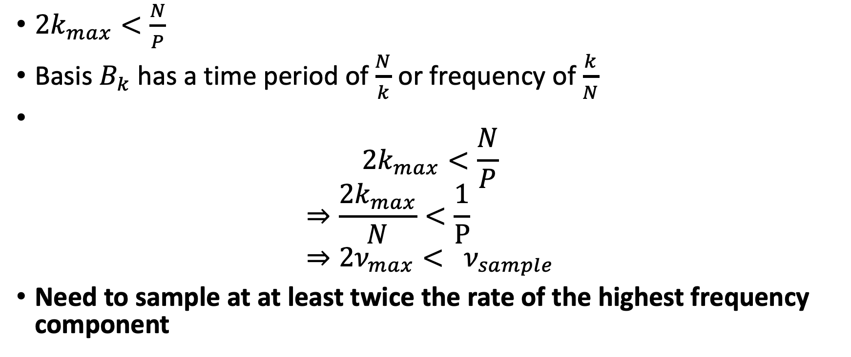
Nyquist Sampling Theorem
$2k_{max}<\frac{N}{P}$
Basis $B_{k}$ has a time period of $\frac{N}{k}$ or frequency of $\frac{k}{N}$
$2k_{max}<\frac{N}{P}$
$$⇒\frac{2k_{max}}{N}<\frac{1}{P} \\ ⇒2ν_{max}< ν_{sample}$$
Need to sample at at least twice the rate of the highest frequency component

Slide 29
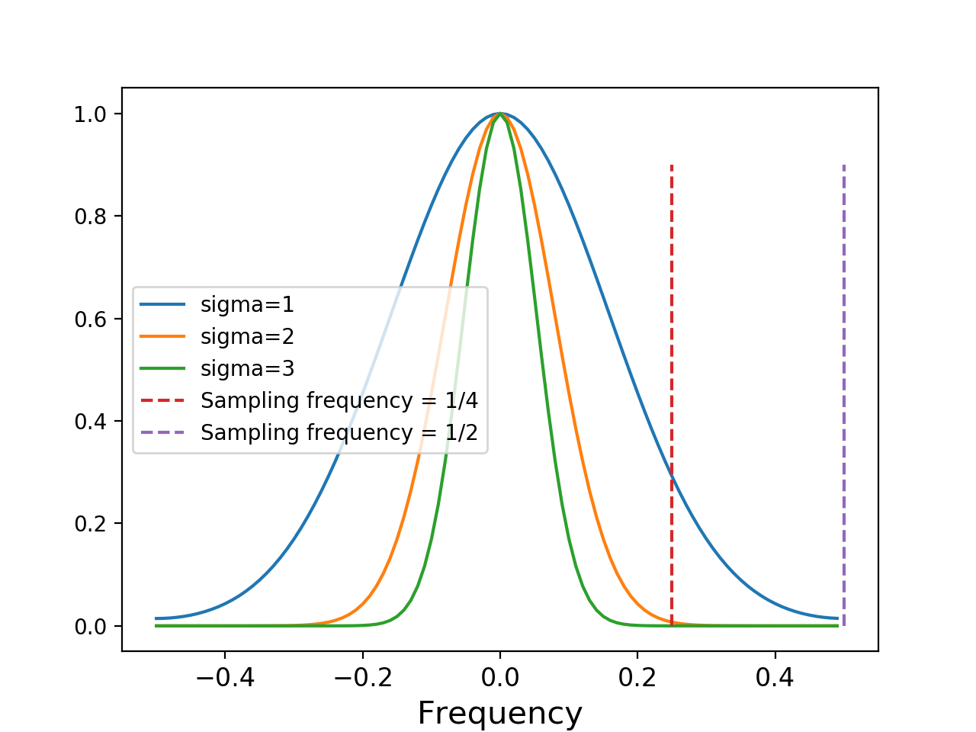
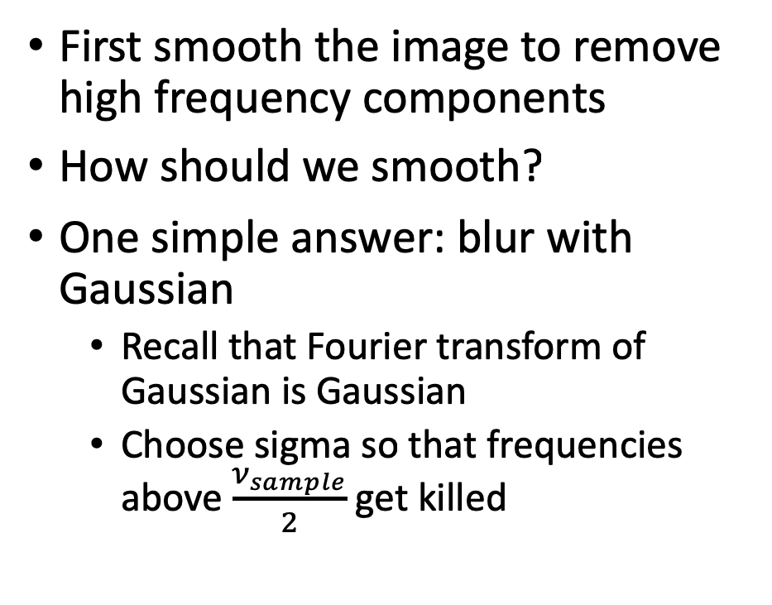
Subsampling the image
First smooth the image to remove high frequency components
How should we smooth?
One simple answer: blur with Gaussian
  Recall that Fourier transform of Gaussian is Gaussian
  Choose sigma so that frequencies above $\frac{ν_{sample}}{2}$ get killed

Slide 30

Subsampling before and after smoothing
Before
After

Slide 31



Image sub-sampling
1/2
1/4 (2x zoom)
1/16 (4x zoom)
Why does this look so crufty? Aliasing!
Source: S. Seitz

Slide 32



Subsampling images correctly
G 1/8
G 1/4
Gaussian 1/2
Solution: filter the image, then subsample
Source: S. Seitz

Slide 33
Subsampling with Gaussian pre-filtering
Gaussian 1/2
G 1/4
G 1/8
Solution: filter the image, then subsample
Source: S. Seitz

Slide 34
Compare with...
1/2
1/4 (2x zoom)
1/8 (4x zoom)
Source: S. Seitz

Slide 35
Low-pass filtering
Convolving with a Gaussian = remove high frequencies
“Low-pass” filtering: low frequencies “pass” through filter, high frequencies don’t
Identity – Low-pass filtered image = “High-pass filtering”

Slide 36
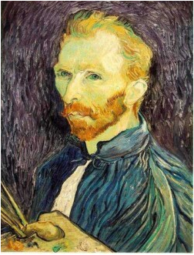







Gaussian pre-filtering
Solution: filter the image, then subsample
F₀
F₁
F₂
…
blur
subsample
blur
subsample
F₀ H
F₁ H
*
*

Slide 37
{
Gaussian pyramid
F₀
F₁
F₂
…
blur
subsample
blur
subsample
F₀ H
F₁ H
*
*

Slide 38
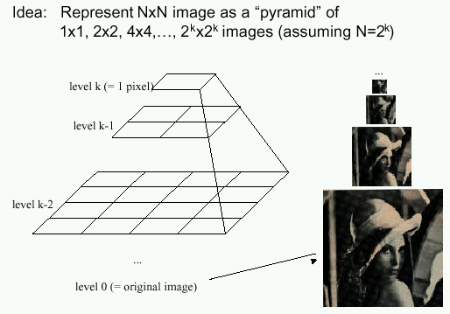
Gaussian pyramids
[Burt and Adelson, 1983]
In computer graphics, a mip map [Williams, 1983]
Gaussian Pyramids have all sorts of applications in computer vision
Source: S. Seitz

Slide 39
Gaussian pyramids - Searching over scales

Slide 40
Gaussian pyramids - Searching over scales

Slide 41
The Gaussian Pyramid
Low resolution
blur
sub-sample
blur
sub-sample
sub-sample
blur
sub-sample
blur
High resolution

Slide 42
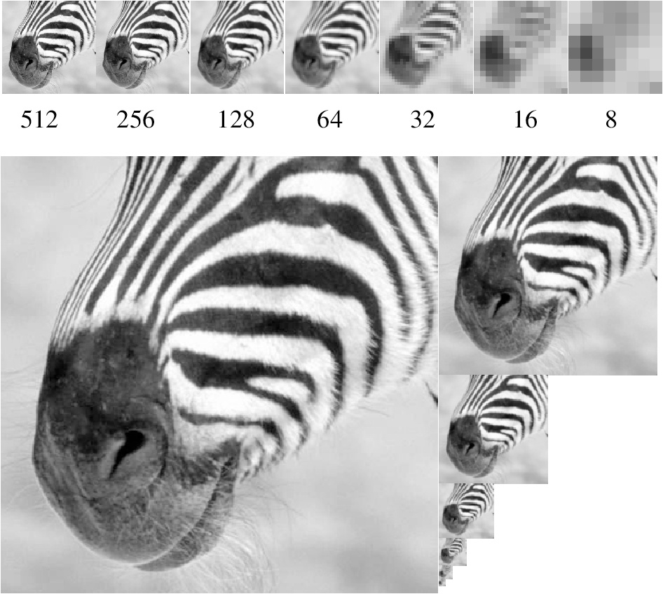
Gaussian pyramid and stack
Source: Forsyth

Slide 43
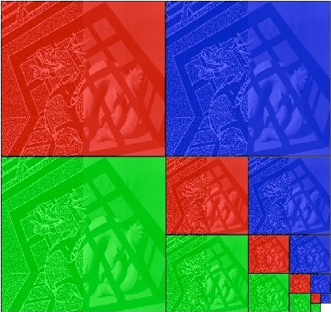
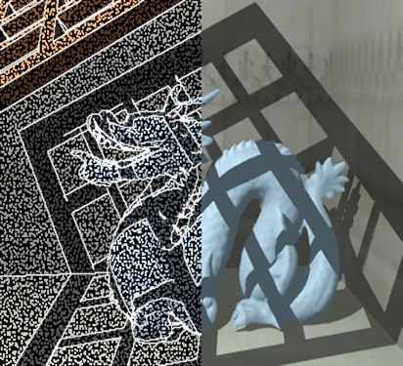
Memory Usage
What is the size of the pyramid?
Notes:
4/3

