Slide 1
CS 3410: Computer System Organization and Programming
Prof. Hakim Weatherspoon
CS 3410, Spring 2015
Computer Science
Cornell University

Slide 2
“Sometimes it is the people that no one imagines anything of
who do the things that no one can imagine”
--quote from the movie The Imitation Game

Slide 3
“Can machines think?”
-- Alan Turing, 1950
Computing Machinery and Intelligence
Notes:
http://en.wikipedia.org/wiki/The_Imitation_Game
The film's title [The Imitation Game] refers to Turing's proposed test of the same name, which he discussed in his 1950 paper on artificial intelligence entitled "Computing Machinery and Intelligence".[29] The paper opens: "I propose to consider the question, 'Can machines think?' This should begin with definitions of the meaning of the terms 'machine' and 'think'.“

Slide 4
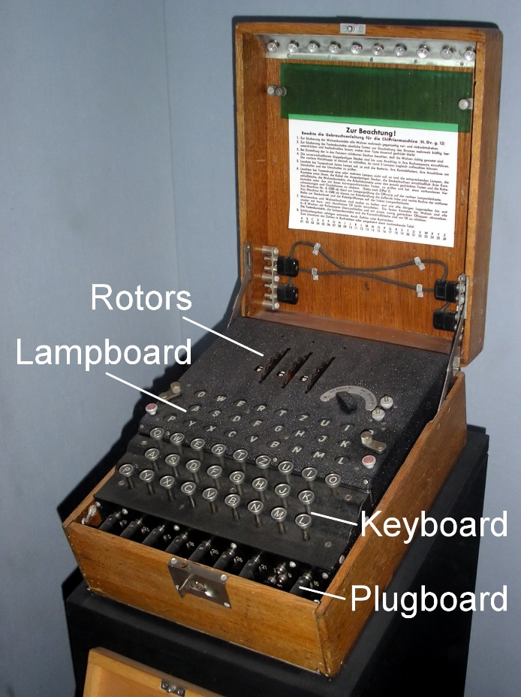
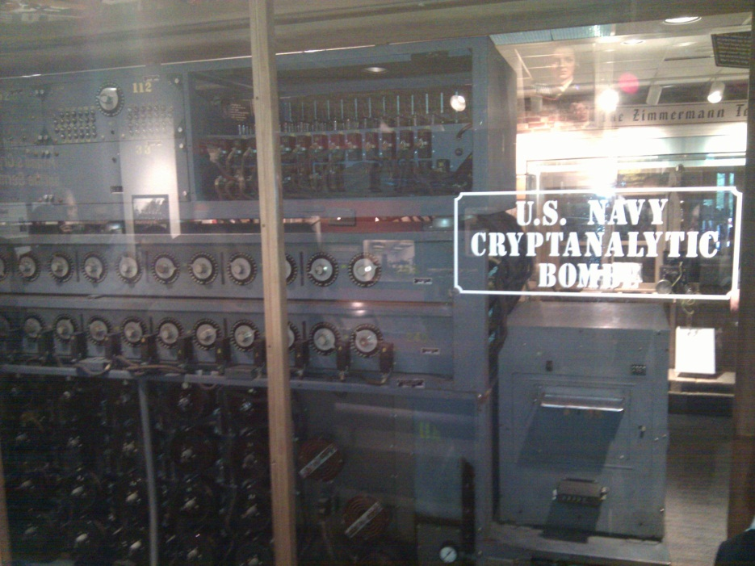
The Bombe
used by the Allies to
break the German
Enigma machine during
World War II
Enigma machine
Used by the Germans during
World War II to encrypt and
exchange secret messages
Notes:
http://en.wikipedia.org/wiki/Bombe
How many possible combinations to break an Enigma cipher text (msg encrypted by the Enigma machine)?
Rotors x Rotor posititions x plugboard combinations with 10 pairs = 159 quintillion = 1.59 x 10^20 158,962,555,217,826,360,000
Rotors (3 of 5 rotors): 5 x 4 x 3 = 60
Rotor positions: 26 x 26 x 26 = 17,526
plugboard: 26! / (6!10!2^10)
Numberphile on Enigma/Bombe
For those who want to learn more about the mechanism of the Bombe and how it exploited the flaw in the Enigma, Numberphile has recently done an excellent episode on it. Enjoy!
Flaw in the Enigma: http://www.youtube.com/watch?v=V4V2bpZlqx8
Previous episode on Enigma: http://www.youtube.com/watch?v=G2_Q9FoD-oQ

Slide 5
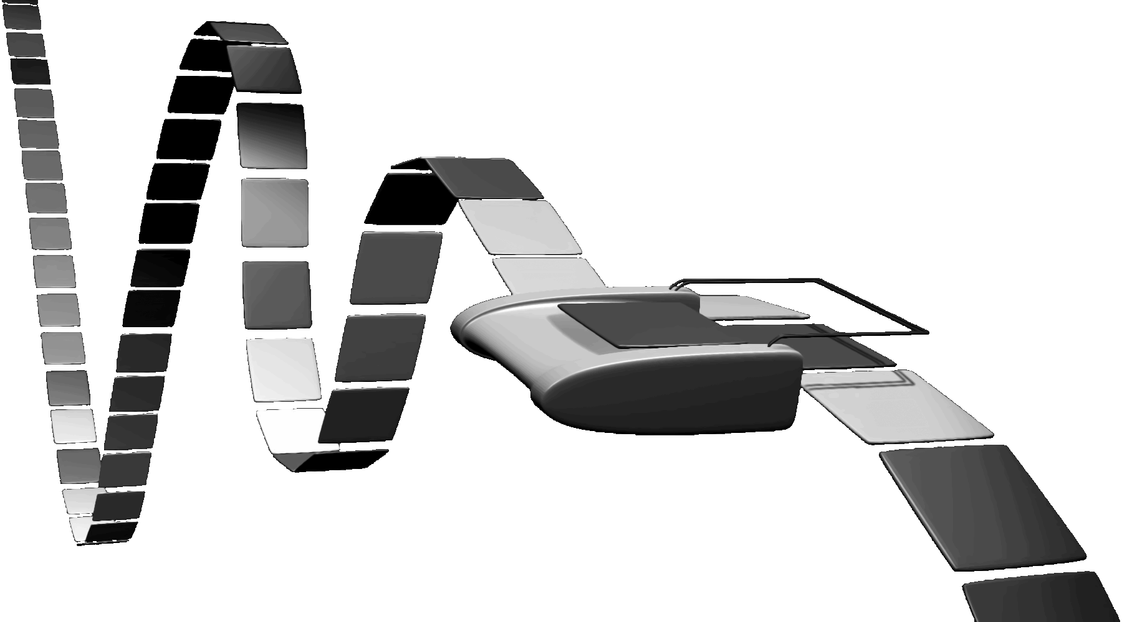

Turing Machine
1936
Alan Turing
Notes:
How does The Imitation Game, Engima/Bombe, Turing relate to you and this course?!
Alan Turing thesis in 1936 came up with an abstract model for a CPU that can simulate any algorithm, a Turing Machine. You will build a CPU and understand it and its organization
http://en.wikipedia.org/wiki/Turing_machine
A Turing machine is a hypothetical device that manipulates symbols on a strip of tape according to a table of rules. Despite its simplicity, a Turing machine can be adapted to simulate the logic of any computer algorithm, and is particularly useful in explaining the functions of a CPU inside a computer.
Note that every part of the machine (i.e. its state, symbol-collections, and used tape at any given time) and its actions (such as printing, erasing and tape motion) is finite, discrete and distinguishable; it is the unlimited amount of tape and runtime that gives it an unbounded amount of storage space.

Slide 6
Course Objective
Bridge the gap between hardware and software
  How a processor works
  How a computer is organized
Establish a foundation for building higher-level applications
  How to understand program performance
  How to understand where the world is going

Slide 7

Where did it begin?
Electrical Switch
  On/Off
  Binary
Transistor
The first transistor on a workbench at AT&T Bell Labs in 1947
Notes:
John Bardeen
Walter Brattain
William Shockley

Slide 8
Moore’s Law
1965
  number of transistors that can be integrated on a die would double every 18 to 24 months (i.e., grow exponentially with time)
Amazingly visionary
  2300 transistors, 1 MHz clock (Intel 4004) - 1971
  16 Million transistors (Ultra Sparc III)
  42 Million transistors, 2 GHz clock (Intel Xeon) – 2001
  55 Million transistors, 3 GHz, 130nm technology, 250mm² die (Intel Pentium 4) – 2004
  290+ Million transistors, 3 GHz (Intel Core 2 Duo) – 2007
  721 Million transistors, 2 GHz (Nehalem) - 2009
  1.4 Billion transistors, 3.4 GHz Intel Haswell (Quad core) – 2013
Notes:
Tbyte = 2^40 bytes (or 10^12 bytes)
Note that Moore’s law is not about speed predictions but about chip complexity

Slide 9
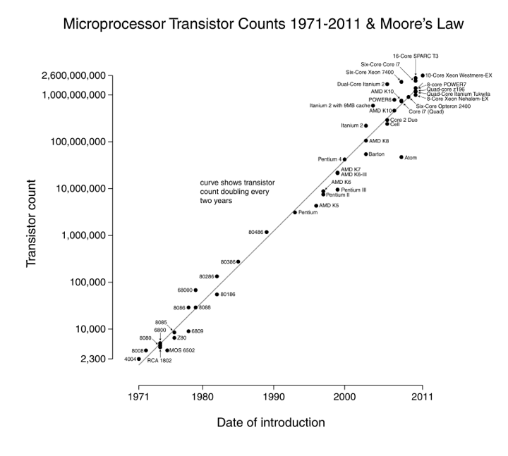

Slide 10
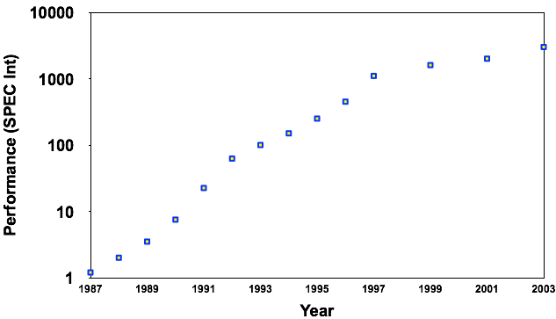
Processor Performance Increase
Intel Pentium 4/3000
Intel Xeon/2000
DEC Alpha 21264A/667
DEC Alpha 5/500
DEC Alpha 21264/600
DEC Alpha 5/300
DEC Alpha 4/266
IBM POWER 100
DEC AXP/500
HP 9000/750
IBM RS6000
MIPS M2000
SUN-4/260
MIPS M/120
Notes:
Another powerpoint “comic” – note that the y axis is log !
x/y where x is the model number and y is the speed in MHz
Rate of performance improvement has been between 1.5 and 1.6 times per year – how much longer will Moore’s Law hold?

Slide 11
Moore’s Law
1965
  number of transistors that can be integrated on a die would double every 18 to 24 months (i.e., grow exponentially with time)
Amazingly visionary
  2300 transistors, 1 MHz clock (Intel 4004) - 1971
  16 Million transistors (Ultra Sparc III)
  42 Million transistors, 2 GHz clock (Intel Xeon) – 2001
  55 Million transistors, 3 GHz, 130nm technology, 250mm² die (Intel Pentium 4) – 2004
  290+ Million transistors, 3 GHz (Intel Core 2 Duo) – 2007
  721 Million transistors, 2 GHz (Nehalem) - 2009
  1.4 Billion transistors, 3.4 GHz Intel Haswell (Quad core) – 2013
Notes:
Tbyte = 2^40 bytes (or 10^12 bytes)
Note that Moore’s law is not about speed predictions but about chip complexity

Slide 12
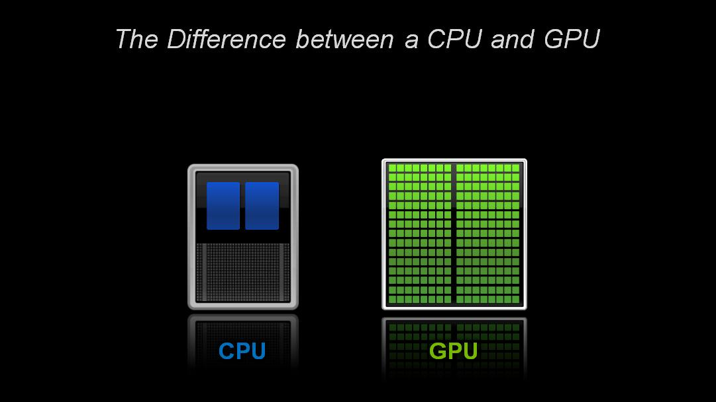
Parallelism
CPU: Central Processing Unit

Slide 13
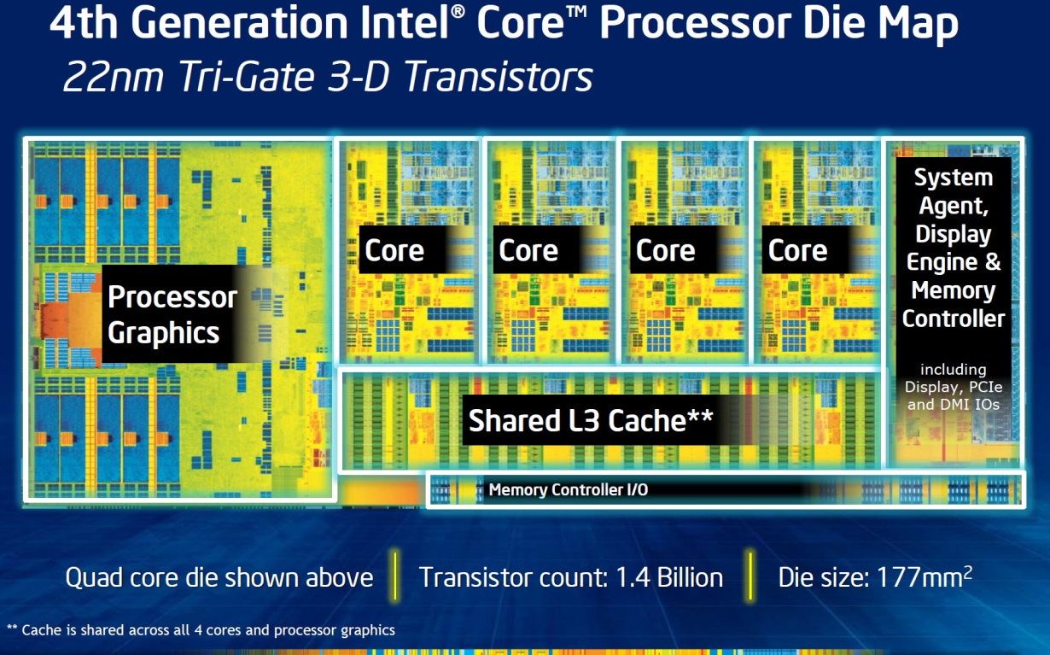
Then and Now
http://techguru3d.com/4th-gen-intel-haswell-processors-architecture-and-lineup/
The first transistor
  One workbench at AT&T Bell Labs
  1947
  Bardeen, Brattain, and Shockley
An Intel Haswell
  1.4 billion transistors
  177 square millimeters
  Four processing cores
Notes:
John Bardeen
Walter Brattain
William Shockley

Slide 14
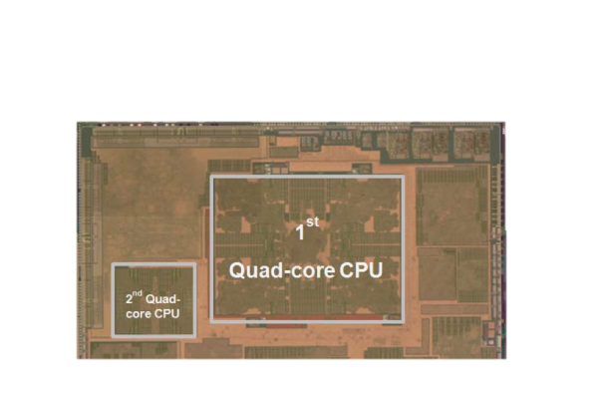
Then and Now
The first transistor
  One workbench at AT&T Bell Labs
  1947
  Bardeen, Brattain, and Shockley
Galaxy Note 3
  8 processing cores
Notes:
John Bardeen
Walter Brattain
William Shockley

Slide 15
Parallelism
CPU: Central Processing Unit
GPU: Graphics Processing Unit

Slide 16
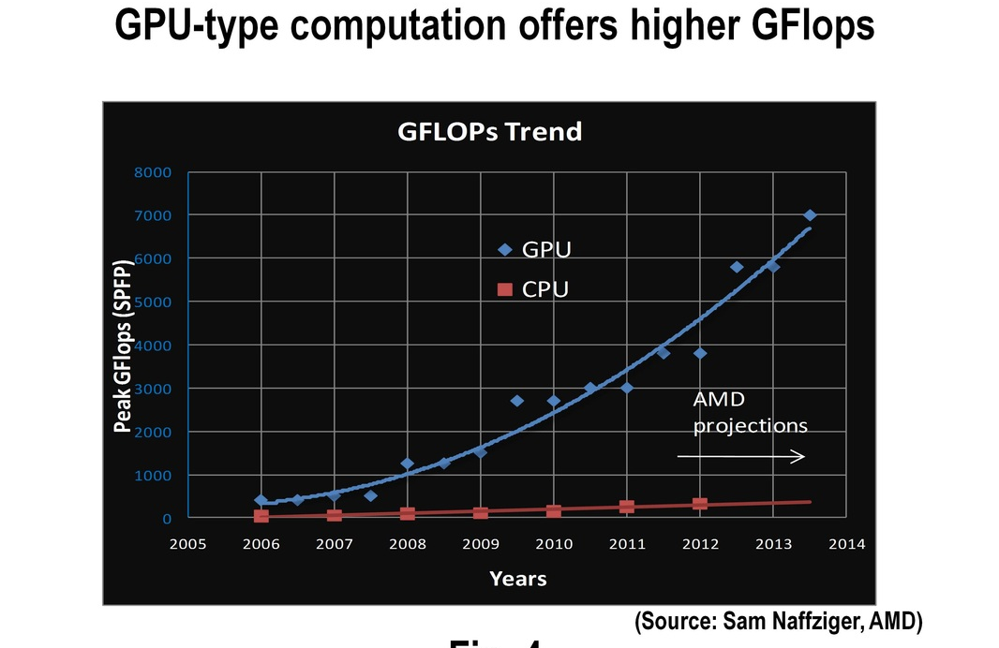

Slide 17
GPUs: Faster than Moore’s Law
nVidia
G70
10
9
10
9
One-pixel polygons (~10M polygons @ 30Hz)
10
8
10
8
Slope ~2.4x/year
UNC/HP PixelFlow
ATI
Radeon 256
SGI
(Moore's Law ~ 1.7x/year)
R-Monster
Peak
7
SGI
GeForce
10
7
Performance
10
Division
Pxpl6
IR
E&S
Nvidia TNT
(Δ's/sec)
Harmony
3DLabs
SGI
Cobalt
UNC Pxpl5
Glint
SGI SkyWriter
Accel/VSIS
Voodoo
6
10
6
Megatek
10
SGI VGX
SGI
E&S Freedom
HP VRX
HP TVRX
RE1
SGI
RE2
PC Graphics
Flat
shading
10
5
E&S
Textures
Division VPX
10
5
Stellar GS1000
F300
UNC Pxpl4
SGI GT
Gouraud
shading
Antialiasing
HP CRX
10
4
SGI Iris
10
4
86
88
90
92
94
96
98
00
Year
Graph courtesy of Professor John Poulton (from Eric Haines)

Slide 18
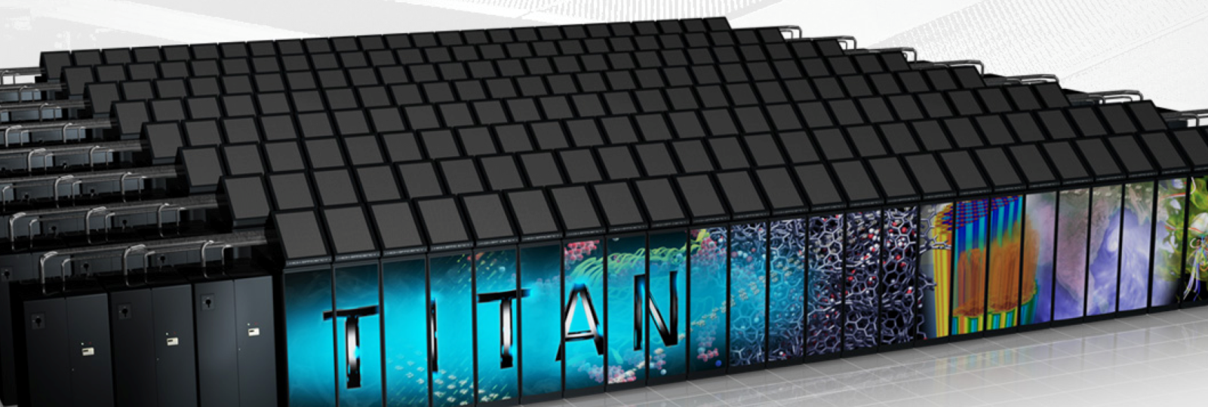
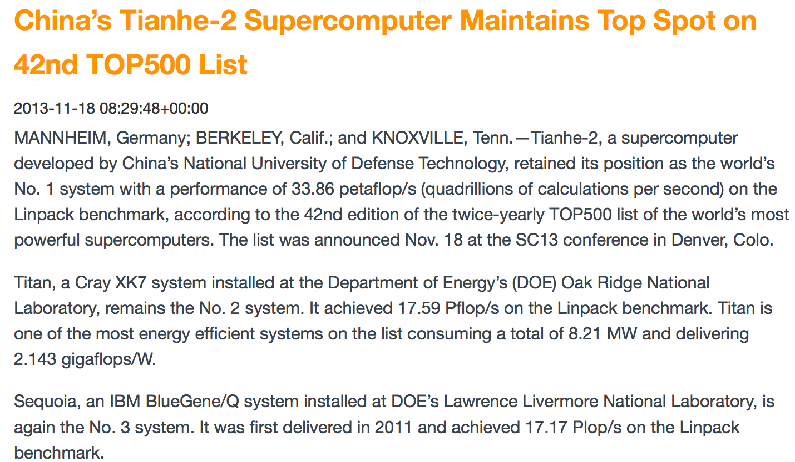
Supercomputers
Petaflops (10¹⁵)
  GPUs/multicore/100s-1000s cores
Notes:
Tianhe-2: 4000 processors with 16 cores SPARC 1.8 GHz
18,688 AMD Opteron 6274 16-core CPUs
18,688 Nvidia Tesla K20X GPUs

Slide 19
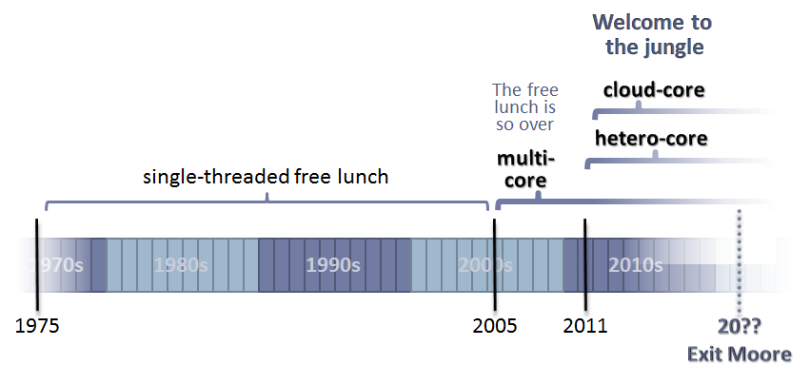

Slide 20
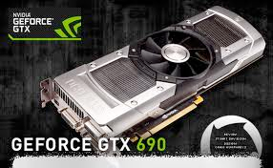
Why?
Parallelism
Pipelining

Slide 21
Programmable Hardware
Started in 1999
Flexible, programmable
  Vertex, Geometry, Fragment Shaders
And much faster, of course
    1999 GeForce256: 0.35 Gigapixel peak fill rate
    2001 GeForce3: 0.8 Gigapixel peak fill rate
    2003 GeForceFX Ultra: 2.0 Gigapixel peak fill rate
    ATI Radeon 9800 Pro : 3.0 Gigapixel peak fill rate
    2006 NV60: ... Gigapixel peak fill rate
    2009 GeForce GTX 285: 10 Gigapixel peak fill rate
    2011
      GeForce GTC 590: 56 Gigapixel peak fill rate
      Radeon HD 6990: 2x26.5
    2012
      GeForce GTC 690: 62 Gigapixel/s peak fill rate

Slide 22
Course Objective
Bridge the gap between hardware and software
  How a processor works
  How a computer is organized
Establish a foundation for building higher-level applications
  How to understand program performance
  How to understand where the world is going

Slide 23
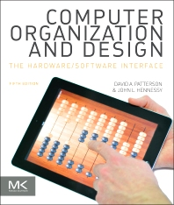
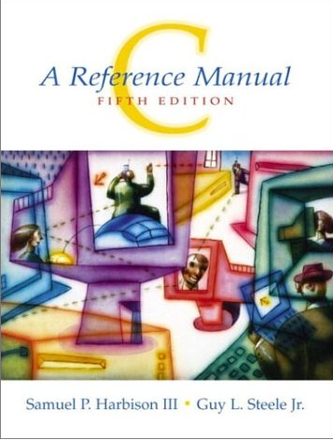

How class is organized
Instructor: Hakim Weatherspoon (hweather@cs.cornell.edu)
Lecture:
  Tu/Th 1:25-2:40
  Statler Auditorium
Lab sections:
  Start next week
  Carpenter 104 (Blue room)
  Carpenter 235 (Red room)
  Upson B7
Required Textbooks
Suggested
Textbook

Slide 24

Who am I?
Prof. Hakim Weatherspoon
  (Hakim means Doctor, wise, or prof. in Arabic)
Career Path
  Undergrad→grad→post-doc→professor
  Washington → Berkeley → Cornell → Cornell

Slide 25











Who am I?
The promise of the Cloud
  ubiquitous, convenient, on-demand network access to a shared pool of configurable computing resources (e.g., networks, servers, storage, applications, and services) that can be rapidly provisioned and released with minimal management effort or service provider interaction.
NIST Cloud Definition
SEATTLE
Notes:
The cloud completes the commoditization process and makes storage and computation a commodity.
Public vs private
IaaS, PaaS, SaaS
On demand (self service), network access, resource pooling, rapid elasticity, measured service

Slide 26
Who am I?
The promise of the Cloud
  ubiquitous, convenient, on-demand network access to a shared pool of configurable computing resources (e.g., networks, servers, storage, applications, and services) that can be rapidly provisioned and released with minimal management effort or service provider interaction.
NIST Cloud Definition
SEATTLE
Notes:
The cloud completes the commoditization process and makes storage and computation a commodity.
Public vs private
IaaS, PaaS, SaaS
On demand (self service), network access, resource pooling, rapid elasticity, measured service

Slide 27
Who am I?
The promise of the Cloud
  ubiquitous, convenient, on-demand network access to a shared pool of configurable computing resources (e.g., networks, servers, storage, applications, and services) that can be rapidly provisioned and released with minimal management effort or service provider interaction.
Requires fundamentals in distributed systems
  Networking
  Computation
  Storage
NIST Cloud Definition
Notes:
The cloud completes the commoditization process and makes storage and computation a commodity.
Public vs private
IaaS, PaaS, SaaS
On demand (self service), network access, resource pooling, rapid elasticity, measured service

Slide 28
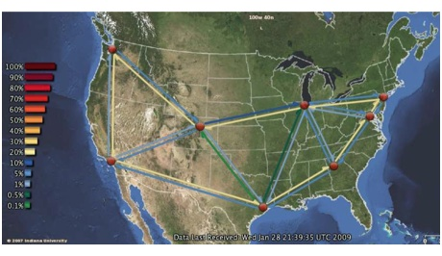


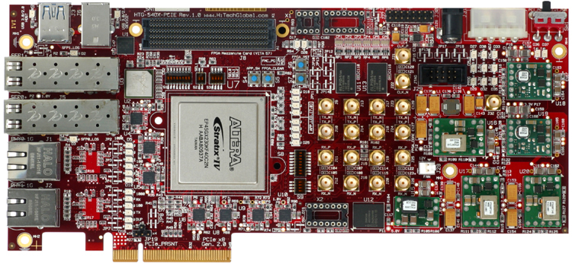
Who am I?
Cloud computing/storage
  Optimizing a global network of data centers

Slide 29
Course Staff
cs-3410-staff-l@cornell.edu
Lab/Homework TA’s
  Deniz Altinbuken <deniz@cs.cornell.edu> (PhD)
  Adam Campbell <atc89@cornell.edu> (PhD)
  Praveen Kumar <praveenk@cs.cornell.edu> (PhD)
  Vishal Shrivastav <vishal@cs.cornell.edu> (PhD)
  Rob Mcguinness <jrm369@cornell.edu> (MEng)
  Akshay Navalakha <adn47@cornell.edu> (MEng)
  Andrew Weymouth <asw75@cornell.edu> (MEng)
  Naman Agarwal <na298@cornell.edu>
  Maxwell Dergosits <mad293@cornell.edu>
  Antoine Pourchet <app63@cornell.edu>
  Gary Zibrat <gdz4@cornell.edu>
  Ari Karo <aak82@cornell.edu>
  Amy Chen <yc624@cornell.edu>
  Stephanie Guo <lg399@cornell.edu>
  Kylar Henderson <kdh59@cornell.edu>
  Megan Carpenter <mnc29@cornell.edu>
  Rebecca Stambler <rls462@cornell.edu>
  Yogisha Dixit <yad4@cornell.edu>
  Mahak Goel <mg785@cornell.edu>
  Spandan Agrawal <sga35@cornell.edu>
  Adwit Tumuluri <at627@cornell.edu>
  Daniel Liu <dl596@cornell.edu>
  Rishab Gupta <rsg246@cornell.edu>
  Oscar Pacheco <ofp3@cornell.edu>
  Lucas Derraugh <ldd49@cornell.edu>
  Brian Wang <bhw45@cornell.edu>
  Anthony Lin <al744@cornell.edu>
  Charles Lai <cjl223@cornell.edu>
  Jonathan Behrens <jkb229@cornell.edu>
  Administrative Assistant:
  Jessica Depew <jd648@cs.cornell.edu>

Slide 30
Pre-requisites and scheduling
CS 2110 is required (Object-Oriented Programming and Data Structures)
  Must have satisfactorily completed CS 2110
  Cannot take CS 2110 concurrently with CS 3410
CS 3420 (ECE 3140) (Embedded Systems)
  Take either CS 3410 or CS 3420
    both satisfy CS and ECE requirements
  However, Need ENGRD 2300 to take CS 3420
CS 3110 (Data Structures and Functional Programming)
  Not advised to take CS 3110 and 3410 together

Slide 31
Pre-requisites and scheduling
CS 2043 (UNIX Tools and Scripting)
  2-credit course will greatly help with CS 3410.
  Meets Mon, Wed, Fri at 11:15am-12:05pm in Hollister (HLS) B14
  Class started yesterday and ends March 5th
CS 2022 (Introduction to C) and CS 2024 (C++)
  1 to 2-credit course will greatly help with CS 3410
  Unfortunately, offered in the fall, not spring
  Instead, we will offer a primer to C during lab sections
  and include some C questions in homeworks

Slide 32
Schedule (subject to change)
Week | Date (Tue) | Lecture# | Lecture Topic | HW | Prelim Evening | Lab Topic | Lab/Proj
1 | 22-Jan | 1 | Intro
 | 27-Jan | 2 | Logic & Gates |  |  | Logisim | Lab 0: (IN-CLASS) Adder/Logisim intro
2 |  | 3 | Numbers & Arithmetic
 | 3-Feb | 4 | State & FSMs |  |  | ALU/Design Docs | Lab 1: ALU Handout
3 |  | 5 | Memory
 | 10-Feb | 6 | Simple CPU | HW1: Logic, Gates, Numbers, & Arithmetic, |  | FSM | Lab 2: (IN-CLASS) FSM Handout
4 |  | 7 | CPU Performance & Pipelines | FSMs, Memory, CPU, Performance,
 | 17-Feb |  | Winter Break | and pipelined MIPS |  | MIPS | Proj 1: MIPS 1 Handout
 |  | 8 | Pipelined MIPS
5 | 24-Feb | 9 | Pipeline Hazards |  |  | C for Java Programmers | C Lab 1 (IN-CLASS)
 |  | 10 | Control Hazards & ISA Variations
6 | 3-Mar | 11 | RISC & CISC & Prelim 1 Review |  | Prelim1 | C lecture 2 | C Lab 2 (IN-CLASS)
 |  | 12 | Calling Conventions
7 | 10-Mar | 13 | Calling Conventions |  |  | MIPS 2 | Proj 2: MIPS 2 Handout
 |  | 14 | Calling Conventions
8 | 17-Mar | 15 | Linkers |  |  | Intro to UNIX/Linux | C Lab 2 (cont. IN-CLASS)
 |  | 16 | Caches 1 |  |  | ssh, gcc, How to tunnel
9 | 24-Mar | 17 | Caches 2 |  |  | VM & Unix | VM & Unix
 |  | 18 | Caches 3
 | 31-Mar |  | Spring Break
 |  |  | Spring Break
10 | 7-Apr | 19 | Virtual Memory 1 |  |  | Stack Smashing | Lab 3: Buffer Overflows handout
 |  | 20 | Virtual Memory 2
11 | 14-Apr | 21 | Traps | HW2: Calling Conventions, RISC, CISC |  | Caches | Proj 3: Caches Handout
 |  | 22 | Multicore Architectures & GPUs | Linkers & and more calling conventions
12 | 21-Apr | 23 | Synchronization | HW2: Virtual memory, Caches, |  | Virtual Memory | Lab 4: (IN-CLASS) Virtual Memory
 |  | 24 | Synchronization 2 | Traps, Multicore, Synchronization
13 | 28-Apr | 25 | GPUs & Prelim 2 Review |  |  | Synchronization | Proj 4: Multicore/NW Handout
 |  | 26 | I/O |  | Prelim 2
14 | 5-May | 27 | Future Directions |  |  |  | Proj 3 Tournament: Monday, May 4th
 | 12-May
 | 19-May

Slide 33
Grading
Lab (50% approx.)
  5-6 Individual Labs
    2 out-of-class labs (5-10%)
    3-4 in-class labs (5-7.5%)
  4 Group Projects (30-35%)
  Participation/Quizzes in lab (2.5%)
Lecture (50% approx.)
  2 Prelims (35%)
    Dates: March 3, April 30
  Homework (10%)
  Participation/Quizzes in lecture (5%)

Slide 34
Grading
Regrade policy
  Submit written request to lead TA,
  and lead TA will pick a different grader
  Submit another written request,
  lead TA will regrade directly
  Submit yet another written request for professor to regrade
Late Policy
  Each person has a total of four “slip days”
  Max of two slip days for any individual assignment
  For projects, slip days are deducted from all partners
  25% deducted per day late after slip days are exhausted

Slide 35
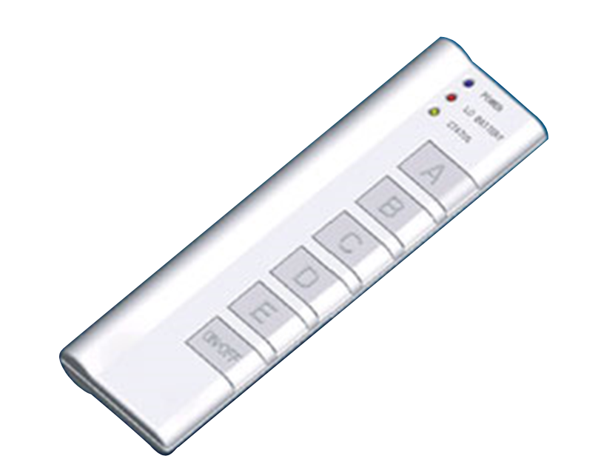
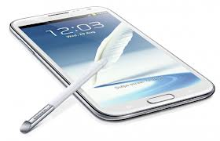

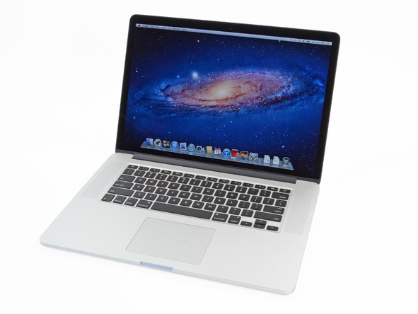
Active Learning
iClicker: Bring to every Lecture
Put all devices into Airplane Mode

Slide 36
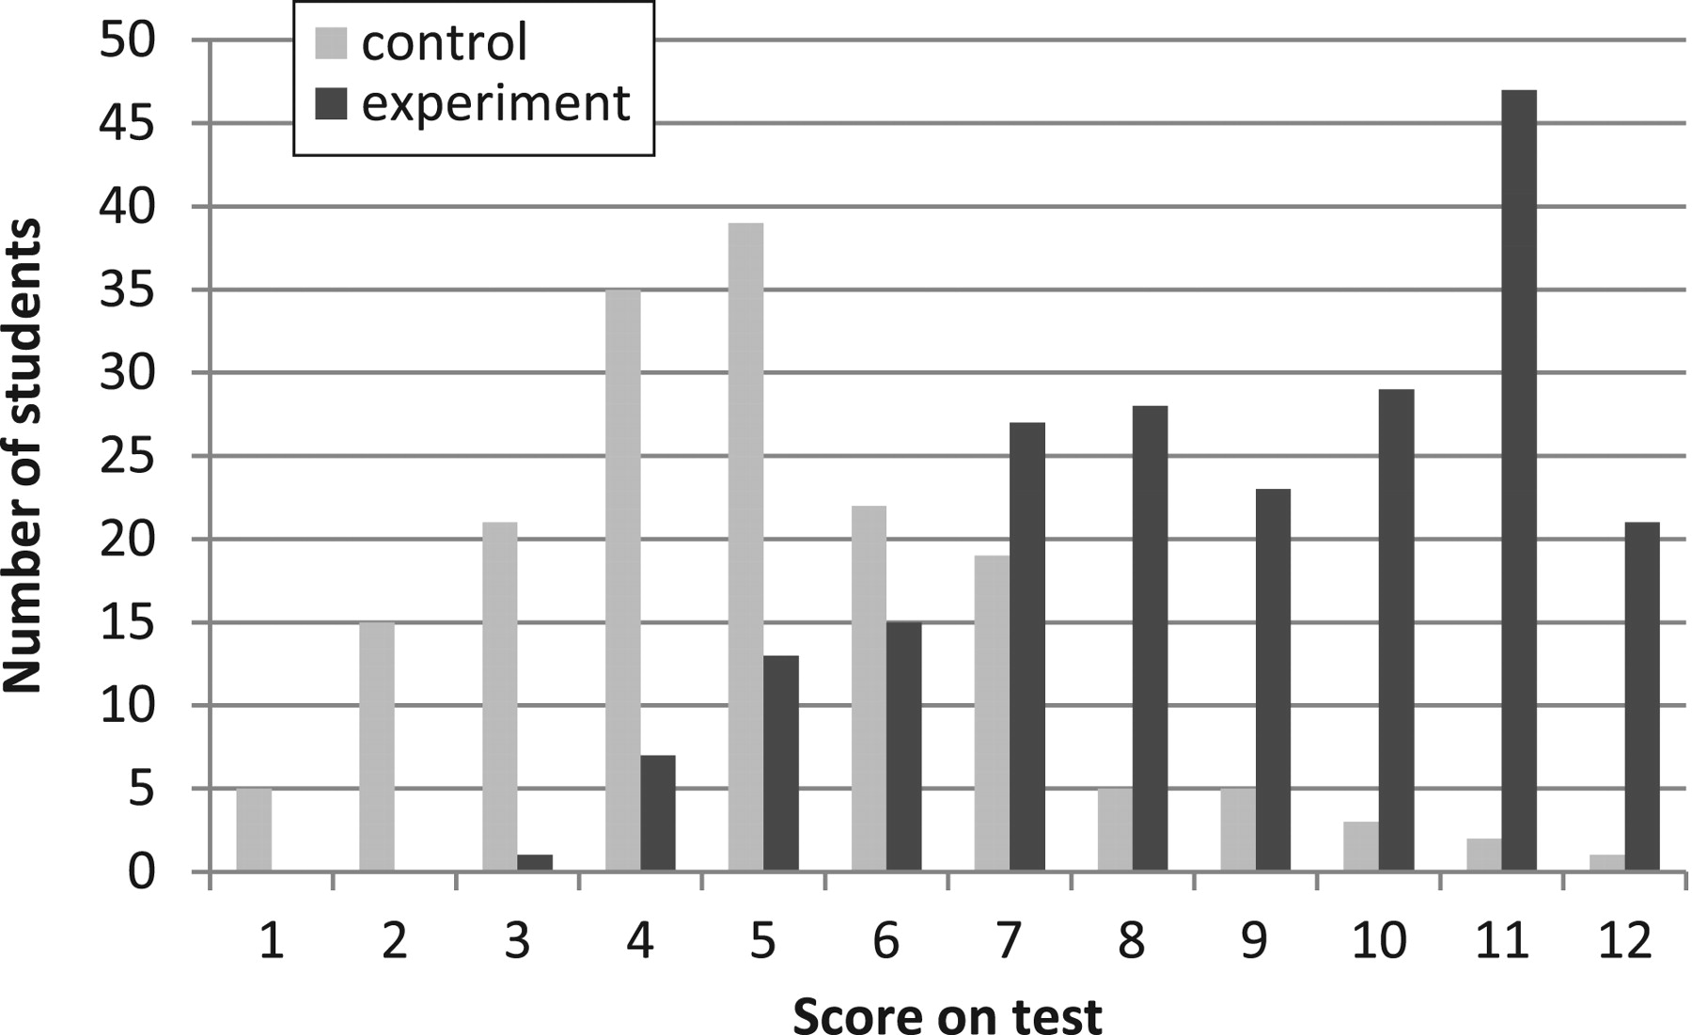

Active Learning
L Deslauriers et al. Science 2011;332:862-864
Fig. 1 Histogram of 270 physic student scores for the two sections:
Experiment w/ quizzes and active learning. Control without.
Published by AAAS
Notes:
Histogram of student scores for the two sections.
Active Learning Teaching Experiment
(by DeSlauriers, Schelew, and Wieman)
Control Class
Teaching: All traditional lecture
Test on week 11 content
Ave = 41%
Experimental Class
Teaching: Week 1 – 10: traditional
Week 11: high engagement
Test on week 11 content
Ave = 74%

Slide 37
Active Learning
Demo: What year are you in school?
Freshman
Sophomore
Junior
Senior
Other

Slide 38
Active Learning
Also, activity handouts will be available before class
In front of doors before you walk in

Slide 39
Administrivia
http://www.cs.cornell.edu/courses/cs3410/2015sp
  Office Hours / Consulting Hours
  Lecture slides, schedule, and Logisim
  CSUG lab access (esp. second half of course)
Lab Sections (start next week)
T 2:55 – 4:10pm Carpenter Hall 104 (Blue Room)
W 8:40—9:55am Carpenter Hall 104 (Blue Room)
W 11:40am – 12:55pm Carpenter Hall 104 (BlueRoom)
W 1:25—2:40pm Carpenter Hall 104 (Blue Room)
W 3:35 – 4:50pm Carpenter Hall 104 (Blue Room)
W 7:30—8:45pm Carpenter Hall 235 (Blue Room)
R 8:40 – 9:55pm Carpenter Hall 104 (Blue Room)
R 11:40 – 12:55pm Carpenter Hall 104 (Blue Room)
R 2:55 – 4:10pm Carpenter Hall 104 (Blue Room)
F 8:40 – 9:55am Carpenter Hall 104 (Blue Room)
F 11:40am – 12:55pm Carpenter Hall 104 (Blue Room)
F 1:25 – 2:40pm Carpenter Hall 104 (Blue Room)
F 2:55 – 4:10pm Carpenter Hall 104 (Blue Room)
  Labs are separate than lecture and homework
  Bring laptop to Labs
  This week: “hello world” lab: Intro to C and virtual machines
  Next week: Intro to logisim, logic circuits, and building an adder

Slide 40
Administrivia
http://www.cs.cornell.edu/courses/cs3410/2015sp
  Office Hours / Consulting Hours
  Lecture slides, schedule, and Logisim
  CSUG lab access (esp. second half of course)
Course Virtual Machine (VM)
  Identical to CSUG Linux machines
  Download and use for labs and projects
  https://confluence.cornell.edu/display/coecis/CSUG+Lab+VM+Information

Slide 41
Communication
Email
  cs-3410-staff-l@cornell.edu
  The email alias goes to me and the TAs, not to whole class
Assignments
  CMS: http://cms.csuglab.cornell.edu
Newsgroup
  http://www.piazza.com/cornell/spring2015/cs3410
  For students
iClicker
  http://atcsupport.cit.cornell.edu/pollsrvc/

Slide 42
Lab Sections, Projects, and Homeworks
Lab Sections start this week
  This week: “hello world” lab: Intro to C and virtual machines
  Next week: Intro to logisim, logic circuits and building an adder
Labs Assignments
  Individual
  One week to finish (usually Monday to Monday)
Projects
  two-person teams
  Find partner in same section
Homeworks
  One before each prelim
  Will be released a few weeks ahead of time
  Finish question after covered in lecture
Notes:
We will pair you up if you don’t have a preferred partner
Design document due one week after handout
Start early, time management is key
Manage the team effort

Slide 43
Academic Integrity
All submitted work must be your own
  OK to study together, but do not share soln’s
  Cite your sources
Project groups submit joint work
  Same rules apply to projects at the group level
  Cannot use of someone else’s soln
Closed-book exams, no calculators
  Stressed? Tempted? Lost?
    Come see us before due date!
Plagiarism in any form will not be tolerated

Slide 44
Why do CS Students Need Transistors?
Notes:
Take a break
Think-Pair-Share

Slide 45
Why do CS Students Need Transistors?
Functionality and Performance
Notes:
Think-Pair-Share

Slide 46
Why do CS Students Need Transistors?
To be better Computer Scientists and Engineers
  Abstraction: simplifying complexity
  How is a computer system organized? How do I build it?
  How do I program it? How do I change it?
  How does its design/organization effect performance?
Notes:
Think-Pair-Share

Slide 47
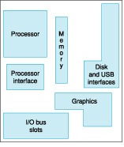
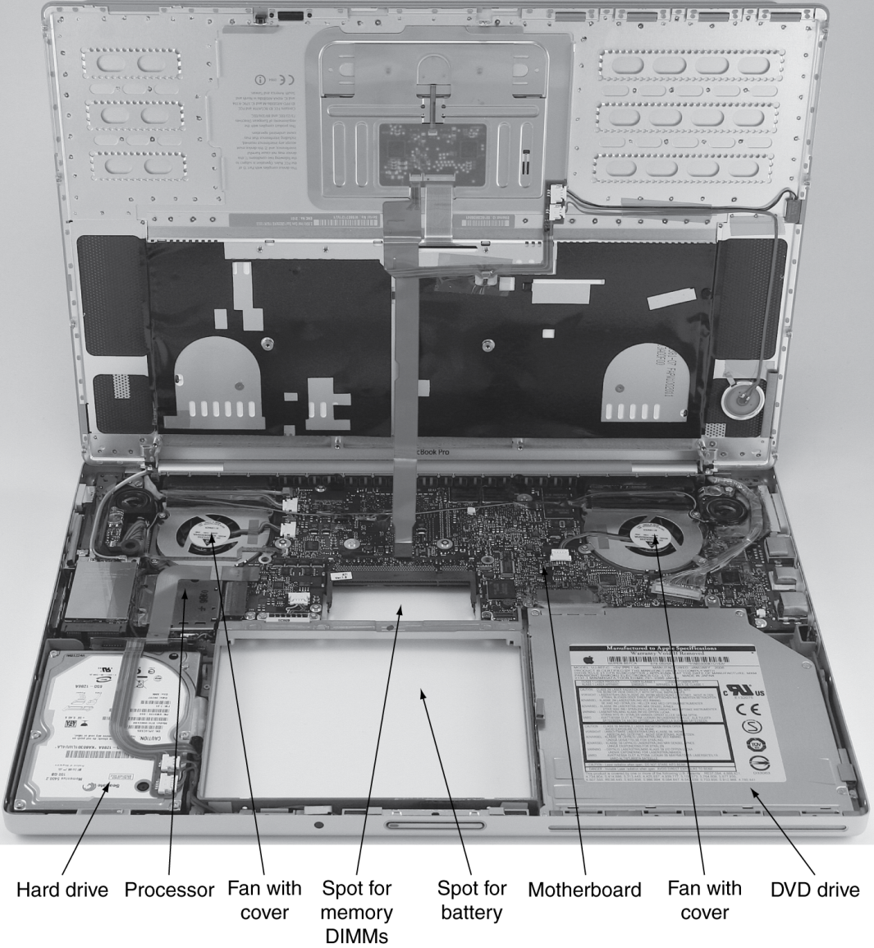
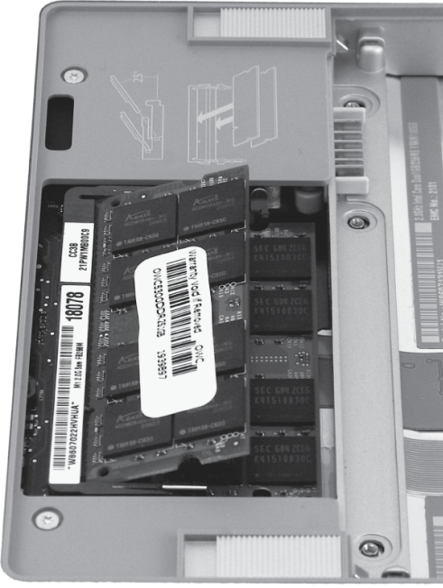
Computer System Organization

Slide 48
Computer System Organization
Computer System =
?
Input +
Output +
Memory +
Datapath +
Control
Keyboard
Mouse
Video
Network
USB
CPU
Registers
bus
bus
Serial
Memory
Disk
Audio

Slide 49
Compilers & Assemblers
C
int x = 10;
x = 2 * x + 15;
compiler
r0 = 0
r5 = r0 + 10
r5 = r5 * 2
r5 = r15 + 15
MIPS
assembly
language
addi r5, r0, 10
muli r5, r5, 2
addi r5, r5, 15
assembler
op = addi r0 r5 10
MIPS
machine
language
00100000000001010000000000001010
00000000000001010010100001000000
00100000101001010000000000001111
op = addi r5 r5 15
Notes:
32 bits, 4 bytes
What time is it?

Slide 50
Instruction Set Architecture
ISA
  abstract interface between hardware and the lowest level software
  user portion of the instruction set plus the operating system interfaces used by application programmers

Slide 51
Basic Computer System
A processor executes instructions
  Processor has some internal state in storage elements (registers)
A memory holds instructions and data
  von Neumann architecture: combined inst and data
A bus connects the two
01010000
10010100
…
bus
regs
addr, data,
r/w
processor
memory

Slide 52
How to Design a Simple Processor
10
inst
r5
0
alu
10
memory
register file
r0
32
2
00
5 5 5
pc
new pc
calculation
control
00: addi r5, r0, 10
04: muli r5, r5, 2
08: addi r5, r5, 15

Slide 53
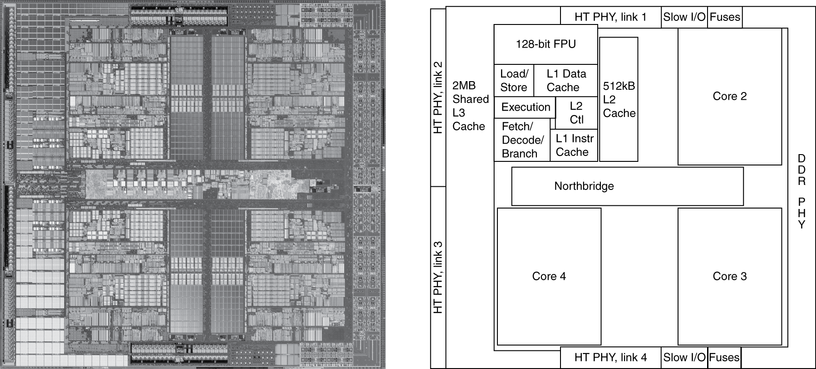
Inside the Processor
AMD Barcelona: 4 processor cores
Figure from Patterson & Hennesssy, Computer Organization and Design, 4th Edition

Slide 54
How to Program the Processor:
MIPS R3000 ISA
Registers
Instruction Categories
  Load/Store
  Computational
  Jump and Branch
  Floating Point
    coprocessor
  Memory Management
R0 - R31
PC
HI
LO
OP
rs
rt
rd
sa
funct
OP
rs
rt
immediate
OP
jump target

Slide 55
Overview
Application
Operating
System
Compiler
Firmware
Instruction Set
Architecture
Memory
system
Instr. Set Proc.
I/O system
Datapath & Control
Digital Design
Circuit Design
Notes:
For class handout

Slide 56
Applications
Everything these days!
  Phones, cars, televisions, games, computers,…

Slide 57
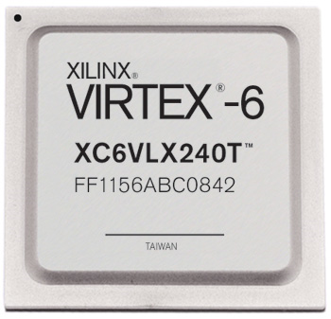

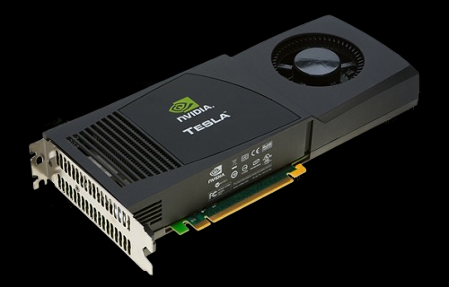

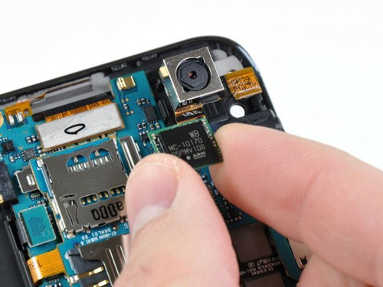
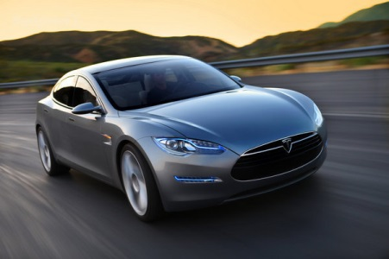
Applications
millions
Xilinx FPGA
Cloud
Computing
Berkeley mote
NVidia GPU
Cell Phone
Cars

Slide 58
Covered in this course
Application
Operating
System
Compiler
Firmware
Instruction Set
Architecture
Memory
system
Instr. Set Proc.
I/O system
Datapath & Control
Digital Design
Circuit Design
Notes:
For class handout

Slide 59
Reflect
Why take this course?
  Basic knowledge needed for all other areas of CS:
    operating systems, compilers, ...
  Levels are not independent
    hardware design ↔ software design ↔ performance
  Crossing boundaries is hard but important
    device drivers
  Good design techniques
    abstraction, layering, pipelining, parallel vs. serial, ...
  Understand where the world is going

