Slide 1
Stack buffer overflow
http://en.wikipedia.org/wiki/Stack_buffer_overflow

Slide 2
What is a stack buffer overflow?
Caused when a program writes more data to a buffer on the stack than what was initially allocated for the buffer
Causes bugs, crashes, and can be used in an attack known as stack smashing (executing arbitrary code on a protected machine)
Notable Example: Twilight Hack

Slide 3
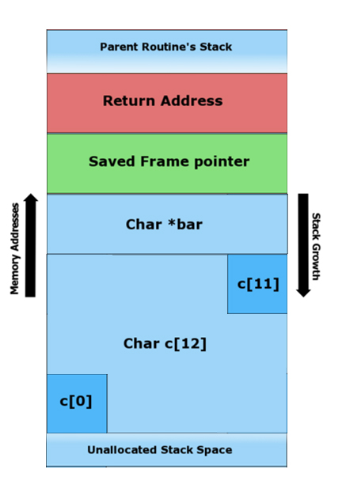
#include <string.h>
void foo (char *bar)
{
char c[12];
strcpy (c, bar); //no bound
}
int main (int argc, char **argv)
{
foo(argv[1]);
}

Slide 4
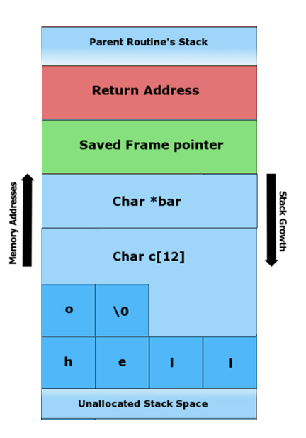
Normal Execution
“hello” is written to the char buffer. Note the null terminating byte.
#include <string.h>
void foo (char *bar)
{
char c[12];
strcpy (c, bar); //no bound
}
int main (int argc, char **argv)
{
foo(argv[1]);
}

Slide 5
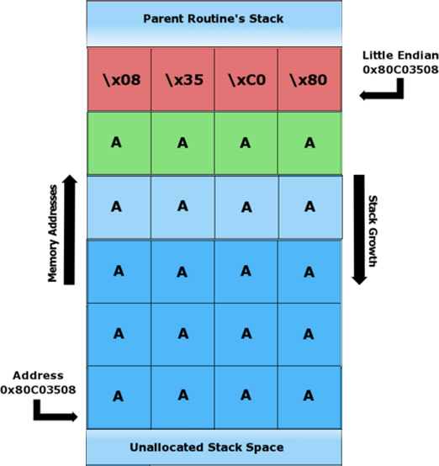
Buffer Overflow!
Called with argument:
AAAAAAAAAAAAAAAAAAAA\x08\x35\xC0\x80
The return address now points to the start of the 12-byte buffer.

Slide 6
Lab 3
Due Wednesday April 15th.
Stack buffer overflow problem, very similar to what we have described today.

