Slide 1
Lab 0: Intro to Logisim

Slide 2
Welcome to CS 3410 Labs!
Introducing the TAs!
Using Logisim:
pins and subcircuits
probes for debugging
bundles/splitters (with labels!)
Logisim Warnings!
In class assignment: 8-bit Adder
Webpage:
http://www.cs.cornell.edu/Courses/cs3410/2015sp/lab/lab0/lab0.html

Slide 3
Logisim Don’ts

Slide 4
Logisim Don’ts

Slide 5
Logisim Don’ts

Slide 6
Logisim Don’ts

Slide 7
Logisim Don’ts

Slide 8
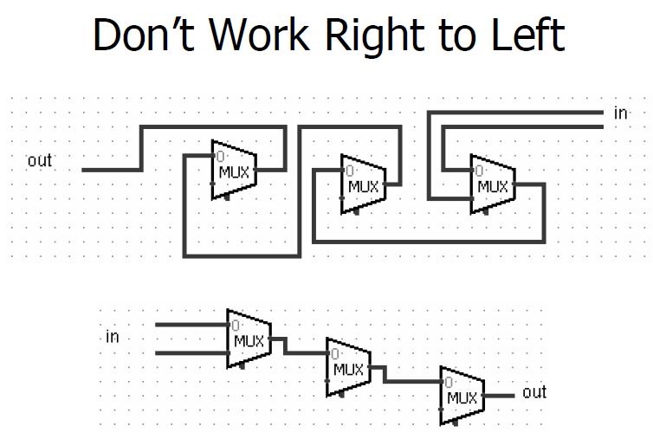
Logisim Don’ts

