Slide 1
Caches 3
CS 3410, Spring 2014
Computer Science
Cornell University
See P&H Chapter: 5.1-5.4, 5.8, 5.15

Slide 2
Compromise
Set-associative cache
Like a direct-mapped cache
Index into a location
Fast
Like a fully-associative cache
Can store multiple entries
decreases conflicts
Search in each element
n-way set assoc means n possible locations

Slide 3
3-Way Set Associative Cache (Reading)
Tag Index Offset
=
=
=
line select
word select
hit?
data

Slide 4
Basic Cache Organization
Q: How to decide block size?
A: Try it and see
But: depends on cache size, workload, associativity, …
Experimental approach!

Slide 5
Experimental Results
Notes:
Top to bottom: bigger cache means fewer misses.
For a given total cache size,
larger block sizes mean….
fewer lines
so fewer tags (and smaller tags for associative caches)
so less overhead
and fewer cold misses (within-block “prefetching”)
But
fewer blocks available (for scattered accesses!)
so more conflicts
and miss penalty (time to fetch block) is larger

Slide 6
Tradeoffs
For a given total cache size,
larger block sizes mean….
fewer lines
so fewer tags, less overhead
and fewer cold misses (within-block “prefetching”)
But also…
fewer blocks available (for scattered accesses!)
so more conflicts
and larger miss penalty (time to fetch block)
Notes:
Same for other parameters: experimental mostly

Slide 7
Associativity

Slide 8
Other Designs
Multilevel caches

Slide 9
Next Goal
What about writes?
What happens when the CPU writes to a register and calls a store instruction?!

Slide 10
What about Stores?
Where should you write the result of a store?
If that memory location is in the cache?
Send it to the cache
Should we also send it to memory right away?
(write-through policy)
Wait until we evict the block (write-back policy)
If it is not in the cache?
Allocate the line (put it in the cache)?
(write allocate policy)
Write it directly to memory without allocation?
(no write allocate policy)

Slide 11
Cache Write Policies
Q: How to write data?
Memory
DRAM
CPU
addr
Cache
SRAM
data
If data is already in the cache…
No-Write
writes invalidate the cache and go directly to memory
Write-Through
writes go to main memory and cache
Write-Back
CPU writes only to cache
cache writes to main memory later (when block is evicted)

Slide 12
Write Allocation Policies
Q: How to write data?
Memory
DRAM
CPU
addr
Cache
SRAM
data
If data is not in the cache…
Write-Allocate
allocate a cache line for new data (and maybe write-through)
No-Write-Allocate
ignore cache, just go to main memory

Slide 13
Next Goal
How does a write-through cache work?
Assume write-allocate

Slide 14
Handling Stores (Write-Through)
Using byte addresses in this example! Addr Bus = 5 bits
Processor
Cache
Memory
Fully Associative Cache
2 cache lines
2 word block
4 bit tag field
1 bit block offset field
Assume write-allocate
policy
0
1
2
3
4
5
6
7
8
9
10
11
12
13
14
15
78
29
120
123
LB $1 ← M[ 1 ]
LB $2 ← M[ 7 ]
SB $2 → M[ 0 ]
SB $1 → M[ 5 ]
LB $2 ← M[ 10 ]
SB $1 → M[ 5 ]
SB $1 → M[ 10 ]
V tag data
71
0
150
162
0
173
18
21
33
$0
$1
$2
$3
28
Misses: 0
Hits: 0
19
200
210
225

Slide 15
Write-Through (REF 1)
Processor
Cache
Memory
0
1
2
3
4
5
6
7
8
9
10
11
12
13
14
15
78
29
120
V tag data
123
LB $1 ← M[ 1 ]
LB $2 ← M[ 7 ]
SB $2 → M[ 0 ]
SB $1 → M[ 5 ]
LB $2 ← M[ 10 ]
SB $1 → M[ 5 ]
SB $1 → M[ 10 ]
71
0
150
162
0
173
18
21
33
$0
$1
$2
$3
28
Misses: 0
Hits: 0
19
200
210
225

Slide 16
Write-Through (REF 1)
Processor
Cache
Memory
0
1
2
3
4
5
6
7
8
9
10
11
12
13
14
15
78
Addr: 00001
29
block offset
120
V tag data
123
LB $1 ← M[ 1 ]
LB $2 ← M[ 7 ]
SB $2 → M[ 0 ]
SB $1 → M[ 5 ]
LB $2 ← M[ 10 ]
SB $1 → M[ 5 ]
SB $1 → M[ 10 ]
M
71
1
0000
78
150
29
162
lru
0
173
18
21
33
$0
$1
$2
$3
28
29
Misses: 1
Hits: 0
19
200
210
225

Slide 17
Write-Through (REF 2)
Processor
Cache
Memory
0
1
2
3
4
5
6
7
8
9
10
11
12
13
14
15
78
29
120
V tag data
123
LB $1 ← M[ 1 ]
LB $2 ← M[ 7 ]
SB $2 → M[ 0 ]
SB $1 → M[ 5 ]
LB $2 ← M[ 10 ]
SB $1 → M[ 5 ]
SB $1 → M[ 10 ]
M
71
1
0000
78
150
29
162
lru
0
173
18
21
33
$0
$1
$2
$3
28
29
Misses: 1
Hits: 0
19
200
210
225

Slide 18
Write-Through (REF 2)
Processor
Cache
Memory
0
1
2
3
4
5
6
7
8
9
10
11
12
13
14
15
78
Addr: 00111
29
block offset
120
V tag data
123
LB $1 ← M[ 1 ]
LB $2 ← M[ 7 ]
SB $2 → M[ 0 ]
SB $1 → M[ 5 ]
LB $2 ← M[ 10 ]
LB $1 ← M[ 1 ]
LB $2 ← M[ 7 ]
SB $2 → M[ 0 ]
SB $1 → M[ 5 ]
LB $2 ← M[ 10 ]
SB $1 → M[ 5 ]
SB $1 → M[ 10 ]
M
M
71
1
0000
78
150
29
162
lru
1
0011
162
173
173
18
21
33
$0
$1
$2
$3
28
29
Misses: 2
Hits: 0
19
173
200
210
225

Slide 19
Write-Through (REF 3)
Processor
Cache
Memory
0
1
2
3
4
5
6
7
8
9
10
11
12
13
14
15
78
29
120
V tag data
123
LB $1 ← M[ 1 ]
LB $2 ← M[ 7 ]
SB $2 → M[ 0 ]
SB $1 → M[ 5 ]
LB $2 ← M[ 10 ]
LB $1 ← M[ 1 ]
LB $2 ← M[ 7 ]
SB $2 → M[ 0 ]
SB $1 → M[ 5 ]
LB $2 ← M[ 10 ]
SB $1 → M[ 5 ]
SB $1 → M[ 10 ]
M
M
71
lru
1
0000
78
150
29
162
1
0011
162
173
173
18
21
33
$0
$1
$2
$3
28
29
Misses: 2
Hits: 0
19
173
200
210
225

Slide 20
Write-Through (REF 3)
Processor
Cache
Memory
0
1
2
3
4
5
6
7
8
9
10
11
12
13
14
15
173
Addr: 00000
29
120
V tag data
123
LB $1 ← M[ 1 ]
LB $2 ← M[ 7 ]
SB $2 → M[ 0 ]
SB $1 → M[ 5 ]
LB $2 ← M[ 10 ]
LB $1 ← M[ 1 ]
LB $2 ← M[ 7 ]
SB $2 → M[ 0 ]
SB $1 → M[ 5 ]
LB $2 ← M[ 10 ]
SB $1 → M[ 5 ]
SB $1 → M[ 10 ]
M
M
H
71
1
0000
173
150
29
162
lru
1
0011
162
173
173
18
21
33
$0
$1
$2
$3
28
29
Misses: 2
Hits: 1
19
173
200
210
225

Slide 21
Write-Through (REF 4)
Processor
Cache
Memory
0
1
2
3
4
5
6
7
8
9
10
11
12
13
14
15
173
Addr: 00101
29
120
V tag data
123
LB $1 ← M[ 1 ]
LB $2 ← M[ 7 ]
SB $2 → M[ 0 ]
SB $1 → M[ 5 ]
LB $2 ← M[ 10 ]
LB $1 ← M[ 1 ]
LB $2 ← M[ 7 ]
SB $2 → M[ 0 ]
SB $1 → M[ 5 ]
LB $2 ← M[ 10 ]
SB $1 → M[ 5 ]
SB $1 → M[ 10 ]
M
M
H
M
71
1
0000
173
150
29
162
lru
1
0010
162
71
173
150
173
18
21
33
$0
$1
$2
$3
28
29
Misses: 2
Hits: 1
19
173
200
210
225

Slide 22
Write-Through (REF 4)
Processor
Cache
Memory
0
1
2
3
4
5
6
7
8
9
10
11
12
13
14
15
173
29
120
V tag data
123
LB $1 ← M[ 1 ]
LB $2 ← M[ 7 ]
SB $2 → M[ 0 ]
SB $1 → M[ 5 ]
LB $2 ← M[ 10 ]
LB $1 ← M[ 1 ]
LB $2 ← M[ 7 ]
SB $2 → M[ 0 ]
SB $1 → M[ 5 ]
LB $2 ← M[ 10 ]
SB $1 → M[ 5 ]
SB $1 → M[ 10 ]
M
M
H
M
71
lru
1
0000
173
29
150
29
162
1
0010
71
173
150
29
150
18
21
33
$0
$1
$2
$3
28
29
Misses: 3
Hits: 1
19
173
200
210
225

Slide 23
Write-Through (REF 5)
Processor
Cache
Memory
0
1
2
3
4
5
6
7
8
9
10
11
12
13
14
15
173
Addr: 01010
29
120
V tag data
123
LB $1 ← M[ 1 ]
LB $2 ← M[ 7 ]
SB $2 → M[ 0 ]
SB $1 → M[ 5 ]
LB $2 ← M[ 10 ]
LB $1 ← M[ 1 ]
LB $2 ← M[ 7 ]
SB $2 → M[ 0 ]
SB $1 → M[ 5 ]
LB $2 ← M[ 10 ]
SB $1 → M[ 5 ]
SB $1 → M[ 10 ]
M
M
H
M
71
lru
1
0101
173
29
29
162
1
0010
71
173
29
18
21
33
$0
$1
$2
$3
28
29
Misses: 3
Hits: 1
19
173
200
210
225

Slide 24
Write-Through (REF 5)
Processor
Cache
Memory
0
1
2
3
4
5
6
7
8
9
10
11
12
13
14
15
173
29
120
V tag data
123
LB $1 ← M[ 1 ]
LB $2 ← M[ 7 ]
SB $2 → M[ 0 ]
SB $1 → M[ 5 ]
LB $2 ← M[ 10 ]
LB $1 ← M[ 1 ]
LB $2 ← M[ 7 ]
SB $2 → M[ 0 ]
SB $1 → M[ 5 ]
LB $2 ← M[ 10 ]
SB $1 → M[ 5 ]
SB $1 → M[ 10 ]
M
M
H
M
M
71
1
0101
33
29
28
162
lru
1
0010
71
173
29
18
21
33
$0
$1
$2
$3
28
29
Misses: 4
Hits: 1
19
33
200
210
225

Slide 25
Write-Through (REF 6)
Processor
Cache
Memory
0
1
2
3
4
5
6
7
8
9
10
11
12
13
14
15
173
Addr: 00101
29
120
V tag data
123
LB $1 ← M[ 1 ]
LB $2 ← M[ 7 ]
SB $2 → M[ 0 ]
SB $1 → M[ 5 ]
LB $2 ← M[ 10 ]
LB $1 ← M[ 1 ]
LB $2 ← M[ 7 ]
SB $2 → M[ 0 ]
SB $1 → M[ 5 ]
LB $2 ← M[ 10 ]
SB $1 → M[ 5 ]
SB $1 → M[ 10 ]
M
M
H
M
M
71
1
0101
33
29
29
28
162
lru
1
0010
71
173
29
29
18
21
33
$0
$1
$2
$3
28
29
Misses: 4
Hits: 1
19
33
200
210
225

Slide 26
Write-Through (REF 6)
Processor
Cache
Memory
0
1
2
3
4
5
6
7
8
9
10
11
12
13
14
15
173
29
120
V tag data
123
LB $1 ← M[ 1 ]
LB $2 ← M[ 7 ]
SB $2 → M[ 0 ]
SB $1 → M[ 5 ]
LB $2 ← M[ 10 ]
LB $1 ← M[ 1 ]
LB $2 ← M[ 7 ]
SB $2 → M[ 0 ]
SB $1 → M[ 5 ]
LB $2 ← M[ 10 ]
SB $1 → M[ 5 ]
SB $1 → M[ 10 ]
M
M
H
M
M
H
71
1
0101
33
29
29
28
162
lru
1
0010
71
173
29
29
18
21
33
$0
$1
$2
$3
28
29
Misses: 4
Hits: 2
19
33
200
210
225

Slide 27
Write-Through (REF 7)
Processor
Cache
Memory
0
1
2
3
4
5
6
7
8
9
10
11
12
13
14
15
173
Addr: 01011
29
120
V tag data
123
LB $1 ← M[ 1 ]
LB $2 ← M[ 7 ]
SB $2 → M[ 0 ]
SB $1 → M[ 5 ]
LB $2 ← M[ 10 ]
LB $1 ← M[ 1 ]
LB $2 ← M[ 7 ]
SB $2 → M[ 0 ]
SB $1 → M[ 5 ]
LB $2 ← M[ 10 ]
SB $1 → M[ 5 ]
SB $1 → M[ 10 ]
M
M
H
M
M
H
71
1
0101
33
29
29
28
162
lru
1
0010
71
173
29
29
18
21
33
$0
$1
$2
$3
28
29
Misses: 4
Hits: 2
19
33
200
210
225

Slide 28
Write-Through (REF 7)
Processor
Cache
Memory
0
1
2
3
4
5
6
7
8
9
10
11
12
13
14
15
173
29
120
V tag data
123
LB $1 ← M[ 1 ]
LB $2 ← M[ 7 ]
SB $2 → M[ 0 ]
SB $1 → M[ 5 ]
LB $2 ← M[ 10 ]
LB $1 ← M[ 1 ]
LB $2 ← M[ 7 ]
SB $2 → M[ 0 ]
SB $1 → M[ 5 ]
LB $2 ← M[ 10 ]
SB $1 → M[ 5 ]
SB $1 → M[ 10 ]
M
M
H
M
M
H
H
71
1
0101
33
29
29
29
28
162
lru
1
0010
71
173
29
29
18
21
33
29
$0
$1
$2
$3
28
29
Misses: 4
Hits: 3
19
33
200
210
225

Slide 29
How Many Memory References?
Write-through performance
Each miss (read or write) reads a block from mem
4 misses → 8 mem reads
Each store writes an item to mem
4 mem writes
Evictions don’t need to write to mem
no need for dirty bit

Slide 30
Write-Through (REF 8,9)
Processor
Cache
Memory
0
1
2
3
4
5
6
7
8
9
10
11
12
13
14
15
173
29
LB $1 ← M[ 1 ]
LB $2 ← M[ 7 ]
SB $2 → M[ 0 ]
SB $1 → M[ 5 ]
LB $2 ← M[ 10 ]
SB $1 → M[ 5 ]
SB $1 → M[ 10 ]
SB $1 → M[ 5 ]
SB $1 → M[ 10 ]
120
M
M
H
M
M
H
H
V tag data
123
71
1
0101
29
29
29
29
28
162
lru
1
0010
71
173
29
29
29
18
21
29
$0
$1
$2
$3
28
29
Misses: 4
Hits: 3
19
33
200
210
225

Slide 31
Write-Through (REF 8,9)
Processor
Cache
Memory
0
1
2
3
4
5
6
7
8
9
10
11
12
13
14
15
173
29
LB $1 ← M[ 1 ]
LB $2 ← M[ 7 ]
SB $2 → M[ 0 ]
SB $1 → M[ 5 ]
LB $2 ← M[ 10 ]
SB $1 → M[ 5 ]
SB $1 → M[ 10 ]
SB $1 → M[ 5 ]
SB $1 → M[ 10 ]
120
M
M
H
M
M
H
H
H
H
V tag data
123
71
1
0101
29
29
29
29
28
162
lru
1
0010
71
173
29
29
29
18
21
29
$0
$1
$2
$3
28
29
Misses: 4
Hits: 5
19
33
200
210
225

Slide 32
Summary: Write Through
Write-through policy with write allocate
Cache miss: read entire block from memory
Write: write only updated item to memory
Eviction: no need to write to memory

Slide 33
Write-Through vs. Write-Back
Can we also design the cache NOT to write all stores immediately to memory?
Keep the most current copy in cache, and update memory when that data is evicted (write-back policy)
Do we need to write-back all evicted lines?
No, only blocks that have been stored into (written)

Slide 34
Write-Back Meta-Data
V | D | Tag | Byte 1 | Byte 2 | … Byte N
V = 1 means the line has valid data
D = 1 means the bytes are newer than main memory
When allocating line:
Set V = 1, D = 0, fill in Tag and Data
When writing line:
Set D = 1
When evicting line:
If D = 0: just set V = 0
If D = 1: write-back Data, then set D = 0, V = 0

Slide 35
Write-back Example
Example: How does a write-back cache work?
Assume write-allocate

Slide 36
Handling Stores (Write-Back)
Using byte addresses in this example! Addr Bus = 5 bits
Processor
Cache
Memory
Fully Associative Cache
2 cache lines
2 word block
3 bit tag field
1 bit block offset field
Assume write-allocate
policy
0
1
2
3
4
5
6
7
8
9
10
11
12
13
14
15
78
29
120
123
LB $1 ← M[ 1 ]
LB $2 ← M[ 7 ]
SB $2 → M[ 0 ]
SB $1 → M[ 5 ]
LB $2 ← M[ 10 ]
V d tag data
LB $1 ← M[ 1 ]
LB $2 ← M[ 7 ]
SB $2 → M[ 0 ]
SB $1 → M[ 5 ]
LB $2 ← M[ 10 ]
SB $1 → M[ 5 ]
SB $1 → M[ 10 ]
71
0
150
162
0
173
18
21
33
$0
$1
$2
$3
28
Misses: 0
Hits: 0
19
200
210
225

Slide 37
Write-Back (REF 1)
Processor
Cache
Memory
0
1
2
3
4
5
6
7
8
9
10
11
12
13
14
15
78
29
120
123
LB $1 ← M[ 1 ]
LB $2 ← M[ 7 ]
SB $2 → M[ 0 ]
SB $1 → M[ 5 ]
LB $2 ← M[ 10 ]
V d tag data
LB $1 ← M[ 1 ]
LB $2 ← M[ 7 ]
SB $2 → M[ 0 ]
SB $1 → M[ 5 ]
LB $2 ← M[ 10 ]
SB $1 → M[ 5 ]
SB $1 → M[ 10 ]
71
0
150
162
0
173
18
21
33
$0
$1
$2
$3
28
Misses: 0
Hits: 0
19
200
210
225

Slide 38
Write-Back (REF 1)
Processor
Cache
Memory
0
1
2
3
4
5
6
7
8
9
10
11
12
13
14
15
78
Addr: 00001
29
block offset
120
123
LB $1 ← M[ 1 ]
LB $2 ← M[ 7 ]
SB $2 → M[ 0 ]
SB $1 → M[ 5 ]
LB $2 ← M[ 10 ]
V d tag data
LB $1 ← M[ 1 ]
LB $2 ← M[ 7 ]
SB $2 → M[ 0 ]
SB $1 → M[ 5 ]
LB $2 ← M[ 10 ]
SB $1 → M[ 5 ]
LB $1 ← M[ 1 ]
LB $2 ← M[ 7 ]
SB $2 → M[ 0 ]
SB $1 → M[ 5 ]
LB $2 ← M[ 10 ]
SB $1 → M[ 5 ]
SB $1 → M[ 10 ]
M
71
1
0
0000
78
150
29
162
lru
0
173
18
21
33
$0
$1
$2
$3
28
29
Misses: 1
Hits: 0
19
200
210
225

Slide 39
Write-Back (REF 1)
Processor
Cache
Memory
0
1
2
3
4
5
6
7
8
9
10
11
12
13
14
15
78
29
120
123
LB $1 ← M[ 1 ]
LB $2 ← M[ 7 ]
SB $2 → M[ 0 ]
SB $1 → M[ 5 ]
LB $2 ← M[ 10 ]
V d tag data
LB $1 ← M[ 1 ]
LB $2 ← M[ 7 ]
SB $2 → M[ 0 ]
SB $1 → M[ 5 ]
LB $2 ← M[ 10 ]
SB $1 → M[ 5 ]
LB $1 ← M[ 1 ]
LB $2 ← M[ 7 ]
SB $2 → M[ 0 ]
SB $1 → M[ 5 ]
LB $2 ← M[ 10 ]
SB $1 → M[ 5 ]
SB $1 → M[ 10 ]
M
71
1
0
0000
78
150
29
162
lru
0
173
18
21
33
$0
$1
$2
$3
28
29
Misses: 1
Hits: 0
19
200
210
225

Slide 40
Write-Back (REF 2)
Processor
Cache
Memory
0
1
2
3
4
5
6
7
8
9
10
11
12
13
14
15
78
29
120
123
LB $1 ← M[ 1 ]
LB $2 ← M[ 7 ]
SB $2 → M[ 0 ]
SB $1 → M[ 5 ]
LB $2 ← M[ 10 ]
V d tag data
LB $1 ← M[ 1 ]
LB $2 ← M[ 7 ]
SB $2 → M[ 0 ]
SB $1 → M[ 5 ]
LB $2 ← M[ 10 ]
SB $1 → M[ 5 ]
LB $1 ← M[ 1 ]
LB $2 ← M[ 7 ]
SB $2 → M[ 0 ]
SB $1 → M[ 5 ]
LB $2 ← M[ 10 ]
SB $1 → M[ 5 ]
SB $1 → M[ 10 ]
M
71
1
0
0000
78
150
29
162
lru
0
173
18
21
33
$0
$1
$2
$3
28
29
Misses: 1
Hits: 0
19
200
210
225

Slide 41
Write-Back (REF 2)
Processor
Cache
Memory
0
1
2
3
4
5
6
7
8
9
10
11
12
13
14
15
78
Addr: 00111
29
block offset
120
123
LB $1 ← M[ 1 ]
LB $2 ← M[ 7 ]
SB $2 → M[ 0 ]
SB $1 → M[ 5 ]
LB $2 ← M[ 10 ]
V d tag data
LB $1 ← M[ 1 ]
LB $2 ← M[ 7 ]
SB $2 → M[ 0 ]
SB $1 → M[ 5 ]
LB $2 ← M[ 10 ]
SB $1 → M[ 5 ]
LB $1 ← M[ 1 ]
LB $2 ← M[ 7 ]
SB $2 → M[ 0 ]
SB $1 → M[ 5 ]
LB $2 ← M[ 10 ]
SB $1 → M[ 5 ]
SB $1 → M[ 10 ]
M
M
71
lru
1
0
0000
78
150
29
162
1
0
0011
162
173
173
18
21
33
$0
$1
$2
$3
28
29
Misses: 2
Hits: 0
19
173
200
210
225

Slide 42
Write-Back (REF 3)
Processor
Cache
Memory
0
1
2
3
4
5
6
7
8
9
10
11
12
13
14
15
78
29
120
123
LB $1 ← M[ 1 ]
LB $2 ← M[ 7 ]
SB $2 → M[ 0 ]
SB $1 → M[ 5 ]
LB $2 ← M[ 10 ]
V d tag data
LB $1 ← M[ 1 ]
LB $2 ← M[ 7 ]
SB $2 → M[ 0 ]
SB $1 → M[ 5 ]
LB $2 ← M[ 10 ]
SB $1 → M[ 5 ]
LB $1 ← M[ 1 ]
LB $2 ← M[ 7 ]
SB $2 → M[ 0 ]
SB $1 → M[ 5 ]
LB $2 ← M[ 10 ]
SB $1 → M[ 5 ]
SB $1 → M[ 10 ]
M
M
71
lru
1
0
0000
78
150
29
162
1
0
0011
162
173
173
18
21
33
$0
$1
$2
$3
28
29
Misses: 2
Hits: 0
19
173
200
210
225

Slide 43
Write-Back (REF 3)
Processor
Cache
Memory
0
1
2
3
4
5
6
7
8
9
10
11
12
13
14
15
78
Addr: 00000
29
120
123
LB $1 ← M[ 1 ]
LB $2 ← M[ 7 ]
SB $2 → M[ 0 ]
SB $1 → M[ 5 ]
LB $2 ← M[ 10 ]
V d tag data
LB $1 ← M[ 1 ]
LB $2 ← M[ 7 ]
SB $2 → M[ 0 ]
SB $1 → M[ 5 ]
LB $2 ← M[ 10 ]
SB $1 → M[ 5 ]
LB $1 ← M[ 1 ]
LB $2 ← M[ 7 ]
SB $2 → M[ 0 ]
SB $1 → M[ 5 ]
LB $2 ← M[ 10 ]
SB $1 → M[ 5 ]
SB $1 → M[ 10 ]
M
M
H
71
1
1
0000
173
150
29
162
lru
1
0
0011
162
173
173
18
21
33
$0
$1
$2
$3
28
29
Misses: 2
Hits: 1
19
173
200
210
225

Slide 44
Write-Back (REF 4)
Processor
Cache
Memory
0
1
2
3
4
5
6
7
8
9
10
11
12
13
14
15
78
29
120
123
LB $1 ← M[ 1 ]
LB $2 ← M[ 7 ]
SB $2 → M[ 0 ]
SB $1 → M[ 5 ]
LB $2 ← M[ 10 ]
V d tag data
LB $1 ← M[ 1 ]
LB $2 ← M[ 7 ]
SB $2 → M[ 0 ]
SB $1 → M[ 5 ]
LB $2 ← M[ 10 ]
SB $1 → M[ 5 ]
LB $1 ← M[ 1 ]
LB $2 ← M[ 7 ]
SB $2 → M[ 0 ]
SB $1 → M[ 5 ]
LB $2 ← M[ 10 ]
SB $1 → M[ 5 ]
SB $1 → M[ 10 ]
M
M
H
71
1
1
0000
173
150
29
162
lru
1
0
0011
162
173
173
18
21
33
$0
$1
$2
$3
28
29
Misses: 2
Hits: 1
19
173
200
210
225

Slide 45
Write-Back (REF 4)
Processor
Cache
Memory
0
1
2
3
4
5
6
7
8
9
10
11
12
13
14
15
78
Addr: 00101
29
120
123
LB $1 ← M[ 1 ]
LB $2 ← M[ 7 ]
SB $2 → M[ 0 ]
SB $1 → M[ 5 ]
LB $2 ← M[ 10 ]
V d tag data
LB $1 ← M[ 1 ]
LB $2 ← M[ 7 ]
SB $2 → M[ 0 ]
SB $1 → M[ 5 ]
LB $2 ← M[ 10 ]
SB $1 → M[ 5 ]
LB $1 ← M[ 1 ]
LB $2 ← M[ 7 ]
SB $2 → M[ 0 ]
SB $1 → M[ 5 ]
LB $2 ← M[ 10 ]
SB $1 → M[ 5 ]
SB $1 → M[ 10 ]
M
M
H
M
71
lru
1
1
0000
173
150
29
162
1
1
0010
71
173
150
29
18
21
33
$0
$1
$2
$3
28
29
Misses: 3
Hits: 1
19
173
200
210
225

Slide 46
Write-Back (REF 5)
Processor
Cache
Memory
0
1
2
3
4
5
6
7
8
9
10
11
12
13
14
15
78
Addr: 01010
29
120
123
LB $1 ← M[ 1 ]
LB $2 ← M[ 7 ]
SB $2 → M[ 0 ]
SB $1 → M[ 5 ]
LB $2 ← M[ 10 ]
SB $1 → M[ 5 ]
V d tag data
LB $1 ← M[ 1 ]
LB $2 ← M[ 7 ]
SB $2 → M[ 0 ]
SB $1 → M[ 5 ]
LB $2 ← M[ 10 ]
SB $1 → M[ 5 ]
SB $1 → M[ 10 ]
M
M
H
M
71
lru
1
1
0000
173
150
29
162
1
1
0010
71
173
29
18
21
33
$0
$1
$2
$3
28
29
Misses: 3
Hits: 1
19
173
200
210
225

Slide 47
Write-Back (REF 5)
Processor
Cache
Memory
0
1
2
3
4
5
6
7
8
9
10
11
12
13
14
15
78
Addr: 01010
173
29
120
123
LB $1 ← M[ 1 ]
LB $2 ← M[ 7 ]
SB $2 → M[ 0 ]
SB $1 → M[ 5 ]
LB $2 ← M[ 10 ]
V d tag data
LB $1 ← M[ 1 ]
LB $2 ← M[ 7 ]
SB $2 → M[ 0 ]
SB $1 → M[ 5 ]
LB $2 ← M[ 10 ]
SB $1 → M[ 5 ]
LB $1 ← M[ 1 ]
LB $2 ← M[ 7 ]
SB $2 → M[ 0 ]
SB $1 → M[ 5 ]
LB $2 ← M[ 10 ]
SB $1 → M[ 5 ]
SB $1 → M[ 10 ]
M
M
H
M
71
lru
1
1
0000
173
150
29
162
1
1
0010
71
173
29
18
21
33
$0
$1
$2
$3
28
29
Misses: 3
Hits: 1
19
173
200
210
225

Slide 48
Write-Back (REF 5)
Processor
Cache
Memory
0
1
2
3
4
5
6
7
8
9
10
11
12
13
14
15
78
Addr: 01010
29
120
123
LB $1 ← M[ 1 ]
LB $2 ← M[ 7 ]
SB $2 → M[ 0 ]
SB $1 → M[ 5 ]
LB $2 ← M[ 10 ]
V d tag data
LB $1 ← M[ 1 ]
LB $2 ← M[ 7 ]
SB $2 → M[ 0 ]
SB $1 → M[ 5 ]
LB $2 ← M[ 10 ]
SB $1 → M[ 5 ]
LB $1 ← M[ 1 ]
LB $2 ← M[ 7 ]
SB $2 → M[ 0 ]
SB $1 → M[ 5 ]
LB $2 ← M[ 10 ]
SB $1 → M[ 5 ]
SB $1 → M[ 10 ]
M
M
H
M
M
71
1
0
0101
33
150
28
162
lru
1
1
0010
71
173
29
18
21
33
$0
$1
$2
$3
28
29
Misses: 4
Hits: 1
19
33
200
210
225

Slide 49
Write-Back (REF 6)
Processor
Cache
Memory
0
1
2
3
4
5
6
7
8
9
10
11
12
13
14
15
78
Addr: 00101
29
120
123
LB $1 ← M[ 1 ]
LB $2 ← M[ 7 ]
SB $2 → M[ 0 ]
SB $1 → M[ 5 ]
LB $2 ← M[ 10 ]
V d tag data
LB $1 ← M[ 1 ]
LB $2 ← M[ 7 ]
SB $2 → M[ 0 ]
SB $1 → M[ 5 ]
LB $2 ← M[ 10 ]
SB $1 → M[ 5 ]
LB $1 ← M[ 1 ]
LB $2 ← M[ 7 ]
SB $2 → M[ 0 ]
SB $1 → M[ 5 ]
LB $2 ← M[ 10 ]
SB $1 → M[ 5 ]
SB $1 → M[ 10 ]
M
M
H
M
M
71
1
0
0101
33
150
28
162
lru
1
1
0010
71
173
29
18
21
33
$0
$1
$2
$3
28
29
Misses: 4
Hits: 1
19
33
200
210
225

Slide 50
Write-Back (REF 6)
Processor
Cache
Memory
0
1
2
3
4
5
6
7
8
9
10
11
12
13
14
15
78
29
120
123
LB $1 ← M[ 1 ]
LB $2 ← M[ 7 ]
SB $2 → M[ 0 ]
SB $1 → M[ 5 ]
LB $2 ← M[ 10 ]
V d tag data
LB $1 ← M[ 1 ]
LB $2 ← M[ 7 ]
SB $2 → M[ 0 ]
SB $1 → M[ 5 ]
LB $2 ← M[ 10 ]
SB $1 → M[ 5 ]
LB $1 ← M[ 1 ]
LB $2 ← M[ 7 ]
SB $2 → M[ 0 ]
SB $1 → M[ 5 ]
LB $2 ← M[ 10 ]
SB $1 → M[ 5 ]
SB $1 → M[ 10 ]
M
M
H
M
M
H
71
lru
1
0
0101
33
150
28
162
1
1
0010
71
173
29
18
21
33
$0
$1
$2
$3
28
29
Misses: 4
Hits: 2
19
33
200
210
225

Slide 51
Write-Back (REF 7)
Processor
Cache
Memory
0
1
2
3
4
5
6
7
8
9
10
11
12
13
14
15
78
29
120
123
LB $1 ← M[ 1 ]
LB $2 ← M[ 7 ]
SB $2 → M[ 0 ]
SB $1 → M[ 5 ]
LB $2 ← M[ 10 ]
V d tag data
LB $1 ← M[ 1 ]
LB $2 ← M[ 7 ]
SB $2 → M[ 0 ]
SB $1 → M[ 5 ]
LB $2 ← M[ 10 ]
SB $1 → M[ 5 ]
LB $1 ← M[ 1 ]
LB $2 ← M[ 7 ]
SB $2 → M[ 0 ]
SB $1 → M[ 5 ]
LB $2 ← M[ 10 ]
SB $1 → M[ 5 ]
SB $1 → M[ 10 ]
M
M
H
M
M
H
71
lru
1
0
0101
33
150
28
162
1
1
0010
71
173
29
18
21
33
$0
$1
$2
$3
28
29
Misses: 4
Hits: 2
19
33
200
210
225

Slide 52
Write-Back (REF 7)
Processor
Cache
Memory
0
1
2
3
4
5
6
7
8
9
10
11
12
13
14
15
78
29
120
123
LB $1 ← M[ 1 ]
LB $2 ← M[ 7 ]
SB $2 → M[ 0 ]
SB $1 → M[ 5 ]
LB $2 ← M[ 10 ]
SB $1 → M[ 5 ]
SB $1 → M[ 10 ]
V d tag data
M
M
H
M
M
H
H
71
1
1
0101
29
150
28
162
lru
1
1
0010
71
173
29
18
21
33
$0
$1
$2
$3
28
29
Misses: 4
Hits: 3
19
33
200
210
225

Slide 53
How Many Memory References?
Write-back performance
Each miss (read or write) reads a block from mem
4 misses → 8 mem reads
Some evictions write a block to mem
1 dirty eviction → 2 mem writes
(+ 2 dirty evictions later → +4 mem writes)

Slide 54
Write-Back (REF 8,9)
Processor
Cache
Memory
0
1
2
3
4
5
6
7
8
9
10
11
12
13
14
15
78
29
120
LB $1 ← M[ 1 ]
LB $2 ← M[ 7 ]
SB $2 → M[ 0 ]
SB $1 → M[ 5 ]
LB $2 ← M[ 10 ]
SB $1 → M[ 5 ]
SB $1 → M[ 10 ]
SB $1 → M[ 5 ]
SB $1 → M[ 10 ]
M
M
H
M
M
H
H
123
V d tag data
71
1
1
0101
29
150
28
162
lru
1
1
0010
71
173
29
18
21
33
$0
$1
$2
$3
28
29
Misses: 4
Hits: 3
19
33
200
210
225

Slide 55
Write-Back (REF 8,9)
Processor
Cache
Memory
0
1
2
3
4
5
6
7
8
9
10
11
12
13
14
15
78
29
120
LB $1 ← M[ 1 ]
LB $2 ← M[ 7 ]
SB $2 → M[ 0 ]
SB $1 → M[ 5 ]
LB $2 ← M[ 10 ]
SB $1 → M[ 5 ]
SB $1 → M[ 10 ]
SB $1 → M[ 5 ]
SB $1 → M[ 10 ]
M
M
H
M
M
H
H
H
H
123
V d tag data
71
1
1
0101
29
150
28
162
lru
1
1
0010
71
173
29
18
21
33
$0
$1
$2
$3
28
29
Misses: 4
Hits: 5
19
33
200
210
225

Slide 56
How Many Memory References?
Write-back performance
Each miss (read or write) reads a block from mem
4 misses → 8 mem reads
Some evictions write a block to mem
1 dirty eviction → 2 mem writes
(+ 2 dirty evictions later → +4 mem writes)
By comparison write-through was
Reads: eight words
Writes: 4/6/8/10/12/… etc words

Slide 57
So is write back just better?
What are other performance tradeoffs between write-through and write-back?
How can we further reduce penalty for cost of writes to memory?

Slide 58
Performance Tradeoffs
Q: Hit time: write-through vs. write-back?
A: Write-through slower on writes
Q: Miss penalty: write-through vs. write-back?
A: Write-back slower on evictions

Slide 59
Write Buffering
Q: Writes to main memory are slow!
A: Use a write-back buffer
A small queue holding dirty lines
Add to end upon eviction
Remove from front upon completion
Q: When does it help?
A: short bursts of writes (but not sustained writes)
A: fast eviction reduces miss penalty

Slide 60
Write-through vs. Write-back
Write-through is slower
But simpler (memory always consistent)
Write-back is almost always faster
write-back buffer hides large eviction cost
But what about multiple cores with separate caches but sharing memory?
Write-back requires a cache coherency protocol
Inconsistent views of memory
Need to “snoop” in each other’s caches
Extremely complex protocols, very hard to get right

Slide 61
Cache-coherency
Q: Multiple readers and writers?
A: Potentially inconsistent views of memory
A’
CPU
CPU
CPU
CPU
A
L1
L1
A
A
L1
L1
L1
L1
L1
L1
A
L2
L2
A
disk
net
Mem
Cache coherency protocol
May need to snoop on other CPU’s cache activity
Invalidate cache line when other CPU writes
Flush write-back caches before other CPU reads
Or the reverse: Before writing/reading…
Extremely complex protocols, very hard to get right

Slide 62
Summary: Write Through
Write-through policy with write allocate
Cache miss: read entire block from memory
Write: write only updated item to memory
Eviction: no need to write to memory
Slower, but cleaner
Write-back policy with write allocate
Cache miss: read entire block from memory
But may need to write dirty cacheline first
Write: nothing to memory
Eviction: have to write to memory, entire cacheline because don’t know what is dirty (only 1 dirty bit)
Faster, but complicated with multicore

Slide 63
Next Goal
Performance: What is the average memory access time (AMAT) for a cache?
AMAT = %hit x hit time + % miss x miss time

Slide 64
Cache Performance Example
Average Memory Access Time (AMAT)
Cache Performance (very simplified):
L1 (SRAM): 512 x 64 byte cache lines, direct mapped
Data cost: 3 cycle per word access
Lookup cost: 2 cycle
Mem (DRAM): 4GB
Data cost: 50 cycle for first word, plus 3 cycles per subsequent word
16 words (i.e. 64 / 4 = 16)
AMAT = %hit x hit time + % miss x miss time
Hit time = 5 cycles
Miss time = hit time + 50 (first word) + 15 x 3 (words)
= 100 cycles
If %hit = 90%, then
AMAT = .9 x 5 + .1 x 100 = 14.5 cycles
Notes:
Hit rate 90%
.90 *5 + .10*(2+50+16*3) = 4.5 + 10.0 = 14.5 cycles on average
Hit rate 95 % → 9.5 cycles on average

Slide 65
Multi Level Caching

Slide 66
Performance Summary
Average memory access time (AMAT)
depends on cache architecture and size
access time for hit,
miss penalty, miss rate
Cache design a very complex problem:
Cache size, block size (aka line size)
Number of ways of set-associativity (1, N, ∞)
Eviction policy
Number of levels of caching, parameters for each
Separate I-cache from D-cache, or Unified cache
Prefetching policies / instructions
Write policy

Slide 67
Cache Conscious Programming
// H = 12, W = 10
int A[H][W];
for(x=0; x < W; x++)
for(y=0; y < H; y++)
sum += A[y][x];
1
2
3
4
5
6
7
8
9
10
11
12
Every access is a cache miss!
(unless entire matrix can fit in cache)

Slide 68
Cache Conscious Programming
// H = 12, W = 10
int A[H][W];
for(y=0; y < H; y++)
for(x=0; x < W; x++)
sum += A[y][x];
1 | 2 | 3 | 4 | 5 | 6 | 7 | 8 | 9 | 10
11 | 12 | 13 | …
Block size = 4 → 75% hit rate
Block size = 8 → 87.5% hit rate
Block size = 16 → 93.75% hit rate
And you can easily prefetch to warm the cache

Slide 69
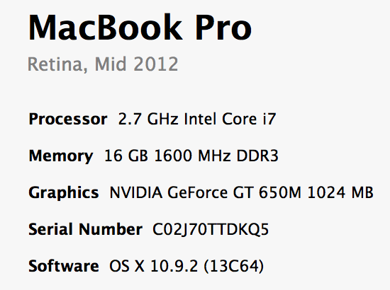
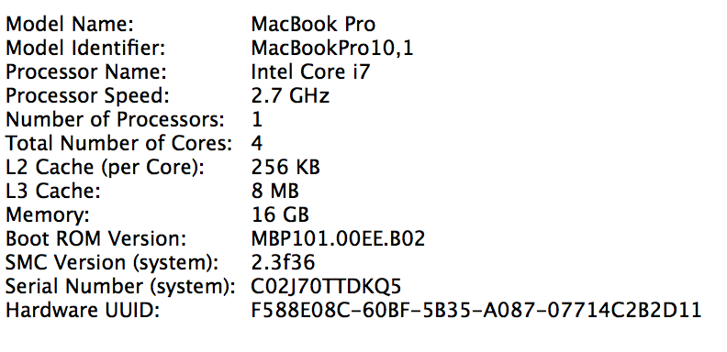
By the end of the cache lectures…

Slide 70
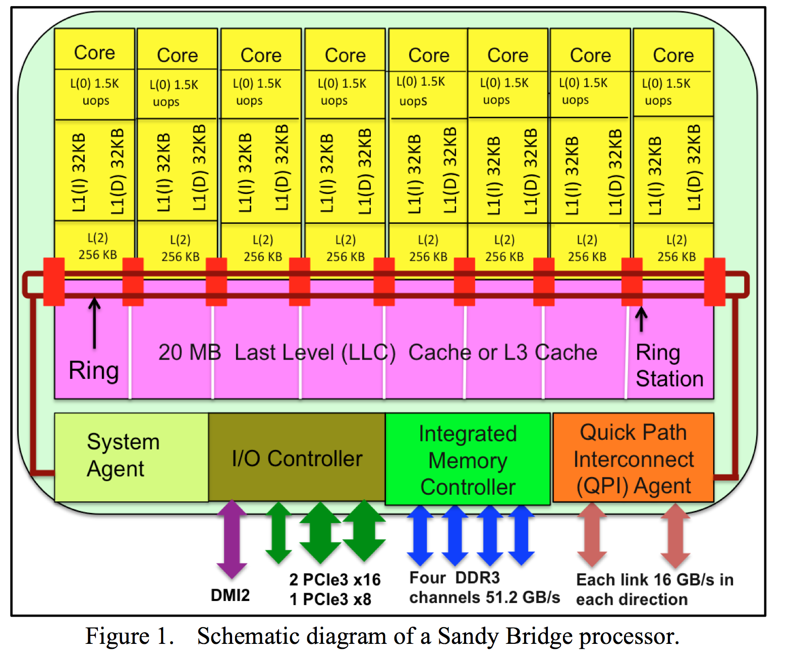

Slide 71
Summary
Memory performance matters!
often more than CPU performance
… because it is the bottleneck, and not improving much
… because most programs move a LOT of data
Design space is huge
Gambling against program behavior
Cuts across all layers: users → programs → os → hardware
Multi-core / Multi-Processor is complicated
Inconsistent views of memory
Extremely complex protocols, very hard to get right

Slide 72
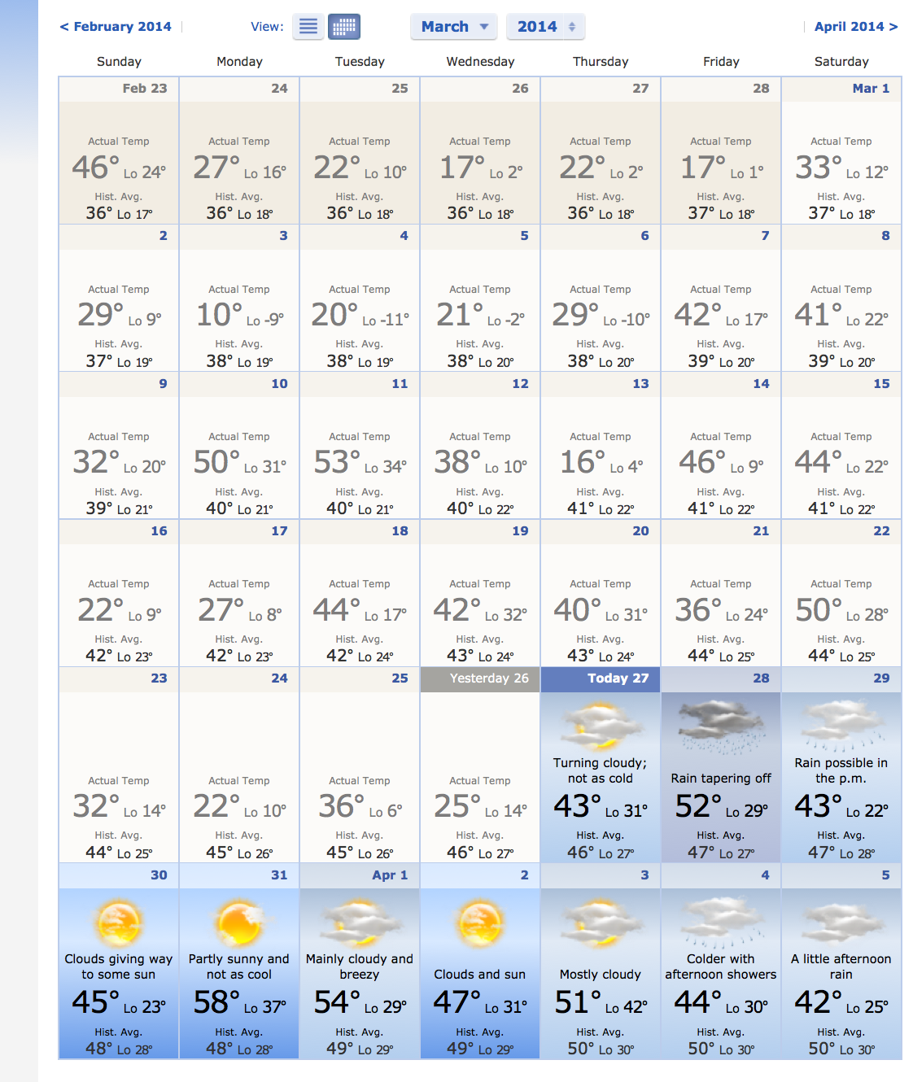
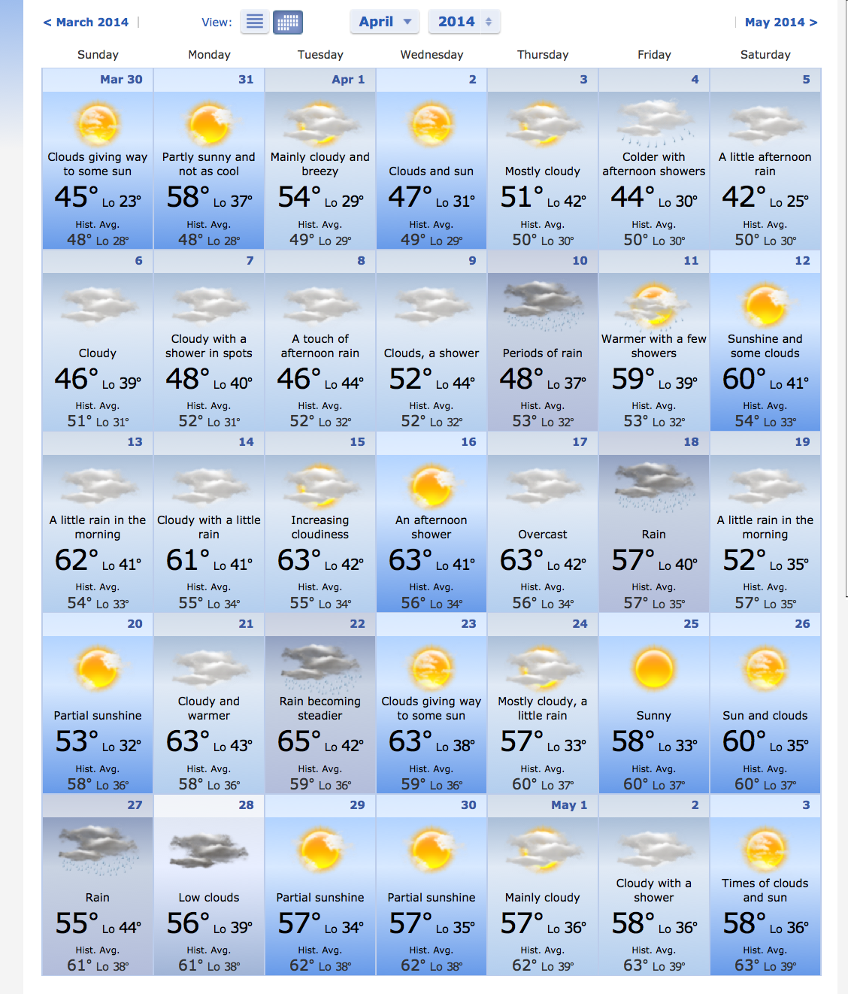
Spring is here!

