Slide 1
GRAPHS
Lecture 17
CS2110 Spring 2018

Slide 2
Announcements
A6 released today. GUIs. Due after Spring Break.
A5 due Thursday.
A4 grades released

Slide 3
A4 Comments
Notes:
It was very time-consuming. Recursion is especially hard to think about.
We really enjoyed this assignment. Although it was more challenging than previous ones, we definitely improved our recursion and algorithm-writing skills.
I've probably watched those 2 videos more than any other video.
Equals and getSharedAncestor gave me the most trouble out of all the methods.

Slide 4
getSharedAncestor
public Person
getSharedAncestor(Person p1, Person p2){
}
if (p1 == null || p2 == null) return null;
List<Person> l1= getRepostRoute(p1);
List<Person> l2= getRepostRoute(p2);
if (l1 == null || l2 == null) return null;
Iterator it1= l1.iterator();
Iterator it2= l2.iterator();
while (it1.hasNext() && it2.hasNext()) {
Person p1= (Person) it1.next();
Person p2- (Person) it2.next();
}
Person sa= root;
if (p1 == p2){ sa= p1; }
else { return sa; }
return sa;

Slide 5
GRAPHS
Lecture 17
CS2110 Spring 2018

Slide 6
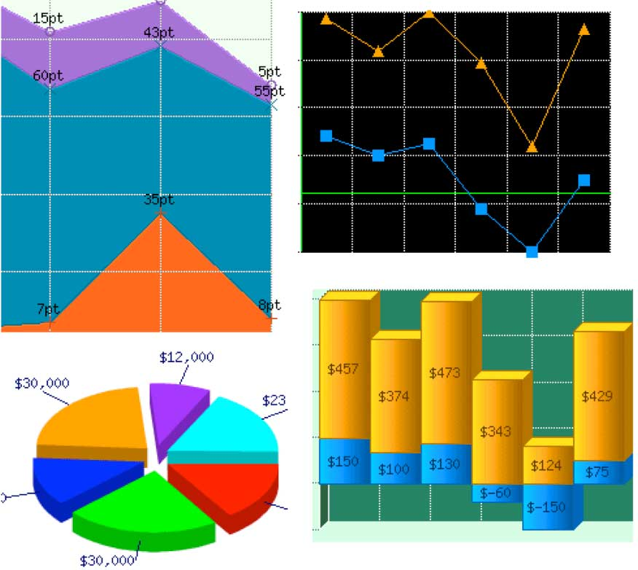
These aren't the graphs we're looking for

Slide 7
Graphs
A graph is a data structure
A graph has
a set of vertices
a set of edges between vertices
Graphs are a generalization of trees

Slide 8
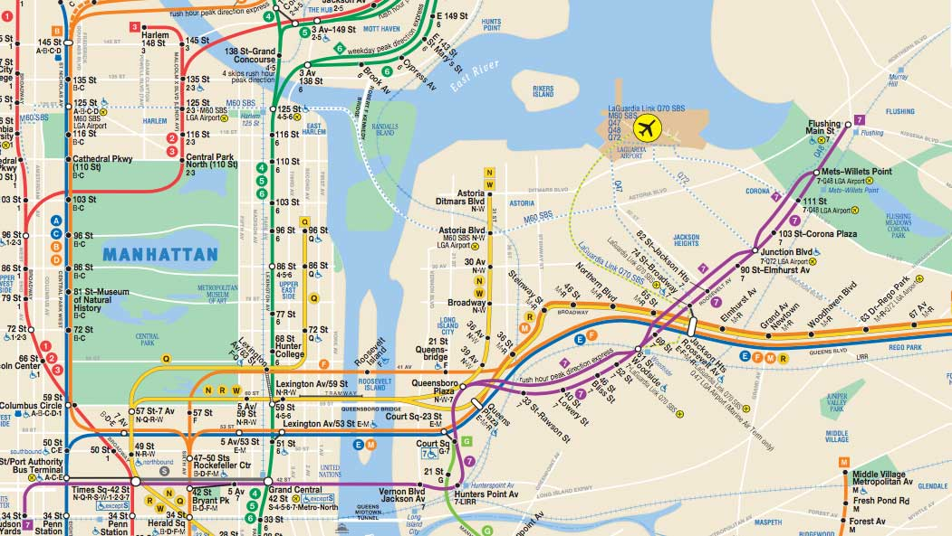
This is a graph

Slide 9
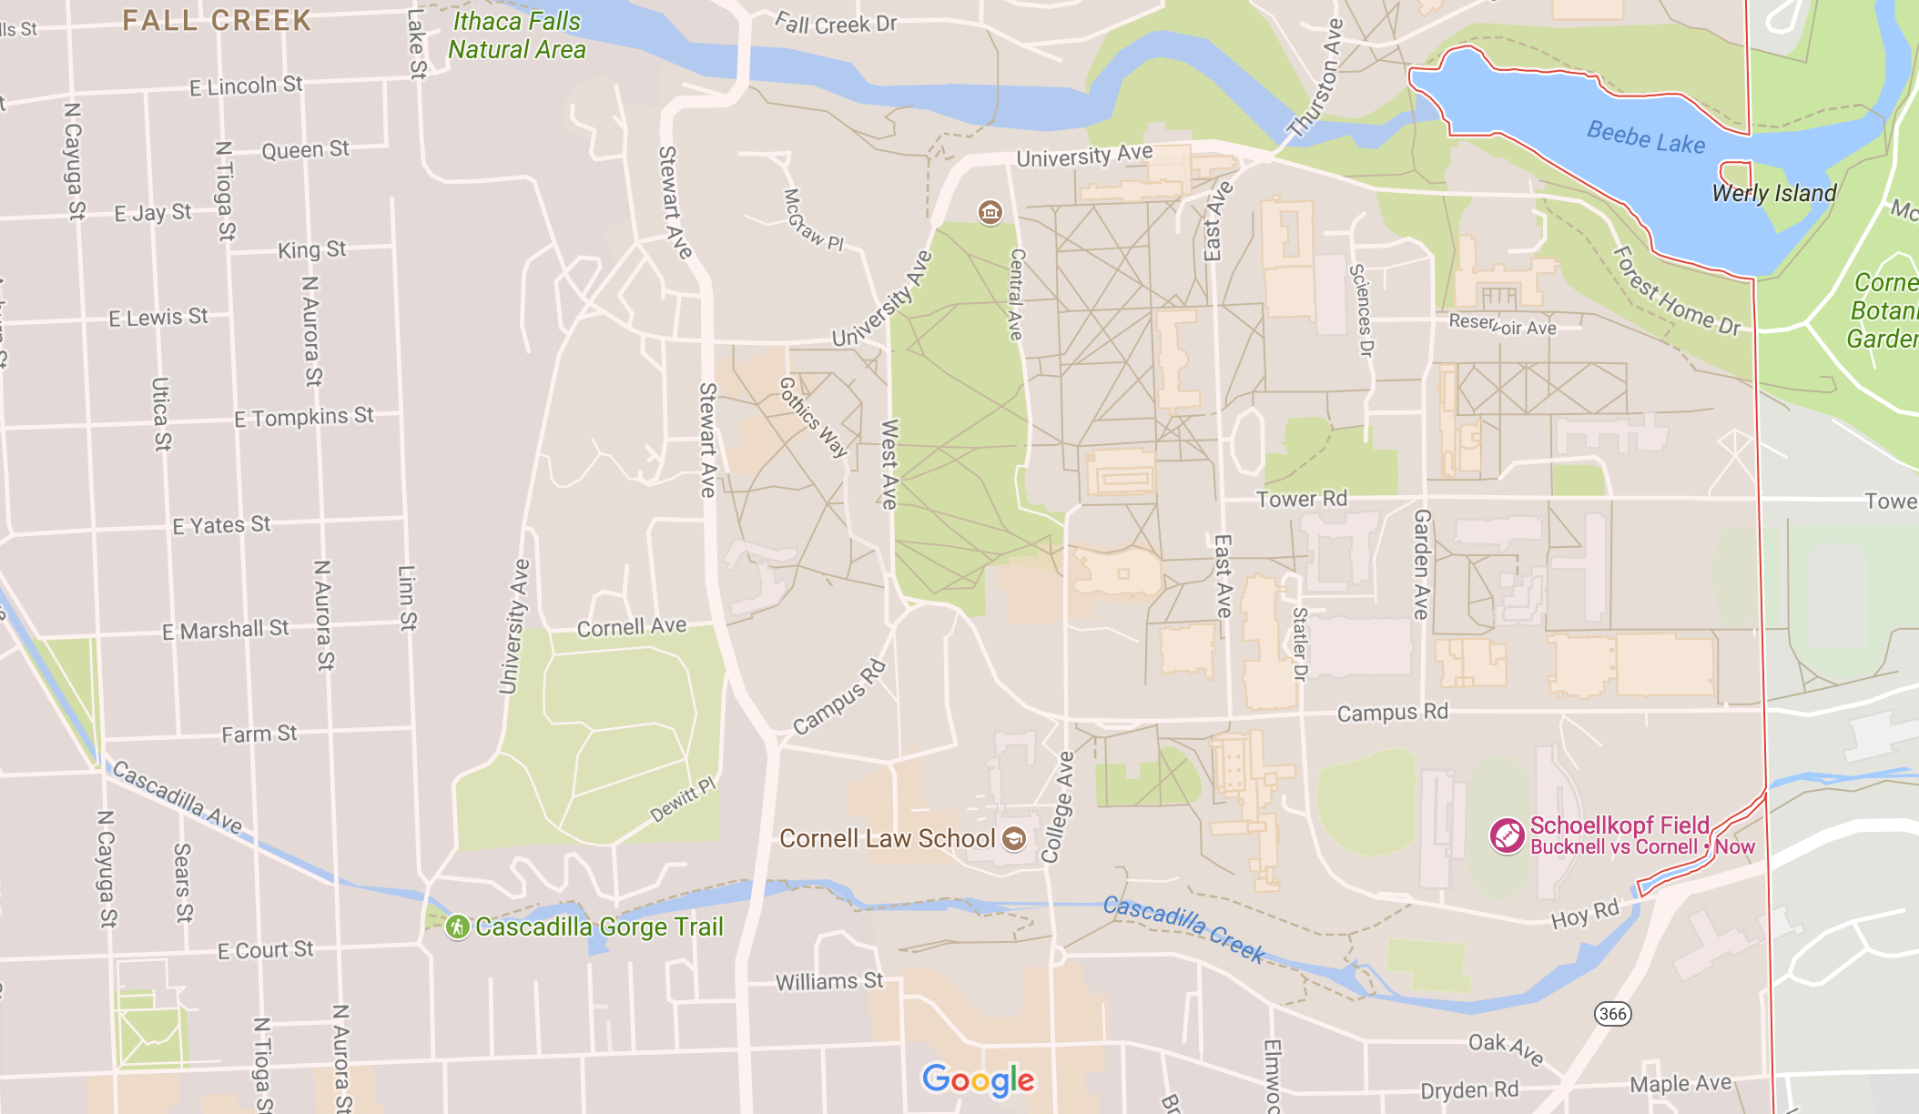
Another transport graph

Slide 10
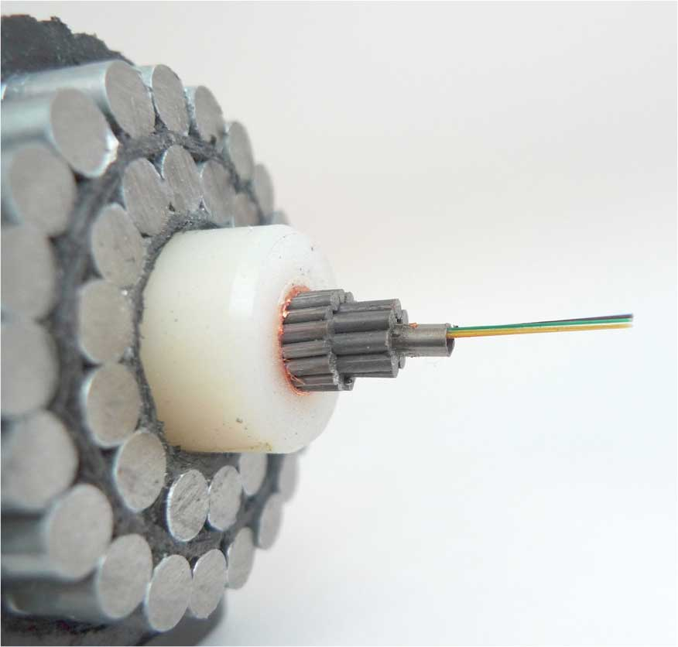
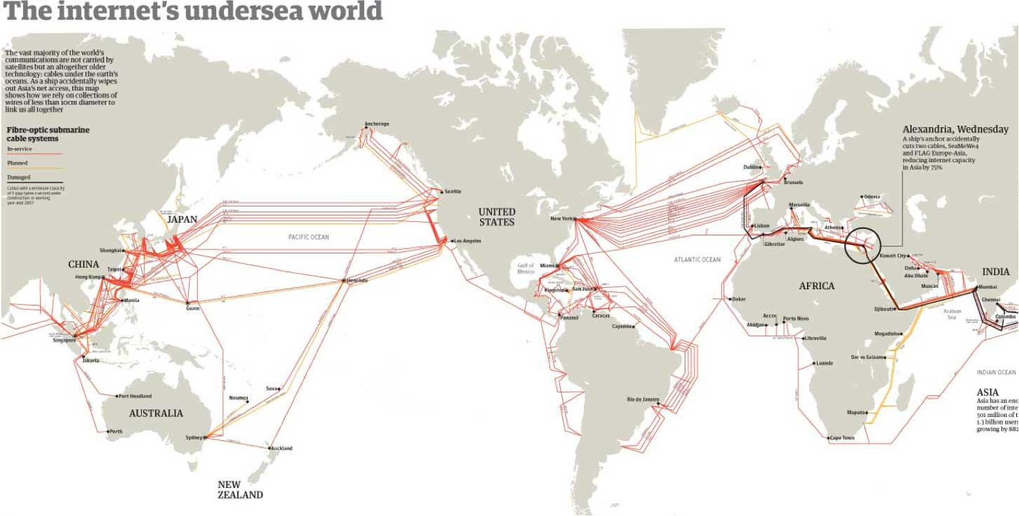
This is a graph

Slide 11
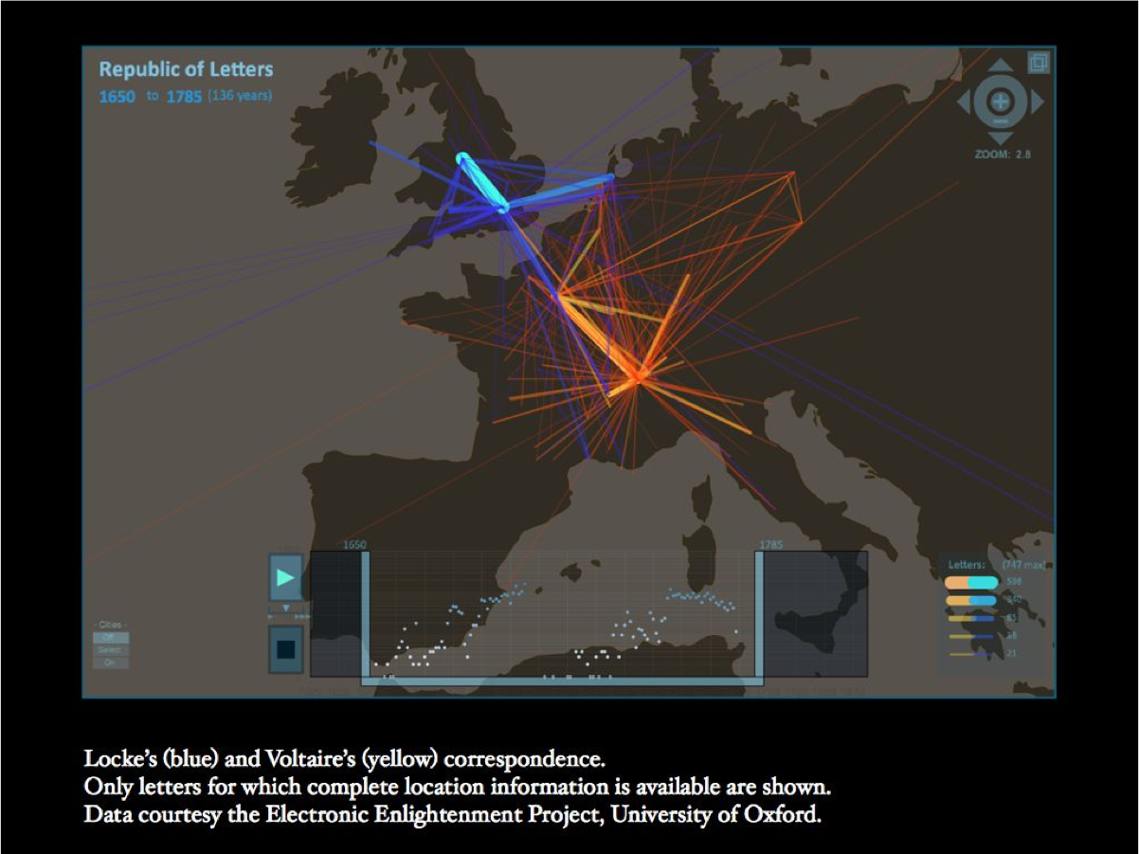
A Social Network Graph

Slide 12
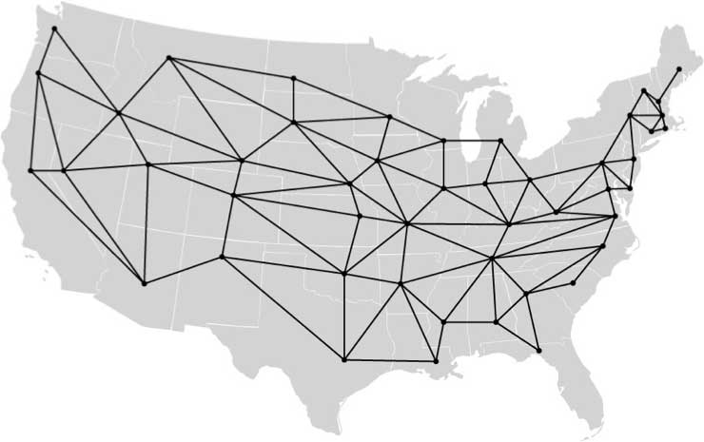
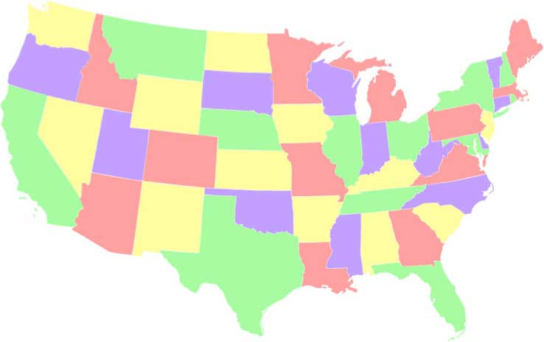
Viewing the map of states as a graph
http://www.cs.cmu.edu/~bryant/boolean/maps.html
Each state is a point on the graph, and neighboring states are connected by an edge.
Do the same thing for a map of the world showing countries

Slide 13
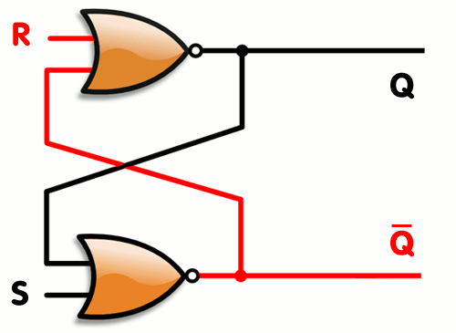
A circuit graph (flip-flop)

Slide 14
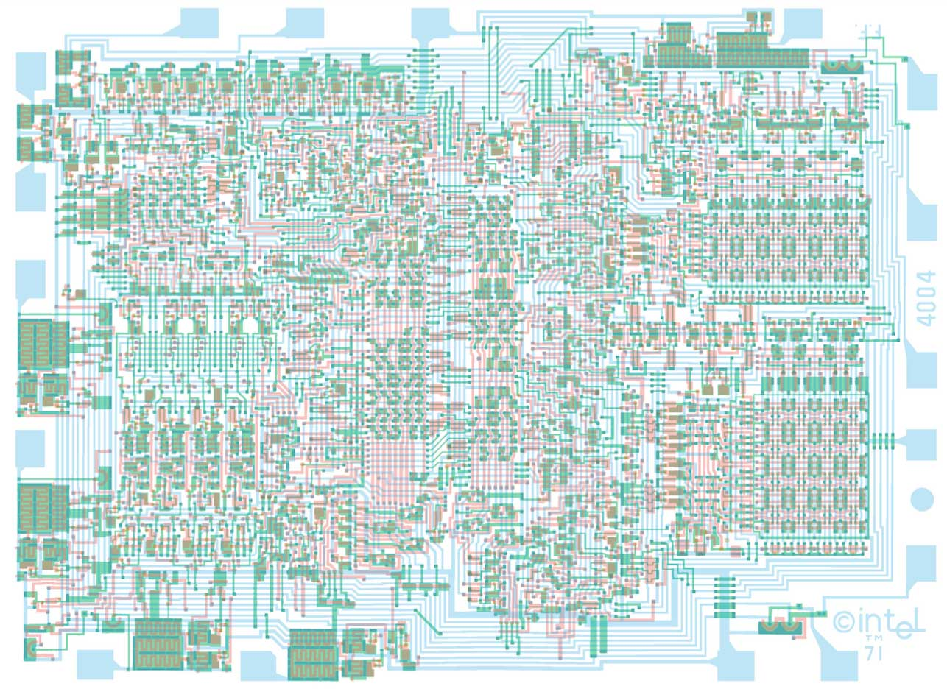
A circuit graph (Intel 4004)

Slide 15
This is not a graph, this is a cat

Slide 16
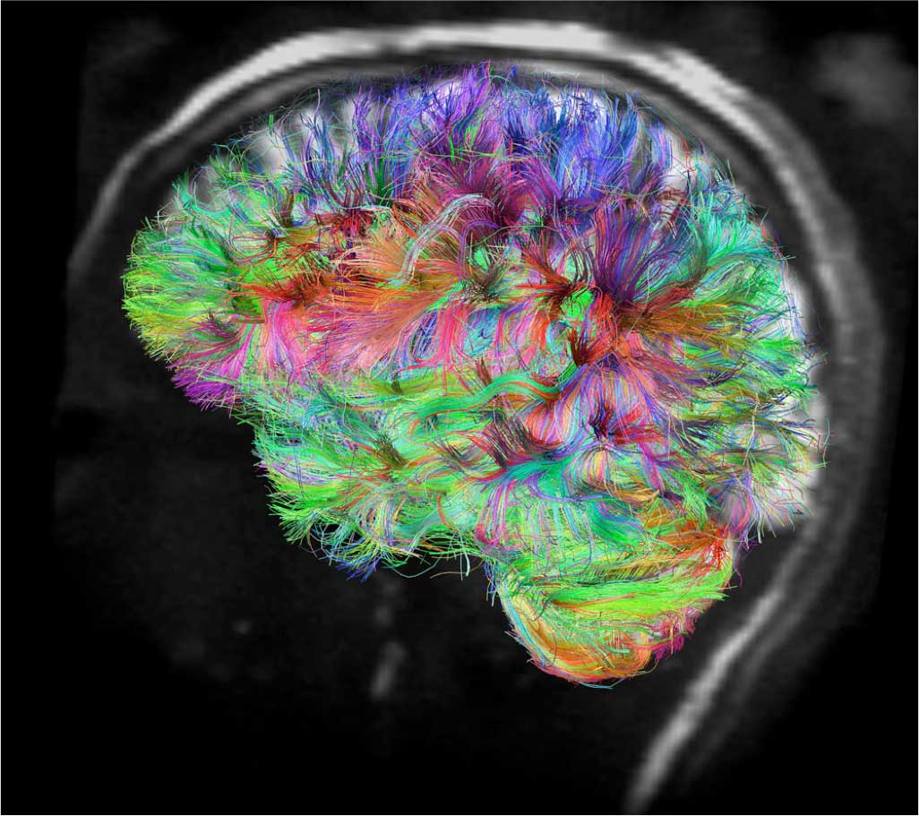
This is a graph
V.J. Wedeen and L.L. Wald, Martinos Center for Biomedical Imaging at MGH

Slide 17
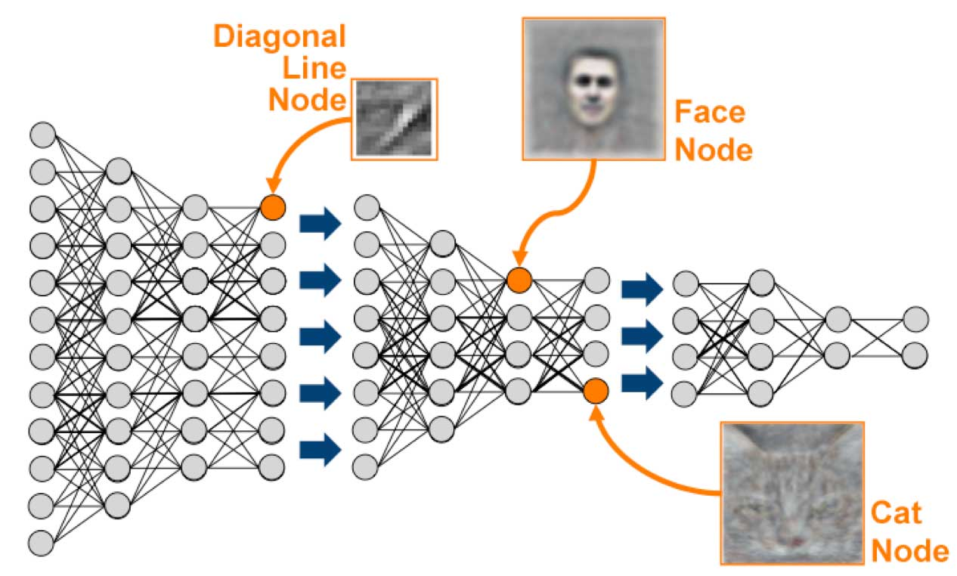
This is a graph(ical model) that has learned to recognize cats

Slide 18
Graphs
K₅
K_{3,3}

Slide 19
Undirect graphs
A undirected graph is a pair (V, E) where
V is a (finite) set
E is a set of pairs (u, v) where u,v ∈ V
Often require u ≠ v (i.e. no self-loops)
Element of V is called a vertex or node
Element of E is called an edge or arc
|V| = size of V, often denoted by n
|E| = size of E, often denoted by m
A
B
C
E
D
V = {A, B, C, D, E}
E = {(A, B), (A, C), (B, C), (C, D)}
|V| = 5
|E| = 4

Slide 20
Directed graphs
A directed graph (digraph) is a lot like an undirected graph
V is a (finite) set
E is a set of ordered pairs (u, v) where u,v ∈ V
Every undirected graph can be easily converted to an equivalent directed graph via a simple transformation:
Replace every undirected edge with two directed edges in opposite directions
… but not vice versa
A
B
C
E
D
V = {A, B, C, D, E}
E = {(A, C), (B, A), (B, C), (C, D),
(D, C)}
|V| = 5
|E| = 5

Slide 21
Graph terminology
Vertices u and v are called
the source and sink of the directed edge (u, v), respectively
the endpoints of (u, v) or {u, v}
Two vertices are adjacent if they are connected by an edge
The outdegree of a vertex u in a directed graph is the number of edges for which u is the source
The indegree of a vertex v in a directed graph is the number of edges for which v is the sink
The degree of a vertex u in an undirected graph is the number of edges of which u is an endpoint
A
B
C
E
D
A
B
C
E
D

Slide 22
More graph terminology
A
Path A,C,D
A path is a sequence v₀,v₁,v₂,...,v_{p} of vertices such that for 0 ≤ i < p,
(v_{i}, v_{i+1})∈E if the graph is directed
{v_{i}, v_{i+1}}∈E if the graph is undirected
The length of a path is its number of edges
A path is simple if it doesn’t repeat any vertices
A cycle is a path v₀, v₁, v₂, ..., v_{p} such that v₀ = v_{p}
A cycle is simple if it does not repeat any vertices except the first and last
A graph is acyclic if it has no cycles
A directed acyclic graph is called a DAG
B
C
E
D
DAG
A
B
C
E
D
Not a DAG

Slide 23
Is this a DAG?
B
D
C
A
F
E
Intuition:
If it’s a DAG, there must be a vertex with indegree zero
This idea leads to an algorithm
A digraph is a DAG if and only if we can iteratively delete indegree-0 vertices until the graph disappears

Slide 24
Is this a DAG?
B
D
C
F
E
Intuition:
If it’s a DAG, there must be a vertex with indegree zero
This idea leads to an algorithm
A digraph is a DAG if and only if we can iteratively delete indegree-0 vertices until the graph disappears

Slide 25
Is this a DAG?
D
C
F
E
Intuition:
If it’s a DAG, there must be a vertex with indegree zero
This idea leads to an algorithm
A digraph is a DAG if and only if we can iteratively delete indegree-0 vertices until the graph disappears

Slide 26
Is this a DAG?
D
F
E
Intuition:
If it’s a DAG, there must be a vertex with indegree zero
This idea leads to an algorithm
A digraph is a DAG if and only if we can iteratively delete indegree-0 vertices until the graph disappears

Slide 27
Is this a DAG?
F
E
Intuition:
If it’s a DAG, there must be a vertex with indegree zero
This idea leads to an algorithm
A digraph is a DAG if and only if we can iteratively delete indegree-0 vertices until the graph disappears

Slide 28
Is this a DAG?
F
Intuition:
If it’s a DAG, there must be a vertex with indegree zero
This idea leads to an algorithm
A digraph is a DAG if and only if we can iteratively delete indegree-0 vertices until the graph disappears

Slide 29
Is this a DAG?
YES!
Intuition:
If it’s a DAG, there must be a vertex with indegree zero
This idea leads to an algorithm
A digraph is a DAG if and only if we can iteratively delete indegree-0 vertices until the graph disappears

Slide 30
Topological sort
2
4
3
1
6
5
We just computed a topological sort of the DAG
This is a numbering of the vertices such that all edges go from lower- to higher-numbered vertices
Useful in job scheduling with precedence constraints

Slide 31
Topological sort
k= 0;
// inv: k nodes have been given numbers in 1..k in such a way that
if n1 <= n2, there is no edge from n2 to n1.
while (there is a node of in-degree 0) {
Let n be a node of in-degree 0;
Give it number k;
Delete n and all edges leaving it from the graph.
k= k+1;
}
2
4
Abstract algorithm
Don’t really want to change the graph.
Will have to invent data structures to make it efficient.
3
1
6
5

Slide 32
Graph coloring
A coloring of an undirected graph is an assignment of a color to each node such that no two adjacent vertices get the same color
How many colors are needed to color this graph?
B
D
C
A
F
E

Slide 33
Graph coloring
A coloring of an undirected graph is an assignment of a color to each node such that no two adjacent vertices get the same color
How many colors are needed to color this graph?
B
D
C
A
F
E

Slide 34
An application of coloring
Vertices are tasks
Edge (u, v) is present if tasks u and v each require access to the same shared resource, and thus cannot execute simultaneously
Colors are time slots to schedule the tasks
Minimum number of colors needed to color the graph = minimum number of time slots required
B
D
C
A
F
E

Slide 35
Coloring a graph
How many colors are needed to color the states so that no two adjacent states have the same color?
Asked since 1852
1879: Kemp publishes a proof that only 4 colors are needed!
1880: Julius Peterson finds a flaw in Kemp's proof…

Slide 36
Four Color Theorem
Every planar graph is 4-colorable [Appel & Haken, 1976]
The proof rested on checking that 1,936 special graphs had a certain property.
They used a computer to check that those 1, 936 graphs had that property!
Basically the first time a computer was needed to check something. Caused a lot of controversy.
Gries looked at their computer program, a recursive program written in the assembly language of the IBM 7090 computer, and found an error, which was safe (it said something didn’t have the property when it did) and could be fixed. Others did the same.
Since then, there have been improvements. And a formal proof has even been done in the Coq proof system

Slide 37
Planarity
A graph is planar if it can be drawn in the plane without any edges crossing
Is this graph planar?
B
D
C
A
F
E

Slide 38
Planarity
A graph is planar if it can be drawn in the plane without any edges crossing
Is this graph planar?
Yes!
B
D
C
A
F
E

Slide 39
Planarity
A graph is planar if it can be drawn in the plane without any edges crossing
Is this graph planar?
Yes!
B
D
C
A
F
E

Slide 40
Detecting Planarity
Kuratowski's Theorem:
A graph is planar if and only if it does not contain a copy of K₅ or K_{3,3} (possibly with other nodes along the edges shown)
K₅
K_{3,3}

Slide 41
Bipartite graphs
A directed or undirected graph is bipartite if the vertices can be partitioned into two sets such that no edge connects two vertices in the same set
The following are equivalent
G is bipartite
G is 2-colorable
G has no cycles of odd length
A
1
B
2
C
3
D

Slide 42
Traveling salesperson
Boston
Ithaca
Copenhagen
1323
1556
224
132
New York
160
512
189
London
Amsterdam
216
210
1078
Paris
1002
Washington
1322
Munich
660
1214
505
419
1356
441
1380
1202
Rome
Atlanta
Find a path of minimum distance that visits every city

Slide 43
Representations of graphs
1
2
4
3
Adjacency List
Adjacency Matrix
1 2 3 4
1
2
3
4
1
2
4
0 1 0 1
0 0 1 0
0 0 0 0
0 1 1 0
2
3
3
4
2
3

Slide 44
Graph Quiz
Which of the following two graphs are DAGs?
Directed Acyclic Graph
Graph 1:
Graph 2:
1 2 3
1
2
3
1
3
2
0 1 1
0 0 0
0 1 0
2
3
3
1
Notes:
TODO: make this a piazza poll

Slide 45
Graph Quiz
3
3
1
1
2
2
1 2 3
1
2
3
1
3
2
0 1 1
0 0 0
0 1 0
2
3
3
1

Slide 46
Adjacency matrix or adjacency list?
1 2 3 4
1
2
3
4
v = number of vertices
e = number of edges
d(u) = degree of u = no. edges leaving u
Adjacency Matrix
Uses space O(v²)
Enumerate all edges in time O(v²)
Answer “Is there an edge from u1 to u2?” in O(1) time
Better for dense graphs (lots of edges)
0 1 0 1
0 0 1 0
0 0 0 0
0 1 1 0

Slide 47
Adjacency matrix or adjacency list?
v = number of vertices
e = number of edges
d(u) = degree of u = no. edges leaving u
Adjacency List
Uses space O(v + e)
Enumerate all edges in time O(v + e)
Answer “Is there an edge from u1 to u2?” in O(d(u1)) time
Better for sparse graphs (fewer edges)
1
2
4
2
3
3
4
2
3

Slide 48
Graph algorithms
Search
Depth-first search
Breadth-first search
Shortest paths
Dijkstra's algorithm
Minimum spanning trees
Jarnik/Prim/Dijkstra algorithm
Kruskal's algorithm

