Slide 1
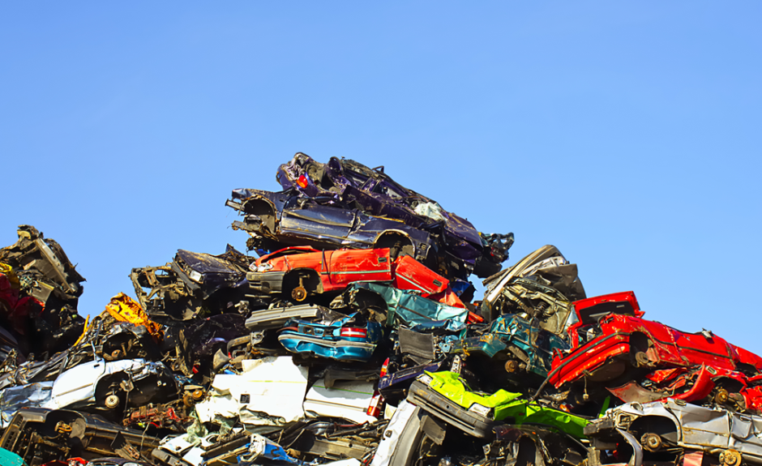
Heaps & Priority Queues
Lecture 16
CS2110 Spring 2018

Slide 2
Announcements
A4 due TOMORROW. Late deadline is Sunday.
A5 released. Due next Thursday.
Deadline for Prelim 1 regrade requests is tomorrow.
Remember to complete your TA evaluations by tonight.

Slide 3
Abstract vs concrete data structures
Abstract data structures are interfaces
they specify only interface (method names and specs)
not implementation (method bodies, fields, …)
Concrete data structures are classes. Abstract data structures can have multiple possible implementations by different concrete data structures.

Slide 4
Concrete data structures
Array
LinkedList (singley-linked, doubly-linked)
Trees (binary, general, red-black)

Slide 5
Abstract data structures
interface List defines an “abstract data type”.
It has methods: add, get, remove, …
Various classes ("concrete data types") implement List:
Class: | ArrayList | LinkedList
Backing storage: | array | chained nodes
add(i, val) | O(n) | O(n)
add(0, val) | O(n) | O(1)
add(n, val) | O(1) | O(1)
get(i) | O(1) | O(n)
get(0) | O(1) | O(1)
get(n) | O(1) | O(1)

Slide 6
Abstract data structures
List (ArrayList, LinkedList)
Set (HashSet, TreeSet)
Map (HashMap, TreeMap)
Stack
Queue
PriorityQueue
Both stack and queue efficiently implementable using a singly linked list with head and tail
head
55
12
19
16
tail

Slide 7
Priority Queue
Data structure in which data items are Comparable
Elements have a priority order (smaller elements---determined by compareTo()---have higher priority)
remove() return the element with the highest priority
break ties arbitrarily

Slide 8
Many uses of priority queues
Surface simplification [Garland and Heckbert 1997]
Event-driven simulation: customers in a line
Collision detection: "next time of contact" for colliding bodies
Graph searching: Dijkstra's algorithm, Prim's algorithm
AI Path Planning: A* search
Statistics: maintain largest M values in a sequence
Operating systems: load balancing, interrupt handling
Discrete optimization: bin packing, scheduling
College: prioritizing assignments for multiple classes.

Slide 9
java.util.PriorityQueue<E>
interface PriorityQueue<E> {
boolean add(E e) {...} //insert e.
E poll() {...} //remove/return min elem.
E peek() {...} //return min elem.
void clear() {...} //remove all elems.
boolean contains(E e)
boolean remove(E e)
int size() {...}
Iterator<E> iterator()
}

Slide 10
Priority queues as lists
Maintain as a list
add() put new element at front – O(1)
poll() must search the list – O(n)
peek() must search the list – O(n)
Maintain as an ordered list
add() must search the list – O(n)
poll() min element at front – O(1)
peek() O(1)
Maintain as red-black tree
add() must search the tree & rebalance – O(log n)
poll() must search the tree & rebalance – O(log n)
peek() O(log n)
Can we do better?

Slide 11
Heaps
A heap is a binary tree that satisfies two properties
Completeness. Every level of the tree (except last) is completely filled.
Heap Order Invariant. Every element in the tree is <= its parent
Do not confuse with heap memory, where a process dynamically allocates space–different usage of the word heap.

Slide 12
Completeness Property
Every level (except last) completely filled.
Nodes on bottom level are as far left as possible.
55
38
22
35
12
19
21
20
6
4
10
8

Slide 13
Completeness Property
Not a heap because:
missing a node on level 2
bottom level nodes are not as far left as possible
55
38
22
35
12
19
20
4
10
8
missing nodes

Slide 14
Order Property
Every element is <= its parent
55
38
22
35
12
19
2
20
6
4
10
18
Note: Bigger elements can be deeper in the tree!

Slide 15
Heap Quiz
Which of the following are valid heaps?
20
20
20
20
12
15
12
12
15
12
15
11
13
11
10
11
15
14
11
10
15
(a)
(b)
(c)
(d)
No
No
No
Yes

Slide 16
Heaps
A heap is a binary tree that satisfies two properties
Completeness. Every level of the tree (except last) is completely filled. All holes in last level are all the way to the right.
Heap Order Invariant. Every element in the tree is <= its parent
A heap implements three key methods:
add(e): adds a new element to the heap
poll(): deletes the max element and returns it
peek(): returns the max element

Slide 17
add(e)
Time is O(log n)
55
38
50
22
35
12
22
19
2
50
20
6
4
10
18
19
50
Put in the new element in a new node (leftmost empty leaf)
Bubble new element up while greater than parent
Notes:
heap maintains balanced tree, so bubble up takes (worst-case) logarithmic time

Slide 18
poll()
Time is O(log n)
50
19
55
55
38
50
22
19
35
12
22
2
19
20
6
4
10
18
19
Save root element in a local variable
Assign last value to root, delete last node.
While less than a child, switch with bigger child (bubble down)
Notes:
heap maintains balanced tree, so bubble up takes (worst-case) logarithmic time

Slide 19
peek()
Time is O(1)
50
50
38
22
35
12
19
2
20
6
4
10
18
Return root value

Slide 20
Implementing Heaps
public class HeapNode<E> {
private E value;
private HeapNode left;
private HeapNode right;
...
}

Slide 21
Implementing Heaps
public class Heap<E> {
private E[] heap;
...
}

Slide 22
Numbering the nodes
Number node starting at root row by row, left to right
Level-order traversal
55
0
1
38
2
22
3
35
12
19
21
4
5
6
7
20
8
6
9
4
Children of node k are nodes 2k+1 and 2k+2
Parent of node k is node (k-1)/2

Slide 23
Storing a heap in an array
Store node number i in index i of array b
Children of b[k] are b[2k +1] and b[2k +2]
Parent of b[k] is b[(k-1)/2]
0
55
1
38
2
22
3
35
12
19
21
4
5
6
7
20
8
6
9
4
parent
0 1 2 3 4 5 6 7 8 9
0 1 2 3 4 5 6 7 8 9
55
38
22
35
12
19
21
20
6
4
children

Slide 24
add() --assuming there is space
/** An instance of a heap */
class Heap<E> {
E[] b= new E[50]; // heap is b[0..n-1]
int n= 0; // heap invariant is true
/** Add e to the heap */
public void add(E e) {
b[n]= e;
n= n + 1;
bubbleUp(n - 1); // given on next slide
}
}

Slide 25
add(). Remember, heap is in b[0..n-1]
class Heap<E> {
/** Bubble element #k up to its position.
* Pre: heap inv holds except maybe for k */
private void bubbleUp(int k) {
// inv: p is parent of k and every elmnt
// except perhaps k is <= its parent
while ( ) {
}
}
int p= (k-1)/2;
k > 0 && b[k].compareTo(b[p]) > 0
swap(b[k], b[p]);
k= p;
p= (k-1)/2;

Slide 26
poll(). Remember, heap is in b[0..n-1]
/** Remove and return the largest element
* (return null if list is empty) */
public E poll() {
if (n == 0) return null;
E v= b[0]; // largest value at root.
b[0]= b[n]; // element to root
n= n – 1; // move last
bubbleDown(0);
return v;
}

Slide 27
poll()
/** Tree has n node.
* Return index of bigger child of node k
(2k+2 if k >= n) */
public int biggerChild(int k, int n) {
int c= 2*k + 2; // k’s right child
if (c >= n || b[c-1] > b[c])
c= c-1;
return c;
}

Slide 28
poll()
/** Bubble root down to its heap position.
Pre: b[0..n-1] is a heap except maybe b[0] */
private void bubbleDown() {
// inv: b[0..n-1] is a heap except maybe b[k] AND
// b[c] is b[k]’s biggest child
while ( ) {
}
}
int k= 0;
int c= biggerChild(k, n);
c < n && b[k] < b[c]
swap(b[k], b[c]);
k= c;
c= biggerChild(k, n);

Slide 29
peek(). Remember, heap is in b[0..n-1]
/** Return the largest element
* (return null if list is empty) */
public E peek() {
if (n == 0) return null;
return b[0]; // largest value at root.
}

Slide 30
Quiz 2: Let's try it!
Here's a heap, stored in an array:
[9 5 2 1 2 2]
What is the state of the array after execution of add(6)? Assume the existing array is large enough to store the additional element.
A. [9 5 2 1 2 2 6] B. [9 5 6 1 2 2 2] C. [9 6 5 1 2 2 2] D. [9 6 5 2 1 2 2]

Slide 31
Quiz 2: Let's try it!
Here's a heap, stored in an array:
[9 5 2 1 2 2]
Write the array after execution of add(6)
$⇒$ [9 5 6 1 2 2 2]
0
9
5
2
1
2
6
1
2
2
6
3
4
5
6
2

Slide 32
HeapSort
Make b[0..n-1] into a max-heap (in place)
for (k= n-1; k > 0; k= k-1) {
b[k]= poll –i.e. take max element out of heap. }
14
55
4
6
12
55
6
6
12
14
0
4
0 1 2 3 4
12
55
4
6
12
6
55
4
12
6
14
14
6
4
4
4
14
14
55
12
4
6
4
6
6
14
4
4
4
12
1
6
2
4
6
14
3
4
6

Slide 33
Priority queues as heaps
A heap is can be used to implement priority queues
Note: need a min-heap instead of a max-heap
Gives better complexity than either ordered or unordered list implementation:
add(): O(log n) (n is the size of the heap)
poll(): O(log n)
peek(): O(1)

Slide 34
java.util.PriorityQueue<E>
interface PriorityQueue<E> { TIME
boolean add(E e) {...} //insert e. log
void clear() {...} //remove all elems.
E peek() {...} //return min elem. constant
E poll() {...} //remove/return min elem. log
boolean contains(E e) linear
boolean remove(E e) linear
int size() {...} constant
Iterator<E> iterator()
}
IF implemented with a heap!

Slide 35
What if the priority is independent from the value?
Separate priority from value and do this:
add(e, p); //add element e with priority p (a double)
THIS IS EASY!
Be able to change priority
change(e, p); //change priority of e to p
THIS IS HARD!
Big question: How do we find e in the heap? Searching heap takes time proportional to its size! No good!
Once found, change priority and bubble up or down. OKAY
Assignment A5: implement this heap! Use a second data structure to make change-priority expected log n time

