Slide 1
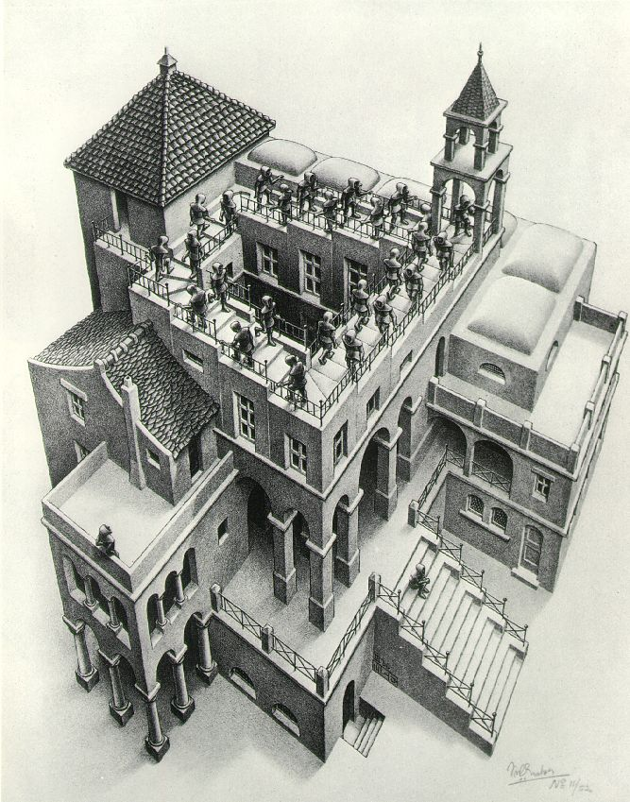
Priority Queues and Heaps
Lecture 17
CS2110 Spring 2016

Slide 2
Readings and Homework
Read Chapter 26 “A Heap Implementation” to learn about heaps
Exercise: Salespeople often make matrices that show all the great features of their product that the competitor’s product lacks. Try this for a heap versus a BST. First, try and
sell someone on a BST: List some desirable properties of a BST that a heap lacks. Now be the heap salesperson: List some good things about heaps that a BST lacks. Can you think of situations where you would favor one over the other?
With ZipUltra heaps, you’ve got it made in the shade my friend!

Slide 3
Statistics of time spent on A4
Copy following comment into top of class State, fill in details. Do carefully. E.g. Don't simply remove "mm minutes" if the minutes is 0. Instead, replace mm by 0.
If you change the format, we have to manually fix it. Thanks!
/* Time spent on a6: hh hours and mm minutes.
* Name(s):
* Netid(s):
* What I thought about this assignment:
*
*/

Slide 4
Stacks and queues are restricted lists
Stack (LIFO) implemented as list
add(), remove() from front of list (push and pop)
Queue (FIFO) implemented as list
add() on back of list, remove() from front of list
These operations are O(1)
Both efficiently implementable using a singly linked list with head and tail
head
55
12
19
16
tail

Slide 5
Interface Bag (not In Java Collections)
interface Bag<E>
implements Iterable {
void add(E obj);
boolean contains(E obj);
boolean remove(E obj);
int size();
boolean isEmpty();
Iterator<E> iterator()
}
Also called multiset
Like a set except that a value can be in it more than once. Example: a bag of coins
Refinements of Bag: Stack, Queue, PriorityQueue

Slide 6
Priority queue
Bag in which data items are Comparable
Smaller elements (determined by compareTo()) have higher priority
remove() return the element with the highest priority = least element in the compareTo() ordering
break ties arbitrarily

Slide 7
Many uses of priority queues (& heaps)
Surface simplification [Garland and Heckbert 1997]
Event-driven simulation: customers in a line
Collision detection: "next time of contact" for colliding bodies
Graph searching: Dijkstra's algorithm, Prim's algorithm
AI Path Planning: A* search
Statistics: maintain largest M values in a sequence
Operating systems: load balancing, interrupt handling
Discrete optimization: bin packing, scheduling

Slide 8
java.util.PriorityQueue<E>
interface PriorityQueue<E> { TIME
boolean add(E e) {...} //insert e. log
void clear() {...} //remove all elems.
E peek() {...} //return min elem. constant
E poll() {...} //remove/return min elem. log
boolean contains(E e) linear
boolean remove(E e) linear
int size() {...} constant
Iterator<E> iterator()
}

Slide 9
Priority queues as lists
Maintain as unordered list
add() put new element at front – O(1)
poll() must search the list – O(n)
peek() must search the list – O(n)
Maintain as ordered list
add() must search the list – O(n)
poll() wamted element at top – O(1)
peek() O(1)
Can we do better?

Slide 10
Heap: binary tree with certain properties
A heap is a concrete data structure that can be used to implement priority queues
Gives better complexity than either ordered or unordered list implementation:
add(): O(log n) (n is the size of the heap)
poll(): O(log n)
O(n log n) to process n elements
Do not confuse with heap memory, where the Java virtual machine allocates space for objects – different usage of the word heap

Slide 11
Heap: first property
Every element is >= its parent
4
6
14
21
8
19
35
22
38
55
10
20
Note: 19, 20 < 35: Smaller elements can be deeper in the tree!

Slide 12
Heap: second property: is complete, has no holes
Every level (except last) completely filled.
Nodes on bottom level are as far left as possible.
4
6
14
21
8
19
35
22
38
55
10
20

Slide 13
Heap: Second property: has no “holes”
Not a heap because it has two holes
4
6
14
21
8
19
22
55
10
20
Not a heap because:
missing a node on level 2
bottom level nodes are not as far left as possible
missing nodes

Slide 14
Heap
Binary tree with data at each node
Satisfies the Heap Order Invariant:
Binary tree is complete (no holes)
1. Every element is ≥ its parent.
2. Every level (except last) completely filled. Nodes on bottom level are as far left as possible.

Slide 15
Numbering the nodes in a heap
Number node starting at root in breadth-first left-right order
0
4
1
6
2
14
3
21
4
8
5
19
6
35
7
22
8
38
9
55
Children of node k are nodes 2k+1 and 2k+2
Parent of node k is node (k-1)/2

Slide 16
Can store a heap in an array b (could also be ArrayList or Vector)
Heap nodes in b in order, going across each level from left to right, top to bottom
Children of b[k] are b[2k + 1] and b[2k + 2]
Parent of b[k] is b[(k – 1)/2]
to parent
0 1 2 3 4 5 6 7 8 9
to children
Tree structure is implicit. No need for explicit links!

Slide 17
add(e)
4
6
14
21
8
19
35
22
38
55
10
20

Slide 18
add(e)
4
6
14
21
8
19
35
22
38
55
10
20
5
1. Put in the new element in a new node

Slide 19
add()
4
6
14
21
8
5
35
22
38
55
10
20
19
2. Bubble new element up if less than parent

Slide 20
add()
4
6
5
21
8
14
35
22
38
55
10
20
19
2. Bubble new element up if less than parent

Slide 21
add()
4
6
5
21
8
14
35
22
38
55
10
20
19

Slide 22
add()
4
6
5
21
8
14
35
22
38
55
10
20
19
2
1. Put in the new element in a new node

Slide 23
add()
4
6
5
21
8
14
2
22
38
55
10
20
19
35
2. Bubble new element up if less than parent

Slide 24
add()
4
6
2
21
8
14
5
22
38
55
10
20
19
35
2. Bubble new element up if less than parent

Slide 25
add()
2
6
4
21
8
14
5
22
38
55
10
20
19
35
2. Bubble new element up if less than parent

Slide 26
add()
2
6
4
21
8
14
5
22
38
55
10
20
19
35

Slide 27
add(e)
Add e at the end of the array
Bubble e up until it no longer violateds heap order
The heap invariant is maintained!

Slide 28
add() to a tree of size n
Time is O(log n), since the tree is balanced
size of tree is exponential as a function of depth
depth of tree is logarithmic as a function of size

Slide 29
add() --assuming there is space
/** An instance of a heap */
class Heap<E> {
E[] b= new E[50]; // heap is b[0..n-1]
int n= 0; // heap invariant is true
/** Add e to the heap */
public void add(E e) {
b[n]= e;
n= n + 1;
bubbleUp(n - 1); // given on next slide
}
}

Slide 30
add(). Remember, heap is in b[0..n-1]
class Heap<E> {
/** Bubble element #k up to its position.
* Pre: heap inv holds except maybe for k */
private void bubbleUp(int k) {
// inv: p is parent of k and every elmnt
// except perhaps k is >= its parent
while ( ) {
}
}
int p= (k-1)/2;
k > 0 && b[k].compareTo(b[p]) < 0
swap(b[k], b[p]);
k= p;
p= (k-1)/2;

Slide 31
poll()
4
6
5
21
8
14
35
22
38
55
10
20
19

Slide 32
poll()
4
6
5
21
8
14
35
22
38
55
10
20
19
1. Save top element in a local variable

Slide 33
poll()
4
6
5
21
8
14
35
22
38
55
10
20
19
2. Assign last value to the root, delete last value from heap

Slide 34
poll()
4
19
6
5
21
8
14
35
22
38
55
10
20
3. Bubble root value down

Slide 35
poll()
4
5
6
19
21
8
14
35
22
38
55
10
20
3. Bubble root value down

Slide 36
poll()
4
5
6
14
21
8
19
35
22
38
55
10
20
3. Bubble root value down

Slide 37
poll()
4
5
6
14
21
8
19
35
22
38
55
10
20
1. Save top element in a local variable

Slide 38
poll()
4 5
6
14
21
8
19
35
22
38
55
10
20
2. Assign last value to the root, delete last value from heap

Slide 39
poll()
4 5
6
14
21
8
19
35
22
38
55
10
20
2. Assign last value to the root, delete last value from heap

Slide 40
poll()
4 5
20
6
14
21
8
19
35
22
38
55
10
3. Bubble root value down

Slide 41
poll()
4 5
6
20
14
21
8
19
35
22
38
55
10
3. Bubble root value down

Slide 42
poll()
4 5
6
8
14
21
20
19
35
22
38
55
10
3. Bubble root value down

Slide 43
poll()
4 5
6
8
14
21
10
19
35
22
38
55
20

Slide 44
poll()
4 5
6
8
14
21
10
19
35
22
38
55
20
3. Bubble root value down

Slide 45
poll()
Save the least element (the root)
Assign last element of the heap to the root.
Remove last element of the heap.
Bubble element down –always with smaller child, until heap invariant is true again.
The heap invariant is maintained!
Return the saved element
Time is O(log n), since the tree is balanced

Slide 46
poll(). Remember, heap is in b[0..n-1]
/** Remove and return the smallest element
* (return null if list is empty) */
public E poll() {
if (n == 0) return null;
E v= b[0]; // smallest value at root.
n= n – 1; // move last
b[0]= b[n]; // element to root
bubbleDown(0);
return v;
}

Slide 47
c’s smaller child
/** Tree has n node.
* Return index of smaller child of node k
(2k+2 if k >= n) */
public int smallerChild(int k, int n) {
int c= 2*k + 2; // k’s right child
if (c >= n || b[c-1].compareTo(b[c]) < 0)
c= c-1;
return c;
}

Slide 48
/** Bubble root down to its heap position.
Pre: b[0..n-1] is a heap except maybe b[0] */
private void bubbleDown() {
// inv: b[0..n-1] is a heap except maybe b[k] AND
// b[c] is b[k]’s smallest child
while ( ) {
}
}
int k= 0;
int c= smallerChild(k, n);
c < n && b[k].compareTo(b[c]) > 0
swap(b[k], b[c]);
k= c;
c= smallerChild(k, n);

Slide 49
Change heap behaviour a bit
Separate priority from value and do this:
add(e, p); //add element e with priority p (a double)
THIS IS EASY!
Be able to change priority
change(e, p); //change priority of e to p
THIS IS HARD!
Big question: How do we find e in the heap? Searching heap takes time proportional to its size! No good!
Once found, change priority and bubble up or down. OKAY
Assignment A6: implement this heap! Use a second data structure to make change-priority expected log n time

Slide 50
HeapSort(b, n) —Sort b[0..n-1]
Whet your appetite –use heap to get exactly n log n in-place sorting algorithm. 2 steps, each is O(n log n)
Make b[0..n-1] into a max-heap (in place)
for (k= n-1; k > 0; k= k-1) {
b[k]= poll –i.e. take max element out of heap. }
This algorithm is on course website
A max-heap has max value at root

