Slide 1
Recitation 13
Software Engineering Practices and Introduction to Design Patterns

Slide 2
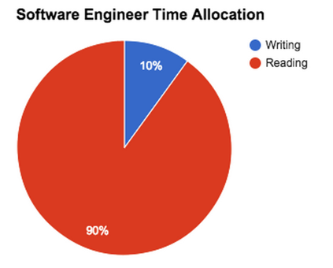
Software Development is chaotic
During that 90% time:
Good engineers think, research, read the codebase, and recognize design patterns

Slide 3
How to be a good great engineer
Focus on code clarity
see style guidelines on course webpage
Adopt practices to help avoid bugs
Utilize design patterns

Slide 4
Coding Strategies

Slide 5
The future of your code...
You write code
Others read it
You may have forgotten how it works
Others write code that depends on it
You have to extend it
You have to modify or fix a bug in it
Others modify it

Slide 6
Method design
Good methods have a clear, crisp purpose
Consequences of good methods:
can test them independently
make code more readable
reduce likelihood of typos
reduce redundancies
Good methods usually:
are short
are reusable
have few parameters
have few side-effects

Slide 7
Wrapper methods
Wrapper methods don’t add much new functionality but increase readability and reduce typos
Example: ArrayList
public boolean contains(Object o) {
return indexOf(o) >= 0;
}
public boolean isEmpty() {
return size == 0
}
Notes:
Technically isEmpty isn’t really a wrapper method, but the idea is the same in this situation.

Slide 8
Use abstractions
Any time you are unsure whether some behavior may change, abstract it (behind an interface, method, etc)
class Person {
public boolean marry(Person p) {
if (isRelated(p)) return false;
...
}
public boolean getRelatives(Person[] people) {
for (Person p : people) {
if (isRelated(p)) ...
}
}
}
if we change our definition of “is related”, the rest of the program remains intact

Slide 9
Clarity vs Efficiency
There is often a trade off between the two. We want to find the right balance.
organized, understandable, error-free, extensible
efficient
Examples:
linear search vs binary search
using bit manipulation vs regular arithmetic
working directly with char arrays vs Strings
caching objects locally for later use vs throwing them away

Slide 10
Premature optimization
Premature Optimization: trying to make code more efficient from the start. This is usually bad.
Why?
You don’t know in advance how slow different parts of the program will be; you may be wasting your efforts optimizing parts that are pretty good already
You will often sacrifice clarity for efficiency
It is almost always easier to take well-organized code and optimize it later than it is to take poorly-organized code and clarify it

Slide 11
How to optimize
Start with optimizations that are obvious and won’t hurt code clarity (ex: using Java.utils HashSet and HashMap
A huge advantage of this process is being able to compare more efficient but complex methods to simpler methods to ensure correctness!
Start simple
Correct program
Code profiling
(timing how long different parts take)
Optimize parts that slow down the program the most
Can use a code-profiler tool or just use built-in methods like System.currentTimeMillis()

Slide 12
Composition vs Inheritance
CarA
start() drive()
If you find your class hierarchy needing to inherit from multiple classes or you need more flexible objects, try composition:
CarB
start() drive()
CarC
start() drive()
Battery1
start()
Battery2
start()
Engine1
drive()
Engine2
drive()
CarD
needs CarB’s start and CarC’s drive
Cars have batteries and engines. They can pick which type, and even change on the fly
Notes:
Good references to study regarding composition over inheritance:
http://engineering.appfolio.com/2014/08/20/a-composition-regarding-inheritance/
http://stackoverflow.com/questions/49002/prefer-composition-over-inheritance

Slide 13
How to avoid bugs!

Slide 14
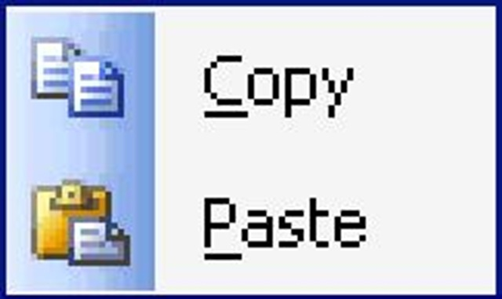
Never use copy/paste!
You may introduce needless bugs unknowingly
You should probably refactor your code to a new helper method

Slide 15
What NOT to do: Shotgun debugging
Shotgun debugging:
a process of making relatively undirected changes to software in the hope that a bug will be perturbed out of existence.
has a relatively low success rate and can be very time consuming
What if I change || to &&?
What if I add parentheses here?
What if I subtract 1 from this value?
http://en.wikipedia.org/wiki/Shotgun_debugging

Slide 16
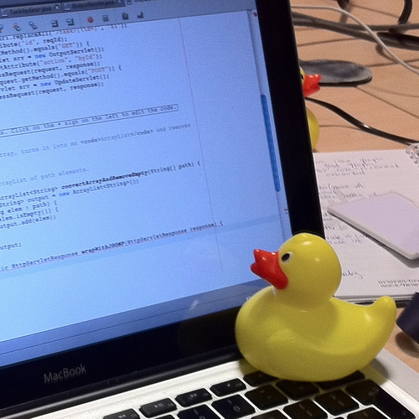
Rubber duck debugging
The process of walking a rubber duck through your code, explaining out loud
Try to do this before even running your code!
Rely more on your reasoning than the test output
http://en.wikipedia.org/wiki/Rubber_duck_debugging

Slide 17
Class diagrams
Dependency:
The dependent class relies on the independent class.
Example:
Class A has a parameter, local variable, or field that is of type C. Class C is isolated from A and B.
class A
Animal
A
Arrow shows dependency on class C
Dog
B
C
Inheritance arrow
Class diagrams help us visualize the design of a system.

Slide 18
Generally, avoid cyclic dependencies
Cyclic dependencies:
Make your code harder to read and maintain
Make it difficult to isolate portions of your codebase to find bugs and test
Make it hard to ensure all objects are updated and valid
A
D
B
C
E
Ideally, your module structure should be a directed acyclic graph.
Notes:
For more information
http://stackoverflow.com/questions/1897537/why-are-circular-references-considered-harmful

Slide 19
Utilize Design Patterns

Slide 20
Design Patterns
solutions to general code design problems
A description, a template, not code
Why?
Common terminology for developers
Best Practices that stand the test of time
Makes code reliable and effective
Notes:
http://www.tutorialspoint.com/design_pattern/design_pattern_overview.htm
Common platform for developers
Design patterns provide a standard terminology and are specific to particular scenario. For example, a singleton design pattern signifies use of single object so all developers familiar with single design pattern will make use of single object and they can tell each other that program is following a singleton pattern.
Best Practices
Design patterns have been evolved over a long period of time and they provide best solutions to certain problems faced during software development. Learning these patterns helps inexperienced developers to learn software design in an easy and faster way.
Big ball of mud pattern
http://en.wikipedia.org/wiki/Big_ball_of_mud
“A big ball of mud is a software system that lacks a perceivable architecture. Although undesirable from a software engineering point of view, such systems are common in practice due to business pressures, developer turnover and code entropy. They have therefore been declared a design anti-pattern.”

Slide 21
Design Patterns
We will talk about two common patterns:
Factory and
Decorator
Structural patterns
Creational patterns
Behavioral patterns
Notes:
These are the 3 categories that most design patterns fall under.

Slide 22
Design Patterns: Creational
Creational patterns: Provide ways to create objects without using the new keyword.
Popular example:
Factory method
Structural patterns
Creational patterns
Behavioral patterns
Notes:
These creational patterns are all about creating objects without really knowing too much about what’s going on under the hood. (The factory method is the classic example!)

Slide 23
Problem
AutomotiveCompany
Car
Car(Engine,Door[],Wheel[])
Engine
Door
Wheel
class AutomotiveCompany shouldn’t have to know about class Engine, Door, and Wheel!
BigWheel
SmallWheel
Notes:
AutomotiveCompany does a lot. It is the main class. It manages financing, marketing, sales, R&D, and of course making the cars.
The AutomotiveCompany works at such a high level that all of the details (like what type of engine, doors, and wheels) actually clutter the class AutomotiveCompany. We want to increase encapsulation and hide away how the Cars are actually created. It then makes our CEO not think as much when trying to make a Car object. It’s nice because then we control how cars are made if we abstract away the Engine, Door, etc (other dependencies to make a Car)

Slide 24
Fix: Factory method Pattern
AutomotiveCompany now doesn’t “know” anything about Engine, Door, and Wheel.
AutomotiveCompany
VehicleFactory
Car
Car(Engine,Door[],Wheel[])
Engine
Door
Wheel
In AutomotiveCompany:
Car c = VehicleFactory.makeCar();
BigWheel
SmallWheel
Notes:
For more info: Factory method
Enter the Factory method Pattern!
A layer of indirection in CS will set you free and it’s true in this case, too.
VehicleFactory took all of the dependency information around making a Car object away from the AutomotiveCompany object. Instead of creating Engine, Door, Wheel objects beforehand and then using them as arguments, VehicleFactory takes care of that and creates a simple interface with zero input.
QUESTION:
Well, why not just make a public constructor with zero args and then make a private constructor with all the args necessary within class Car? (This basically moves all of the creation info to the Car class.)
This is arguably the same thing as the factory method. However, in software engineering, we often are concerned with how the next software engineer will screw up our beautifully written code. So, adding another class enforces the clean interface for car construction. A software engineer won’t easily be able to sneak in a public constructor with dependencies in this case.

Slide 25
Benefits of Factory method
More encapsulation!
AutomotiveCompany cannot “see” how objects are constructed
AutomotiveCompany is more readable with fewer dependencies
Allows for an Object Pool!
Don’t necessarily need to reallocate objects! Can reuse old ones.
Notes:
BRIEFLY go over Object Pool! Not too important!
Basically we can have a set of objects, the “object pool”, that are not in use (eg Junk Cars) and then when we want to revive them, we take them out of our object pool and use them like normal. When we’re done using the car, we can destroy any references and put it back into the object pool. The Factory method allows us to make it look like we’re not using an object pool but are creating new objects each time.
By reusing old objects, this allows us to cut down on the system time of allocating space for new objects.

Slide 26
Design Patterns: Structural
Structural patterns:
Patterns that identify and realize relationships between entities
Popular example:
Decorator
Structural patterns
Creational patterns
Behavioral patterns
Notes:
Creational Patterns
Factory method, Singleton
Structural Patterns
Decorator, Composite, Adapter
Behavioral Patterns

Slide 27
Scenario: Sandwich Shop
Menu
Veggie Sandwich … $4
Tuna Sandwich … $5
Add Cheese … $1
Add Olives … $2
Add Tomato … $3
We need to return the correct price.
How do we represent all combinations of toppings at runtime/dynamically?
Notes:
We would like to represent each sandwich possibility as an object. However, there’s this combinatorial explosion of types.
This is a very difficult structural problem to solve with the simple inheritance we’ve been talking about all semester.
For this example, we can add any topping to any base sandwich.
NOTE: This is a really simple example that doesn’t show why the pattern comes in handy. You could imagine a simple Sandwich class that has a HashMap of Topping -> additional price. However, if a student asks, just tell them that we would like to make it as extensible as possible with a certain type of sandwich.

Slide 28
Problem: Sandwich Shop
TunaSandwich
Same complicated structure with VeggieSandwich!
TunaOliveSandwich
TunaCheeseSandwich
TunaTomatoSandwich
TunaTomatoOliveSandwich
TunaTomatoCheeseSandwich
TunaTomatoOliveCheeseSandwich
Notes:
Each class will have a getPrice method! So why doesn’t this work? Well, we run into a explosion of different sandwich types. What if we added another topping? Then we would need to make twice as many types, this time with the new condiment added to each type.
And also, this looks awful and you can be sure that the code would be confusing to read as well.

Slide 29
Fix: Decorator Pattern
AbstractSandwich
getPrice();
SandwichDecorator
AbstractSandwich sandwich;
SandwichDecorator(AbstractSandwich)
Cheese
Olive
Tomato
VeggieSandwich
TunaSandwich
Components
Decorators
Notes:
For more info: decorator explanation
We start with an abstract class for the sandwich. It just has a getPrice method declaration.
There are two basic components, Veggie and Tuna. These are the least common denominator types for our sandwiches. We need at least one. We can’t build a sandwich out of just cheese and olives.
(Next comes the tricky part. Spend a bit more time explaining the SandwichDecorator.)
The SandwichDecorator (extends AbstractSandwich) is a class that has one field that points to an AbstractSandwich. The constructor just takes in the AbstractSandwich. What this class does is adds things ON TOP OF the current AbstractSandwich. It decorates the input sandwich. In our case, we’re going to be adding things to the current price.
Lastly, we have our decorators. Each decorator does something different because Cheese is a different topping from Olives and Tomatoes. Cheese has a different price, … etc.

Slide 30
Fix: Decorator Pattern
AbstractSandwich
SandwichDecorator
Cheese
Olive
Tomato
VeggieSandwich
TunaSandwich
Components
Decorators
class VeggieSandwich {
double getPrice(){
return 4;
}
}
class Tomato {
double getPrice(){
return sandwich.getPrice()
3;
}
}
Recursive nature of the decorators
Notes:
This slide goes over the difference between the methods in a component (tuna and veggie) vs the methods in a decorator (Cheese, Olive, Tomato).
The Component classes act as the bare bones implementation. At the heart of a naked Veggie Sandwich is a price of $4.
The Decorators add onto the sandwiches passed in. The decorator methods should always call upon the input sandwich’s getPrice and modify it. In this case, we’re adding the additional cost. In this way, the decorator pattern is recursive. We won’t stop calling “sandwich.getPrice()” until we reach a component (veggie or tuna).

Slide 31
Fix: Decorator Pattern
AbstractSandwich
SandwichDecorator
Cheese
Olive
Tomato
VeggieSandwich
TunaSandwich
Making a Tuna sandwich with cheese and olives:
AbstractSandwich sammy = new TunaSandwich();
sammy = new Cheese(sammy);
sammy = new Olive(sammy);
System.out.println(sammy.getPrice());
Notes:
Run through how to make a tuna sandwich with cheese and olives.
See how it’s nested?
We could have written it in one line like this:
new Olive(new Cheese(new TunaSandwich()));
There’s a reason why they say that the decorator pattern is like
Wrapping a gift, putting it in a box, and wrapping the box.

Slide 32
Fix: Decorator Pattern
AbstractSandwich sammy = new TunaSandwich();
sammy = new Cheese(sammy);
sammy = new Olive(sammy);
System.out.println(sammy.getPrice());
sammy
Olive
Cheese
TunaSandwich
Essentially a linked list of objects of type AbstractSandwich, where a component (eg TunaSandwich) is the base case. Olive and Cheese were the decorators.
Notes:
Run through how you would get the price of the final sandwich.
Explain the recursive nature of the decorator pattern.

Slide 33
Benefits of the Decorator Pattern
AbstractSandwich
SandwichDecorator
Cheese
Olive
Tomato
VeggieSandwich
TunaSandwich
Components
Decorators
Much simpler design!
Useful when you would like to add features to a component at runtime

Slide 34
Design Patterns: Behavioral
Behavioral patterns:
Patterns that dictate how objects communicate and share data
Popular examples:
Visitor
Observer
Structural patterns
Creational patterns
Behavioral patterns

Slide 35
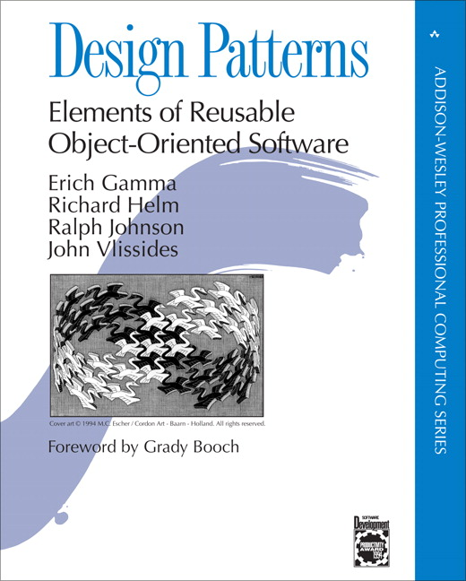
Design Patterns References:
There are many more patterns to learn!
Seminal Book:
Erich Gamma, Richard Helm, Ralph Johnson, and John Vlissides. 1995. Design Patterns: Elements of Reusable Object-Oriented Software. Addison-Wesley Longman Publishing Co., Inc., Boston, MA, USA.
Good online references:
http://www.codeproject.com/Articles/430590/Design-Patterns-of-Creational-Design-Patterns
https://sourcemaking.com/design_patterns
cornell CS PhD

Slide 36
Good rules of thumb for success
"Program testing can at best show the presence of errors but never their absence."
Edsger W. Dijkstra
Think fully before testing!
Document your code and communicate effectively with your team
Write methods that have a clear, crisp purpose

Slide 37
Thank you!
Have a great summer!

