Slide 1
Threads and
Concurrency
CS 2110, Spring 2015

Slide 2
A single computer can simultaneously run several programs

Slide 3
Several computers can simultaneously access a shared server

Slide 4
The server can itself be a distributed system with different data and programs on different nodes

Slide 5
Heap memory, files, and other shared resources
Heap memory, files, and other shared resources
Registers
Registers
Registers
Registers
Stack
Stack
Stack
Stack
Single-threaded
Multi-threaded
Each program can have several threads of execution

Slide 6
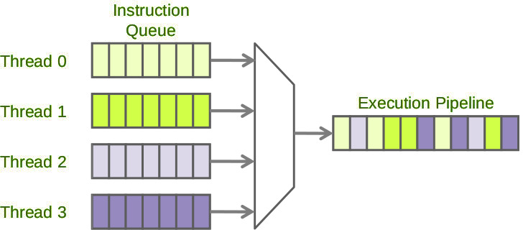
Several threads can be run on a single processor pipeline. Each thread is run for a short time and then suspended, giving the effect that they are running simultaneously

Slide 7
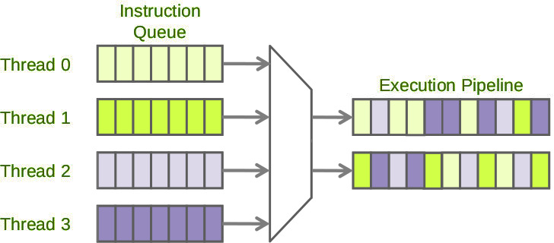
If the processor has multiple cores (modern CPUs often have 2, 4, 8 or more cores), the threads may be assigned to different cores (or more generally, to different “hardware threads”) and actually run simultaneously

Slide 8
Threads in Java
Threads are instances of class Thread
Can create many, but they consume space & time
The Java Virtual Machine created the initial Thread that executes your method main
Threads have a priority
Higher priority Threads are executed preferentially
A newly created Thread has initial priority equal to the Thread that created it (but can change)

Slide 9
A Java Thread runs a Runnable object
class PrimeRun
implements Runnable {
long a, b;
PrimeRun(long a, long b) {
this.a= a; this.b= b;
}
public void run() {
// compute primes // in a..b
...
}
}
Runnable
run()
PrimeRun@...
toString() …
Object
PrimeRun
run() …
Method start() will call p’s method run() in the new thread of execution
PrimeRun p=
new PrimeRun(143, 195);
new Thread(p).start();

Slide 10
A Java Thread runs a Runnable object
class PrimeRun
implements Runnable {
long a, b;
PrimeRun(long a, long b) {
this.a= a; this.b= b;
}
public void run() {
// compute primes // in a..b
...
}
}
Runnable
run()
PrimeRun@...
toString() …
Object
PrimeRun
run() …
No new thread!!!
run() runs in same thread as its caller.
PrimeRun p=
new PrimeRun(143, 195);
p.run();

Slide 11
Another way of creating a Thread
run()
Runnable
class PrimeThread
extends Thread {
long a, b;
PrimeThread(long a, long b) {
this.a= a; this.b= b;
}
public void run() {
// compute primes // in a..b
...
}
}
PT@...
toString() …
Object
interrupt() isAlive()
getState() …
Thread
run() …
PT
PrimeThread p=
new PrimeThread(143, 195);
p.start();
Class Thread has methods to allow more control over threads

Slide 12
Class Thread has methods to handle threads
run()
Runnable
PT@...
You can interrupt a thread, maintain a group of threads, set/change its priority, sleep it for a while, etc.
toString() …
Object
interrupt() isAlive()
getState() …
Thread
run() …
PT
PrimeThread extends Thread, which implements Runnable

Slide 15
Race Condition
Two or more simultaneous threads of execution (concurrency)
Outcome depends on the exact order in which they are executed
… which cannot be predicted in advance
Betting on races does not guarantee winnings
Two chefs can cook great dishes one after the other, but not if they’re trying to simultaneously use the same stove

Slide 16
Race conditions yield unexpected results
Suppose x is initially 0
Thread t1
Thread t2
x= x + 1;
x= x + 1;
... after finishing, x = 1, not 2! Why?
time
Thread t1
Read x (= 0)
Increment (= 1)
Write x (= 1)
Thread t2
Read x (= 0)
Increment (= 1)
Write x (= 1)

Slide 17
Synchronization
Writing correct concurrent programs is very hard
Ideally, two threads would never access the same data
This is frequently unrealistic
We need some form of synchronization
E.g. ensure a thread completes its read-modify-write sequence on a piece of data before another thread is allowed to touch it
E.g. ensure a thread accesses a resource only after another thread has finished accessing it
There are many methods. We will only look at Java’s synchronized keyword.

Slide 18
Fixing the x= x + 1 bug
class Counter {
int value = 0;
public synchronized void inc() { value= value + 1; }
}
class CounterThread
extends Thread {
static Counter x=
new Counter(); public void run() { x.inc(); }
}
Only one thread can execute this method on a given counter at a time
time
Thread t1
Read x (= 0)
Increment (= 1)
Write x (= 1)
Thread t2
Read x (= 1)
Increment (= 2)
Write x (= 2)

Slide 19
The synchronized block
Stack<String> s= new Stack<String>();
{
This is a block of code
}
synchronized(s) {
This is a synchronized block of code
}
Only one thread can be executing a block B synchronized on s at any given time. All other threads trying to execute a block synchronized on s (need not be the same as B) must wait until the first thread finishes executing B.
The synchronized block is a primary tool for eliminating shared data problems. (There are others)

Slide 20
Accessing a stack in a threadsafe way
private Stack<String> s= new Stack<String>();
public void doSomething() {
String str;
synchronized (s) {
if (s.isEmpty()) return;
str= s.pop();
}
// code to do something with str
}
Synchronized
block
Put critical operations in a synchronized block
The Stack object acts as a lock
Only one thread can own the lock at a time
Make synchronized blocks as small as possible

Slide 21
Locking on this, and synchronized methods
You can lock on any object, including this.
public void doSomething(){
synchronized (this) {
// body
}
}
Note: the whole body is synchronized on this. There’s a shorthand for this in Java
is equivalent to
public synchronized void doSomething(){
// body
}
A threadsafe Stack<T> class will have
public synchronized T pop() { … } public synchronized void push(…) { … } etc
Note: the lock is this stack. Two threads can access two different stacks simultaneously.

Slide 22
Synchronized collections
Study class Collections and the following methods before working on A8:
synchronizedCollection
synchronizedSet
synchronizedSortedSet
synchronizedList
synchronizedMap
synchronizedSortedMap

