Slide 1
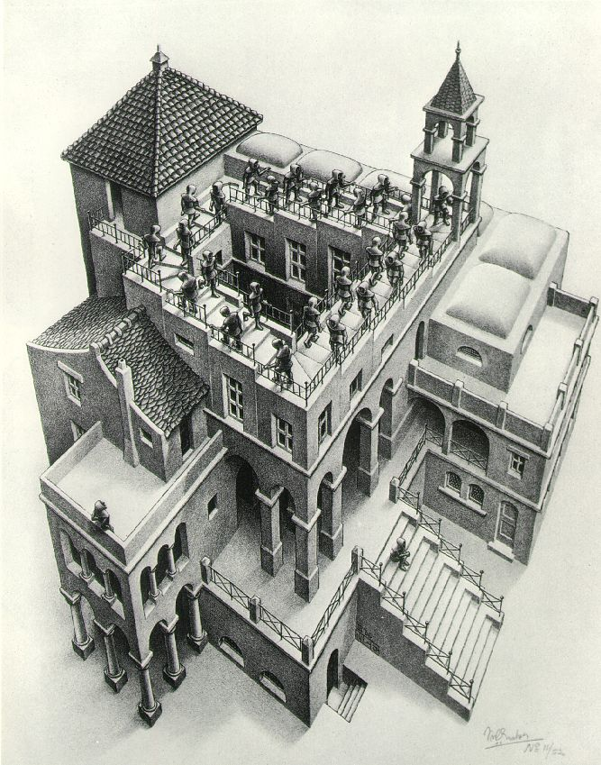
Priority Queues and Heaps
Lecture 16
CS2110 Spring 2015

Slide 2
Readings and Homework
Read Chapter 26 “A Heap Implementation” to learn about heaps
Exercise: Salespeople often make matrices that show all the great features of their product that the competitor’s product lacks. Try this for a heap versus a BST. First, try and
sell someone on a BST: List some desirable properties of a BST that a heap lacks. Now be the heap salesperson: List some good things about heaps that a BST lacks. Can you think of situations where you would favor one over the other?
With ZipUltra heaps, you’ve got it made in the shade my friend!

Slide 3
Cool data structures you now know about
Linked lists –singly linked, doubly linked, circular
Binary search trees
BST-like tree for A4 (BlockTree)
Example of how one changes a data structure to make for efficiency purposes:
In A4 a Shape (consisting of 1,000 Blocks?) gets moved around, rather than change the position field in each Block, have a field of Shape that gives the displacement for all Blocks.

Slide 4
Interface Bag (not In Java Collections)
interface Bag<E>
implements Iterable {
void add(E obj);
boolean contains(E obj);
boolean remove(E obj);
int size();
boolean isEmpty();
Iterator<E> iterator()
}
Also called multiset
Like a set except that a value can be in it more than once. Example: a bag of coins
Refinements of Bag: Stack, Queue, PriorityQueue

Slide 5
Stacks and queues are restricted lists
Stack (LIFO) implemented as list
add(), remove() from front of list
Queue (FIFO) implemented as list
add() on back of list, remove() from front of list
These operations are O(1)
Both efficiently implementable using a singly linked list with head and tail
head
55
12
19
16
tail

Slide 6
Priority queue
Bag in which data items are Comparable
Smaller elements (determined by compareTo()) have higher priority
remove() return the element with the highest priority = least in the compareTo() ordering
break ties arbitrarily

Slide 7
Examples of Priority Queues
Scheduling jobs to run on a computer
default priority = arrival time
priority can be changed by operator
Scheduling events to be processed by an event handler
priority = time of occurrence
Airline check-in
first class, business class, coach
FIFO within each class
Tasks that you have to carry out. You determine priority

Slide 8
java.util.PriorityQueue<E>
boolean add(E e) {...} //insert an element
void clear() {...} //remove all elements
E peek() {...} //return min element without removing
E poll() {...} //remove and return min element
boolean contains(E e)
boolean remove(E e)
int size() {...}
Iterator<E> iterator() //an iterator over the priority queue

Slide 9
Priority queues as lists
Maintain as unordered list
add() put new element at front – O(1)
poll() must search the list – O(n)
peek() must search the list – O(n)
Maintain as ordered list
add() must search the list – O(n)
poll() must search the list – O(n)
peek() O(1)
Can we do better?

Slide 10
Important Special Case
Fixed number of priority levels 0,...,p – 1
FIFO within each level
Example: airline check-in
add()– insert in appropriate queue – O(1)
poll()– must find a nonempty queue – O(p)
first class many miles paying frequent flier

Slide 11
Heap
A heap is a concrete data structure that can be used to implement priority queues
Gives better complexity than either ordered or unordered list implementation:
add(): O(log n)
poll(): O(log n)
O(n log n) to process n elements
Do not confuse with heap memory, where the Java virtual machine allocates space for objects – different usage of the word heap

Slide 12
Heap
Binary tree with data at each node
Satisfies the Heap Order Invariant:
Binary tree is complete (no holes)
1. The least (highest priority) element of any subtree is at the root of that subtree.
2. Every level (except last) completely filled. Nodes on bottom level are as far left as possible.

Slide 13
Heap
Smallest element in any subtree is always found at the root of that subtree
4
6
14
21
8
19
35
22
38
55
10
20
Note: 19, 20 < 35: Smaller elements can be deeper in the tree!

Slide 14
Not a heap —has two holes
Should be complete:
* Every level (except last) completely filled.
* Nodes on bottom level are as far
left as possible.
4
6
14
21
8
19
22
55
10
20
missing nodes

Slide 15
Heap: number nodes as shown
children of node k: at 2k + 1 and 2k + 2
0
4
1
6
2
14
parent of node k: at (k-1) / 2
3
21
4
8
5
19
6
35
7
22
8
38
9
55
Remember, tree has no holes

Slide 16
We illustrate using an array b (could also be ArrayList or Vector)
Heap nodes in b in order, going across each level from left to right, top to bottom
Children b[k] are b[2k + 1] and b[2k + 2]
Parent of b[k] b[(k – 1)/2]
to parent
0 1 2 3 4 5 6 7 8 9
to children
Tree structure is implicit. No need for explicit links!

Slide 17
add(e)
Add e at the end of the array
If this violates heap order because it is smaller than its parent, swap it with its parent
Continue swapping it up until it finds its rightful place
The heap invariant is maintained!

Slide 18
add()
4
6
14
21
8
19
35
22
38
55
10
20

Slide 19
add()
4
6
14
21
8
19
35
22
38
55
10
20
5

Slide 20
add()
4
6
14
21
8
5
35
22
38
55
10
20
19

Slide 21
add()
4
6
5
21
8
14
35
22
38
55
10
20
19

Slide 22
add()
4
6
5
21
8
14
35
22
38
55
10
20
19

Slide 23
add()
4
6
5
21
8
14
35
22
38
55
10
20
19
2

Slide 24
add()
4
6
5
21
8
14
2
22
38
55
10
20
19
35

Slide 25
add()
4
6
2
21
8
14
5
22
38
55
10
20
19
35

Slide 26
add()
2
6
4
21
8
14
5
22
38
55
10
20
19
35

Slide 27
add()
2
6
4
21
8
14
5
22
38
55
10
20
19
35

Slide 28
add() to a tree of size n
Time is O(log n), since the tree is balanced
size of tree is exponential as a function of depth
depth of tree is logarithmic as a function of size

Slide 29
add() --assuming there is space
/** An instance of a heap */
Class Heap<E>{
E[] b= new E[50]; //heap is b[0..n-1]
int n= 0; // heap invariant is true
/** Add e to the heap */
public void add(E e) {
b[n]= e;
n= b + 1;
bubbleUp(n - 1); // given on next slide
}
}

Slide 30
add(). Remember, heap is in b[0..n-1]
class Heap<E> {
/** Bubble element #k up to its position.
* Precondition: heap inv true except maybe for element k */
private void bubbleUp(int k) {
int p= (k-1)/2; // p is the parent of k
// inv: p is k’s parent and
// Every element satisfies the heap property
// except perhaps k (might be smaller than its parent)
while (k>0 && b[k].compareTo(b[p]) < 0) {
Swap b[k] and b[p];
k= p;
p= (k-1)/2;
}
}

Slide 31
poll()
Remove the least element and return it – (at the root)
This leaves a hole at the root – fill it in with the last element of the array
If this violates heap order because the root element is too big, swap it down with the smaller of its children
Continue swapping it down until it finds its rightful place
The heap invariant is maintained!

Slide 32
poll()
4
6
5
21
8
14
35
22
38
55
10
20
19

Slide 33
poll()
4
6
5
21
8
14
35
22
38
55
10
20
19

Slide 34
poll()
4
6
5
21
8
14
35
22
38
55
10
20
19

Slide 35
poll()
4
19
6
5
21
8
14
35
22
38
55
10
20

Slide 36
poll()
4
5
6
19
21
8
14
35
22
38
55
10
20

Slide 37
poll()
4
5
6
14
21
8
19
35
22
38
55
10
20

Slide 38
poll()
4
5
6
14
21
8
19
35
22
38
55
10
20

Slide 39
poll()
4 5
6
14
21
8
19
35
22
38
55
10
20

Slide 40
poll()
4 5
6
14
21
8
19
35
22
38
55
10
20

Slide 41
poll()
4 5
20
6
14
21
8
19
35
22
38
55
10

Slide 42
poll()
4 5
6
20
14
21
8
19
35
22
38
55
10

Slide 43
poll()
4 5
6
8
14
21
20
19
35
22
38
55
10

Slide 44
poll()
4 5
6
8
14
21
10
19
35
22
38
55
20

Slide 45
poll()
4 5
6
8
14
21
10
19
35
22
38
55
20

Slide 46
poll()
Time is O(log n), since the tree is balanced

Slide 47
poll(). Remember, heap is in b[0..n-1]
/** Remove and return the smallest element
(return null if list is empty) */
public E poll() {
if (n == 0) return null;
E val= b[0]; // smallest value is at root
b[0]= b[n-1]; // move last element to root
n= n - 1;
bubbleDown(0);
return val;
}

Slide 48
/** Bubble root down to its heap position.
Pre: b[0..n-1] is a heap except: b[0] may be > than a child */
private void bubbleDown() {
int k= 0;
// Set c to smaller of k’s children
int c= 2*k + 2; // k’s right child
if (c >= n || b[c-1].compareTo(b[c]) < 0) c= c-1;
// inv: b[0..n-1] is a heap except: b[k] may be > than a child.
// Also, b[c] is b[k]’s smallest child
while (c < n && b[k].compareTo(b[c]) > 0) {
Swap b[k] and b[c];
k= c;
c= 2*k + 2; // k’s right child
if (c >= n || b[c-1].compareTo(b[c]) < 0) c= c-1;
}
}

Slide 49
HeapSort(b, n) —Sort b[0..n-1]
Whet your appetite –use heap to get exactly n log n in-place sorting algorithm. 2 steps, each is O(n log n)
Make b[0..n-1] into a max-heap (in place)
for (k= n-1; k > 0; k= k-1) {
b[k]= poll –i.e. take max element out of heap. }
We’ll post this algorithm on course website
A max-heap has max value at root

Slide 50
Many uses of priority queues & heaps
Surface simplification [Garland and Heckbert 1997]
Mesh compression: quadric error mesh simplification
Event-driven simulation: customers in a line
Collision detection: "next time of contact" for colliding bodies
Data compression: Huffman coding
Graph searching: Dijkstra's algorithm, Prim's algorithm
AI Path Planning: A* search
Statistics: maintain largest M values in a sequence
Operating systems: load balancing, interrupt handling
Discrete optimization: bin packing, scheduling
Spam filtering: Bayesian spam filter

