Slide 1
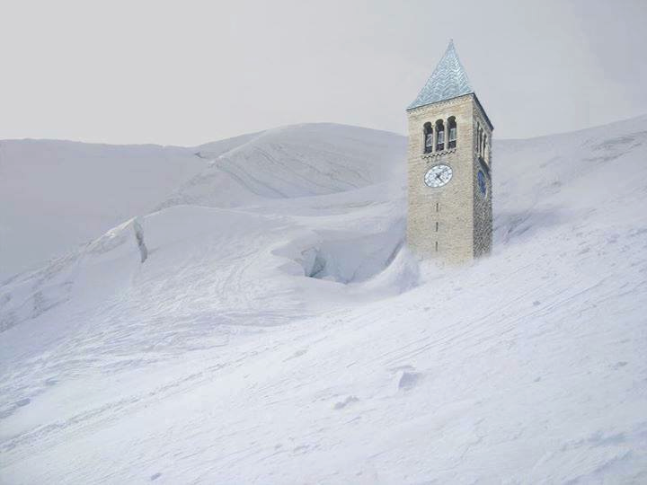
Searching, Sorting, and Asymptotic Complexity
CS2110 – Spring 2015
Lecture 10
2n + 2 ops
n*n ops
n + 2 ops
n ops
Constant time
0 1 2 3 …
size n
Pic: Natalie Diebold

Slide 2
Merge two adjacent sorted segments
/* Sort b[h..k]. Precondition: b[h..t] and b[t+1..k] are sorted. */
public static merge(int[] b, int h, int t, int k) {
Copy b[h..t] into another array c;
Copy values from c and b[t+1..k] in ascending order into b[h..]
}
We leave you to write this method. It is not difficult. Just have to move values from c and b[t+1..k] into b in the right order, from smallest to largest.
Runs in time O(k+1–h)
c
4 7 7 8 9
h t k
b
4 7 7 8 9 3 4 7 8
b
3 4 4 7 7 7 8 8 9

Slide 3
Mergesort
/** Sort b[h..k] */
public static mergesort(int[] b, int h, int k]) {
if (size b[h..k] < 2)
return;
int t= (h+k)/2;
mergesort(b, h, t);
mergesort(b, t+1, k);
merge(b, h, t, k);
}
merge is O(k+1-h)
This is O(n log n) for an initial array segment of size n
But space is O(n) also!

Slide 4
Mergesort
/** Sort b[h..k] */
public static mergesort(
int[] b, int h, int k]) {
if (size b[h..k] < 2)
return;
int t= (h+k)/2;
mergesort(b, h, t);
mergesort(b, t+1, k);
merge(b, h, t, k);
}
Runtime recurrence
T(n): time to sort array of size n T(1) = 1
T(n) = 2T(n/2) + O(n)
Can show by induction that T(n) is O(n log n)
Alternatively, can see that T(n) is O(n log n) by looking at tree of recursive calls

Slide 5
QuickSort versus MergeSort
5
/** Sort b[h..k] */
public static void QS
(int[] b, int h, int k) {
if (k – h < 1) return;
int j= partition(b, h, k);
QS(b, h, j-1);
QS(b, j+1, k);
}
/** Sort b[h..k] */
public static void MS
(int[] b, int h, int k) {
if (k – h < 1) return;
MS(b, h, (h+k)/2);
MS(b, (h+k)/2 + 1, k);
merge(b, h, (h+k)/2, k);
}
One processes the array then recurses.
One recurses then processes the array.

Slide 6
Readings, Homework
Textbook: Chapter 4
Homework:
Recall our discussion of linked lists and A2.
What is the worst case complexity for appending an items on a linked list? For testing to see if the list contains X? What would be the best case complexity for these operations?
If we were going to talk about complexity (speed) for operating on a list, which makes more sense: worst-case, average-case, or best-case complexity? Why?

Slide 7
What Makes a Good Algorithm?
Suppose you have two possible algorithms or ADT implementations that do the same thing; which is better?
What do we mean by better?
Faster?
Less space?
Easier to code?
Easier to maintain?
Required for homework?
How do we measure time and space of an algorithm?

Slide 8
Basic Step: One “constant time” operation
Basic step:
Input/output of scalar value
Access value of scalar variable, array element, or object field
assign to variable, array element, or object field
do one arithmetic or logical operation
method call (not counting arg evaluation and execution of method body)
If-statement: number of basic steps on branch that is executed
Loop: (number of basic steps in loop body) * (number of iterations) –also bookkeeping
Method: number of basic steps in method body (include steps needed to prepare stack-frame)

Slide 9
Counting basic steps in worst-case execution
Let n = b.length
Linear Search
worst-case execution
basic step # times executed
i= 0; 1
i < b.length n+1
i++ n
b[i] == v n
return true 0
return false 1
Total 3n + 3
/** return true iff v is in b */
static boolean find(int[] b, int v) {
for (int i = 0; i < b.length; i++) {
if (b[i] == v) return true;
}
return false;
}
We sometimes simplify counting by counting only important things.
Here, it’s the number of array element comparisons b[i] == v. that’s the number of loop iterations: n.

Slide 10
Sample Problem: Searching
Second solution: Binary Search
/** b is sorted. Return h satisfying
b[0..h] <= v < b[h+1..] */
static int bsearch(int[] b, int v) {
int h= -1;
int k= b.length;
while (h+1 != k) {
int e= (h+ k)/2;
if (b[e] <= v) h= e;
else k= e;
}
return h;
}
inv:
b[0..h] <= v < b[k..]
Number of iterations
(always the same):
~log b.length
Therefore, log b.length arrray comparisons

Slide 11
What do we want from a definition of “runtime complexity”?
1. Distinguish among cases for large n, not small n
Number of operations executed
2. Distinguish among important cases, like
n*n basic operations
n basic operations
log n basic operations
5 basic operations
n*n ops
2+n ops
3. Don’t distinguish among trivially different cases.
5 or 50 operations
n, n+2, or 4n operations
5 ops
0 1 2 3 …
size n of problem

Slide 12
Definition of O(…)
Formal definition: f(n) is O(g(n)) if there exist constants c and N such that for all n ≥ N, f(n) ≤ c·g(n)
Graphical view
c·g(n)
f(n)
Get out far enough –for n >=N–
c·g(n) is bigger than f(n)
N

Slide 13
What do we want from a definition of “runtime complexity”?
Formal definition: f(n) is O(g(n)) if there exist constants c and N such that for all n ≥ N,
f(n) ≤ c·g(n)
Number of operations executed
n*n ops
2+n ops
Roughly, f(n) is O(g(n)) means that f(n) grows like g(n) or slower, to within a constant factor
5 ops
0 1 2 3 …
size n of problem

Slide 14
Prove that (n² + n) is O(n²)
Formal definition: f(n) is O(g(n)) if there exist constants c and N such that for all n ≥ N, f(n) ≤ c·g(n)
Example: Prove that (n² + n) is O(n²)
f(n)
= <definition of f(n)>
n² + n
<= <for n >= 1>
n² + n²
= <arith>
2*n²
= <choose g(n) = n²>
2*g(n)
Choose
N = 1 and c = 2

Slide 15
Prove that 100 n + log n is O(n)
Formal definition: f(n) is O(g(n)) if there exist constants c and N such that for all n ≥ N, f(n) ≤ c·g(n)
f(n)
= <put in what f(n) is>
100 n + log n
<= <We know log n ≤ n for n ≥ 1>
100 n + n
= <arith>
101 n
= <g(n) = n>
101 g(n)
Choose
N = 1 and c = 101

Slide 16
O(…) Examples
Let f(n) = 3n² + 6n – 7
f(n) is O(n²)
f(n) is O(n³)
f(n) is O(n⁴)
…
p(n) = 4 n log n + 34 n – 89
p(n) is O(n log n)
p(n) is O(n²)
h(n) = 20·2^{n} + 40n
h(n) is O(2^{n})
a(n) = 34
a(n) is O(1)
Only the leading term (the term that grows most rapidly) matters
If it’s O(n²), it’s also O(n³)
etc! However, we always use the smallest one

Slide 17
Problem-size examples
Suppose a computer can execute 1000 operations per second; how large a problem can we solve?
alg | 1 second | 1 minute | 1 hour
O(n) | 1000 | 60,000 | 3,600,000
O(n log n) | 140 | 4893 | 200,000
O(n²) | 31 | 244 | 1897
3n² | 18 | 144 | 1096
O(n³) | 10 | 39 | 153
O(2^{n}) | 9 | 15 | 21

Slide 18
Commonly Seen Time Bounds
O(1) | constant | excellent
O(log n) | logarithmic | excellent
O(n) | linear | good
O(n log n) | n log n | pretty good
O(n²) | quadratic | OK
O(n³) | cubic | maybe OK
O(2^{n}) | exponential | too slow

Slide 19
Worst-Case/Expected-Case Bounds
May be difficult to determine time bounds for all imaginable inputs of size n
Simplifying assumption #4: Determine number of steps for either
worst-case or
expected-case or average case
Worst-case
Determine how much time is needed for the worst possible input of size n
Expected-case
Determine how much time is needed on average for all inputs of size n

Slide 20
Simplifying Assumptions
Use the size of the input rather than the input itself – n
Count the number of “basic steps” rather than computing exact time
Ignore multiplicative constants and small inputs (order-of, big-O)
Determine number of steps for either
worst-case
expected-case
These assumptions allow us to analyze algorithms effectively

Slide 21
Worst-Case Analysis of Searching
Binary Search
// Return h that satisfies
// b[0..h] <= v < b[h+1..]
static bool bsearch(int[] b, int v {
int h= -1; int t= b.length;
while ( h != t-1 ) {
int e= (h+t)/2;
if (b[e] <= v) h= e;
else t= e;
}
}
Linear Search
// return true iff v is in b
static bool find (int[] b, int v) {
for (int x : b) {
if (x == v) return true;
}
return false;
}
worst-case time: O(n)
Always takes ~(log n+1) iterations.
Worst-case and expected times:
O(log n)

Slide 22
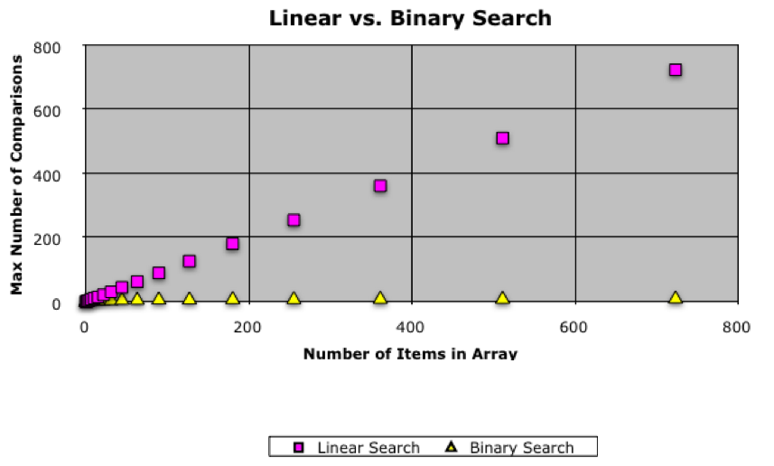
Comparison of linear and binary search

Slide 23
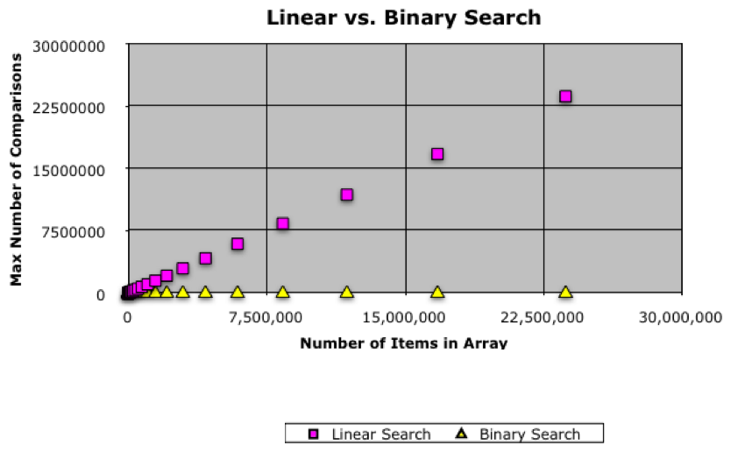
Comparison of linear and binary search

Slide 24
Analysis of Matrix Multiplication
Multiply n-by-n matrices A and B:
Convention, matrix problems measured in terms of n, the number of rows, columns
Input size is really 2n², not n
Worst-case time: O(n³)
Expected-case time:O(n³)
for (i = 0; i < n; i++)
for (j = 0; j < n; j++) {
c[i][j] = 0;
for (k = 0; k < n; k++)
c[i][j] += a[i][k]*b[k][j];
}

Slide 25
Remarks
Once you get the hang of this, you can quickly zero in on what is relevant for determining asymptotic complexity
Example: you can usually ignore everything that is not in the innermost loop. Why?
One difficulty:
Determining runtime for recursive programs Depends on the depth of recursion

Slide 26
Why bother with runtime analysis?
Computers so fast that we can do whatever we want using simple algorithms and data structures, right?
Not really – data-structure/algorithm improvements can be a very big win
Scenario:
A runs in n² msec
A' runs in n²/10 msec
B runs in 10 n log n msec
Problem of size n=10³
A: 10³ sec ≈ 17 minutes
A': 10² sec ≈ 1.7 minutes
B: 10² sec ≈ 1.7 minutes
Problem of size n=10⁶
A: 10⁹ sec ≈ 30 years
A': 10⁸ sec ≈ 3 years
B: 2·10⁵ sec ≈ 2 days
1 day = 86,400 sec ≈ 10⁵ sec
1,000 days ≈ 3 years

Slide 27
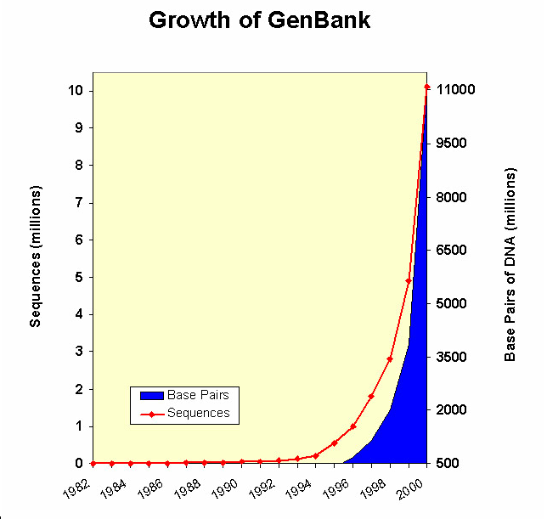
Algorithms for the Human Genome
Human genome = 3.5 billion nucleotides ~ 1 Gb
@1 base-pair instruction/μsec
n² → 388445 years
n log n → 30.824 hours
n → 1 hour

Slide 28
Limitations of Runtime Analysis
Big-O can hide a very large constant
Example: selection
Example: small problems
The specific problem you want to solve may not be the worst case
Example: Simplex method for linear programming
Your program may not be run often enough to make analysis worthwhile
Example: one-shot vs. every day
You may be analyzing and improving the wrong part of the program
Very common situation
Should use profiling tools

Slide 29
What you need to know / be able to do
Know the definition of f(n) is O(g(n))
Be able to prove that some function f(n) is O(g(n). The simplest way is as done on two slides.
Know worst-case and average (expected) case O(…) of basic searching/sorting algorithms: linear/binary search, partition alg of Quicksort, insertion sort, selection sort, quicksort, merge sort.
Be able to look at an algorithm and figure out its worst case O(…) based on counting basic steps or things like array-element swaps/

Slide 30
Lower Bound for Comparison Sorting
Goal: Determine minimum time required to sort n items
Note: we want worst-case, not best-case time
Best-case doesn’t tell us much. E.g. Insertion Sort takes O(n) time on already-sorted input
Want to know worst-case time for best possible algorithm
How can we prove anything about the best possible algorithm?
Want to find characteristics that are common to all sorting algorithms
Limit attention to comparison-based algorithms and try to count number of comparisons

Slide 31
Comparison Trees
Comparison-based algorithms make decisions based on comparison of data elements
Gives a comparison tree
If algorithm fails to terminate for some input, comparison tree is infinite
Height of comparison tree represents worst-case number of comparisons for that algorithm
Can show: Any correct comparison-based algorithm must make at least n log n comparisons in the worst case
a[i] < a[j]
no
yes

Slide 32
Lower Bound for Comparison Sorting
Say we have a correct comparison-based algorithm
Suppose we want to sort the elements in an array b[]
Assume the elements of b[] are distinct
Any permutation of the elements is initially possible
When done, b[] is sorted
But the algorithm could not have taken the same path in the comparison tree on different input permutations

Slide 33
Lower Bound for Comparison Sorting
How many input permutations are possible? n! ~ 2^{n log n}
For a comparison-based sorting algorithm to be correct, it must have at least that many leaves in its comparison tree
To have at least n! ~ 2^{n log n} leaves, it must have height at least n log n (since it is only binary branching, the number of nodes at most doubles at every depth)
Therefore its longest path must be of length at least n log n, and that it its worst-case running time

