Slide 1
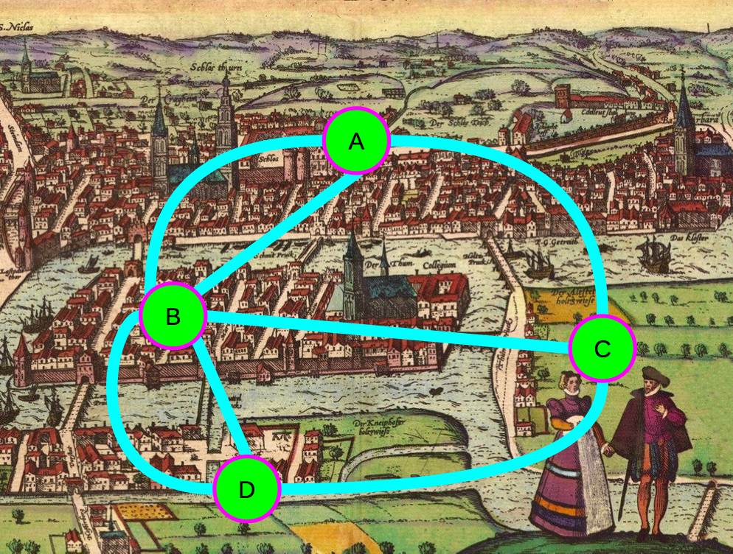
Graphs - I
CS 2110, Fall 2015

Slide 2
Announcements
Gries office hours canceled on Thursday
Reading:
Chapter 28: Graphs
Chapter 29: Graph Implementations

Slide 3
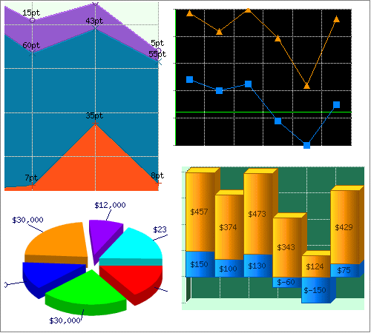
These aren’t the graphs we’re interested in

Slide 4
These aren’t the graphs we’re interested in

Slide 5
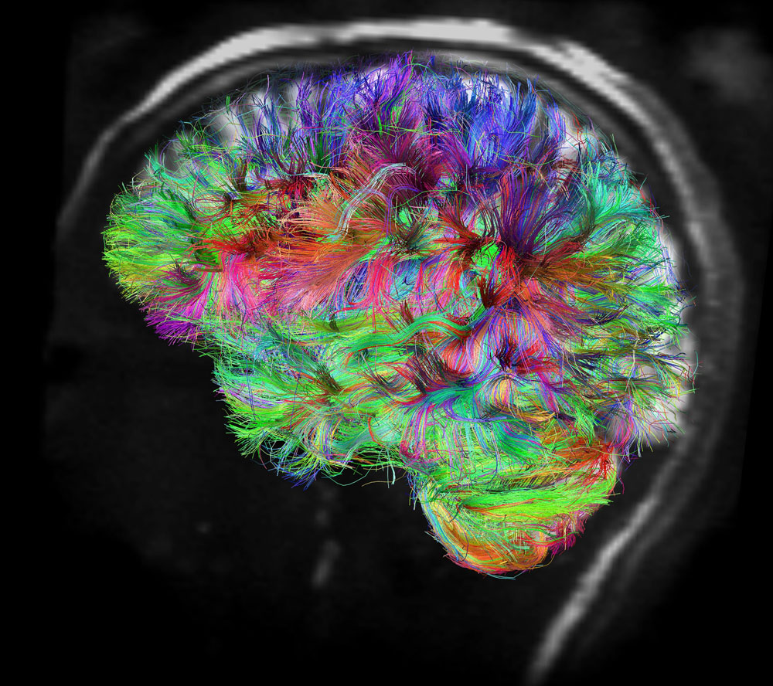
This is
V.J. Wedeen and L.L. Wald, Martinos Center for Biomedical Imaging at MGH

Slide 6
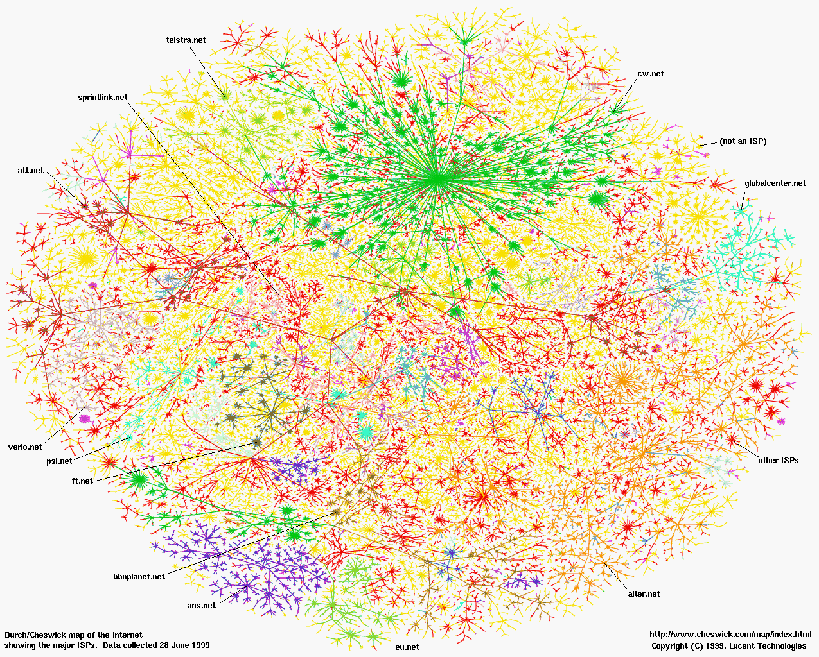
And so is this

Slide 7
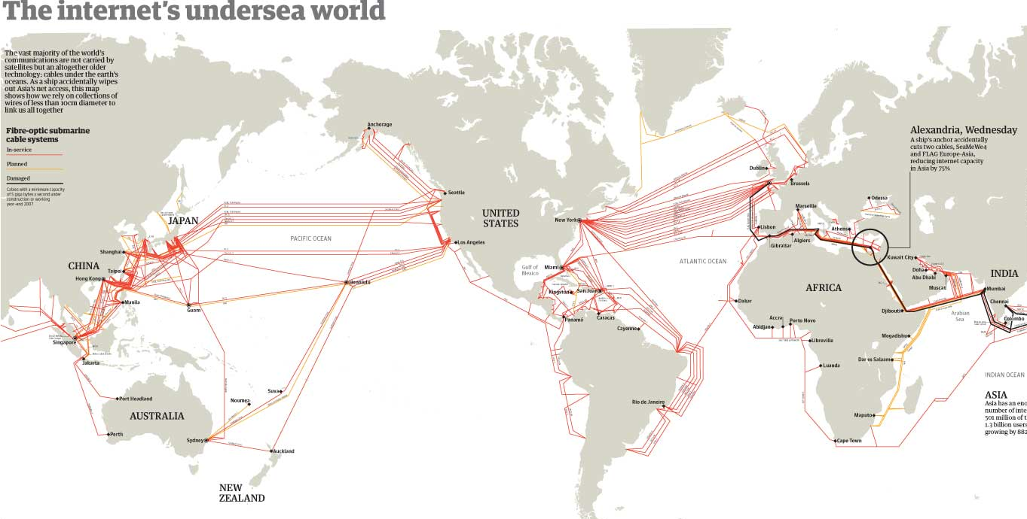
And this

Slide 8
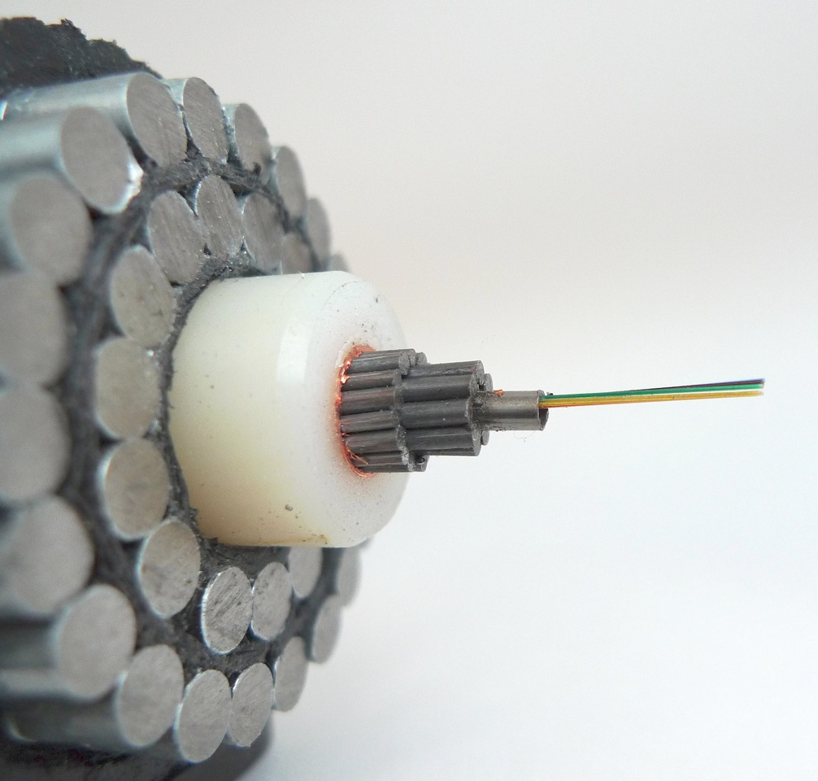
This carries Internet traffic across the oceans

Slide 9
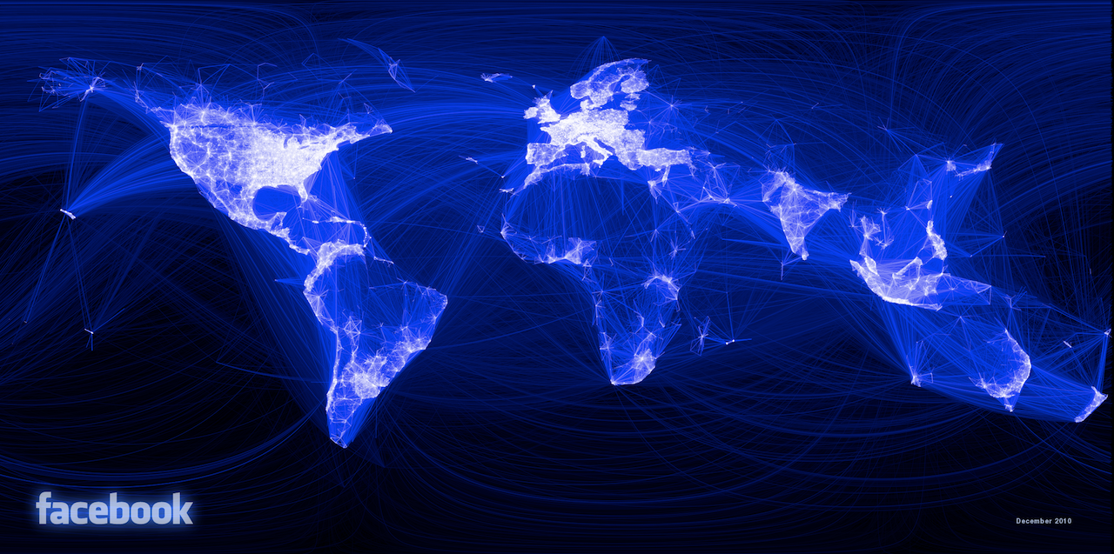
A social graph

Slide 10
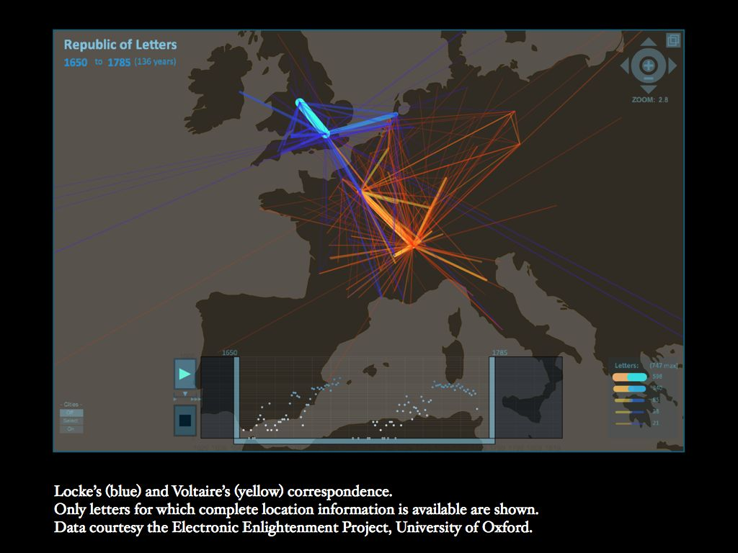
An older social graph

Slide 11
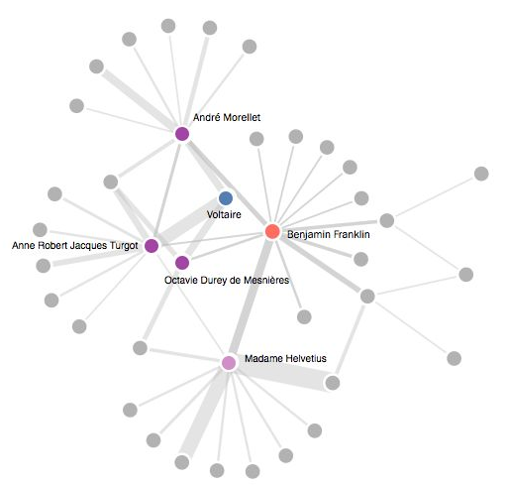
An older social graph
Voltaire and Benjamin Franklin

Slide 12
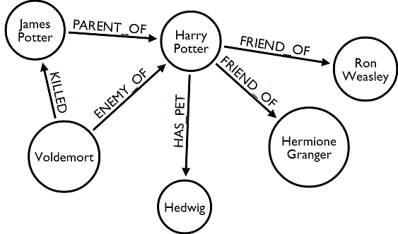
A fictional social graph

Slide 13
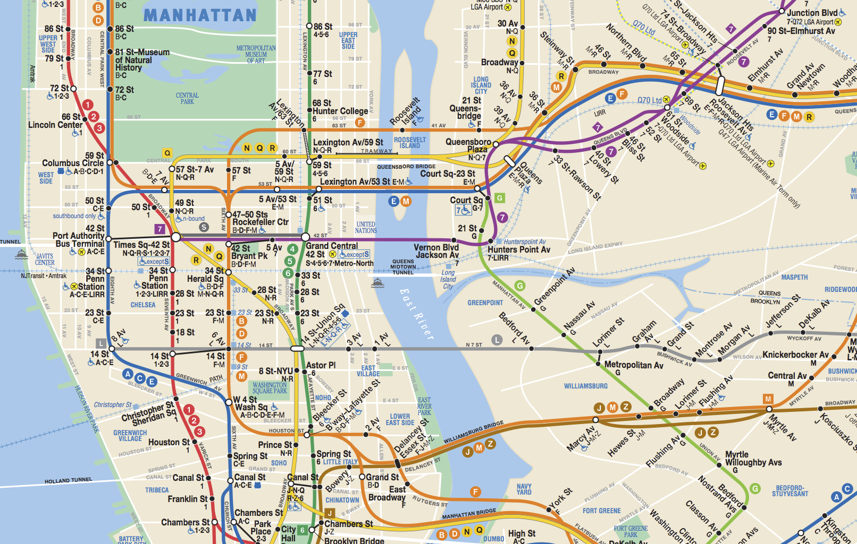
A transport graph

Slide 14
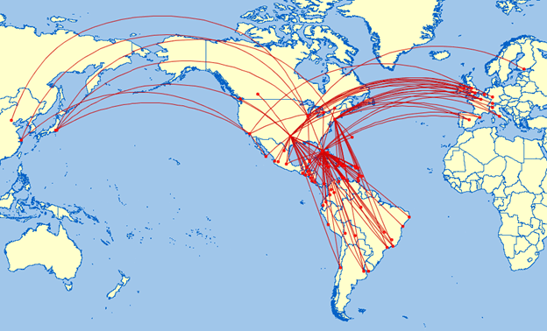
Another transport graph

Slide 15
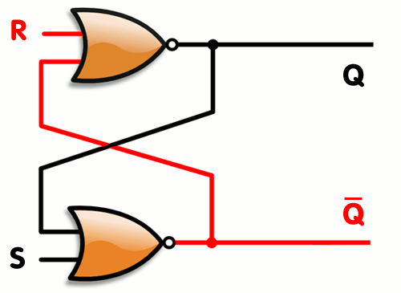
A circuit graph (flip-flop)

Slide 16
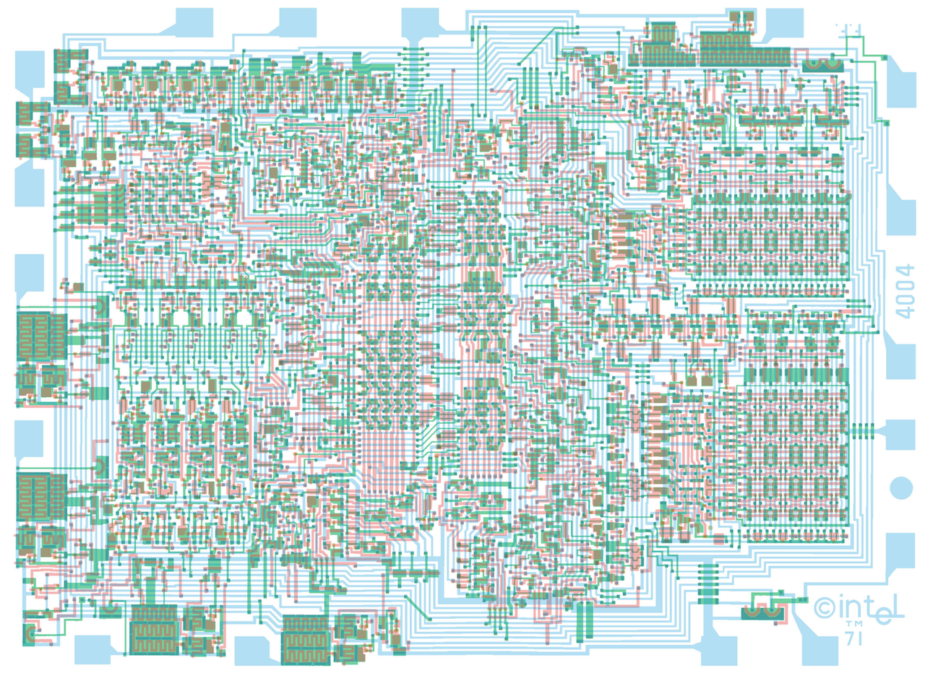
A circuit graph (Intel 4004)

Slide 17
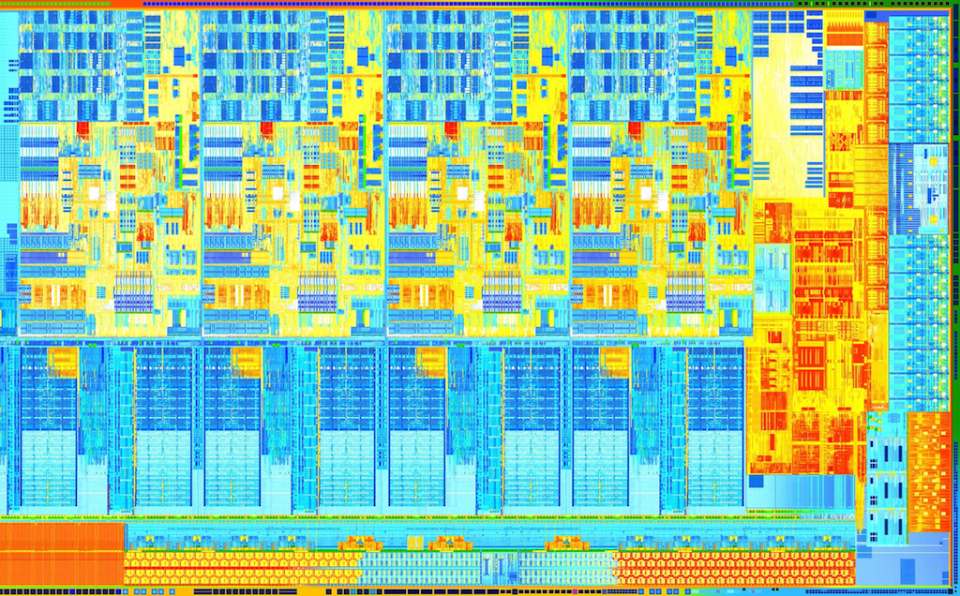
A circuit graph (Intel Haswell)

Slide 18
This is not a graph, this is a cat

Slide 19
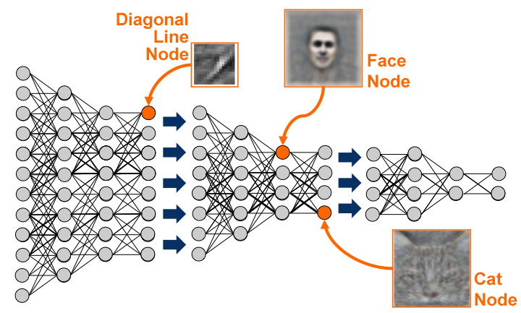
This is a graph(ical model) that has learned to recognize cats

Slide 20
Some abstract graphs
K₅
K_{3,3}
=

Slide 21
Applications of Graphs
Communication networks
Social networks
Routing and shortest path problems
Commodity distribution (network flow)
Traffic control
Resource allocation
Numerical linear algebra (sparse matrices)
Geometric modeling (meshes, topology, …)
Image processing (e.g. graph cuts)
Computer animation (e.g. motion graphs)
Systems biology
Digital humanities (e.g. Republic of Letters)
…

Slide 22
Directed Graphs
A directed graph (digraph) is a pair (V, E) where
V is a set
E is a set of ordered pairs (u, v) where u,v ∈ V
Often require u ≠ v (i.e. no self-loops)
An element of V is called a vertex or node
An element of E is called an edge or arc
|V| = size of V, often denoted n
|E| = size of E, often denoted m
A
B
C
D
E
V = {A, B, C, D, E}
E = {(A,C), (B,A), (B,C),
(C,D), (D,C)}
|V| = 5
|E| = 5

Slide 23
Undirected Graphs
An undirected graph is just like a directed graph!
… except that E is now a set of unordered pairs {u, v} where u,v ∈ V
Every undirected graph can be easily converted to an equivalent directed graph via a simple transformation:
Replace every undirected edge with two directed edges in opposite directions
… but not vice versa
A
B
C
D
E
V = {A, B, C, D, E}
E = {{A,C}, {B,A},
{B,C}, {C,D}}
|V| = 5
|E| = 4

Slide 24
Graph Terminology
Vertices u and v are called
the source and sink of the directed edge (u, v), respectively
the endpoints of (u, v) or {u, v}
Two vertices are adjacent if they are connected by an edge
The outdegree of a vertex u in a directed graph is the number of edges for which u is the source
The indegree of a vertex v in a directed graph is the number of edges for which v is the sink
The degree of a vertex u in an undirected graph is the number of edges of which u is an endpoint
A
B
C
E
D
A
B
C
E
D

Slide 25
More Graph Terminology
A
Path A,C,D
A path is a sequence v₀,v₁,v₂,...,v_{p} of vertices such that for 0 ≤ i ≤ p – 1,
(v_{i},v_{i+1})∈E if the graph is directed
{v_{i},v_{i+1}}∈E if the graph is undirected
The length of a path is its number of edges
In this example, the length is 2
A path is simple if it doesn’t repeat any vertices
A cycle is a path v₀,v₁,v₂,...,v_{p} such that v₀ = v_{p}
A cycle is simple if it does not repeat any vertices except the first and last
A graph is acyclic if it has no cycles
A directed acyclic graph is called a DAG
B
C
E
D
DAG
A
B
C
E
D
Not a DAG

Slide 26
Is this a DAG?
B
D
C
A
F
E
Intuition:
If it’s a DAG, there must be a vertex with indegree zero
This idea leads to an algorithm
A digraph is a DAG if and only if we can iteratively delete indegree-0 vertices until the graph disappears

Slide 27
Is this a DAG?
B
D
C
F
E
Intuition:
If it’s a DAG, there must be a vertex with indegree zero
This idea leads to an algorithm
A digraph is a DAG if and only if we can iteratively delete indegree-0 vertices until the graph disappears

Slide 28
Is this a DAG?
D
C
F
E
Intuition:
If it’s a DAG, there must be a vertex with indegree zero
This idea leads to an algorithm
A digraph is a DAG if and only if we can iteratively delete indegree-0 vertices until the graph disappears

Slide 29
Is this a DAG?
D
F
E
Intuition:
If it’s a DAG, there must be a vertex with indegree zero
This idea leads to an algorithm
A digraph is a DAG if and only if we can iteratively delete indegree-0 vertices until the graph disappears

Slide 30
Is this a DAG?
F
E
Intuition:
If it’s a DAG, there must be a vertex with indegree zero
This idea leads to an algorithm
A digraph is a DAG if and only if we can iteratively delete indegree-0 vertices until the graph disappears

Slide 31
Is this a DAG?
F
Intuition:
If it’s a DAG, there must be a vertex with indegree zero
This idea leads to an algorithm
A digraph is a DAG if and only if we can iteratively delete indegree-0 vertices until the graph disappears

Slide 32
Is this a DAG?
YES!
Intuition:
If it’s a DAG, there must be a vertex with indegree zero
This idea leads to an algorithm
A digraph is a DAG if and only if we can iteratively delete indegree-0 vertices until the graph disappears

Slide 33
Topological Sort
2
4
3
1
6
5
We just computed a topological sort of the DAG
This is a numbering of the vertices such that all edges go from lower- to higher-numbered vertices
Useful in job scheduling with precedence constraints

Slide 34
Graph Coloring
A coloring of an undirected graph is an assignment of a color to each node such that no two adjacent vertices get the same color
How many colors are needed to color this graph?
B
D
C
A
F
E

Slide 35
Graph Coloring
A coloring of an undirected graph is an assignment of a color to each node such that no two adjacent vertices get the same color
How many colors are needed to color this graph?
B
D
C
A
F
E

Slide 36
An Application of Coloring
Vertices are jobs
Edge (u, v) is present if jobs u and v each require access to the same shared resource, and thus cannot execute simultaneously
Colors are time slots to schedule the jobs
Minimum number of colors needed to color the graph = minimum number of time slots required
B
D
C
A
F
E

Slide 37
Planarity
A graph is planar if it can be drawn in the plane without any edges crossing
Is this graph planar?
B
D
C
A
F
E

Slide 38
Planarity
A graph is planar if it can be drawn in the plane without any edges crossing
Is this graph planar?
Yes!
B
D
C
A
F
E

Slide 39
Planarity
A graph is planar if it can be drawn in the plane without any edges crossing
Is this graph planar?
Yes!
B
D
C
A
F
E

Slide 40
Detecting Planarity
Kuratowski's Theorem:
A graph is planar if and only if it does not contain a copy of K₅ or K_{3,3} (possibly with other nodes along the edges shown)
K₅
K_{3,3}

Slide 41
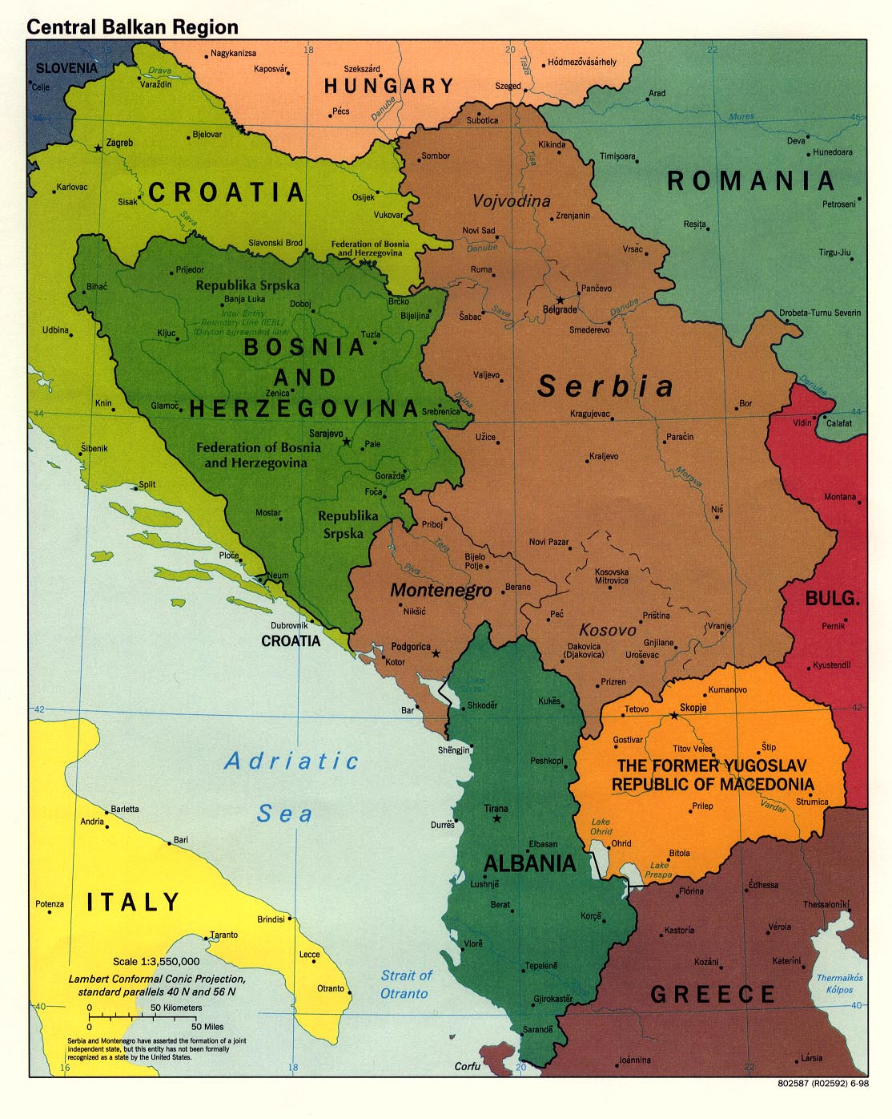
Four-Color Theorem:
Every planar graph is 4-colorable [Appel & Haken, 1976]
(Every map defines a planar graph – countries are vertices, and two adjacent countries define an edge)

Slide 42
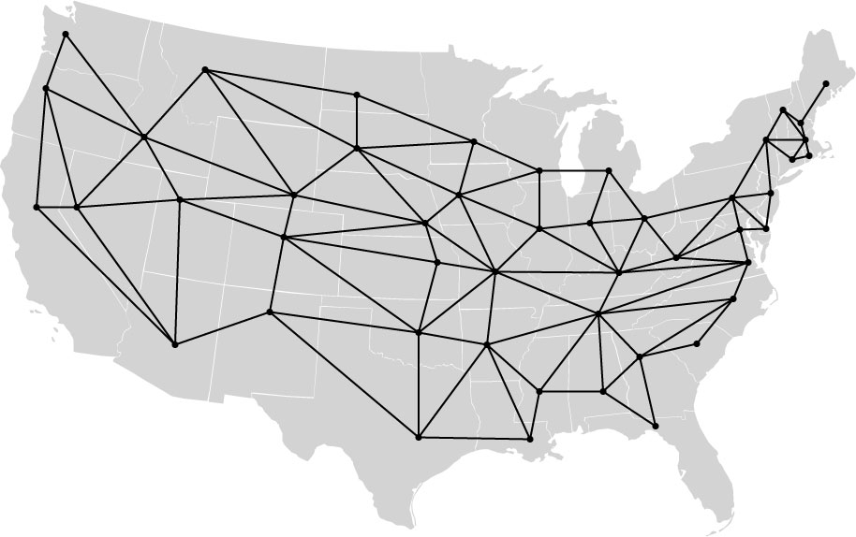
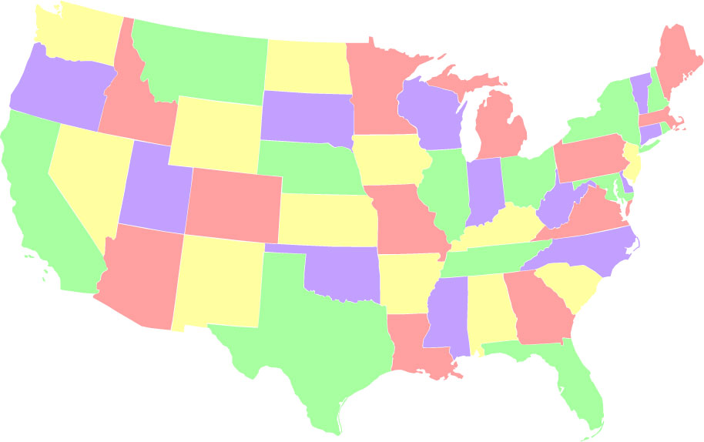
Another 4-colored planar graph
http://www.cs.cmu.edu/~bryant/boolean/maps.html

Slide 43
Bipartite Graphs
A directed or undirected graph is bipartite if the vertices can be partitioned into two sets such that no edge connects two vertices in the same set
The following are equivalent
G is bipartite
G is 2-colorable
G has no cycles of odd length
A
1
B
2
C
3
D

Slide 44
Traveling Salesperson
Boston
Ithaca
Copenhagen
1323
1556
224
132
160
512
New York
London
189
216
210
Amsterdam
1078
Paris
1002
Washington
1322
Munich
660
1214
505
419
1356
441
1380
1202
Rome
Atlanta
Find a path of minimum distance that visits every city

Slide 45
Representations of Graphs
1
2
4
3
Adjacency List
Adjacency Matrix
1
2
4
1 2 3 4
1
2
3
4
0 1 0 1
0 0 1 0
0 0 0 0
0 1 1 0
2
3
3
4
2
3

Slide 46
Adjacency Matrix or Adjacency List?
Definitions:
n = number of vertices
m = number of edges
d(u) = degree of u = number of edges leaving u
Adjacency Matrix
Uses space O(n²)
Can iterate over all edges in time O(n²)
Can answer “Is there an edge from u to v?” in O(1) time
Better for dense graphs (lots of edges)
Adjacency List
Uses space O(m + n)
Can iterate over all edges in time O(m + n)
Can answer “Is there an edge from u to v?” in O(d(u)) time
Better for sparse graphs (fewer edges)

Slide 47
Graph Algorithms
Search
Depth-first search
Breadth-first search
Shortest paths
Dijkstra's algorithm
Minimum spanning trees
Prim's algorithm
Kruskal's algorithm

Slide 48
Readings
Chapter 28: Graphs
Chapter 29: Graph Implementations

