Slide 1
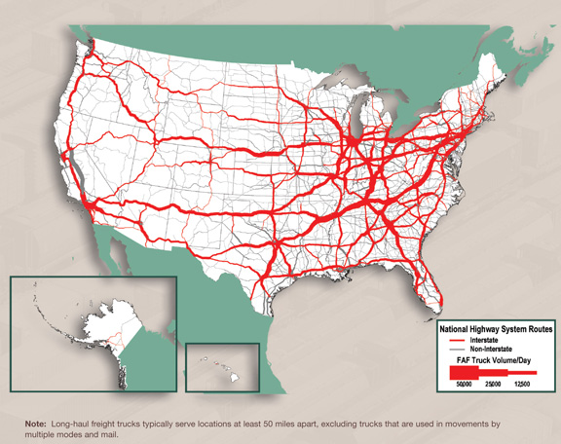
Graphs IV: APPLICATIONS
Lecture 22
CS2110 – Spring 2014

Slide 2
Example Directed Graph (Digraph)
b
d
c
a
f
e
V = { a,b,c,d,e,f }
E = { (a,b), (a,c), (a,e), (b,c), (b,d), (b,e), (c,d), (c,f), (d,e), (d,f), (e,f) }
|V| = 6, |E| = 11

Slide 3
Example Undirected Graph
An undirected graph is just like a directed graph, except the edges are unordered pairs (sets) {u,v}
Example:
b
d
c
a
f
e
V = { a,b,c,d,e,f }
E = { {a,b}, {a,c}, {a,e}, {b,c}, {b,d}, {b,e}, {c,d}, {c,f}, {d,e}, {d,f }, {e,f } }

Slide 4
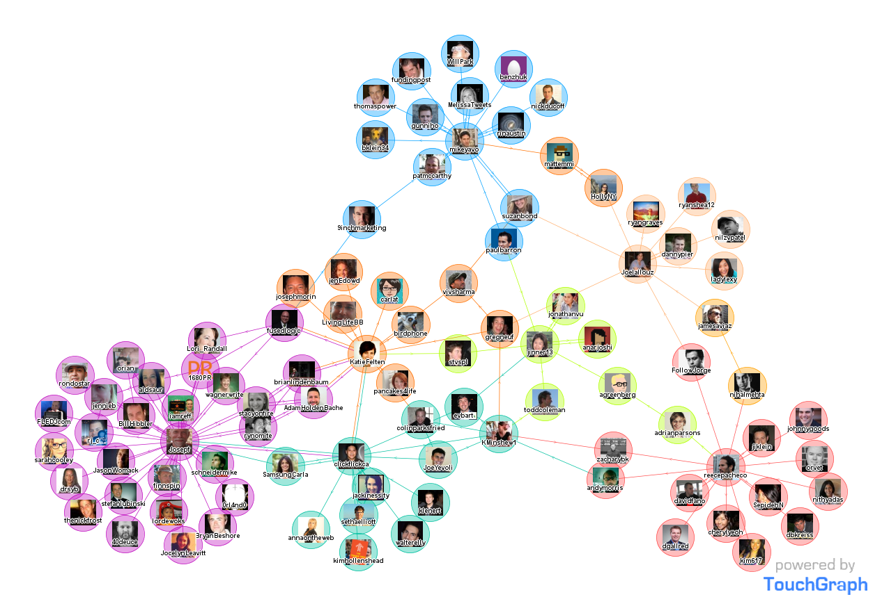
Social Network Graph

Slide 5
Graph Concepts and Algorithms
Adjacency Matrix
Topological Sort
Search
  depth-first search
  breadth-first search
Shortest paths
  Dijkstra's algorithm
Minimum spanning trees
  Prim's algorithm
  Kruskal's algorithm
Others:
Graph Coloring
Planarity
Traveling Salesman problem.

Slide 6
Graph Adjacency Matrix
1
2
Adjacency Matrix
4
3
1 2 3 4
1 0 1 0 1
2 0 0 1 0
3 0 0 0 0
4 0 1 1 0
Adjacency List
1
2
4
2
3
3
4
2
3

Slide 7
Graph Adjacency Matrix
1
2
Squaring adjacency matrix gives number of possible paths of length 2!
4
3
Adjacency Matrix
1 2 3 4
1 0 1 0 1
2 0 0 1 0
3 0 0 0 0
4 0 1 1 0
1 2 3 4
1 0 1 2 0
2 0 0 0 0
3 0 0 0 0
4 0 0 1 0
2

Slide 8
Graph Adjacency Matrix
1
2
Cubing adjacency matrix gives number of possible paths of length 3!
4
3
Adjacency Matrix
1 2 3 4
1 0 1 0 1
2 0 0 1 0
3 0 0 0 0
4 0 1 1 0
1 2 3 4
1 0 0 1 0
2 0 0 0 0
3 0 0 0 0
4 0 0 0 0
3

Slide 9
Graph Adjacency Matrix
Same idea holds for undirected graphs.

Slide 10
How would you find friends of friends?

Slide 11
Find the number of common friends?

Slide 12

Graph Concepts and Algorithms
Adjacency Matrix
Topological Sort
Search
  depth-first search
  breadth-first search
Shortest paths
  Dijkstra's algorithm
Minimum spanning trees
  Prim's algorithm
  Kruskal's algorithm
Others:
Graph Coloring
Planarity
Traveling Salesman problem.

Slide 13
Search if a person is someone’s Friend?

Slide 14
Graph Concepts and Algorithms
Adjacency Matrix
Topological Sort
Search
  depth-first search
  breadth-first search
Shortest paths
  Dijkstra's algorithm
Minimum spanning trees
  Prim's algorithm
  Kruskal's algorithm
Others:
Graph Coloring
Planarity
Traveling Salesman problem.

Slide 15
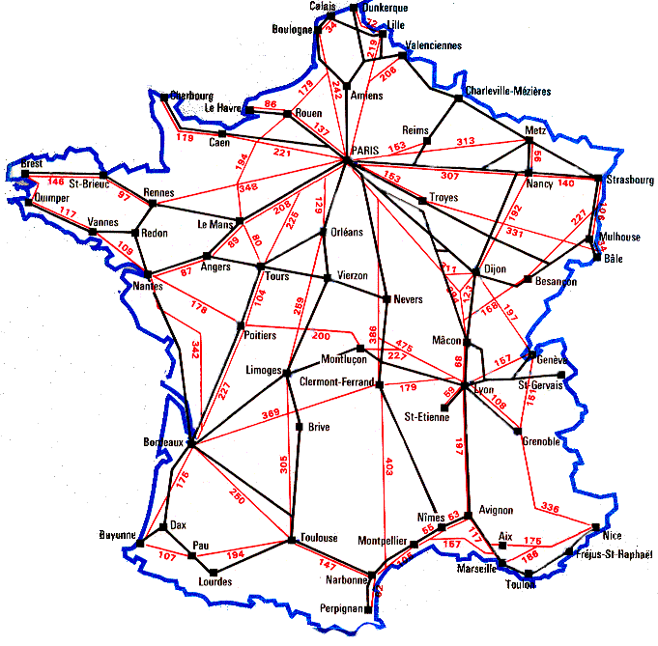
Shortest Path Algorithm: Used Everyday!
Train Network in France.

Slide 16
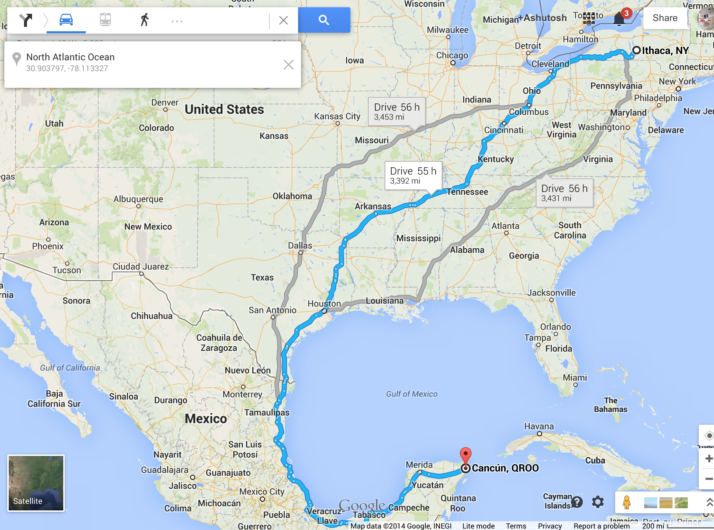
Shortest Path Algorithm: Used Everyday!
Maps!
GPS
directions!

Slide 17
Graph Concepts and Algorithms
Adjacency Matrix
Topological Sort
Search
  depth-first search
  breadth-first search
Shortest paths
  Dijkstra's algorithm
Minimum spanning trees
  Prim's algorithm
  Kruskal's algorithm
Others:
Graph Coloring
Planarity
Traveling Salesman problem.

Slide 18
Topological Sort
Topological sort of the dag
  This is a numbering of the vertices such that all edges go from lower- to higher-numbered vertices
Useful in job scheduling with precedence constraints
1
3
2
0
5
4

Slide 19
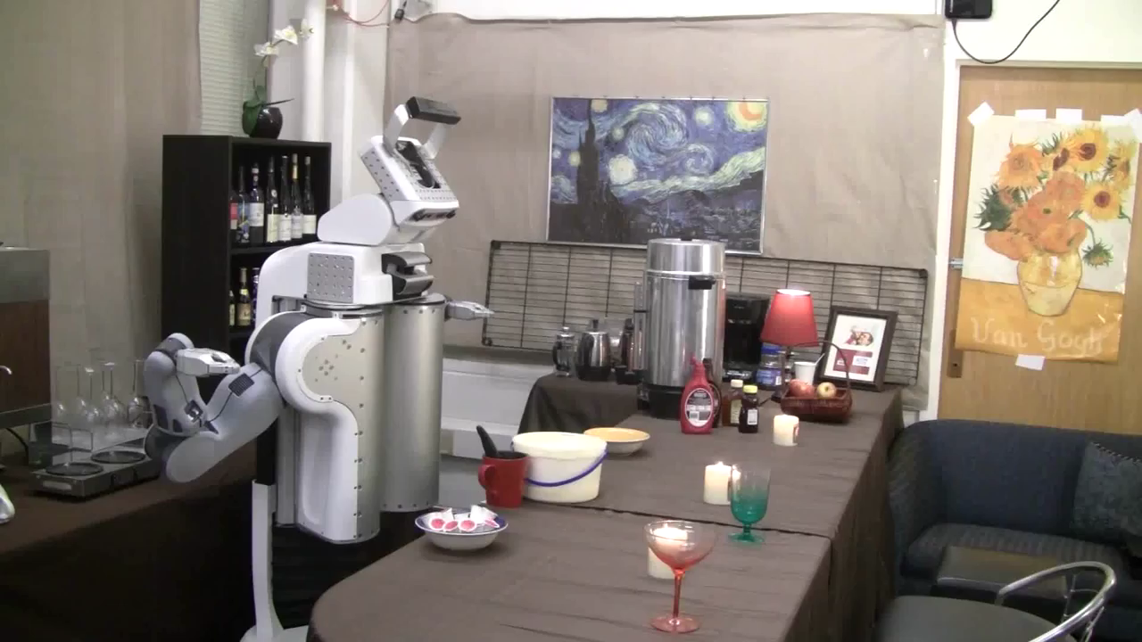
Tell Me Dave: Making ‘Avoffato’

Slide 20
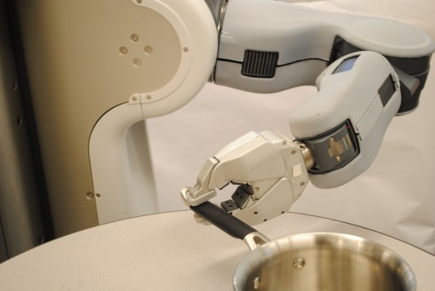
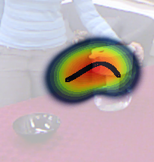
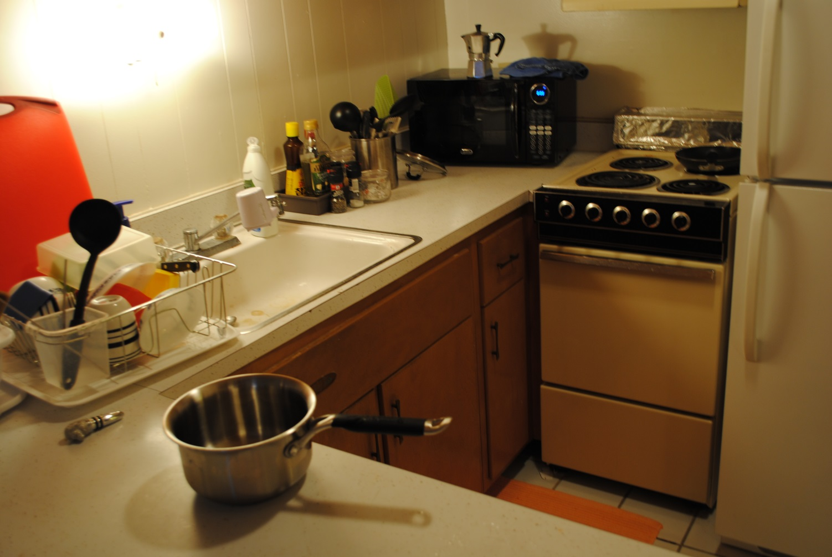
Input:
Output: Inferred Sequences
Environment:
moveTo(pot1)
grasp(pot1)
Place the pot on the tap
moveTo(sink1)
keep(pot1,sink1,on)
<no-op>
Turn the tap on
keep(pot2,sink2,on)
toggle(sink1knob1,on)
wait()
<no-op>
Turn the tap off
toggle(sink1knob1,off)
NL Instruction:
moveTo(pot1)
grasp(pot1)
moveTo(stove1)
Place the pot on the tap and turn the tap on. When it is filled, turn the tap off and heat the pot.
keep(pot1,burner1,on)
toggle(stove1knob1,on)
wait()
toggle(stove1knob1,off)
Heat the pot

Slide 21
Topological Sort
Topological sort of the dag
  This is a numbering of the vertices such that all edges go from lower- to higher-numbered vertices
Useful in job scheduling with precedence constraints
Turn coffee machine tap
1
3
2
Move Bowl to coffee machine
5
Put ice-cream in bowl
0
4
Scoop Ice-cream

Slide 22
Graph Concepts and Algorithms
Adjacency Matrix
Topological Sort
Search
  depth-first search
  breadth-first search
Shortest paths
  Dijkstra's algorithm
Minimum spanning trees
  Prim's algorithm
  Kruskal's algorithm
Others:
Graph Coloring
Planarity
Traveling Salesman problem.

Slide 23
AI: Vision and Robotics
Number of cell-phones in 2014: 7 billion!
So many images everywhere.
But do computers understand the images?

Slide 24
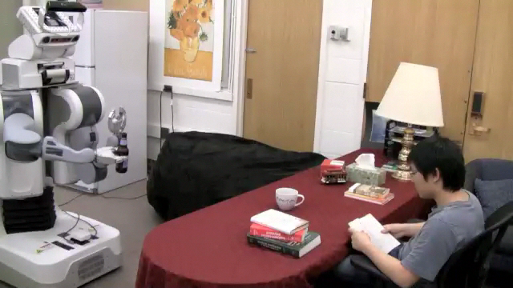
Without Graph Algorithms

Slide 25
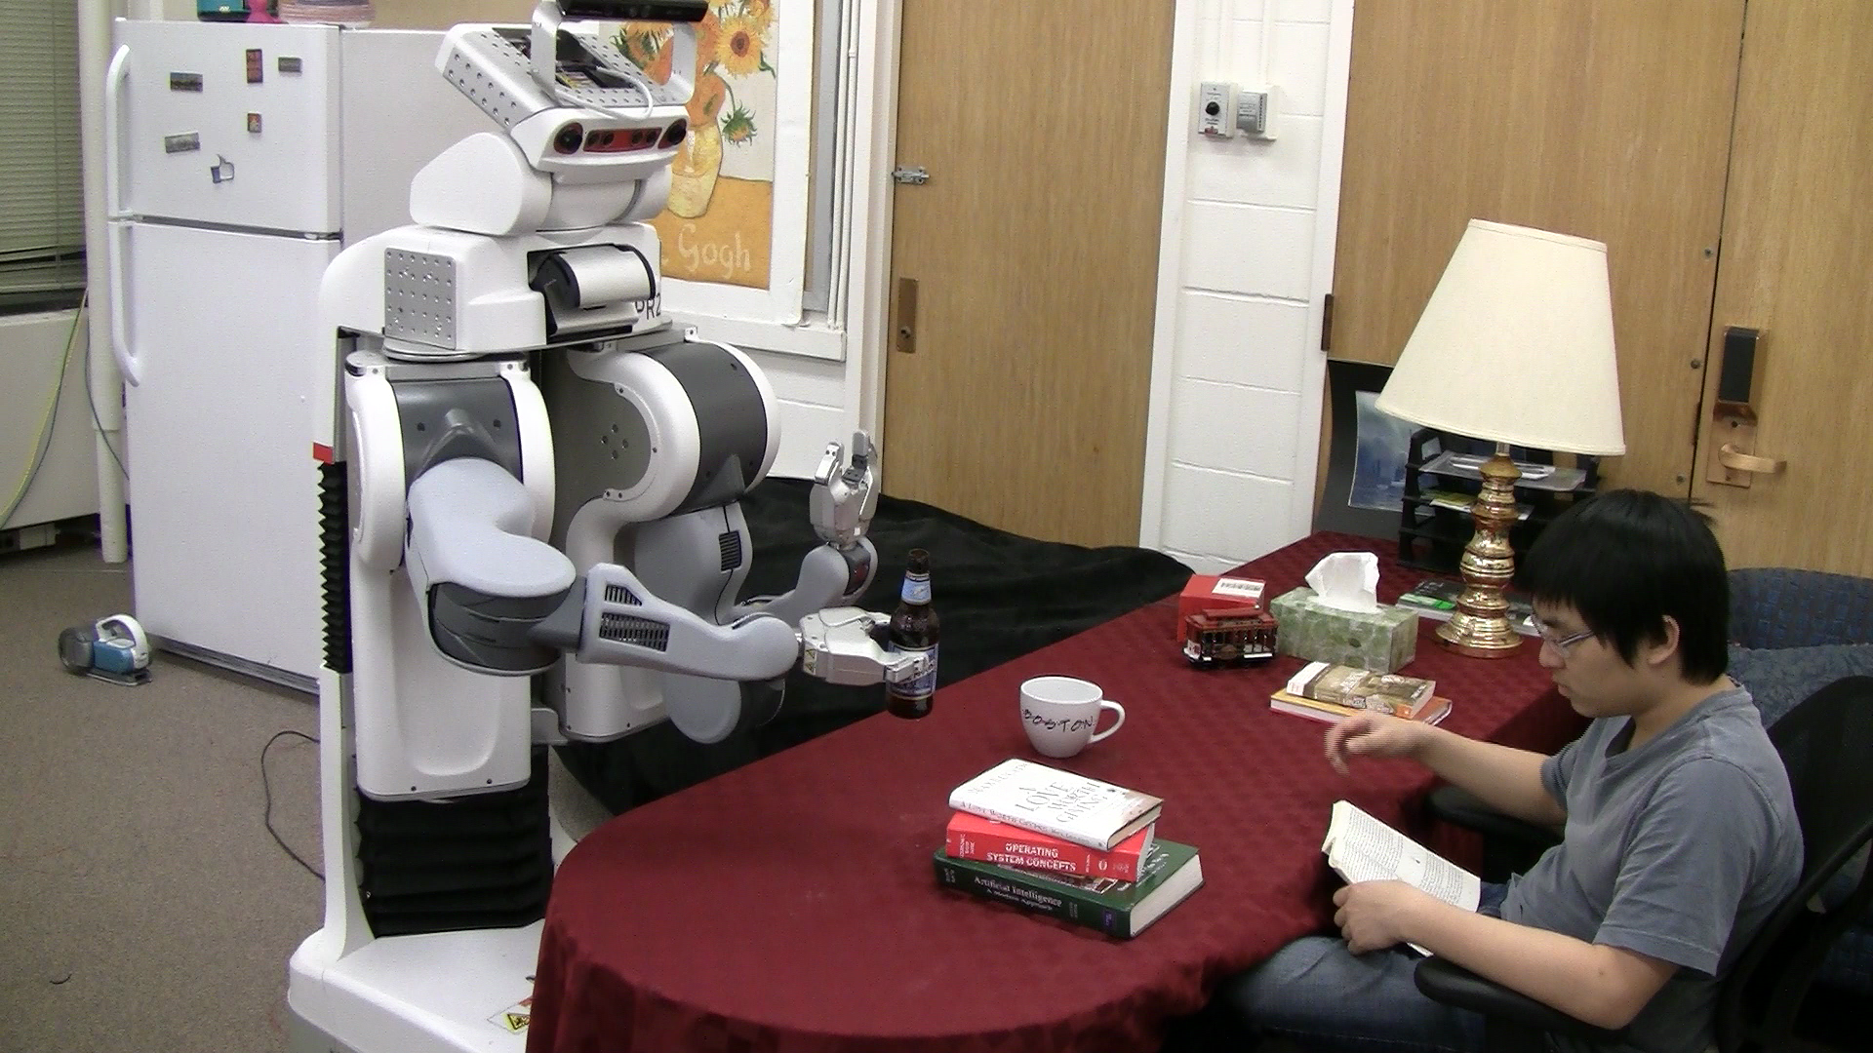
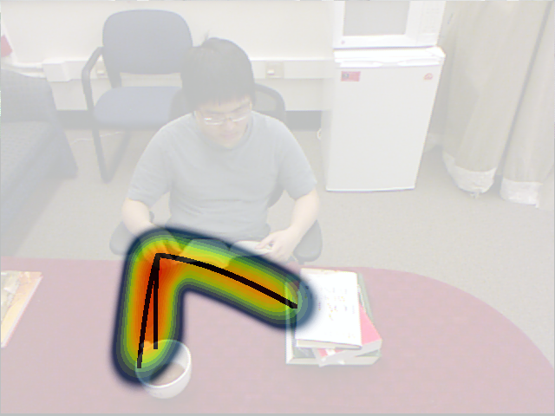
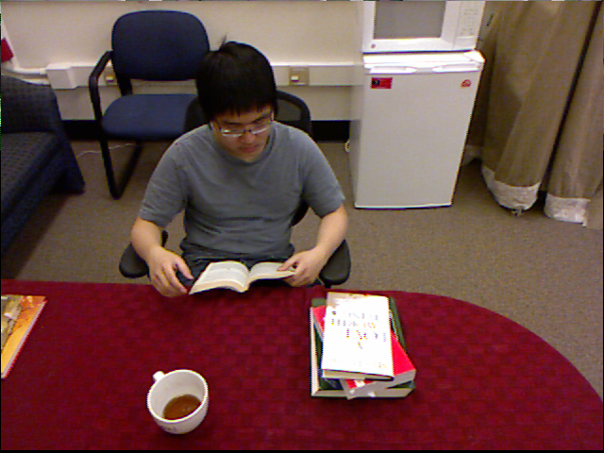
Anticipating Future Actions
Future anticipations
Robot’s view

Slide 26
Anticipating Future Actions
Robot’s view
Future anticipations
Humans use anticipation all the time
  e.g., interacting with other people, playing sports, driving, etc.

Slide 27
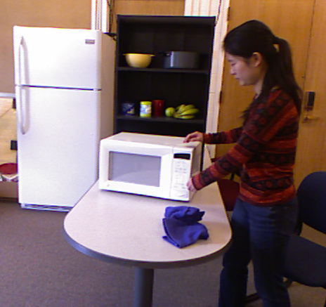
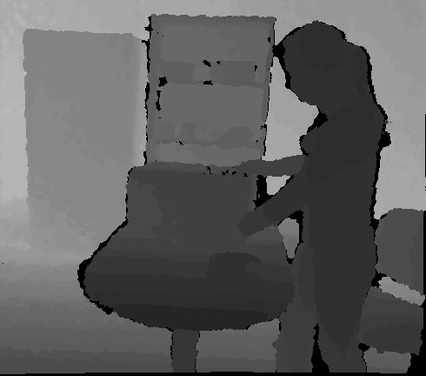
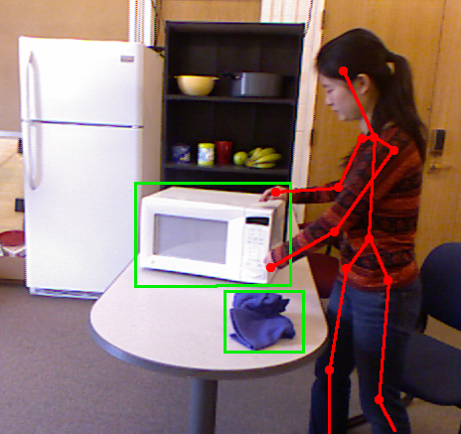
Modeling the Activities with an Undirected Graph

Slide 28

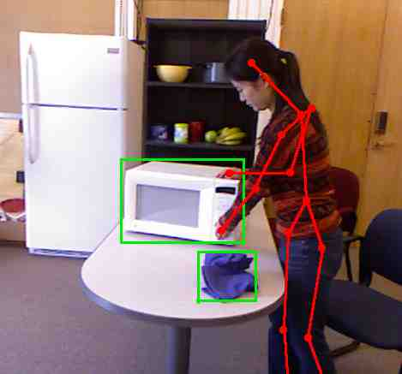
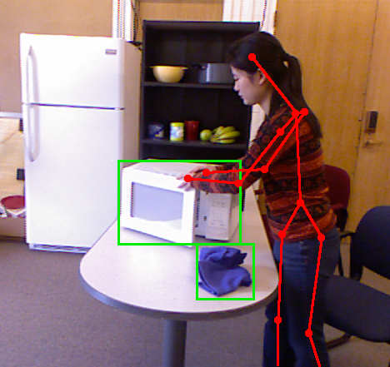
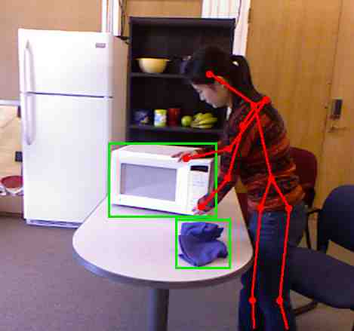
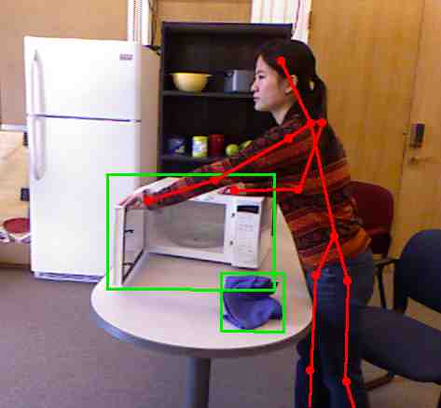
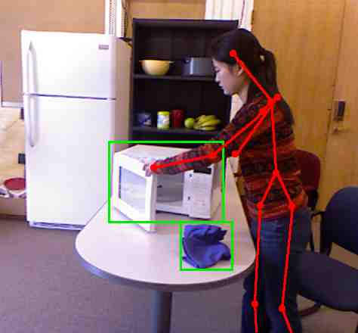
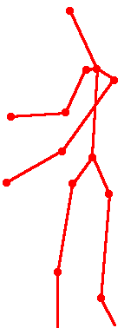
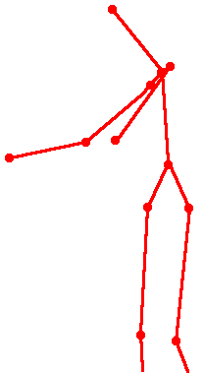
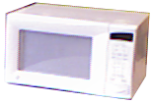


Modeling the Activities with an Undirected Graph

Slide 29
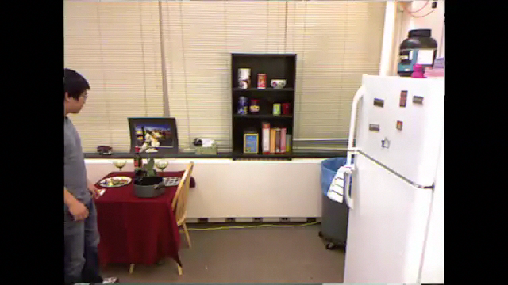

Robot Sees the Future!
Studio B, with Shepherd Smith
With Lewis Black, Comedy Central

Slide 30
Graph Concepts and Algorithms
Adjacency Matrix
Topological Sort
Search
  depth-first search
  breadth-first search
Shortest paths
  Dijkstra's algorithm
Minimum spanning trees
  Prim's algorithm
  Kruskal's algorithm
Others:
Graph Coloring
Planarity
Traveling Salesman problem.

Slide 31
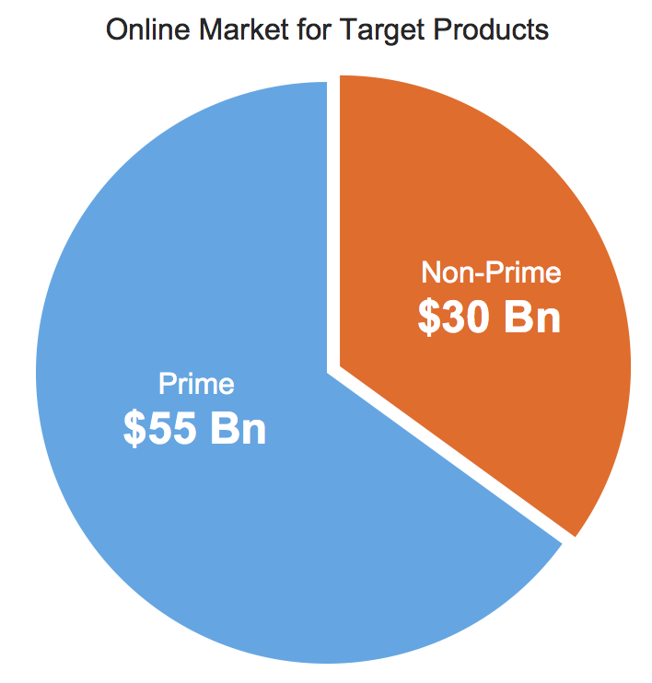
Graphs in Practice
In 2012, we started a company called Cognical.
Problem:
65 million US consumers cannot finance electronics, furniture, appliances and other durable goods online

Slide 32
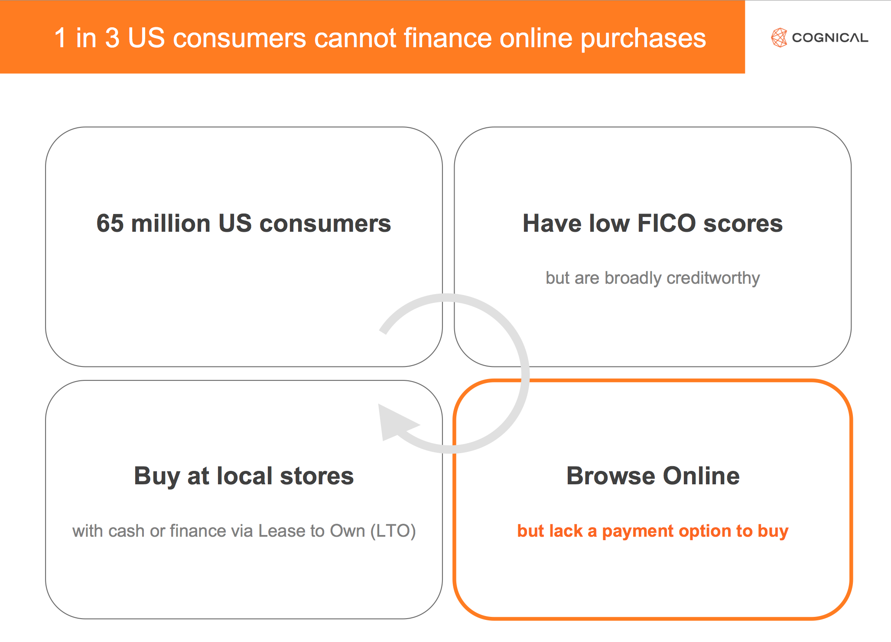

Slide 33

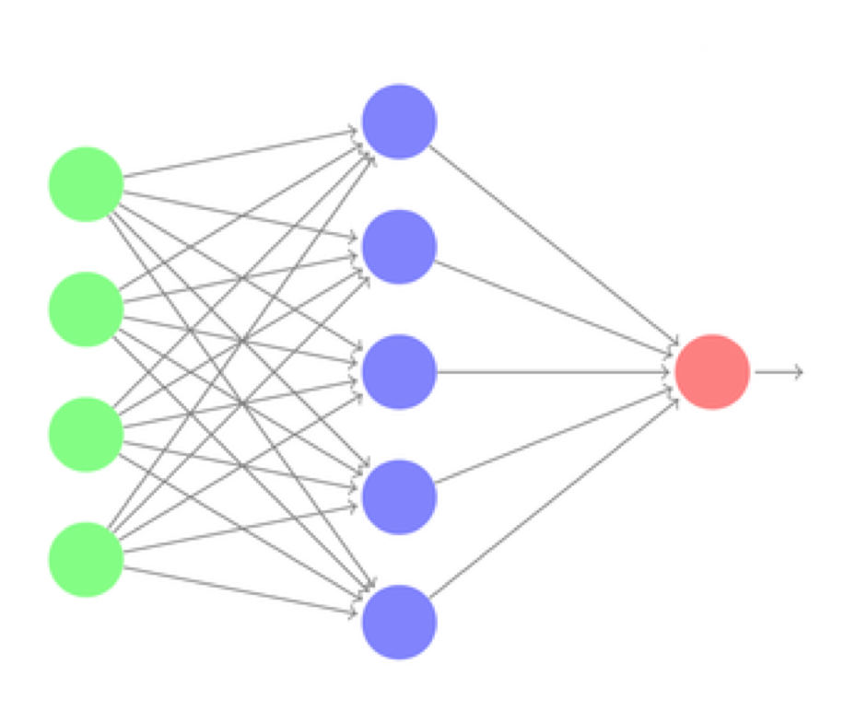
Cognical collects data about customers from various sources.
Represents over a graph, and predicts how to finance.

Slide 34
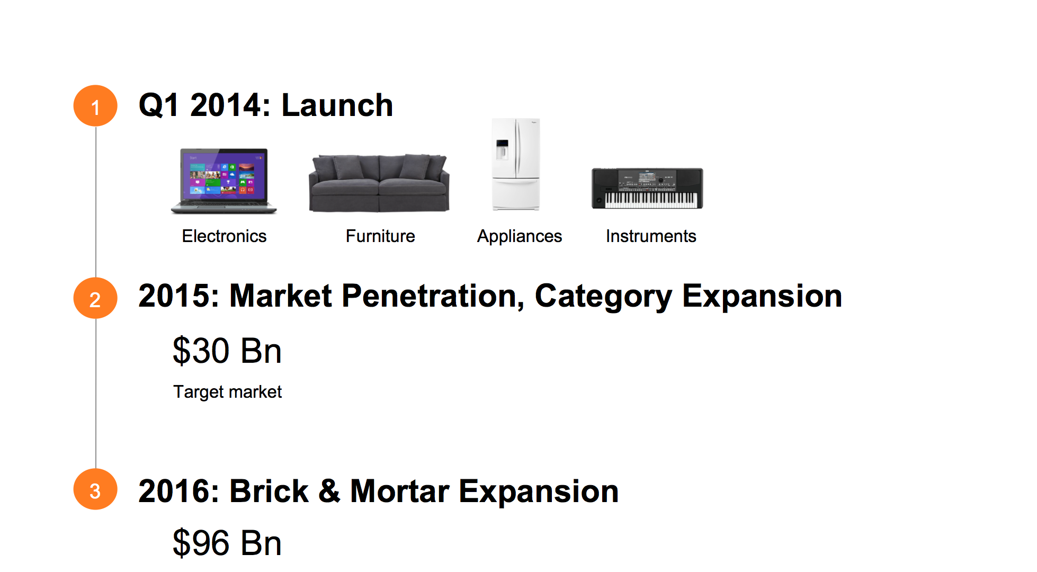

Slide 35
Graphs!
Adjacency Matrix
Topological Sort
Search
  depth-first search
  breadth-first search
Shortest paths
  Dijkstra's algorithm
Minimum spanning trees
  Prim's algorithm
  Kruskal's algorithm
Others:
Graph Coloring
Planarity
Traveling Salesman problem.

