Slide 1
CS 1114: Objects, Events and Recursion
Prof. Graeme Bailey
http://cs1114.cs.cornell.edu

Slide 2
Object behaviours
Passing by reference:
Since a = pointy(1,2,3) gives a the address of the data content, writing b = a ends up with both a and b pointing to the same data, so a.set_x(9) will mean that a.get_x() and b.get_x() will both return 9 … it’s exactly the same data being changed by set_x and being accessed by get_x !
If you really want to copy a in order to end up with 2 distinct copies, then you’ll have to write a copy method inside the class to return a new object cloning a , then changing one copy will leave the other copy unchanged.
Technically, handle is a pre-existing class in MATLAB, and writing pointy < handle is telling pointy to inherit everything from handle (such as the ability to pass by reference). It can of course have extra abilities all of its own if we define those inside pointy.

Slide 3
Linked Lists Revisited
classdef node < handle
% creates nodes for a doubly linked list.
properties % better to make access private and have gettor and settor methods
data;
next;
previous;
end
methods
function obj = node(d, n, p)
% class constructor
if (nargin == 3) % if all input values were given
obj.data = d;
obj.next = n;
obj.previous = p;
end
if (nargin == 1) % if only data given
obj.data = d;
end
end % end constructor
end
end
1
2
10
9
3
5
6
8
4
7

Slide 4
Linked Lists Revisited
Classdef linky < handle % creates a doubly linked list.
properties % better to make access private and have gettor and settor methods
header; length; % header points to the first real node when there’s content
end
methods
function obj = linky() % class constructor
obj.header = node(); % empty node
obj.length = 0;
end % end constructor
function vide = isempty(obj) % returns true if empty
vide = (obj.length == 0);
end % end isempty function
function preface(obj, data) % insert at front
temp = node(data) % creates a non-empty node
temp.next = obj.header.next; % adjust temp’s pointers
temp.previous = obj.header;
obj.header.next = temp; % adjust header’s next
temp.next.previous = temp; % adjust temp’s next’s previous
obj.length = obj.length + 1;
end % end insertion at front preface method
function current_list = display(obj)
current_list = ‘ ‘;
temp = obj.header;
for counter = 1 : obj.length
temp = temp.next;
current_list = [ current_list , num2str(temp.data) , ‘ → ‘ ] ;
end % ending loop through all the list nodes
end % overwriting the default display method
end
end
1
2
10
9
3
5
6
8
4
7

Slide 5
Class Inheritance
So we inherited linky from the handle class … what does this mean?
Every property handle has, linky gets
Every method handle has, linky gets
Any values that handle might have, linky doesn’t get! Sorry, you don’t get your parent’s bank balance!
We can use inheritance with our own classes, but why and how?
The notation is A < B for A inheriting from B
If you find yourself writing the same properties and methods for two different classes, consider pooling those that are common to both into a fresh class C and then have A < C and B < C
This saves effort and makes maintaining and debugging the code easier

Slide 6
Events in MATLAB
Events are ways of triggering responses to stimuli
Something must be listening – event listener
Something must be notifying – event trigger
Triggers notify all listeners, so each listener has to decide if it wants to respond to that trigger
We need to list our events formally
Pointers are needed, so must inherit from handle
The handle class ‘donates’ the addlistener() and notify() methods to the ‘child’ class(es)
We can declare some properties to be ‘observable’ via SetObservable = true and GetObservable = true
If set, then the following event types notify automatically for those properties (these don’t get listed in an event block)
PreSet and PreGet happen just before a value is accessed
PostSet and PostGet happen just after a value is accessed

Slide 7
Events in MATLAB - example
classdef RespondToToggle < handle
methods
function obj = RespondToToggle(toggle_obj)
addlistener(toggle_obj,'ToggledFlag',@RespondToToggle.handleEvnt);
end
end
methods (Static)
function handleEvnt(src,evtdata)
if src.flag
disp(’-->: ToggledFlag is true’)
else
disp('-->: ToggledFlag is false’)
end
end
end
end
Inherit from
handle class
Listens!
event name
‘callback’, a pointer to
the function to be called
when the event is triggered
classdef Toggle < handle
properties
flag = false
end
events
ToggledFlag
end
methods
...
function change_flag(obj,newState)
% Call to set flag value
if newState ~= obj.flag
obj.flag = newState;
notify(obj,'ToggledFlag');
end
end
end
end
Accessed by class name, not via object
List the
events
Use like this:
t = Toggle();
r = RespondToToggle(t); % notice connection to t
t.change_flag(true);
-->: ToggledFlag is true
t.change_flag(true); % no change, so no trigger
t.change_flag(false);
-->: ToggledFlag is false
Notifies every
listening object

Slide 8
Recursion and Induction
x
Suppose you are given a ‘rule’ such as
and also know that
Then we can use this to build a sequence of numbers
which you recognise as factorials. It’s easy to see this by building up from the bottom
although using this approach one-by-one to show that this really only produces factorials would take an infinite amount of time !
an = n an-1
a1 = 1
1 , 2 , 6 , 24 , 120 , 720 , . . .
1 , 2 x 1 , 3 x ( 2 x 1 ) , 4 x (3 x 2 x 1 ) , . . .
a1 2 a2 3 a3 4 a4

Slide 9
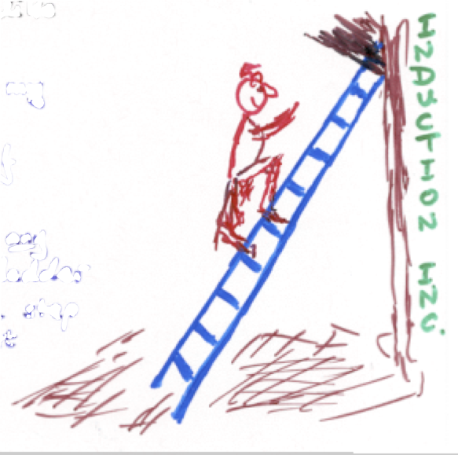
Recursion and Induction
We could prove this in an intuitively rigorous inductive way by
This is rather like saying
This way of arguing, called induction,
is very nice because
➀ Remark that a1 = 1 = (1)!
➁ Notice that if we were to assume that
an = n!
then
an+1 = (n+1) x an by our ‘rule’
= (n+1) x (n!) by our assumption
= (n+1)!
➀ I can put my foot on the first rung of a ladder.
➁ IF I’m on any rung of the ladder THEN I can
step onto the next rung.
a. We don’t have to do
infinitely many steps.
b. It’s “jolly obvious” that
we’ve covered every case!

Slide 10
Recursion and Induction
Instead of working from the bottom up, we could work from the top down (provided our ‘top’ is only ‘finitely high’) . . .
RECURSION
If you follow the arrows, you can see that this process first finds the BOTTOM, and then assembles the calculation as it returns to the top. Obviously, if there is no bottom then we will be waiting a jolly long time for any results!! Let’s see this process in code.
Then our facto( n ) behaves just like our an , so calling it for example via facto( 6 ) would invoke a succession of calls to facto, producing the same bottom-hungry routine we saw for an until it calls facto( 1 ).
a6 = 6 a5 = 720
a5 = 5 a4 = 120
a4 = 4 a3 = 24
a3 = 3 a2 = 6
a2 = 2 a1 = 2
a1 = 1
function value = facto ( n )
if ( n == 1 ) value = 1 ;
else value = n * facto ( n-1 ) ;
end

Slide 11
Recursion and Induction
In fact, any sequence defined by a recurrence relation can be converted very easily into recursive code. Without making any comments about efficiency(!), recursive code is typically very short.
As experiments, first you should run this code (previous page) to compute facto(10) and then facto(50). After that, try to find the 10th and the 50th term in the following Fibonacci sequence, and then look at the schematic of the recursive calls on the previous page to understand what’s going on (and then fix it)!
It’s worth noting that very similar code can be used to compute the binomial coefficients Cn,r (for the intuition behind this look at Pascal’s triangle).
and powers of a (an example of a ‘divide and conquer’ approach). Note the vastly faster computation for powers when coded this way!
an = an-1 + an-2
a1 = 1 , and a2 = 1
Hint: to get information on the time taken to process lines of code, use tic; (to start a matlab stopwatch) then t = toc; (to acquire the time taken). By making t into an array, you could even graph this using plot(t);
Cn , r = Cn-1 , r + Cn-1 , r-1 with Cn , n = 1 , and Cn , 0 = 1
a^{n} = ( a^{n/2} )² for n even , a^{n} = a( a^{n/2} )² for n odd , and a⁰ = 1

