Slide 1
Learning with
Humans in the Loop
Josef Broder, Olivier Chapelle, Geri Gay, Arpita Ghosh,
Laura Granka, Thorsten Joachims, Bobby Kleinberg, Madhu Kurup, Filip Radlinski, Karthik Raman, Tobias Schnabel,
Pannaga Shivaswamy, Yisong Yue
Department of Computer Science
Cornell University

Slide 2


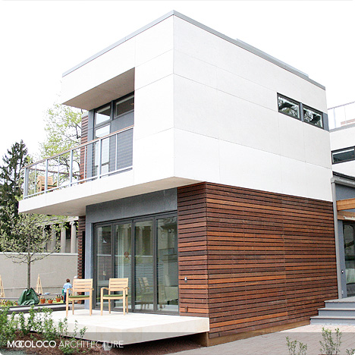
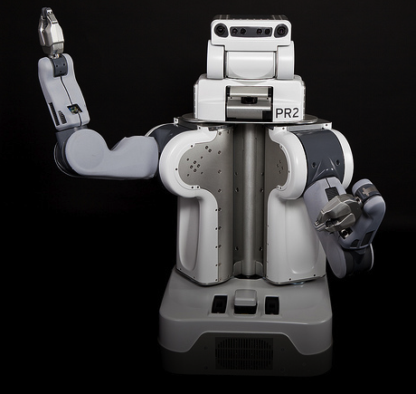
User-Facing Machine Learning
Examples
  Search Engines
  Netflix
  Smart Home
  Robot Assistant
Learning
  Gathering and maintenance
  of knowledge
  Measure and optimize
  performance
  Personalization

Slide 3
Interactive Learning System
Design!
y_{t} dependent on x_{t}
(e.g. ranking for query)
Model!
Algorithm
User
Utility: U(y_{t})
x_{t+1} dependent on y_{t}
(e.g. click given ranking, new query)
Knowledge constrained
Computation constrained
Observed Data ≠ Training Data
  Observed data is user’s decisions
  Even explicit feedback reflects user’s decision process
Decisions → Feedback → Learning Algorithm

Slide 4
Decide between two Ranking Functions
Distribution P(u,q)
of users u, queries q

(tj,”SVM”)

Retrieval Function 1
f₁(u,q) → r₁
Retrieval Function 2
f₂(u,q) → r₂
Which one
is better?
1. Kernel Machines
http://svm.first.gmd.de/
2. SVM-Light Support Vector Machine
http://svmlight.joachims.org/
3. School of Veterinary Medicine at UPenn
http://www.vet.upenn.edu/
4. An Introduction to Support Vector Machines
http://www.support-vector.net/
5. Service Master Company
http://www.servicemaster.com/
⁞
1. School of Veterinary Medicine at UPenn
http://www.vet.upenn.edu/
2. Service Master Company
http://www.servicemaster.com/
3. Support Vector Machine
http://jbolivar.freeservers.com/
4. Archives of SUPPORT-VECTOR-MACHINES
http://www.jiscmail.ac.uk/lists/SUPPORT...
5. SVM-Light Support Vector Machine
http://ais.gmd.de/~thorsten/svm light/
⁞
U(tj,”SVM”,r₁)
U(tj,”SVM”,r₂)
Notes:
Scenario:
Off-the-shelf IR system installed on company intranet
scientific paper search
any other search that does not have big bucks

Slide 5
Measuring Utility
Name | Description | Aggre-gation | Hypothesized Change with Decreased Quality
Abandonment Rate | % of queries with no click | N/A | Increase
Reformulation Rate | % of queries that are followed by reformulation | N/A | Increase
Queries per Session | Session = no interruption of more than 30 minutes | Mean | Increase
Clicks per Query | Number of clicks | Mean | Decrease
Click@1 | % of queries with clicks at position 1 | N/A | Decrease
Max Reciprocal Rank* | 1/rank for highest click | Mean | Decrease
Mean Reciprocal Rank* | Mean of 1/rank for all clicks | Mean | Decrease
Time to First Click* | Seconds before first click | Median | Increase
Time to Last Click* | Seconds before final click | Median | Decrease
(*) only queries with at least one click count

Slide 6


ArXiv.org: User Study
User Study in ArXiv.org
  Natural user and query population
  User in natural context, not lab
  Live and operational search engine
  Ground truth by construction
  Orig Â Swap2 Â Swap4
    Orig: Hand-tuned fielded
    Swap2: Orig with 2 pairs swapped
    Swap4: Orig with 4 pairs swapped
  Orig Â Flat Â Rand
    Orig: Hand-tuned fielded
    Flat: No field weights
    Rand : Top 10 of Flat shuffled
[Radlinski et al., 2008]

Slide 7
ArXiv.org: Experiment Setup
Experiment Setup
  Phase I: 36 days
    Users randomly receive ranking from Orig, Flat, Rand
  Phase II: 30 days
    Users randomly receive ranking from Orig, Swap2, Swap4
  User are permanently assigned to one experimental condition based on IP address and browser.
Basic Statistics
  ~700 queries per day / ~300 distinct users per day
Quality Control and Data Cleaning
  Test run for 32 days
  Heuristics to identify bots and spammers
  All evaluation code was written twice and cross-validated

Slide 8
Arxiv.org: Results
Conclusions
None of the absolute metrics reflects expected order.
Most differences not significant after one month of data.
Absolute metrics not suitable for ArXiv-sized search engines.
[Radlinski et al., 2008]
Notes:
Mention:
Data Cleaning
Two months worth of data (700 queries / 300 users per day)

Slide 9
Yahoo! Search: Results
    Retrieval Functions
      4 variants of production retrieval function
    Data
      10M – 70M queries for each retrieval function
      Expert relevance judgments
    Results
      Still not always significant even after more than 10M queries per function
      Only Click@1 consistent with DCG@5.
[Chapelle et al., 2012]

Slide 10

How about Explicit Feedback?
[Sipos et al., to appear]

Slide 11
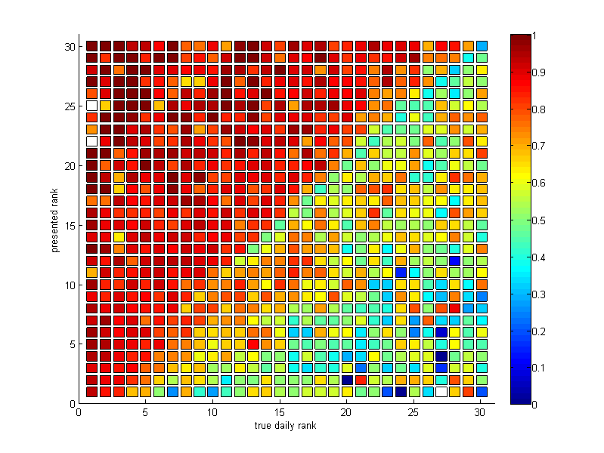
Polarity of Answer
[Sipos et al., to appear]

Slide 12
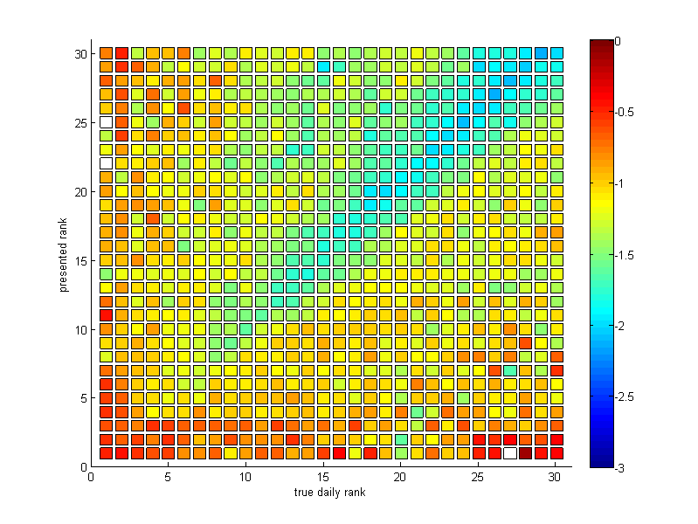
Participation
[Sipos et al., to appear]

Slide 13
Interactive Learning System
Design!
y_{t} dependent on x_{t}
(e.g. ranking for query)
Model!
Algorithm
User
Utility: U(y_{t})
x_{t+1} dependent on y_{t}
(e.g. click given ranking, new query)
Observed Data ≠ Training Data
  Observed data is user’s decisions
  Even explicit feedback reflects user’s decision process
Decisions → Feedback → Learning Algorithm
  Model the users decision process to extract feedback
  Design learning algorithm for this type of feedback

Slide 14
Decide between two Ranking Functions
Distribution P(u,q)
of users u, queries q

(tj,”SVM”)

Retrieval Function 1
f₁(u,q) → r₁
Retrieval Function 2
f₂(u,q) → r₂
Which one
is better?
1. Kernel Machines
http://svm.first.gmd.de/
2. SVM-Light Support Vector Machine
http://svmlight.joachims.org/
3. School of Veterinary Medicine at UPenn
http://www.vet.upenn.edu/
4. An Introduction to Support Vector Machines
http://www.support-vector.net/
5. Service Master Company
http://www.servicemaster.com/
⁞
1. School of Veterinary Medicine at UPenn
http://www.vet.upenn.edu/
2. Service Master Company
http://www.servicemaster.com/
3. Support Vector Machine
http://jbolivar.freeservers.com/
4. Archives of SUPPORT-VECTOR-MACHINES
http://www.jiscmail.ac.uk/lists/SUPPORT...
5. SVM-Light Support Vector Machine
http://ais.gmd.de/~thorsten/svm light/
⁞
U(tj,”SVM”,r₁)
U(tj,”SVM”,r₂)
Notes:
Scenario:
Off-the-shelf IR system installed on company intranet
scientific paper search
any other search that does not have big bucks

Slide 15

Economic Models of
Decision Making
Rational Choice
  Alternatives Y
  Utility function U(y)
  Decision
  y*=argmax_{y2Y}{U(y)}
Bounded Rationality
  Time constraints
  Computation constraints
  Approximate U(y)
Behavioral Economics
  Framing
  Fairness
  Loss aversion
  Handling uncertainty
Click
Notes:
If only I could get 1 (noisy) bit of knowledge out of every user interaction.

Slide 16

A Model of how Users Click in Search
Model of clicking:
  Users explore ranking to position k
  Users click on most relevant (looking) links in top k
  Users stop clicking when time budget up or other action more promising (e.g. reformulation)
  Empirically supported by [Granka et al., 2004]
Click
$$\underset{y∈Top k}{argmax}{U(y)}$$

Slide 17
Balanced Interleaving
(u=tj, q=“svm”)
f₁(u,q) → r₁
f₂(u,q) → r₂
1. Kernel Machines
http://svm.first.gmd.de/
2. Support Vector Machine
http://jbolivar.freeservers.com/
3. An Introduction to Support Vector Machines
http://www.support-vector.net/
4. Archives of SUPPORT-VECTOR-MACHINES ...
http://www.jiscmail.ac.uk/lists/SUPPORT...
5. SVM-Light Support Vector Machine
http://ais.gmd.de/~thorsten/svm light/
1. Kernel Machines
http://svm.first.gmd.de/
2. SVM-Light Support Vector Machine
http://ais.gmd.de/~thorsten/svm light/
3. Support Vector Machine and Kernel ... References
http://svm.research.bell-labs.com/SVMrefs.html
4. Lucent Technologies: SVM demo applet
http://svm.research.bell-labs.com/SVT/SVMsvt.html
5. Royal Holloway Support Vector Machine
http://svm.dcs.rhbnc.ac.uk
Interleaving(r₁,r₂)
1. Kernel Machines 1
http://svm.first.gmd.de/
2. Support Vector Machine 2
http://jbolivar.freeservers.com/
3. SVM-Light Support Vector Machine 2
http://ais.gmd.de/~thorsten/svm light/
4. An Introduction to Support Vector Machines 3
http://www.support-vector.net/
5. Support Vector Machine and Kernel ... References 3
http://svm.research.bell-labs.com/SVMrefs.html
6. Archives of SUPPORT-VECTOR-MACHINES ... 4
http://www.jiscmail.ac.uk/lists/SUPPORT...
7. Lucent Technologies: SVM demo applet 4
http://svm.research.bell-labs.com/SVT/SVMsvt.html
Model of User:
Better retrieval functions is more likely to get more clicks.
Invariant:
For all k, top k of balanced interleaving is union of top k₁ of r₁ and top k₂ of r₂ with k₁=k₂ ± 1.
Interpretation: (r₁ Â r₂) ↔ clicks(topk(r₁)) > clicks(topk(r₂))
→ see also [Radlinski, Craswell, 2012] [Hofmann, 2012]
[Joachims, 2001] [Radlinski et al., 2008]
Notes:
You might want to skip this slide.
This is the evaluation method. Get the ranking for the learned retrieval function and for the standard retrieval function (e.g. Google).
Combine both rankings into one combined ranking in a “fair and unbiased” way. This means, that at each position in the combined ranking the number of links from “learned” equals the number of links from “google” plus/minus 1. So, if user have no preference for a ranking function, with 50/50 chance they will click on links from either ranking function.
We then evaluate, if the users click on links from one ranking function significantly more often. In the example, the lowest click in the combined ranking is 7. Due to the “fair” merging, the user has seen the top 4 from both rankings. Tracing back where the clicked on links came from, 3 links were in the top 4 from “Learned”, but only one in the top 4 from “google”. So, “learned” wins on this query.
Note that this is a blind test. Users do not know which retrieval function the link came from. In particular, we use the same abstract generator.

Slide 18
Arxiv.org: Interleaving Experiment
Experiment Setup
  Phase I: 36 days
    Balanced Interleaving of (Orig,Flat) (Flat,Rand) (Orig,Rand)
  Phase II: 30 days
    Balanced Interleaving of (Orig,Swap2) (Swap2,Swap4) (Orig,Swap4)
Quality Control and Data Cleaning
  Same as for absolute metrics

Slide 19
Arxiv.org: Interleaving Results
% wins Orig
% wins Rand
Conclusions
All interleaving experiments reflect the expected order.
All differences are significant after one month of data.
Same results also for alternative data-preprocessing.
Percent Wins

Slide 20
Yahoo and Bing: Interleaving Results
Yahoo Web Search [Chapelle et al., 2012]
  Four retrieval functions (i.e. 6 paired comparisons)
  Balanced Interleaving
  → All paired comparisons consistent with ordering by NDCG.
Bing Web Search [Radlinski & Craswell, 2010]
  Five retrieval function pairs
  Team-Game Interleaving
  → Consistent with ordering by NDGC when NDCG significant.

Slide 21
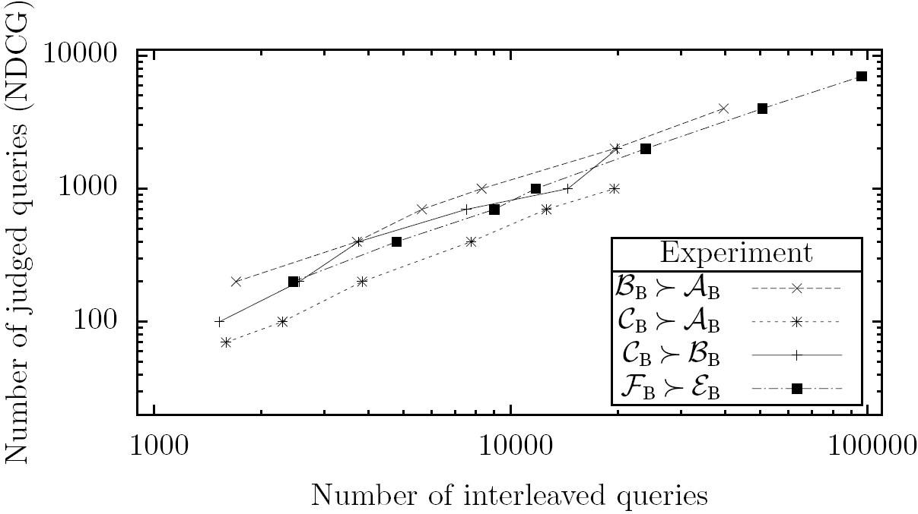
Efficiency: Interleaving vs. Explicit
Bing Web Search
  4 retrieval function
  pairs
  ~12k manually
  judged queries
  ~200k interleaved
  queries
Experiment
  p = probability that NDCG is correct on subsample of size y
  x = number of queries needed to reach same p-value with interleaving
➔ Ten interleaved queries are equivalent to one manually judged query.
[Radlinski & Craswell, 2010]

Slide 22
Interactive Learning System
Design!
y_{t} dependent on x_{t}
(e.g. ranking for query)
Model!
Algorithm
User
Utility: U(y_{t})
x_{t+1} dependent on y_{t}
(e.g. click given ranking, new query)
Observed Data ≠ Training Data
Decisions → Feedback → Learning Algorithm
  Model the users decision process to extract feedback
    → Pairwise comparison test P( y_{i} Â y_{j} | U(y_{i})>U(y_{j}) )
  Design learning algorithm for this type of feedback

Slide 23
Learning on Operational System
Example:
  4 retrieval functions: A > B >> C > D
  10 possible pairs for interactive experiment
    (A,B) → low cost to user
    (A,C) → medium cost to user
    (C,D) → high cost to user
    (A,A) → zero cost to user
    …
Minimizing Regret
  Algorithm gets to decide on the sequence of pairwise tests
  Don’t present “bad” pairs more often than necessary
  Trade off (long term) informativeness and (short term) cost
➔ Dueling Bandits Problem
[Yue, Broder, Kleinberg, Joachims, 2010]
Notes:
G,B,Y,A in order of sponsorship

Slide 24
Regret for Dueling Bandits
Given:
  A finite set H of candidate retrieval functions f₁…f_{K}
  A pairwise comparison test f Â f’ on H with P(f Â f’)
Regret:
  R(A) = ∑_{t=1..T} [P(f* Â f_{t}) + P(f* Â f_{t}’) - 1]
  f*: best retrieval function in hindsight (assume single f* exists)
  (f,f’): retrieval functions tested at time t
Example:
Time Step: t₁ t₂ … T
Comparison: (f₉,f₁₂) → f₉ (f₅,f₉) → f₅ (f₁,f₃) → f₃
Regret: P(f*Âf₉)+P(f*Âf₁₂)-1 P(f*Âf₅)+P(f*Âf₉)-1
= 0.90+0.95-1 = 0.85 = 0.78 = 0.01
[Yue, Broder, Kleinberg, Joachims, 2010]

Slide 25
First Thought: Tournament
Noisy Sorting/Max Algorithms:
  [Feige et al.]: Triangle Tournament Heap O(n/ε² log(1/δ)) with prob 1-δ
  [Adler et al., Karp & Kleinberg]: optimal under weaker assumptions
X₁
X₁
X₅
X₁
X₃
X₅
X₇
X₁
X₂
X₃
X₄
X₅
X₆
X₇
X₈

Slide 26
Algorithm: Interleaved Filter 2
f₁ | f₂ | f’=f₃ | f₄ | f₅
0/0 | 0/0 |  | 0/0 | 0/0
Algorithm
  InterleavedFilter1(T,W={f₁…f_{K}})
    Pick random f’ from W
    δ=1/(TK²)
    WHILE |W|>1
      FOR b 2 W DO
        duel(f’,f)
        update P_{f}
      t=t+1
      c_{t}=(log(1/δ)/t)^{0.5}
      Remove all f from W with P_{f} < 0.5-c_{t} [worse with prob 1-δ]
      IF there exists f’’ with P_{f’’} > 0.5+c_{t} [better with prob 1-δ]
        Remove f’ from W
        Remove all f from W that are empirically inferior to f’
        f‘=f’’; t=0
    UNTIL T: duel(f’,f’)
f₁ | f₂ | f’=f₃ | f₄ | f₅
8/2 | 7/3 |  | 4/6 | 1/9
f₁ | f₂ | f’=f₃ | f₄
13/2 | 11/4 |  | 7/8 | XX
f’=f₁ | f₂ |  | f₄
0/0 | 0/0 | XX | XX | XX
  Related Algorithms: [Hofmann, Whiteson, Rijke, 2011] [Yue, Joachims, 2009] [Yue, Joachims, 2011]
[Yue et al., 2009]

Slide 27

Assumptions
Preference Relation: f_{i} Â f_{j} ⬄ P(f_{i} Â f_{j}) = 0.5+ε_{i,j} > 0.5
Weak Stochastic Transitivity: f_{i} Â f_{j} and f_{j} Â f_{k} → f_{i} Â f_{k}
f₁ Â f₂ Â f₃ Â f₄ Â f₅ Â f₆ Â … Â f_{K}
Strong Stochastic Transitivity: ε_{i,k} ≥ max{ε_{i,j}, ε_{j,k}}
ε_{1,4} ≥ ε_{2,4} ≥ ε_{3,4} ≥ 0.5 ≥ ε_{5,4} ≥ ε_{6,4} ≥ … ≥ ε_{K,4}
Stochastic Triangle Inequality: f_{i} Â f_{j} Â f_{k} → ε_{i,k} ≤ ε_{i,j}+ε_{j,k}
ε_{1,2} = 0.01 and ε_{2,3} = 0.01 → ε_{1,3} ≤ 0.02
ε-Winner exists: ε = max_{i}{ P(f₁ Â f_{i})-0.5 } = ε_{1,2} > 0
Theorem: IF2 incurs expected average regret bounded by

Slide 28
Proof Sketch
Number of duels per match between f_{i} and f_{j}
  Correct winner after O(1/ε_{ij} log(TK)) comparisons with probability 1-1/(TK²)
  → Hoeffding bound
  → Union bound ensures overall winner with prob 1-1/T
Overall regret
  E[R] · (1-1/T) E[R(IF2)] + 1/T O(T) = O(E[R(IF2)])
Regret per match between f_{i} and f_{j}
  Upper bounded by gap between f₁ and f₂: O(1/ε₁₂ log(T))
  → Strong Stochastic Transitivity
  → Stochastic Triangle Inequality
Number of matches
  When IF2 mistake free, then O(K) matches in expectation.
  → Random Walk of b’

Slide 29

Lower Bound
Theorem: Any algorithm for the dueling bandits problem
has regret
Theorem: Any algorithm for the dueling bandits problem has regret
Proof: [Karp, Kleinberg, 2007] [Kleinberg et al., 2007]
Intuition:
  Magically guess the best bandit, just verify guess
  Worst case: 8 f_{i} Â f_{j}: P(f_{i} Â f_{j})=0.5+ε
  Need O(1/ε² log T) duels to get 1-1/T confidence.
Notes:
We have seen that, given two bandits bi and bj with P(bi > bj) = 1=2 + eps; we
can identify the better bandit with probability at least 1-1/T after O(log T/eps^2)
comparisons. If this is in fact the minimum number of comparisons required,
then we would suspect that any algorithm for the above decision problem that
is uniformly good over all problem instances must perform (log T=2) comparisons
involving each inferior bandit.

Slide 30
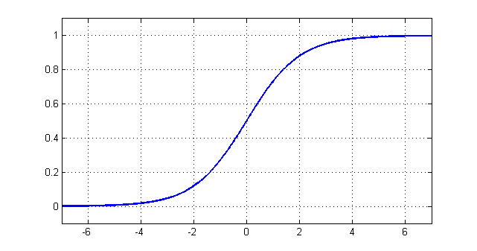
Convex Dueling Bandits Problem
Given:
  A infinite set H of functions f_{w} parameterized by w 2 F ½ <^{d}
  A convex value function v(w) describing utility of f_{w}
  P(f_{w} Â f_{w’}) = σ(v(w)-v(w’)) = 0.5+ε(w,w’)
  P is L-Lipschitz
Regret:
  R(A) = ∑_{t=1..T} [P(f* Â f_{t}) + P(f* Â f_{t}’) - 1]
  f*: best retrieval function in hindsight
  (f,f’): retrieval functions tested at time t
Approach:
  Stochastic estimated gradient method [Zinkevich 03] [Flaxman et al. 04]
  Regret
[with Yisong Yue]

Slide 31
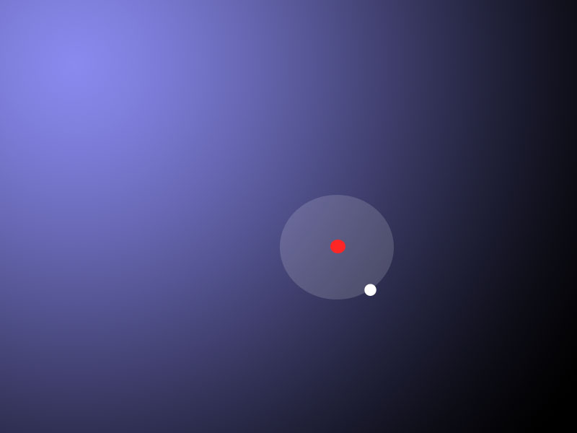
δ – explore step size
γ – exploit step size
Current point
Losing candidate
Winning candidate
Dueling Bandit Gradient Descent

Slide 32
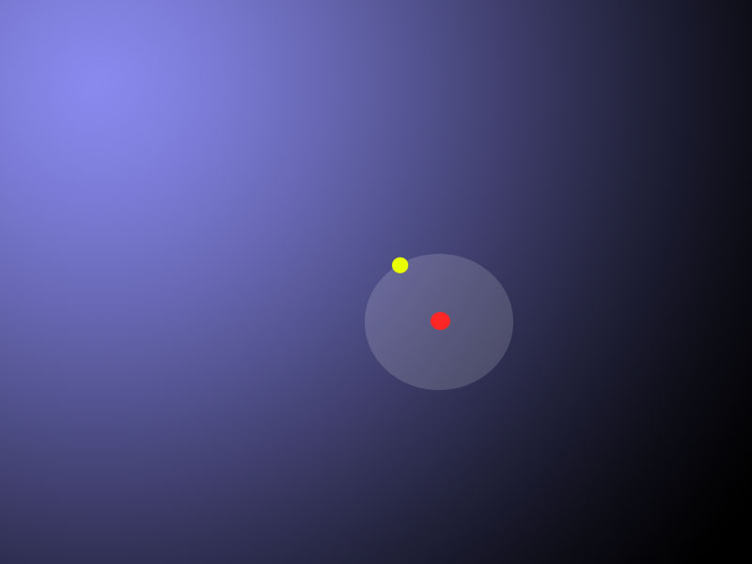
δ – explore step size
γ – exploit step size
Current point
Losing candidate
Winning candidate
Dueling Bandit Gradient Descent

Slide 33
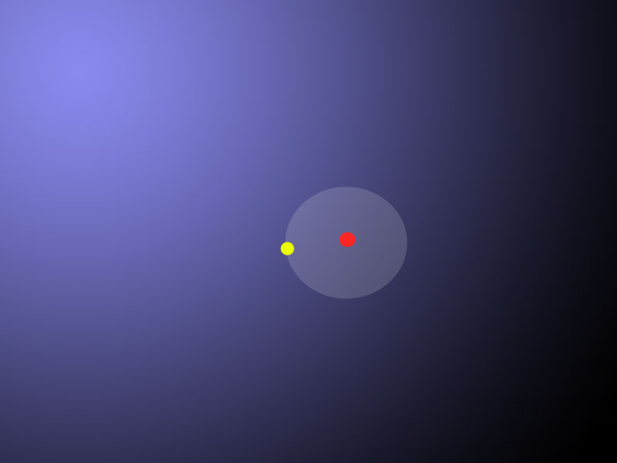
δ – explore step size
γ – exploit step size
Current point
Losing candidate
Winning candidate
Dueling Bandit Gradient Descent

Slide 34
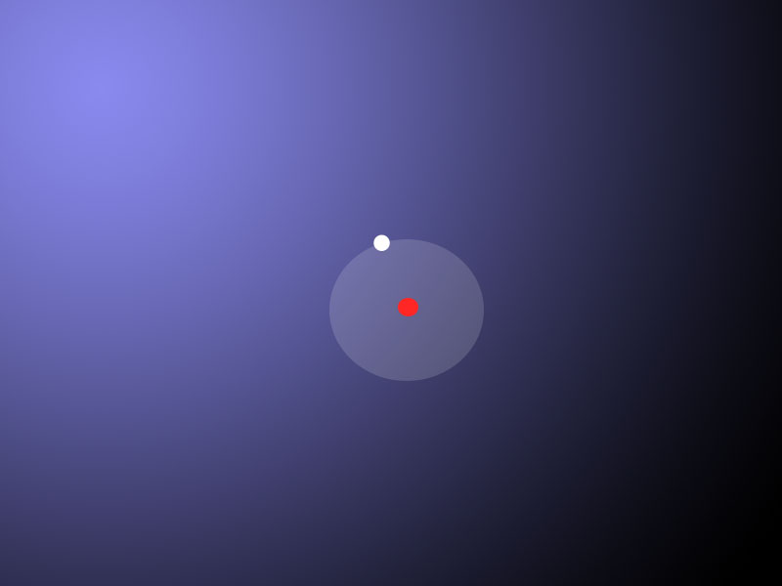
δ – explore step size
γ – exploit step size
Current point
Losing candidate
Winning candidate
Dueling Bandit Gradient Descent

Slide 35
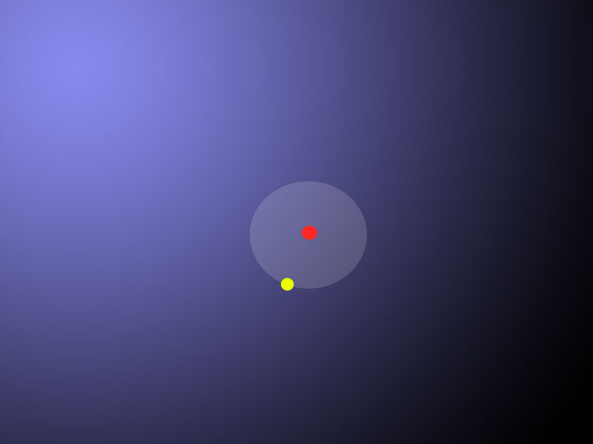
δ – explore step size
γ – exploit step size
Current point
Losing candidate
Winning candidate
Dueling Bandit Gradient Descent

Slide 36
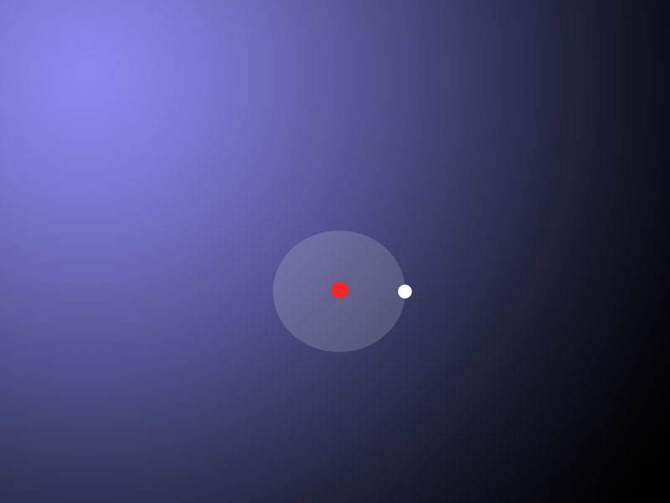
δ – explore step size
γ – exploit step size
Current point
Losing candidate
Winning candidate
Dueling Bandit Gradient Descent

Slide 37
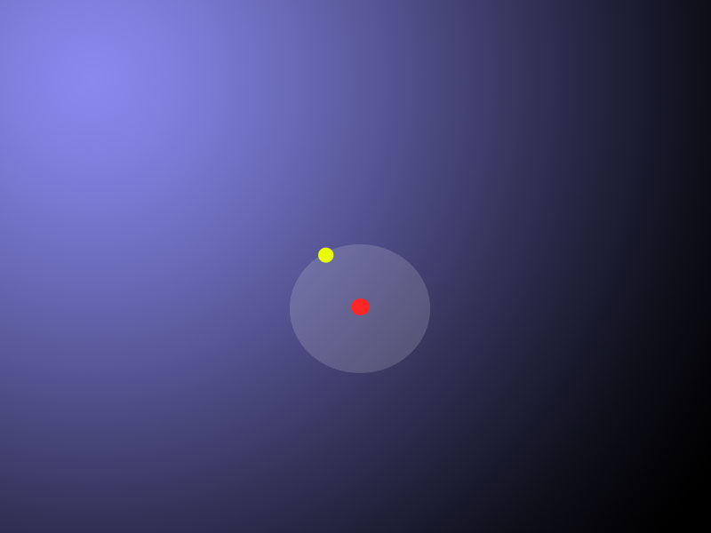
δ – explore step size
γ – exploit step size
Current point
Losing candidate
Winning candidate
Dueling Bandit Gradient Descent

Slide 38
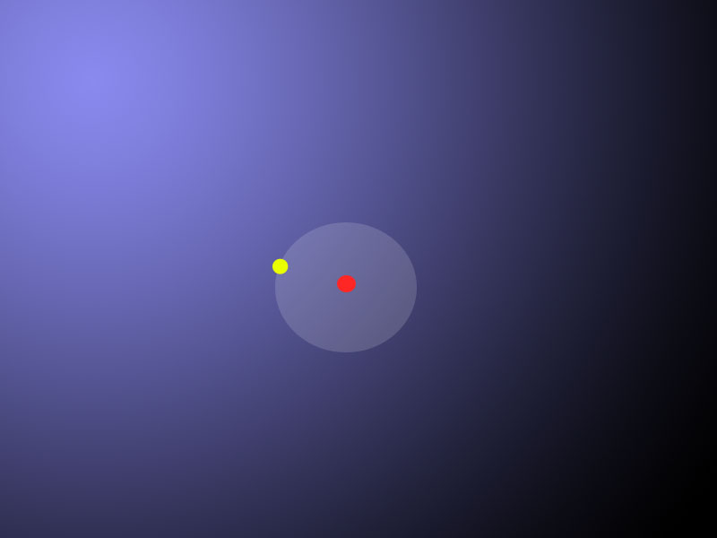
δ – explore step size
γ – exploit step size
Current point
Losing candidate
Winning candidate
Dueling Bandit Gradient Descent

Slide 39
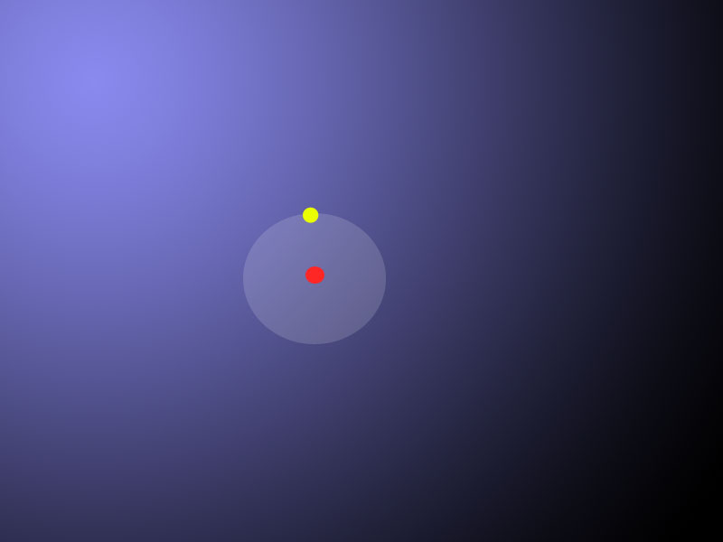
δ – explore step size
γ – exploit step size
Current point
Losing candidate
Winning candidate
Dueling Bandit Gradient Descent

Slide 40
Leveraged web search dataset
  1000 Queries, 367 Dimensions (Features)
Simulate “users” issuing queries

Slide 41
Interactive Learning System
Design!
y_{t} dependent on x_{t}
(e.g. ranking for query)
Model!
Algorithm
User
Utility: U(y_{t})
x_{t+1} dependent on y_{t}
(e.g. click given ranking, new query)
Observed Data ≠ Training Data
Decisions → Feedback → Learning Algorithm
  Model the users decision process to extract feedback
    → Pairwise comparison test P( y_{i} Â y_{j} | U(y_{i})>U(y_{j}) )
  Design learning algorithm for this type of feedback
    → Dueling Bandits problem and algorithms (e.g. IF2)

Slide 42


Who does the exploring?
Example 1

Slide 43

Who does the exploring?
Example 2
Click

Slide 44

Who does the exploring?
Example 3
Click

Slide 45


Coactive Feedback Model
Interaction: given x
Set of all y for context x
User explored
$$\overline{y}$$
Improved
Prediction
Algorithm
prediction
$$y$$
Feedback:
  Improved prediction ӯ_{t}
  U(ӯ_{t}|x_{t}) > U(y_{t}|x_{t})
  Supervised learning: optimal prediction y_{t}*
  y_{t}* = argmax_{y} U(y|x_{t})

Slide 46
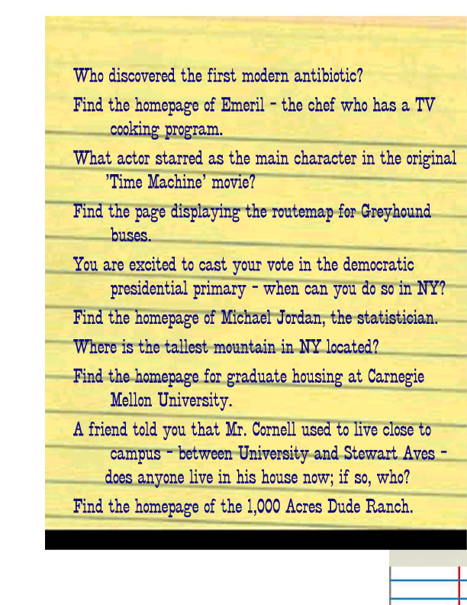
User Study: Search Engine
Study
  16 undergrads, familiar with Google
Task
  find answers to 10 given questions
Data
  queries, clicks, logs, manual judgments
Results
➔ Preferences from clicks are highly accurate.

Slide 47
Viewing vs. Clicking
[Joachims et al. 2005, 2007]

Slide 48
Presentation Bias
Hypothesis: Order of presentation influences where users look, but not where they click!
More relevant
1
2
1
2
=> Users appear to have trust in Google’s ability to
rank the most relevant result first.
Normal: Google’s order of results
Swapped:
Order of top 2 results swapped
[Joachims et al. 2005, 2007]

Slide 49
Quality-of-Context Bias
Hypothesis: Clicking depends only on the result
itself, but not on other results.
 | Rank of clicked link as sorted by relevance judges
Normal + Swapped | 2.67
Reversed | 3.27
Reversed:
Top 10 results in reversed order.
=> Users click on less relevant results, if they are embedded between irrelevant results.
[Joachims et al. 2005, 2007]

Slide 50
Which Results are Viewed Before Click?
Clicked Link
=> Users typically do not look at lower results before they click (except maybe the next result).

Slide 51
Machine Translation
x_{t}
We propose Coactive Learning as a model of interaction between a learning system and a human user, where both have the common goal of providing results of maximum utility to the user.
y_{t}
Wir schlagen vor, koaktive Learning als ein Modell der Wechselwirkung zwischen einem Lernsystem und menschlichen Benutzer, wobei sowohl die gemeinsame Ziel, die Ergebnisse der maximalen Nutzen für den Benutzer.
Wir schlagen vor, koaktive Learning als ein Modell der Wechselwirkung des Dialogs zwischen einem Lernsystem und menschlichen Benutzer, wobei sowohl die beide das gemeinsame Ziel haben, die Ergebnisse der maximalen Nutzen für den Benutzer zu liefern.
ӯ_{t}
Á

Slide 52
Coactive Learning Model
Unknown Utility Function: U(y|x)
  Boundedly rational user
Algorithm/User Interaction:
  LOOP FOREVER
    Observe context x (e.g. query)
    Learning algorithm presents y (e.g. ranking)
    User returns ӯ with U(ӯ|x) > U(y|x)
    Regret = Regret + [ U(y*|x) – U(y|x) ]
Relationship to other online learning models
  Expert setting: receive U(y|x) for all y
  Bandit setting: receive U(y|x) only for selected y
  Dueling bandits: for selected y and ӯ, receive U(ӯ|x) > U(y|x)
  Coactive setting: for selected y, receive ӯ with U(ӯ|x) > U(y|x)
Never revealed:
cardinal feedback
optimal y*
Loss for prediction ŷ
Optimal prediction y*=argmax_{y} { U(x,y) }

Slide 53

Preference Perceptron: Algorithm
Model
  Linear model of user utility: U(y|x) = w^{T} Á(x,y)
Algorithm
    Set w₁ = 0
    FOR t = 1 TO T DO
      Observe x_{t}
      Present y_{t} = argmax_{y} { w_{t}^{T} φ(x_{t},y) }
      Obtain feedback ӯ_{t}
      Update w_{t+1} = w_{t} + φ(x_{t},ӯ_{t}) - φ(x_{t},y_{t})
This may look similar to a multi-class Perceptron, but
  Feedback ӯ_{t} is different (not get the correct class label)
  Regret is different (misclassifications vs. utility difference)
[Shivaswamy, Joachims, 2012]

Slide 54




α-Informative Feedback
Presented
Slack
Feedback
Optimal
Definition: Strict ®-Informative Feedback
Definition: ®-Informative Feedback
»
Feedback ≥ Presented + α (Best – Presented)
Slacks both pos/neg
[Shivaswamy, Joachims, 2012]

Slide 55

Preference Perceptron: Regret Bound
Assumption
  U(y|x) = w^{T} ɸ(x,y), but w is unknown
Theorem
  For user feedback ӯ that is α-informative, the average
  regret of the Preference Perceptron is bounded by
Other Algorithms and Results
  Feedback that is α-informative only in expectation
  General convex loss functions of U(y*|x)-U(ŷ|x)
  Regret that scales log(T)/T instead of T^{-0.5} for strongly convex
noise
→ zero
[Shivaswamy, Joachims, 2012]

Slide 56
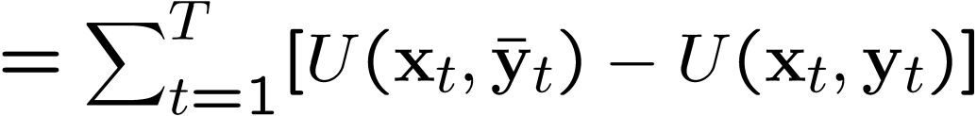
Proof: Regret Bound
Definition
®-informative
[Shivaswamy, Joachims, 2012]

Slide 57





Expected α-Informative Feedback
Presented
Optimal
Definition: Expected ®-Informative Feedback
Theorem: Coactive Pref Perceptron achieves
[Shivaswamy, Joachims, 2012]

Slide 58
Lower Bound
Theorem: For any coactive learning algorithm A with linear utility, there exist x_{t}, objects Y, and w such that REG_{T} of A in T steps is Ω(1/T^{0.5}).
[Shivaswamy, Joachims, 2012]

Slide 59

Experiments
Web-search ranking: structured prediction
  present a ranked list, feedback is ranked list
  Yahoo! Learning to Rank dataset (30k queries)
  Joint feature map
Movie recommendation: item prediction
  present a movie, feedback is another movie
  MovieLens dataset (1M ratings)
  Joint feature map based on “SVD features”
Ground truth: best least-squares fit to ratings
[Shivaswamy, Joachims, 2012]

Slide 60
Strong vs Weak Feedback
Web: Click on highest utility docs until strictly
®-informative
Movie: Lowest utility movie that is strictly
®-informative

Slide 61
Noisy Feedback
Web: Click on the 5 most relevant docs in top 10 results
Movie: Some movie with rating that is higher by one star

Slide 62
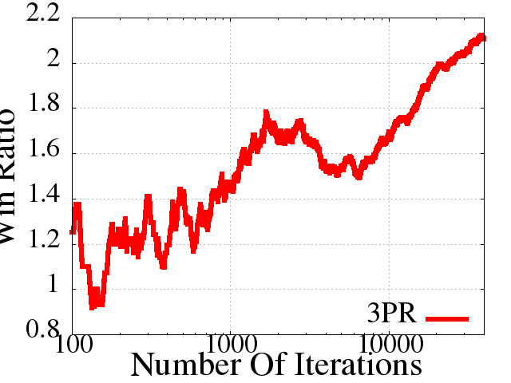
Preference Perceptron: Experiment
  Experiment:
    Automatically optimize Arxiv.org Fulltext Search
  Model
    Utility of ranking y for query x: U_{t}(y|x) = ∑_{ι} °_{i} w_{t}^{T} Á(x,y^{(i)}) [~1000 features]
    →Computing argmax ranking: sort by w_{t}^{T} Á(x,y^{(i)})
  Feedback
    Construct ӯ_{t} from y_{t} by moving
    clicked links one position
    higher.
  Baseline
    Handtuned w_{base} for U_{base}(y|x)
  Evaluation
    Interleaving of ranking from
    U_{t}(y|x) and U_{base}(y|x)
Analogous to DCG
Coactive Learning
Cumulative Win Ratio
Baseline
Number of Feedback
[Raman et al., 2013]

Slide 63
Related Models
Ordinal Regression
(Crammer & Singer 2001)
  Examples: ,
  r_{i} is numeric rank
Pair Preference Learning (Herbrich et al., 1999); Freund et al. 2003)
  Examples:
  i.i.d. assumption, batch
Ranking
(Joachims, 2002; Liu 2009)
  Examples: ,
  y_{i}* is optimal ranking
  Structured Prediction, list-wise ranking
Expert Model
  Cardinal feedback for all arms / optimal y_{i}*
Bandit Model
  Cardinal feedback only for chosen arm
Dueling Bandit Model
(Yue et al. 2009; Yue, Joachims 2009)
  Preference feedback between two arms chosen by algorithm

Slide 64
Summary and Conclusions
Design!
y_{t} dependent on x_{t}
(e.g. ranking for query)
Model!
Algorithm
User
Utility: U(y_{t})
x_{t+1} dependent on y_{t}
(e.g. click given ranking, new query)
Observed Data ≠ Training Data
Decisions → Feedback → Learning Algorithm
  Dueling Bandits
    Model: Pairwise comparison test P( y_{i} Â y_{j} | U(y_{i})>U(y_{j}) )
    Algorithm: Interleaved Filter 2, O(|Y|log(T)) regret
  Coactive Learning
    Model: for given y, user provides ӯ with U(ӯ|x) > U(y|x)
    Algorithm: Preference Perceptron, O(ǁwǁ T^{0.5}) regret
 | Utility model | Decision model | Actions y_{t} / Experiment | Feedback | Exploration | Regret
Dueling Bandits | Ordinal | Noisy rational | Comparison pairs | Noisy comparison | Algorithm | Lost comparisons
Coactive Learning | Linear | Bounded rational | Structured object | α-informa-tive ӯ | User | Cardinal utility
⁞ | ⁞ | ⁞ | ⁞ | ⁞ | ⁞ | ⁞

Slide 65
Research in Interactive Learning
Decision Model
Learning Algorithm
Design Space:
Decision Model
Utility Model
Interaction Experiments
Feedback Type
Regret
Applications
Related Fields:
Micro Economics
Decision Theory
Econometrics
Psychology
Communications
Cognitive Science
Behavioral Studies

