Slide 1
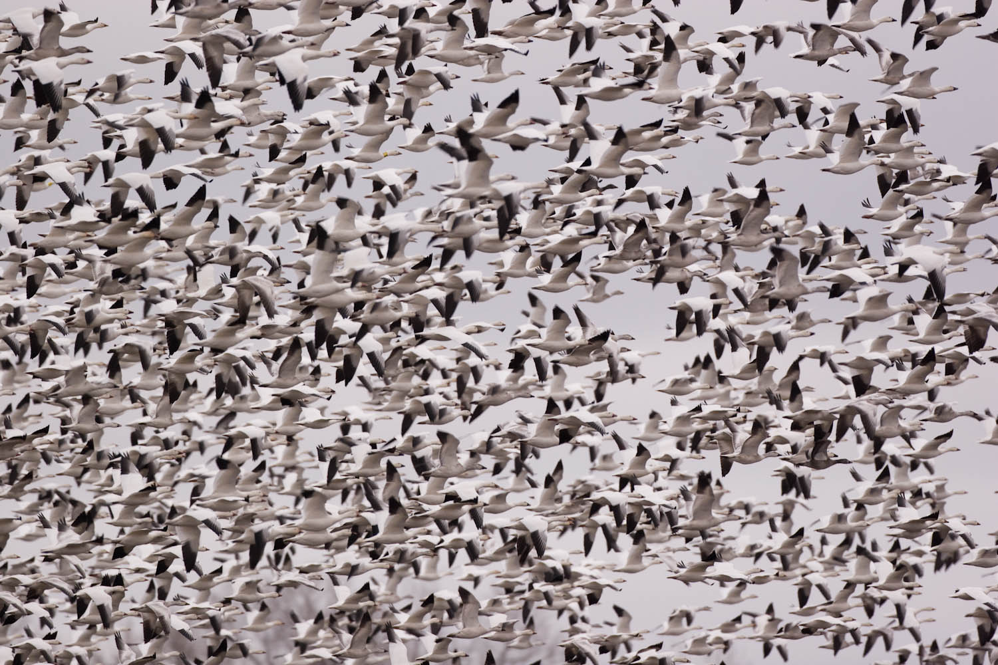

How To Identify Ducks In Flight
Steve Kelling
Notes:
Before I jump into my talk I thought it might be fun to go over how to identify several species of birds.
I want to focus on the identification of flying ducks and geese

Slide 2
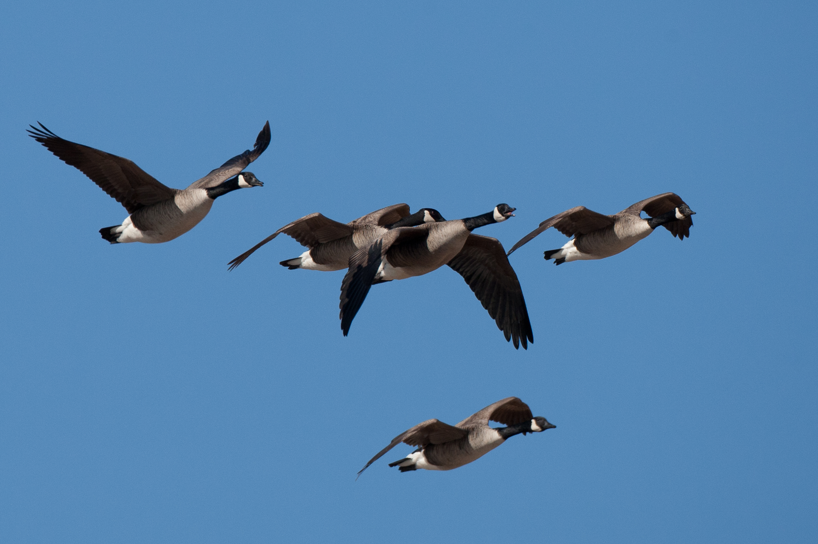
Notes:
You all probably know what these birds are
The general shape, black neck and white chin strap help identify these as Canada Geese

Slide 3
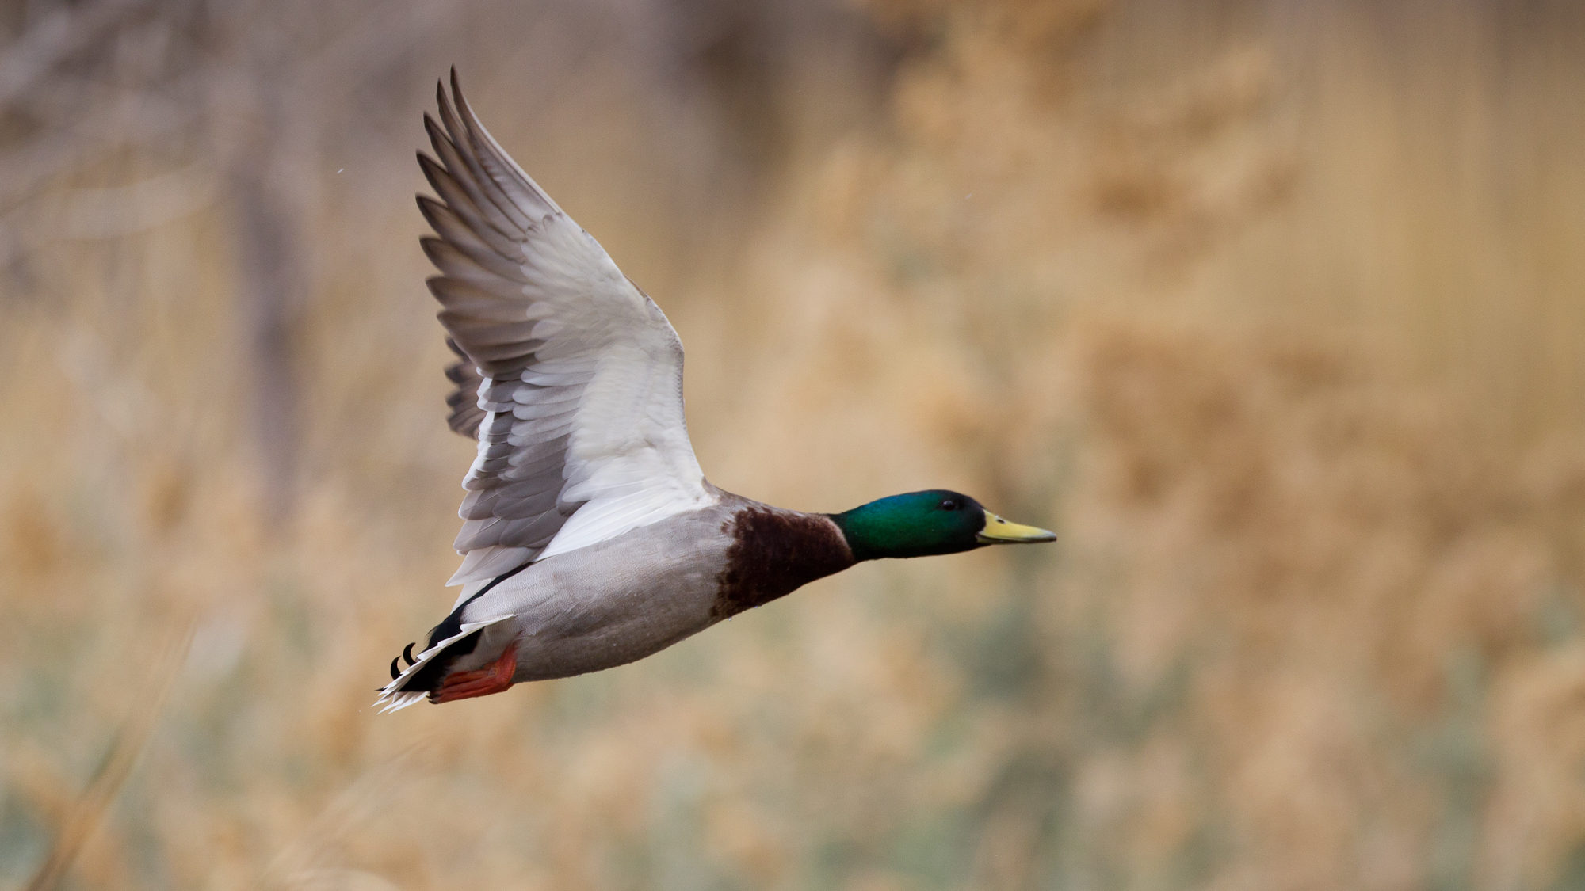
Notes:
Another duck that should be easy for most of you is the Mallard.
Note the green head and brown breast, characteristics that easily identify this bird as a male Mallard
Female mallards look very different

Slide 4
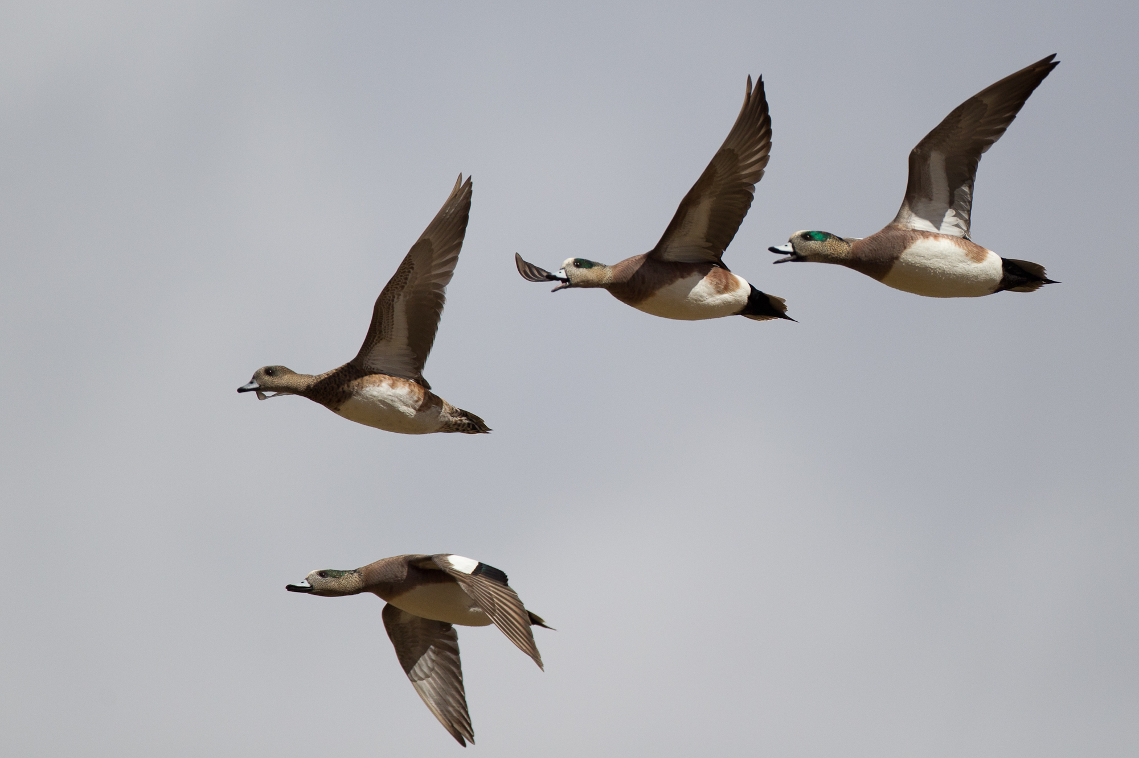
Notes:
This flock of birds are all of the same species, but there is a female amongst the males.
The white crown, green around the eye, white belly and white on the upper wings identify these as American Wigeon
There are more than 10,000 species of birds in the world.

Slide 5
So What?
Notes:
So why am I telling you all of this?
There are no machines or artificail intelligence that has been developed to identify birds to the species level
Only humans can, and many millions do
Identifying a species is a complex task that relies on a combination of factors. Observers must be able to process impressions of shape, size, and behavior under variable observation conditions. As this process takes place, the observer must combine these impressions with a mental list of species most likely to occur at that specific location and date, and constantly recalibrate until the species is correctly identified. Only humans can make this difficult computation of classifying organisms to the species level. And for birds, tens of thousands of birdwatchers do this every day for fun. we need to be more general, thus removing plumage and vocalizations

Slide 6
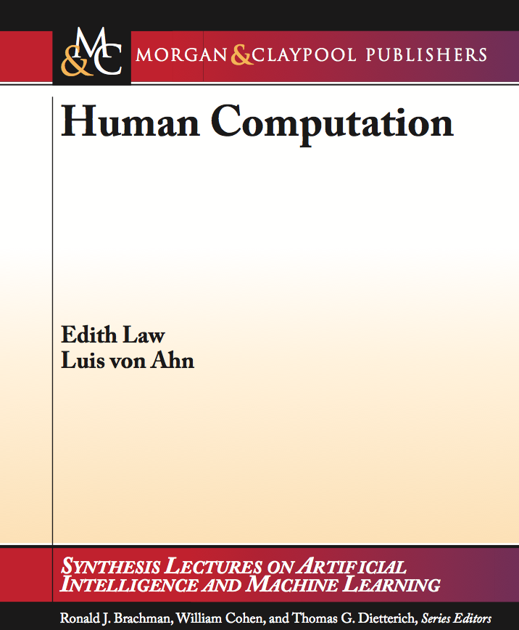
CAPTCHA
Fold It
Galaxy Zoo
Notes:
What I am going to talk about today is the work that we have been doing at the Cornell Lab of Ornithology that takes advantage of human computational skills, and describe our research at the interface between humans and computers that are allowing us to study bird populations at spatial and temporal scales that were previoulsy unimaginable.
eBird is part of the growing field of human computation, which focuses on harnessing human intelligence to solve computational problems that are beyond the scope of existing Artificial Intelligence (AI) algorithms (ADD LAW CITATION). Many of these services use the web and include game-based approaches such as the ESP Game, which has collected millions of image labels (von Ahn and Dabbish xxx); protein folding in the game FoldIt (Cooper et. Al xxx); Galaxy Zoo, which has engaged more than 200,000 participants who have classified more than 100 million galaxies collected during the Sloan Digital Sky Survey (Raddick et. Al xxx); and reCAPTCHA which provides security measures on the web while transcribing old print material one word at a time (von Ahn et. al 2004).
you need to say what the purpose is ESP is to label images, foldit is to what?

Slide 7
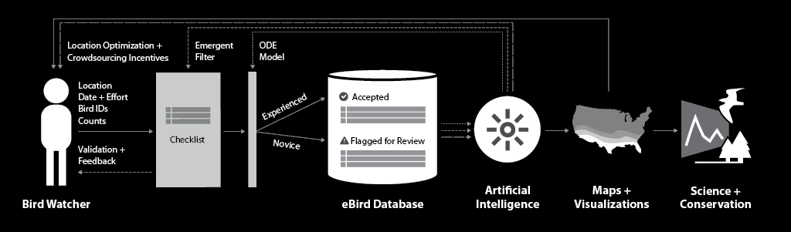
Human Computer Learning Network
S Kelling, C Lagoze, W-K Wong, J Yu, T Damoulas, J Gerbracht, D Fink, C Gomes. 2012. eBird: A Human/Computer Learning Network to Improve Biodiversity Conservation and Research. Artificial Intelligence
Notes:
We call this integration of human computing and machine computing a human computer learning network.
In this case we take advantage of birdwatcher’s ability to identify and count birds, the Internet to connect to a global network of birdwatchers, databases to store data, and new AI techniques to not only provide maps and visualizations of the data but to also feed back to the birdwathcers information about their observations

Slide 8

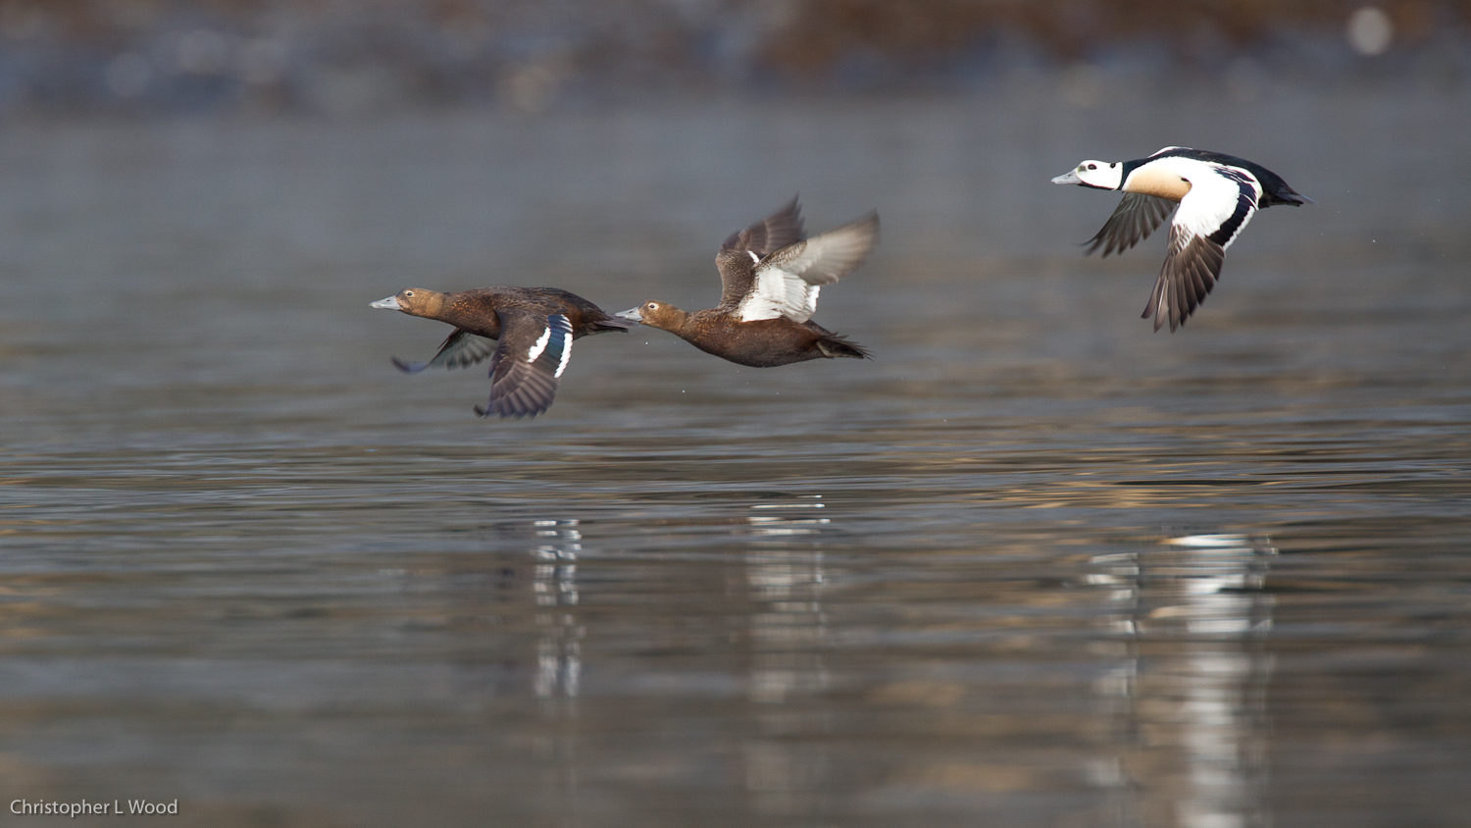
Sullivan, B. L., C. L. Wood, M. J. Iliff, R. E. Bonney, D. Fink, and S. Kelling. 2009. eBird: A citizen-based bird observation network in the biological sciences. Biological Conservation 142:2282-2292.
Notes:
For more than two-hundred years the public has contributed significantly to our understanding of bird identification, distribution, and abundance (Barrow 1998).
Building on this tradition, eBird (http://ebird.org) is a citizen-science project that takes advantage of numerous information technologies to engage a global network of bird watchers to report their bird observations to a central database.

Slide 9
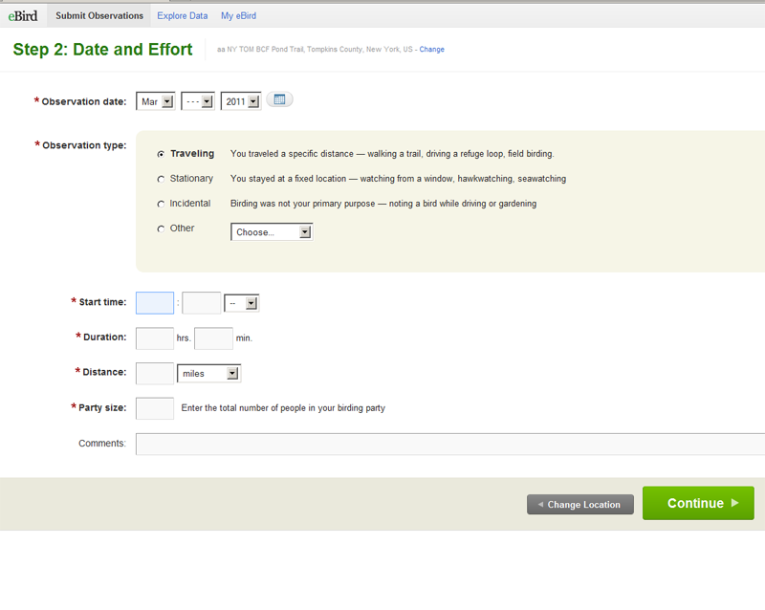
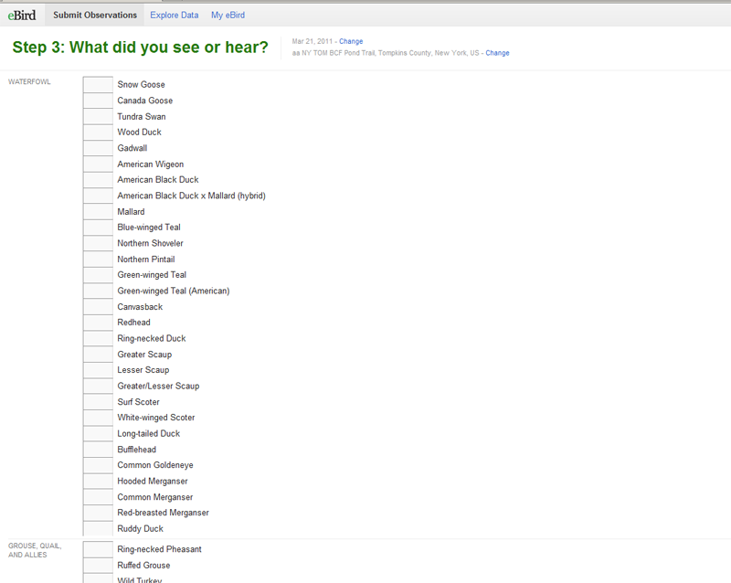
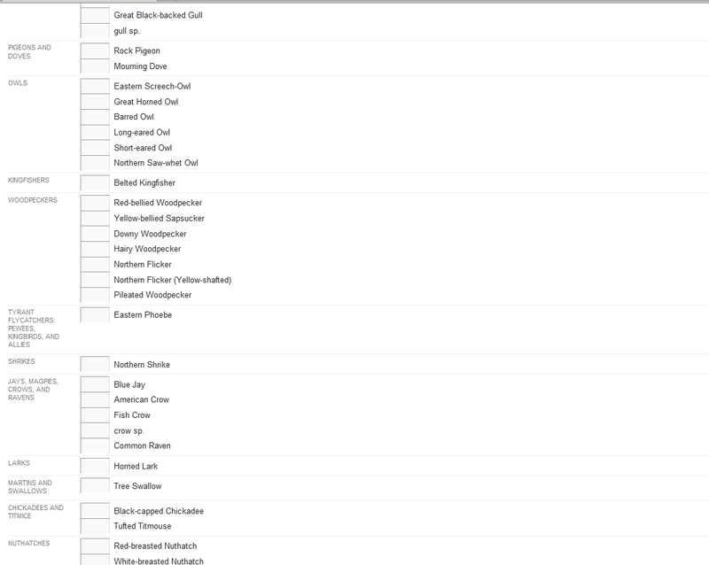
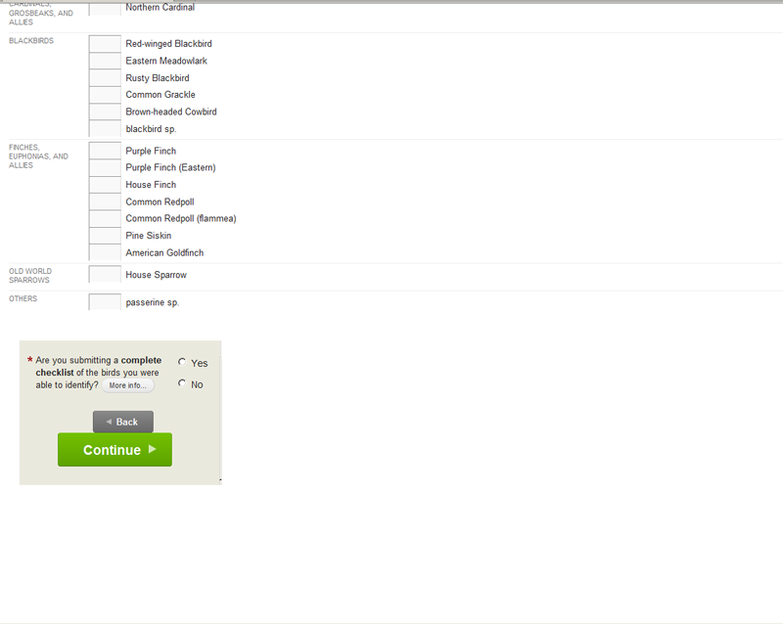
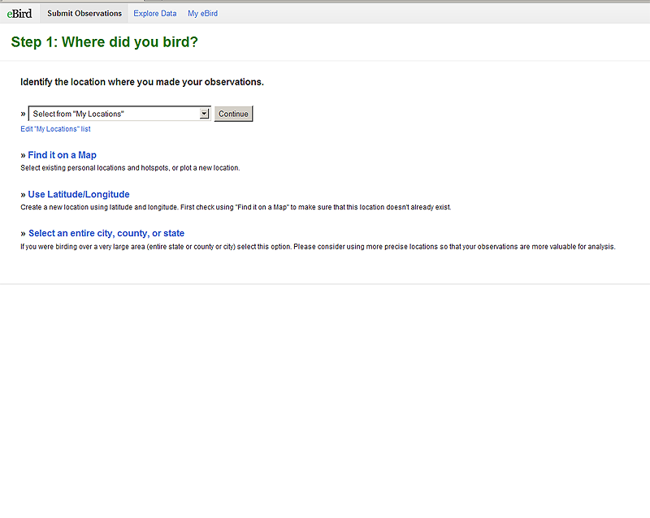

Slide 10
More than…
8.14 million checklists
113 million observations
1.3 million locations
9751 species

Slide 11
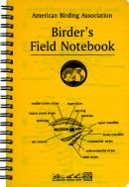
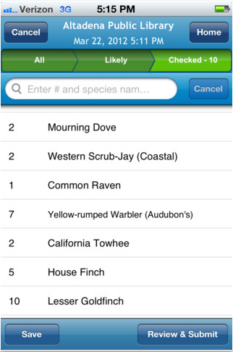
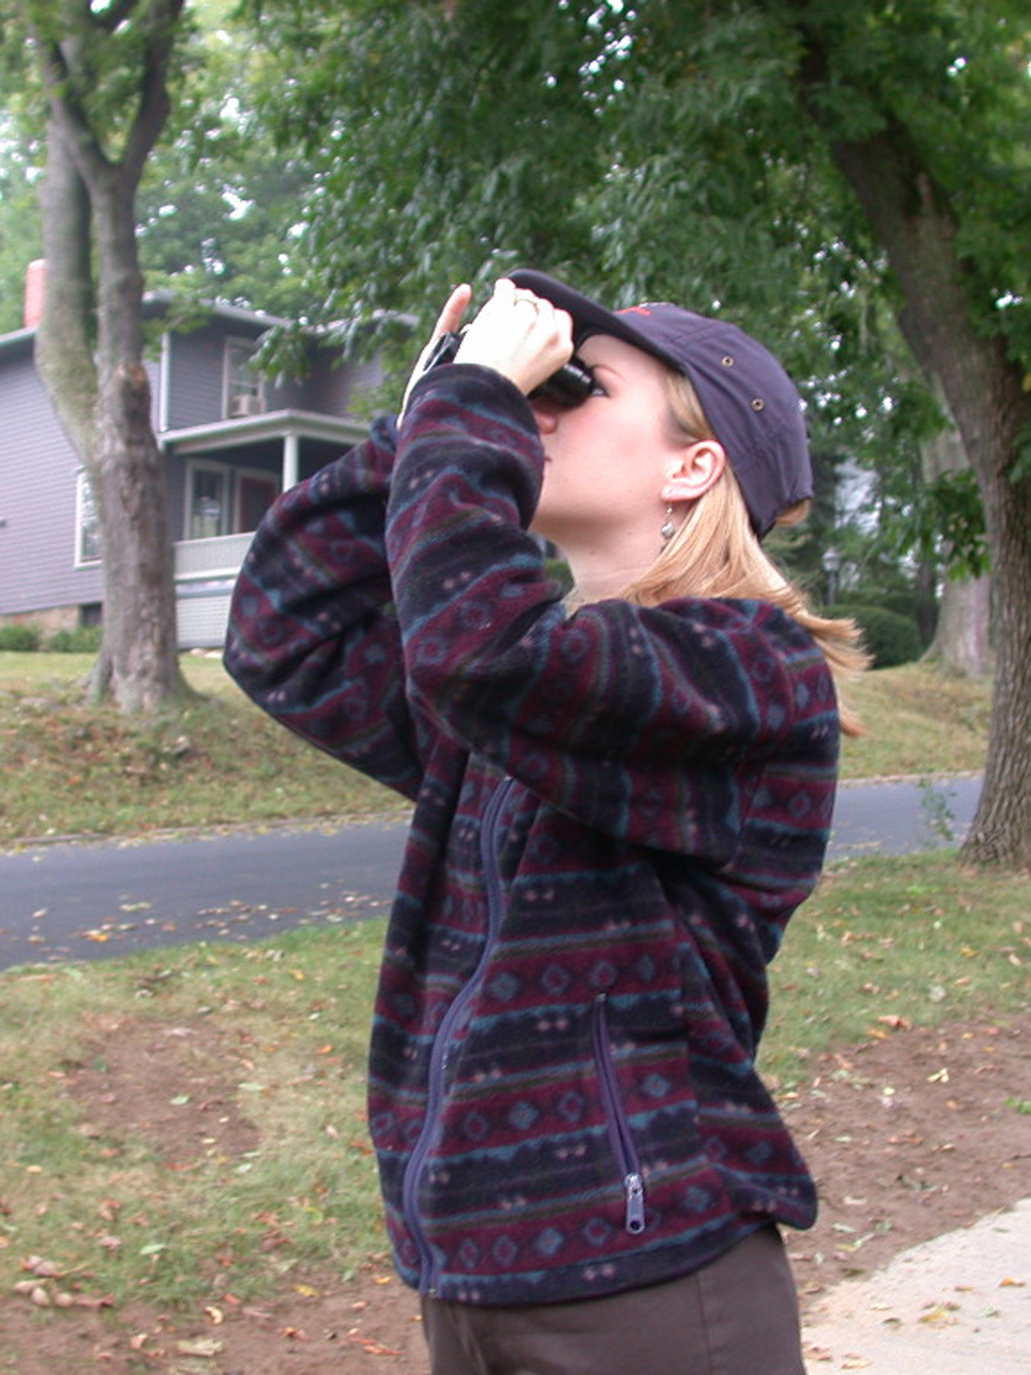
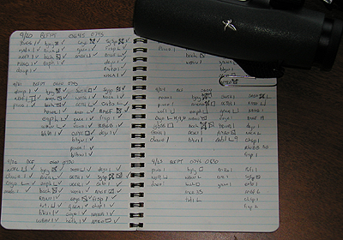
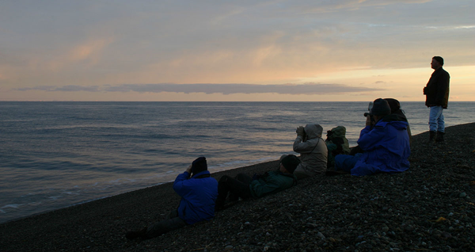
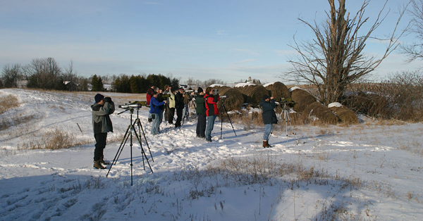
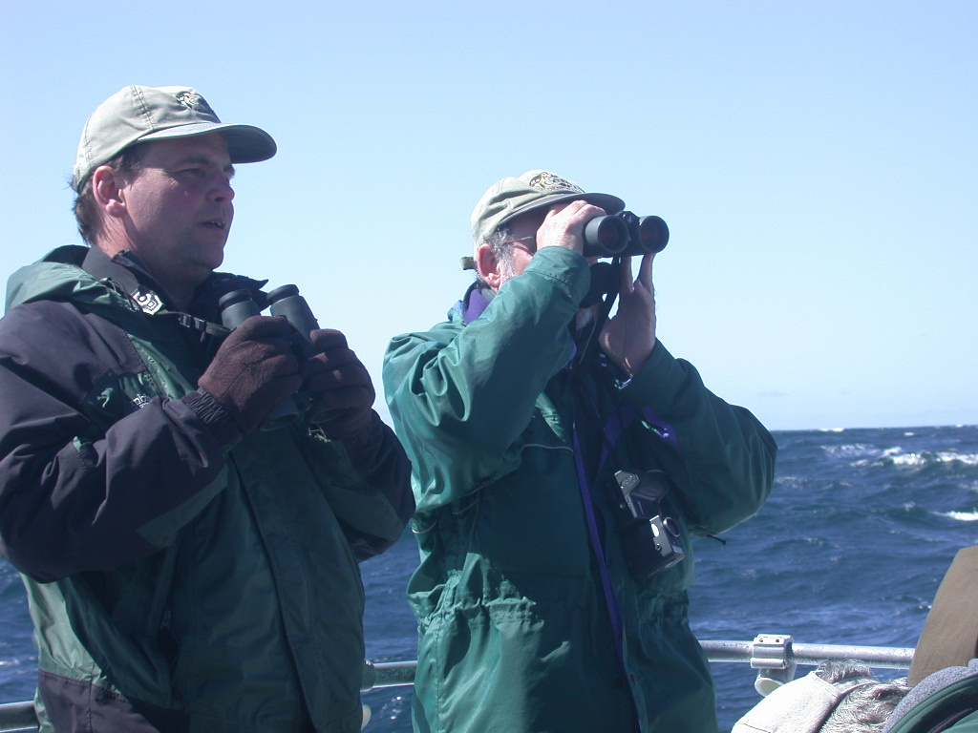
Who Contributes to eBird
And only humans can identify them to species.
A global network of more than 90 thousand contributors.
Notes:
There are many millions of bird watchers globally.
Bird watchers like to keep lists of the birds that they observed
The most serious bird watchers keep detailed records of their observations

Slide 12
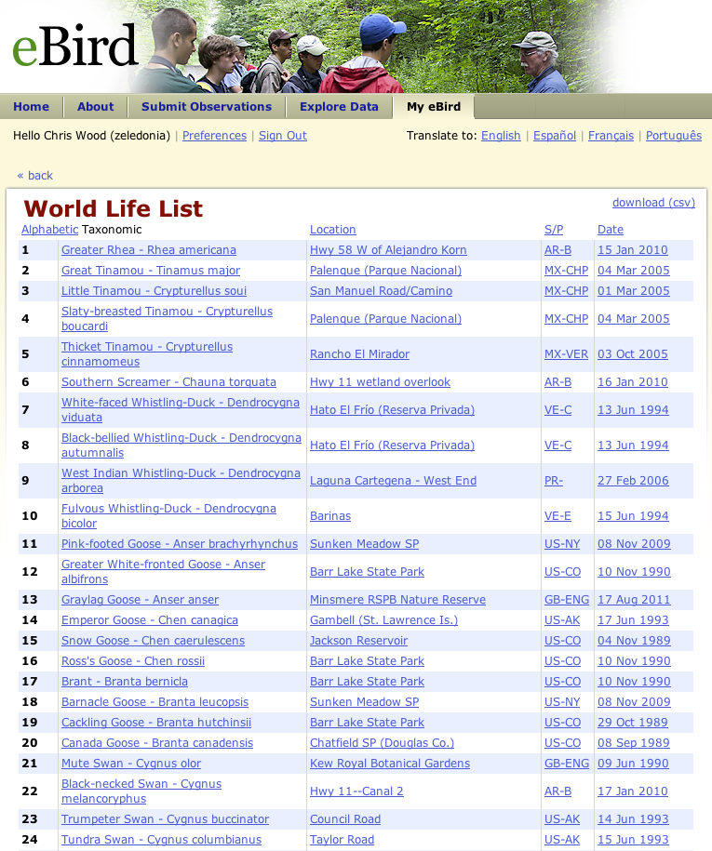
Personal Life List
Notes:
eBird has built a community of birdwatchers by developing the tools and functionality that birdwatchers desire

Slide 13
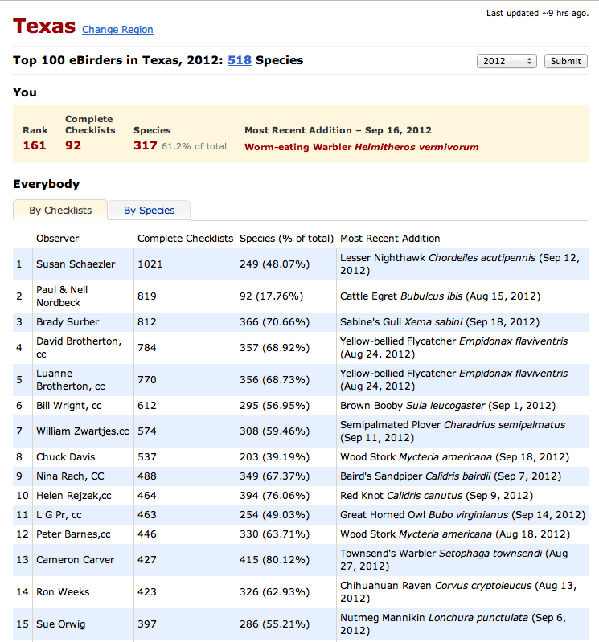
Number of Checklists
Texas 2012

Slide 14
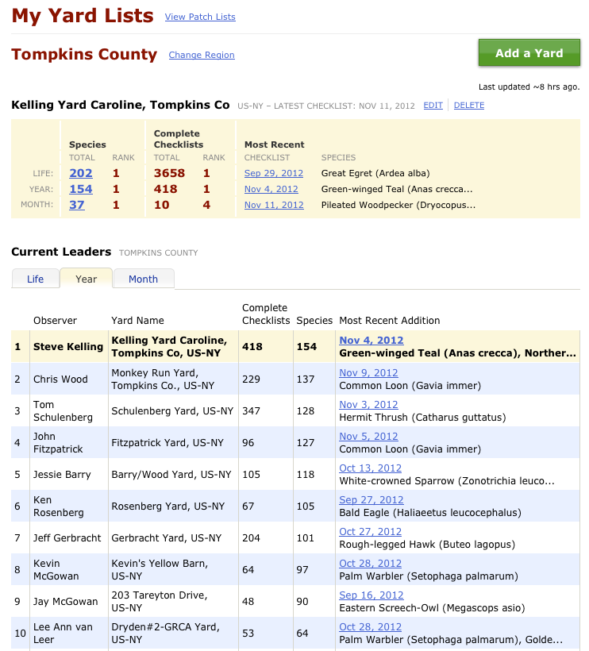
Yard Lists
Tompkins County, NY
Notes:
Steve is killing me. At least I’m ahead of Fitz.
Jeff is way down at number 8.
Iain and Karen can appreciate. The application developers often work harder and may not be able
Wes is number one for most checklist submitted in Tompkins County and Sapsucker Woods.
Lots of games that birders play, we try to bring in as many as we can to motivate them.

Slide 15
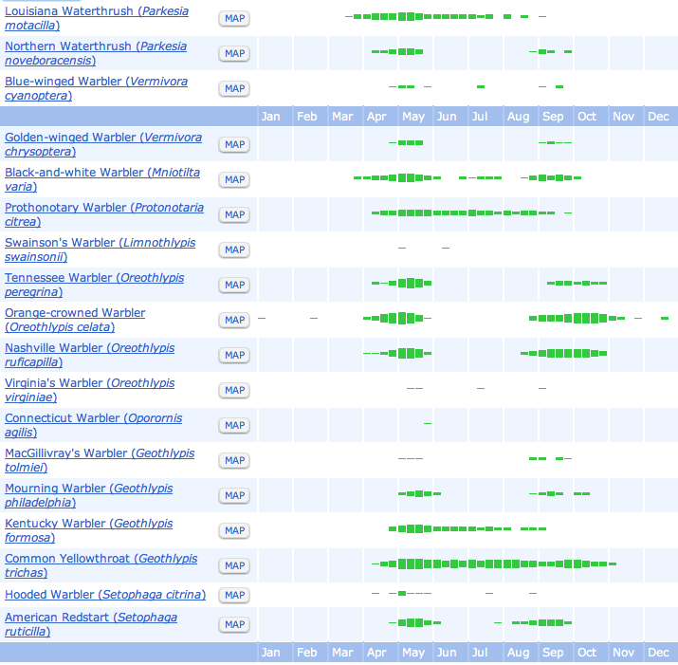
Kansas
Warblers

Slide 16
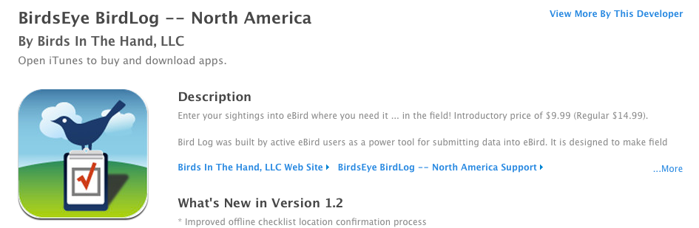
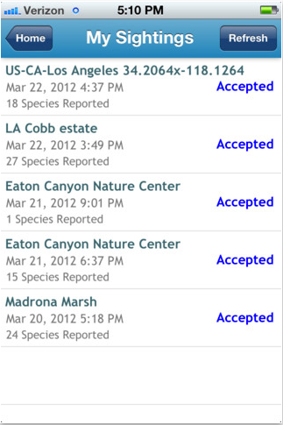
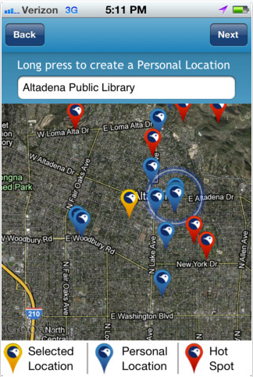
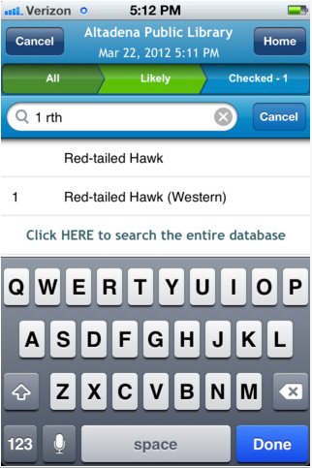
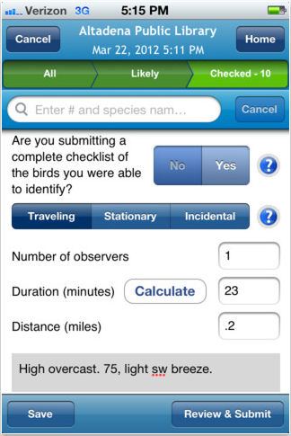

Slide 17
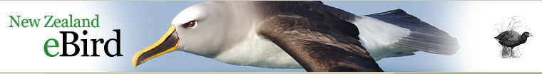
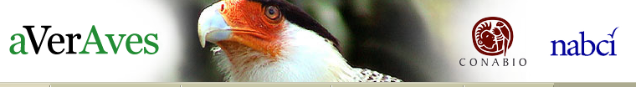
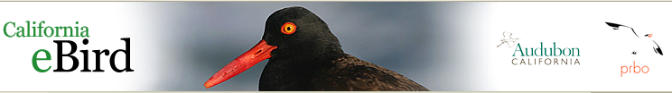
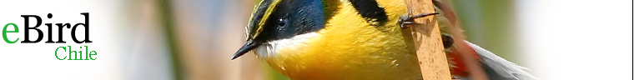
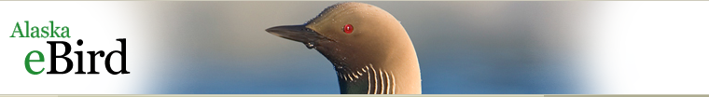
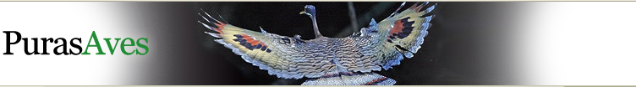
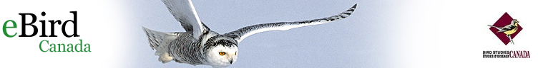
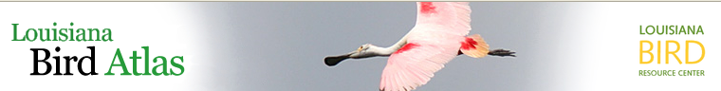
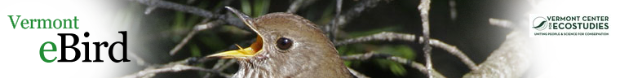
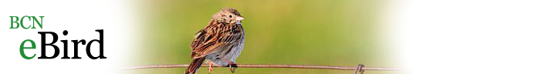
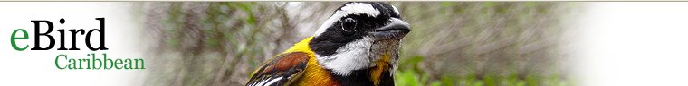
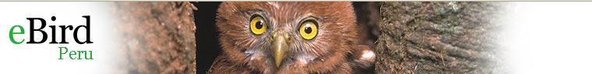
Notes:
eBird is a rapidly growing community of partners. Currently there are more than 25 regional or applied partners

Slide 18
Growth in Monthly eBird Observations and Checklists
eBird 2.0 launch
Observations
Checklists

Slide 19
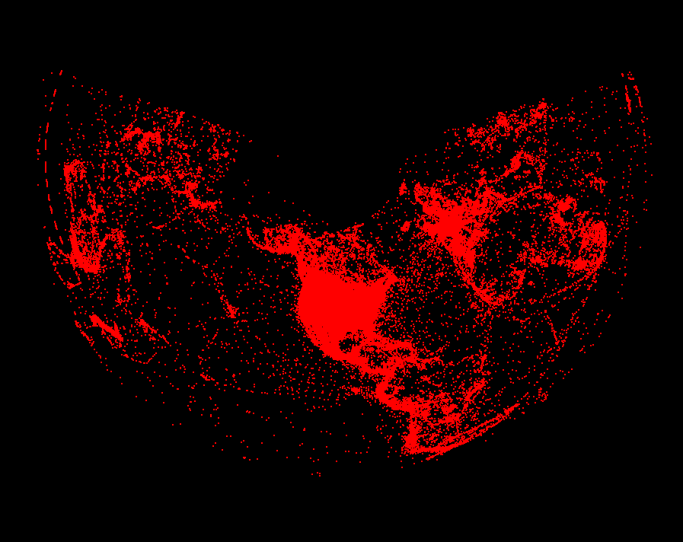
In will volunteer more
than 7,600,000 hours
collecting bird observations.

Slide 20
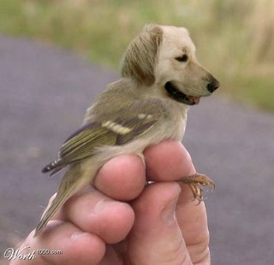
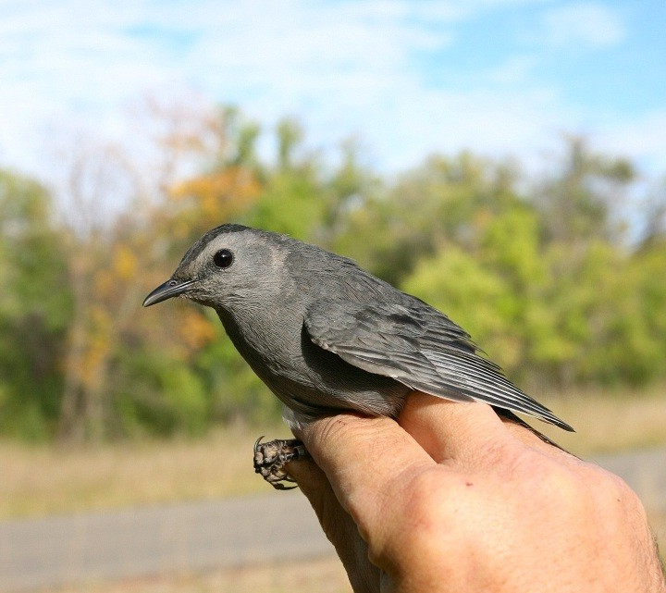
Data Quality
4% submitted records were flagged for review
60% of those records were reviewed and validated
x
Dogbird
Catbird
Notes:
There is no question that eBird data are noisy. Issues of detectability of birds and proper identification are major issues.
Currently a network of more than 500 experts in bird occurrence and identification vet the eBird data
Recently, a new NSF award has allowed us to employ new AI intelligence techniques in machine learning and emergent filter development to continue to improve eBird data

Slide 21
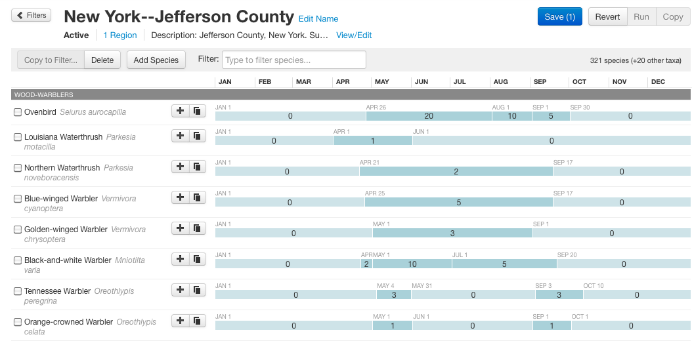
Emergent Filters
Kelling, S., J. Yu, J. Gerbracht, and W. K. Wong. 2011. Emergent Filters: Automated Data Verification in a Large-scale Citizen Science Project. Proceedings of the IEEE eScience Conference.

Slide 22
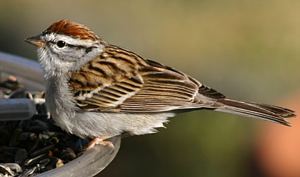
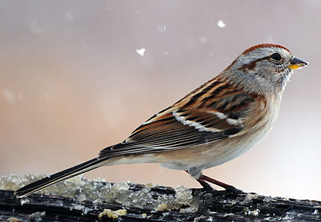

Slide 23
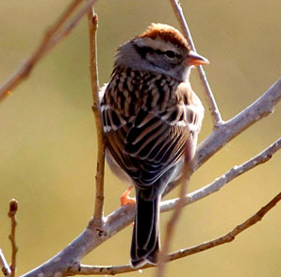
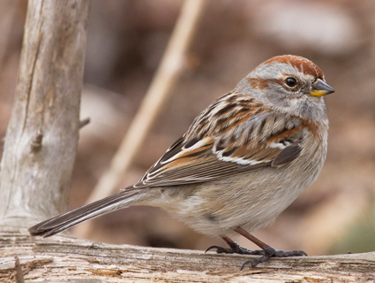

Slide 24
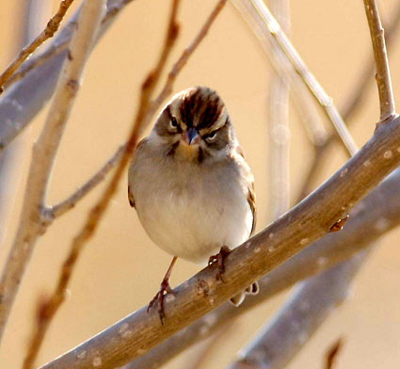
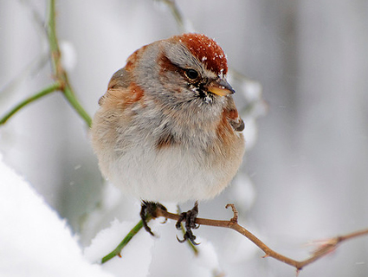

Slide 25

Individual Variation
Novice
Expert

Slide 26
Can we use eBird data to rank observers?
Main issue: birders have different levels of expertise
Novice
Expert

Slide 27

Methodology
Labeled Training Set
Birder ID: 42
Expertise: Expert
Birder ID: 56
Expertise: Novice
Blue Heron X
House Finch √
Purple Finch X
Tree Sparrow √
. . .
Blue Heron X
House Finch √
Purple Finch X
Tree Sparrow √
. . .
Train model
Blue Heron X
House Finch √
Purple Finch X
Tree Sparrow √
. . .
Blue Heron X
House Finch X
Purple Finch X
Tree Sparrow √
. . .
Blue Heron X
House Finch √
Purple Finch X
Tree Sparrow √
. . .
Blue Heron X
House Finch √
Purple Finch X
Tree Sparrow √
. . .
Blue Heron X
House Finch √
Purple Finch X
Tree Sparrow √
. . .
Use model
32 experts (2532 checklists)
88 novices (2107 checklists)

Slide 28
Methodology
Environmental
Covariates
Detection
Covariates
Occupancy (Latent)
Detection
X_{i}
o_{i}
Z_{i}
Y_{it}
d_{it}
W_{it}
t=1,…,T_{i}
i=1,…,N
Start with Occupancy-Detection (OD) model [Mackenzie et al. 2006]
Notes:
28

Slide 29
Methodology
Expertise
Expertise
Covariates
U_{j}
v_{j}
E_{j}
j=1,…,M
o_{i}
Z_{i}
Y_{it}
d_{it}, f_{it}
X_{i}
W_{it}
t=1,…,T_{i}
i=1,…,N
Occupancy-Detection-Expertise (ODE) model

Slide 30
Average Difference in Detection Probability
Common birds
Hard-to-detect birds
Yu, J., W. K. Wong, and R. A. Hutchinson. 2010. Modeling Experts and Novices in Citizen Science Data for Species Distribution Modeling. Data Mining (ICDM), 2010 IEEE 10th International Conference
Notes:
We have yet to implement the ODE models for observer expertise, but we believe that what we will do is weight observations based on the expertise of the observer in the species distribution models that I will describe later

Slide 31
American Tree Sparrow Tompkins Co.

Slide 32
Chipping Sparrow Tompkins Co.

Slide 33
Human Computer Learning Network
S Kelling, C Lagoze, W-K Wong, J Yu, T Damoulas, J Gerbracht, D Fink, C Gomes. 2012. eBird: A Human/Computer Learning Network to Improve Biodiversity Conservation and Research. Artificial Intelligence
Notes:
We call this integration of human computing and machine computing a human computer learning network.
In this case we take advantage of birdwatcher’s ability to identify and count birds, the Internet to connect to a global network of birdwatchers, databases to store data, and new AI techniques to not only provide maps and visualizations of the data but to also feed back to the birdwathcers information about their observations

Slide 34

Notes:
The increasing availability of massive volumes of scientific data requires new synthetic analysis techniques to explore and identify interesting patterns that were otherwise not apparent. For biodiversity studies a “data driven” approach is necessary due to the complexity of ecological systems, particularly when viewed at large spatial and temporal scales.

Slide 35








Observational Data Sources
Sensors, sensor networks, and
remote sensing gather observations
Notes:
There are a wide variety of sensors and sensor networks that gather observational data. Each of these sensors and networks have there own particular biases in calibration and data gathering, as well as detecting phenomena.
While autonomous sensors gather accurate data of many types, they are not useful for collecting species data, a task for which human observers are still needed.
The one sensor network that I am most familiar with is a global network of volunteer observers (citizen scientists) who gather observations of birds.

Slide 36





Observational Data Model

Slide 37



Data Interoperability

Slide 38









High-Performance Computer Modeling Framework
Model results
eBird
Seasonal Occurrence of Indigo Bunting
Land Cover
Jan
Apr
Jun
Sep
Dec
Climate
Potential Uses-
Fine-scale distributions
Examine patterns of migration
Infer impacts of climate change
Measure patterns of habitat use
Measure population trends
MODIS – Remote sensing data
Notes:
In order to map bird distributions throughout their range, and not just where birders go birding, we needed to develop a new computer modeling framework at the Cornell Lab to analyze the massive amounts of eBird data we were collecting….
Under this framework, Observations from eBird – are combined with environmental features like land cover, human population, climate, and other remote sensing data
.
This Huge amount of data can only be analyzed on Supercomputers, and we were able to use the XSEDE High Performance Computing facilities through our NSF partnerships
The results are highly detailed models that can predict the occurrence of bird species through space and time….
38

Slide 39


Slide 40


Slide 41


Slide 42


Slide 43


Slide 44


BirdCast

Slide 45

Forecasting Bird Migration

Slide 46













Modeling and forecasting nocturnal bird migration
Blackpoll Warbler
Swainson’s
Thrush
Canada Warbler
Blackpoll Warbler
Heavy spring flight:
2500 birds/km³
Exodus from coastal plain:
1750 birds/km³
Scattered light rain
Exodus from Cuba:
250 birds/km³
Circum-gulf flight: 1750 birds/km³
Visual Observations + eBird
Topographic Features
Land Cover Features
Notes:
AF

Slide 47
Human Computer Learning Network
S Kelling, C Lagoze, W-K Wong, J Yu, T Damoulas, J Gerbracht, D Fink, C Gomes. 2012. eBird: A Human/Computer Learning Network to Improve Biodiversity Conservation and Research. Artificial Intelligence
Notes:
We call this integration of human computing and machine computing a human computer learning network.
In this case we take advantage of birdwatcher’s ability to identify and count birds, the Internet to connect to a global network of birdwatchers, databases to store data, and new AI techniques to not only provide maps and visualizations of the data but to also feed back to the birdwathcers information about their observations

Slide 48

Merlin
Can a computer ID your bird?
Miyoko Chu
Senior Director, Communications

Slide 49
Building Merlin
eBird
Machine learning
Merlin
Photo identifier
Bird Attributes
Notes:
Here’s an inside look at how we’re building Merlin with dynamic time and location data from eBird; crowdsourced descriptors from thousands of people to populate Merlin’s brain; artificial intelligence to help Merlin make sense of the information, and visual recognition software to recognize birds from photos.

Slide 50



Notes:
But let’s say that you saw this orange bird and the computer asked you questions, listened to your replies, and led you to an intelligent answer.
At the Cornell Lab we’re creating a smart ID tool called Merlin to do just that. (15)

Slide 51

Notes:
And didyou see it?

Slide 52

Notes:
It might ask details such as the approximate size of the bird

Slide 53

Notes:
Or about features such as the main colors you saw.

Slide 54





July 1
Washington, D.C.
Baltimore Oriole
Males are bright orange and black with some white edging on the wings. Females and immature males are yellowish-gray. Look and listen for orioles whistling from treetops in Eastern forests.
Size and Shape
Slightly smaller than American Robin with a long, sharply pointed bill.
Notes:
Merlin will show you the most likely species

Slide 55
Acknowledgements
Art Munson - CS
Daniel Fink - ST
Wesley Hochachka - EC
Denis Lepage - IN
Rich Caruana - CS
Mirek Riedewald - CS
Daria Sorokina - CS
Kevin Webb - IN
Giles Hooker - ST
Brian Sullivan - OR
Chris Wood - OR
Marshall Iliff – OR
Andrew Farnsworth – OR
David Winkler – OR
Jeff Gerbracht – IN
Tim Lenz- IN
Tom Fredericks- IN
Will Morris- IN
Carla Gomes - CS
Tom Dietterich - CS
Daniel Sheldon - CS
Ken Rosenberg - OR
Rebecca Hutchinson - CS
Weng-Keen Wong – CS
Jun Yu- CS
Stefan Hames – OR
Frank La Sorte - ST
Theo Damoulas - CS
Bistra Dilkina - CS
Bill Michener - IN
Bob Cook - IN
Jeff Morrisette - ST
Juliana Freire - CS
Claudio Silva -CS
Matt Jones - IN
Suresh SanthanaVannan – IN
Carl Lagoze - CS
CS- Computer Science
ST- Statistics
IN- Informatics/Programming
OR- Ornithology

