Slide 1


Slide 2



NSF Expeditions in
Computational Sustainability
Head PI: Carla Gomes
David R. Schneider, drs44@cornell.edu

Slide 3

Broader Impacts Goals:

Slide 4
Broader Impacts Goals:
To Increase the General Awareness of the New Field of Computational Sustainability

Slide 5
Broader Impacts Goals:
To Increase the General Awareness of the New Field of Computational Sustainability
Create a motivating experience to help students recognize the social value of computer science and empower them to realize that they can make a difference through computer science

Slide 6
The Need is Great…

Slide 7
The Need is Great…
The U.S. Bureau of Labor Statistics:
"Computer software engineers, application" jobs are expected to grow by over 34% during 2008-2018.^{[1]}

Slide 8
The Need is Great…
The U.S. Bureau of Labor Statistics:
"Computer software engineers, application" jobs are expected to grow by over 34% during 2008-2018.^{[1]}
The Computer Research Association (CRA): Bachelor's computer science enrollment has decreased by approximately 40% since 2002.^{[2]}

Slide 9
The Need is Great…
The U.S. Bureau of Labor Statistics:
"Computer software engineers, application" jobs are expected to grow by over 34% during 2008-2018.^{[1]}
The Computer Research Association (CRA): Bachelor's computer science enrollment has decreased by approximately 40% since 2002.^{[2]}
More information:
[1] http://www.bls.gov/emp/ep_table_104.htm
[2] Most clearly seen in CRA 2007-2008 Taulbee Survey,
Page 11, Figure 7, published May 2009.

Slide 10
Expedition Grants are
an Opportunity to Inspire
Notes:
Each Edutainment Video Game:
Teaches a different set of algorithms & CS principles
Focuses on a different sustainability issue
Offers a different & unique style of gameplay
Targets a different demographic (rural, urban, women, etc.)

Slide 11
Expedition Grants are
an Opportunity to Inspire
Today’s students are:
Sensitive to today’s energy, environmental, & economic crises
Seeking ways to make a social difference
Concerned about their own personal futures & careers
Notes:
Each Edutainment Video Game:
Teaches a different set of algorithms & CS principles
Focuses on a different sustainability issue
Offers a different & unique style of gameplay
Targets a different demographic (rural, urban, women, etc.)

Slide 12
Expedition Grants are
an Opportunity to Inspire
Today’s students are:
Sensitive to today’s energy, environmental, & economic crises
Seeking ways to make a social difference
Concerned about their own personal futures & careers
The Creation of 5 Edutainment Video Games
The fastest growing form of entertainment
underrepresented populations
Notes:
Each Edutainment Video Game:
Teaches a different set of algorithms & CS principles
Focuses on a different sustainability issue
Offers a different & unique style of gameplay
Targets a different demographic (rural, urban, women, etc.)

Slide 13
Expedition Grants are
an Opportunity to Inspire
Today’s students are:
Sensitive to today’s energy, environmental, & economic crises
Seeking ways to make a social difference
Concerned about their own personal futures & careers
The Creation of 5 Edutainment Video Games
The fastest growing form of entertainment
underrepresented populations
Target Middle School students
When Career impressions are formed
Notes:
Each Edutainment Video Game:
Teaches a different set of algorithms & CS principles
Focuses on a different sustainability issue
Offers a different & unique style of gameplay
Targets a different demographic (rural, urban, women, etc.)

Slide 14
Expedition Grants are
an Opportunity to Inspire
Today’s students are:
Sensitive to today’s energy, environmental, & economic crises
Seeking ways to make a social difference
Concerned about their own personal futures & careers
The Creation of 5 Edutainment Video Games
The fastest growing form of entertainment
underrepresented populations
Target Middle School students
When Career impressions are formed
Freely available & downloadable
Notes:
Each Edutainment Video Game:
Teaches a different set of algorithms & CS principles
Focuses on a different sustainability issue
Offers a different & unique style of gameplay
Targets a different demographic (rural, urban, women, etc.)

Slide 15
Expedition Grants are
an Opportunity to Inspire
Today’s students are:
Sensitive to today’s energy, environmental, & economic crises
Seeking ways to make a social difference
Concerned about their own personal futures & careers
The Creation of 5 Edutainment Video Games
The fastest growing form of entertainment
underrepresented populations
Target Middle School students
When Career impressions are formed
Freely available & downloadable
Inspired by the research of this grant
Notes:
Each Edutainment Video Game:
Teaches a different set of algorithms & CS principles
Focuses on a different sustainability issue
Offers a different & unique style of gameplay
Targets a different demographic (rural, urban, women, etc.)

Slide 16
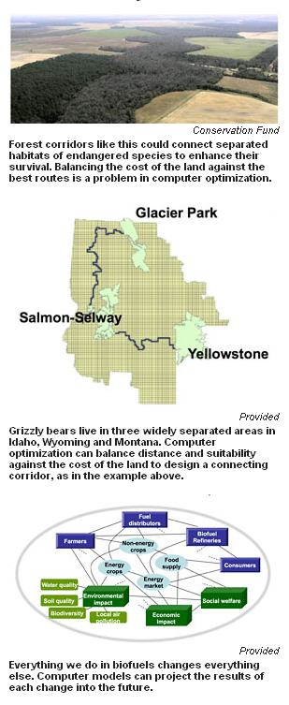
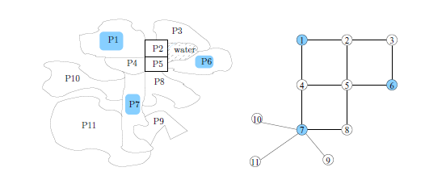
Grizzly Bear Corridor Research
“CALS Newsroom: Cornell to help grizzly bears mate and to stabilize tuna populations” http://www.cals.cornell.edu/cals/public/comm/news/computational_sustainability.cfm, Cornell Press Relations Office, Sept 3,2008
Jon Conrad, Carla P. Gomes, Willem Jan Van Hoeve, Ashish Sabharwal, Jordan Suter “Connections in Networks: Hardness of Feasibility Versus Optimality”, CPAIOR, 2007

Slide 17
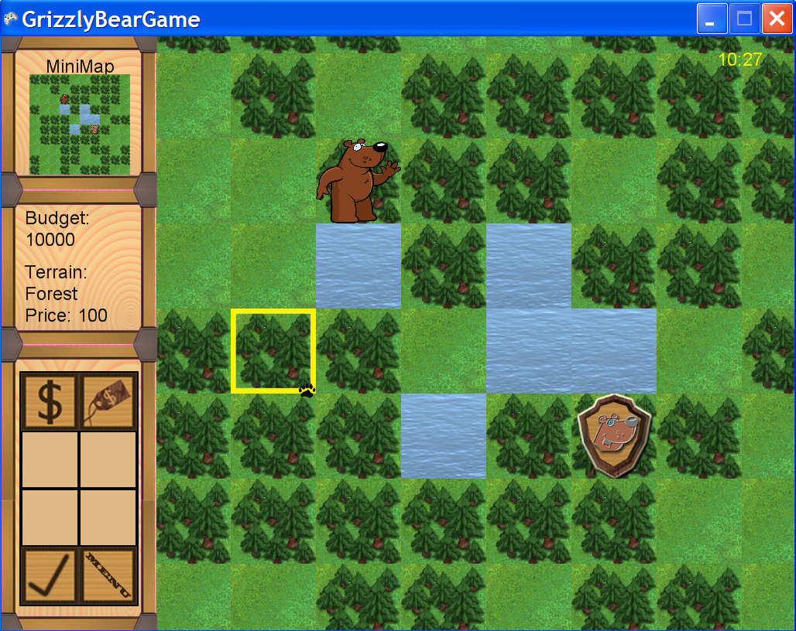

Slide 18
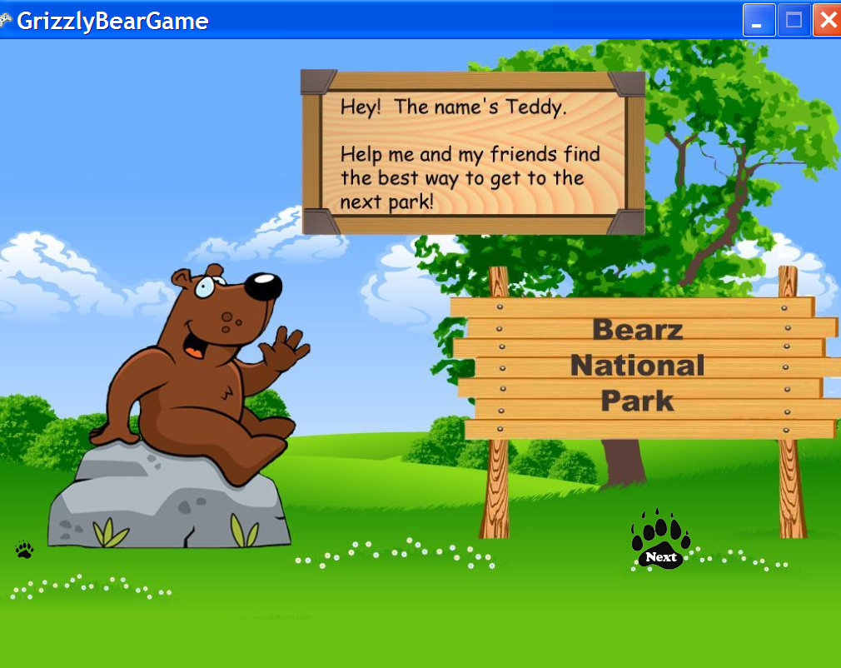

Slide 20




Slide 21
Edutainment Game Summaries
Game
Name
Computer
Science
Sustainability
Issue
Target
Audience
Gameplay
Style
Bear Necessities
Midnight Drivers
Lumber Rescue
Piscary
YourTown

Slide 22
Edutainment Game Summaries
Game
Name
Computer
Science
Sustainability
Issue
Target
Audience
Gameplay
Style
Dijkstra’s Shortest Path, Utility, A*, Steiner Trees, Local Optimization
Bear Necessities
Graphical Representation, Greedy Approximation, Minimum Spanning Tree, Traveling Salesman, 2-Opt
Midnight Drivers
Pattern Recognition, Genetic Programming, Probability, Path Planning, Obstacle Avoidance,
Lumber Rescue
Interval Scheduling, Weighted Interval Scheduling, Sorting,
Piscary
Constraint Determination, Graphing, Optimization Techniques, Linear Prog.
YourTown

Slide 23
Edutainment Game Summaries
Game
Name
Computer
Science
Sustainability
Issue
Target
Audience
Gameplay
Style
Dijkstra’s Shortest Path, Utility, A*, Steiner Trees, Local Optimization
Habitat Management
Bear Necessities
Graphical Representation, Greedy Approximation, Minimum Spanning Tree, Traveling Salesman, 2-Opt
Midnight Drivers
Fuel Conservation, Transportation Routing
Pattern Recognition, Genetic Programming, Probability, Path Planning, Obstacle Avoidance,
Lumber Rescue
Resource Management
Interval Scheduling, Weighted Interval Scheduling, Sorting,
Piscary
Wildlife Management
Constraint Determination, Graphing, Optimization Techniques, Linear Prog.
YourTown
Sustainability Triangle

Slide 24
Edutainment Game Summaries
Game
Name
Computer
Science
Sustainability
Issue
Target
Audience
Gameplay
Style
Dijkstra’s Shortest Path, Utility, A*, Steiner Trees, Local Optimization
Habitat Management
Rural Students,
Nature Lovers
Bear Necessities
Graphical Representation, Greedy Approximation, Minimum Spanning Tree, Traveling Salesman, 2-Opt
Midnight Drivers
Fuel Conservation, Transportation Routing
Urban Students
Pattern Recognition, Genetic Programming, Probability, Path Planning, Obstacle Avoidance,
Lumber Rescue
Resource Management
Blue Collar Backgrounds
Interval Scheduling, Weighted Interval Scheduling, Sorting,
Piscary
Wildlife Management
Coastal Towns
Fish Lovers
Constraint Determination, Graphing, Optimization Techniques, Linear Prog.
YourTown
Sustainability Triangle
Women

Slide 25
Edutainment Game Summaries
Game
Name
Computer
Science
Sustainability
Issue
Target
Audience
Gameplay
Style
Dijkstra’s Shortest Path, Utility, A*, Steiner Trees, Local Optimization
Habitat Management
Rural Students,
Nature Lovers
Bear Necessities
Boardgame
Graphical Representation, Greedy Approximation, Minimum Spanning Tree, Traveling Salesman, 2-Opt
Midnight Drivers
Fuel Conservation, Transportation Routing
Urban Students
Racing
Pattern Recognition, Genetic Programming, Probability, Path Planning, Obstacle Avoidance,
Lumber Rescue
Resource Management
Blue Collar Backgrounds
Puzzle
Interval Scheduling, Weighted Interval Scheduling, Sorting,
Real-
Time
Strategy
Piscary
Wildlife Management
Coastal Towns
Fish Lovers
Constraint Determination, Graphing, Optimization Techniques, Linear Prog.
YourTown
Sustainability Triangle
Women
Simulation

Slide 26
Innovative Approach to Edutainment
Notes:
Motivated formal research on the effectiveness of this approach to be conducted this summer

Slide 27
Innovative Approach to Edutainment
If games can be used to create a scenario where the educational material will help the player succeed in the game…
Notes:
Motivated formal research on the effectiveness of this approach to be conducted this summer

Slide 28
Innovative Approach to Edutainment
If games can be used to create a scenario where the educational material will help the player succeed in the game…
…the educational material will have a higher perceived value and the player will be inclined to master the material on their own in order to master the game.
Notes:
Motivated formal research on the effectiveness of this approach to be conducted this summer

Slide 29
Designing Games with Edu. Material directly integrated with the game’s Reward System

Slide 30
Designing Games with Educational Material directly integrated with the game’s Reward System.
Design Methodology
Implementation Enhancements
The Game presents the players with an easily understood objective

Slide 31
Designing Games with Educational Material directly integrated with the game’s Reward System.
Design Methodology
Implementation Enhancements
The Game presents the players with an easily understood objective
Minimal instruction presented in as interactive a means as possible

Slide 32
Designing Games with Educational Material directly integrated with the game’s Reward System.
Design Methodology
Implementation Enhancements
The Game presents the players with an easily understood objective
The students “experiment” in trying to meet that objective and gain intuition regarding the problem objective (they play the game)
Minimal instruction presented in as interactive a means as possible

Slide 33
Designing Games with Educational Material directly integrated with the game’s Reward System.
Design Methodology
Implementation Enhancements
The Game presents the players with an easily understood objective
The students “experiment” in trying to meet that objective and gain intuition regarding the problem objective (they play the game)
Minimal instruction presented in as interactive a means as possible
Easy levels with easier success to help build confidence

Slide 34
Designing Games with Educational Material directly integrated with the game’s Reward System.
Design Methodology
Implementation Enhancements
The Game presents the players with an easily understood objective
The students “experiment” in trying to meet that objective and gain intuition regarding the problem objective (they play the game)
The game difficulty increases to a point where the educational material will significantly help the student improve their performance
Minimal instruction presented in as interactive a means as possible
Easy levels with easier success to help build confidence

Slide 35
Designing Games with Educational Material directly integrated with the game’s Reward System.
Design Methodology
Implementation Enhancements
The Game presents the players with an easily understood objective
The students “experiment” in trying to meet that objective and gain intuition regarding the problem objective (they play the game)
The game difficulty increases to a point where the educational material will significantly help the student improve their performance
Minimal instruction presented in as interactive a means as possible
Easy levels with easier success to help build confidence
It’s a bit harder but they’ve “won” a new ability
Highly interactive tutorial to explain the
educational material

Slide 36
Designing Games with Educational Material directly integrated with the game’s Reward System.
Design Methodology
Implementation Enhancements
The Game presents the players with an easily understood objective
The students “experiment” in trying to meet that objective and gain intuition regarding the problem objective (they play the game)
The game difficulty increases to a point where the educational material will significantly help the student improve their performance
The educational material now has a higher perceived value to student
Minimal instruction presented in as interactive a means as possible
Easy levels with easier success to help build confidence
It’s a bit harder but they’ve “won” a new ability
Highly interactive tutorial to explain the
educational material

Slide 37
Designing Games with Educational Material directly integrated with the game’s Reward System.
Design Methodology
Implementation Enhancements
The Game presents the players with an easily understood objective
The students “experiment” in trying to meet that objective and gain intuition regarding the problem objective (they play the game)
The game difficulty increases to a point where the educational material will significantly help the student improve their performance
The educational material now has a higher perceived value to student
Minimal instruction presented in as interactive a means as possible
Easy levels with easier success to help build confidence
It’s a bit harder but they’ve “won” a new ability
Highly interactive tutorial to explain the
educational material
Enhanced by additional reward mechanisms for performing well in the tutorial (bonus pts)

Slide 38
Designing Games with Educational Material directly integrated with the game’s Reward System.
Design Methodology
Implementation Enhancements
The Game presents the players with an easily understood objective
The students “experiment” in trying to meet that objective and gain intuition regarding the problem objective (they play the game)
The game difficulty increases to a point where the educational material will significantly help the student improve their performance
The educational material now has a higher perceived value to student
This will lead to a desire to learn and then master their ability to apply these ideas
Minimal instruction presented in as interactive a means as possible
Easy levels with easier success to help build confidence
It’s a bit harder but they’ve “won” a new ability
Highly interactive tutorial to explain the
educational material
Enhanced by additional reward mechanisms for performing well in the tutorial (bonus pts)

Slide 39
Designing Games with Educational Material directly integrated with the game’s Reward System.
Design Methodology
Implementation Enhancements
The Game presents the players with an easily understood objective
The students “experiment” in trying to meet that objective and gain intuition regarding the problem objective (they play the game)
The game difficulty increases to a point where the educational material will significantly help the student improve their performance
The educational material now has a higher perceived value to student
This will lead to a desire to learn and then master their ability to apply these ideas
Minimal instruction presented in as interactive a means as possible
Easy levels with easier success to help build confidence
It’s a bit harder but they’ve “won” a new ability
Highly interactive tutorial to explain the
educational material
Enhanced by additional reward mechanisms for performing well in the tutorial (bonus pts)
Followed by a scenario of similar difficulty as the one just prior to the tutorial and where the educational material offers the player a significant advantage or benefit

Slide 40
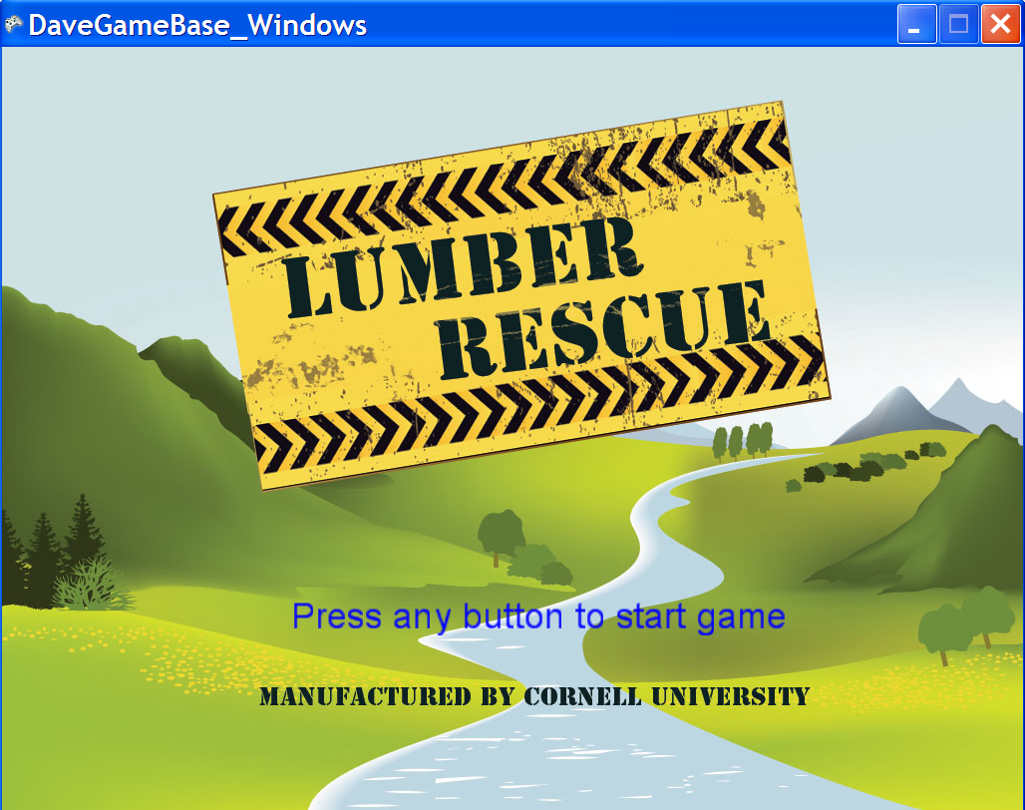

Slide 41
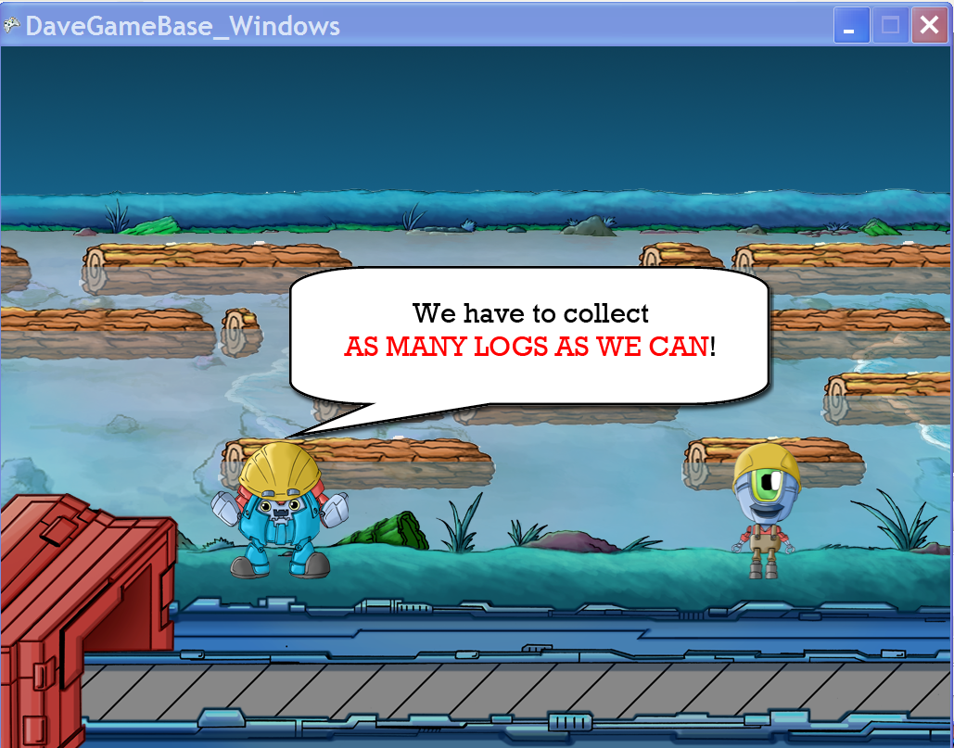

Slide 42
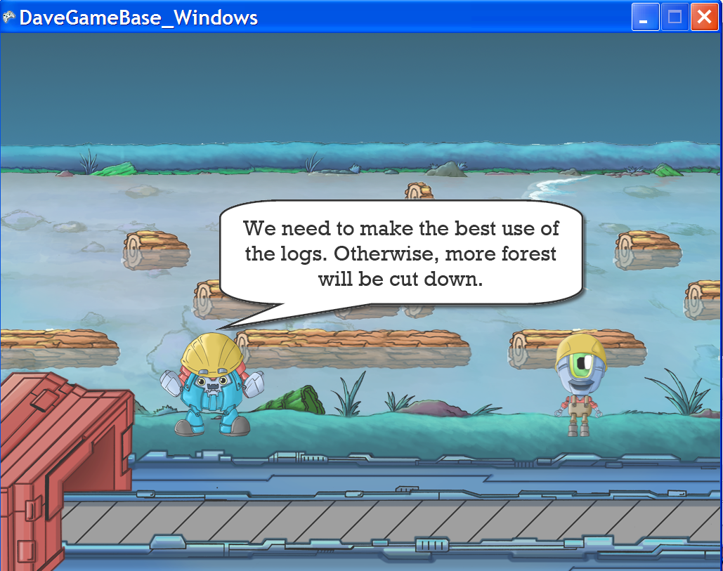

Slide 43
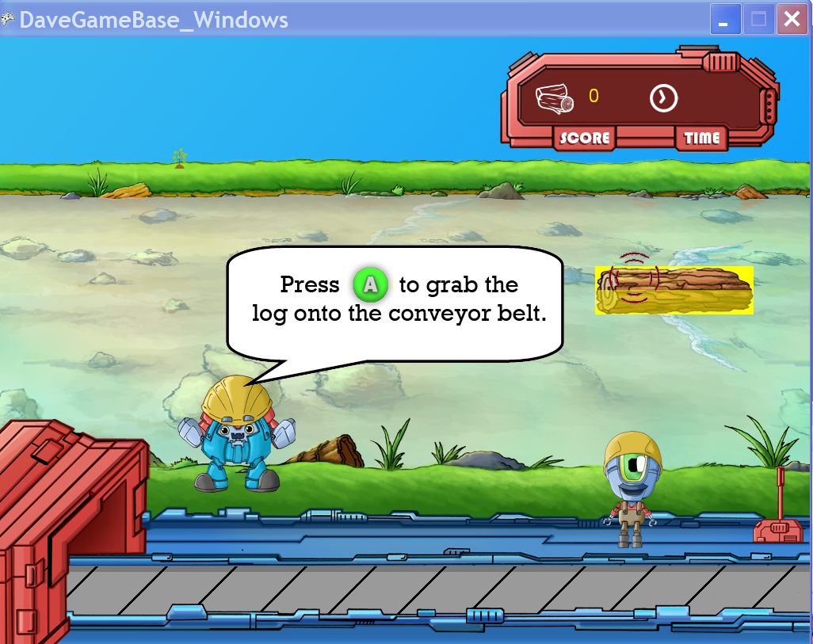

Slide 44
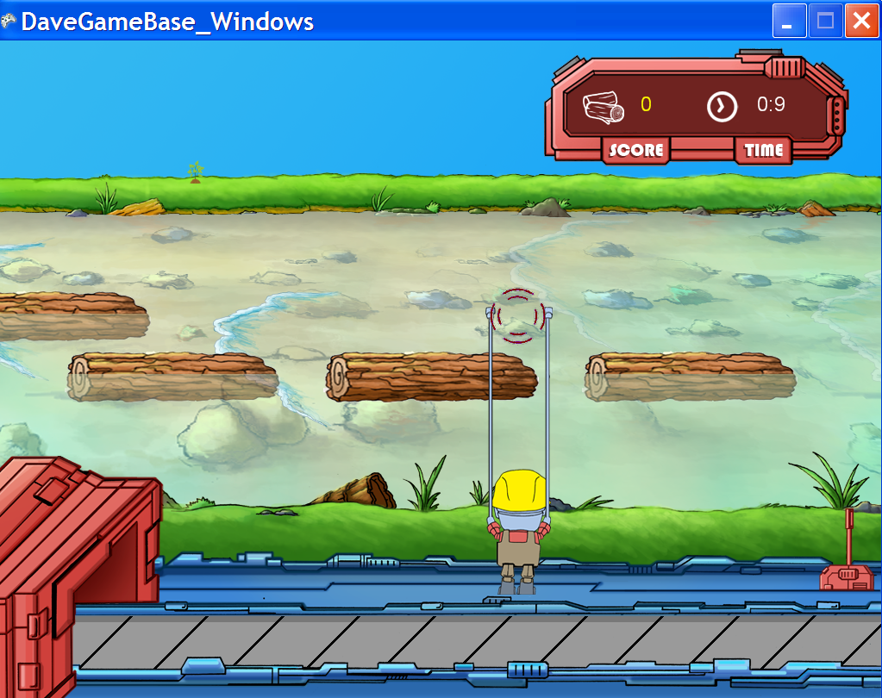

Slide 45
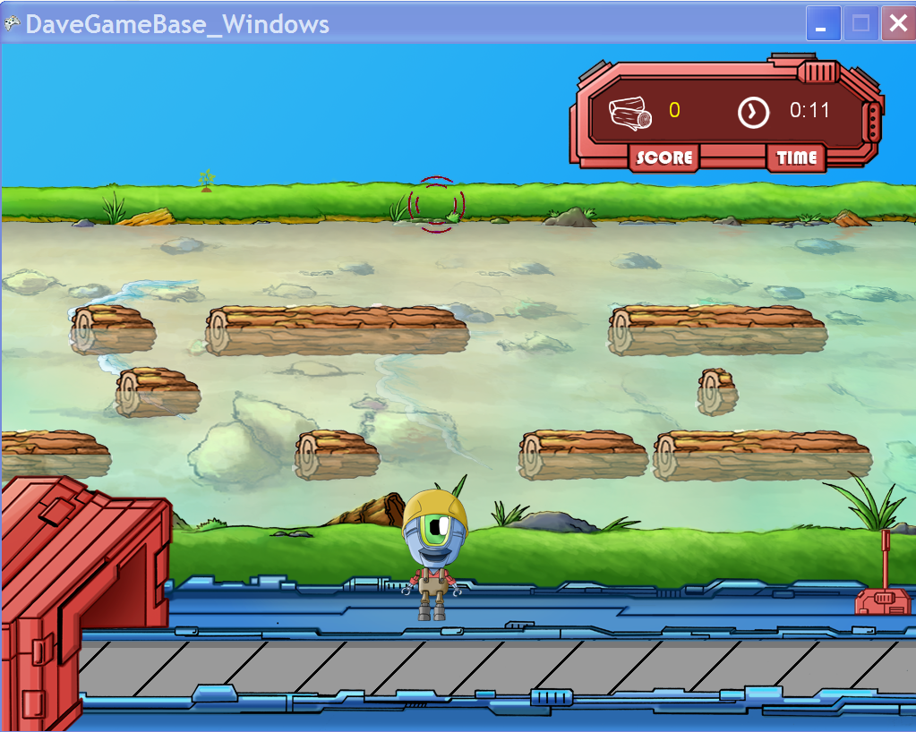

Slide 46
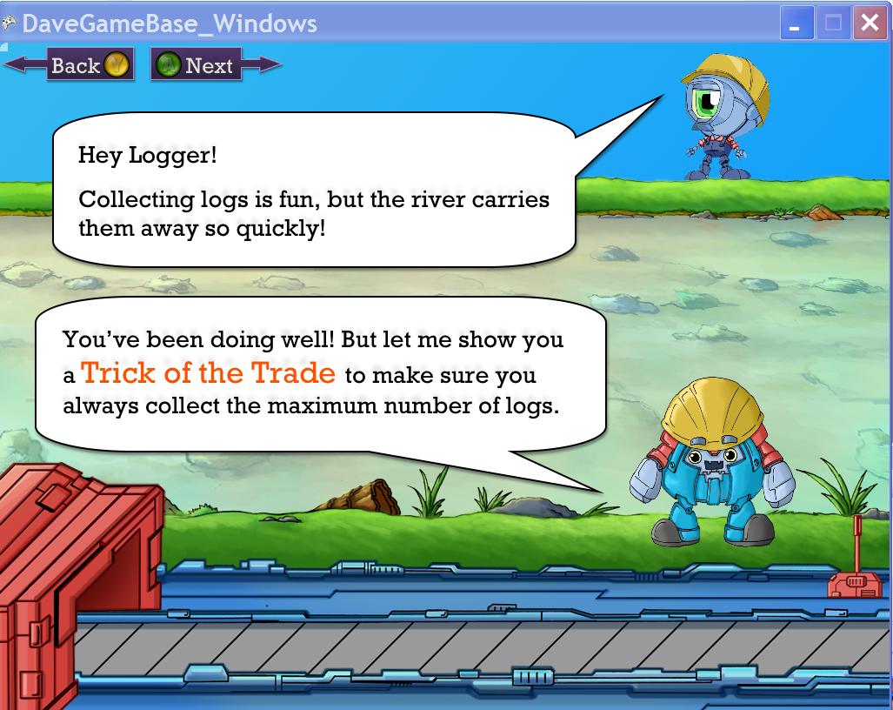

Slide 47
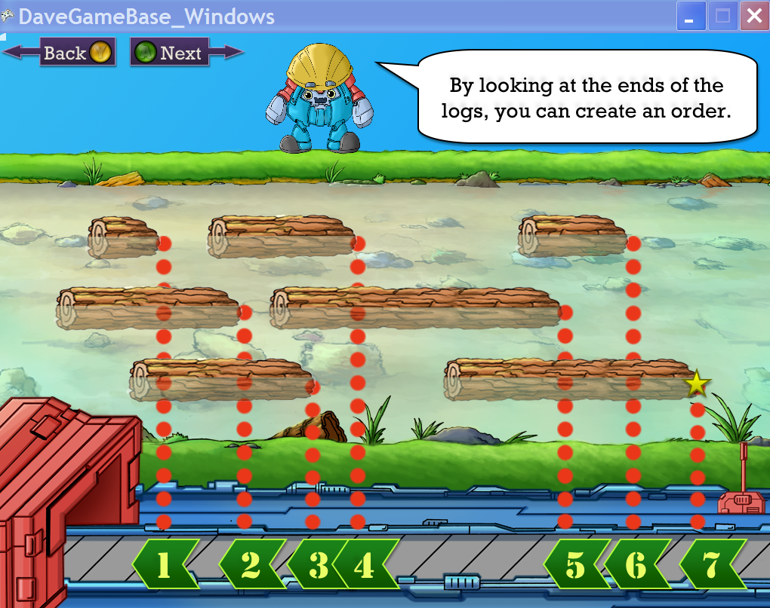

Slide 48
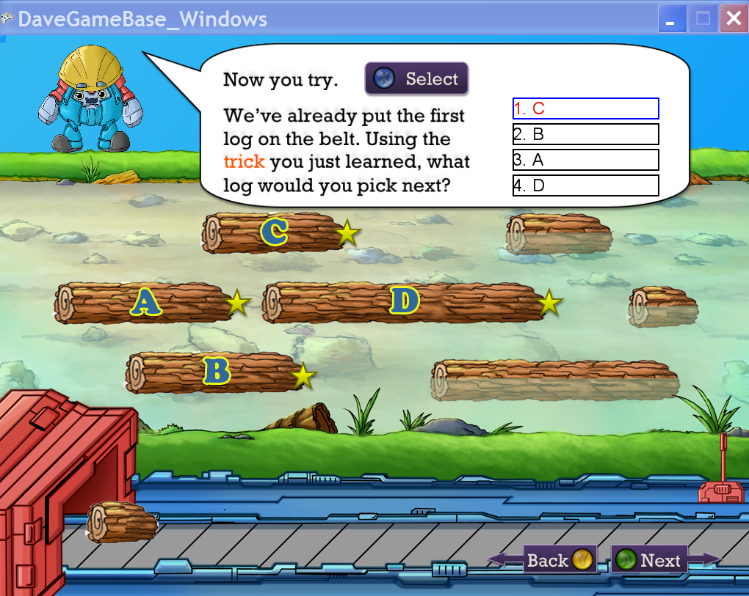

Slide 49
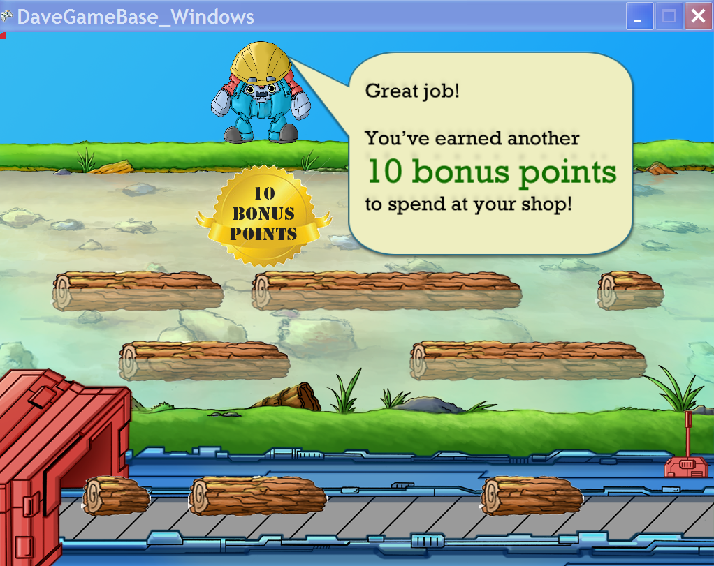

Slide 50
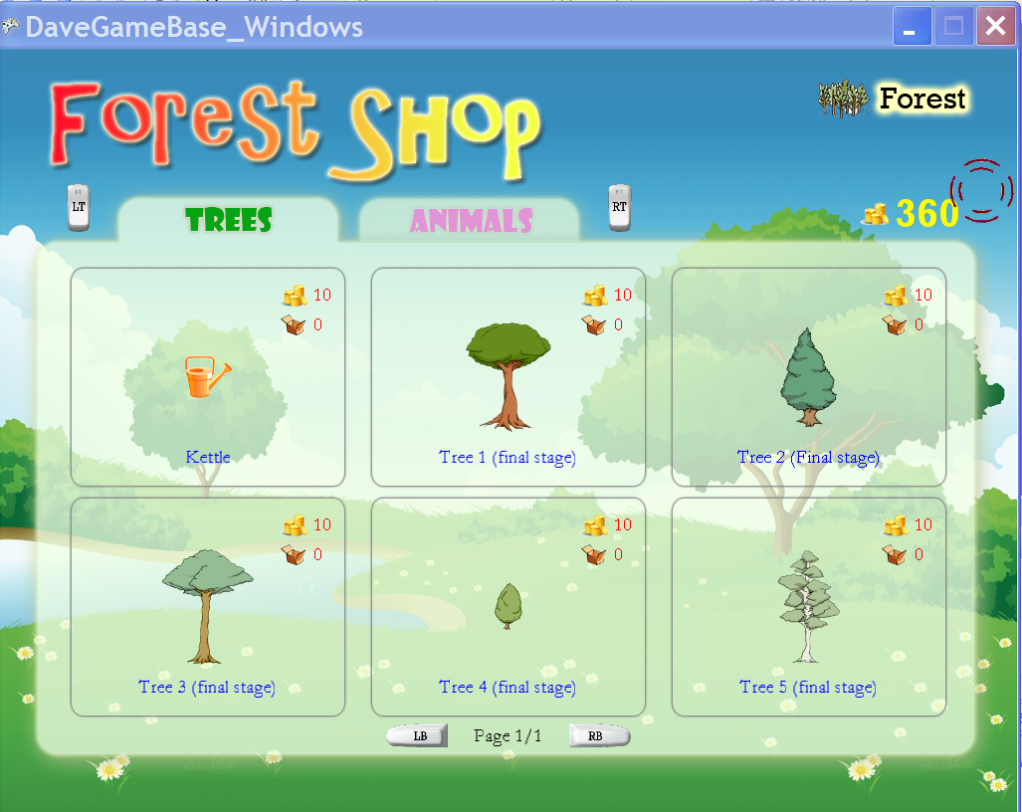
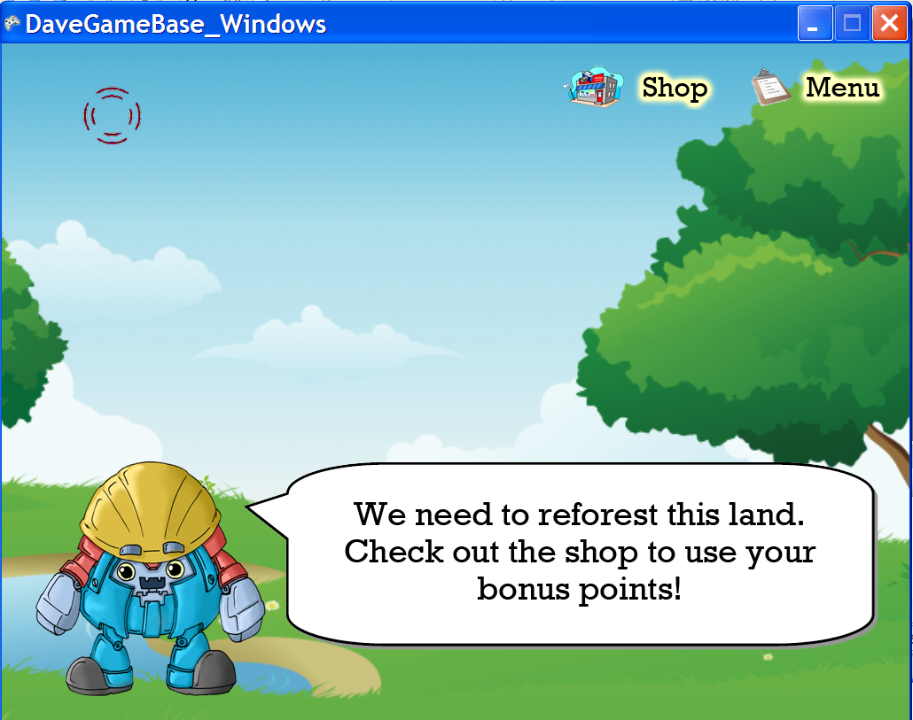

Slide 51
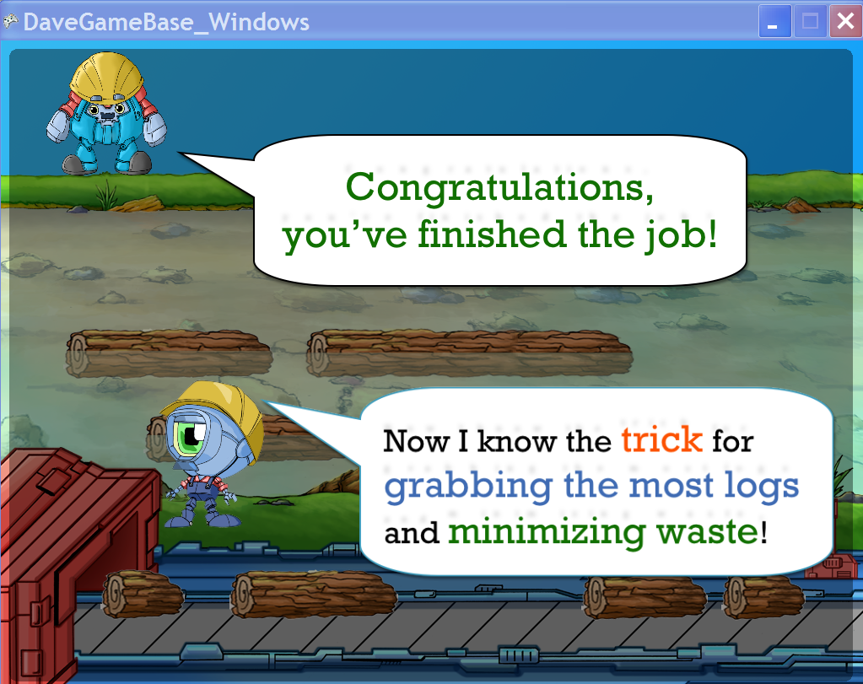

Slide 52
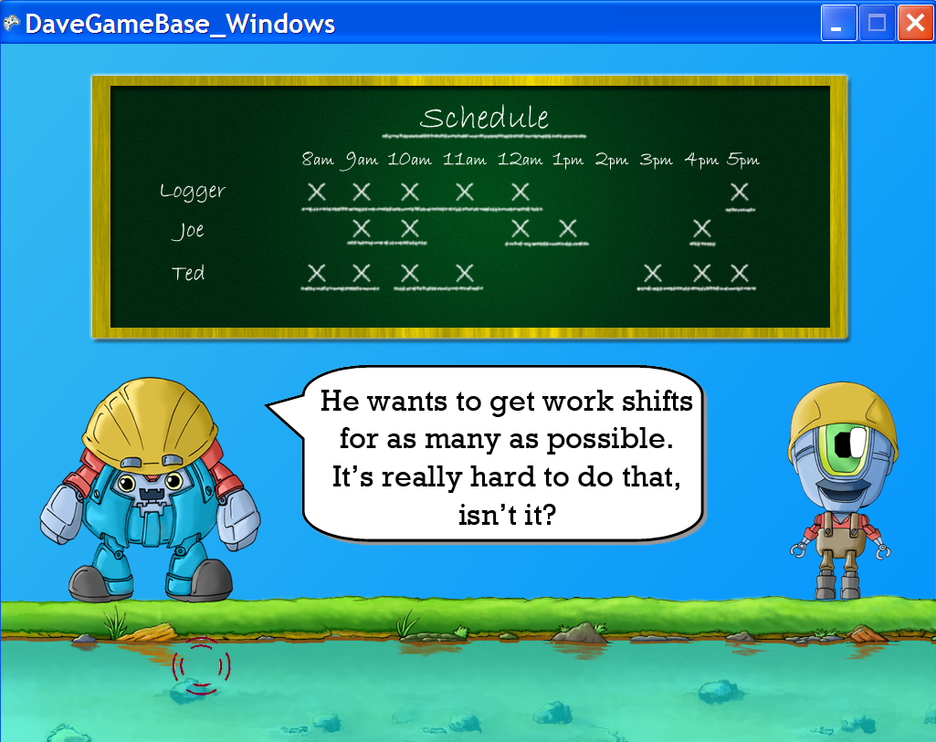

Slide 53
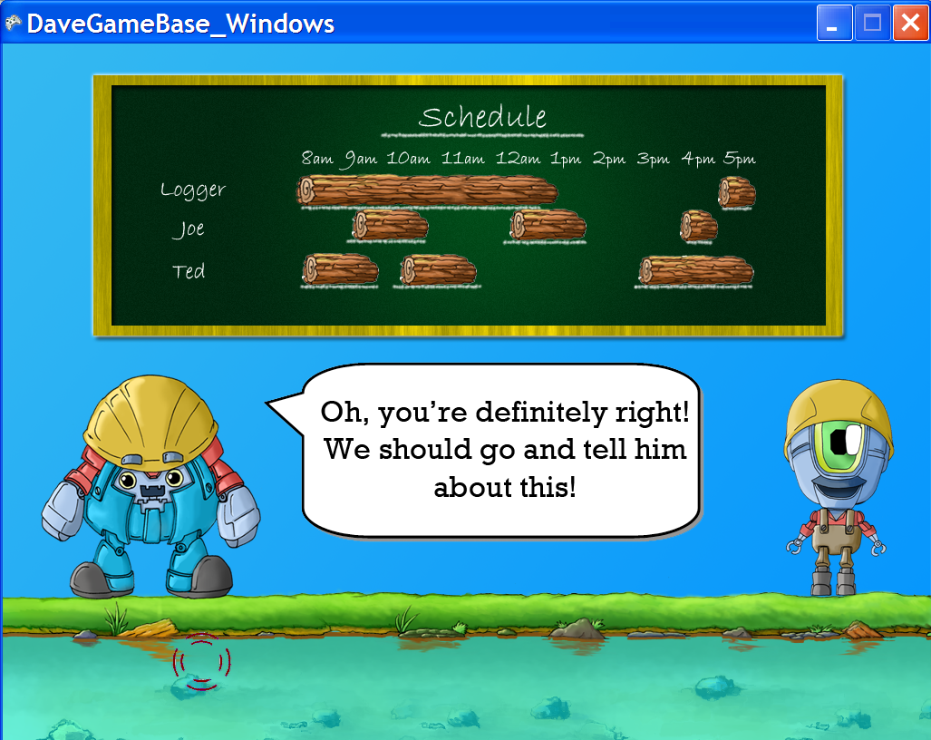

Slide 54
Educational Methodologies Employed

Slide 55
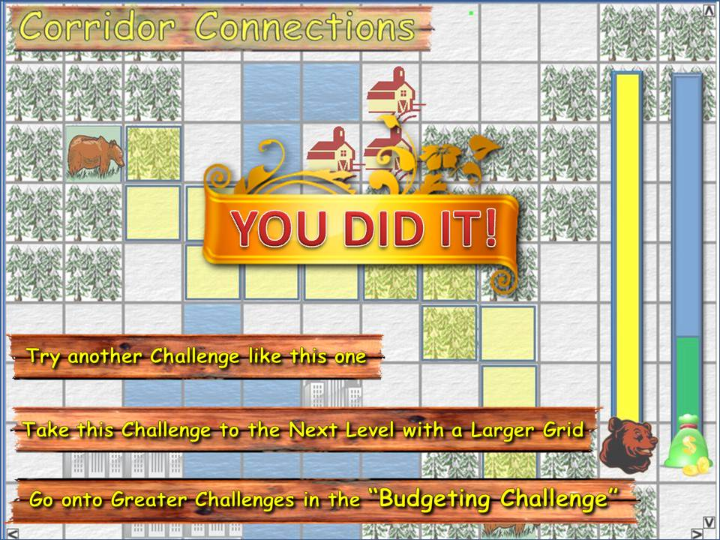
Educational Methodologies Employed

Slide 56
Educational Methodologies Employed
Self-Paced, Practice Oriented,
Learner Centered
Continued, Embedded,
Data-Driven feedback
Active & Cooperative
Learning Techniques
Higher Levels of
Bloom’s Taxonomy

Slide 57
Targeting a Different Demographics

Slide 58
Targeting a Different Demographics
YourTown Example : Women

Slide 59
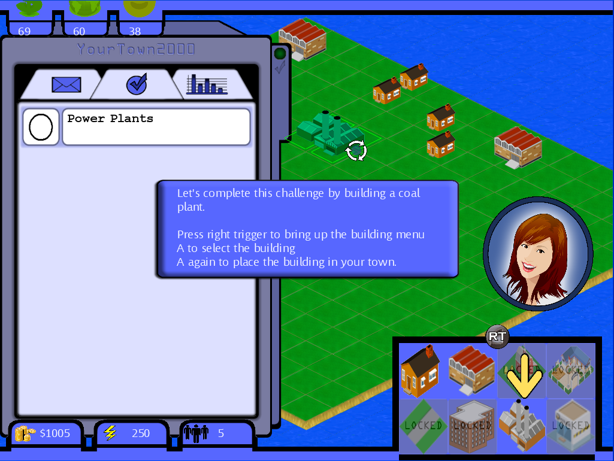
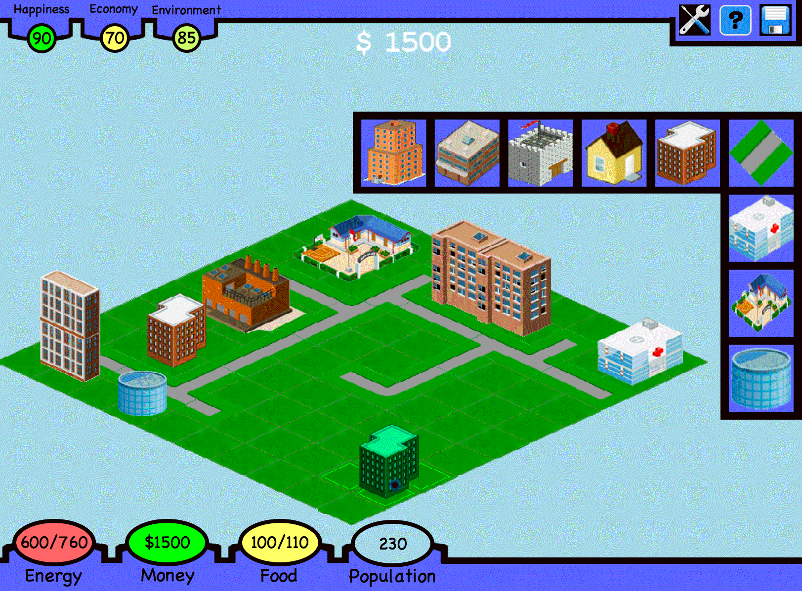
Targeting a Different Demographics
YourTown Example : Women

Slide 60
Targeting a Different Demographics
YourTown Example : Women
Self-Expression
Nurturing Gameplay
Time-Independent
Option (Casual)
Minor Focus on Score
Continuous Play
with Story Challenges
“I’m Grown-Up” Play
(Adult Emulation)

Slide 61
Targeting a Different Demographics
YourTown Example : Women
Self-Expression
Nurturing Gameplay
Time-Independent
Option (Casual)
Minor Focus on Score
Continuous Play
with Story Challenges
“I’m Grown-Up” Play
(Adult Emulation)
Other Audience Enhancements
Fair “Balanced” Game
Increased Socialization
Improve your “community”

Slide 62
So how did it work…
Notes:
Nobody said the tutorials should be removed, i.e. not “stupid” or “worthless”

Slide 63

So how did it work…
Early Development Testing at Boynton Middle School Math Day,
70 Middle School Students
Notes:
Nobody said the tutorials should be removed, i.e. not “stupid” or “worthless”

Slide 64
So how did it work…
Early Development Testing at Boynton Middle School Math Day,
70 Middle School Students
70% reported educational tutorials were “Very Easy” or “Easy”
23% Medium difficulty
7% Hard
0% Very Hard
Notes:
Nobody said the tutorials should be removed, i.e. not “stupid” or “worthless”

Slide 65
So how did it work…
Early Development Testing at Boynton Middle School Math Day,
70 Middle School Students
70% reported educational tutorials were “Very Easy” or “Easy”
23% Medium difficulty
7% Hard
0% Very Hard
85% “Yes” or “Maybe” would like to play the game again
Notes:
Nobody said the tutorials should be removed, i.e. not “stupid” or “worthless”

Slide 66
So how did it work…
Early Development Testing at Boynton Middle School Math Day,
70 Middle School Students
70% reported educational tutorials were “Very Easy” or “Easy”
23% Medium difficulty
7% Hard
0% Very Hard
85% “Yes” or “Maybe” would like to play the game again
Improvement Areas
Students don’t want to read
Intro Instruction Assumptions
Gameplay Suggestions
More Prevalent Story
Notes:
Nobody said the tutorials should be removed, i.e. not “stupid” or “worthless”

Slide 67
So how did it work…
Early Development Testing at Boynton Middle School Math Day,
70 Middle School Students
70% reported educational tutorials were “Very Easy” or “Easy”
23% Medium difficulty
7% Hard
0% Very Hard
85% “Yes” or “Maybe” would like to play the game again
Improvement Areas
Students don’t want to read
Intro Instruction Assumptions
Gameplay Suggestions
More Prevalent Story
How many students improved after the tutorial?
Nearly All
Notes:
Nobody said the tutorials should be removed, i.e. not “stupid” or “worthless”

Slide 68
So how did it work…
Early Development Testing at Boynton Middle School Math Day,
70 Middle School Students
70% reported educational tutorials were “Very Easy” or “Easy”
23% Medium difficulty
7% Hard
0% Very Hard
85% “Yes” or “Maybe” would like to play the game again
Improvement Areas
Students don’t want to read
Intro Instruction Assumptions
Gameplay Suggestions
More Prevalent Story
“Best Math Day Ever!”
How many students improved after the tutorial?
Nearly All
Notes:
Nobody said the tutorials should be removed, i.e. not “stupid” or “worthless”

Slide 69

So how did it work…
Early Development Testing at Boynton Middle School Math Day,
70 Middle School Students
70% reported educational tutorials were “Very Easy” or “Easy”
23% Medium difficulty
7% Hard
0% Very Hard
85% “Yes” or “Maybe” would like to play the game again
Improvement Areas
Students don’t want to read
Intro Instruction Assumptions
Gameplay Suggestions
More Prevalent Story
“Best Math Day Ever!”
How many students improved after the tutorial?
Nearly All
Notes:
Nobody said the tutorials should be removed, i.e. not “stupid” or “worthless”

Slide 70
Additional Major Educational Events
In Class Activities
Active & Cooperative Learning
Peer Learning

Slide 71

Additional Major Educational Events
In Class Activities
Active & Cooperative Learning
Peer Learning
Little Falls School District
Testing & Activity Development
May 17th :
All Math & Science Teachers

Slide 72
Additional Major Educational Events
In Class Activities
Active & Cooperative Learning
Peer Learning
Little Falls School District
Testing & Activity Development
May 17th :
All Math & Science Teachers
NY STEM Projects
Opportunity for Research
80 NYC Middle School Students, 10 NYC Middle School Teachers

Slide 73
Additional Major Educational Events
In Class Activities
Active & Cooperative Learning
Peer Learning
Little Falls School District
Testing & Activity Development
May 17th :
All Math & Science Teachers
NY STEM Projects
Opportunity for Research
80 NYC Middle School Students, 10 NYC Middle School Teachers
NSBE PCI (Pre College Initiative)
15~20 High School Students / event

Slide 74
Unique Gameplay == Unique Education
Unique Elements in All Games (Not Clones)
Attractive to both Dedicated & Casual Gamers

Slide 75
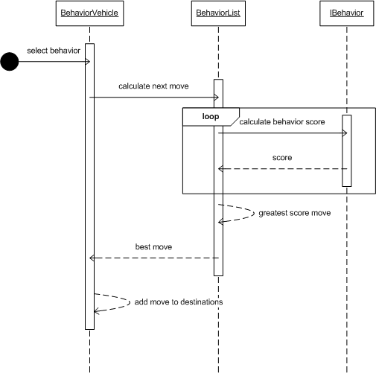
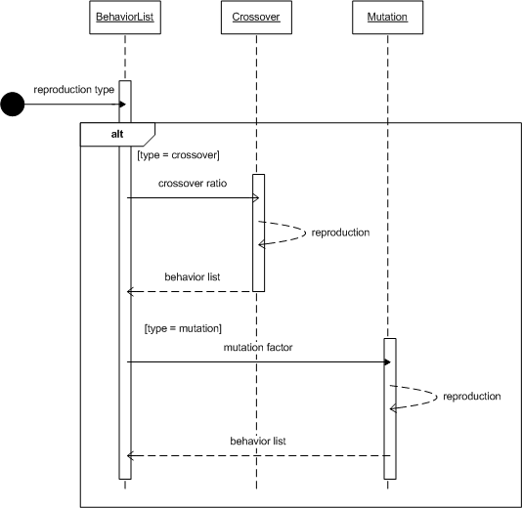
Unique Gameplay == Unique Education
Unique Elements in All Games (Not Clones)
Attractive to both Dedicated & Casual Gamers

Slide 76

Unique Gameplay == Unique Education
Unique Elements in All Games (Not Clones)
Attractive to both Dedicated & Casual Gamers
Based on work lead as Co-Founder of the NASA Robotics Alliance Cadets Program
w/ Mark Leon, NASA AMES Director of Education

Slide 77


Unique Gameplay == Unique Education
Unique Elements in All Games (Not Clones)
Attractive to both Dedicated & Casual Gamers
Based on work lead as Co-Founder of the NASA Robotics Alliance Cadets Program
w/ Mark Leon, NASA AMES Director of Education
31 Technical Students on the Team + 5 Artists
Total Code: ~150,000 lines

Slide 78



V
Computer Science + Systems Engineering

Slide 79

V
Computer Science Common Team Roles

Slide 80

V
Computer Science Common Team Roles

Slide 81
V
Computer Science Common Team Roles
PM
Dev
Art
Test

Slide 82

V
Computer Science Common Team Roles
Testers
Developers
Systems Leads

Slide 83
V
Computer Science Common Team Roles
Testers
Developers
Systems Leads
Algorithm Dev & Implementation
Architecture Implementation
Internal Documentation
Algorithm External Documentation

Slide 84
V
Computer Science Common Team Roles
SVN Code Repository Managers
Testing & Bug Tracking /Verification Plans
Load and Save (XML)
Internal Documentation Editing
Testers
Developers
Systems Leads
Algorithm Dev & Implementation
Architecture Implementation
Internal Documentation
Algorithm External Documentation

Slide 85
V
Computer Science Common Team Roles
SVN Code Repository Managers
Testing & Bug Tracking /Verification Plans
Load and Save (XML)
Internal Documentation Editing
Testers
Developers
Systems Leads
Project Requirements & Planning
Architecture Dev. & Review
Internal Documentation Review
Architecture External Documentation
Algorithm External Documentation
Algorithm Dev & Implementation
Architecture Implementation
Internal Documentation
Algorithm External Documentation

Slide 86
V
Computer Science Common Team Roles
SVN Code Repository Managers
Testing & Bug Tracking /Verification Plans
Load and Save (XML)
Internal Documentation Editing
Testers
Features
Developers
Systems Leads
Project Requirements & Planning
Architecture Dev. & Review
Internal Documentation Review
Architecture External Documentation
Algorithm External Documentation
Algorithm Dev & Implementation
Architecture Implementation
Internal Documentation
Algorithm External Documentation

Slide 87
V
Computer Science Common Team Roles
SVN Code Repository Managers
Testing & Bug Tracking /Verification Plans
Load and Save (XML)
Internal Documentation Editing
Testers
Robustness
Features
Developers
Systems Leads
Project Requirements & Planning
Architecture Dev. & Review
Internal Documentation Review
Architecture External Documentation
Algorithm External Documentation
Algorithm Dev & Implementation
Architecture Implementation
Internal Documentation
Algorithm External Documentation

Slide 88
V
Computer Science Common Team Roles
SVN Code Repository Managers
Testing & Bug Tracking /Verification Plans
Load and Save (XML)
Internal Documentation Editing
Testers
Robustness
Features
Longevity
Developers
Systems Leads
Project Requirements & Planning
Architecture Dev. & Review
Internal Documentation Review
Architecture External Documentation
Algorithm External Documentation
Algorithm Dev & Implementation
Architecture Implementation
Internal Documentation
Algorithm External Documentation

Slide 89
V
Computer Science Common Team Roles
SVN Code Repository Managers
Testing & Bug Tracking /Verification Plans
Load and Save (XML)
Internal Documentation Editing
Testers
Robustness
Visual Experience
Artists
Features
Longevity
Developers
Systems Leads
Project Requirements & Planning
Architecture Dev. & Review
Internal Documentation Review
Architecture External Documentation
Algorithm External Documentation
Algorithm Dev & Implementation
Architecture Implementation
Internal Documentation
Algorithm External Documentation

Slide 90
Waterfall
V
Define
Design
Build
Test

Slide 91
Spiral Development
V
Identify and resolve risks
Determine objectives
Develop
and test
Plan the next iteration

Slide 92
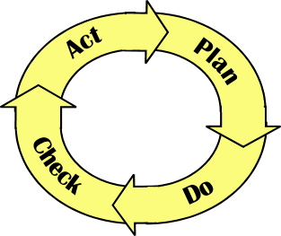
Plan-Do-Check-Act
V
Deming’s Continuous Improvement Cycle (a.k.a. the Shewhart Cycle)

Slide 93
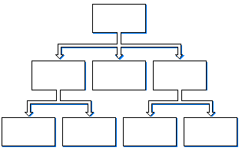
Divide and Conquer
V
The design of complex systems involves
Defining subsystems of the system
Defining their relations (interfaces!!!)
Repeating the process for each subsystem
Stop defining subsystems when a real component can be built and tested.
The subsystems are integrated and tested until a working system is achieved
A verification failure is followed by a design iteration.

Slide 94
Agile Development
V

Slide 95
Agile Development
V
Functionality Progress
Time

Slide 96
Agile Development
V
Develop
A Fully
Releasable
Product
Of Reduced
Functionality
Functionality Progress
Time

Slide 97
Agile Development
V
Develop
A Fully
Releasable
Product
Of Reduced
Functionality
Functionality Progress
Time

Slide 98
Agile Development
V
Develop
A Fully
Releasable
Product
Of Reduced
Functionality
Functionality Progress
Then add
a new
Set of
Functionality
Time

Slide 99
Agile Development
V
“Sawtooth” Graph
Develop
A Fully
Releasable
Product
Of Reduced
Functionality
Functionality Progress
Then add
a new
Set of
Functionality
Time

Slide 100
Agile Development
V
“Sawtooth” Graph
Develop
A Fully
Releasable
Product
Of Reduced
Functionality
Functionality Progress
Then add
a new
Set of
Functionality
Time

Slide 101
V
Agile 4 Phase Development Cycle

Slide 102
V
Agile 4 Phase Development Cycle
Phase 0 Work:
All Team members decide on what is the next set of features
Architecture should be well established for 2-milestones ahead
System Leads have draft architecture documentation
Testing plan draft developed
Joint Development Outlined (ex. Grid)

Slide 103
V
Agile 4 Phase Development Cycle
Phase 0 Work:
All Team members decide on what is the next set of features
Architecture should be well established for 2-milestones ahead
System Leads have draft architecture documentation
Testing plan draft developed
Joint Development Outlined (ex. Grid)
Phase I Work:
Dev’s Work on Phase I Feature Milestone
System Leads deal with Architecture Issues as they arrise
Testers offer advice on implementation
Dev’s write internal documentation to their new features

Slide 104
V
Agile 4 Phase Development Cycle
Phase 0 Work:
All Team members decide on what is the next set of features
Architecture should be well established for 2-milestones ahead
System Leads have draft architecture documentation
Testing plan draft developed
Joint Development Outlined (ex. Grid)
Phase I Work:
Dev’s Work on Phase I Feature Milestone
System Leads deal with Architecture Issues as they arrise
Testers offer advice on implementation
Dev’s write internal documentation to their new features
Phase II Work:
Tester completes testing plan, also looking for code simplification
Dev’s adjust code and internal documentation as needed based on testing
System Leads deal with Architecture changes based on testing

Slide 105
V
Agile 4 Phase Development Cycle
Phase 0 Work:
All Team members decide on what is the next set of features
Architecture should be well established for 2-milestones ahead
System Leads have draft architecture documentation
Testing plan draft developed
Joint Development Outlined (ex. Grid)
Phase I Work:
Dev’s Work on Phase I Feature Milestone
System Leads deal with Architecture Issues as they arrise
Testers offer advice on implementation
Dev’s write internal documentation to their new features
Phase II Work:
Tester completes testing plan, also looking for code simplification
Dev’s adjust code and internal documentation as needed based on testing
System Leads deal with Architecture changes based on testing
Phase III Work:
Systems Leads review documentation & performance testing results
Dev’s work with Systems Leads on any internal documentation questions
Dev’s write algorithmic documentation, reviewed/improved by Systems Leads
Testers turn over completed testing plan and store code version forever & ever
Systems Leads complete all other documentation (Architecture, Planning Decisions)

Slide 106
V
Agile 4 Phase Development Cycle
Phase 0 Work:
All Team members decide on what is the next set of features
Architecture should be well established for 2-milestones ahead
System Leads have draft architecture documentation
Testing plan draft developed
Joint Development Outlined (ex. Grid)
Phase I Work:
Dev’s Work on Phase I Feature Milestone
System Leads deal with Architecture Issues as they arise
Testers offer advice on implementation
Dev’s write internal documentation to their new features
Phase II Work:
Tester completes testing plan, also looking for code simplification
Dev’s adjust code and internal documentation as needed based on testing
System Leads deal with Architecture changes based on testing
Phase III Work:
Systems Leads review documentation & performance testing results
Dev’s work with Systems Leads on any internal documentation questions
Dev’s write algorithmic documentation, reviewed/improved by Systems Leads
Testers turn over completed testing plan and store code version forever & ever
Systems Leads complete all other documentation (Architecture, Planning Decisions)
1-4 Weeks / Milestone

Slide 107
V
Agile 4 Phase Development Cycle
Cycle 1
Phase 0
a
b
c
d
e
f
g

Slide 108
V
Agile 4 Phase Development Cycle
Cycle 1
Phase 0
Phase 1
Cycle 2
0
a
b
c
d
e
f
g

Slide 109
V
Agile 4 Phase Development Cycle
Cycle 1
Phase 0
Phase 1
Phase 2
Cycle 2
0
1
Cycle 3
0
a
b
c
d
e
f
g

Slide 110
V
Agile 4 Phase Development Cycle
Cycle 1
Phase 0
Phase 1
Phase 2
Phase 3
Cycle 2
0
1
2
3
Cycle 3
0
1
2
3
…
…
Cycle n
0
1
2
3
a
b
c

Slide 111
V
Agile 4 Phase Dev. Cycle: Transitions

Slide 112
V
Agile 4 Phase Dev. Cycle: Transitions
Phase 0 to Phase I: Creating the Newest Milestone
List of Features to be Created (Jointly?)
Architecture used to Create those features
Testing Plans / Concerns
(Planned modifications to past completed code)

Slide 113
V
Agile 4 Phase Dev. Cycle: Transitions
Phase 0 to Phase I: Creating the Newest Milestone
List of Features to be Created (Jointly?)
Architecture used to Create those features
Testing Plans / Concerns
(Planned modifications to past completed code)
Phase I to Phase II: Testing the Previous Milestone
Testing Plan Update and schedule to complete testing plans

Slide 114
V
Agile 4 Phase Dev. Cycle: Transitions
Phase 0 to Phase I: Creating the Newest Milestone
List of Features to be Created (Jointly?)
Architecture used to Create those features
Testing Plans / Concerns
(Planned modifications to past completed code)
Phase I to Phase II: Testing the Previous Milestone
Testing Plan Update and schedule to complete testing plans
Phase II to Phase III: Recording Achievements & “Lessons Learned”
All code has passed Phase II

Slide 115
V
Agile 4 Phase Dev. Cycle: Transitions
Phase 0 to Phase I: Creating the Newest Milestone
List of Features to be Created (Jointly?)
Architecture used to Create those features
Testing Plans / Concerns
(Planned modifications to past completed code)
Phase I to Phase II: Testing the Previous Milestone
Testing Plan Update and schedule to complete testing plans
Phase II to Phase III: Recording Achievements & “Lessons Learned”
All code has passed Phase II
All performance data is collected

Slide 116
V
Agile 4 Phase Dev. Cycle: Transitions
Phase 0 to Phase I: Creating the Newest Milestone
List of Features to be Created (Jointly?)
Architecture used to Create those features
Testing Plans / Concerns
(Planned modifications to past completed code)
Phase I to Phase II: Testing the Previous Milestone
Testing Plan Update and schedule to complete testing plans
Phase II to Phase III: Recording Achievements & “Lessons Learned”
All code has passed Phase II
All performance data is collected
Phase R: Architecture Redevelopment
Testers in charge of a test plan
Everyone tests as need be
At the end all output code should be at least Phase II is not Phase III

Slide 117
V
Milestone Meetings
50%
Listing of Accomplishments
Demonstration of New Features
Report on Testing (Code that has made it to Phase II)
Submission of Phase III Documentation
10%
Update on Overall Progress
30%
Planning Details for the start of the next Phase I or Phase R

Slide 118
V
Computer Science Culture

Slide 119

V
Cowboy Programming

Slide 120
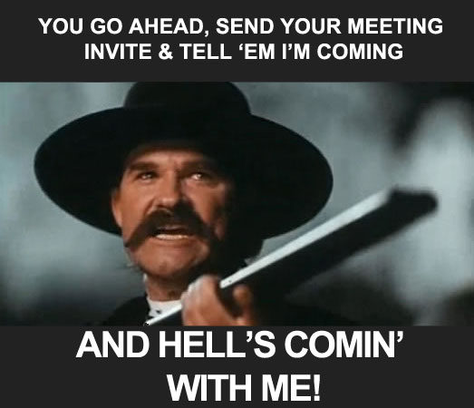
V
Cowboy Programming

Slide 121
V
Agile Scrum

Slide 122

V
Agile Scrum, Not SCUMM

Slide 123

V
Agile Scrum, Not SCUMM

Slide 124
V
Agile Scrum
“the purpose of the scrum is to restart play quickly, safely and fairly after a minor [infringement or] a stoppage.” (Law 20).

Slide 125
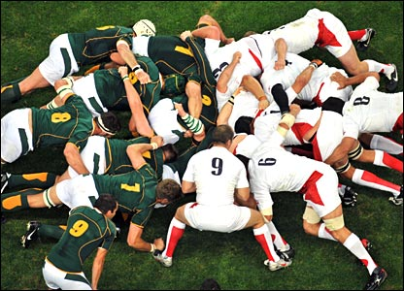
V
Agile Scrum
“the purpose of the scrum is to restart play quickly, safely and fairly after a minor [infringement or] a stoppage.” (Law 20).

Slide 126
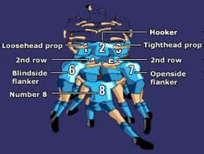
V
Agile Scrum
“the purpose of the scrum is to restart play quickly, safely and fairly after a minor [infringement or] a stoppage.” (Law 20).

Slide 127
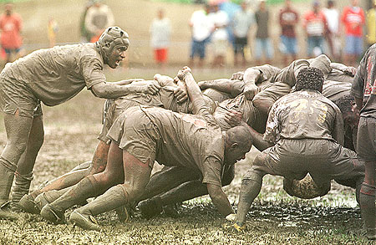
V
Agile Scrum
“the purpose of the scrum is to restart play quickly, safely and fairly after a minor [infringement or] a stoppage.” (Law 20).

Slide 128
Product Owner: Voice of the Customer & Stakeholders
Scrum Master: Rule Enforcer & Team Protector (Servent-Leader)
Development Team: Do Work, Self-Assigning in Roles
V
Agile Scrum
Notes:
Weak in Testing by itself due to self-assigning roles, fixed by assigning general roles and using a 4 phase agile process

Slide 129
Product Owner: Voice of the Customer & Stakeholders
Scrum Master: Rule Enforcer & Team Protector (Servent-Leader)
Development Team: Do Work, Self-Assigning in Roles
V
Agile Scrum
Functionality Progress
Time
Notes:
Weak in Testing by itself due to self-assigning roles, fixed by assigning general roles and using a 4 phase agile process

Slide 130



Product Owner: Voice of the Customer & Stakeholders
Scrum Master: Rule Enforcer & Team Protector (Servent-Leader)
Development Team: Do Work, Self-Assigning in Roles
V
Agile Scrum
Functionality Progress
Time
Product
Backlog
Sprint
Backlog
Sprint
Sprint
Release
Notes:
Weak in Testing by itself due to self-assigning roles, fixed by assigning general roles and using a 4 phase agile process

Slide 131
Product Owner: Voice of the Customer & Stakeholders
Scrum Master: Rule Enforcer & Team Protector (Servent-Leader)
Development Team: Do Work, Self-Assigning in Roles
V
Agile Scrum
Product
Backlog
Sprint
Backlog
Sprint
Sprint
Release
List of Functional Needs,
Originating Requirements
User Stories ≈ Use Cases
Notes:
Weak in Testing by itself due to self-assigning roles, fixed by assigning general roles and using a 4 phase agile process

Slide 132
Product Owner: Voice of the Customer & Stakeholders
Scrum Master: Rule Enforcer & Team Protector (Servent-Leader)
Development Team: Do Work, Self-Assigning in Roles
V
Agile Scrum
Backlog Grooming
/ Storytime
Product
Backlog
Sprint
Backlog
Sprint
Sprint
Release
List of Functional Needs,
Originating Requirements
User Stories ≈ Use Cases
Notes:
Weak in Testing by itself due to self-assigning roles, fixed by assigning general roles and using a 4 phase agile process

Slide 133
Product Owner: Voice of the Customer & Stakeholders
Scrum Master: Rule Enforcer & Team Protector (Servent-Leader)
Development Team: Do Work, Self-Assigning in Roles
V
Agile Scrum
Delve into Func. Needs
Est. Effort to meet Func. Needs
Not Task Defining
Backlog Grooming
/ Storytime
Product
Backlog
Sprint
Backlog
Sprint
Sprint
Release
List of Functional Needs,
Originating Requirements
User Stories ≈ Use Cases
Notes:
Weak in Testing by itself due to self-assigning roles, fixed by assigning general roles and using a 4 phase agile process

Slide 134
Product Owner: Voice of the Customer & Stakeholders
Scrum Master: Rule Enforcer & Team Protector (Servent-Leader)
Development Team: Do Work, Self-Assigning in Roles
V
Agile Scrum
Delve into Func. Needs
Est. Effort to meet Func. Needs
Not Task Defining
Backlog Grooming
/ Storytime
Product
Backlog
Sprint
Backlog
Sprint
Sprint
Release
List of Functional Needs,
Originating Requirements
User Stories ≈ Use Cases
Notes:
Weak in Testing by itself due to self-assigning roles, fixed by assigning general roles and using a 4 phase agile process

Slide 135
Product Owner: Voice of the Customer & Stakeholders
Scrum Master: Rule Enforcer & Team Protector (Servent-Leader)
Development Team: Do Work, Self-Assigning in Roles
V
Agile Scrum
Delve into Func. Needs
Est. Effort to meet Func. Needs
Not Task Defining
Backlog Grooming
/ Storytime
Product
Backlog
Sprint
Backlog
Sprint
Sprint
Release
List of Functional Needs,
Originating Requirements
User Stories ≈ Use Cases
Notes:
Weak in Testing by itself due to self-assigning roles, fixed by assigning general roles and using a 4 phase agile process

Slide 136
Product Owner: Voice of the Customer & Stakeholders
Scrum Master: Rule Enforcer & Team Protector (Servent-Leader)
Development Team: Do Work, Self-Assigning in Roles
V
Agile Scrum
Delve into Func. Needs
Est. Effort to meet Func. Needs
Not Task Defining
Backlog Grooming
/ Storytime
Sprint
Planning
Mtg.
Product
Backlog
Sprint
Backlog
Sprint
Sprint
Release
List of Functional Needs,
Originating Requirements
User Stories ≈ Use Cases
Notes:
Weak in Testing by itself due to self-assigning roles, fixed by assigning general roles and using a 4 phase agile process

Slide 137
Product Owner: Voice of the Customer & Stakeholders
Scrum Master: Rule Enforcer & Team Protector (Servent-Leader)
Development Team: Do Work, Self-Assigning in Roles
V
Agile Scrum
Delve into Func. Needs
Est. Effort to meet Func. Needs
Not Task Defining
Backlog Grooming
/ Storytime
Sprint
Planning
Mtg.
Product
Backlog
Sprint
Backlog
Sprint
Sprint
Release
List of Functional Needs,
Originating Requirements
User Stories ≈ Use Cases
Subset of Functions
to be made in the
next Sprint
Notes:
Weak in Testing by itself due to self-assigning roles, fixed by assigning general roles and using a 4 phase agile process

Slide 138
Product Owner: Voice of the Customer & Stakeholders
Scrum Master: Rule Enforcer & Team Protector (Servent-Leader)
Development Team: Do Work, Self-Assigning in Roles
V
Agile Scrum
Delve into Func. Needs
Est. Effort to meet Func. Needs
Not Task Defining
Backlog Grooming
/ Storytime
Sprint
Planning
Mtg.
Timeboxed
Period
Product
Backlog
Sprint
Backlog
Sprint
Sprint
Release
List of Functional Needs,
Originating Requirements
User Stories ≈ Use Cases
Subset of Functions
to be made in the
next Sprint
Actual Work being done
Notes:
Weak in Testing by itself due to self-assigning roles, fixed by assigning general roles and using a 4 phase agile process

Slide 139
Product Owner: Voice of the Customer & Stakeholders
Scrum Master: Rule Enforcer & Team Protector (Servent-Leader)
Development Team: Do Work, Self-Assigning in Roles
V
Agile Scrum
Delve into Func. Needs
Est. Effort to meet Func. Needs
Not Task Defining
Backlog Grooming
/ Storytime
Typically 1 month
sometimes less
Sprint
Planning
Mtg.
Timeboxed
Period
Product
Backlog
Sprint
Backlog
Sprint
Sprint
Release
List of Functional Needs,
Originating Requirements
User Stories ≈ Use Cases
Subset of Functions
to be made in the
next Sprint
Actual Work being done
Notes:
Weak in Testing by itself due to self-assigning roles, fixed by assigning general roles and using a 4 phase agile process

Slide 140
Product Owner: Voice of the Customer & Stakeholders
Scrum Master: Rule Enforcer & Team Protector (Servent-Leader)
Development Team: Do Work, Self-Assigning in Roles
V
Agile Scrum
Delve into Func. Needs
Est. Effort to meet Func. Needs
Not Task Defining
Backlog Grooming
/ Storytime
Followed by Scrum of Scrums for Details
Daily
Scrum
Typically 1 month
sometimes less
Sprint
Planning
Mtg.
Timeboxed
Period
Product
Backlog
Sprint
Backlog
Sprint
Sprint
Release
List of Functional Needs,
Originating Requirements
User Stories ≈ Use Cases
Subset of Functions
to be made in the
next Sprint
Actual Work being done
Notes:
Weak in Testing by itself due to self-assigning roles, fixed by assigning general roles and using a 4 phase agile process

Slide 141
Product Owner: Voice of the Customer & Stakeholders
Scrum Master: Rule Enforcer & Team Protector (Servent-Leader)
Development Team: Do Work, Self-Assigning in Roles
V
Agile Scrum
Delve into Func. Needs
Est. Effort to meet Func. Needs
Not Task Defining
15 Min. “Stand-up”
Update Mtg
Backlog Grooming
/ Storytime
Followed by Scrum of Scrums for Details
Daily
Scrum
Typically 1 month
sometimes less
Sprint
Planning
Mtg.
Timeboxed
Period
Product
Backlog
Sprint
Backlog
Sprint
Sprint
Release
List of Functional Needs,
Originating Requirements
User Stories ≈ Use Cases
Subset of Functions
to be made in the
next Sprint
Actual Work being done
Notes:
Weak in Testing by itself due to self-assigning roles, fixed by assigning general roles and using a 4 phase agile process

Slide 142
Product Owner: Voice of the Customer & Stakeholders
Scrum Master: Rule Enforcer & Team Protector (Servent-Leader)
Development Team: Do Work, Self-Assigning in Roles
V
Agile Scrum
Delve into Func. Needs
Est. Effort to meet Func. Needs
Not Task Defining
15 Min. “Stand-up”
Update Mtg
Backlog Grooming
/ Storytime
Followed by Scrum of Scrums for Details
Daily
Scrum
Typically 1 month
sometimes less
Sprint
Planning
Mtg.
Timeboxed
Period
Product
Backlog
Sprint
Backlog
Sprint
Sprint
Release
List of Functional Needs,
Originating Requirements
User Stories ≈ Use Cases
Subset of Functions
to be made in the
next Sprint
Actual Work being done
Current
Working,
Fully Tested,
Software
Notes:
Weak in Testing by itself due to self-assigning roles, fixed by assigning general roles and using a 4 phase agile process

Slide 143
Product Owner: Voice of the Customer & Stakeholders
Scrum Master: Rule Enforcer & Team Protector (Servent-Leader)
Development Team: Do Work, Self-Assigning in Roles
V
Agile Scrum
Delve into Func. Needs
Est. Effort to meet Func. Needs
Not Task Defining
15 Min. “Stand-up”
Update Mtg
Backlog Grooming
/ Storytime
Followed by Scrum of Scrums for Details
Daily
Scrum
Typically 1 month
sometimes less
Sprint
Planning
Mtg.
Timeboxed
Period
Product
Backlog
Sprint
Backlog
Sprint
Sprint
Release
List of Functional Needs,
Originating Requirements
User Stories ≈ Use Cases
Subset of Functions
to be made in the
next Sprint
Actual Work being done
Current
Working,
Fully Tested,
Software
Sprint Review Mtg.
(4Hrs.) Asses Release
with Product Owner
and/or Customer
Notes:
Weak in Testing by itself due to self-assigning roles, fixed by assigning general roles and using a 4 phase agile process

Slide 144
Product Owner: Voice of the Customer & Stakeholders
Scrum Master: Rule Enforcer & Team Protector (Servent-Leader)
Development Team: Do Work, Self-Assigning in Roles
V
Agile Scrum
Delve into Func. Needs
Est. Effort to meet Func. Needs
Not Task Defining
15 Min. “Stand-up”
Update Mtg
Backlog Grooming
/ Storytime
Followed by Scrum of Scrums for Details
Daily
Scrum
Typically 1 month
sometimes less
Sprint
Planning
Mtg.
Timeboxed
Period
Product
Backlog
Sprint
Backlog
Sprint
Sprint
Release
List of Functional Needs,
Originating Requirements
User Stories ≈ Use Cases
Subset of Functions
to be made in the
next Sprint
Actual Work being done
Current
Working,
Fully Tested,
Software
Sprint Retrospective
Sprint Review Mtg.
(3 Hrs.) Internal review
What went well?
What could be improved?
(4Hrs.) Asses Release
with Product Owner
and/or Customer
Notes:
Weak in Testing by itself due to self-assigning roles, fixed by assigning general roles and using a 4 phase agile process

Slide 145
Product Owner: Voice of the Customer & Stakeholders
Scrum Master: Rule Enforcer & Team Protector (Servent-Leader)
Development Team: Do Work, Self-Assigning in Roles
V
Agile Scrum
Delve into Func. Needs
Est. Effort to meet Func. Needs
Not Task Defining
15 Min. “Stand-up”
Update Mtg
Backlog Grooming
/ Storytime
Followed by Scrum of Scrums for Details
Daily
Scrum
Typically 1 month
sometimes less
Sprint
Planning
Mtg.
Timeboxed
Period
Product
Backlog
Sprint
Backlog
Sprint
Sprint
Release
List of Functional Needs,
Originating Requirements
User Stories ≈ Use Cases
Subset of Functions
to be made in the
next Sprint
Actual Work being done
Current
Working,
Fully Tested,
Software
Sprint Burndown
Sprint Retrospective
Sprint Review Mtg.
Update Product Backlog from Achievements
And from new Customer Needs (stories)
(3 Hrs.) Internal review
What went well?
What could be improved?
(4Hrs.) Asses Release
with Product Owner
and/or Customer
Notes:
Weak in Testing by itself due to self-assigning roles, fixed by assigning general roles and using a 4 phase agile process

Slide 146
Product Owner: Voice of the Customer & Stakeholders
Scrum Master: Rule Enforcer & Team Protector (Servent-Leader)
Development Team: Do Work, Self-Assigning in Roles
V
Agile Scrum
Delve into Func. Needs
Est. Effort to meet Func. Needs
Not Task Defining
15 Min. “Stand-up”
Update Mtg
Backlog Grooming
/ Storytime
Followed by Scrum of Scrums for Details
Daily
Scrum
Typically 1 month
sometimes less
Sprint
Planning
Mtg.
Timeboxed
Period
Product
Backlog
Sprint
Backlog
Sprint
Sprint
Release
List of Functional Needs,
Originating Requirements
User Stories ≈ Use Cases
Subset of Functions
to be made in the
next Sprint
Actual Work being done
Current
Working,
Fully Tested,
Software
Sprint Burndown
Sprint Retrospective
Sprint Review Mtg.
Update Product Backlog from Achievements
And from new Customer Needs (stories)
(3 Hrs.) Internal review
What went well?
What could be improved?
(4Hrs.) Asses Release
with Product Owner
and/or Customer
Notes:
Weak in Testing by itself due to self-assigning roles, fixed by assigning general roles and using a 4 phase agile process

Slide 147

V
To Agile or Not To Agile

Slide 148
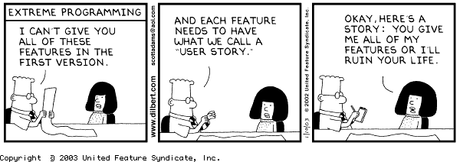
V
To Agile or Not To Agile

Slide 149
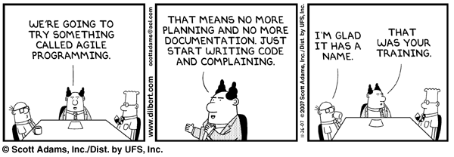
V
To Agile or Not To Agile

Slide 150
V
Want your work to live on…

Slide 151
V
Want your work to live on…
Document!

Slide 152

V
Want your work to live on…
Document!
Test your Docs:
Explain your work to an Uninformed Audience

Slide 153

V
Want your work to live on…
Document!

Slide 154
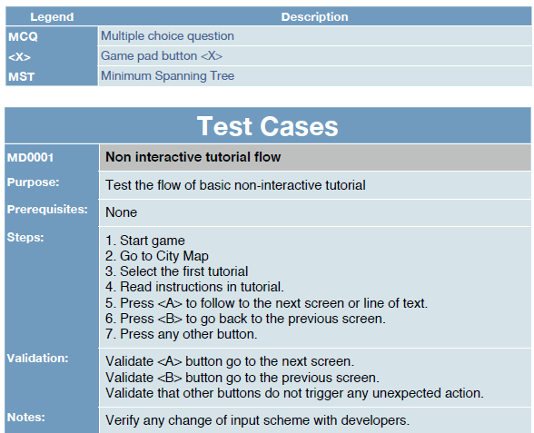
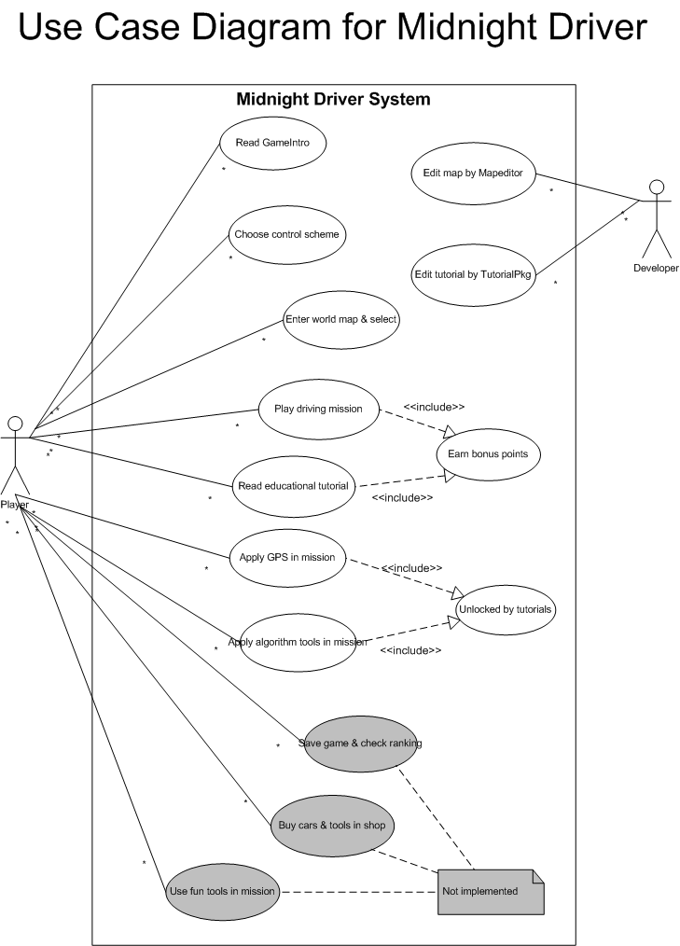
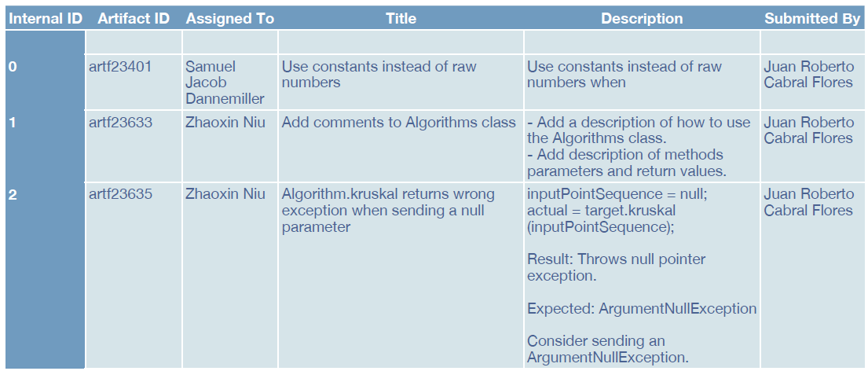
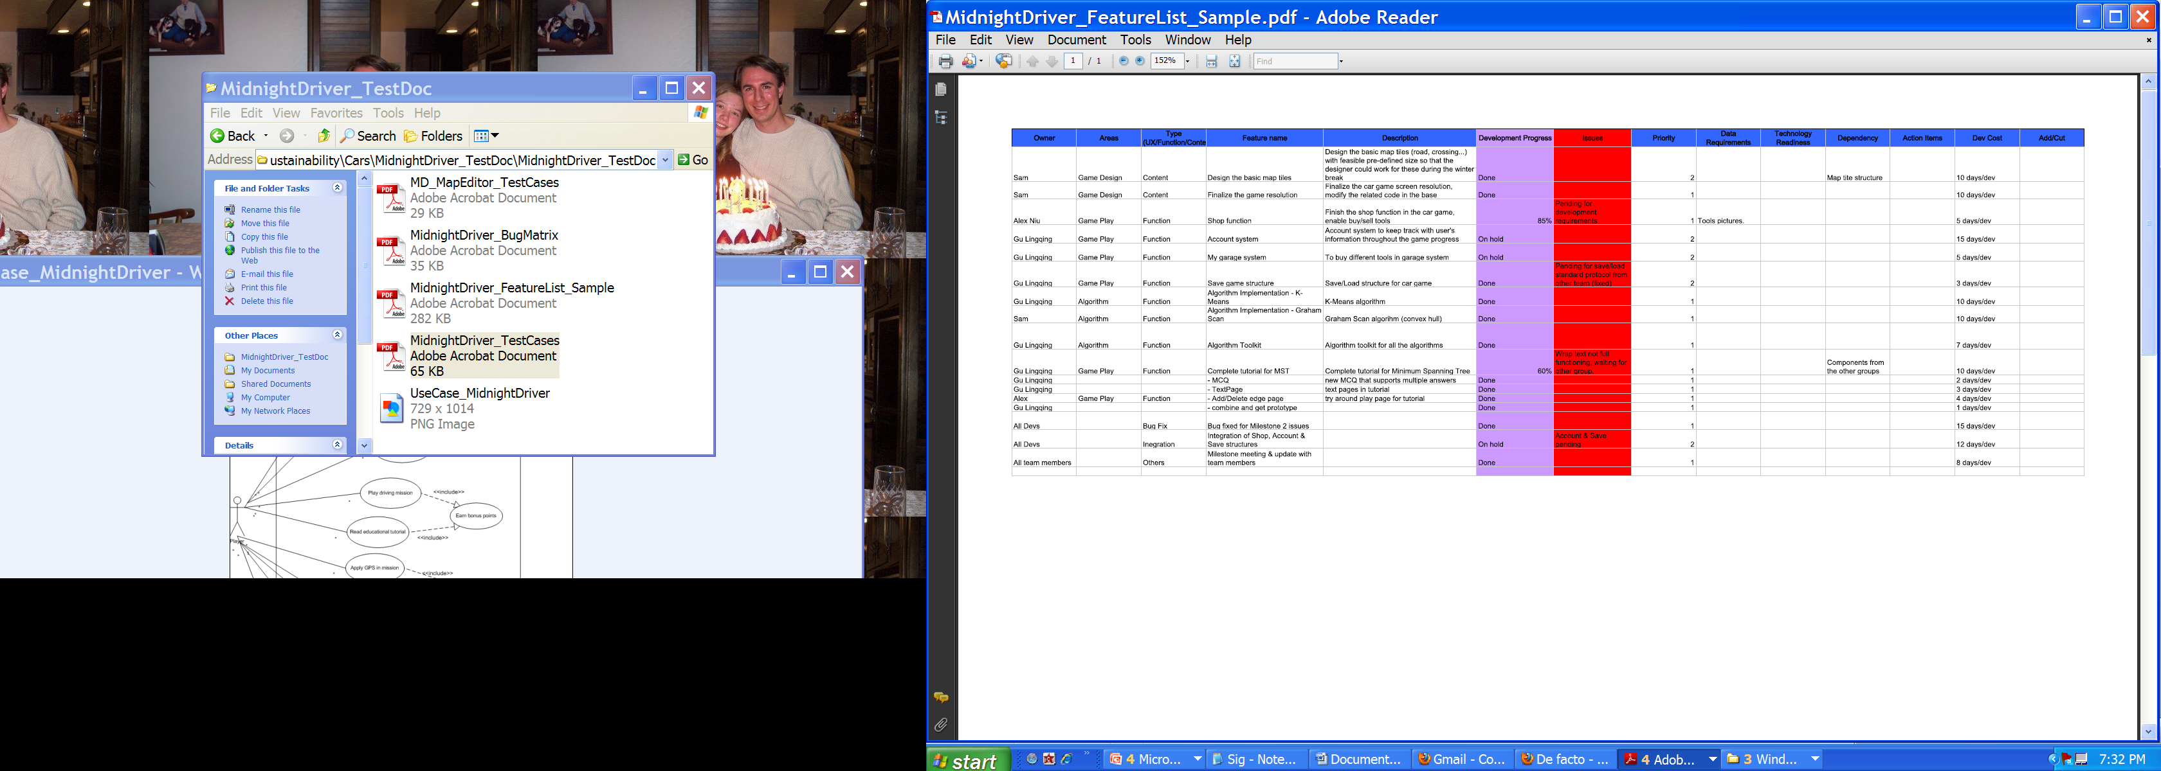
Test & Tracking
Bug Tracking Matrices
Functional Checklists

Slide 155
Project Advisors:
David Schneider, Carla Gomes, Ashish Sabharwal
Student Team Members:
Ethan Benanav
Mathew Butt
William Chao
William Chen
Sonam Dalal
Sam Dannemiller
Ryan de Haas
Monish Desai
Cooper Findley
Juan Roberto Cabral Flores
Caroline Greenwood
Adam Goodman
Lingqing Gu
Laura Hao
Kevin Hobson
Jonathan Hui
Lai Jiang
Antoinette Kretsch
Brian Klien
Akhil Kuduvalli
Hang Li
Sherwin Li
Constantine Moraites
Zhaoxin Niu
Tiffany Ng
Adedamola Omotosho
Eric Chin Sang
Harry Terkelsen
Ran Wei
Jae Yoon
Ozgur Yonter
Jonathan Yu
Gregory Zecchini

Slide 156
Distributing
Outreach Materials

Slide 157

Distributing
Outreach Materials
Website
Not Public Yet
Use this as a tool for future development as well

Slide 158
Designing Games with Edu. Material directly integrated with the game’s Reward System
“Quick Start” Build Initial Intuition & Belief they can Succeed

Slide 159
Designing Games with Edu. Material directly integrated with the game’s Reward System
“Quick Start” Build Initial Intuition & Belief they can Succeed
Earn “New Ability Tutorials” which are truly Algorithm Edu.

Slide 160
Designing Games with Edu. Material directly integrated with the game’s Reward System
“Quick Start” Build Initial Intuition & Belief they can Succeed
Earn “New Ability Tutorials” which are truly Algorithm Edu.
Modify the problem/objective slightly
Results in increasing in the challenge
Opportunity to change the gameplay
Extend the game’s story as well
Further
captivating
the player

Slide 161
Designing Games with Edu. Material directly integrated with the game’s Reward System
“Quick Start” Build Initial Intuition & Belief they can Succeed
Earn “New Ability Tutorials” which are truly Algorithm Edu.
Modify the problem/objective slightly
Results in increasing in the challenge
Opportunity to change the gameplay
Extend the game’s story as well
Further
captivating
the player
Stay away from words like :
“Example Problem”, “Teach”, “Algorithm”

Slide 162
Designing Games with Edu. Material directly integrated with the game’s Reward System
“Quick Start” Build Initial Intuition & Belief they can Succeed
Earn “New Ability Tutorials” which are truly Algorithm Edu.
Modify the problem/objective slightly
Results in increasing in the challenge
Opportunity to change the gameplay
Extend the game’s story as well
Further
captivating
the player
Stay away from words like :
“Example Problem”, “Teach”, “Algorithm”
Only in the later part of the game is it “revealed” that:
They’ve been doing CS and
They have been “Winning” at it.

