Slide 1
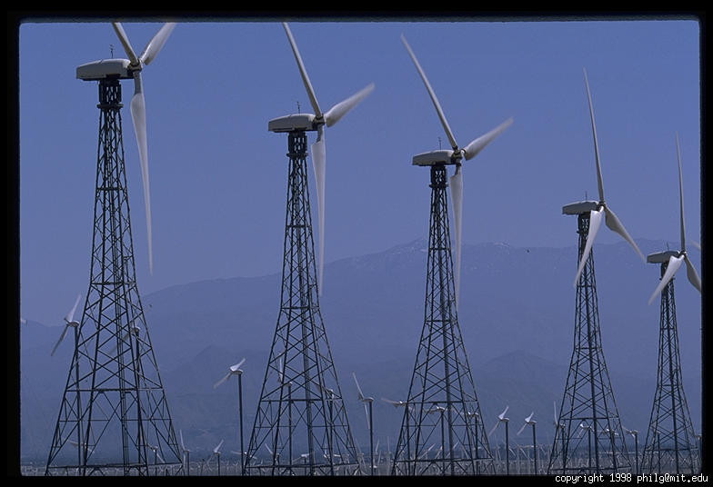
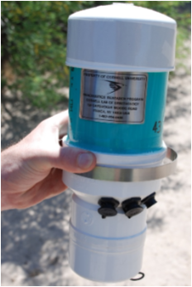
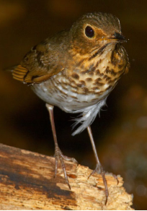

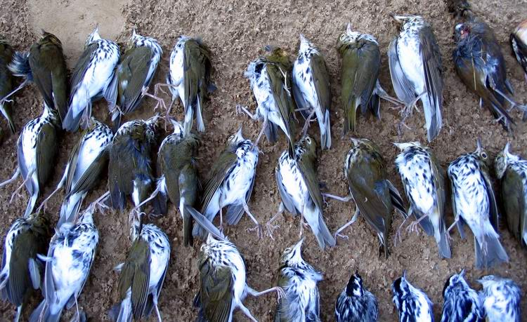

Wind Energy and Scientific Conservation: Assessment of Risks to Migratory Birds
Andrew Farnsworth, Conservation Science Program
Kenneth V. Rosenberg, Director Conservation Science Program

Slide 2
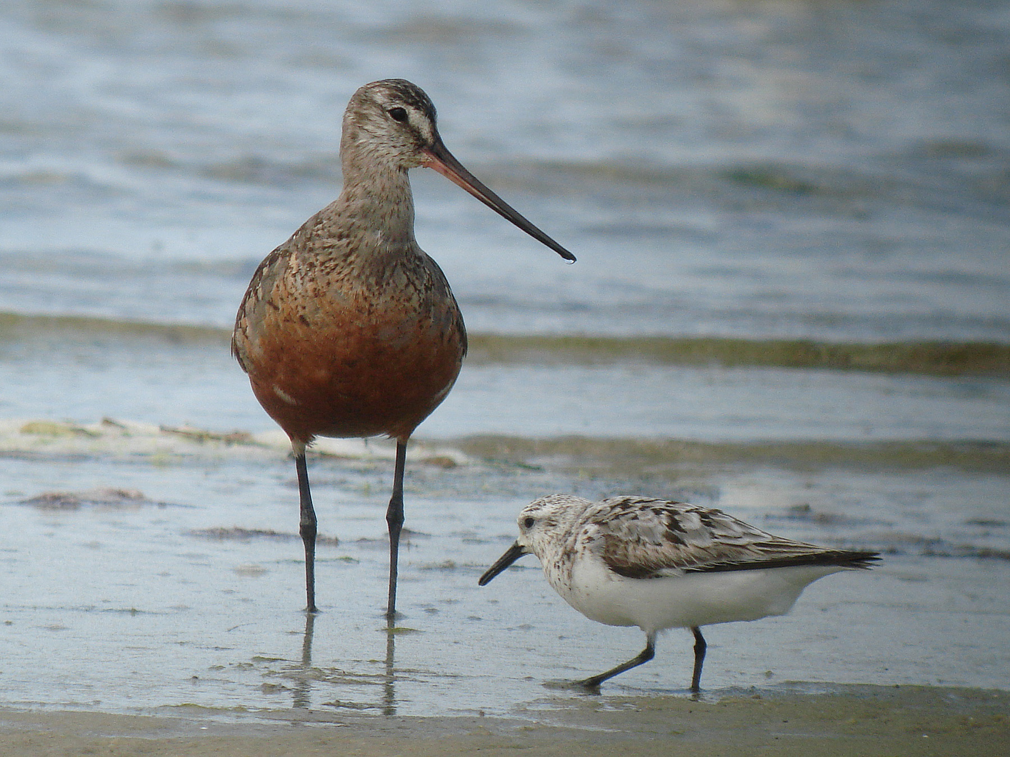
Birds as Indicators of Environmental Health
Abundant and widespread
Integral component of most ecosystems
Sensitive to environmental change and degradation
Indicators of human quality of life
Respond quickly to recovery efforts

Slide 3
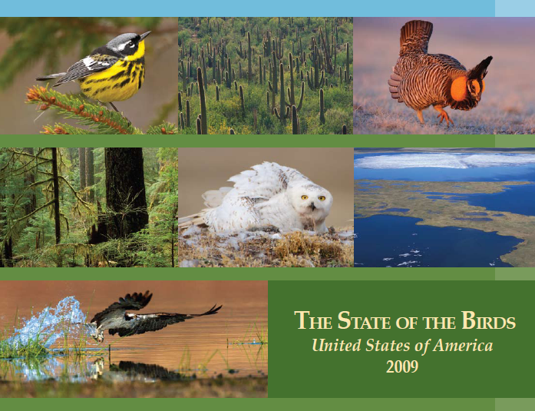
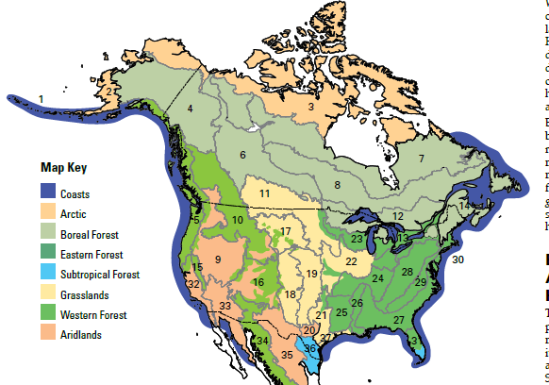
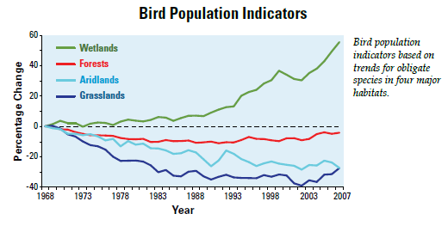
Notes:
The first SOTB report was published in 2009

Slide 4

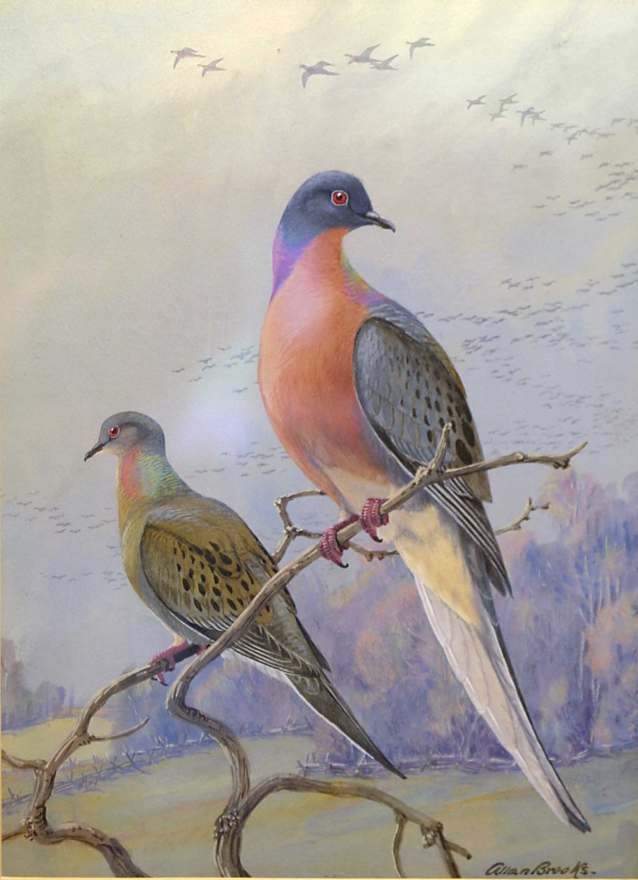
Partners in Flight
Keeping common birds common
Helping species at risk
Voluntary partnerships
www.PartnersInFlight.org/

Slide 5
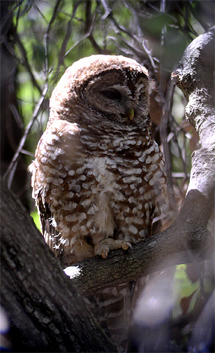
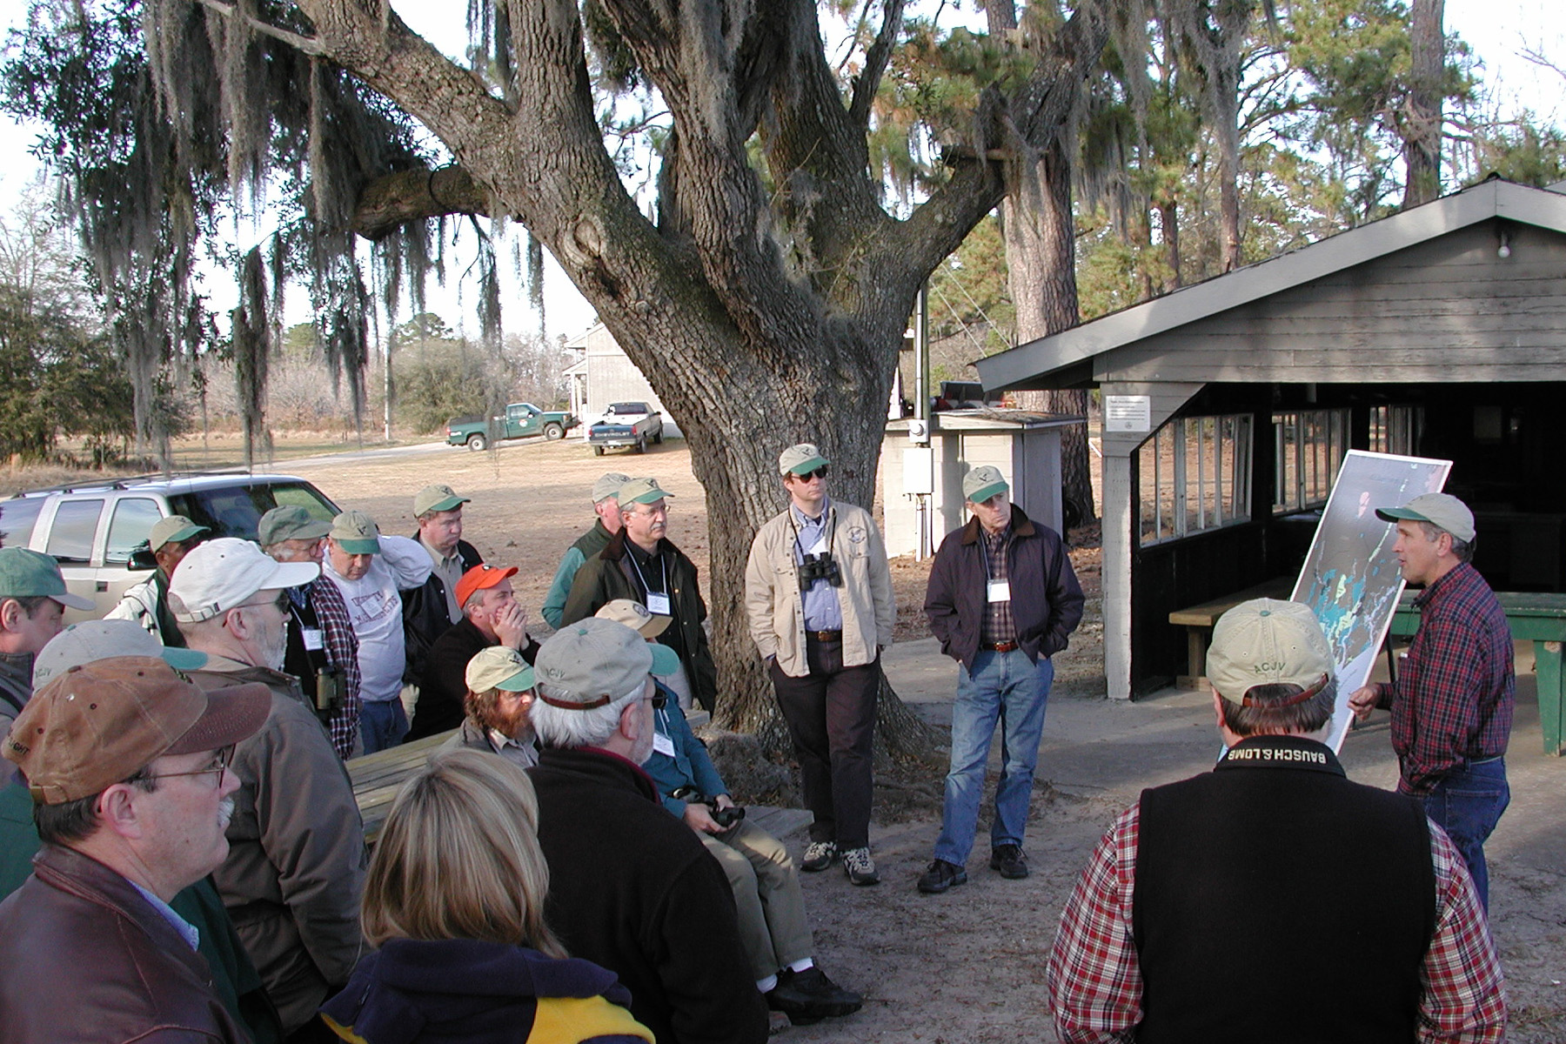
Proactive -- conserve birds before they become endangered or threatened
Non-adverserial partnerships

Slide 6
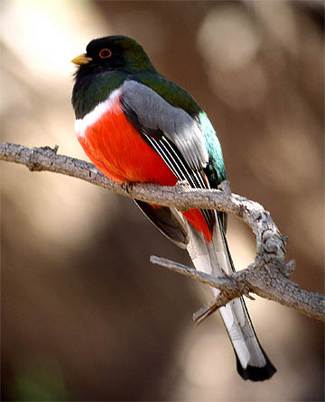

Species Conservation Assessment: six measures of vulnerability (1-5)
Population Size (PS)
Breeding Distribution (BD)
Non-breeding Distribution (ND)
Threats Breeding (TB)
Threats Non-breeding (TN)
Population Trend (PT)
PIF species assessment database: http://www.rmbo.org/pif/pifdb.html

Slide 7
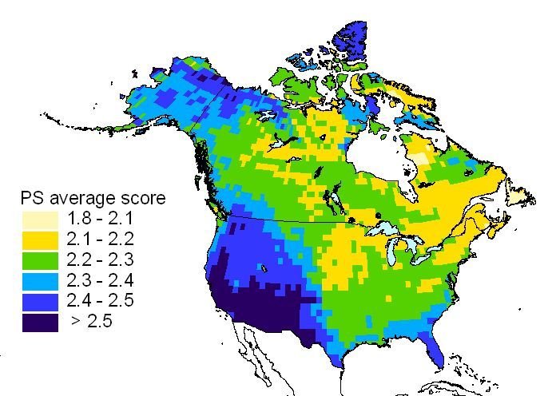
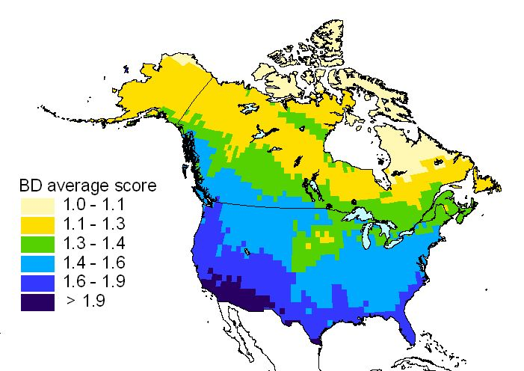
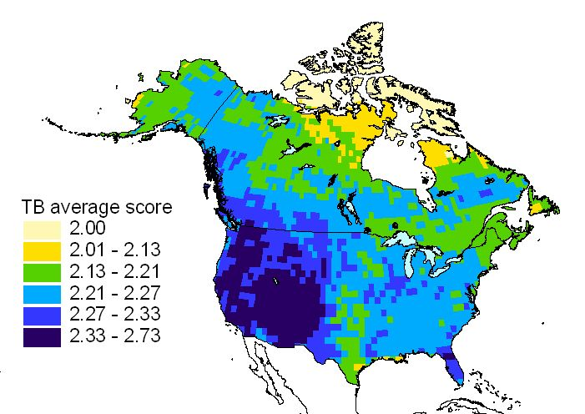
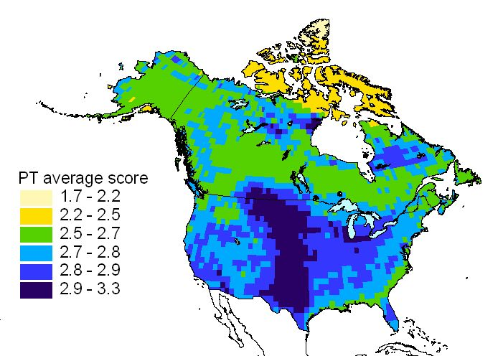
Distribution of Vulnerability

Slide 8
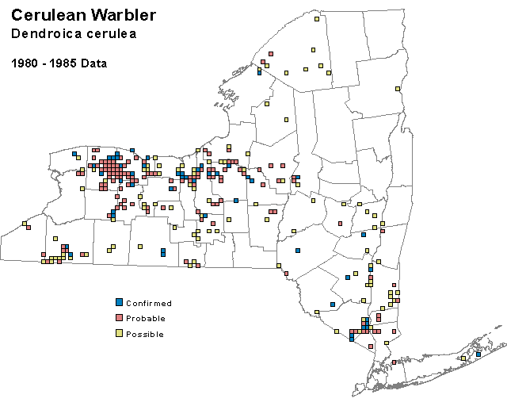
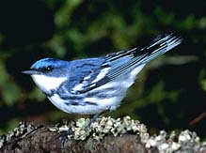
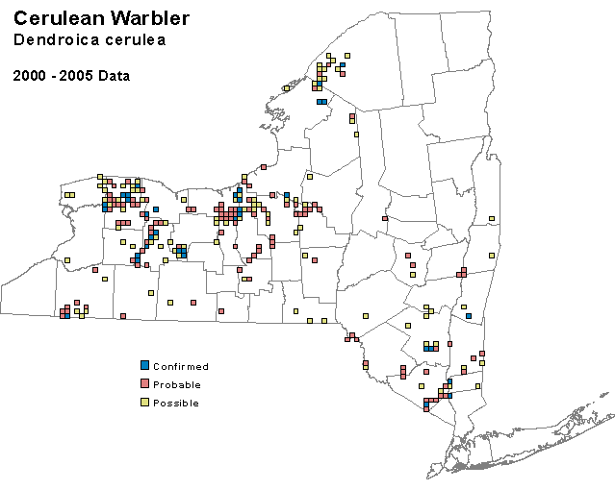
-13%

Slide 9
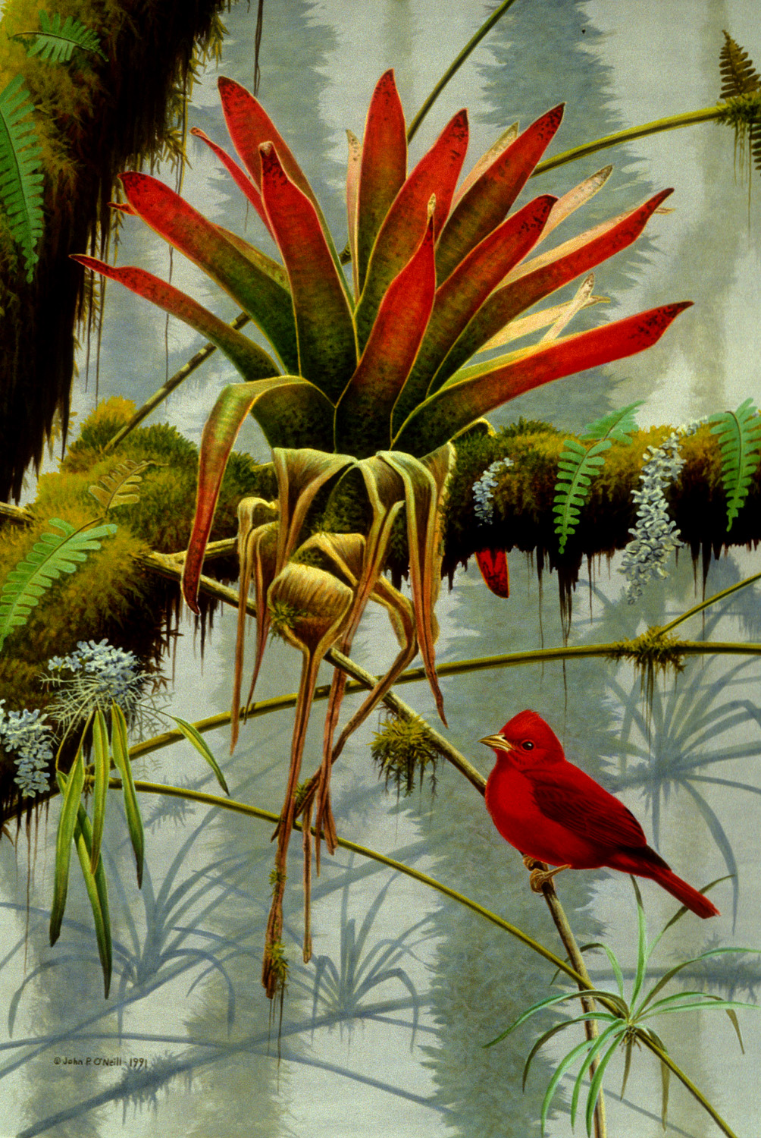
Full Life-cycle Stewardship
Winter:
Survival
Fitness
Jan
Dec
Feb
Nov
Mar
Migration:
Survival
Fitness
Oct
Apr
Sep
May
Migration
Breeding:
Fecundity
Survival
Aug
Jun
Jul
Notes:
In order to save birds, people need to stay connected and work together.

Slide 10
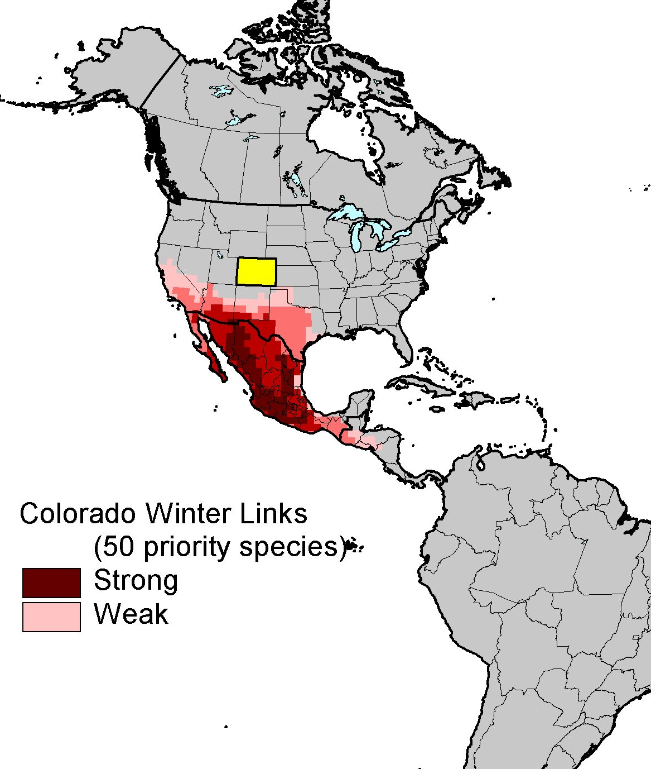
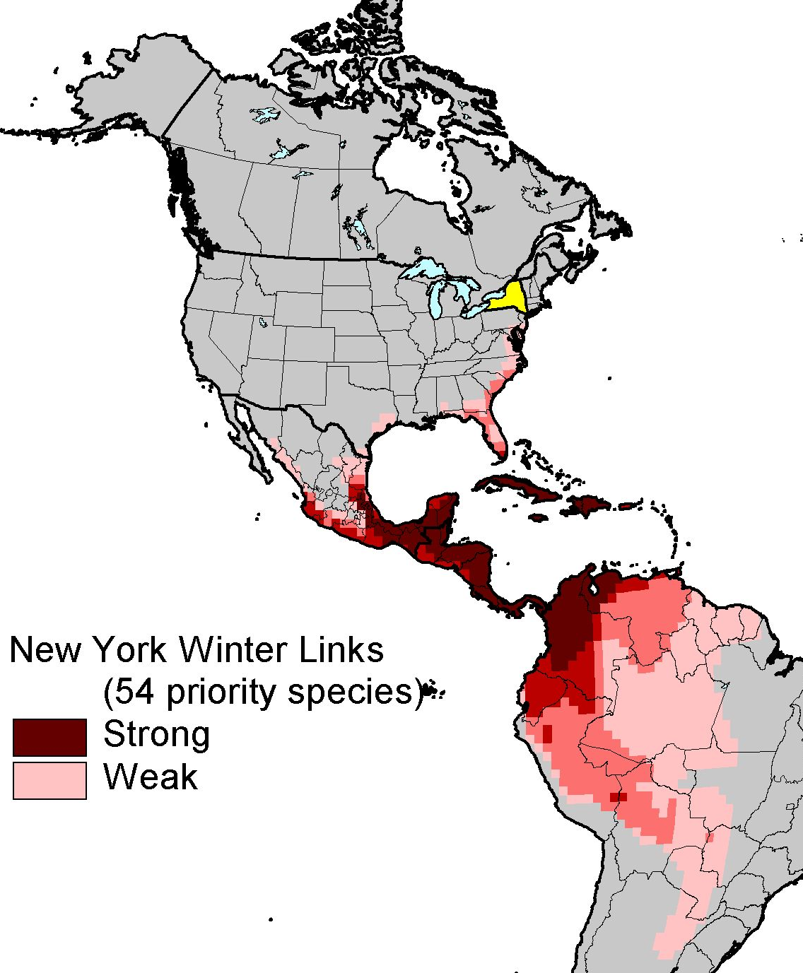
Migratory Connections

Slide 11
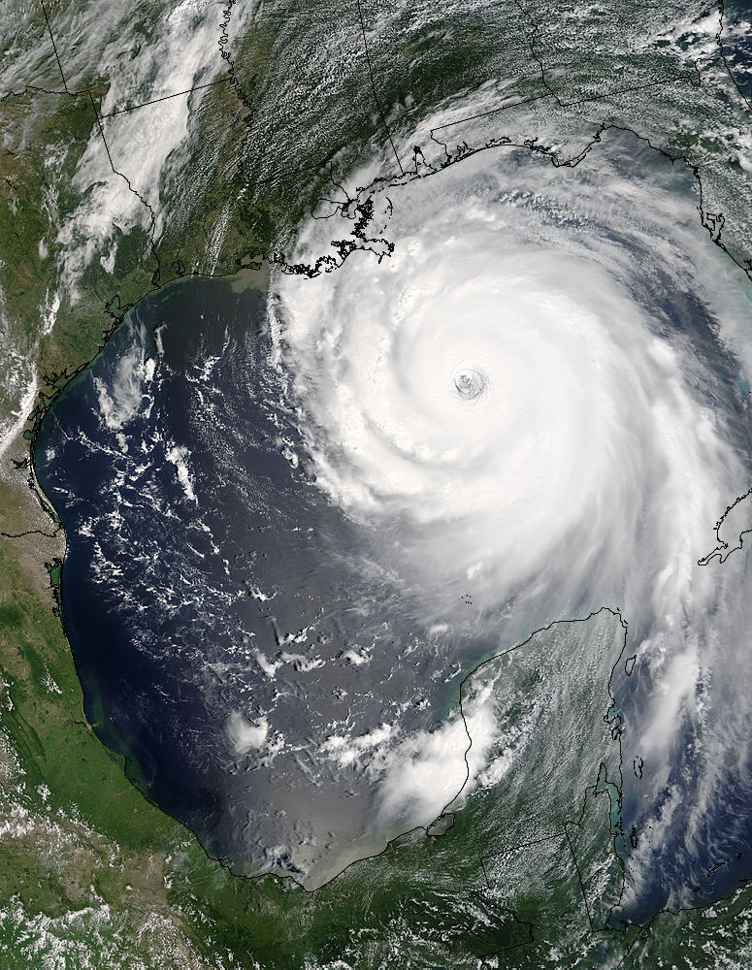
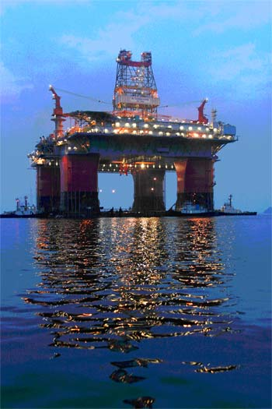
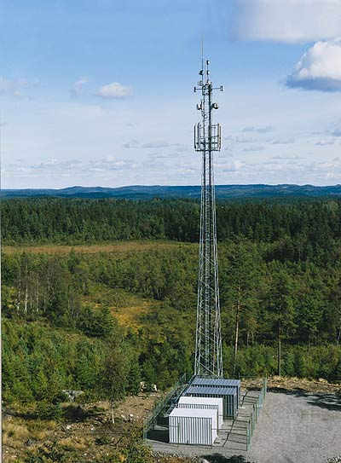
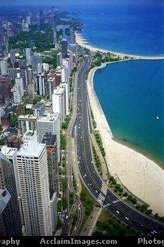
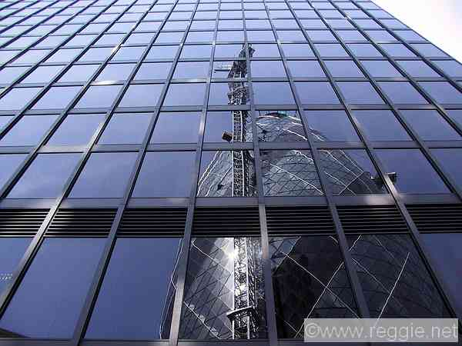
Mortality on Migration

Slide 12
Wind Energy and Bird Conservation
“conventional wisdom”
BUT, few data from sites/turbines and used inconsistent methodologies
(Erickson et al. 2002)
Wind
<1
???
Communication Towers
Pesticides
Vehicles
High Tension Lines
Other
Cats
Buildings/Windows

Slide 13

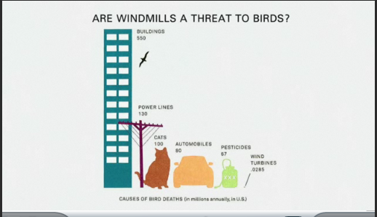

Slide 14
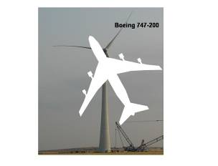
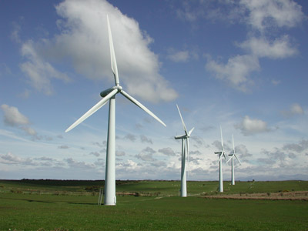
Wind Energy and Bird Conservation
Airspace as bird habitat
Rotor-swept area = 4 acres
Unknowns: re birds
3D distribution
Temporal occurrence
Can birds Avoid turbines?
95m

Slide 15
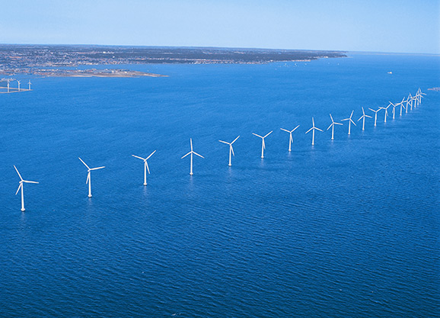
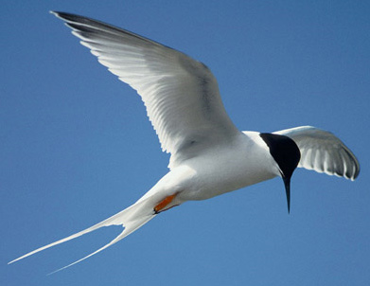
Off Shore Wind Development
3 km
Middelgrunden, Denmark
Roseate Tern

Slide 16
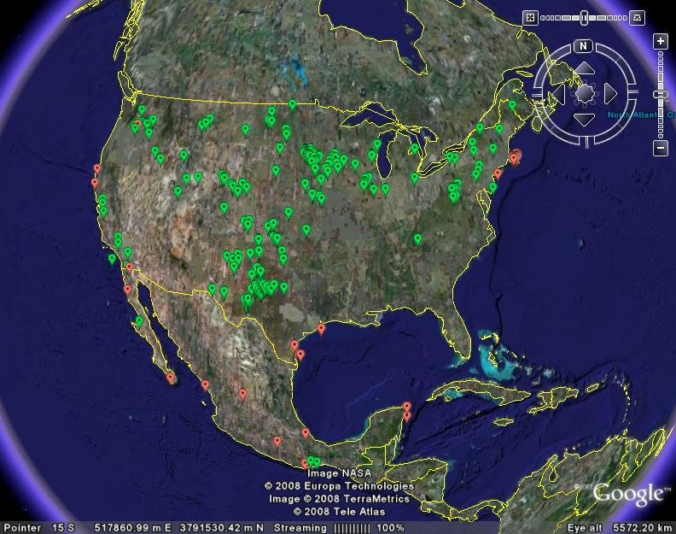
Wind Energy and Bird Conservation
Existing and proposed wind farms in US and MX (2008)
26,000+ turbines
1.5% of potential
“Build-out” to reach potential would require 1.7 million turbines
Notes:
Green dots are proposes wind sites. Red circles are areas known for major bird migrations that are also areas targeted for wind-power development

Slide 17
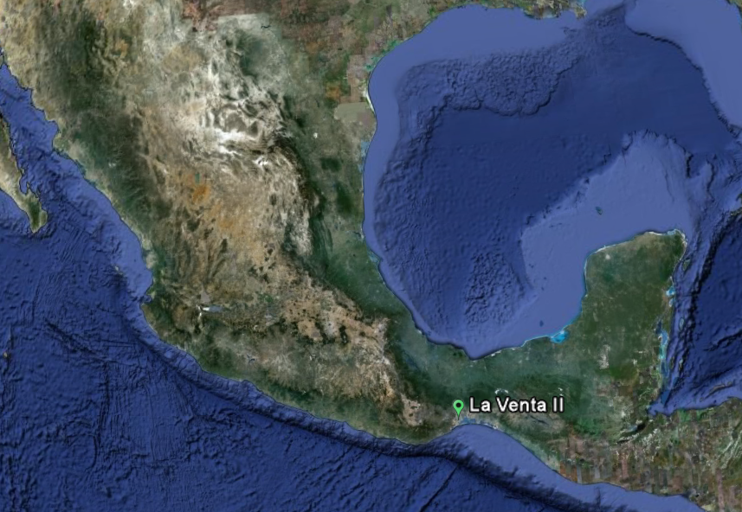
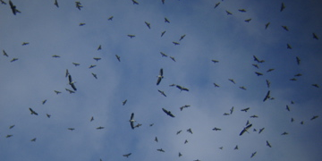
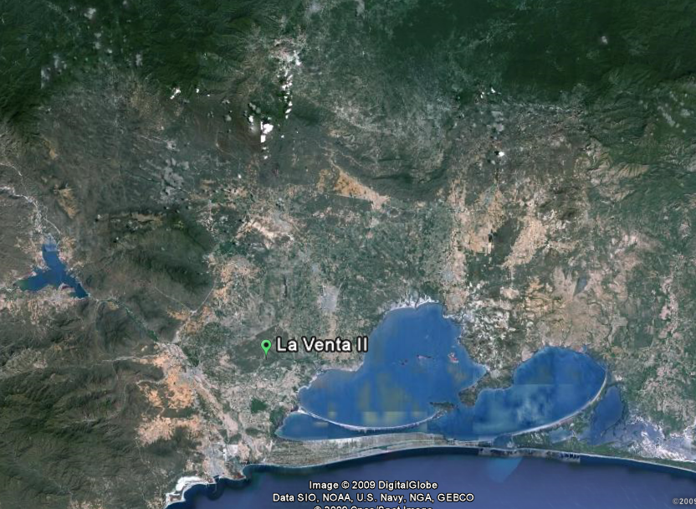
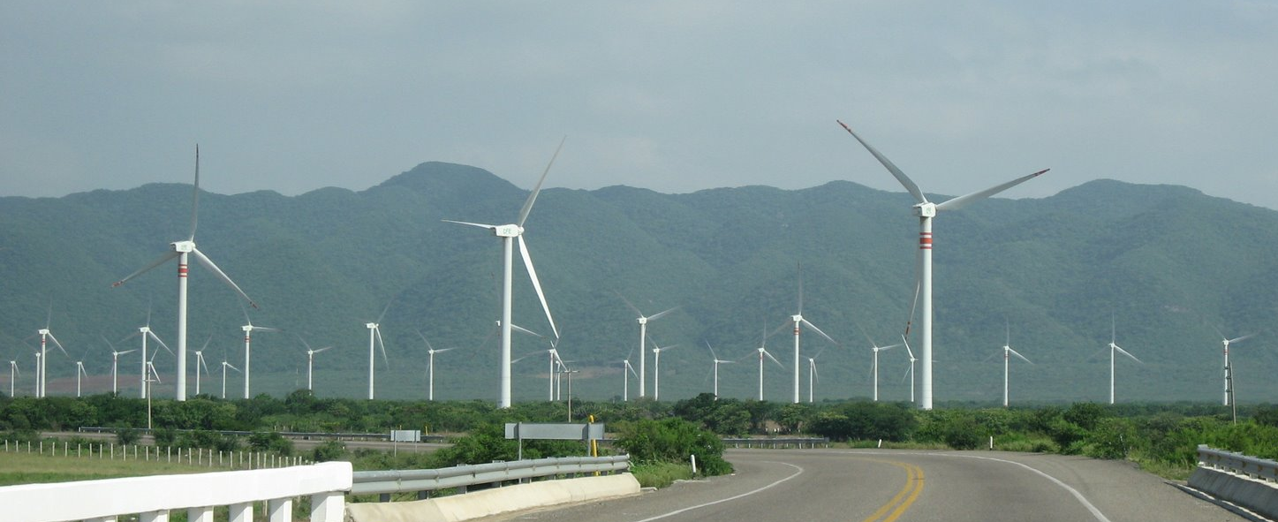
Wind Power and Birds at the Isthmus of Tehauntepec
River of Raptors
Major Migration Routes
MW Production
# Turbines
2,500MW of development by 2012
La Venta II

Slide 18
Wind Energy and Bird Conservation
What we know:
Areas with most favorable winds are also often associated with migratory pathways
Birds and bats do collide with turbines causing mortality, especially during migration
Population level effects are unknown because of a lack of standardized research
No mandatory environmental impact guidelines
Need coordinated research to assess risk and establish guidelines for siting and operation of turbines based on science

Slide 19
“Assessing Risks to Migratory Wildlife from Wind Energy Development
Major Research Priorities
  Standardize methodology for studying behavior and mortality during pre- and post- construction.
  Use current data to focus research on critically important migration and movement corridors. (“Red zones”)
  Predictive risk assessment – how are distributions of birds and within the rotor-swept area affected by species biology, weather, topography, and time?
  Coordinate data access, analysis, and archiving
Notes:
Under each of these major research priorities there are more specific sub-group questions to address species-level patterns, Siting, Post-construction monitoring (including fatalities, sub-lethal collisions or interactions, exposure risks, attraction or avoidance, and forecasting risk of interaction mortality), and Data Access, Analysis, and Archiving.

Slide 20
American Wind Wildlife Institute
“Imagine if a similar effort had taken place at the turn of the 20th century with the auto industry and air quality. We’d probably be in a completely different place when it comes to global climate change and energy dependence.” – Kraig Butrum, AWWI

Slide 21
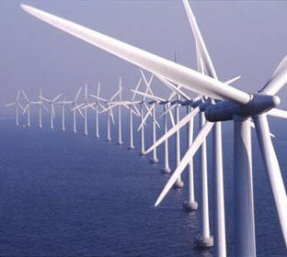
Wind Energy and Bird Conservation
Wind energy is fundamentally a good idea
We do not know what the research will reveal
The hope: incorporate safeguards at front end of design and construction
Cornell Lab will play lead role with acoustics and risk-assessment modeling

Slide 22
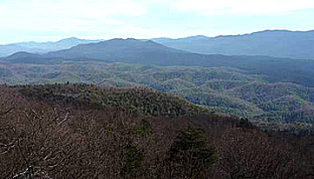
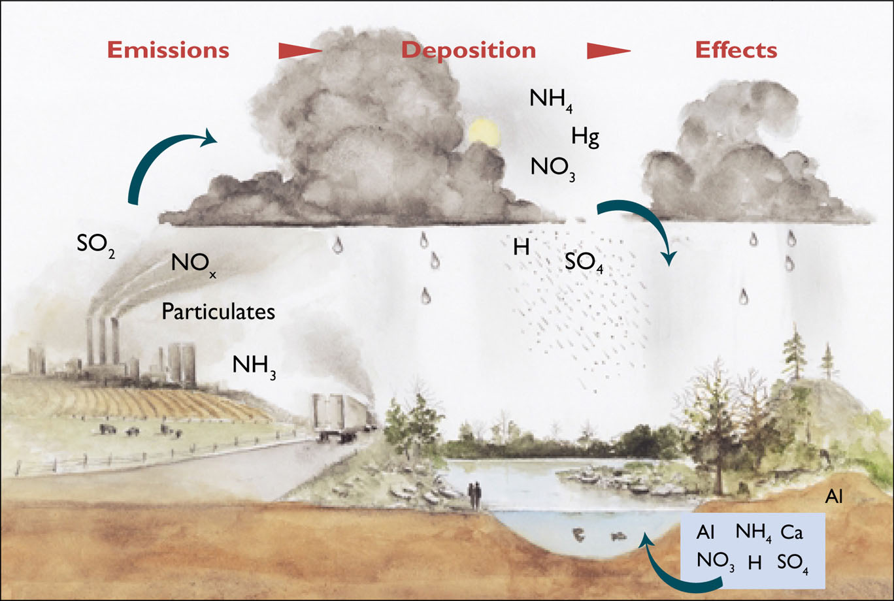
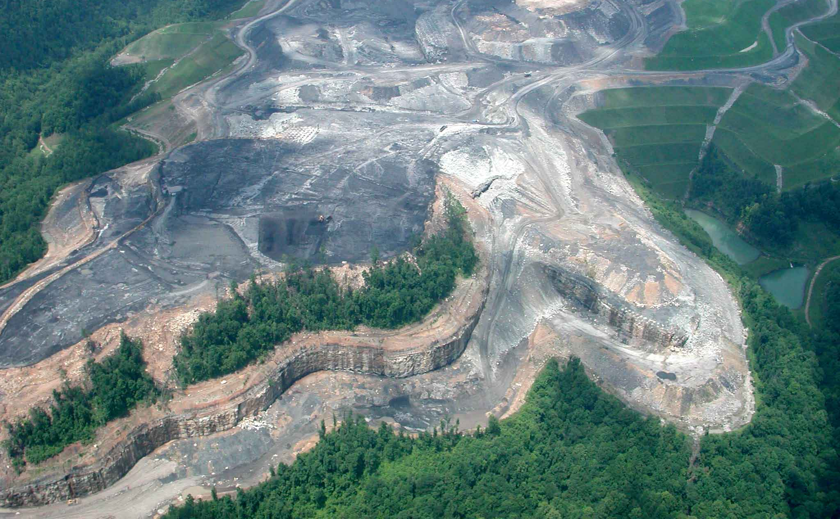
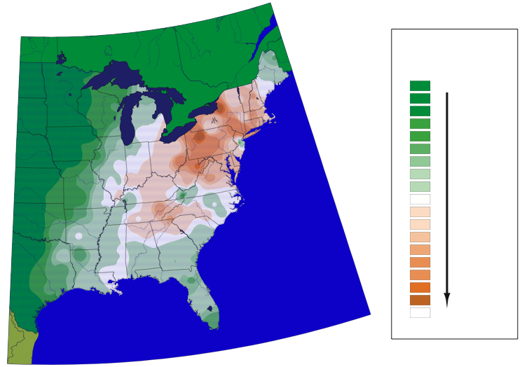
Must Compare with Alternatives – “birds/kw”
Mercury
Mountaintop removal
Acid deposition

Slide 23
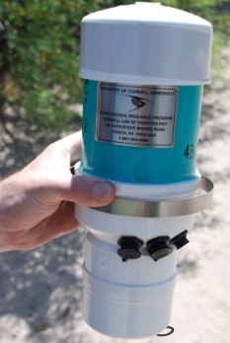
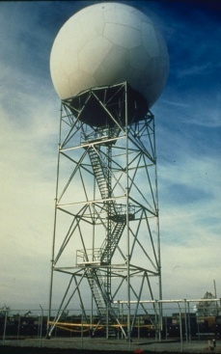
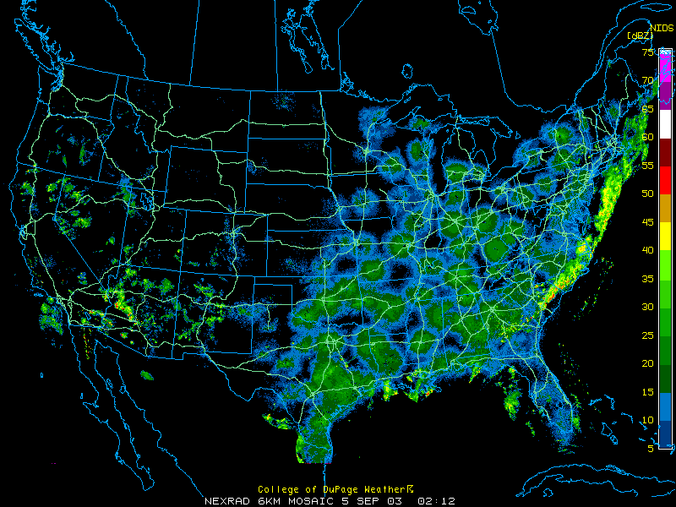
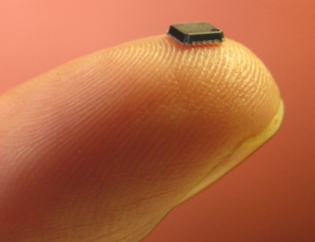
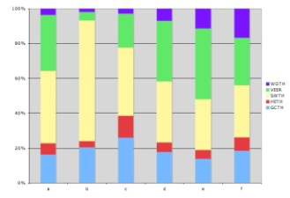
Integrated Basic and Applied Research for Conserving Migrants
Combining multiple technologies, integrating expertise, and fostering the next generation of scientists & leaders
Acoustics
Radar
Tags & tracking
eBird

