Slide 1
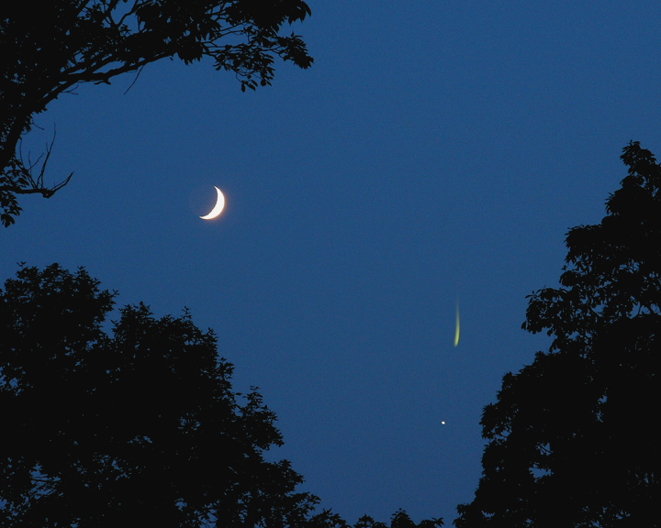

Notes:
1

Slide 2
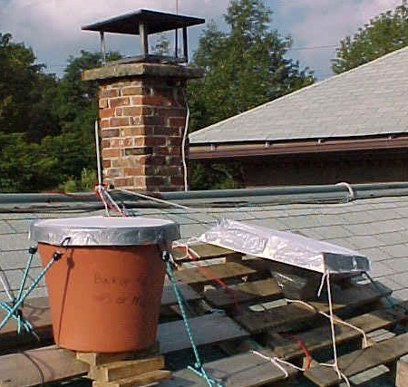
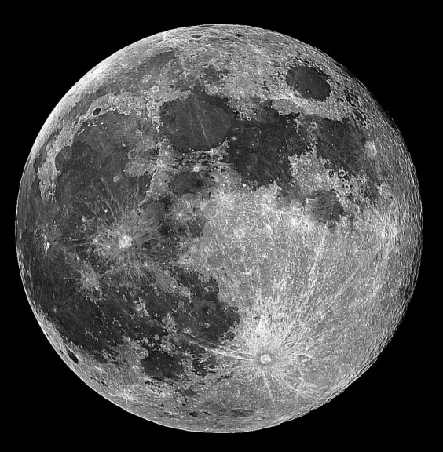
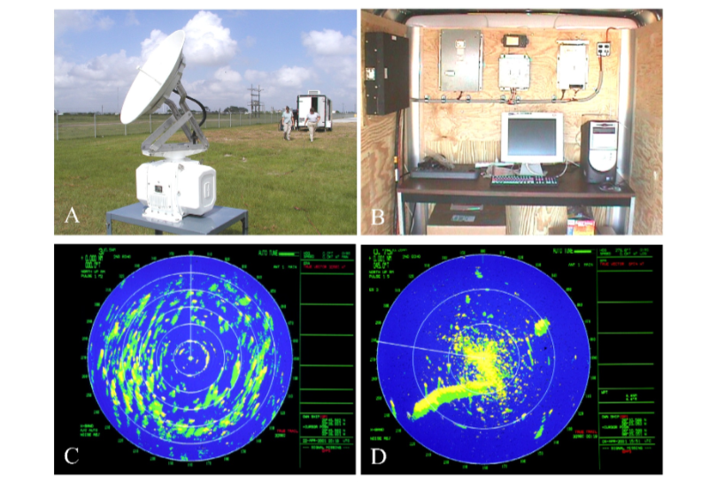
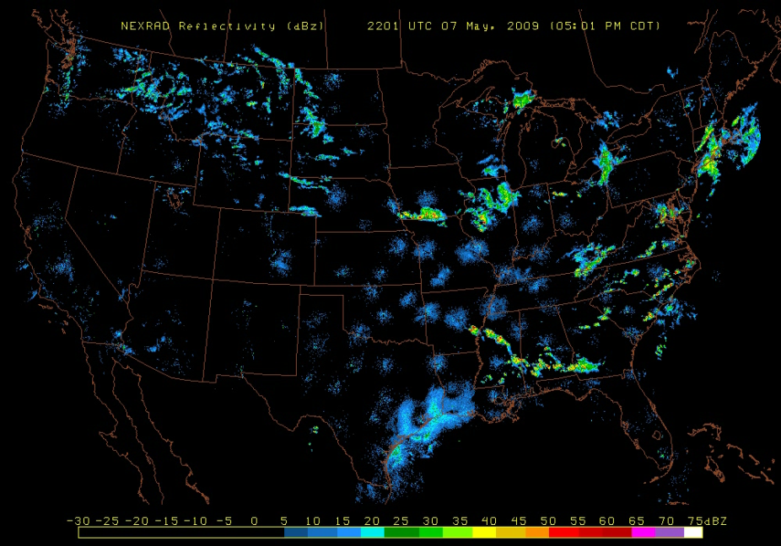
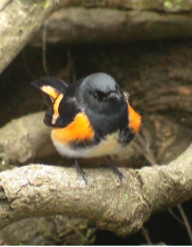
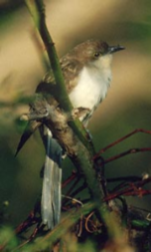
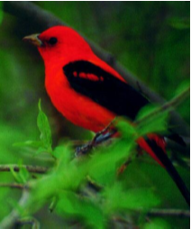

Slide 3
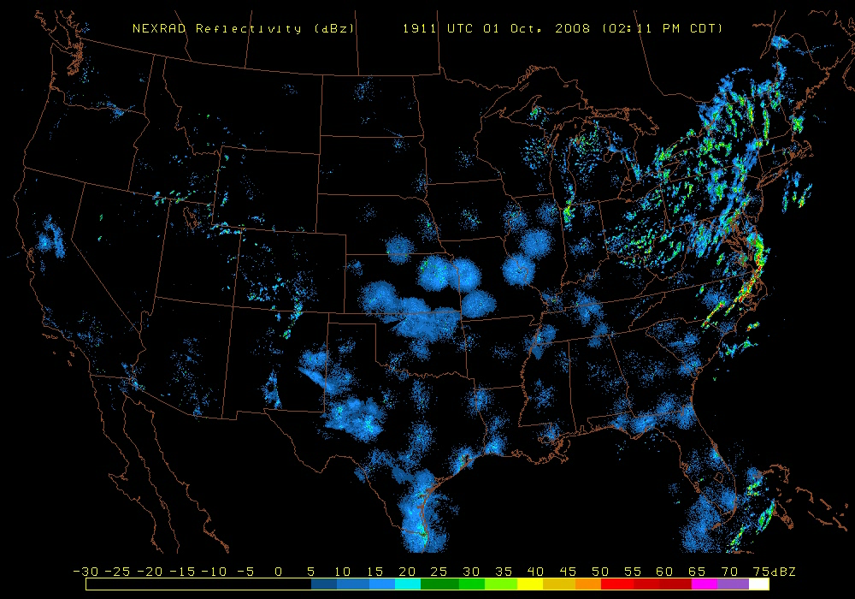
Continental Scale Phenomenon
The application of NEXRAD
Notes:
CHALLENGES!

Slide 4
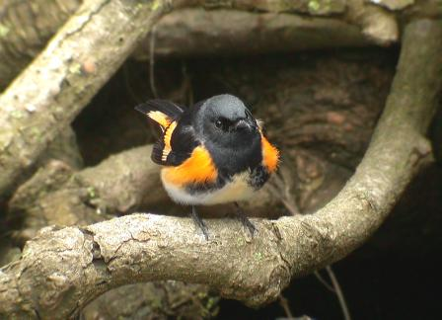
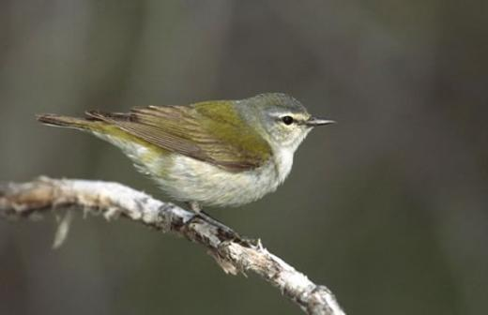
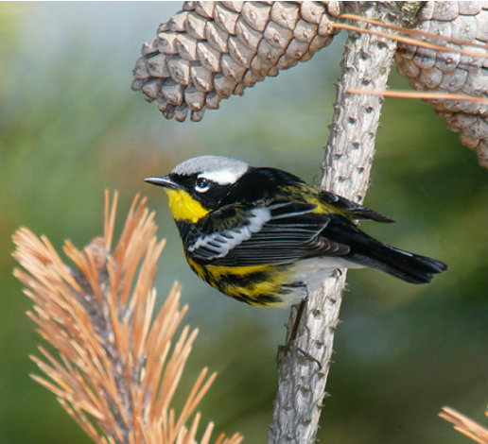
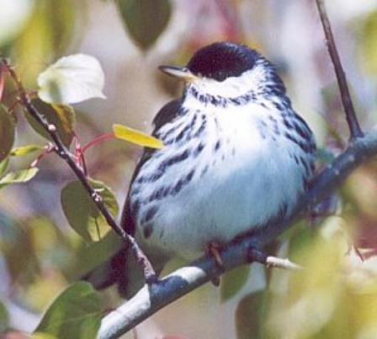

Slide 5

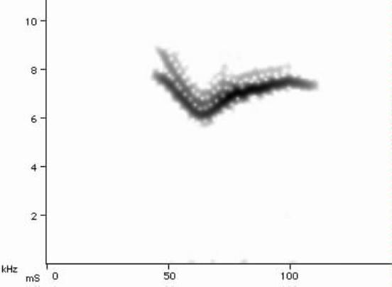
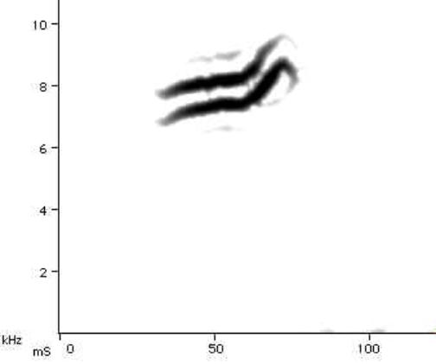
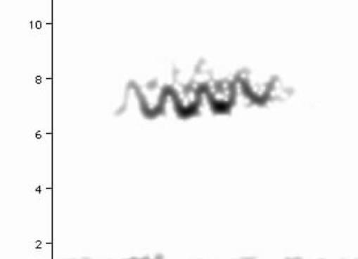
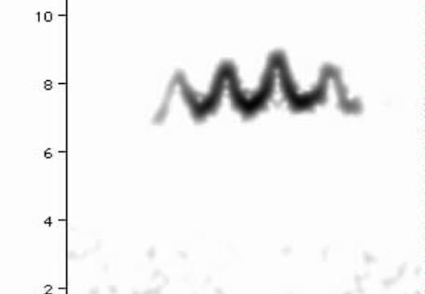

Slide 6
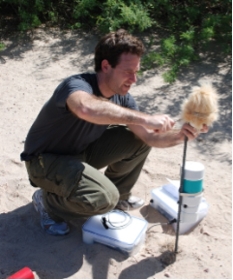
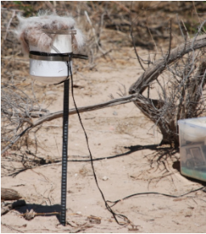
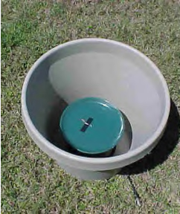
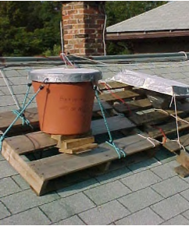
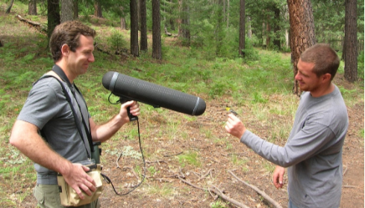
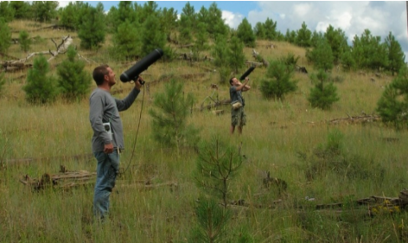
Recording flight calls: nocturnal
Recording flight calls: diurnal

Slide 7
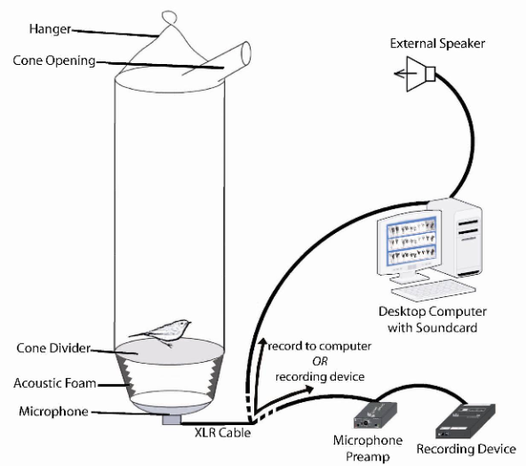
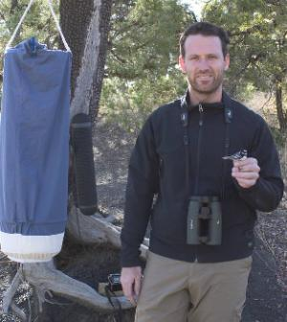





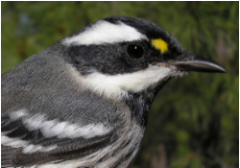

Recording flight calls: captive birds
(Lanzone et al. 2009)

Slide 8
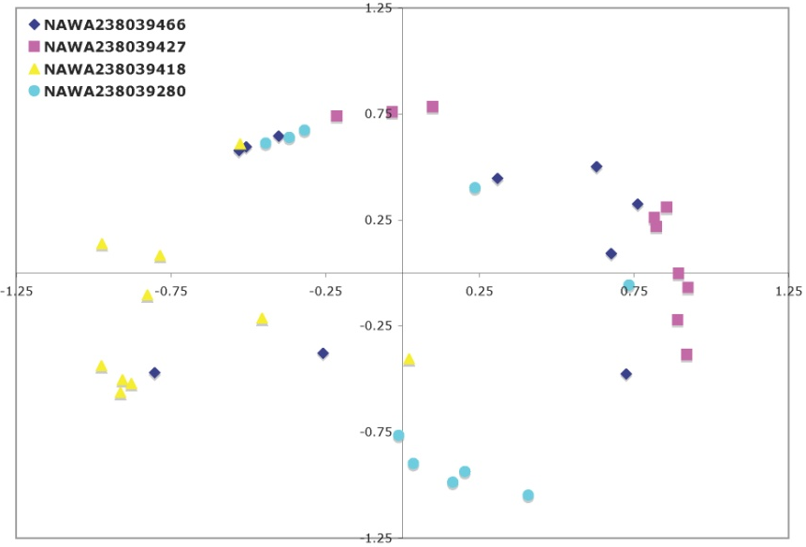
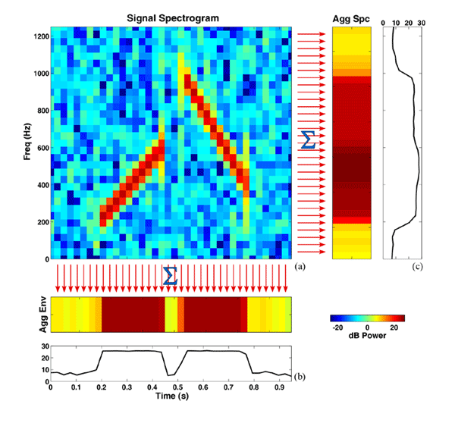
Some current ways to represent flight-calls
Spectrogram Cross Correlation
  Acoustic similarity among species
  Identify “template” for each species that best correlates with sample calls
Robust Signal Measurement
  Treat as probability distributions
  Characterize with statistics (e.g. median)
K. Cortopassi, unpublished data
Notes:
Now it’s possible to use much more objective method to quantify syllabic similarity, basically over-laying two sound spectrograms to see how well they match (in this case, perfect).
I used a program, written by Kathy Cortopassi in the Bioacoustic Research program, designed to cross-correlate and then ordinate sounds.
The idea here is to determine how similar are a pair of sounds, do this for a large number of sounds, then summarize the variation in similarity using a statistical method to reduce and to ordinate a large number of sounds.
I used this program to two ends
To represent variation among several thousand calls within a species for each of 47 species by choosing one template call that represented the greatest variation in the remaining calls
To compare syllabic properties among the 47 different template calls for each species

Slide 9
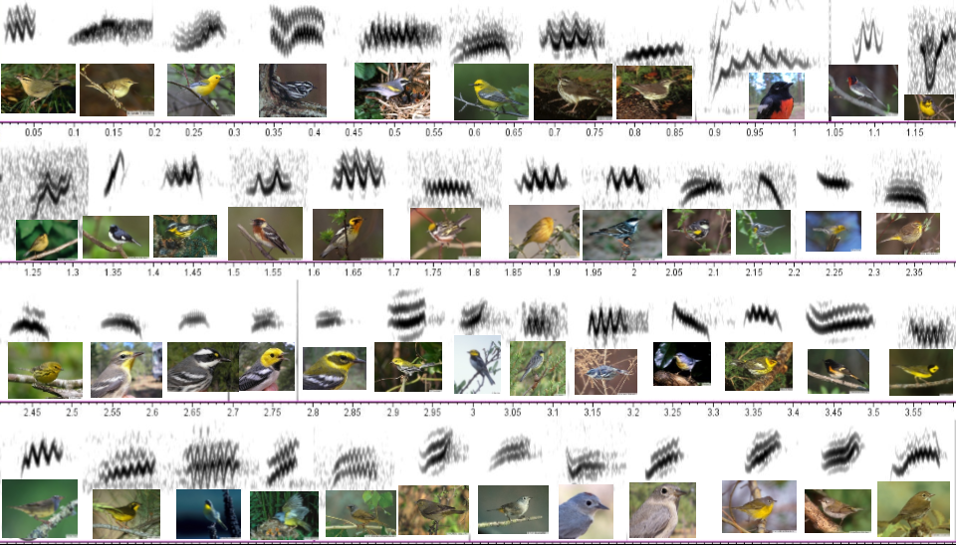

Using a “Rosetta Stone . . .”

Slide 10
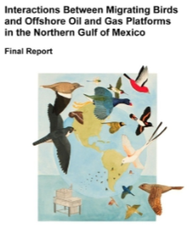
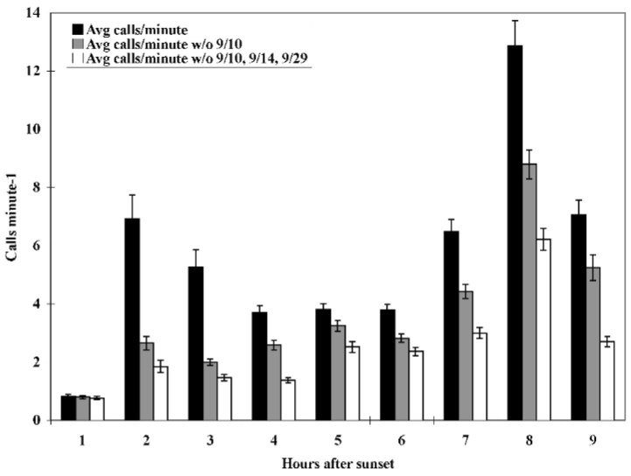
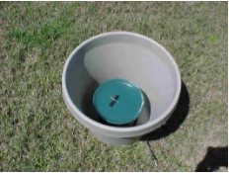

Daily Temporal Patterns Vary
Microphone Sensor
Sampling offshore
Farnsworth and Russell 2007

Slide 11
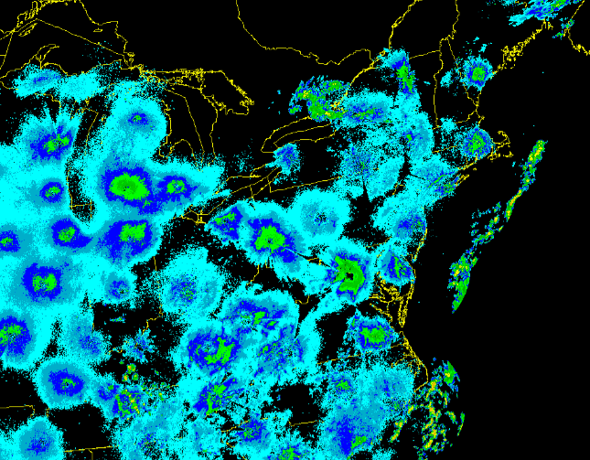
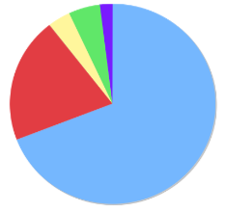
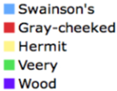
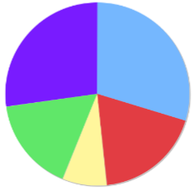
Species Composition Varies Over Time and Space
1142
New Jersey
114
Virginia

Slide 12
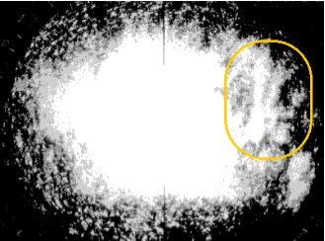
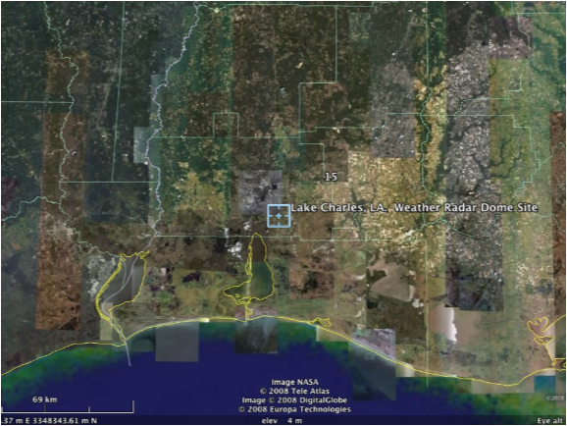
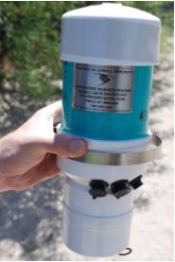

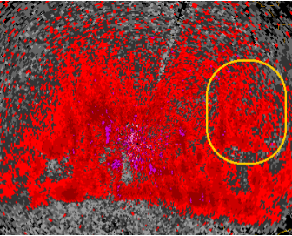
Identifying Key Stop-over Habitats using acoustic sensors and radar
Radar Image from Spring 1958
Radar Image from Spring 2001
Lake Charles, Louisiana WSR-88D
Images from Dr. Sidney A. Gauthreaux
Clemson University Radar Ornithology Laboratory

Slide 13
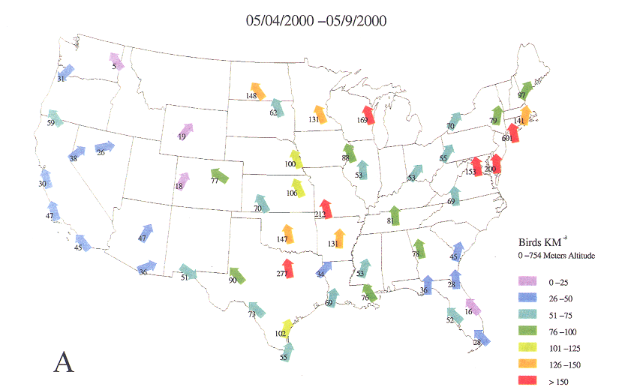
Direction and Magnitude of Migration
Gauthreaux et al. 2003

Slide 14
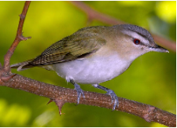
Challenges of Applying Technology for Monitoring Migrant Birds
  Very large datasets (TB) to analyze per sampling period per site.
  Data management, distribution, and integration
  Validation of species signal variation.
  Quantification of signal variation (individual, species).
  Quantification of signal probability detection functions.
  Quantification of location precision and accuracy.
  Software development for automatic detection, recognition and classification.
  Integration of data (radar, visual, tags)

Slide 15
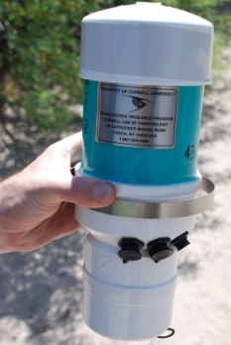
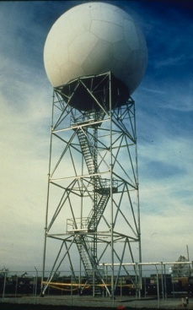
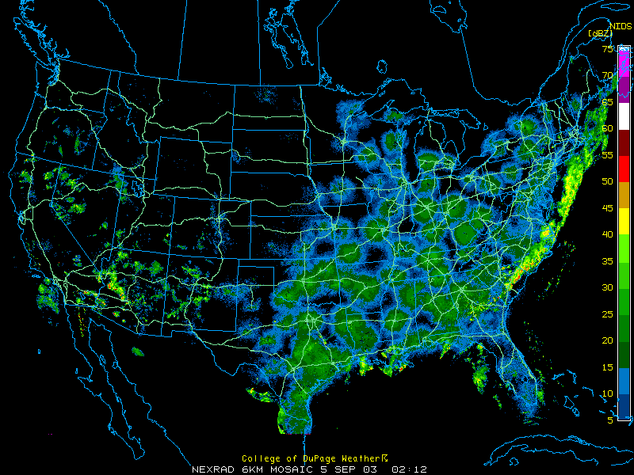
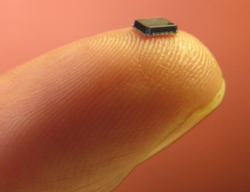
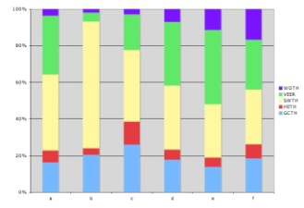
Integrated Basic and Applied Research for Conserving Migrants
Combining multiple technologies, integrating expertise, and fostering the next generation of scientist & leaders today
Acoustics
Radar
Tags & tracking
eBird

Slide 16
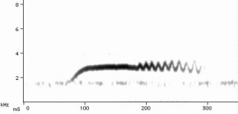
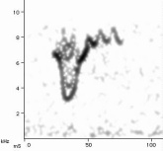
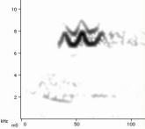








Understanding nocturnal bird migration patterns
Swainson’s Thrush
Canada Warbler
Blackpoll Warbler
Heavy spring flight - 2500 birds/km³
Scattered light rain
Exodus from coastal plain – 1750 birds/km³
Land Cover Features
Circum-gulf flight: 1750 birds/km³
Exodus from Cuba - 250 birds/km³
Topographic Features

Slide 17

Notes:
I’ll be generalizing to warblers here.

Slide 18








Why Study Migrants and Migration
Using Acoustic Technology?
It samples beyond the range of traditional mechanisms, simultaneously for multiple species.

Slide 19






Why Study Migrants and Migration
Using Acoustic Technology?
To monitor human activities with potential risks to wildlife.

Slide 20


Many species produce flight calls: unique signals given presumably for communication (e.g. in sustained flight).
Dickcissel
Black-billed Cuckoo
Red-breasted Nuthatch
Bobolink
White-throated Sparrow
Swainson’s Thrush
Evans and O’Brien (2002)

