Slide 1
Federated Array of Bricks Y Saito et al HP Labs
CS 6464
Presented by
Avinash Kulkarni

Slide 2
Agenda
Motivation
Current Approaches
FAB
Design
Protocols, Implementation, Optimizations
Evaluation
SSDs in enterprise storage

Slide 3
Motivation
Enterprise storage devices offer high reliability and availability
Rely on custom hardware solutions to gain better performance
Redundant hardware configuration to eliminate any single point of failure, but still very centralized
Workload characteristics vary widely based on client application
Advantages – good performance, reliability, failover capabilities
Disadvantages – expensive, high cost of development, lack of scalability
Can we build a distributed, reliable but cheap storage solution that is also scalable and strongly consistent?
Could we do this without altering clients in any way?

Slide 4
Have we come across some solutions in this class?
GFS – Google File System
Cheap, Scalable, Reliable
Optimized for workloads that are mostly composed of reads, and appends
Requires clients to be aware of file system semantics
Some aspects are centralized
Amazon - Dynamo
Cheap, Scalable, Reliable
Optimized for key-value storage
Eventual consistency
Pushes conflict resolution on to clients
Anti entropy, sloppy quorum, hinted handoff needed to manage ‘churn’
So, neither fits all our needs

Slide 5
Enter FAB
Aims to provide a scalable, reliable distributed storage solution that is also strongly consistent and cheap
Requires no modification to clients
Innovations
Voting based replication
Dynamic quorum reconfiguration
Strongly consistent
Safety over liveness
Not optimized for any particular workload pattern
Assumptions
Churn is low?
Failstop
Non-byzantine

Slide 6
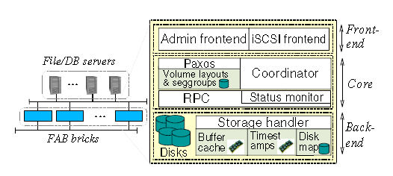
FAB Structure
Organized as a decentralized collection of bricks
Each brick is composed of a server attached to some amount of storage
All servers are connected with standard Ethernet interface
Each server runs the same software stack composed
iSCSI front end,
Core layer for metadata processing,
backend layer for disk access
Each server can take on 2 roles
Coordinator
Replica
Observation
Buffer cache management is done by backend layer on each individual server. No global cache…

Slide 7
FAB operation
Client sends a request <vol id, offset, length> to coordinator
Coordinator locates the subset of bricks that store data for the request
Coordinator runs replication or erasure code protocol against set of bricks, passing the <vol id, offset, length> to them
Bricks user the tuple provided to locate the data on physical disks they contain

Slide 8
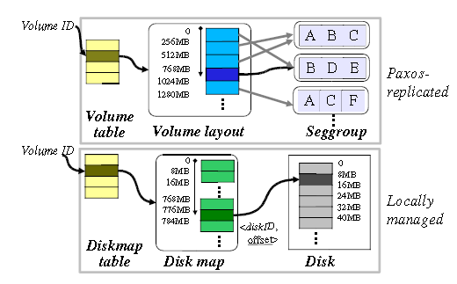
Key Data Structures
Volume layout
Maps a logical offset to a seggroup at segment granularity(256MB)
Seggroup
Describes layout of segment, including bricks that store the data
Disk Map
Maps logical offset in a request tuple to physical offset on disk at page granularity(8MB)
Timestamp table
Information about recently modified blocks of data

Slide 9
Data layout & Load balancing
All segments in a seggroup store data at same replication/erasure code level
Logical segments are mapped semi-randomly, preferring seggroups that are lightly utilized
Logical block to physical offset mapping on bricks is done randomly
How many seggroups per brick?
Higher the number, the more evenly load can be spread in the system on event of a brick failure
But as we increase the ratio, we reduce the reliability of the system because it increases the chances of data loss from combination failures
FAB uses 4 as an optimal number
Load balancing
Status messages flow between replicas, exchanging information about load
Gossip based failure detection mechanism
Not static like Dynamo which relies on consistent hashing for distributing load
No concept of virtual nodes to accommodate heterogeneity of storage server capabilities.

Slide 10
Design decisions
2 approaches to redundancy
Replication
Erasure codes
Replication
Each segment of data is replicated across some number of replicas
Unlike Dynamo, no version numbers are assigned to copies of data as vector timestamps
Instead, each replica maintains 2 timestamps for each 512 byte block of data on the replica
ordT: Timestamp of the newest ongoing write operation
valT: Timestamp of the last completed write that has been written out to disks

Slide 11
Design Decisions - Replication
Write proceeds in 2 phases
Order phase
Generate a new timestamp for this write, and send it to the bricks. Wait till majority accept
Write phase
Replicas update data from client and set valT to be equal to ordT generated above
Read is usually 1 phase
Except when an incomplete write is detected.
Read must now discover the value with the newest timestamp from majority, then writes that value with timestamp greater than any previous writes to a majority
Unlike Dynamo, Read always returns the value of the last recent write that was committed by a majority.

Slide 12
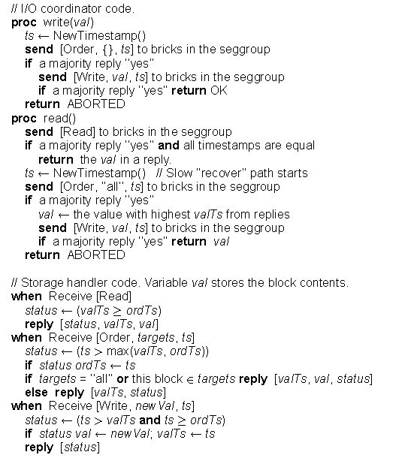
Design Decisions – Replication Protocol

Slide 13
Design Decisions – Erasure Coding
FAB supports (m, n) Reed-Solomon erasure coding.
Generate (n-m) parity blocks
Reconstruct original data blocks by reading any m of n blocks
Coordinator must now collect m + ceil( (n – m )/2 ) responses for any operation, so that intersection of any 2 quorums will contain at least m bricks
Write requests are now written to a log during phase 2 instead of being flushed to the disk right away
On detecting incomplete write, read will scan log to find newest strip value that can be reconstructed
Log does not have to grow infinitely. Coordinator can direct bricks to compress logs once response is returned to client. A asynchronous ‘Commit’ operation is sent to bricks to direct them to flush log writes to disks

Slide 14
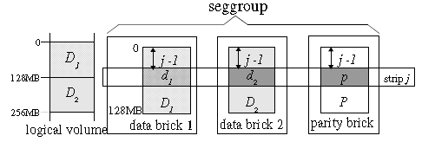
Design Decisions – Erasure Code
Some modifications to replication layer needed to implement EC on FAB
Addition of a log layer on replicas to eliminate strip corruption on incomplete writes
Addition of a asynchronous commit operation at the end of write to compress and garbage collect logs on replicas

Slide 15
Design Decision - Optimizations
Timestamps
One 24 byte timestamp for every 512byte block is very expensive in terms of storage
Recall that timestamps are needed only to distinguish between concurrent operations
So, coordinator can ask bricks to garbage collect the timestamps once all replicas have committed the operation to disks
Most requests span multiple blocks, so they will have the same timestamps. An ordered tree could be used to store a mapping between timestamps and the data blocks they pertain to
Read operations
Reads of data from a quorum can be expensive in terms of bandwidth. So read requires only timestamps from replicas, while data could be efficiently read off one replica
Coordinator failures are not handled by the system as a simplification. Clients can detect these, and issue the same request to a new coordinator

Slide 16
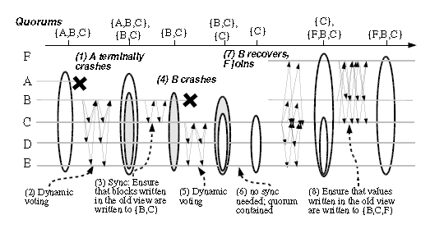
Design Decisions - Reconfiguration
View agreement through dynamic voting in a three-round membership protocol
Need for a synchronization step after a new view is agreed upon

Slide 17
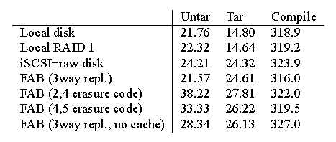
Evaluation
Application performance
3 different workloads – tar(bulk reads), untar(bulk writes), compile(reads and writes)
Notes:
How are FAB(3way) numbers for Untar better than Local Disk?

Slide 18
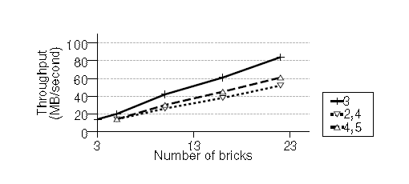
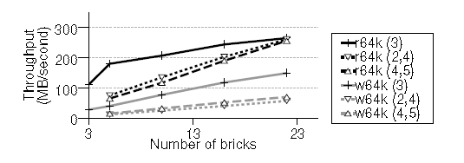
Evaluation
Scalability – aggregate throughput and random read/write throughput

Slide 19
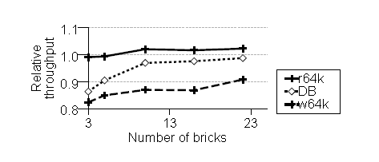
Evaluation
Scalability – comparison of throughput with master-slave FAB

Slide 20
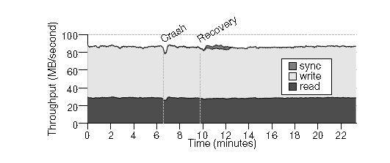
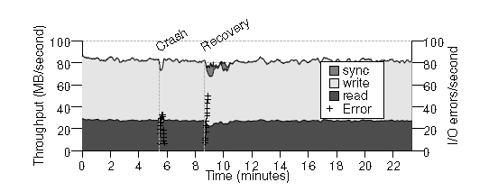
Evaluation
Handling changes – comparison with master-slave FAB

Slide 21
SSDs in enterprise storage – An analysis of tradeoffs
Dushyanth Narayanan et al

Slide 22
Are SSDs useful in current enterprise environment?
Use of SSDs in enterprise storage systems requires optimizing for performance, capacity, power and reliability
Currently, SSDs offer very high advantage in terms of random access read operations, and lower power consumption
But they are very expensive
Orders of magnitude costlier than current disks(IDE/SCSI)
Prices have been declining, and predicted to fall further
But are there situations in current enterprise environment where SSDs could be used now?

Slide 23
Analysis of tradeoffs
Here’s a listing of device characteristics

Slide 24
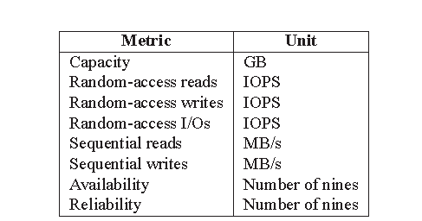
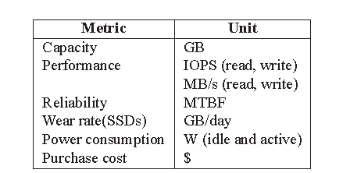
Analysis of tradeoffs
Authors traced typical workloads in enterprise environment and enumerated device characteristics

Slide 25
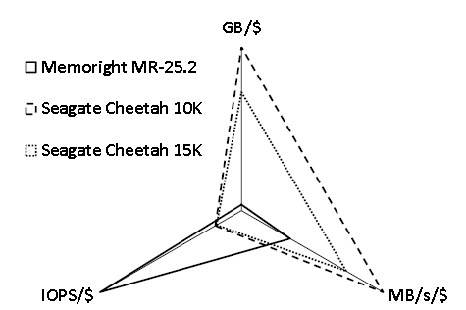
Analysis of tradeoffs
How do SSDs rack up against normal drives?

Slide 26
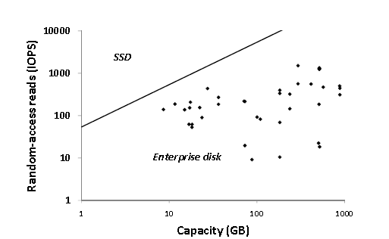
Analysis of tradeoffs
Can SSDs completely replace normal drives for the workloads traced based on their capacity/random-reads requirement? Not really.

Slide 27
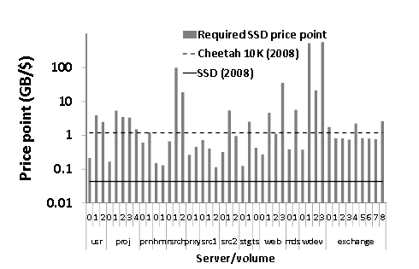
Analysis of tradeoffs
How do SSDs measure up to normal drives on price points? Not very well at present.

Slide 28
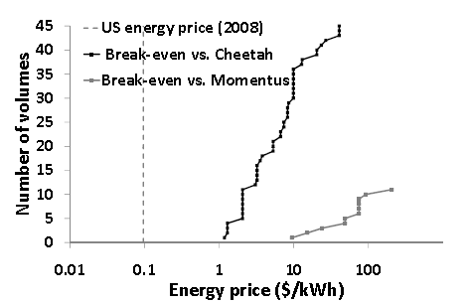
Analysis of tradeoffs
How about power? Can we not save a lot of money based on the small power footprint of SSDs? Turns out we don’t really save much at current energy prices

Slide 29
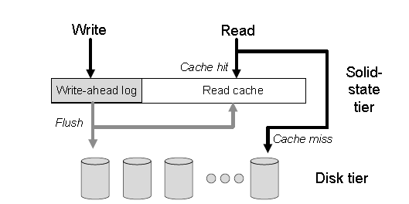
Analysis of tradeoffs
So, is there a place for SSDs in enterprise storage?
Maybe – recall the tiered storage model we use with DRAM and normal drives
DRAM serves as a buffer for underlying slow, normal drives
Insight – SSDs could do serve the same purpose! They are fast, but cheaper than DRAM. Also, they are persistent, compared to DRAM.
We need to account for the poor random write performance before we do this. Use newer flash file systems that convert random writes to sequential log entries

Slide 30
Some discussion points
Each brick in FAB maintains its own cache – how does that affect performance?
How can FAB accommodate heterogeneous storage servers?
Any others?

Slide 31
Analysis of tradeoffs

