Slide 1
Cumulus: Filesystem Backup to the Cloud
Michael Vrable, Stefan Savage, and Geoffrey M. Voelker
Presented by Hakim Weatherspoon

Slide 2
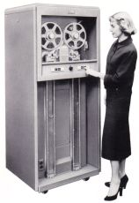
Good ‘ole Days
Replace your tape drives
with something truly scalable

Slide 3
Amazon S3 to the rescue
In Spring 2006, Amazon released a new
storage API: Put, Get, List, Delete
Build whatever you want!
Quickly

Slide 4
Backing up the new way (S3)‏
Smart
Scales - no longer our concern... Amazon's concern - all servers backup in parallel
Cheap - old cost = XXX per year - new cost = YYY per year
where YYY < XXX

Slide 5
Thin vs Thick Cloud
E.g. Amazons S3 vs EMC’s MozyPro
Thin
Can change provider easier
Applications can work across providers
Thick
Better performance
Locked into a provider
Provider can go out of business

Slide 6
Cumulus
Simple storage backup utility for Thin Clouds
Evaluates efficacy of cloud storage
Working prototype
http://www.cs.ucsd.edu/~mvrable/cumulus/

Slide 7
Outline
Motivation/Intro
Related Work
Design
Evaluation
Thoughts and Conclusions

Slide 8
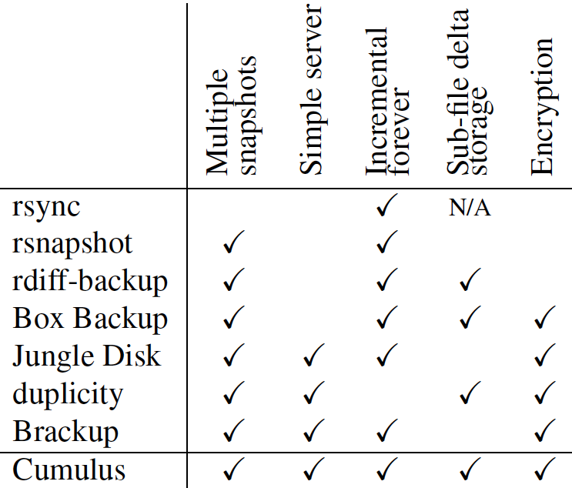
Related Work

Slide 9
Outline
Motivation/Intro
Related Work
Design
API
Segments
Snapshots
Subfile incrementals
Cleaning
restoring
Evaluation
Thoughts and Conclusions

Slide 10
API
Same as S3
Put, Get, List, Delete
Thin cloud – does not rely on integrated services
Can easily change provider and network protocols
S3, FTP, SFTP
WORM Model
Write-once, read-many
Requires writing new entirely file if changes occur
What are the cleaning overheads?

Slide 11
Segments
Aggregation via Segment Goals
Avoid costs due to small files
S3 charges on per file bases
Many small files
Avoid costs in network protocols
Small files have higher latency and other overheads
Compression
inter-file similarities
Privacy
Hide file boundaries
Negative consequences?
Need an entire segment to write

Slide 12
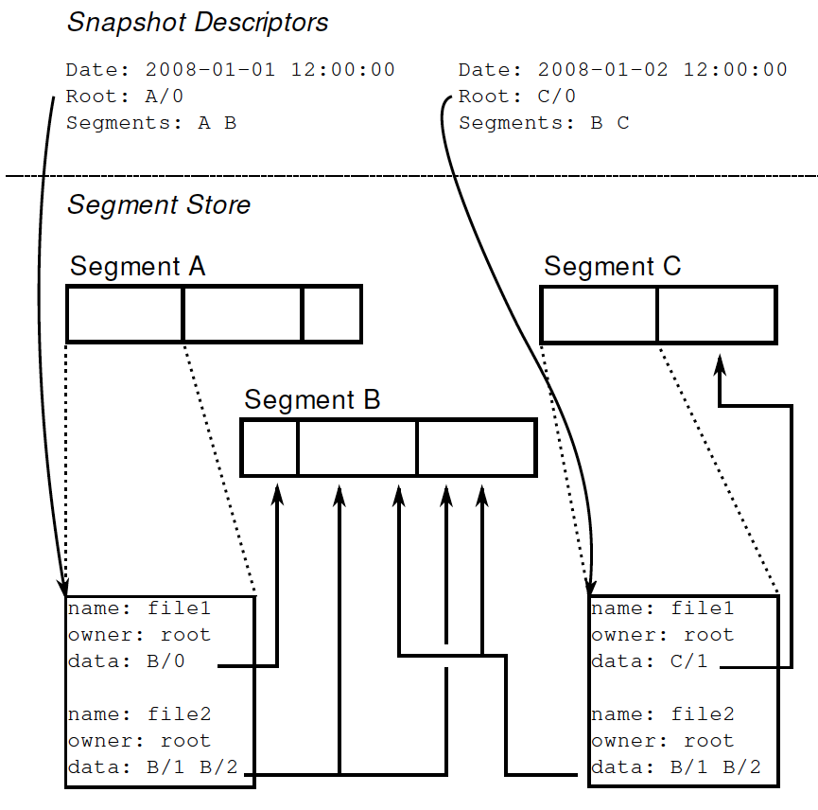
Snapshots

Slide 13
Sub-File Incrementals
Only stored changed part of files
New snapshots point to old objects when data unchanged
Byte ranges – portions of old objcts to be reused

Slide 14
Segment Cleaning
Similar to a log-structured file system (LFS)
Clean based on utilization of segment, α
α = 0, no cleaning
α = 1, clean with the slightest change
Cumulus
attempts to find an equilibrium for α
Uses a different process to clean
Marks a local database as “expired”
Then, next snapshot will not refer to expired segment

Slide 15
Restore
Full Restore
Download all segments for a snapshot
Partial Restore
Download snapshot descriptor, metadata, and only necessary segments
What happens if client machine dies?
How is latest snapshot descriptors identified?
What about sharing between client machines?

Slide 16
Outline
Motivation/Intro
Related Work
Design
Evaluation
Performance Case Study
Monetary Case Study
Thoughts and Conclusions

Slide 17
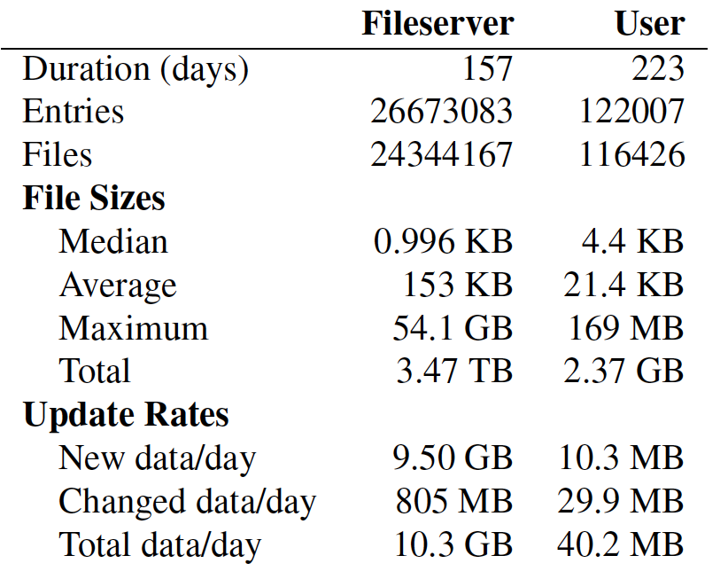
Evaluation Traces

Slide 18
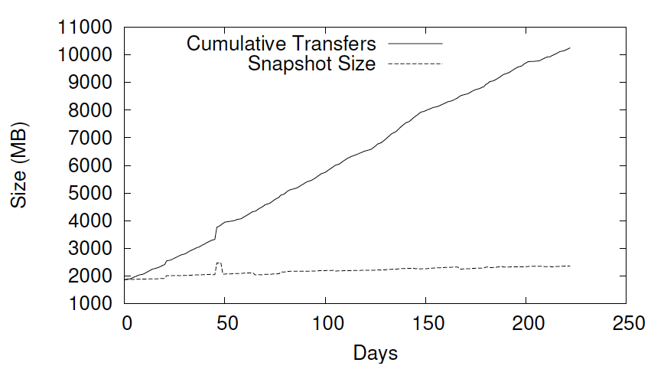
Backup over time (user trace)

Slide 19
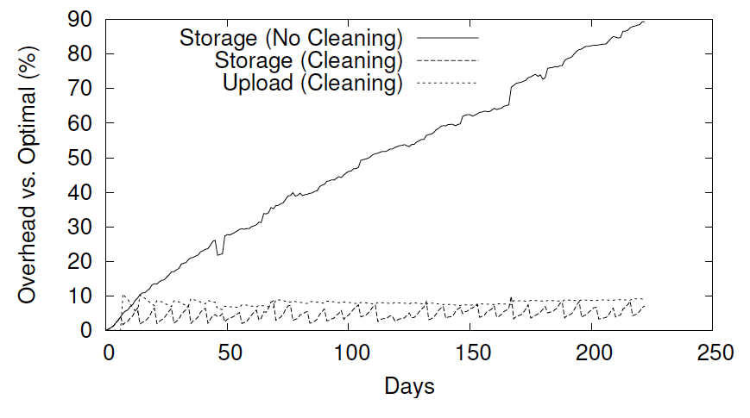
Backup w/out Segment Cleaning (user trace)

Slide 20
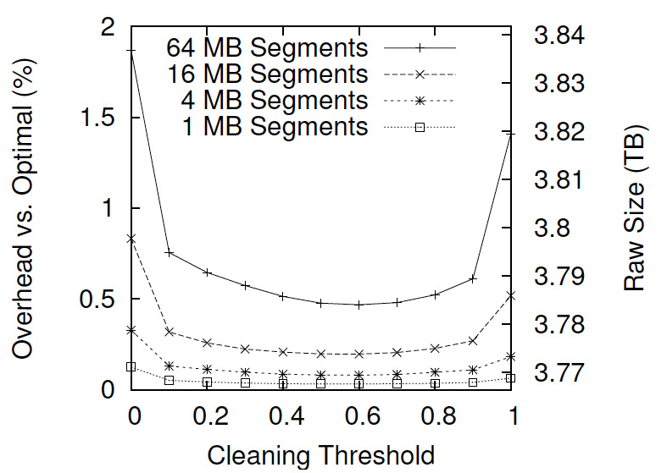
Average Daily Storage (fileserver)

Slide 21
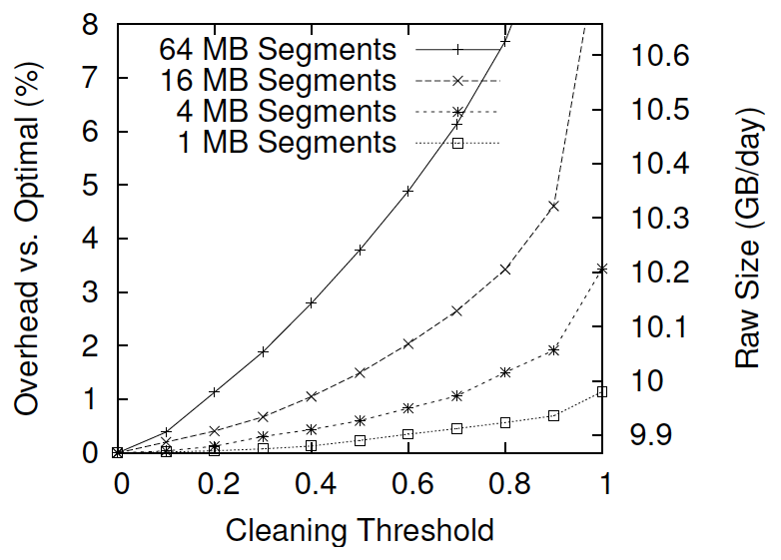
Average Daily Upload (fileserver)

Slide 22
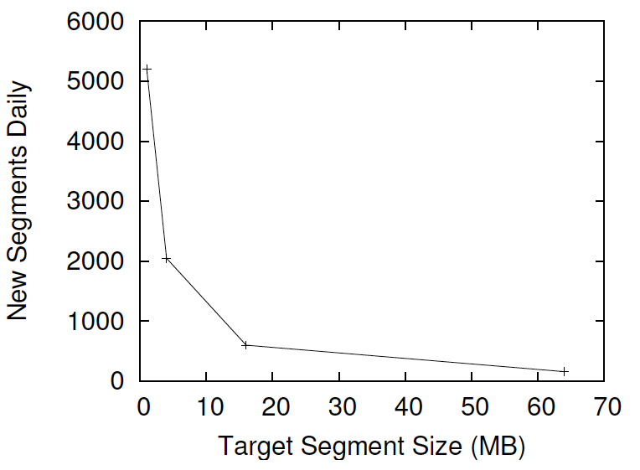
Average Segments per Day (fileserver)

Slide 23
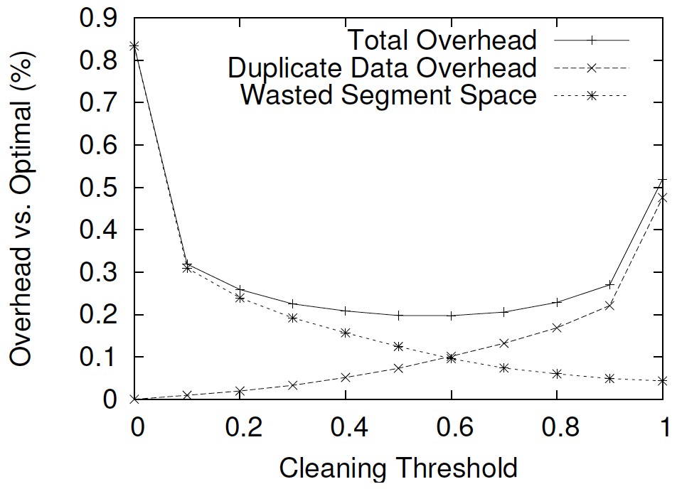
Storage overhead for 16MB Segment (fileserver)

Slide 24
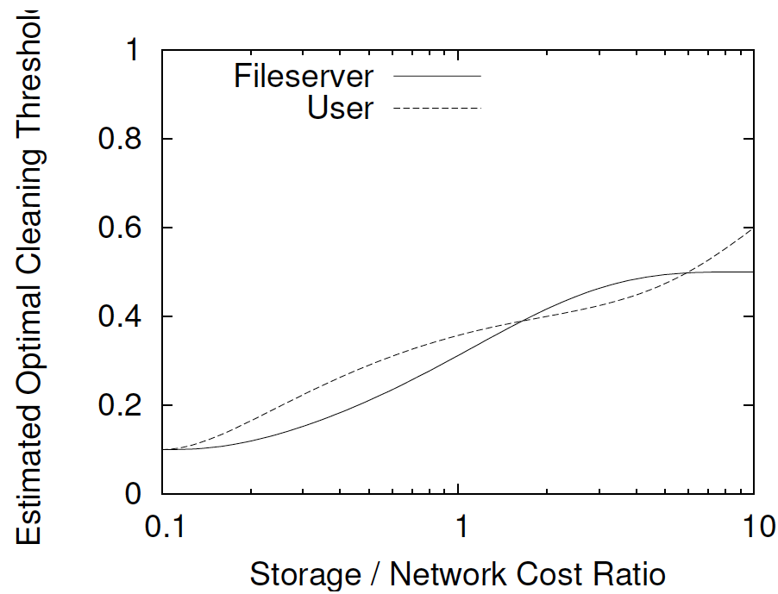
Optimal Cleaning Threshold

Slide 25
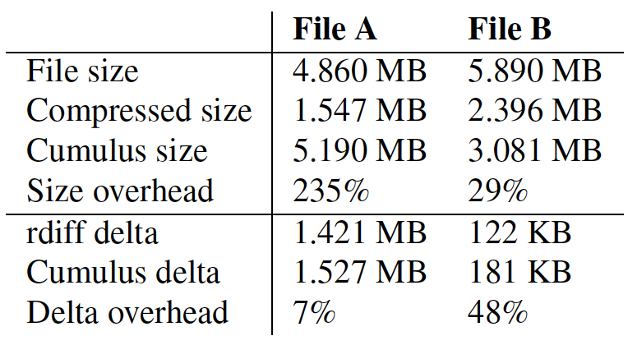
Overheads

Slide 26
Monetary Case Study
Storage: $0.15 per GB . Month
Upload: $0.10 per GB
Segment: $0.01 per 1000 files uploaded
We are charged this amount, so please be careful with your labs and projects!!!

Slide 27
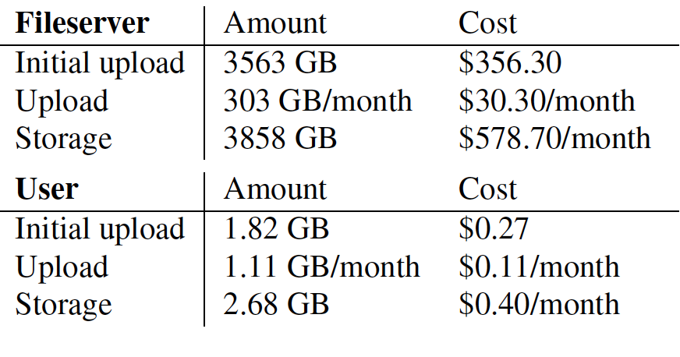
Monetary Costs for Backup

Slide 28
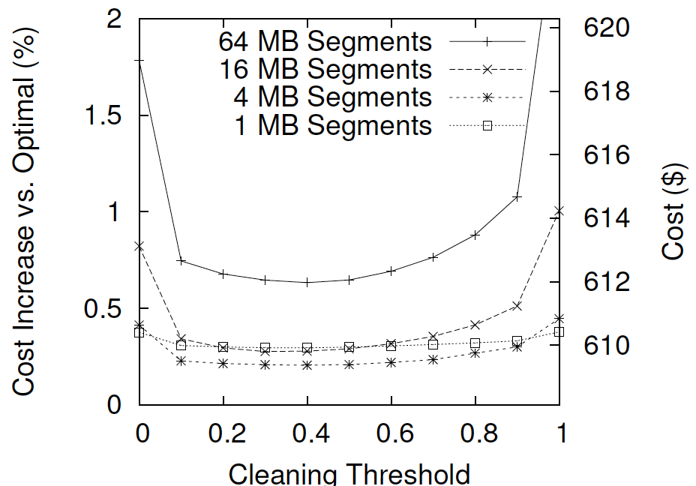
Costs for Backup (fileserver)

Slide 29
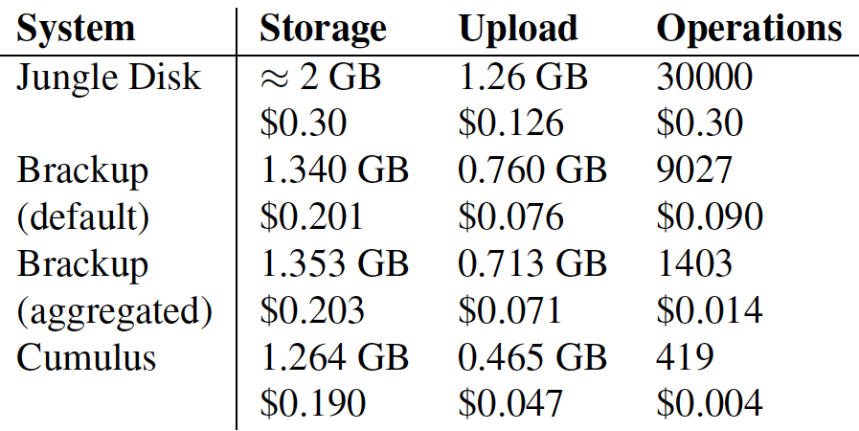
Monetary Cost Comparison (user trace)

Slide 30
Outline
Motivation/Intro
Related Work
Design
Evaluation
Thoughts and Conclusions

Slide 31
Discussion
Thoughts?
Did paper make case for Thin Clouds?
Sharing between clients ignored?
What every happened to P2P?!

Slide 32
Lab 0
http://s3.amazonaws.com/edu-cornell-cs-cs5300/aws-get-started.html

Slide 33
Next Time
Read NFS and write review:
Design and Implementation of a Network File System, Sandberg, Goldberg, Kleiman, Walsh, and Lyon, USENIX 1985
Do Lab 0
Check website for updated schedule

