Slide 1
CS5412:
Diving IN: Inside the Data Center
Lecture V
Ken Birman

Slide 2
We’ve seen one “cloud service”
Inside a cloud, Dynamo is an example of a service used to make sure that cloud-hosted applications can scale at low cost
It offers a very scalable key-value way to store and fetch data, and this model is very important and popular, probably the single most important idea in all of cloud computing!
But it isn’t the only example of a cloud service we should know about

Slide 3
Data centers
Once traffic reaches a data center it tunnels in
  First passes through a filter that blocks attacks
  Next, a router that directs it to a “tier one” computer (one of many) hosting the proper services
  Each hosted company has its own “domain” but also runs inside a kind of virtual enterprise: looks like a private network, with its own IP addresses etc.
  These can make use of shared services provided by the cloud provider, like file system services

Slide 4
Tier two and Inner Tiers
If tier one faces the user and constructs responses, what lives in tier two?
  Caching services are very common (many flavors)
  Other kinds of rapidly responsive lightweight services that are massively scaled
  Inner tier services might still have “online” roles, but tend to live on smaller numbers of nodes: maybe tens rather than hundreds or thousands

Slide 5
Tier two and Inner Tiers
Tiers one and two soak up the load
  This reduces load on the inner tiers, and in fact there may be further layers of caching to soak up load outside the data center (Akamai, Facebook edge, etc.)
Many services use asynchronous streams of updates
  Send updates “down” towards inner services
  but don’t wait and don’t hold locks!
  Notifications percolate up, often showing up
  much later. Meanwhile, tier one runs with
  potentially out-of-data cached data.
Tier 1 Service
Tier 1 Service
Tier 1 Service
Tier 1 Service
Tier 1 Service
Backend DB

Slide 6
Contrast with “Back office”
A term often used for services and systems that don’t play online roles
  In some sense the whole cloud has an outward facing side, handling users in real-time, and an inward side, doing “offline” tasks
  Still can have immense numbers of nodes involved but the programming model has more of a batch feel to it
For example, MapReduce (Hadoop)

Slide 7
Some interesting services we’ll consider
Memcached: In-memory caching subsystem
Dynamo: Amazon’s shopping cart
BigTable: A “sparse table” for structured data
GFS: Google File System
Chubby: Google’s locking service
Zookeeper: File system with locking, strong semantics
TAO: Used by Facebook to track relationships such as “Friends” and “Likes”
MapReduce: “Functional” computing for big datasets

Slide 8
Connection to DHT concept
Last time we focused on a P2P style of DHT
These services are mostly built as layers over a data center DHT deployment
  Same idea and similar low-level functionality
  But inside the data center we can avoid costly indirect routing. We’ll discuss that next time.

Slide 9
Memcached
Very simple concept:
  High performance distributed in-memory caching service that manages “objects”
  Key-value API has become an accepted standard
  Many implementations
Simplest versions: just a library that manages a list or a dictionary
Fanciest versions: distributed services implemented using a cluster of machines

Slide 10
Memcached API
Memcached defines a standard API
  Defines the calls the application can issue to the library or the server (either way, it looks like library)
  In theory, this means an application can be coded and tested using one version of memcached, then migrated to a different one
function get_foo(foo_id)
foo = memcached_get("foo:" . foo_id)
if foo != null return foo
    foo = fetch_foo_from_database(foo_id)
    memcached_set("foo:" . foo_id, foo)
    return foo end

Slide 11
A single memcached server is easy
Today’s tools make it trivial to build a server
  Build a program
  Designate some of its methods as ones that expose service APIs
  Tools will create stubs: library procedures that automate binding to the service
  Now run your service at a suitable place and register it in the local registry
Applications can do remote procedure calls, and these code paths are heavily optimized: quite fast

Slide 12
Can one use a cluster to host a scalable version of Memcached?
This is what Amazon’s Dynamo service does!
Built over a version of Chord DHT
  Basic idea is to offer a key-value API, like memcached
  But now we’ll have thousands of service instances
  Used for shopping cart: a very high-load application
Basic innovation?
  To speed things up (think BASE), Dynamo sometimes puts data at the “wrong place”
  Idea is that if the right nodes can’t be reached, put the data somewhere in the DHT, then allow repair mechanisms to migrate the information to the right place asynchronously

Slide 13
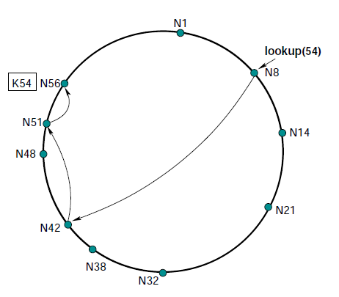
Dynamo in practice
Suppose key should map to N56
Dynamo replicates data
on neighboring nodes
(N1 here)
Will also save key,value
on subsequent nodes if
targets don’t respond
Data migrates to correct
location eventually

Slide 14
Dynamo in practice
When Amazon rolled Dynamo out, there was a huge need for scalable key-value storage, and Dynamo responded to this (e.g. shopping cart)
But in fact it wasn’t popular with people more familiar with database APIs
Eventually Amazon introduced Dynamo-DB which has a “NoSQL” API: SQL but with weak consistency. This has been far more successful for many uses.

Slide 15
Lessons learned?
Notice that we started with Chord: a DHT for big P2P uses. But nobody has big P2P systems!
Dynamo was initially just Chord adapted for use inside a data-center, as a service, adjusted to deal with the peculiar failure patterns seen at Amazon.
But ultimately, with Dynamo-DB, Amazon was forced to change the “model” to bridge to developers.

Slide 16
BigTable
Yet another key-value store!
Built by Google over their GFS file system and Chubby lock service
Idea is to create a flexible kind of table that can be expanded as needed dynamically
Like Dynamo-DB, starts with a DHT idea but then grew to become a specialized solution with many features

Slide 17
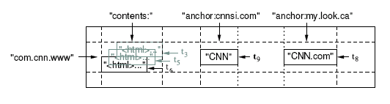
Data model: a big map
<Row, Column, Timestamp> triple for key Arbitrary “columns” on a row-by-row basis
  Column family:qualifier. Family is heavyweight, qualifier lightweight
  Column-oriented physical store- rows are sparse!
Does not support a relational model
  No table-wide integrity constraints
  No multirow transactions

Slide 18
API
Metadata operations
  Create/delete tables, column families, change metadata
Writes (atomic)
  Set(): write cells in a row
  DeleteCells(): delete cells in a row
  DeleteRow(): delete all cells in a row
Reads
  Scanner: read arbitrary cells in a bigtable
    Each row read is atomic
    Can restrict returned rows to a particular range
    Can ask for just data from 1 row, all rows, etc.
    Can ask for all columns, just certain column families, or specific columns

Slide 19
Versions
Data has associated version numbers
  To perform a transaction, create a set of pages all using some new version number
  Then can atomically install them
For reads can let BigTable select the version or can tell it which one to access

Slide 20
How did they build it
We’ll skim very lightly over the main data structures but you don’t need to learn the details
Idea is just to have a feeling for how it works
And how does it work? They map BigTable down to a kind of key-value system!

Slide 21
SSTable
Immutable, sorted file of key-value pairs
Chunks of data plus an index
  Index is of block ranges, not values
64K block
64K block
64K block
SSTable
Index

Slide 22
Tablet
Contains some range of rows of the table
Built out of multiple SSTables
Tablet
Start:aardvark
End:apple
64K block
64K block
64K block
SSTable
64K block
64K block
64K block
SSTable
Index
Index

Slide 23
Table
Multiple tablets make up the table
SSTables can be shared
Tablets do not overlap, SSTables can overlap
Tablet
Tablet
aardvark
apple
apple_two_E
boat
SSTable
SSTable
SSTable
SSTable

Slide 24
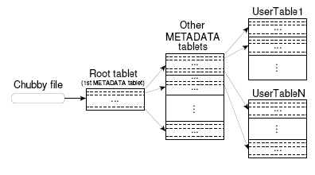
Finding a tablet
Stores: Key: table id + end row, Data: location
Cached at clients, which may detect data to be incorrect
  in which case, lookup on hierarchy performed
Also prefetched (for range queries)

Slide 25
Finding a tablet
Stepping back, can you see how this is a bit like using a DHT in two layers?
To look for something, you use the row and column information as a key, and that key lets you find the metadata on the tablet server, and then you can track down the actual data
So the DHT (key-value) concept can be “turned into” this very fancy infinitely large table!

Slide 26
Programming model
Application reads information
Uses it to create a group of updates
Then uses group commit to install them atomically
  Conflicts? One “wins” and the other “fails”, or perhaps both attempts fail
  But this ensures that data moves in a predictable manner version by version: a form of the ACID model!
Thus BigTable offers strong consistency, up to a limit
  There are failure cases they deliberately don’t cover

Slide 27
Microbenchmarks

Slide 28
Performance

Slide 29
Application at Google

Slide 30
So where does this table live?
Google actually stores the table inside its “global file system” or GFS
GFS is a kind of DHT too!
  It has a “name node” service where you can find a list of data nodes and a key-value mapping from file name to data nodes that host that file (actually, “chunks” of that file, because Google’s files are huge)
  Sort of the same idea as we just saw for BigTable

Slide 31
GFS and Chubby
GFS file system used under the surface for storage
  Has a master and a set of chunk servers
  To access a file, ask master… it directs you to some chunk server and provides a capability
  That server sends you the data
Chubby lock server
  Implements locks with varying levels of durability
  Implemented over Paxos, a protocol we’ll look at a few lectures from now

Slide 32
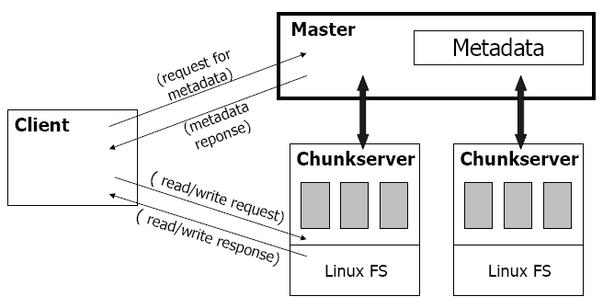
GFS Architecture

Slide 33
Write Algorithm is trickier
1. Application originates write request.
2. GFS client translates request from (filename, data) -> (filename, chunk index), and sends it to master.
3. Master responds with chunk handle and (primary + secondary) replica locations.
4. Client pushes write data to all locations. Data is stored in chunkservers’ internal buffers.
5. Client sends write command to primary.

Slide 34
Write Algorithm is trickier
6. Primary determines serial order for data instances stored in its buffer and writes the instances in that order to the chunk.
7. Primary sends serial order to the secondaries and tells them to perform the write.
8. Secondaries respond to the primary.
9. Primary responds back to client.
Note: If write fails at one of chunkservers, client is informed and retries the write.

Slide 35
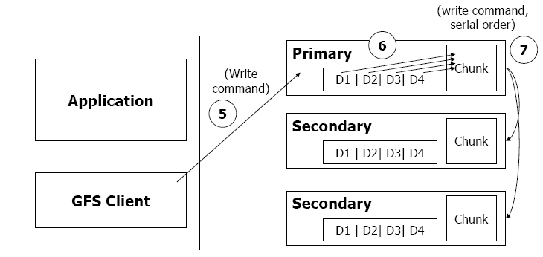
Write Algorithm is trickier

Slide 36
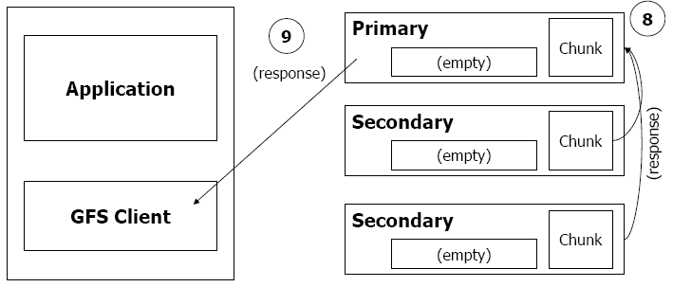
Write Algorithm is trickier

Slide 37
We’ve only scratched the surface
We’ve focused on scalable storage
But there are many other major, important services
What are some examples? We don’t have time for deep dives but can at least mention a few…

Slide 38
Zookeeper
Created at Yahoo!
Integrates locking and storage into a file system
  Files play the role of locks
  Also has a way to create unique version or sequence numbers
  But basic API is just like a Linux file system
Implemented using virtual synchrony protocols (we’ll study those too, when we talk about Paxos)
Extremely popular, widely used

Slide 39
TAO
At Facebook the need is sort of different from Google or Yahoo
  Facebook is concerned mostly with the relationships between people and companies or other things
  A likes B (and B likes A), A friends B (and B friends A), A tracks updates by B (and B sends updates to A)…
  This involves a whole collection of “graphs”
TAO is a fancy file system like GFS or Zookeeper but specialized to track these kinds of graphs

Slide 40
TAO
Some TAO ideas
  One is to try and use key-value caching “at the edge” to be super fast even at risk of using stale data for a little while
  Updates flow in a huge pipeline towards the core of the cloud, are done in a batched way, then cache-updates flow back out.
  Every layer has redundancy and backup options if the layer below it is broken temporarily
We’ll study TAO more carefully later…

Slide 41
What about MapReduce (Hadoop)
So famous that people have heard of it as often as TCP/IP or XML…
This is an example of a service that lives deeper in the cloud and isn’t used “while” processing requests from clients
Instead, MapReduce is useful for “offline” tasks

Slide 42
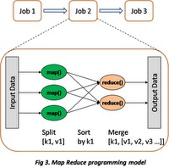
MapReduce
Used for functional style of computing with
massive numbers of machines and huge data sets
Works in a series of stages
  Map takes some operations and “maps” it on a set of servers so that each does some part
  The operations are functional: they don’t modify the data they read and can be reissued if needed
  Result: a large number of partial results, each from running the function on some part of the data
  Reduce combines these partial results to obtain a smaller set of result files (perhaps just one, perhaps a few)
Often iterates with further map/reduce stages

Slide 43
Hadoop
Open source MapReduce
  Has many refinements and improvements
  Widely popular and used even at Google!
Challenges
  Dealing with variable sets of worker nodes
  Computation is functional; hard to accommodate adaptive events such as changing parameter values based on rate of convergence of a computation

Slide 44
Classic MapReduce examples
Make a list of terms appearing in some set of web pages, counting the frequency
Find common misspellings for a word
Sort a very large data set via a partitioning merge sort
Nice features:
  Relatively easy to program
  Automates parallelism, failure handling, data management tasks

Slide 45
MapReduce debate
The database community dislikes MapReduce
  Databases can do the same things
  In fact can do far more things
  And database queries can be compiled automatically into MapReduce patterns; this is done in big parallel database products all the time!
Counter-argument:
  Easy to customize MapReduce for a new application
  Hadoop is free, parallel databases not so much…

Slide 46
Summary
We’ve touched upon a series of examples of cloud computing infrastructure components
  Each really could have had a whole lecture
They aren’t simple systems and many were very hard to implement!
  Hard to design… hard to build… hard to optimize for stable and high quality operation at scale
  Major teams and huge resource investments
  Design decisions that may sound simple often required very careful thought and much debate and experimentation!

Slide 47
Summary
Some recurring themes
  Data replication using (key,value) tuples
  Anticipated update rates, sizes, scalability drive design
  Use of multicast mechanisms: Paxos, virtual synchrony
  Need to plan adaptive behaviors if nodes come and go, or crash, while system is running
  High value for “latency tolerant” solutions
    Extremely asynchronous structures
    Parallel: work gets done “out there”
Many offer strong consistency guarantees, but not necessarily for every aspect. “Selective” guarantees.

