Slide 1
CS5412:
NETWORKS AND THE CLOUD
Lecture III
Ken Birman

Slide 2
The Internet and the Cloud
Cloud computing is transforming the Internet!
  Mix of traffic has changed dramatically
  Demand for networking of all kinds is soaring
  Cloud computing systems want “control” over network routing, want better availability and performance
  ISPs want more efficiency, and also a cut of the action
Early Internet: “Don’t try to be the phone system”
Now: “Be everything”. A universal critical resource
  Like electric power (which increasingly, depends on networked control systems!)
  And the phone system (which now runs over the Internet)

Slide 3
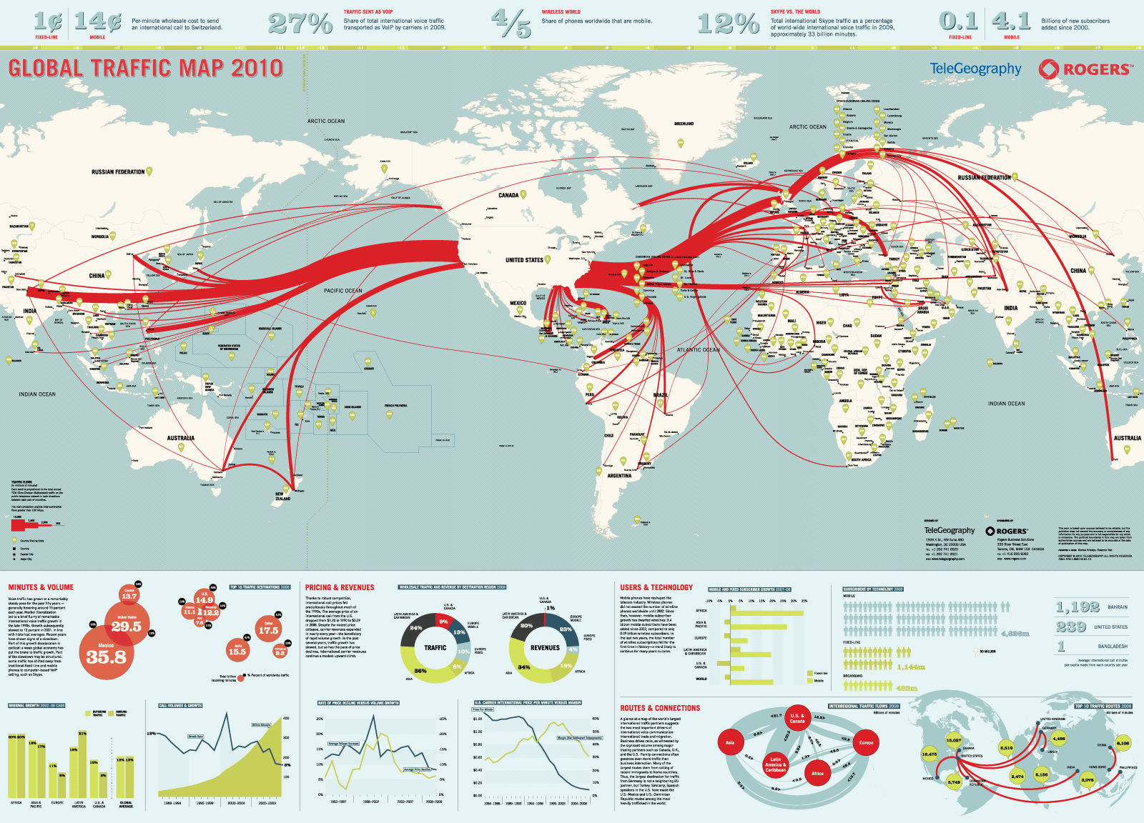

Slide 4
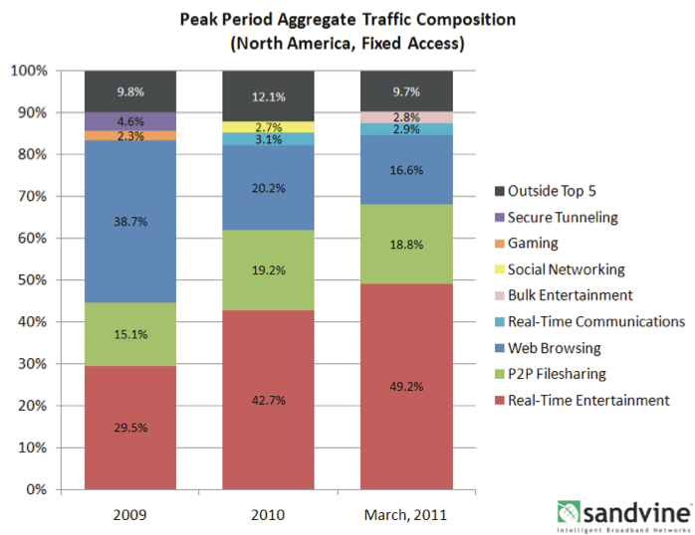
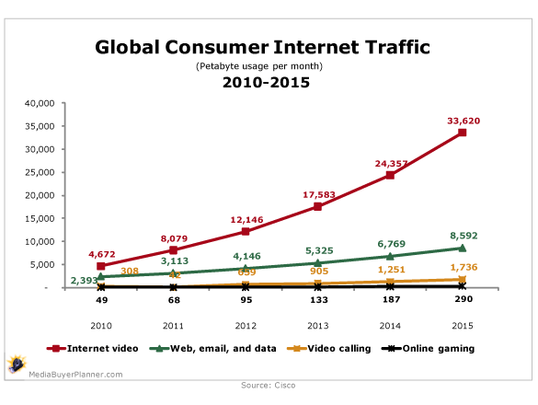
Current Internet loads
Source: Cisco
Source: Sandvine's Fall 2010 report on global Internet trends

Slide 5
Looking closer
As of 2010:
  42.7% of all traffic on North American “fixed access” networks was attributable to real-time media
  Netflix was responsible for 20.6% of peak traffic
  YouTube was associated with 9.9% of peak traffic
  iTunes was generating 2.6% of downstream traffic
By late 2011
  Absolute data volumes continuing rapid rise
  Amazon “market share”, and that of others, increasing

Slide 6
Implications of these trends?
Internet is replacing voice telephony, television... will be the dominant transport technology for everything
Properties that previously only mattered for telephones will matter for the Internet too
Quality of routing is emerging as a dominent cost issue
  If traffic is routed to the “wrong” data center, and must be redirected (or goes further than needed), everyone suffers
  Complication: Only the cloud knows which route is the “right” or the “best” one!

Slide 7
Cloud needs from the network
Continuous operation of routers is key to stream quality and hence to VOIP or VOD quality
A high availability router is one that has redundant components and masks failures, adapts quickly
2004 U. Michigan study of router availability:

Slide 8
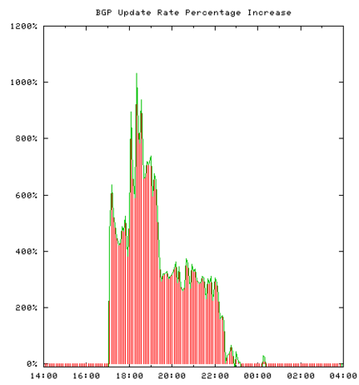
Minor BGP bugs cause big headaches
In this example, a small
ISP in Japan sent
3 minor but incorrect
BGP updates
Certain BGP programs
crashed when processing
these misreported routes
Triggers a global
wave of incorrect BGP
activity that lasts for
four hours
Software patch required
to fix issue!

Slide 9
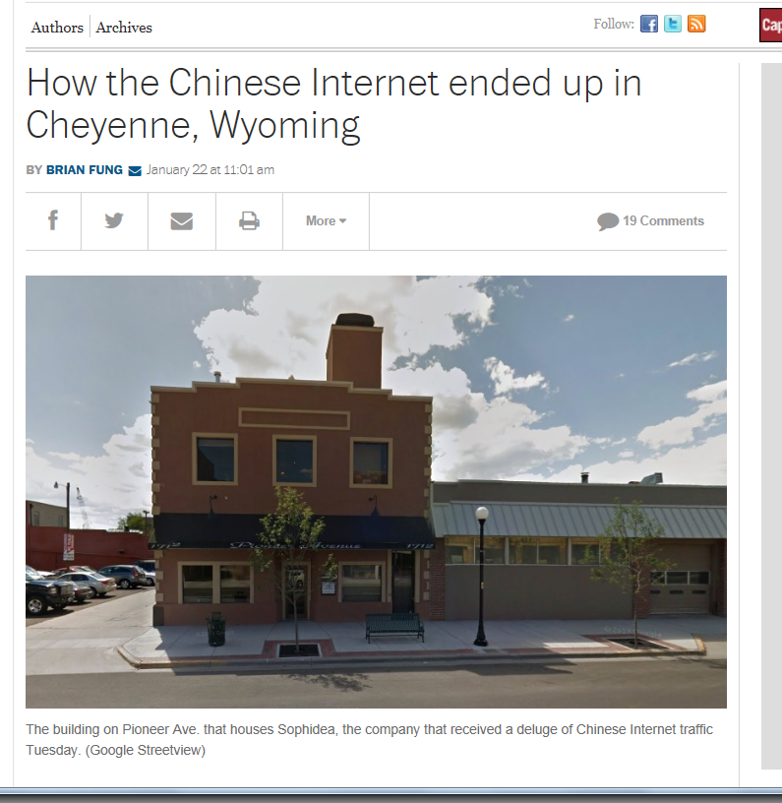


Minor BGP bugs cause big headaches
A typo in a BGP
configuration file…
… major consequences!

Slide 10
What is BGP and how does it work?
Modern routers are
  Hardware platforms that shunt packets between lines
  But also computers that run “routing software”
BGP is one of many common routing protocols
  Border Gateway Protocol
  Defined by an IETF standard
Other common routing protocols include OSPF, IS-IS, and these are just three of a long list

Slide 11
What is BGP and how does it work?
BGP is implemented by router programs such as the widely popular Quagga routing system, Cisco’s proprietary BGP for their core Internet routers, etc
Each implementation
  ... follows the basic IETF rules and specifications
  ... but can extend the BGP protocol by taking advantage of what are called “options”

Slide 12
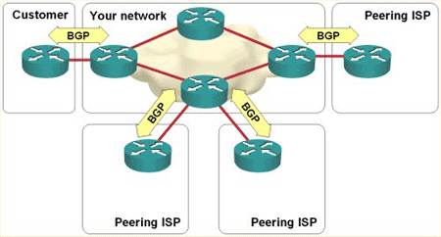
What is BGP and how does it work?
Any particular router that hosts BGP:
  Would need to run some BGP program on one of its nodes (“one” because many routers are clusters)
  Configure it by telling it which routers are its neighbors (the term “BGP peers” is common)
  BGP peers advertise
  routes to one-another
  For example, “I have a
  route to 172.23.*.*”

Slide 13
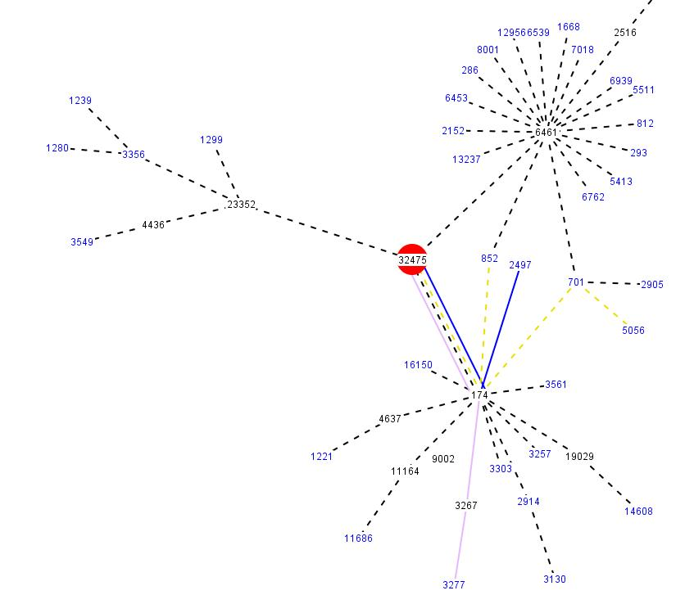
BGP in action (provided by Cogent.com)
Initially, the 174 network advertises a route to 2497

Slide 14
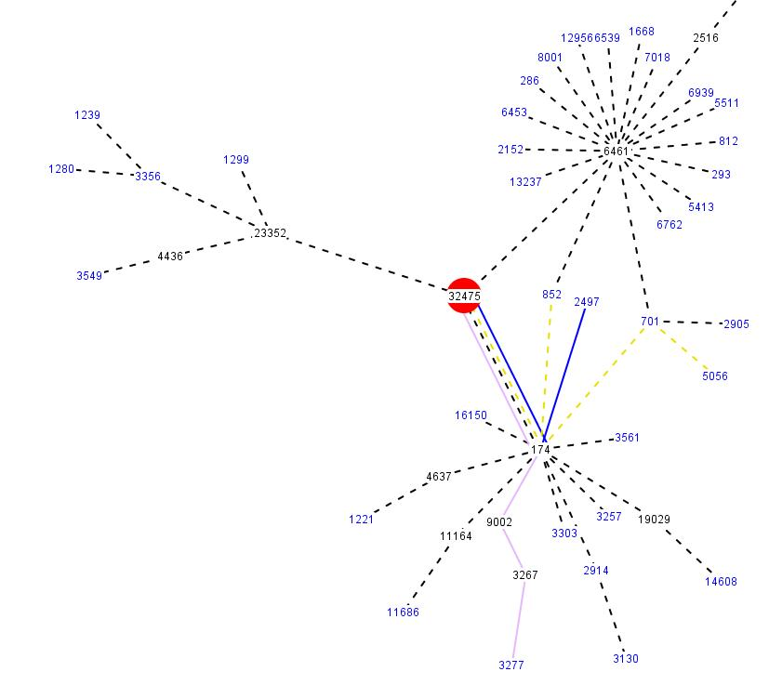
BGP in action (provided by Cogent.com)
Routing updates occur within the 174 network

Slide 15
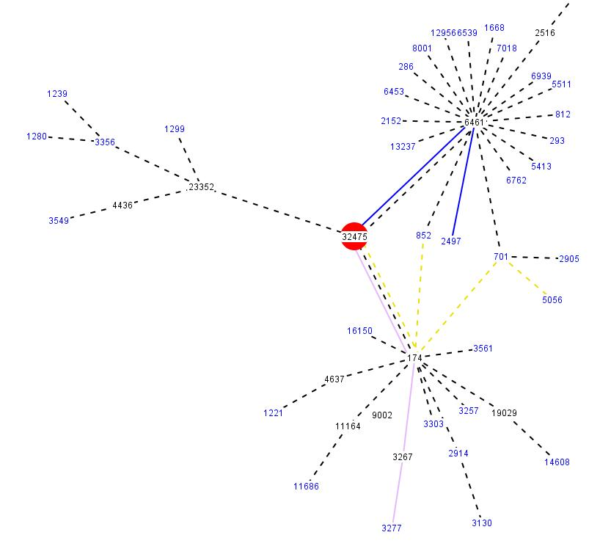
BGP in action (provided by Cogent.com)
When the 174 network withdraws its route to 2497, the 6461 network activates a backup route and advertises it

Slide 16
Notations for IP addresses
IP addresses are just strings of bits
  IPv4 uses 32-bit addresses
  In IPv6 these become 64-bit addresses
  Otherwise IPv4 and IPv6 are similar
BGP uses “IP address prefixes”
  Some string of bits that must match
  Plus an indication of how many bits are in the match part
  Common IPv4 notations: 172.23.*.*, or 172.23.0.0/7
  IPv6 usually shown in hex: 0F.AE.17.31.6D.DD.EA.A0
  The Cogent slide simply omitted the standard “a.b.c.d” notation, but this is purely a question of preferences

Slide 17
BGP routing table
Basic idea is that BGP computes a routing table
Loads it into the router, which is often a piece of hardware because line speeds are too fast for any kind of software action
Router finds the “first match” and forwards packet

Slide 18
Routers in 2004... versus today
In 2004 most routers were a single machine controlling one line-card per peer
In 2012, most core Internet routers are clusters with multiple computers, dual line-cards per peer, dual links per peering relationship
In principle, a 2012 router can “ride out” a failure that would have caused problems in 2004!
But what about BGP?

Slide 19
Worst case problems
Suppose our router has many processors but BGP is running on processor A
  After all, BGP is just a program, like Quagga-BGP
  You could have written it yourself!
Now we need BGP to move to processor B
  Perhaps A crashes
  Perhaps we’re installing a patch to BGP
  Or we might be doing routine hardware maintenance

Slide 20
Remote peers connect over TCP
BGP talks to other BGPs over TCP connections
  So we had a connection from, say, London to New York and it was a TCP connection from X to A.
  Now we want it to be a connection from X to B.
BGP doesn’t have any kind of “migration” feature in its protocols hence this is a disruptive event
  BGP will terminate on A, or crash
  BGP’ starts running on B
  Makes connection to X. Old connection “breaks”

Slide 21
How BGP handles broken connections
If BGP in New York is seen to have crashed, BGP in London assumes the New York router is down!
  So it switches to other routes “around” New York
  Perhaps very inefficient. And the change takes a long time to propagate, and could impact the whole Internet
Later when BGP restarts, this happens again
So one small event can have a lasting impact!
  How lasting? Cisco estimated a 3 to 5 minute disruption when we asked them!

Slide 22
What happens in those 3 minutes?
When BGP “restarts” on node B, London assumes it has no memory at all of the prior routing table
  So London sends the entire current routing table, then sends any updates
  This happens with all the BGP peers, and there could be many of them!
Copying these big tables and processing them takes time, which is why the disruption is long

Slide 23
BGP “graceful restart”
An IETF protocol that reduces the delay, somewhat
With this feature, BGP B basically says “I’m on a new node with amnesia, but the hardware router still is using the old routing table.”
  Same recovery is required, but London continues to route packets via New York. Like a plane on autopilot, the hardware keeps routing
  However, that routing table will quickly become stale because updates won’t be applied until BGP’ on B has caught up with current state (still takes 3-5 minutes)

Slide 24
High assurance for BGP?
We need a BGP that is up and in sync again with no visible disruption at all!
Steps to building one
  Replicate the BGP state so that BGP’ on B can recover the state very quickly
    We’ll do this by replicating data within memory in the nodes of our cluster-style router
    BGP’ on B loads state from the replicas extremely rapidly
  Splice the new TCP connections from BGP’ on B to peers to the old connections that went to BGP on A
    They don’t see anything happen at all!

Slide 25
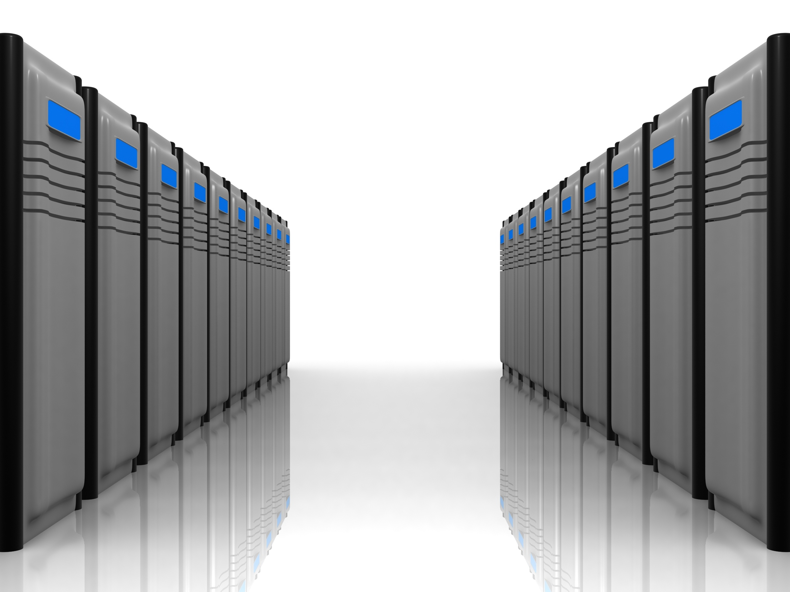
Picture of high-availability BGP
(1) State of BGP replicated within router-cluster nodes
Router Control-Processor Cluster
runs the FTSS service
(4) Attempt to reconnect to peer intercepted, spliced to old connection
Remote BGPD
FTSS
BGP state
(3)
(4)
(1)
TCP-R
TCP-R
BGPD
BGPD’
FTSS
(2)
Shim
(2) Failure causes BGP to migrate
Original Host
Backup Host
(3) Reload state from replicas

Slide 26
How does TCP-R work?
Role of TCPR is to
  Detect an attempt to reconnect to the same peer
  Connect the new TCP endpoint on node B to the old TCP session that was active between London and node A!
  Can this be done? Can BGP operate over the resulting half-old, half-new connection?
Need to understand how TCP works to answer these questions

Slide 27
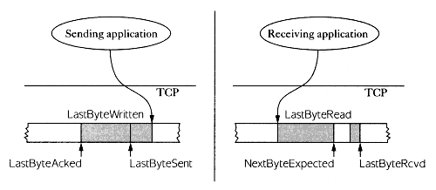
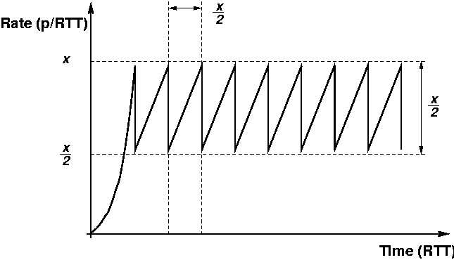
TCP protocol in action
TCP has a pair of “windows” within which it sends data “segments” numbered by byte offsets
Varies window size to match data rate network and receiver can handle

Slide 28
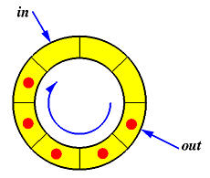
TCP windows are like a pair of bounded buffers

Slide 29
Sequence numbers established in initial handshake
Connection creator (say, A) says to B:
  I want to make a connection to you using initial sequence number A→B 1234 (a random number)
  B replies I will accept your connection using initial sequence number from B→A 9171 (also random)
  A responds “our connection is established”
Notice that both numbers start at random values
This protects against confusion if msg redelivered
Called a “three-way handshake”

Slide 30
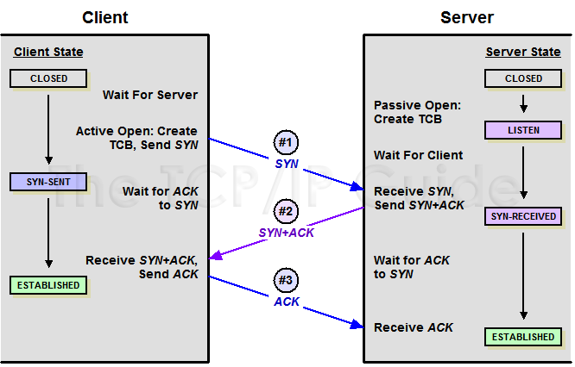
Sequence numbers established in initial handshake

Slide 31
Basic TCP-R idea
TCP-R just notes the old sequence pair
  When BGP B tries to connect to the old peer, TCPR intercepts the handshake and runs it “locally”, noting the delta between old and new sequence numbers
  Now on each packet, TCPR can “translate” from new numbering to old and back, fooling the old TCP stack into accepting the new packets
  Updates the TCP checksum field on packet headers
This splices the connections together

Slide 32
FT-BGP
FT-BGP has a bit more work to do
  Old BGP just accepted updates and processed them
  FT-BGP must log any updates it sends or receives before TCP acknowledges the incoming update, or sends the outgoing one
  FT-BGP must also complete any receive or send that was disrupted by the failover from node A to B
But these are easy to do
Total time for failover: milliseconds!

Slide 33
Thus we’ve made our router more available
Goal was to improve on the 2004 situation:
... every element of the picture has been “fixed”!
  Replicated links and line cards
  FT-BGP for failover
  Better management tools to reduce risk of misconfiguration

Slide 34
How available can the network be?
Today’s Internet achieves between 2 and 3 “nines” of availability
  Means that over a period of X seconds, would expect to see between 99% and 99.9% of “good behavior”
  Between 1% and 0.1% of time, something is seriously wrong
Hubble project at UW: finds that on a national scale Internet has large numbers of black holes, slow patches, terrible choices of routes, etc at all times
With work like what we’ve seen could probably push towards a “5-nines” Internet, comparable to voice telephony but at Internet data rates

Slide 35
Could we go further?
Same idea can harden other routing protocols
But what about other kinds of router problems?
  For example, “distributed denial of service attacks” that overload links with garbage data or overwhelm a web site with junk packets?
Also, how could cloud providers “customize” routing?
  Cloud operators want a degree of routing control
  Ideally would want to look inside the packets

Slide 36
These are active research topics...
Ideas include:
  Better control over routing within entire regions
  Some way to support end-to-end “circuits” with pre-authentication between sender and receiever
  New routing ideas aimed at better support for media streams
  Monitoring BGP to notice if something very wrong occurs
Leads to the vision of a collection of “SuperNets” each specialized in different ways, but sharing routers

Slide 37

SuperNet examples
Google might want to build a Google+ net optimized for its social networking applications
Netflix would imagine a NetFlixNet ideally tuned for transport of media data
The smart power grid might want a “grid net” that has security and other assurance features, for use in monitoring the power grid and controlling it

Slide 38
Sharing resources
The idea is very much like sharing a machine using virtual machines!
  With VMs user thinks she “owns” the machine but in reality one computer might host many VMs
  With SuperNet idea, Google thinks it “owns” the GoogleNet but the routers actually “host” many nets
Could definitely be done today
  Probably would use the OpenFlow standards to define behaviors of these SuperNets.

Slide 39
Can we “secure” the Internet?
End-to-end route path security would help...
... but if routers are just clusters of computers, must still worry about attacks that deliberately disrupt the router itself
  Like a virus or worm but one that infects routers!
  This is a genuine risk today
  Must also worry about disruption of BGP, or the DNS or other critical services

Slide 40
A secured router
We would need a way to know precisely what we’re running on it
  Can be done using “trusted platform modules” (TPM is a kind of hardware repository for security keys)
  Would need to run trustworthy code (use best development techniques, theorem provers)
  Then “model check” by monitoring behavior against model of what code does and rules for how network operates
Entails a way of securely replicating those control rules, but this is a topic we’ll “solve” later in the course

Slide 41

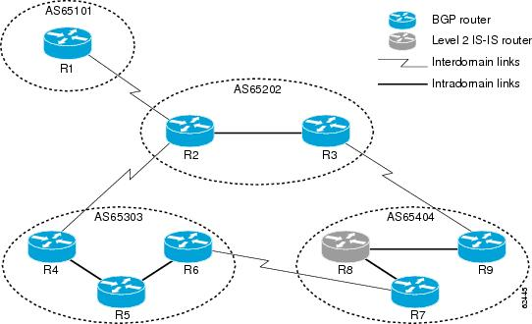


A secured network
NOC, this is the network topology I want you to use.
Central command controls routing for a region, and sets the policy for BGP updates
A securely replicated command
Guards supervise router communication but can’t create fake router packets: Lack signature authority (TPM keys)
Use a hardware-security feature called the TPM to offer hardened virtual machines
A monitored router can only behave in ways the policy permits
Safe router in a box

Slide 42
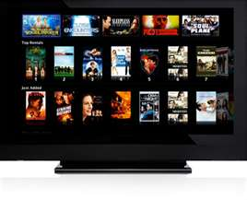
Hosting a SuperNet on a SecureNet
Secure net is an infrastructure on which the SuperNet runs with no means to disrupt other users!
SuperNet controls its own virtual resources (maybe even dedicated links)
Netflix Movie
Service
SuperNet “in a box” benefits from a non-disruptable network
Trusted network

Slide 43
Conclusions?
Cloud is encouraging rapid evolution of the Internet
Different cloud “use cases” will want to customize routing and security in different ways
Nobody wants to be disrupted by other users or by hackers, and this is a big issue for cloud providers
Tomorrow’s network will probably have features that allow each provider to create its own super-net specialized in just the ways it wishes. They will share physical infrastructure.

