Slide 1


Xen and the Art of Virtualization
Ian Pratt
University of Cambridge and Founder of XenSource Inc.
Computer Laboratory

Slide 2
Outline
Virtualization Overview
Xen Today : Xen 2.0 Overview
Architecture
Performance
Live VM Relocation
Xen 3.0 features (Q3 2005)
Research Roadmap

Slide 3
Virtualization Overview
Single OS image: Virtuozo, Vservers, Zones
  Group user processes into resource containers
  Hard to get strong isolation
Full virtualization: VMware, VirtualPC, QEMU
  Run multiple unmodified guest OSes
  Hard to efficiently virtualize x86
Para-virtualization: UML, Xen
  Run multiple guest OSes ported to special arch
  Arch Xen/x86 is very close to normal x86
Notes:
POPF doesn’t trap if executed with insufficient privilege

Slide 4
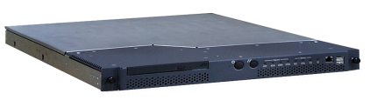



Virtualization in the Enterprise
Consolidate under-utilized servers
to reduce CapEx and OpEx
X
Avoid downtime with VM Relocation
Dynamically re-balance workload
to guarantee application SLAs
X
X
Enforce security policy

Slide 5
Xen Today : 2.0 Features
Secure isolation between VMs
Resource control and QoS
Only guest kernel needs to be ported
  All user-level apps and libraries run unmodified
  Linux 2.4/2.6, NetBSD, FreeBSD, Plan9
Execution performance is close to native
Supports the same hardware as Linux x86
Live Relocation of VMs between Xen nodes
Notes:
Commercial / production use
Released under the GPL; Guest OSes can be any licensce

Slide 6
Para-Virtualization in Xen
Arch xen_x86 : like x86, but Xen hypercalls required for privileged operations
  Avoids binary rewriting
  Minimize number of privilege transitions into Xen
  Modifications relatively simple and self-contained
Modify kernel to understand virtualised env.
  Wall-clock time vs. virtual processor time
    Xen provides both types of alarm timer
  Expose real resource availability
    Enables OS to optimise behaviour
Notes:
popf
Avoiding fault trapping : cli/sti can be handled at guest level

Slide 7
x86 CPU virtualization
Xen runs in ring 0 (most privileged)
Ring 1/2 for guest OS, 3 for user-space
  GPF if guest attempts to use privileged instr
Xen lives in top 64MB of linear addr space
  Segmentation used to protect Xen as switching page tables too slow on standard x86
Hypercalls jump to Xen in ring 0
Guest OS may install ‘fast trap’ handler
  Direct user-space to guest OS system calls
MMU virtualisation: shadow vs. direct-mode

Slide 8
MMU Virtualizion : Shadow-Mode
guest reads
Virtual → Pseudo-physical
guest writes
Guest OS
Accessed &
Updates
dirty bits
Virtual → Machine
VMM
Hardware
MMU
Notes:
At least double the number of faults
Memory requirements
Hiding which machine pages are in use: may interfere with page colouring, large TLB entries etc.

Slide 9
MMU Virtualization : Direct-Mode
guest reads
Virtual → Machine
guest writes
Guest OS
Xen VMM
Hardware
MMU
Notes:
RaW hazards

Slide 10
Para-Virtualizing the MMU
Guest OSes allocate and manage own PTs
  Hypercall to change PT base
Xen must validate PT updates before use
  Allows incremental updates, avoids revalidation
Validation rules applied to each PTE:
  1. Guest may only map pages it owns*
  2. Pagetable pages may only be mapped RO
Xen traps PTE updates and emulates, or ‘unhooks’ PTE page for bulk updates
Notes:
Important for fork

Slide 11
MMU Micro-Benchmarks
1.1
1.0
0.9
0.8
0.7
0.6
0.5
0.4
0.3
0.2
0.1
0.0
L
X
V
U
L
X
V
U
Page fault (µs)
Process fork (µs)
lmbench results on Linux (L), Xen (X), VMWare Workstation (V), and UML (U)
Notes:
Most benchmark results identical. In addition to these, some slight slowdown

Slide 12
Queued Update Interface (Xen 1.2)
guest reads
Virtual → Machine
guest
writes
Guest OS
validation
Xen VMM
Hardware
MMU
Notes:
RaW hazards

Slide 13
Writeable Page Tables : 1 – write fault
guest reads
Virtual → Machine
first guest
write
Guest OS
page fault
Xen VMM
Hardware
MMU
Notes:
RaW hazards

Slide 14
Writeable Page Tables : 2 - Unhook
guest reads
X
Virtual → Machine
guest writes
Guest OS
Xen VMM
Hardware
MMU
Notes:
typically 2 pages writeable : one in other page table

Slide 15
Writeable Page Tables : 3 - First Use
guest reads
X
Virtual → Machine
guest writes
Guest OS
page fault
Xen VMM
Hardware
MMU
Notes:
RaW hazards

Slide 16
Writeable Page Tables : 4 – Re-hook
guest reads
Virtual → Machine
guest writes
Guest OS
validate
Xen VMM
Hardware
MMU
Notes:
RaW hazards

Slide 17
I/O Architecture
Xen IO-Spaces delegate guest OSes protected access to specified h/w devices
  Virtual PCI configuration space
  Virtual interrupts
Devices are virtualised and exported to other VMs via Device Channels
  Safe asynchronous shared memory transport
  ‘Backend’ drivers export to ‘frontend’ drivers
  Net: use normal bridging, routing, iptables
  Block: export any blk dev e.g. sda4,loop0,vg3

Slide 18
Xen 2.0 Architecture
VM0
VM1
VM2
VM3
Device
Manager &
Control s/w
Unmodified
User
Software
Unmodified
User
Software
Unmodified
User
Software
GuestOS
(XenLinux)
GuestOS
(XenLinux)
GuestOS
(XenLinux)
GuestOS
(XenBSD)
Back-End
Back-End
Native
Device
Driver
Native
Device
Driver
Front-End
Device Drivers
Front-End
Device Drivers
Control IF
Safe HW IF
Event Channel
Virtual CPU
Virtual MMU
Xen Virtual Machine Monitor
Hardware (SMP, MMU, physical memory, Ethernet, SCSI/IDE)

Slide 19
System Performance
1.1
1.0
0.9
0.8
0.7
0.6
0.5
0.4
0.3
0.2
0.1
0.0
L
X
V
U
L
X
V
U
L
X
V
U
L
X
V
U
SPEC INT2000 (score)
Linux build time (s)
OSDB-OLTP (tup/s)
SPEC WEB99 (score)
Benchmark suite running on Linux (L), Xen (X), VMware Workstation (V), and UML (U)

Slide 20
TCP results
1.1
1.0
0.9
0.8
0.7
0.6
0.5
0.4
0.3
0.2
0.1
0.0
L
X
V
U
L
X
V
U
L
X
V
U
L
X
V
U
Tx, MTU 1500 (Mbps)
Rx, MTU 1500 (Mbps)
Tx, MTU 500 (Mbps)
Rx, MTU 500 (Mbps)
TCP bandwidth on Linux (L), Xen (X), VMWare Workstation (V), and UML (U)
Notes:
disk is easy
new IO isn’t as fast as not all ring 0 ; win big time

Slide 21
Scalability
1000
800
600
400
200
0
L
X
L
X
L
X
L
X
2
4
8
16
Simultaneous SPEC WEB99 Instances on Linux (L) and Xen(X)

Slide 22
Xen 3.0 Architecture
VM0
VM1
VM2
VM3
Device
Manager &
Control s/w
Unmodified
User
Software
Unmodified
User
Software
Unmodified
User
Software
GuestOS
(XenLinux)
GuestOS
(XenLinux)
GuestOS
(XenLinux)
Unmodified
GuestOS
(WinXP))
AGP
ACPI
PCI
Back-End
Back-End
SMP
Native
Device
Driver
Native
Device
Driver
Front-End
Device Drivers
Front-End
Device Drivers
VT-x
32/64bit
Control IF
Safe HW IF
Event Channel
Virtual CPU
Virtual MMU
Xen Virtual Machine Monitor
Hardware (SMP, MMU, physical memory, Ethernet, SCSI/IDE)

Slide 23
3.0 Headline Features
AGP/DRM graphics support
Improved ACPI platform support
Support for SMP guests
x86_64 support
Intel VT-x support for unmodified guests
Enhanced control and management tools
IA64 and Power support, PAE
Notes:
XXX inclusion in mainline

Slide 24
x86_64
Intel EM64T and AMD Opteron
Requires different approach to x86 32 bit:
  Can’t use segmentation to protect Xen from guest OS kernels as no segment limits
  Switch page tables between kernel and user
    Not too painful thanks to Opteron TLB flush filter
  Large VA space offers other optimisations
Current design supports up to 8TB mem

Slide 25
SMP Guest OSes
Takes great care to get good performance while remaining secure
Paravirtualized approach yields many important benefits
  Avoids many virtual IPIs
  Enables ‘bad preemption’ avoidance
  Auto hot plug/unplug of CPUs
SMP scheduling is a tricky problem
  Strict gang scheduling leads to wasted cycles
Notes:
Xen has always supported SMP hosts
Important to make virtualization ubiquitous, enterprise

Slide 26
VT-x / Pacifica
Will enable Guest OSes to be run without paravirtualization modifications
  E.g. Windows XP/2003
CPU provides traps for certain privileged instrs
Shadow page tables used to provide MMU virtualization
Xen provides simple platform emulation
  BIOS, Ethernet (e100), IDE and SCSI emulation
Install paravirtualized drivers after booting for high-performance IO
Notes:
Pacifica

Slide 27








VM Relocation : Motivation
VM relocation enables:
  High-availability
    Machine maintenance
  Load balancing
    Statistical multiplexing gain
Xen
Xen

Slide 28
Assumptions
Networked storage
  NAS: NFS, CIFS
  SAN: Fibre Channel
  iSCSI, network block dev
  drdb network RAID
Good connectivity
  common L2 network
  L3 re-routeing
Xen
Xen
Storage

Slide 29
Challenges
VMs have lots of state in memory
Some VMs have soft real-time requirements
  E.g. web servers, databases, game servers
  May be members of a cluster quorum
  Minimize down-time
Performing relocation requires resources
  Bound and control resources used

Slide 30
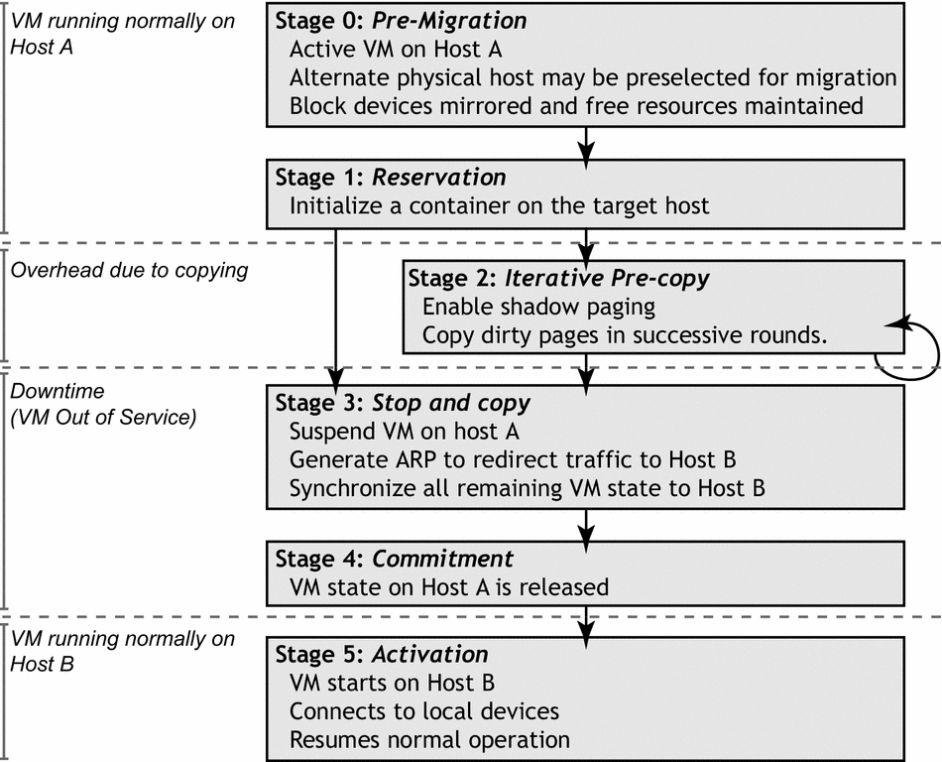
Relocation Strategy
Notes:
lift’ domain on to shadow page tables
Bitmap of dirtied pages; reads; receives
Atomic ‘zero bitmap & make PTEs read-only’
Iterate until no forward progress, then stop and copy remainder
Unsolicited ARP reply / MAC migrate

Slide 31
Relocation Strategy
VM active on host A
Destination host selected
(Block devices mirrored)
Stage 0: pre-migration
Stage 1: reservation
Initialize container on target host
Stage 2: iterative pre-copy
Copy dirty pages in successive rounds
Stage 3: stop-and-copy
Suspend VM on host A
Redirect network traffic
Synch remaining state
Stage 4: commitment
Activate on host B
VM state on host A released

Slide 32
Pre-Copy Migration: Round 1

Slide 33
Pre-Copy Migration: Round 1

Slide 34
Pre-Copy Migration: Round 1

Slide 35
Pre-Copy Migration: Round 1

Slide 36
Pre-Copy Migration: Round 1

Slide 37
Pre-Copy Migration: Round 2

Slide 38
Pre-Copy Migration: Round 2

Slide 39
Pre-Copy Migration: Round 2

Slide 40
Pre-Copy Migration: Round 2

Slide 41
Pre-Copy Migration: Round 2

Slide 42
Pre-Copy Migration: Final

Slide 43
Writable Working Set
Pages that are dirtied must be re-sent
  Super hot pages
    e.g. process stacks; top of page free list
  Buffer cache
  Network receive / disk buffers
Dirtying rate determines VM down-time
  Shorter iterations → less dirtying → …
App. ‘phase changes’ may knock us back

Slide 44
Writable Working Set
Set of pages written to by OS/application
Pages that are dirtied must be re-sent
  Hot pages
    E.g. process stacks
    Top of free page list (works like a stack)
  Buffer cache
  Network receive / disk buffers

Slide 45
Page Dirtying Rate
#dirty
time into iteration
Dirtying rate determines VM down-time
  Shorter iters → less dirtying → shorter iters
  Stop and copy final pages
Application ‘phase changes’ create spikes

Slide 46
Writable Working Set

Slide 47
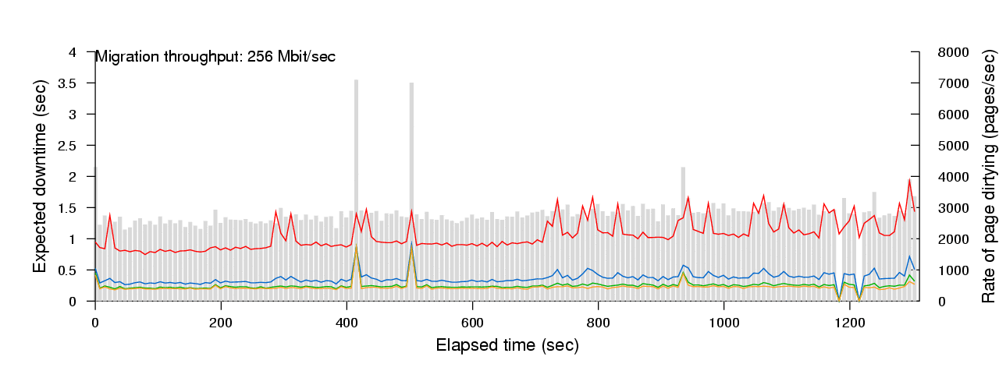
PostgreSQL/OLTP down-time

Slide 48
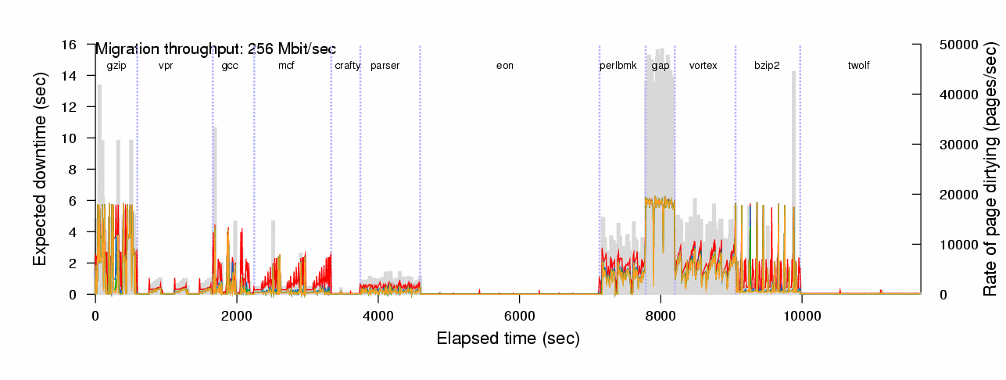
CINT2000 down-time

Slide 49
Rate Limited Relocation
Dynamically adjust resources committed to performing page transfer
  Dirty logging costs VM ~2-3%
  CPU and network usage closely linked
E.g. first copy iteration at 100Mb/s, then increase based on observed dirtying rate
  Minimize impact of relocation on server while minimizing down-time

Slide 50
Web Server Relocation

Slide 51
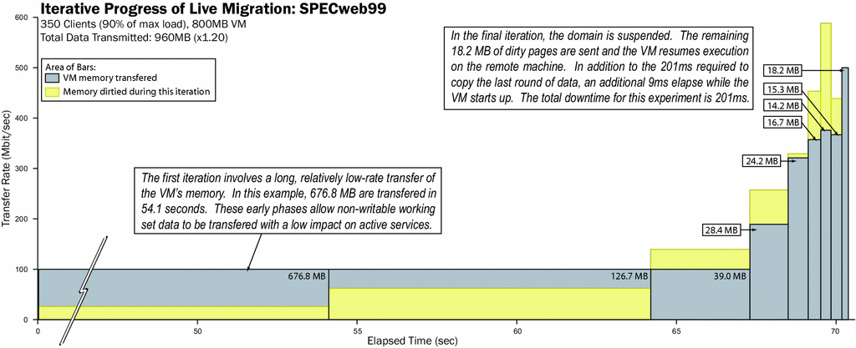
Iterative Progress: SPECWeb
52s

Slide 52
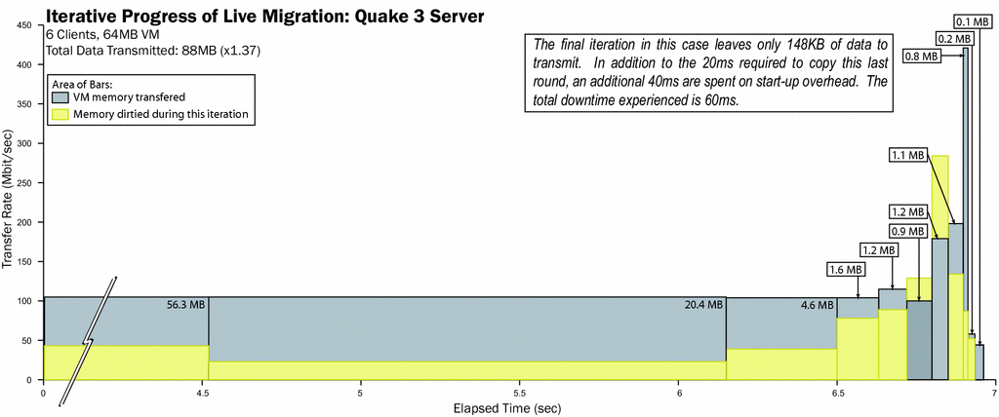
Iterative Progress: Quake3

Slide 53
Quake 3 Server relocation

Slide 54
Relocation Transparency
 | Requires VMM support | Changes to OS | Able to adapt | QoS
Transparent | yes | none | no | harder
Assisted | yes | minor | yes | harder
Self | no | significant | Yes | easier

Slide 55
Relocation Notification
Opportunity to be more co-operative
  Quiesce background tasks to avoid dirtying
Doesn’t help if the foreground task is the cause of the problem…
Self-relocation allows the kernel fine-grained control over trade-off
  Decrease priority of difficult processes

Slide 56
Extensions
Cluster load balancing
  Pre-migration analysis phase
  Optimization over coarse timescales
Evacuating nodes for maintenance
  Move easy to migrate VMs first
Storage-system support for VM clusters
  Decentralized, data replication, copy-on-write
Wide-area relocation
  IPSec tunnels and CoW network mirroring

Slide 57
Research Roadmap
Software fault tolerance
  Exploit deterministic replay
System debugging
  Lightweight checkpointing and replay
VM forking
  Lightweight service replication, isolation
Secure virtualization
  Multi-level secure Xen

Slide 58









Xen Supporters
Operating System and Systems Management
Hardware Systems
Acquired by
Platforms & I/O
* Logos are registered trademarks of their owners

Slide 59
Conclusions
Xen is a complete and robust GPL VMM
Outstanding performance and scalability
Excellent resource control and protection
Live relocation makes seamless migration possible for many real-time workloads
http://xensource.com

Slide 60
Thanks!
The Xen project is hiring, both in Cambridge, Palo Alto and New York
ian@xensource.com
Computer Laboratory

Slide 61
Backup slides

Slide 62
Research Roadmap
Whole distributed system emulation
  I/O interposition and emulation
  Distributed watchpoints, replay
VM forking
  Service replication, isolation
Secure virtualization
  Multi-level secure Xen
XenBIOS
  Closer integration with the platform / BMC
Device Virtualization

Slide 63
Isolated Driver VMs
Run device drivers in separate domains
Detect failure e.g.
  Illegal access
  Timeout
Kill domain, restart
E.g. 275ms outage from failed Ethernet driver
350
300
250
200
150
100
50
0
0
5
10
15
20
25
30
35
40
time (s)
Notes:
Net-restart

Slide 64
Segmentation Support
Segmentation req’d by thread libraries
  Xen supports virtualised GDT and LDT
  Segment must not overlap Xen 64MB area
  NPT TLS library uses 4GB segs with –ve offset!
    Emulation plus binary rewriting required ☹
x86_64 has no support for segment limits
  Forced to use paging, but only have 2 prot levels
  Xen ring 0; OS and user in ring 3 w/ PT switch
    Opteron’s TLB flush filter CAM makes this fast

Slide 65
Device Channel Interface
Notes:
newring

Slide 66
Live migration for clusters
Pre-copy approach: VM continues to run
‘lift’ domain on to shadow page tables
  Bitmap of dirtied pages; scan; transmit dirtied
  Atomic ‘zero bitmap & make PTEs read-only’
Iterate until no forward progress, then stop VM and transfer remainder
Rewrite page tables for new MFNs; Restart
Migrate MAC or send unsolicited ARP-Reply
Downtime typically 10’s of milliseconds
  (though very application dependent)
Notes:
8seconds for 1GB on 1Gb/s

Slide 67
Scalability
Scalability principally limited by Application resource requirements
  several 10’s of VMs on server-class machines
Balloon driver used to control domain memory usage by returning pages to Xen
  Normal OS paging mechanisms can deflate quiescent domains to <4MB
  Xen per-guest memory usage <32KB
Additional multiplexing overhead negligible
Notes:
We have run 128 guests
Tickerless patch may help for large numbers of guests

Slide 68
Scalability
1000
800
600
400
200
0
L
X
L
X
L
X
L
X
2
4
8
16
Simultaneous SPEC WEB99 Instances on Linux (L) and Xen(X)

Slide 69
Resource Differentation
2.0
1.5
Aggregate throughput relative to one instance
1.0
0.5
0.0
2
4
8
8(diff)
2
4
8
8(diff)
OSDB-IR
OSDB-OLTP
Simultaneous OSDB-IR and OSDB-OLTP Instances on Xen
Notes:
8(diff) : using QoS controls to split resources in 1:2:3:4:5:6:7:8 ratios.
OSDB-OLTP suffers due to current poor disk scheduling – should be fixed in future Xen release

