Slide 1
Phishing, Spoofing
In-Flight Editing
Ken Birman

Slide 2
OK, we can build a PKI…
Can we use it to create a secure banking platform?
  Better hope the answer is yes!
  After all: Most people are already using web banking systems at least to track their balance, and many pay their bills using them too
Today
  First look at the kinds of attacks that have been common
  Then ask if the kinds of O/S mechanisms we’ve learned about can protect against them

Slide 3
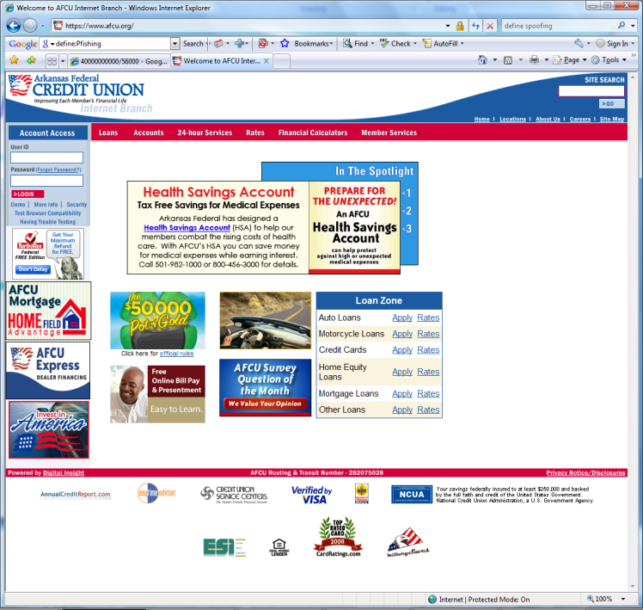
Online banking
Suppose you visit your bank’s
web site… is it really your bank?
Common attacks
  In the field of computer security, phishing is the criminally fraudulent process of attempting to acquire sensitive information such as usernames, passwords and credit card details by masquerading as a trustworthy entity in an electronic communication.
  Typically involves email with incorrect hyperlinks

Slide 4
Spoofing
Website spoofing is the act of creating a website, as a hoax, with the intention of misleading readers that the website has been created by a different person or organization. Normally, the website will adopt the design of the target website and sometimes has a similar URL.
For example, a spoofer might try to become a man in the middle
  Spoofer attempts to log into your bank
  It passes you the bank’s web page, and passes the bank what you type. But it actually sees everything

Slide 5
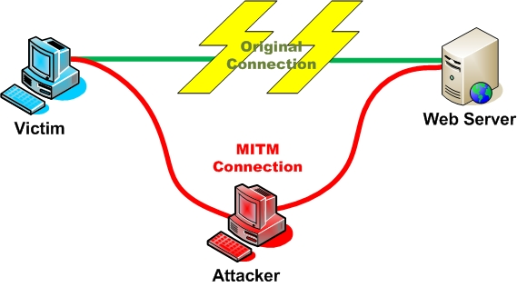

A man in the middle

Slide 6
A man in the middle
What could he do?
  He could “act on your behalf,” relaying pages from the bank to you and keystrokes from you to the bank
  He could modify pages in flight, adding or modifying URLs, tucking Javascript code in spots where you’ll run it but won’t realize it’s running
  He could just watch
Clearly none of this is good!

Slide 7
Can this really happen?
Man in the middle could be a
compromised web proxy (e.g. “pretty bad proxy”)
  “Normal” proxy caches web pages, for performance
If a web proxy goes bad, you would want the O/S to warn
  DANGER: This mail isn’t really from afcu.com!
  CAUTION: This isn’t really the afcu.com website!
Question posed: How well can we do?
Web cache

Slide 8
Layers of insecurity
Application
Application
Presentation
Presentation
Session
Session
Transport
Transport
Network
Network
Recall that the Internet is
  Layered: OSI standard…
  Fiercely end-to-end:
  Issues like security are left for the end-points to resolve
Our problem starts with these Internet features
  If we exchange packets with afcu.org, do we really know we were talking to the right endpoint?
Data Link
Data Link
Physical
Physical
Network

Slide 9
Physical insecurity
At the lowest layer of the Internet are routers
  When a router boots, a configuration file tells it what IP addresses it should handle directly
    For example, perhaps this router handles traffic for Cornell.edu
  Router talks to its neighbors using a protocol called BGP
    Says “I can reach Cornell.edu”
    They tell it what IP prefixes they can reach
    Router blends, sifts, decides how to route packets to the rest of the Internet universe
Problem?
  All of this is very trusting! No obvious way to know if someone is lying or malfunctioning

Slide 10
Implication?
In fact, when you talk to an IP address on the Internet, you have no way to be sure who you are talking to!
  All you know is that the router is sending traffic to some site (perhaps incorrectly)
  It could even be duplicating the traffic and sending a copy to some other site entirely (basis of NSA covert program called “Eschalon”)
    Widely reported by cnn, fox, others
    NSA is apparently “trawling” for interesting web traffic, phone traffic, etc precisely this way
    Legality not at all clear

Slide 11
So much for layers 1-3!
This is also why spam is so hard to pin down
  You know that the “From” field of an email can easily be forged – basically, it just contains text
  But in fact the originating IP address can also be faked!
Thought question
  Why can’t we tell that a message has a fake “from” address in it, at the Internet level?

Slide 12
Implication?
Even something as simple as “afcu.org” poses challenges:
  How can I know what it’s true IP address is?
  And even if I do know, how can I know I’m really talking to afcu.org and not a middleman?

Slide 13
Roll out the PKI!
Last time we saw a plausible answer to this
  I trust Microsoft
  It trusts Verisign
  Verisign says that such-and-such is a certificate for afcu.org
  Certificate has a public key in it
So if afcu.org is for real, I can establish a secure connection to it, right?

Slide 14
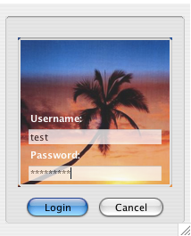
Trusted Password Window
Dedicated window
Trusted path customization
Random photo assigned or chosen
Image stored in browser
Image overlaid across window
User recognizes image first
  then enters password
Password not sent to server
Basis for what are called “Secure browser skins”

Slide 15
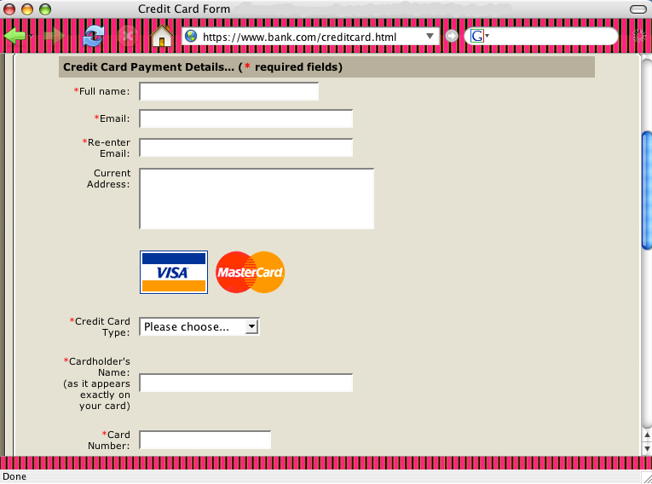
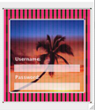
Browser Generated Images
Browser chooses random number and generates image
Can be used to modify border or web elements

Slide 16
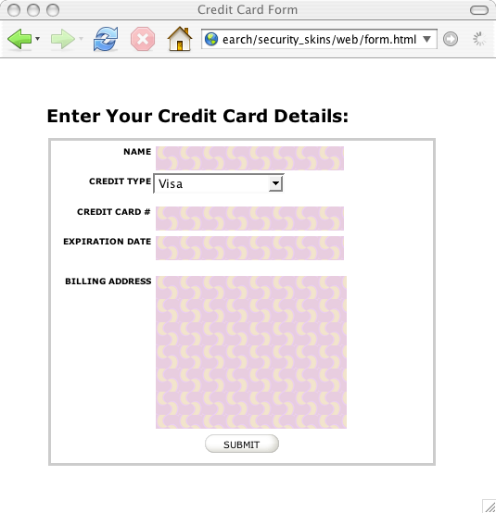
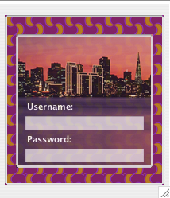
Server Generated Images
Server & browser independently generate same image
Server can customize its own page

Slide 17
Objective
With secure browser skins user is sure that
  His browser is directly connected to afcu.org
  Login connection isn’t passing through a man-in-the-middle
Key idea:
  The image is actually split between the machine your browser runs on and the remote web site
  Transmitted in a cryptographically secure form, combined in the browser itself
  But user must remember to check for the picture!

Slide 18

A new issue: Web “frames”
A web page is really a collection of frames

Slide 19
Frame is like a mini-web-page
Each frame has an associated “security context”
  This is a binding to the web site the frame came from
  Normally single page won’t mix https (secure) and http (insecure) content; if it does, browser warns you
But there are confusing cases that can be deceptive
  For example, perfectly nested frames with invisible borders
  On almost all modern web browsers, the inner frame runs in the security context of the outer one! And no security warning occurs
Outer frame https://afcu.org
Inner frame: http://spoof.com

Slide 20
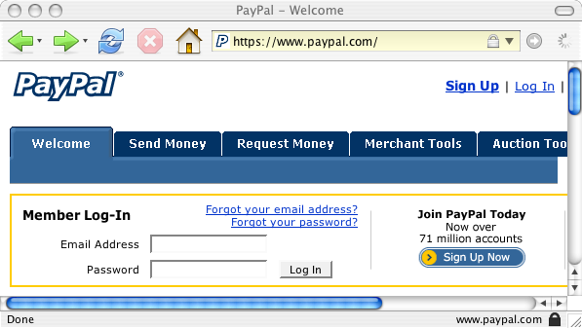
Firefox Browser - SSL indicators

Slide 21
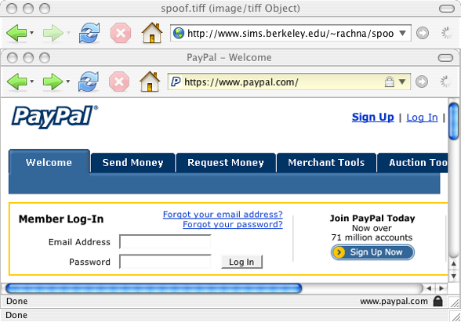
Example: unsecure indicators

Slide 22




Http in Https?
Web browser designers haven’t managed to think of every possible combination of features
  Afcu.org wanted to provide advertising on their web page for various products from the bank and its affiliates
  Also wanted to use an external hosting service for some of the image content to speed up its web site
Constant warnings are a nuisance; people ignore them
  So… web browsers have ways to mix secure and insecure content without triggering warnings
  Could be misused by a man-in-the-middle, for example “Pretty Bad Proxy”, a deliberately evil web proxy

Slide 23
Consequence?
You could be logged into AFCU.org securely
  Yet there could actually be an inner page that looks exactly like the AFCU.org page but is really being relayed via the man in the middle (an evil web proxy)
  And it gets to see what you type (or fake your actions), selectively routing what it wants to send to AFCU.org or to spoof.com, or even could do both
Secure browser skins would reveal this attack… but many browsers and sites don’t user browser skins
And this is just one of many such issues

Slide 24
Other issues
Pretty bad proxy could be asked to connect to afcu.org, perhaps even securely over https
  But it doesn’t even try
  Instead it returns an error code (“site unreachable”) and an error message (an arbitrary Javascript application)
  The Javascript creates a nested insecure window and connects to afcu.org, showing the response as if it had made the original secure connection
User sees an error message and yet the window looks right, because browser displays afcu.org welcome screen and it looks normal… so ignores error message
  Tested… most browsers will malfunction this way

Slide 25
Other issues
Pretty bad proxy can also steal cookies
  Turns out that when using a proxy, browser sends cookies in the initial connection without waiting to see if the secure SSL handshake succeeds
  So bad proxy doesn’t need to even bother to connect to the remote site
  Just reads the cookie off the TCP connection
Now it can forward your cookies to any place it likes

Slide 26
Implication?
Somehow, the mixture of the operating system, the Internet, the web browser, and the web site has left us with a hugely complex, insecure infrastructure
Yes, we have PKIs and can make secure connections
  But who made the connection? You, or the middleman?
  Do we have any reason for confidence that there is a direct connection from you to the bank?

Slide 27
More contemporary issues
Malware:
  Keystroke loggers: they capture every action you take and relay a script to BadGuys.com
  Famous example? FaceBook.com “Beacon” online ad placement system
    Basically, installed an add-on (with your permission) that tracked every action you took, sending records to Facebook
    Including actions in non-Facebook sites, like gmail
    Then used this to optimize ad placement

Slide 28
More contemporary issues
Virtual machines
  We’ll discuss in more detail soon
  Basically, malware “virtualizes” your entire computer
Applications think they are running on a normal Windows or Linux platform… everything works
  Perhaps a tiny bit slower than usual for some operations
But in fact the machine is being watched by the virtualization layer
  It can, for example, record every bit displayed on screen, every network packet, every file on the disk
  This defeats secure browser skins unless TPM hardware is used

Slide 29
More contemporary issues
Google Voice… the best tool ever for managing your telephone communications….. It manages voice mail, gives free transcripts of calls… includes free voice conferencing, inexpensive overseas calls, and more. You'll also be able to record and store your calls online.
But all that information will be routed through Google. Google will know everyone who called you and when they called. They'll have records of your voice mail, and because they offer free transcription, it means they'll have not just the voice, but text of your calls as well.
              [Computerworld 3/12/2009]

Slide 30
GPS
Most telephones and laptops have GPS location chips
  We use them to get directions
But this means that the location of the machine can be continuously tracked
Google (and other companies) will know
  Where you were. Who was with you. Who you phoned. What you talked about.

Slide 31
Opt-In
We explicitly agree to let Facebook run Beacon or to let Google Voice play these roles!
  When you think of implications you get outraged
  But when the “user agreement” pops up you sign without even reading it
Reasoning? Would Google really be spying on me?
  Get real!
But of course some people really do spy on others…

Slide 32
Major recent spying scandals
Hackers apparently broke into computer used by Vice President Cheney during 2007
  And more broadly into a number of military computers
Corporate espionage increasingly common and serious
  No need to plant bugs: just bug the guy’s computer
  By some estimates, 70% or more of all computers have at least some form of serious virus/malware on them, and this includes computers used in military and intelligence settings

Slide 33
Could we build a secure O/S?
A major area for research
  Like it or not, we’re displacing medical records, financial systems, corporate activities onto computers
  We need to be able to trust the solutions
  Clearly we can’t today
How might a secure O/S work?

Slide 34
Start with the TPM
TPM gives us a
  Guaranteed “safe” place to store secret keys
  Way to encrypt or sign data securely
  Way to execute code that can’t be virtualized or spoofed
Sirer: Nexus kernel
  A small, easily audited software module that exploits the TPM to offer various services
  Goal is to know what software is really running on a machine and that you are really talking to that software, not some form of malware spoofing it

Slide 35
What makes this hard?
One issue is the sheer size of modern systems
  Systems like Windows Vista and Linux have tens of millions of lines of code
  Internet adds tens of millions of lines more
  Built by armies of developers, many revisions and patches for every module. Some are “evil developers”
Effect of this?
  In some sense, every computer is running a unique mixture of software
  Even knowing what it runs won’t give much confidence!

Slide 36
The Enemy?
We’ve noticed that ad placement is a kind of economic enemy: creates incentives for companies to spy
But there are other kinds of actors too
  Nation-state competitors
  Russian mafia
  Corporate competitors
  Disgruntled ex’s
  Counter terrorism organizations
  Moms and Dads trying to monitor the sites their little bunny has been visiting…

Slide 37
Bugs
Even with perfect, “clean-room” development
  Most software remains buggy
  New software? Perhaps 1 bug per 1000 lines
  Mature? Perhaps 1 bug in 10,000 lines
There are also configuration errors, features that can be misused or tricked, and user-approved malware
So even with Nexus one has to wonder if the problem can actually be resolved

Slide 38
Summary
Phishing and Spoofing are a serious problem
This problem leads us down a path to a deeper and broader problem
Only rational conclusion is that the problem just can’t be solved today
So anything we put on computers is at risk and will be at risk for the foreseeable future, like it or not.

Slide 39
Who cares?
The issue is that for cost reasons, banking, medical records, business applications are moving to the web
  These need to be secure, otherwise crooks will steal your money, sell your medical records to insurance companies and spy on your business transactions
  Not even clear what things are legal and what aren’t!
Are we actually entitled to privacy on the web?
  Many people think so… but nobody has yet asked the Supreme Court to weigh in on this
  Google gathering all the data they can in the mean time

Slide 40
Lessig: East code vs West code
Lawrence Lessig writes about web challenges
He points out that there is a kind of arms race
  East code: laws and other regulation
  West code: technology
Technology often outstrips the law
Meanwhile many laws are basically meaningless because unenforceable.

Slide 41

West Code runs amok
We probably all agree that dealing in child porn is disgusting, illegal and should be, too
But suppose that Sheriff Smith seizes your computer on a tip and searches it. He finds offensive content.
  Can he be sure you put it there?
  What if your computer was “tricked” into downloading it, for example by a malicious Javascript application, or an evil web site, or a computer virus?
  Can we hold you responsible if you didn’t know you were doing it?

Slide 42
East Code Derails
Congress passes a law
  “No ISP should transport child pornography images”
Images on the Internet are
  Broken into packets: little chunks of data
  When you see a packet how can you tell what image it came from?
  Data is also often encrypted
So: can we hold an ISP responsible for something it didn’t know it was doing?

Slide 43
Bottom Line?
Modern web is simultaneously simple… and complex
  Simple in the sense that we get very sophisticated results from what are basically very simple actions that run fast and in parallel
  Scale by massive “brute force”
But on the other hand, it doesn’t provide meaningful guarantees
  We can’t really know if things are working correctly
  Not even a defined concept!
  And certainly can’t preserve privacy, security

Slide 44
Bottom Line?
Yet the world is moving to rely more and more on this insecure, not private, not reliable infrastructure
Laws can probably help… but beware unenforceable laws that just cause trouble!
Technology could do better… but for 40 years trends have always favored features first, fancy properties later or never
  Usually never…

Slide 45
Future of Privacy
Scott McNealy (CEO of Sun Microsystems):
  You have zero privacy anyway. Get over it. [1/26/1999]
Brian Bershad (Lab Director, Google Seattle):
  Everything we do is legal. If you don’t like the law, change the law. [visit to Cornell, 2007]
Lawrence Lessig (Professor of Law, Stanford)
  A free culture has been our past, but it will only be our future if we change the path we are on right now.

