Slide 1
Critical Sections with lots of Threads
Ken Birman

Slide 2
Refresher: Deker’s Algorithm
Assumes two threads, numbered 0 and 1
CSEnter(int i)
{
int J = i^1;
inside[i] = true;
turn = J;
while(inside[J] && turn == J)
continue;
}
CSExit(int i)
{
inside[i] = false;
}

Slide 3
Can we generalize to many threads?
Obvious approach won’t work:
Issue: notion of “who’s turn” is next for breaking ties
CSEnter(int i)
{
inside[i] = true;
for(J = 0; J < N; J++)
while(inside[J] && turn == J)
continue;
}
CSExit(int i)
{
inside[i] = false;
}

Slide 4
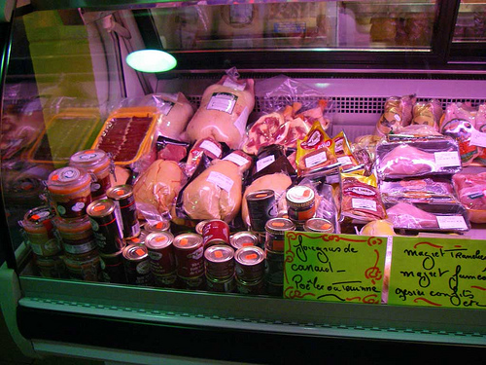
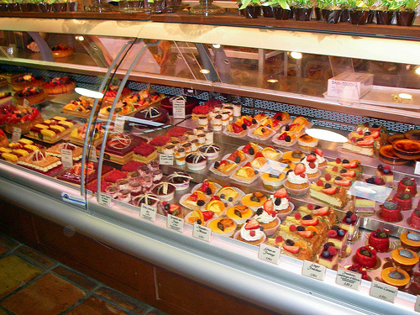
Bakery idea
Think of the (very popular) pastry shop in Montreal’s Marché Atwater
People take a ticket from a machine
If nobody is waiting, tickets don’t matter
When several people are waiting, ticket order determines sequence in which they can place their order

Slide 5
Bakery Algorithm: “Take 1”
CSExit(int i)
{
ticket[i] = 0;
}
int ticket[n];
int next_ticket;
CSEnter(int i)
{
ticket[i] = ++next_ticket;
for(k = 0; k < N; k++)
while(ticket[k] && ticket[k] < ticket[i])
continue;
}
Oops… access to next_ticket is a problem!

Slide 6
Bakery Algorithm: “Take 2”
CSExit(int i)
{
ticket[i] = 0;
}
int ticket[n];
CSEnter(int i)
{
ticket[i] = max(ticket[0], … ticket[N-1])+1;
for(k = 0; k < N; k++)
while(ticket[k] != 0 && ticket[k] < ticket[i])
continue;
}
Clever idea: just add one to the max.
Oops… two could pick the same value!

Slide 7
Bakery Algorithm: “Take 3”
If i, k pick same ticket value, id’s break tie:
(ticket[k] < ticket[i]) || (ticket[k]==ticket[i] && k<i)
Notation: (B,J) < (A,i) to simplify the code:
(B<A || (B==A && k<i)), e.g.:
(ticket[k],k) < (ticket[i],i)

Slide 8
Bakery Algorithm: “Take 4”
CSExit(int i)
{
ticket[i] = 0;
}
int ticket[N];
boolean picking[N] = false;
CSEnter(int i)
{
ticket[i] = max(ticket[0], … ticket[N-1])+1;
for(k = 0; k < N; k++)
while(ticket[k] && (ticket[k],k) < (ticket[i],i))
continue;
}
Oops… i could look at k when k is still storing its ticket, and yet k could have the lower ticket number!

Slide 9
Bakery Algorithm: Almost final
int ticket[N];
boolean choosing[N] = false;
CSEnter(int i)
{
choosing[i] = true;
ticket[i] = max(ticket[0], … ticket[N-1])+1;
choosing[i] = false;
for(k = 0; k < N; k++) {
while(choosing[k]) continue;
while(ticket[k] && (ticket[k],k) < (ticket[i],i))
continue;
}
}
CSExit(int i)
{
ticket[i] = 0;
}

Slide 10
Bakery Algorithm: Issues?
What if we don’t know how many threads might be running?
The algorithm depends on having an agreed upon value for N
Somehow would need a way to adjust N when a thread is created or one goes away
Also, technically speaking, ticket can overflow!
Solution: Change code so that if ticket is “too big”, set it back to zero and try again.

Slide 11
Eliminating overflow
do {
ticket[i] = 0;
choosing[i] = true;
ticket[i] = max(ticket[0], … ticket[N-1])+1;
choosing[i] = false;
} while(ticket[i] >= MAXIMUM);

Slide 12
Adjusting N
This won’t happen often
Simplest: brute force!
Disable threading temporarily
Then change N, reallocate array of tickets, initialize to 0
Then restart the threads package
Sometimes a crude solution is the best way to go…

Slide 13
Bakery Algorithm: Final
int ticket[N]; /* Important: Disable thread scheduling when changing N */
boolean choosing[N] = false;
CSEnter(int i)
{
do {
ticket[i] = 0;
choosing[i] = true;
ticket[i] = max(ticket[0], … ticket[N-1])+1;
choosing[i] = false;
} while(ticket[i] >= MAXIMUM);
for(k = 0; k < N; k++) {
while(choosing[k]) continue;
while(ticket[k] && (ticket[k],k) < (ticket[i],i))
continue;
}
}
CSExit(int i)
{
ticket[i] = 0;
}

Slide 14
Getting Real…
Bakery Algorithm is really theory... A lesson in thinking about concurrency

Slide 15
Synchronization in real systems
Few real systems actually use algorithms such as the bakery algorithm
In fact we learned because it helps us “think about” synchronization in a clear way
Real systems avoid that style of “busy waiting” although, with multicore machines, it may be coming back

Slide 16
Critical Sections with Hardware
Hardware (multicore) platforms demand some kind of synchronization down in the O/S kernel
Needs to map directly to machine instructions
Usually exploits some form of “test and set” instruction
This kind of instruction is also available in user code, but user-level applications would rarely employ it
In applications user’s build, there is usually some kind of language-level support for synchronization

Slide 17
Critical Sections with Atomic Hardware Primitives
Process i
While(test_and_set(&lock));
Critical Section
lock = false;
Share: int lock;
Initialize: lock = false;
Assumes that test_and_set is compiled to a special hardware instruction that sets the lock and returns the OLD value (true: locked; false: unlocked)
Problem: Does not satisfy liveness (bounded waiting)
(see book for correct solution)

Slide 18
Higher level constructs
Even with special instructions available, many O/S designers prefer to implement a synchronization abstraction using the special instructions
Why?
Makes the O/S more portable (not all machines use the same set of instructions)
Help’s us think about synchronization in higer-level terms, rather than needing to think about hardware

Slide 19
Mutex variables
A special kind of variable
Mutex x = new Mutex();
Implemented as a semaphore initialized to 1 (next slide)
Two operations:
x.acquire() wait until x > 0, then set x = x-1 and continue
x.release() x = x+1
stmts performs statements atomically

Slide 20
Semaphores
In Java, a semaphore is a form of Mutex initialized to some integer value greater than 1
Semaphore max_readers = new Semaphore(3);
…
max_reader.acquire(); // counts down, then blocks
…
max_reader.release();

Slide 21
Side remark
Dijkstra was first to introduce semaphores with operations
P(x) – passeren
V(x) – verhogan
Book calls them
x.wait()
X.signal()
We’re focusing on Java because you are more likely to use Java in your career

Slide 22
Definition: atomically
Means “this code must (somehow) execute without interruptions
O/S implementer would need to find a way to implement the atomic portion
Perhaps using special instructions
Perhaps by disabling interrupts (if there is just one core)
Perhaps some other tricky scheme…
Idea is to separate the “behavior” required from the best way of supporting that behavior on a particular CPU

Slide 23
Mutex and Critical Sections
Mutex mutex;
CSEnter() { mutex.acquire();}
CSExit() { mutex.release(); }

Slide 24
Attempt
In Java, you can “attempt” to acquire a mutex or semaphore
With no timeout, either your attempt succeeds, or it throws an exception
There is also a timer variation, where you can specify an amount of time your code is willing to wait
This is used to avoid getting “stuck” waiting forever, in complex programs where many people implemented different parts of the code

Slide 25
Java also has “synchronized”
Under the covers, the real Java synchronization mechanism is a kind of built-in lock on objects
public synchronized void myProcedure( …)
Can also synchronize on a variable
public synchronized(x) void myProcedure( …)
Or even use as a statement
synchronized(x) { …. code …. }

Slide 26
But synchronized is tricky…
Based on slide by Felber, who based his on one by Grossman
void deposit(…) { synchronized(this) { … } }
void withdraw(…) { synchronized(this) { … } }
int balance(…) { synchronized(this) { … } }
void transfer(account from, int amount) {
if (from.balance() >= amount) {
from.withdraw(amount);
this.deposit(amount);
}
}
No concurrency control: race!

Slide 27
But synchronized is tricky…
Based on slide by Felber, who based his on one by Grossman
void deposit(…) { synchronized(this) { … } }
void withdraw(…) { synchronized(this) { … } }
int balance(…) { synchronized(this) { … } }
void transfer(account from, int amount) {
synchronized(this) {
if (from.balance() >= amount) {
from.withdraw(amount);
this.deposit(amount);
}
}
}
Race!

Slide 28
Based on slide by Felber, who based his on one by Grossman
But synchronized is tricky…
void deposit(…) { synchronized(this) { … } }
void withdraw(…) { synchronized(this) { … } }
int balance(…) { synchronized(this) { … } }
void transfer(account from, int amount) {
synchronized(this) {
synchronized(from) {
if (from.balance() >= amount) {
from.withdraw(amount);
this.deposit(amount);
}
}
}
}
Deadlock!

Slide 29
Yet additional options
Every Java object also has built-in methods:
Obj.wait(): not semaphores! Calling thread always blocks
Obj.notify(): wakes up one blocked thread (FIFO)
Obj.notifyAll(): wakes up all blocked threads
These are used to support monitors (next lecture)

Slide 30
Main “take away”
Java has many options for locking things
Mutex (binary semaphores): like locks
General semaphores
Synchronized classes
Object.wait/notify
Too many choices!
What we really need to understand is how to use these to obtain correct solutions…

