Slide 1
CS/ENGRD 2110 Fall 2018
Lecture 6: Consequence of type, casting; function equals
http://courses.cs.cornell.edu/cs2110
Notes:
The fattest knight at King Arthur's round table was Sir Cumference. He acquired his size from too much pi.

Slide 2
Overview references in
Quick look at arrays: array
Casting among classes cast, object-casting rule
Operator instanceof
Function getClass
Function equals
compile-time reference rule
Homework: while-loop, for-loop
while ( <bool expr> ) { … } // syntax
for (int k= 0; k < 200; k= k+1) { … } // example

Slide 3
A2 is due Sunday
Everyone should get 100/100 since we gave you all the test cases you need.
Please look at the pinned Piazza note “Assignment A2” for information that is not in the handout and answers to questions.

Slide 4
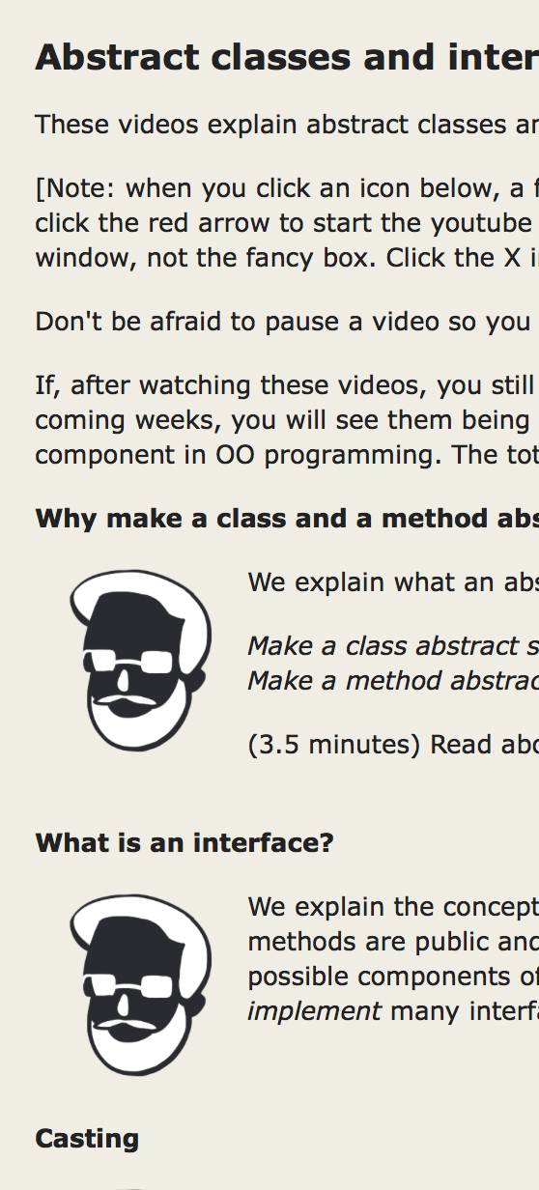
Before Next Lecture…
Follow the tutorial on abstract classes and interfaces, and watch <13 minutes of videos.
Abstract classes and interfaces
This will prepare you for Thursday’s lecture.
Click these

Slide 5
Classes we work with today
class Animal
subclasses Cat and Dog
Put components common to animals in Animal
Cat pet1= new Cat(5);
Dog pet2= new Dog(6);
pet1
a0
Cat
pet2
a1
Dog
a0
a1
Animal
Animal
5
age
isOlder(Animal)
age
isOlder(Animal)
class hierarchy:
6
Object
Cat
toString() purr()
Dog
Animal
toString()
Dog
Cat
(Object partition is there but not shown)

Slide 6
Casting

Slide 7
Casting objects
Object
Animal
You know about casts like:
(int) (5.0 / 7.5)
(double) 6
double d= 5; // automatic cast
Dog
Cat
a0
pet1
null
Animal
pet2
a0
Cat
You can also use casts with class types:
Animal pet1= new Cat(5);
Cat pet2= (Cat) pet1;
a0
5
Animal
age
isOlder(Animal)
pet1 “blinders”
Cat
A class cast doesn’t change the object. It just changes the perspective: how it is viewed!
toString() purr()

Slide 8
Explicit casts: unary prefix operators
Object-casting rule: At runtime, an object can be cast to the name of any partition that occurs within it —and to nothing else.
a0 can be cast to Object, Animal, Cat.
An attempt to cast it to anything else causes an exception
a0
Object
equals() …
5
Animal
age
isOlder(Animal)
(Cat) c
(Object) c
(Cat) (Animal) (Cat) (Object) c
Cat
toString() purr()
These casts don’t take any time. The object does not change. It’s a change of perception.
c
a0
Cat
Notes:
And they cannot fail at run time!

Slide 9
Implicit upward cast
a0
5
Animal
age
isOlder(Animal)
public class Animal {
/** = "this Animal is older than h" */
public boolean isOlder(Animal h) {
return age > h.age; }
Cat
h “blinders”
toString() purr()
Cat pet1= new Cat(5);
Dog pet2= new Dog(6);
if (pet2.isOlder(pet1)) {…}
a1
Animal
age
isOlder(Animal)
6
// pet1 is cast up to class Animal and stored in h
Dog
toString()
h
a0
pet1
a0
pet2
a1
Animal
Cat
Dog

Slide 10
Components used from h
a0
5
Animal
age
isOlder(Animal)
public class Animal {
/** = "this is older than h" */
public boolean isOlder(Animal h) {
return age > h.age; }
Cat
h “blinders”
toString() purr()
h.toString() OK —it’s in class Object partition
h.isOlder(…) OK —it’s in Animal partition
h.purr() ILLEGAL —not in Animal
partition or Object partition
Which toString() gets called?
See slide 18.
h
a0
Animal

Slide 11
Compile-time reference rule

Slide 12
Compile-time reference rule (v1)
see
From a variable of type C, you can reference only methods/fields that are available in class C.
Animal pet1= new Animal(5);
pet1.purr();
pet1
a0
Animal
obviously illegal
The compiler will give you an error.
a0
Animal
5
age
isOlder(Animal)
Checking the legality of pet1.purr(…):
Since pet1 is an Animal, purr must be declared in Animal or one of its superclasses.
From an Animal variable, can use only methods available in class Animal
Notes:
The Java compiler wants to keep you *safe*. So this rule requires there to be *some* method with the right name. But it doesn't have to know *which* method will be called!

Slide 13
Compile-time reference rule (v2)
see
From a variable of type C, you can reference only methods/fields that are available in class C.
Animal pet1= new Cat(5);
pet1.purr();
pet1
a0
Animal
a0
still illegal!
The compiler still gives you an error.
Animal
5
age
isOlder(Animal)
Checking the legality of pet1.purr(…):
Since pet1 is an Animal, purr must be declared in Animal or one of its superclasses.
Cat
getNoise() toString() purr()
From an Animal variable, can use only methods available in class Animal
Notes:
Types exist at compile time. Objects exist at run time. The compiler has NO IDEA what object you will put in what variable, except that it obeys the type rule: Animal variables hold objects with *some* Animal segment.

Slide 14
Why would we ever do this?
Why would a variable of type Animal ever not have just an Animal in it?
This is one of the beautiful things about OO programming!
We want to use an Animal method (seen)
We want to keep a list of all our pets
Create an array of type Animal!

Slide 15
Animal[] v= new Animal[3];
declaration of array v
Create array of 3 elements
v
null
a6
Assign value of new-exp to v
a6
Animal[]
Assign and refer to elements as usual:
v[0]= new Animal(…);
…
a= v[0].getAge();
0
1
2
null
null
null
Sometimes use horizontal picture of an array:
0 1 2
v
null null null

Slide 16
Consequences of a class type
Animal[] v; // declaration of v
v= new Animal[3]; // initialization of v
v[0]= new Cat(5); // initialization of 1st elem
v[2]= new Dog(6);
0 1 2
The type of v is Animal[]
The type of each v[k] is Animal
The type is part of the syntax/grammar of the language. Known at compile time.
v
a0 null a1
Animal objects
A variable’s type:
• Restricts what values it can contain.
• Determines which methods are legal to call on it.
Notes:
• For example, a variable of type Animal can hold any object with an Animal segment. So a plain Animal, a Dog, or a Cat.
• (On next slide.)

Slide 17
Compile-time reference rule, revisited
0 1 2
Animal[] v; // declaration of v
v= new Animal[3]; // initialization of v
Cat pet1= new Cat(5); // initialization of pet1
v[0]= pet1; // initialization of 1st elem
v[0].purr(); // should this be allowed?
// will it compile?
v
null null null
a0
pet1
a0
a0
5
Animal
age
isOlder(Animal)
Checking the legality of v[0].purr(…):
Since v[0] is an Animal, purr must be declared in Animal or one of its superclasses.
Cat
“v[0] blinders”
toString() purr()
From an Animal variable, can use only methods available in class Animal
Notes:
Again, the value of k only exists at run time! Not when you're compiling your code. So the compiler cannot *possibly* know which object you're referring to. And it just wants to keep you safe!

Slide 18
Bottom-up / Overriding rule revisited
Animal[] v= new Animal[3];
v[0]= new Cat(5);
v[2]= new Dog(6);
v[0].toString();
v[2].toString();
Which toString()
gets called?
0 1 2
v
a0 null a1
a0
a1
Object
Object
toString()
toString()
age
isOlder(Animal)
5
Animal
Animal
age
isOlder(Animal)
6
Bottom-up / Overriding rule says function toString in Cat partition
Cat
toString() purr()
Dog
toString()

Slide 19
Equals

Slide 20
Example: Point Class
public class Point {
public int x;
public int y;
public Point(int x, int y) {
this.x= x;
this.y= y;
}
}

Slide 21
How Object defines equals(x)
public boolean equals(Object x) {
return this == x;
}
p1
a0
Point
p2
a0
Point
p3
a1
Point
Point p1= new Point(5,4);
Point p2= p1;
if (p1 == p2) {...} // true?
if (p1.equals(p2)) {...} // true?
Point p3= new Point(5,4);
if (p1 == p3) {...} // true?
if (p1.equals(p3)) {...} // true?
a0
Point
5
x
4
y
a1
Point
5
x
4
y
Using the Point class as defined in previous slide.

Slide 22
Can define equals for your own class!
Can I define it any way I like?
https://docs.oracle.com/javase/8/docs/api/java/lang/Object.html#equals-java.lang.Object-
Java spec says:
Reflexive
Symmetric
Transitive
(click on the link to see what these are)
Notes:
x == x
x == y → y == x
x == y, y == z, → x == z

Slide 23
How do we define equality for a Point?
/** return “obj is a Point and
obj and this have the same x and y fields” */
@Override
public boolean equals(Object obj) { // why Object?
// how can we access the x y fields
// if this is an Object?
}
Notes:
If you change the parameter to type Point, it will no longer be an override

Slide 24
Use operator instanceof
ob instanceof C
true iff ob has a partition named C
a0
5
Animal
age
isOlder(Animal)
h instanceof Object true
h instanceof Animal true
h instanceof Cat true
h instanceof JFrame false
Cat
toString() purr()
h
a0
Animal
Notes:
We could teach them instanceof later.

Slide 25
How do we define equality for a Point?
/** return “obj is a Point and
obj and this have the same x and y fields” */
@Override
public boolean equals(Object obj) {
if (!(obj instanceof Point))
return false;
Point p= (Point)obj;
return (x == p.x && y == p.y);
}

Slide 26
Opinions about casting
Use of instanceof and down-casts can indicate bad design
DON’T:
if (x instanceof C1)
do thing with (C1) x
else if (x instanceof C2)
do thing with (C2) x
else if (x instanceof C3)
do thing with (C3) x
DO:
x.do()
… where do is overridden in the classes C1, C2, C3
But how do I implement equals() ?
That requires casting!

Slide 27
Equals in Animal
a0
5
Animal
age
equals(Object)
public class Animal { private int age;
/** return true iff this and obj are of the same class
* and their age fields have same values */
public boolean equals(Object obj) {
// how to check that objects are of the
// same class??
}
Notes:
If you change the parameter to type Animal, it will no longer be an override

Slide 28
Use function getClass
h.getClass()
Let Cat be the lowest partition of object h
Then h.getClass() == Cat.class
h.getClass() != Animal.class
a0
5
Animal
age
isOlder(Animal)
Cat
toString() purr()
h
a0
Animal

Slide 29
Equals in Animal
a0
5
Animal
age
equals(Object)
public class Animal { private int age;
/** return true iff this and obj are of the same class
* and their age fields have same values */
public boolean equals(Object obj) {
}
if (obj == null || getClass() != obj.getClass())
return false;
Animal an= (Animal) obj; // cast obj to Animal!!!!
return age == an.age; // downcast needed to reference age

Slide 30
Equals in Cat
a0
5
Animal
age
equals(Object)
public class Animal { private int age;
/** return true iff this and ob are of
* same class and their age fields
* have same values */
public boolean equals(Object ob) {...}
Cat
likesPeople
equals(Object)
false
public class Cat extends Animal { private boolean likesPeople;
/** return true iff this and ob are of same class
* and age and likesPeople fields have same values*/
public boolean equals(Object obj) {
}
}
if (!super.equals(obj)) return false;
Cat c1= (Cat) obj; // downcast is necessary!
return likesPeople == c1.likesPeople;

