Slide 1
Atomicity
CS 2110 – Fall 2017

Slide 2
Parallel Programming Thus Far
Parallel programs can be faster and more efficient
Problem: race conditions
Solution: synchronization
Are there more efficient ways to ensure the correctness of parallel programs?
Notes:
Answer: depends on what you are trying to do

Slide 3
Selling Widgets
public class WidgetStore{
private int numWidgets;
/** produce widgets */
public void produce(){…}
/** sell all the widgets */
public void sell(){…}
/** diplay widget if there
/* are any available */
public void display(){…}
}
sell()
display()
display() might continue displaying widgets after all the widgets are sold!!!

Slide 4
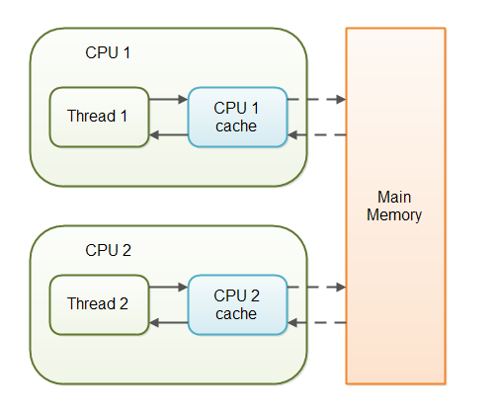
Caching
Data is stored in caches: small, fast storage units
Only written to main memory occasionally
Huge efficiency gains!
Each CPU has its own cache
Each thread maintains its own cache entries
Huge concurrency headaches!

Slide 5
keyword volatile
public class WidgetStore{
private volatile int numWidgets;
/** produce widgets */
public void produce(){…}
/** sell all the widgets */
public void sell(){…}
/** diplay widget if there
/* are any available */
public void display(){…}
}
Variables declared as volatile will not be stored in the cache. All writes will write directly to main memory. All reads will read directly from main memory.
Notes:
Note: actually get serialization, but let's not worry about that.

Slide 6
Handling Writes
int numWidgets = 0;
numWidgets++;
Thread 1(produce)
numWidgets--;
Thread 2 (sell)
What is the value of x?
Can be either -1, 0, or 1!

Slide 7
Handling Writes
volatile int numWidgets = 0;
numWidgets++;
Thread 1(produce)
numWidgets--;
Thread 2 (sell)
What is the value of x?
Can be either -1, 0, or 1!
Notes:
Volatility prevents data from being out of sync for a long time because of caching
If one thread only reads the value, volatile would be necessary (to guarantee you have the latest value) and sufficient.
Doesn't guarantee atomicity, so still have problems with writes

Slide 8
The Problem with Writes…
Thread 1
Thread 2
Initially, i = 0
tmp = load i;
Load 0 from memory
Load 0 from memory
tmp = load i;
tmp = tmp + 1;
store tmp to i;
Store 1 to memory
tmp = tmp - 1;
store tmp to i;
Store 1 to memory
time
Finally, i = -1

Slide 9
Concurrent Writes
Solution 1: synchronized
It works
But locks can be slow
Solution 2: atomic values
Less powerful
More efficient
private int numWidgets;
public void produce(){
...
synchronized(this){
numWidgets++;
}
...
}
private AtomicInteger numWidgets;
public void produce(){
...
synchronized(this){
numWidgets++;
}
...
}

Slide 10
Atomic Values
Package java.util.concurrent.atomic defines a toolkit of classes that implement atomic values
atomic values support lock-free, thread-safe programming on single variables
class AtomicInteger, AtomicReference<E>, …
Atomic values extend the idea of volatile
method get(): reads current value like volatile
method set(newValue): writes value like volatile
implements new atomic operations

Slide 11
Compare and Set (CAS)
boolean compareAndSet(expectedValue, newValue)
If value doesn’t equal expectedValue, return false
if equal, store newValue in value and return true
executes as a single atomic action!
supported by many processors – as hardware instructions
does not use locks!
AtomicInteger n = new AtomicInteger(5);
n.compareAndSet(3, 6); // return false – no change
n.compareAndSet(5, 7); // returns true – now is 7

Slide 12
Incrementing with CAS
/** Increment n by one. Other threads use n too. */
public static void increment(AtomicInteger n) {
int i = n.get();
while (!n.compareAndSet(i, i+1)) {
i = n.get();
}
}
// AtomicInteger has increment methods that do this
public int incrementAndGet()
public int addAndGet(int delta)
public int updateAndGet(InUnaryOperator updateFunction)

Slide 13
Locks with CAS
public class WidgetStore{
private int numWidgets;
/** produce widgets */
public synchronized void produce(){…}
}
public class WidgetStore{
private int numWidgets;
private boolean lock;
/** produce widgets */
public synchronized void produce(){
while(!lock.compareAndSet(false, true)){}
…
lock = false;
}
Notes:
spinlock, no locklist, waitlist

Slide 14
Lock-Free Data Structures
Usable by many concurrent threads
using only atomic actions – no locks!
compare and swap is your best friend
but it only atomically updates one variable at a time!
Let’s look at one!
Lock-free binary search tree [Ellen et al., 2010] http://www.cs.vu.nl//~tcs/cm/cds/ellen.pdf

Slide 15
More Concurrency
Concurrency is actually an OS-level concern
Different platforms have different concurrency APIs
Programming languages provide abstractions
There are lots of techniques for write concurrent programs
lock (e.g., synchronized), mutex
atomic operations
semaphores
condition variables
transactional memory

