Slide 1
Prelim 3 Review
Hakim Weatherspoon
CS 3410, Spring 2012
Computer Science
Cornell University

Slide 2
Administrivia
Pizza party: PA3 Games Night
  Tomorrow, Friday, April 27th, 5:00-7:00pm
  Location: Upson B17
Prelim 3
  Tonight, Thursday, April 26th, 7:30pm
  Location: Olin 155
PA4: Final project out next week
  Demos: May 14-16
  Will not be able to use slip days

Slide 3
Goals for Today
Prelim 3 review
  Caching,
  Virtual Memory, Paging, TLBs
  Operating System, Traps, Exceptions,
  Multicore and synchronization

Slide 4
Big Picture
compute
jump/branch
targets
memory
register
file
A
alu
D
D
B
+4
addr
PC
inst
control
B
d_{in}
d_{out}
M
memory
new
pc
extend
imm
detect
hazard
forward
unit
Instruction
Fetch
Instruction
Decode
Write-
Back
ctrl
ctrl
ctrl
Execute
Memory
IF/ID
ID/EX
EX/MEM
MEM/WB
Notes:
Caching,
Virtual Memory, Paging, TLBs
Operating System, Traps, Exceptions,
Multicore and synchronization

Slide 5
Memory Hierarchy and Caches

Slide 6
Memory Pyramid
RegFile
100s bytes
< 1 cycle access
L1 Cache
(several KB)
1-3 cycle access
L3 becoming more common
(eDRAM ?)
L2 Cache (½-32MB)
5-15 cycle access
Memory Pyramid
Memory (128MB – few GB)
50-300 cycle access
Disk (Many GB – few TB)
1000000+
cycle access
These are rough numbers: mileage may vary for latest/greatest
Caches usually made of SRAM (or eDRAM)
Notes:
L1 L2 and even L3 all on-chip these days using SRAM and eDRAM

Slide 7
Memory Hierarchy
A: Data that will be used soon
Insight for Caches
If Mem[x] is was accessed recently...
… then Mem[x] is likely to be accessed soon
  Exploit temporal locality:
    Put recently accessed Mem[x] higher in memory hierarchy
    since it will likely be accessed again soon
… then Mem[x ± ε] is likely to be accessed soon
  Exploit spatial locality:
    Put entire block containing Mem[x] and surrounding addresses higher in memory hierarchy since nearby address will likely
    be accessed
put recently accessed Mem[x] higher in the pyramid
put entire block containing Mem[x] higher in the pyramid
Notes:
soon = frequency of loads

Slide 8
Memory Hierarchy
Processor
Cache
Memory
4 cache lines
2 word block
0
1
2
3
4
5
6
7
8
9
10
11
12
13
14
15
100
110
120
LB $1 ← M[ 1 ]
LB $2 ← M[ 5 ]
LB $3 ← M[ 1 ]
LB $3 ← M[ 4 ]
LB $2 ← M[ 0 ]
tag data
130
V
140
0
150
160
0
170
180
0
190
200
$0
$1
$2
$3
0
210
220
230
240
250

Slide 9
Three Common Cache Designs
A given data block can be placed…
  … in exactly one cache line → Direct Mapped
  … in any cache line → Fully Associative
  … in a small set of cache lines → Set Associative

Slide 10
Direct Mapped Cache
Tag Index Offset
V
Tag
Block
=
=
word select
word select
data
hit?
hit?
data
32bits

Slide 11
Fully Associative Cache
Tag Offset
V
Tag
Block
=
=
=
=
line select
64bytes
word select
32bits
hit?
data
Notes:
“way” = line

Slide 12
3-Way Set Associative Cache
Tag Index Offset
=
=
=
line select
64bytes
word select
hit?
data
32bits

Slide 13
Cache Misses
Three types of misses
  Cold (aka Compulsory)
    The line is being referenced for the first time
  Capacity
    The line was evicted because the cache was not large enough
  Conflict
    The line was evicted because of another access whose index conflicted

Slide 14
Writing with Caches

Slide 15
Eviction
Which cache line should be evicted from the cache to make room for a new line?
  Direct-mapped
    no choice, must evict line selected by index
  Associative caches
    random: select one of the lines at random
    round-robin: similar to random
    FIFO: replace oldest line
    LRU: replace line that has not been used in the longest time

Slide 16
Cached Write Policies
Q: How to write data?
Memory
DRAM
CPU
addr
Cache
SRAM
data
If data is already in the cache…
No-Write
  writes invalidate the cache and go directly to memory
Write-Through
  writes go to main memory and cache
Write-Back
  CPU writes only to cache
  cache writes to main memory later (when block is evicted)

Slide 17
What about Stores?
Where should you write the result of a store?
  If that memory location is in the cache?
    Send it to the cache
    Should we also send it to memory right away?
    (write-through policy)
    Wait until we kick the block out (write-back policy)
  If it is not in the cache?
    Allocate the line (put it in the cache)?
    (write allocate policy)
    Write it directly to memory without allocation?
    (no write allocate policy)

Slide 18
Cache Performance

Slide 19
Cache Performance
Consider hit (H) and miss ratio (M)
H x AT_{cache} + M x AT_{memory}
Hit rate = 1 – Miss rate
Access Time is given in cycles
Ratio of Access times, 1:50
90% : .90 + .1 x 50 = 5.9
95% : .95 + .05 x 50 = .95+2.5=3.45
99% : .99 + .01 x 50 = 1.49
99.9%: .999 + .001 x 50 = 0.999 + 0.05 = 1.049

Slide 20
Cache Conscious Programming

Slide 21
Cache Conscious Programming
// H = 12, NCOL = 10
int A[NROW][NCOL];
for(col=0; col < NCOL; col++)
for(row=0; row < NROW; row++)
sum += A[row][col];
1 | 11 | 21
 |  | 2 | 12 | 22
 |  |  |  | 3 | 13 | 23
 |  |  |  |  |  | 4 | 14 | 24
 |  |  |  |  |  |  |  | 5 | 15
25
6 | 16 | 26
 |  | 7 | 17 | …
 |  |  |  | 8 | 18
 |  |  |  |  |  | 9 | 19
 |  |  |  |  |  |  |  | 10 | 20
Every access is a cache miss!
(unless entire matrix can fit in cache)

Slide 22
Cache Conscious Programming
// NROW = 12, NCOL = 10
int A[NROW][NCOL];
for(row=0; row < NROW; row++)
for(col=0; col < NCOL; col++)
sum += A[row][col];
1 | 2 | 3 | 4 | 5 | 6 | 7 | 8 | 9 | 10
11 | 12 | 13 | …
Block size = 4 → 75% hit rate
Block size = 8 → 87.5% hit rate
Block size = 16 → 93.75% hit rate
And you can easily prefetch to warm the cache.

Slide 23
MMU, Virtual Memory, Paging, and TLB’s

Slide 24
Multiple Processes
Q: What happens when another program is executed concurrently on another processor?
A: The addresses will conflict
  Even though, CPUs may take
  turns using memory bus
CPU
0xfff…f
0x7ff…f
Stack
Stack
Heap
Heap
CPU
Data
Data
Text
Text
0x000…0
Memory

Slide 25
Virtual Memory
Virtual Memory: A Solution for All Problems
Each process has its own virtual address space
  Programmer can code as if they own all of memory
On-the-fly at runtime, for each memory access
  all access is indirect through a virtual address
  translate fake virtual address to a real physical address
  redirect load/store to the physical address

Slide 26
Virtual Memory Advantages
Advantages
Easy relocation
  Loader puts code anywhere in physical memory
  Creates virtual mappings to give illusion of correct layout
Higher memory utilization
  Provide illusion of contiguous memory
  Use all physical memory, even physical address 0x0
Easy sharing
  Different mappings for different programs / cores
Different Permissions bits

Slide 27
Address Space
X
CPU
CPU
A
C
X
B
B
Y
C
Z
Z
MMU
MMU
Y
A
Programs load/store to virtual addresses
Actual memory uses physical addresses
Memory Management Unit (MMU)
  Responsible for translating on the fly
  Essentially, just a big array of integers:
  paddr = PageTable[vaddr];
Notes:
each mmu has own mappings
Easy relocation
Higher memory utilization
Easy sharing

Slide 28
Address Translation
Virtual page number
Page Offset
vaddr
Lookup in PageTable
Physical page number
Page offset
paddr
Attempt #1: For any access to virtual address:
  Calculate virtual page number and page offset
  Lookup physical page number at PageTable[vpn]
  Calculate physical address as ppn:offset
Notes:
4kb pages = 12 bits for page offset, 20 bits for VPN

Slide 29
Beyond Flat Page Tables
Assume most of PageTable is empty
How to translate addresses?
Multi-level PageTable
10 bits
10 bits
10 bits
2
vaddr
Word
PTEntry
Page
PDEntry
Page Table
PTBR
Page Directory
* x86 does exactly this
Notes:
Q: Benefits?
A1: Don’t need 4MB contiguous physical memory
A2: Don’t need to allocate every PageTable, only those containing valid PTEs
Q: Drawbacks?
A: Longer lookups.

Slide 30
Virtual Addressing with a Cache
Thus it takes an extra memory access to translate a VA to a PA
VA
PA
miss
Trans-
lation
Cache
Main
Memory
CPU
hit
data
This makes memory (cache) accesses very expensive (if every access was really two accesses)

Slide 31
A TLB in the Memory Hierarchy
hit
VA
PA
miss
TLB
Lookup
Cache
Main
Memory
CPU
miss
hit
Trans-
lation
data
A TLB miss:
  If the page is not in main memory, then it’s a true page fault
    Takes 1,000,000’s of cycles to service a page fault
TLB misses are much more frequent than true page faults

Slide 32
Virtual vs. Physical Caches
CPU
addr
Cache
SRAM
Memory
DRAM
MMU
data
Cache works on physical addresses
addr
Memory
DRAM
CPU
Cache
SRAM
MMU
data
Cache works on virtual addresses
Q: What happens on context switch?
Q: What about virtual memory aliasing?
Q: So what’s wrong with physically addressed caches?
Notes:
A1: Physically-addressed: nothing; Virtually-addressed: need to flush cache
A2: Physically-addressed: nothing; Virtually-addressed: problems

Slide 33
Indexing vs. Tagging
Physically-Addressed Cache
  slow: requires TLB (and maybe PageTable) lookup first
Virtually-Indexed, Virtually Tagged Cache
  fast: start TLB lookup before cache lookup finishes
  PageTable changes (paging, context switch, etc.)
    → need to purge stale cache lines (how?)
  Synonyms (two virtual mappings for one physical page)
    → could end up in cache twice (very bad!)
Virtually-Indexed, Physically Tagged Cache
  ~fast: TLB lookup in parallel with cache lookup
  PageTable changes → no problem: phys. tag mismatch
  Synonyms → search and evict lines with same phys. tag
Virtually-Addressed Cache

Slide 34
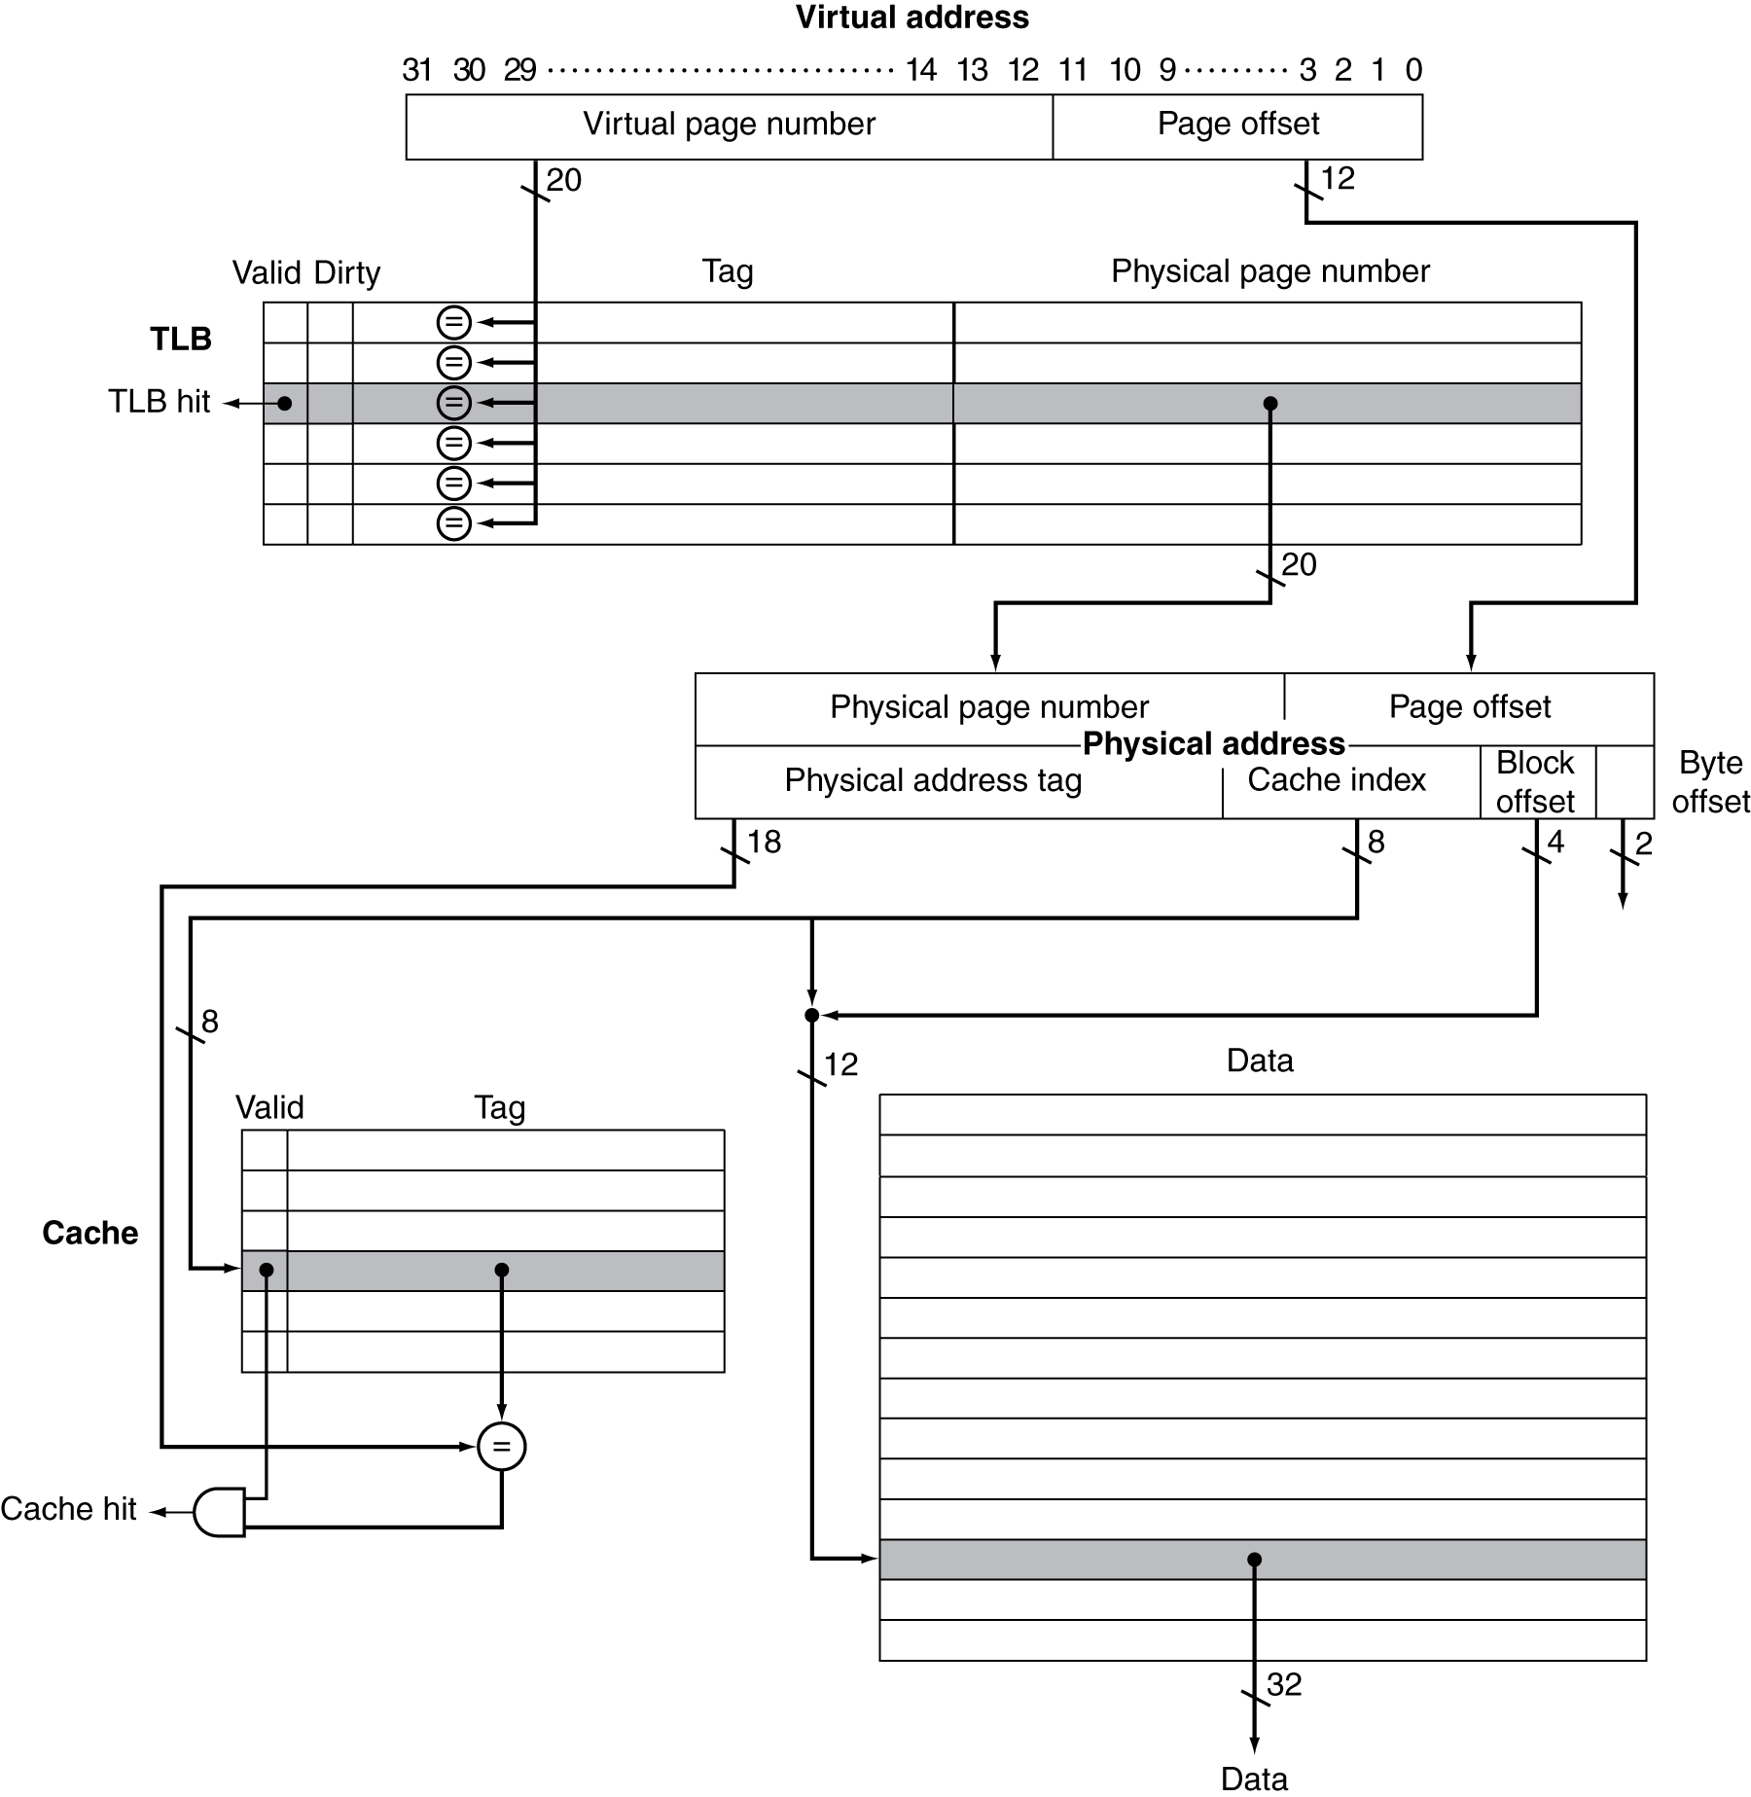
Indexing vs. Tagging

Slide 35
Typical Cache Setup
Memory
DRAM
CPU
addr
L2 Cache
SRAM
L1 Cache
SRAM
MMU
data
TLB SRAM
Typical L1: On-chip virtually addressed, physically tagged
Typical L2: On-chip physically addressed
Typical L3: On-chip …

Slide 36
Hardware/Software Boundary

Slide 37
Hardware/Software Boundary
Virtual to physical address translation is assisted by hardware?
  Translation Lookaside Buffer (TLB) that caches the recent translations
    TLB access time is part of the cache hit time
    May allot an extra stage in the pipeline for TLB access
  TLB miss
    Can be in software (kernel handler) or hardware

Slide 38
Hardware/Software Boundary
Virtual to physical address translation is assisted by hardware?
  Page table storage, fault detection and updating
    Page faults result in interrupts (precise) that are then handled by the OS
    Hardware must support (i.e., update appropriately) Dirty and Reference bits (e.g., ~LRU) in the Page Tables

Slide 39
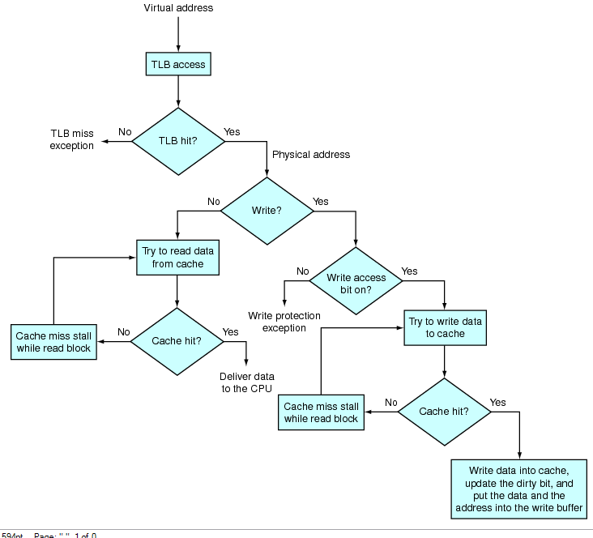

Slide 40
Paging

Slide 41
Traps, exceptions, and operating system

Slide 42
Operating System
Some things not available to untrusted programs:
  Exception registers, HALT instruction, MMU instructions, talk to I/O devices, OS memory, ...
Need trusted mediator: Operating System (OS)
  Safe control transfer
  Data isolation
P1
P2
P3
P4
VM
filesystem
net
driver
driver
MMU
disk
eth
Notes:
user/kernel/hardware

Slide 43
Terminology
Trap: Any kind of a control transfer to the OS
Syscall: Synchronous (planned), program-to-kernel transfer
  SYSCALL instruction in MIPS (various on x86)
Exception: Synchronous, program-to-kernel transfer
  exceptional events: div by zero, page fault, page protection err, …
Interrupt: Aysnchronous, device-initiated transfer
  e.g. Network packet arrived, keyboard event, timer ticks
* real mechanisms, but nobody agrees on these terms

Slide 44
Multicore and Synchronization

Slide 45
Multi-core is a reality…
… but how do we write multi-core safe code?

Slide 46
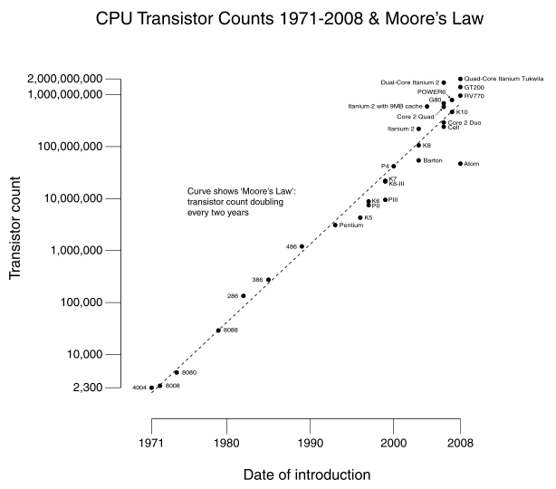
Why Multicore?
Moore’s law
  A law about transistors
    (Not speed)
  Smaller means faster
  transistors
Power consumption growing with transistors

Slide 48
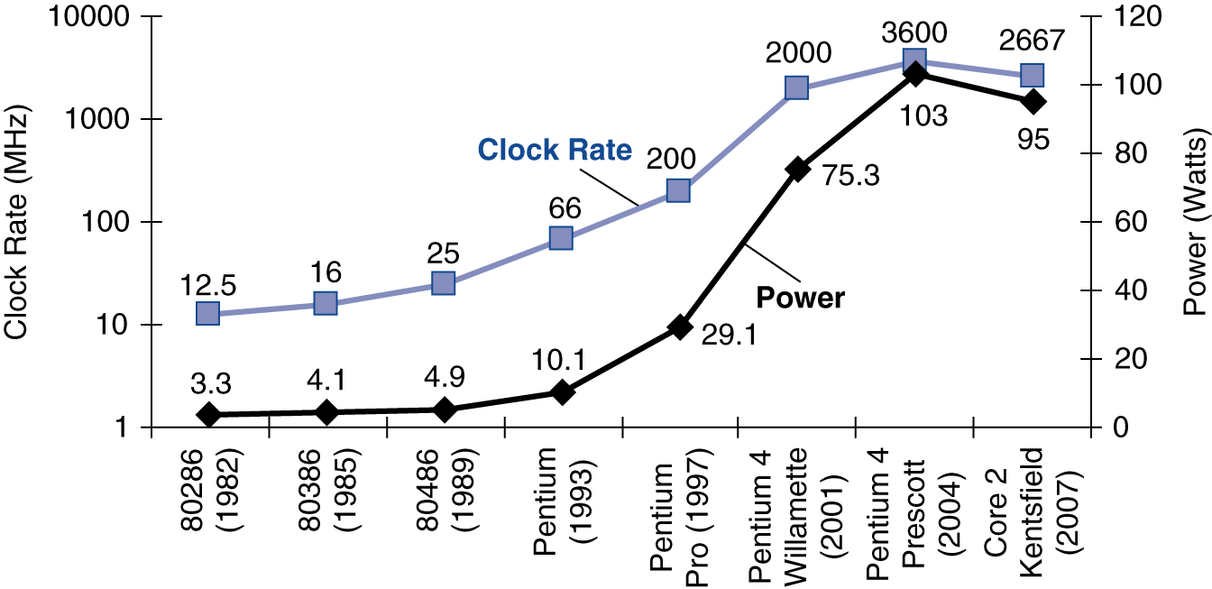
Power Trends
In CMOS IC technology
×30
5V → 1V
×1000

Slide 49
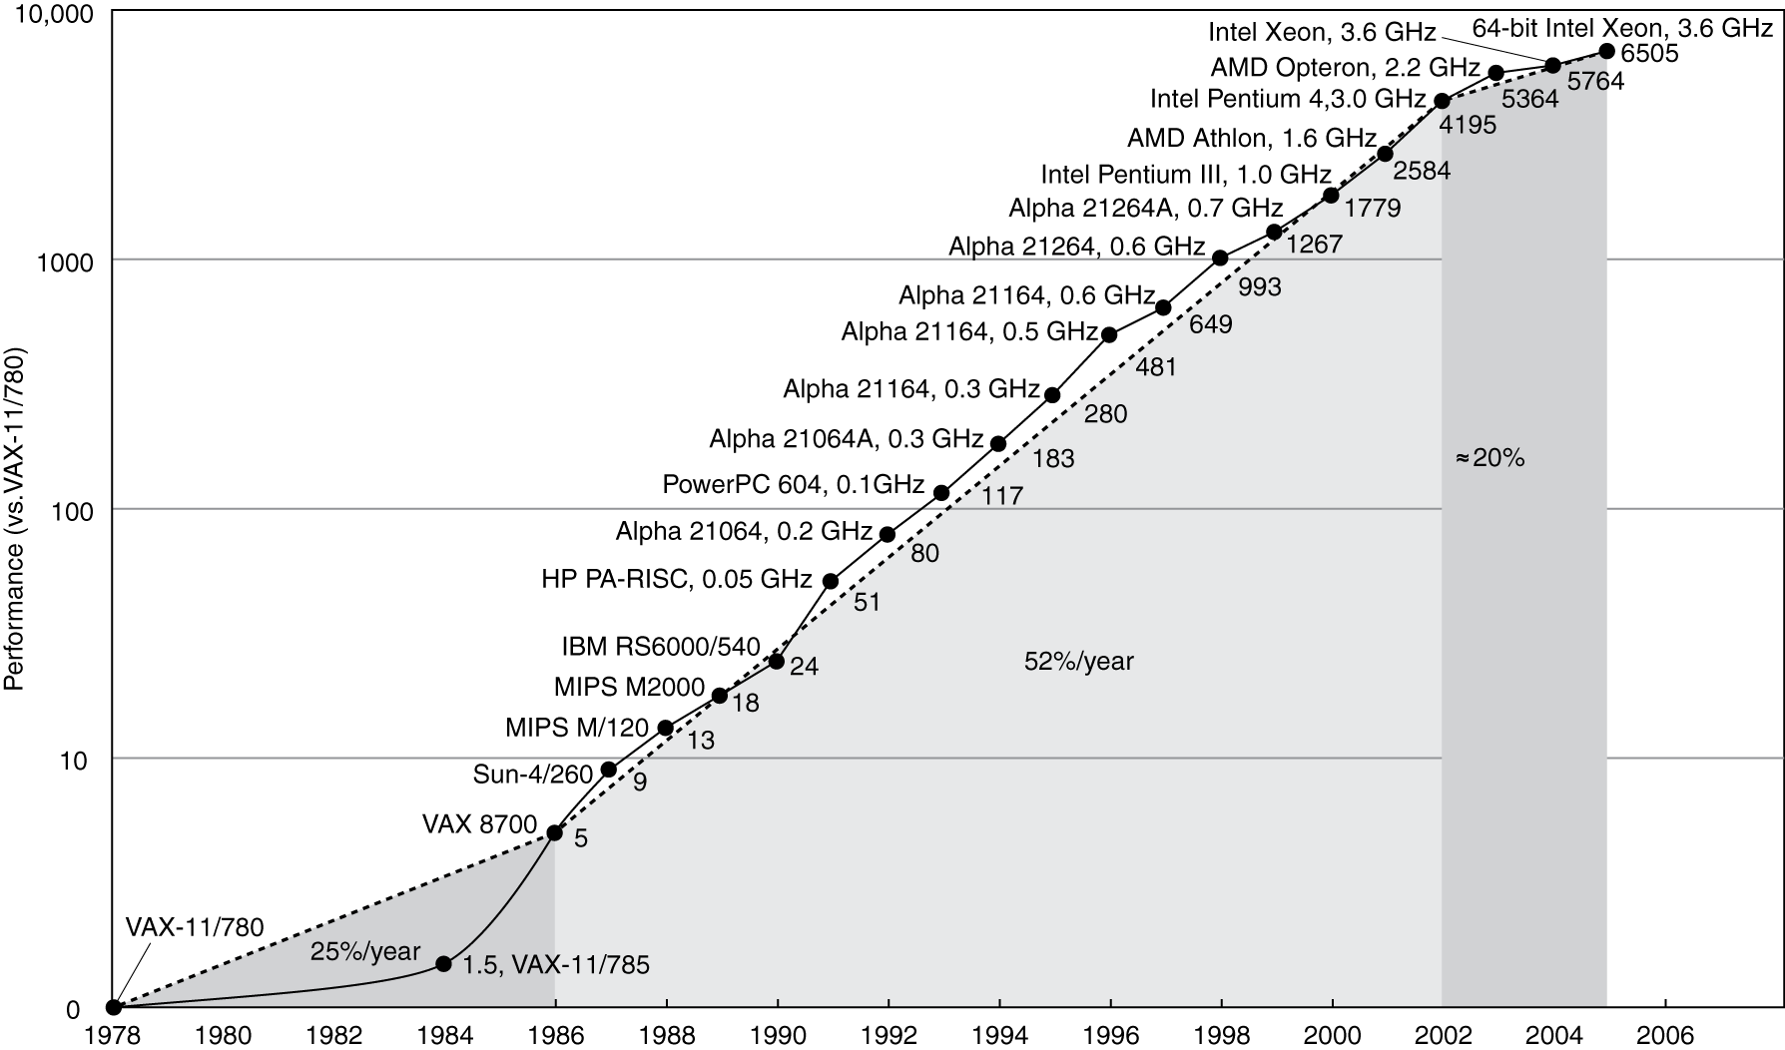
Uniprocessor Performance
Constrained by power, instruction-level parallelism, memory latency

Slide 50
Why Multicore?
Moore’s law
  A law about transistors
  Smaller means faster transistors
Power consumption growing with transistors
The power wall
  We can’t reduce voltage further
  We can’t remove more heat
How else can we improve performance?

Slide 51
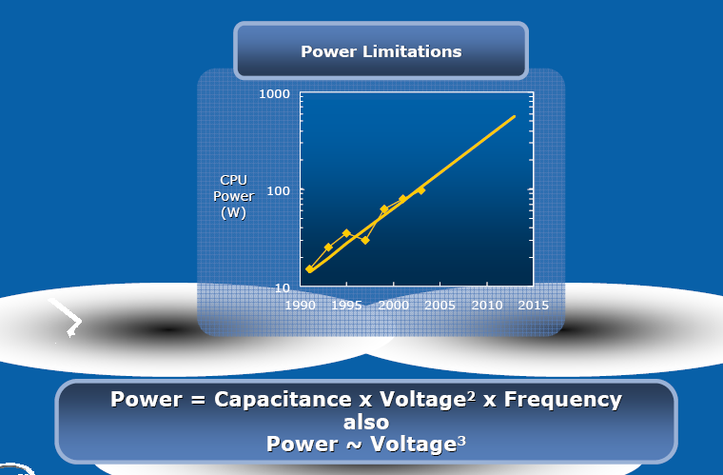
Intel’s argument

Slide 52
1.6x
1.2x

Slide 53
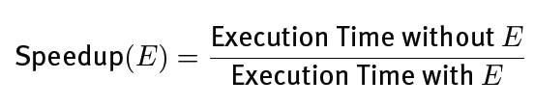
Amdahl’s Law
Task: serial part, parallel part
As number of processors increases,
  time to execute parallel part goes to zero
  time to execute serial part remains the same
Serial part eventually dominates
Must parallelize ALL parts of task

Slide 54
Amdahl’s Law
Consider an improvement E
F of the execution time is affected
S is the speedup
Notes:
F = 0.5, S = 2
1/(0.5 + 0.25) = 1/0.75 = 1.333
F = 0.9, S = 2
1/(0.1 + 0.9/2) = 1/(0.1 + 0.45) = 1/0.55 = 1.8
F = 0.99, S = 2
1/(0.01+0.99/2) = 1/(0.01+0.495) = 1.98
F = 0.5, S = 8
1/(0.5+0.5/8) -> 2

Slide 55

Multithreaded Processes

Slide 56
Shared counters
Usual result: works fine.
Possible result: lost update!
Occasional timing-dependent failure ⇒ Difficult to debug
Called a race condition
hits = 0
T1
T2
time
read hits (0)
read hits (0)
hits = 0 + 1
hits = 0 + 1
hits = 1

Slide 57
Race conditions
Def: a timing dependent error involving shared state
  Whether it happens depends on how threads scheduled: who wins “races” to instructions that update state
  Races are intermittent, may occur rarely
    Timing dependent = small changes can hide bug
  A program is correct only if all possible schedules are safe
    Number of possible schedule permutations is huge
    Need to imagine an adversary who switches contexts at the worst possible time

Slide 58
Critical Sections
Basic way to eliminate races: use critical sections that only one thread can be in
  Contending threads must wait to enter
T1
T2
time
CSEnter();
  Critical section
CSExit();
CSEnter();
  Critical section
CSExit();
T1
T2

Slide 59
Mutexes
Critical sections typically associated with mutual exclusion locks (mutexes)
Only one thread can hold a given mutex at a time
Acquire (lock) mutex on entry to critical section
  Or block if another thread already holds it
Release (unlock) mutex on exit
  Allow one waiting thread (if any) to acquire & proceed
pthread_mutex_init(m);
pthread_mutex_lock(m);
  hits = hits+1;
pthread_mutex_unlock(m);
pthread_mutex_lock(m);
  hits = hits+1;
pthread_mutex_unlock(m);
T1
T2

Slide 60
Protecting an invariant
// invariant: data is in buffer[first..last-1]. Protected by m.
pthread_mutex_t *m;
char buffer[1000];
int first = 0, last = 0;
void put(char c) {
pthread_mutex_lock(m);
buffer[last] = c;
last++;
pthread_mutex_unlock(m);
}
Rule of thumb: all updates that can affect
invariant become critical sections.
char get() {
pthread_mutex_lock(m);
char c = buffer[first];
first++;
pthread_mutex_unlock(m);
}
X what if first==last?

Slide 61
See you Tonight
Good Luck!

